Slide 1
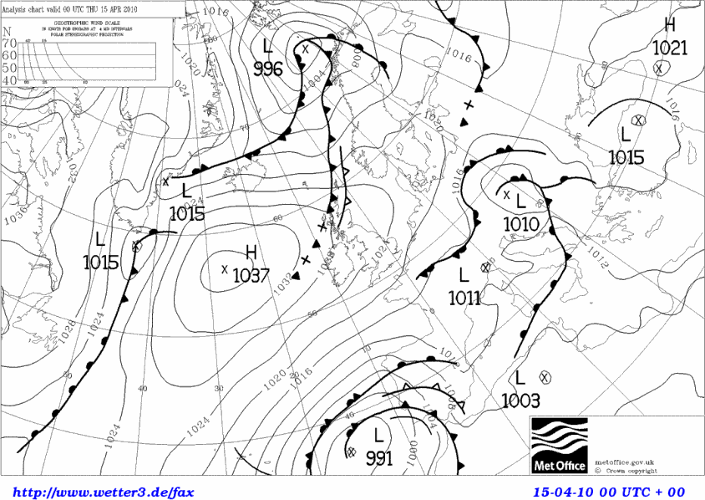
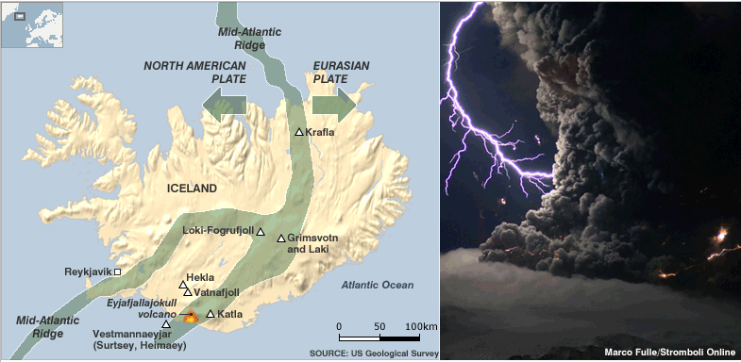
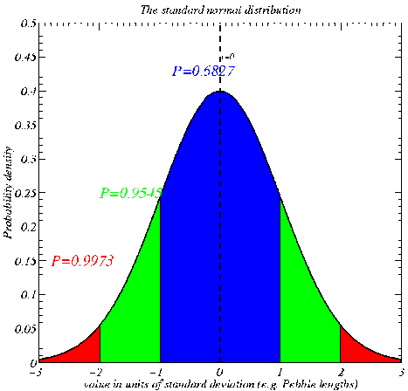
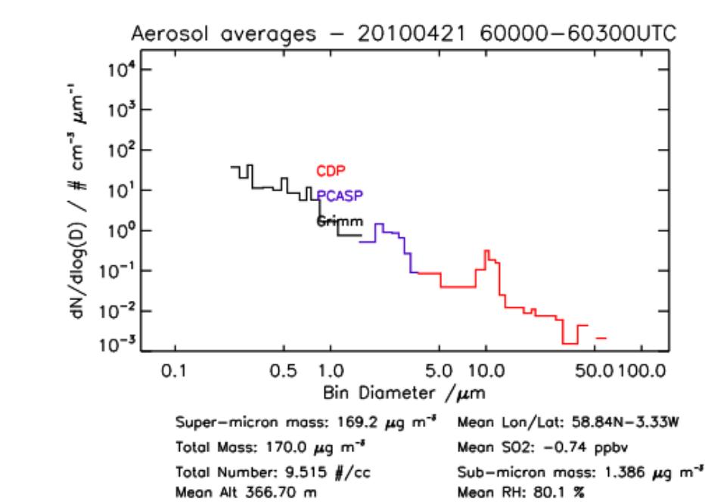
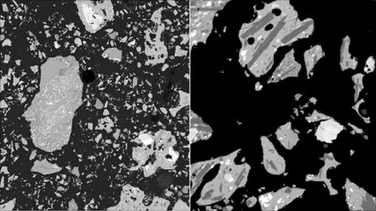
EART20170 data analysis lecture 3: the normal distribution and central limit theorem
Dr Paul Connolly

Slide 2
Information
Week 6: no practical class, but a mid-term on Blackboard. Available from Today and due on the 7th November, the Monday before the lecture.

Slide 3
Week 5 practical – the normal distribution
What is a probability distribution?
The `normal distribution’
How can we use them?
Distributions and percentiles.
The central limit theorem

Slide 4

Probability distribution
Basically it is a relative histogram with very small bin-widths
It describes how the data is distributed with regard to some property or variable.
This particular one is a normal distribution or `bell’-shaped curve

Slide 5
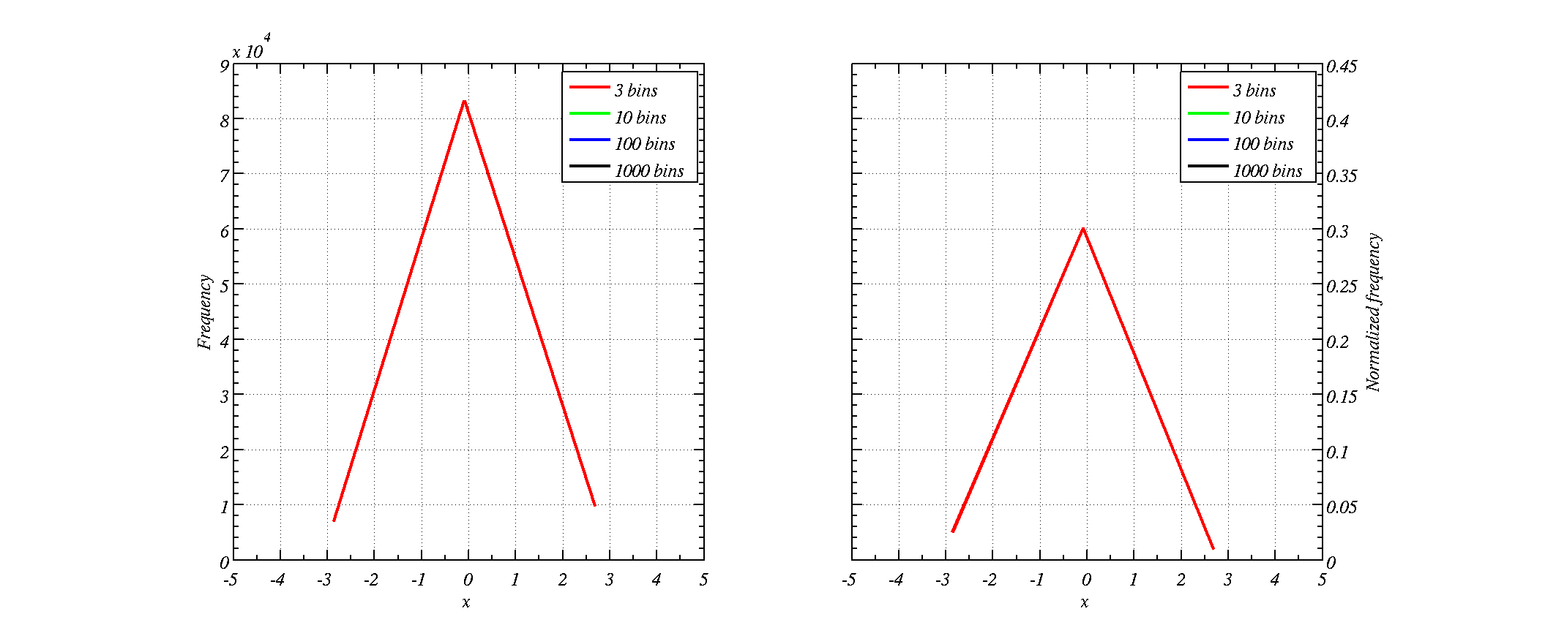
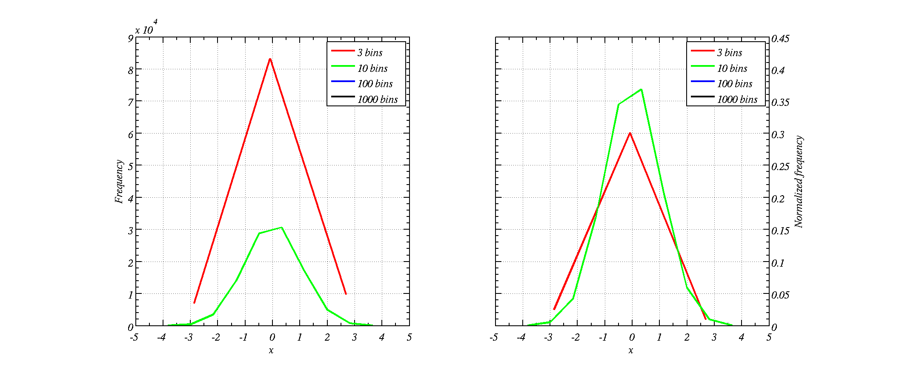
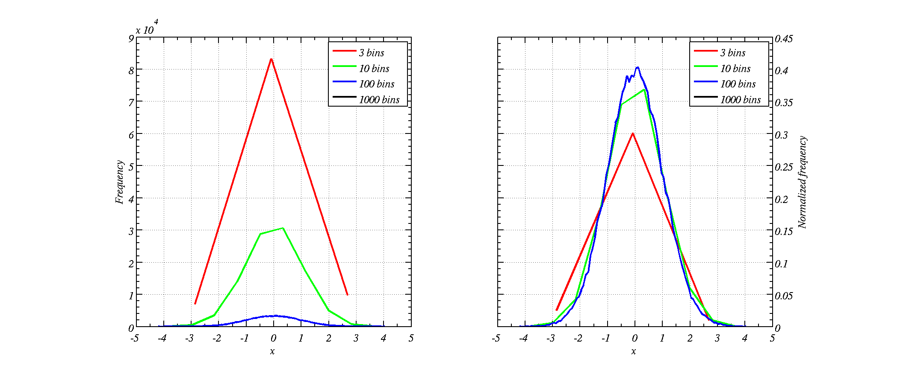
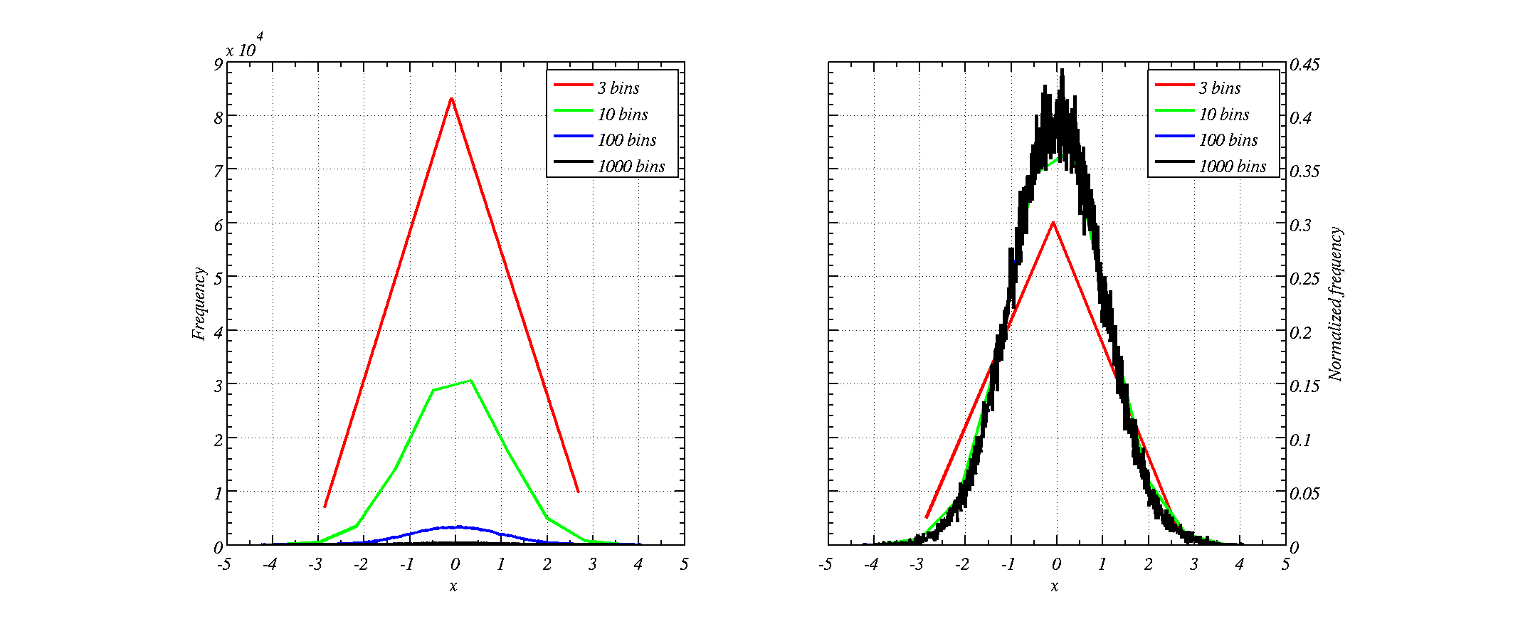
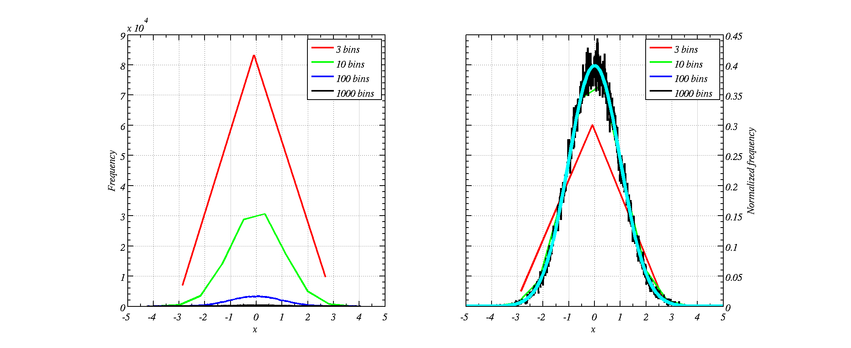
What is probability density?
(different histograms of data)
Frequency alone makes comparing the histograms difficult
Dividing by the sum of the total and the bin width enables us to compare histograms

Slide 6
The normal distribution is the most important distribution in statistics
Because many instruments have instrumental noise that results in a measurement being normally distributed (e.g. instrumental noise can be due to many factors).
Processes that depend on sum of many factors also tend to be normally distributed
  Heights of people, IQ of people
  Bouguer anomaly (effectively density of ground)
  Freezing temperature of cloud drops (depends on what is in them).

Slide 7
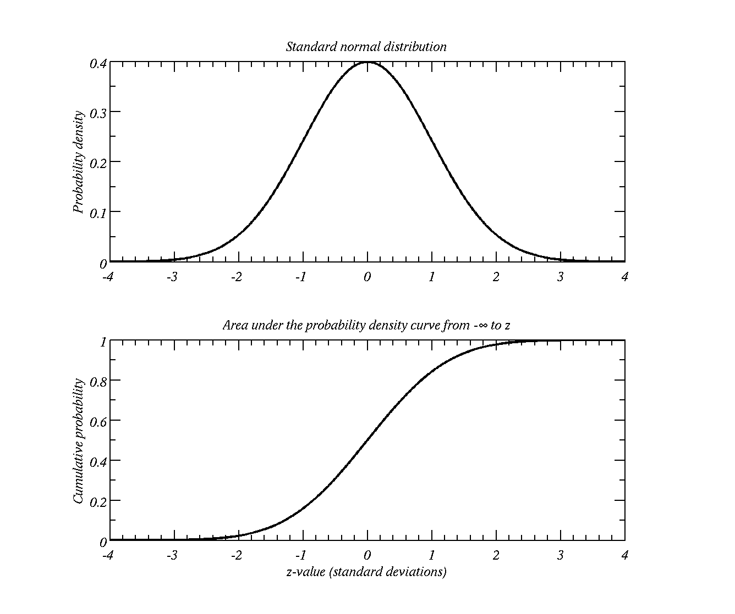
Properties of the normal distribution
Symmetrical about the mean
99.9% of area within three standard deviations
95.4% of area within two standard deviations
68% within one standard dev.

Slide 8
Practise Qs
At exactly 0C a cheap digital thermometer has readings that are normally distributed with a mean of 0C and a standard deviation of 1 C.
  What is the probability that the measurement reported is less than 0 C?
  What is the probability that the measurement reported is greater than 0.5 C?
  What is the probability that the measurement reported is between than -0.2 and 0.5 C?
Excel use: NORMDIST(x,mean,std,1)
MATLAB use: normcdf(x,mean,std);

Slide 9
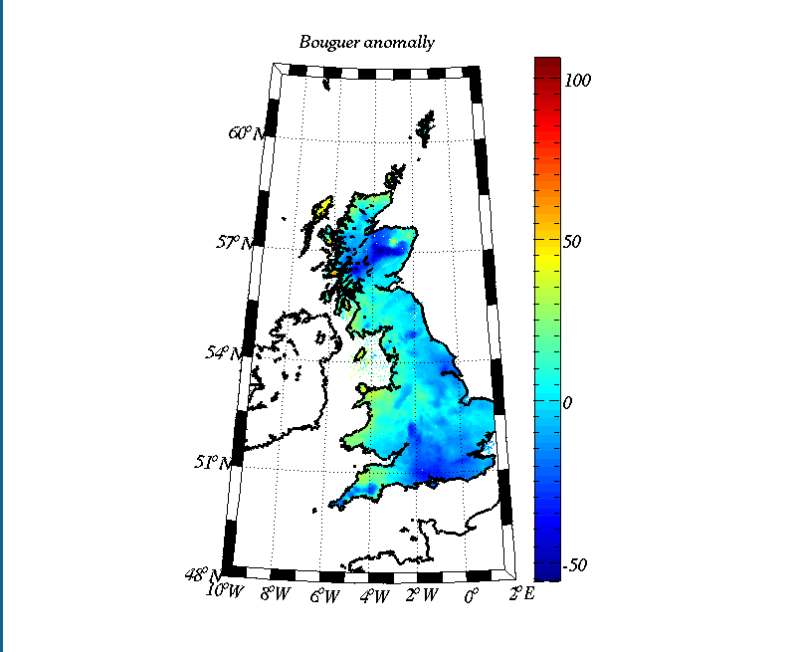
The Bouguer anomaly
Difference between expected value of gravity and actual.
Tells you about how dense the underlying surface is.
For UK it is normally distributed.

Slide 10
More practise Qs
The Bouguer anomaly over the UK is normally distributed with a mean of -0.5 mGal and a standard deviation of 15 mGal
  What is the fraction of UK area that has a Bouguer anomaly less than -0.5 mGal?
  What is the fraction of UK area that has a Bouguer anomaly less than -15 mGal? (i.e. potential oil fields)
  What is the fraction of UK area that has a Bouguer anomaly between -15 and 15 mGal? (i.e. no unknown oil fields or buried Meteorites)
Excel use: NORMDIST(x,mean,std,1)
MATLAB use: normcdf(x,mean,std);

Slide 11
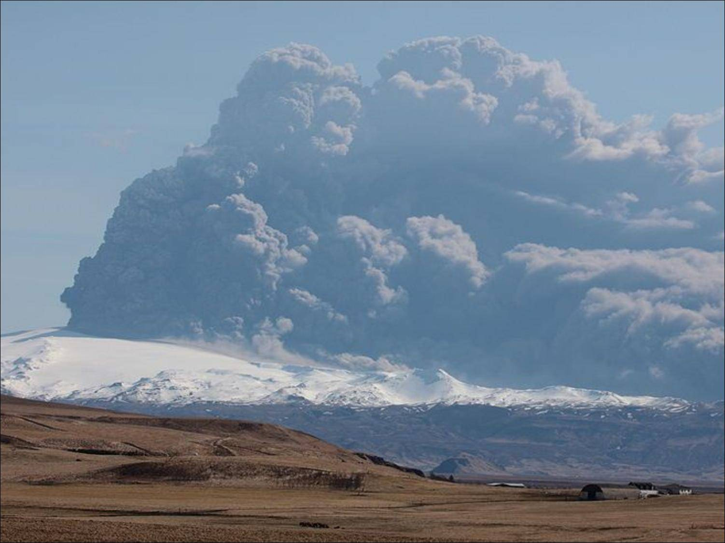
Impact of Icelandic volcano ash
Expertise in the Centre for Atmospheric Science provided advice regarding the ash cloud of Icelandic volcanoes
Centre for Atmospheric Science
played leading role in the characterisation of volcanic ash during the Eyafyallajokull eruption in Iceland. Provision of advice to UK Government and Air Traffic agencies
Slides and data courtesy of Prof. G. Vaughan

Slide 12
Why did the volcano erupt?
Tectonic plates moving apart under Iceland cause a number of active volcanoes

Slide 13
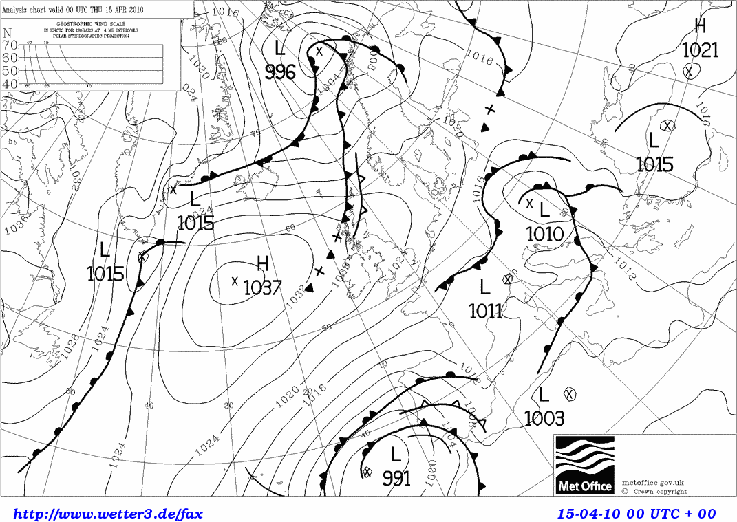
Why did ash come our way?
Winds tend to blow along isobars, with low pressure on the left
April is statistically the worst month for winds to blow from Iceland to the UK!
Persistent blocking anticyclone during late April/early May

Slide 14
LIDAR observations
Clear skies meant that LIDAR observations could monitor the ash cloud
LIDAR measures backscattered light as a function of height and time.
Like a radar, using light rather than radio waves
Backscatter from air, clouds and aerosols as well as ash
Scattering layer
height
time
Pulse of light
Light Detection And Ranging

Slide 15
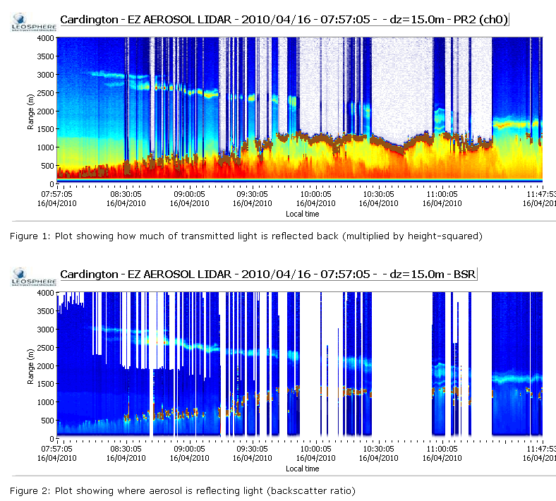
First event: 15 April 2010
`Boundary Layer’
Note layers ~ 100 m thick. At Cardington they descend over time, being mixed into the BL
Depolarisation plot shows that the particles are non-spherical => ash.
Hugo Ricketts, Univ. Manchester

Slide 16
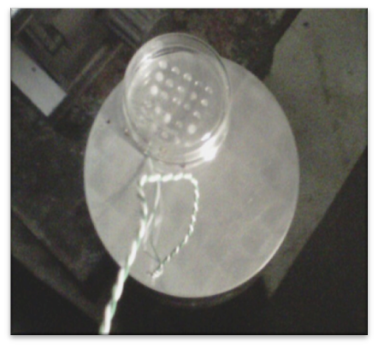
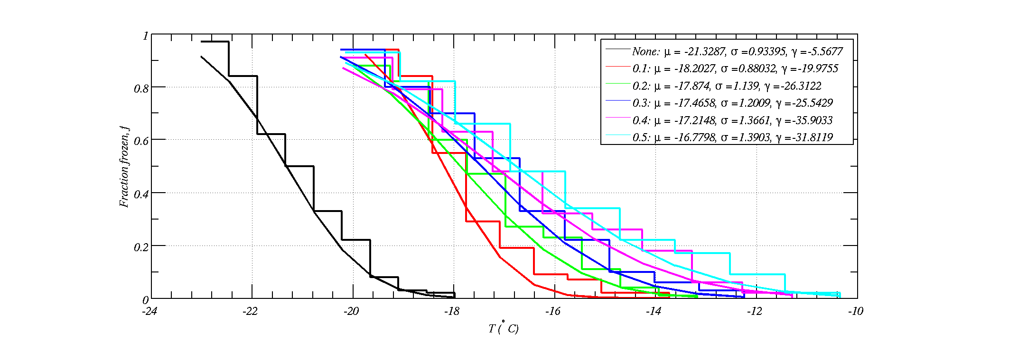
Eyjafjallajökull volcanic ash impact on cloud formation
Ice `nucleation’ in supercooled water is a statistical effect. Freezing temperatures are normally distributed
Depends on fluctuations in water, which can be the sum of many things (heat, material diffusion, etc)

Slide 17
Percentiles
Value corresponding to location expressed as a percentage in a ranked list.
E.g. median is the 50th percentile.
Excel function PERCENTILE
MATLAB function prctile
Air quality directives from EU:
  There should be no more than 18 exceedences of 200 micrograms per cubic metre for the hourly mean NO₂ concentration in one year
  Number of hours in 1 year: 365x24=8760
  Therefore if there are 18 exceedences then NO₂ exceeds 200 μg m⁻³ is for 18/(8760)=0.2055% of the time, or is less than 200 μg m⁻³ for 100%-0.2055%=99.79%
  So calculate the 99.79th percentile of the hourly means and if it is larger than 200 μg m⁻³ there has been an exceedence

Slide 18
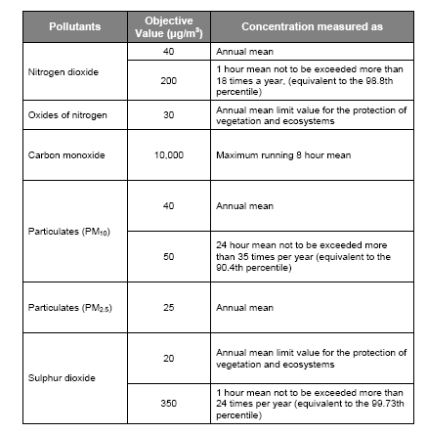
Data from a recent Public Inquiry
(attention to detail)
Using a smaller value for the percentile will underestimate the NO2 level.

Slide 19
Similar questions phrased a different way
The freezing temperature of drops containing volcano dust is normally distributed with a mean of -21C and a standard deviation of 1C
  What temperature separates the upper 50% of drop freezing temps? i.e. the median.
  What temperature separates the coldest 95% of freezing temperatures
  Between what two temperatures are the 50% that are closest to the mean freezing temperature? i.e. the inter-quartile range.
Take care with middle one!
Excel use: NORMINV(P,mean,std)
MATLAB use: norminv(P,mean,std);

Slide 20
Central limit theorem, page 10/11 notes
The distribution of sample means is a normal distribution with a standard deviation of the population standard deviation divided by sqrt(N).
E.g. if I select 1 drop at random from the population, with mean freezing temp -21C and standard deviation 1C, what is the probability its freezing temp will be less than -22C?
If I select a sample of 10 drops at random and calculate the mean freezing temperature what is the probability its freezing temp will be less than -22C?

Slide 21
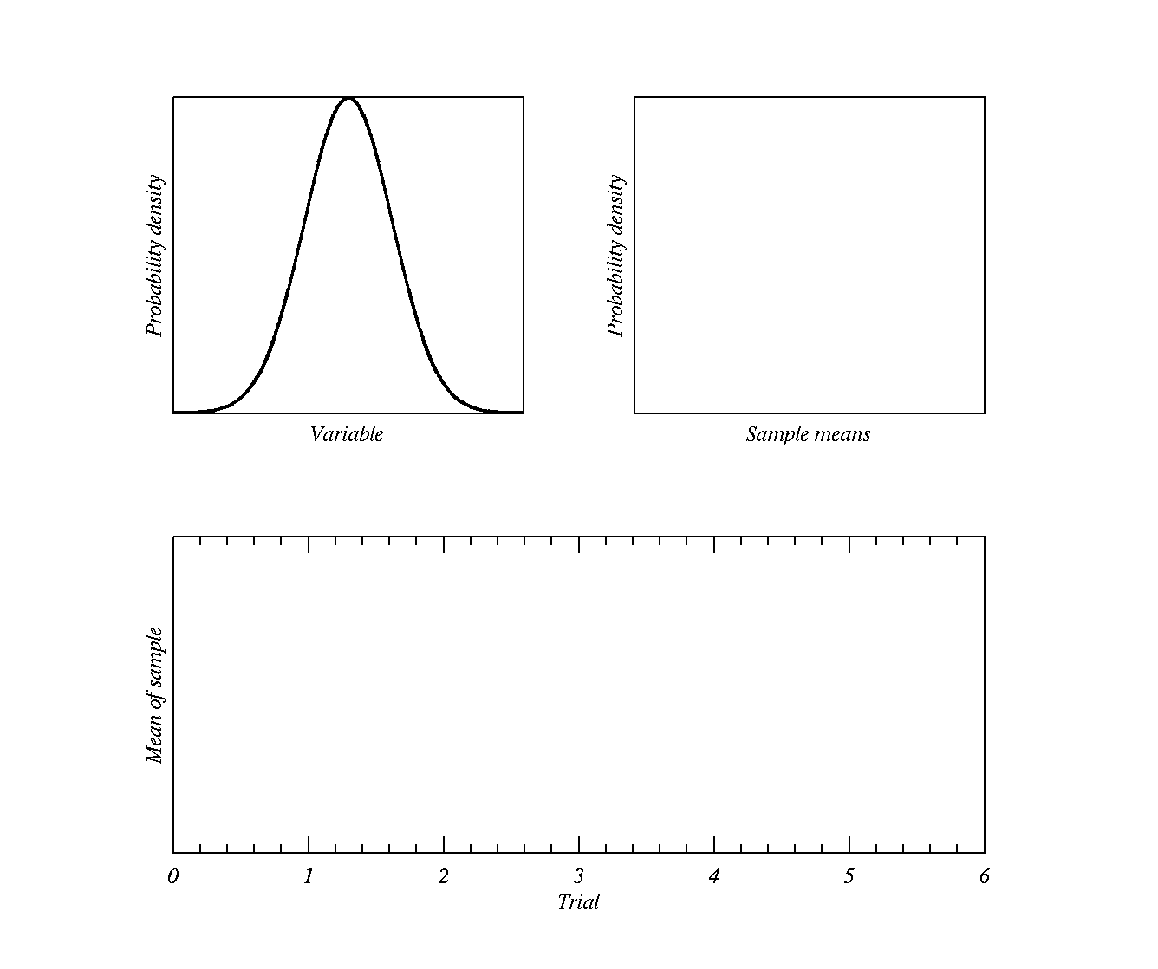
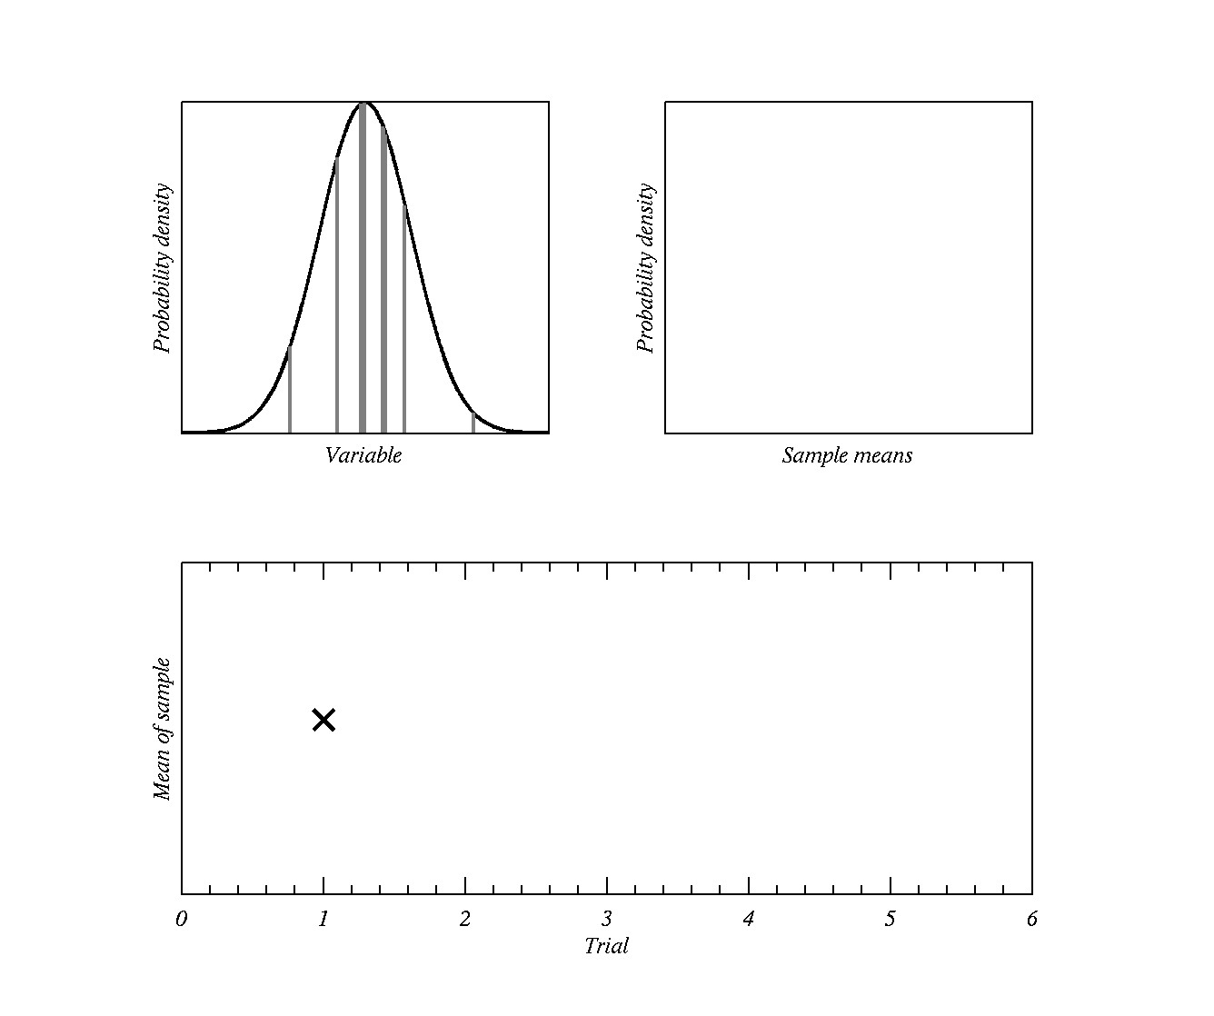
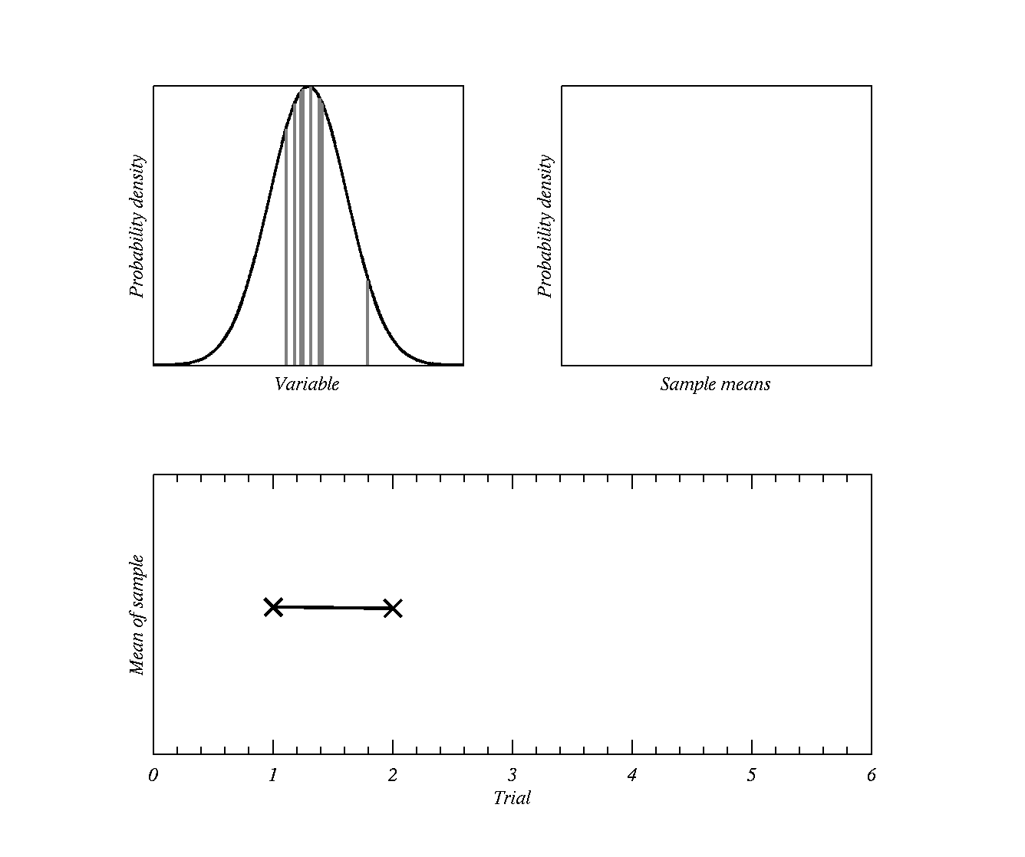
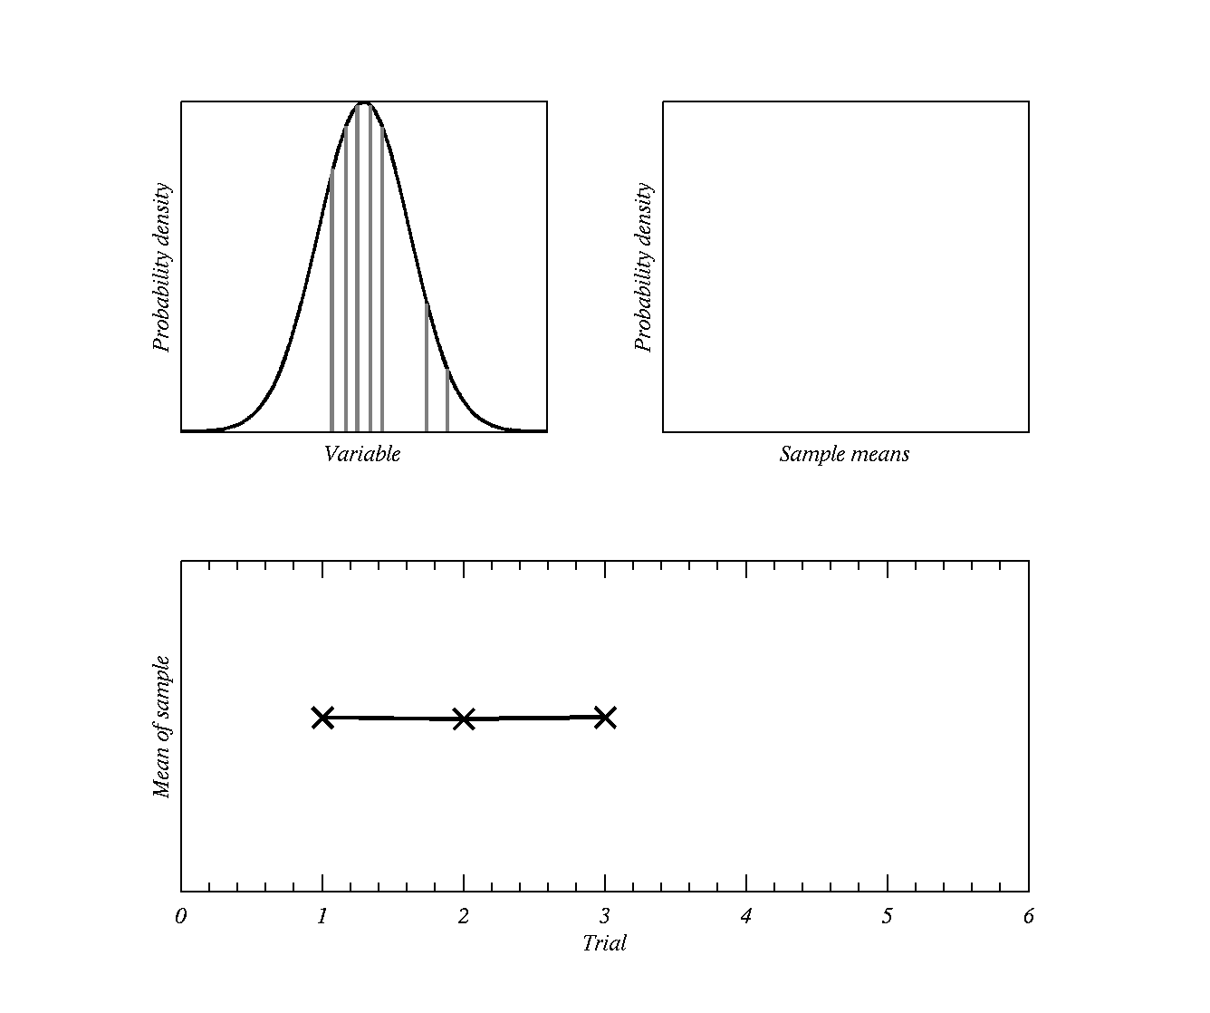
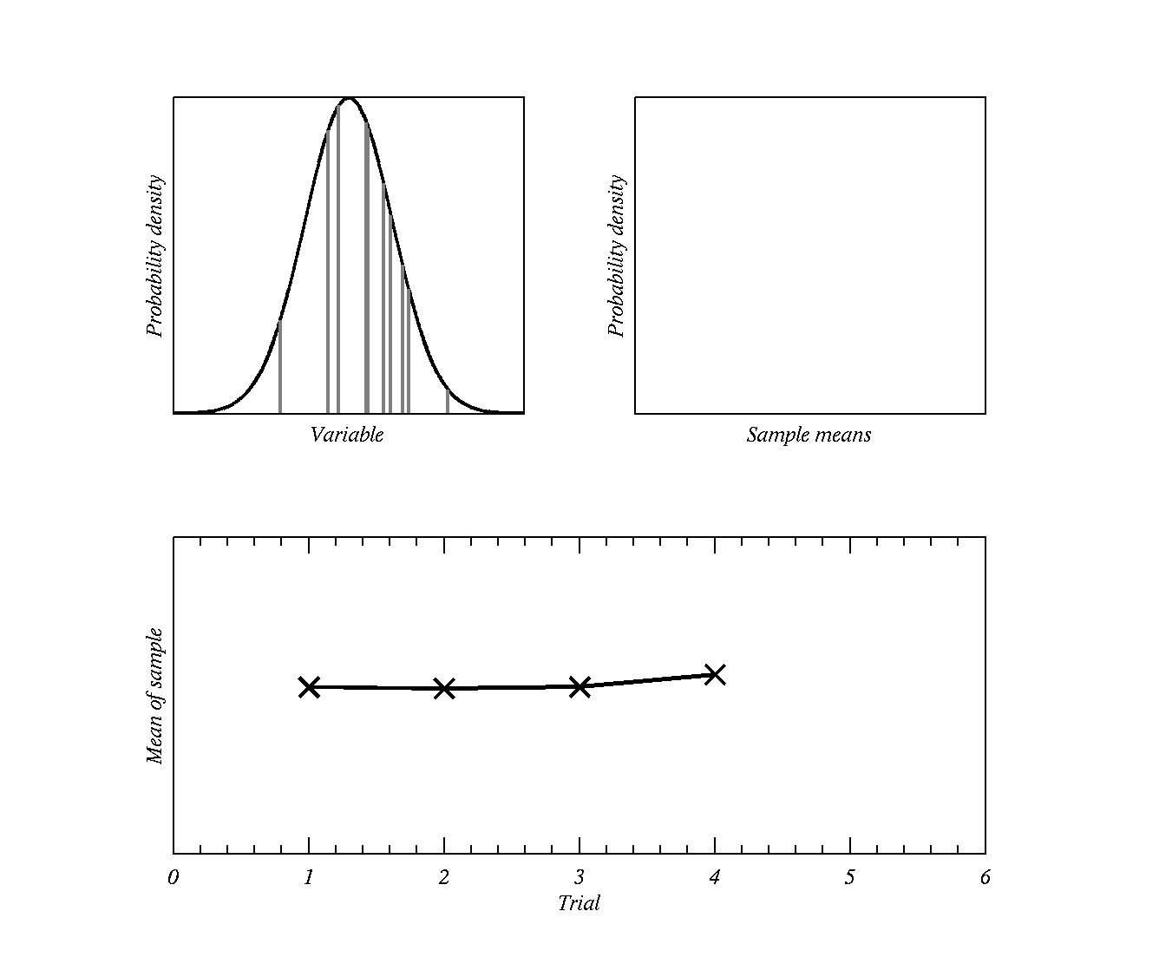
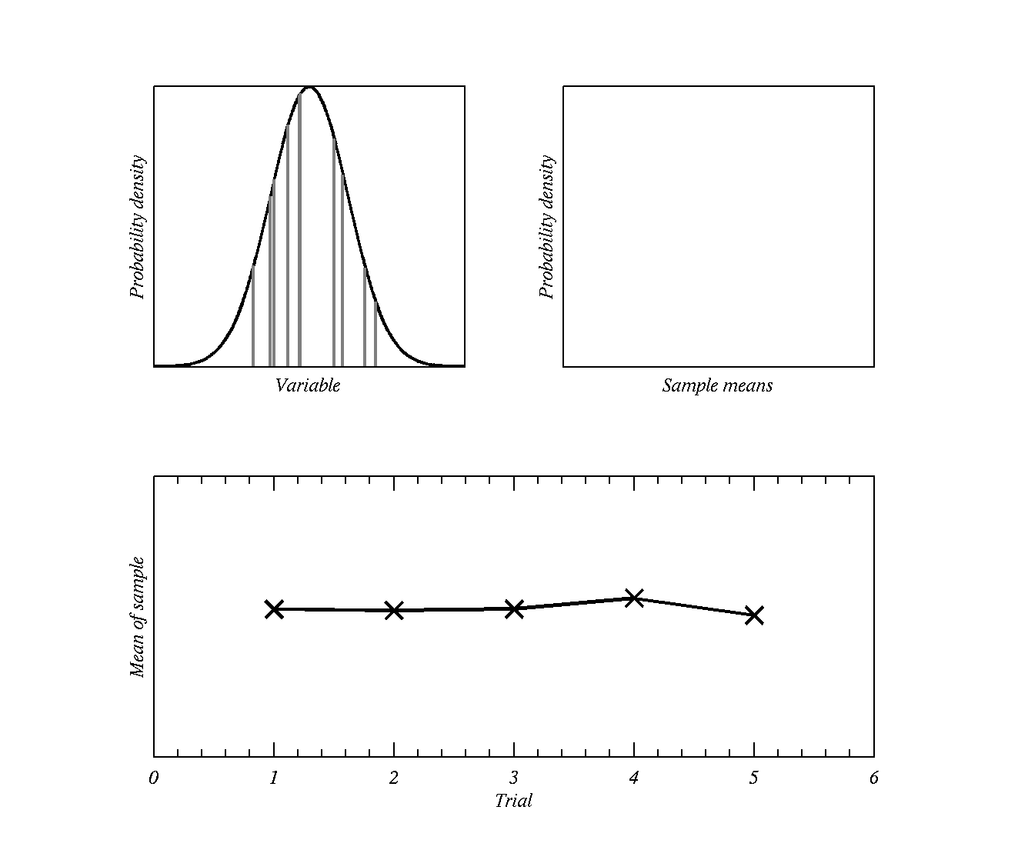
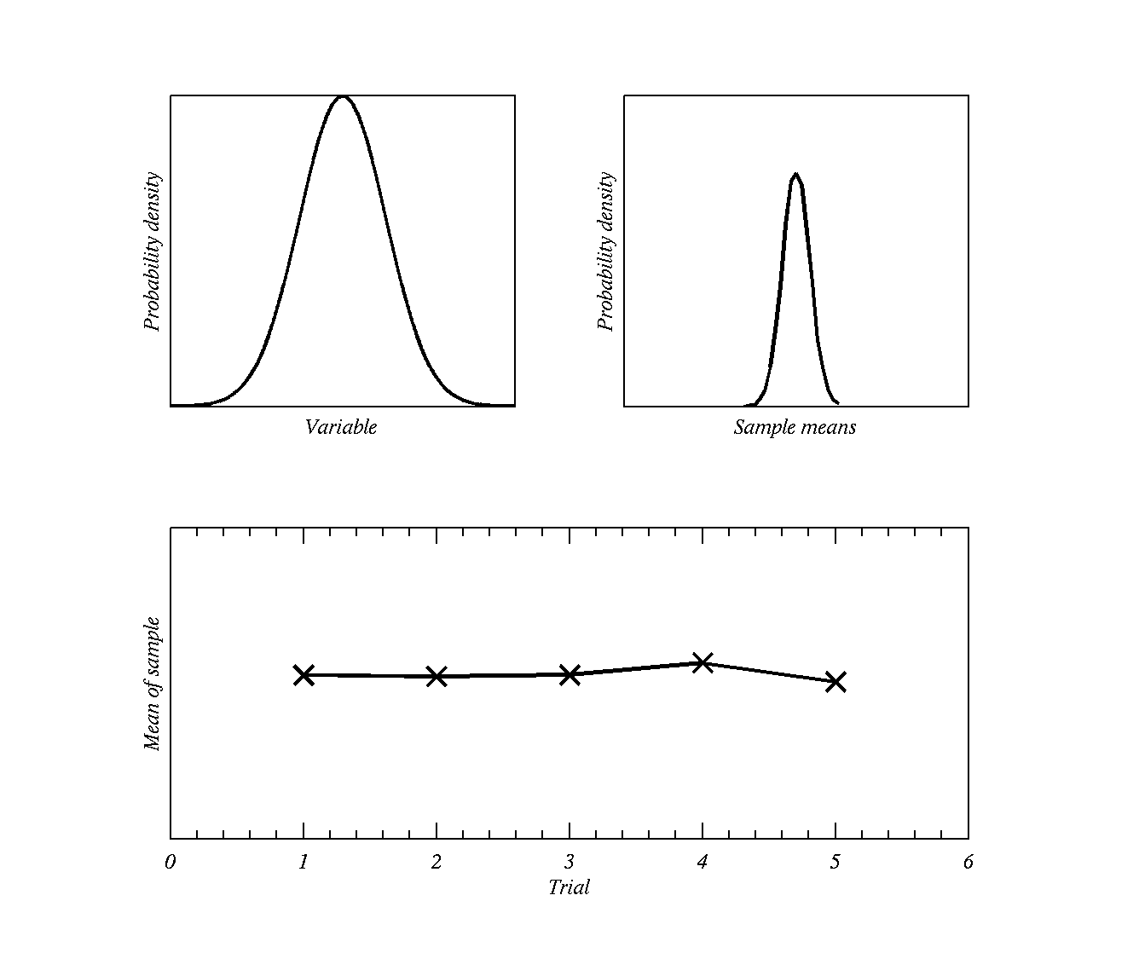
Central limit theorem
σ
σ/N^{0.5}

Slide 22
Tomorrow
Usual – work through Practical PDF (check the notes if you are unsure of how functions work, etc)
Finish the Blackboard assessment
In Reading Week there is also the mid-term test for you to finish.

Slide 24


Slide 25
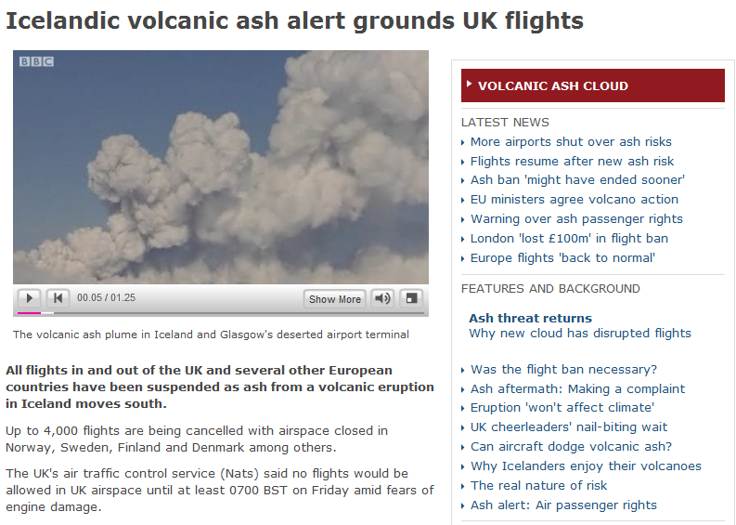
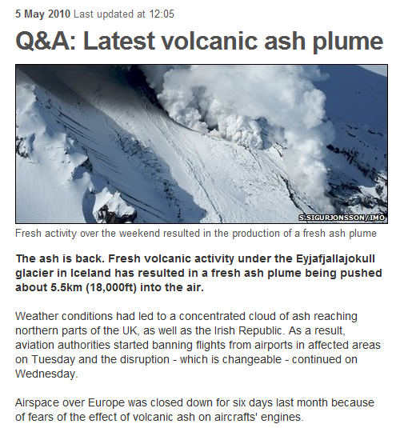
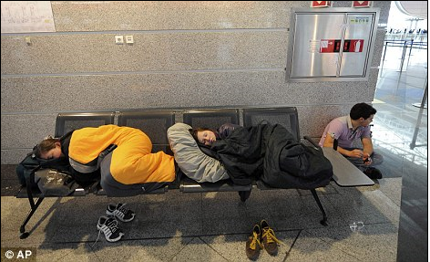

Largest closure of European airspace since World War II, with losses estimated at between €1.5bn and 2.5bn.

Slide 26

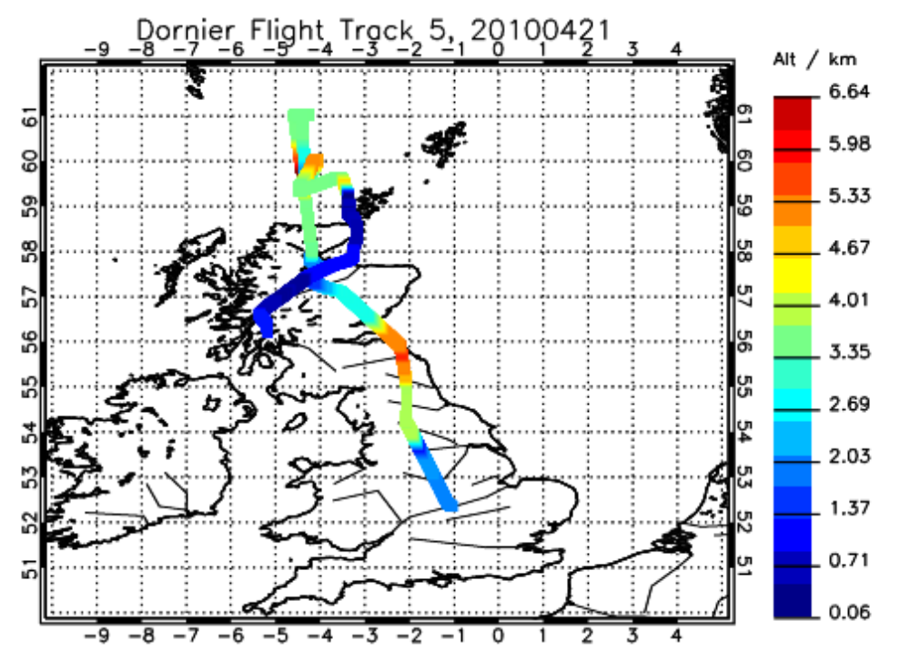
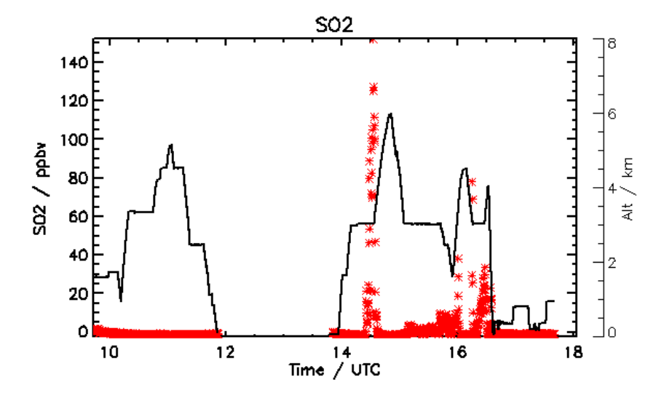
Scientists at Uni Manchester flew into the ash cloud
Airborne measurements 21 April
NERC Dornier aircraft
Particle sizes:
SO₂ approaching danger levels
Grant Allen, Univ. Manchester

Slide 27

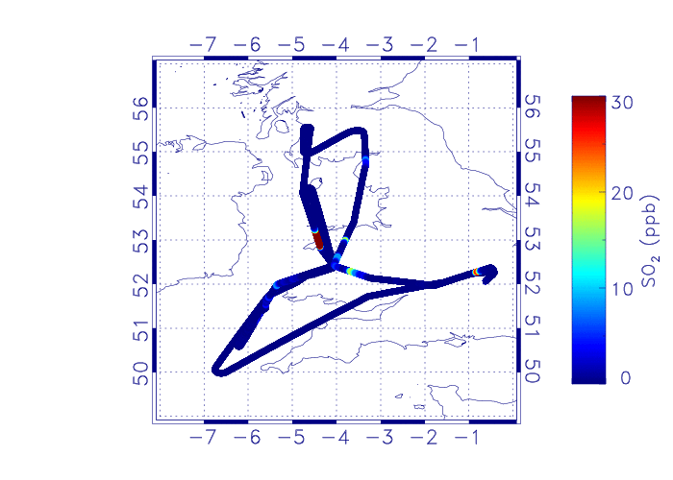
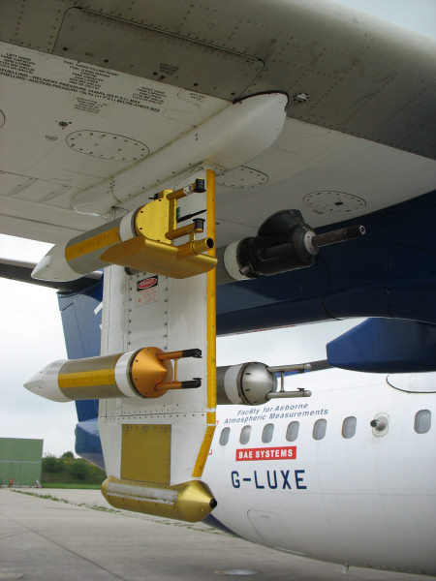
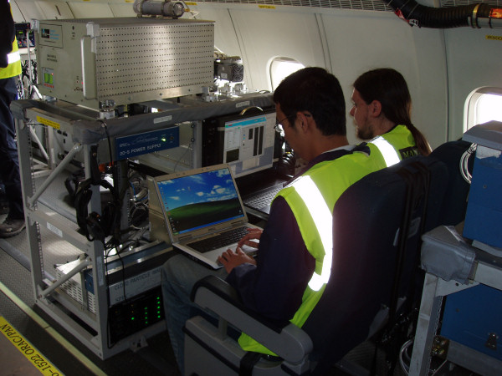
Scientists at Uni Man. flew into it again: 3-4 May
UK research aircraft flown to measure extent and nature of ash cloud
4 May
30 ppbv SO₂ now well below danger levels ( > 100 ppbv )
Data courtesy of Jim Haywood, Met Office

Slide 28
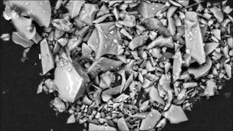
The ash particles were sharp and abrasive
Grimsvotn ash was similar to that found in the later stages of the Eyjafjallajokull eruption (R) rather than the small (sub-micron) and very abrasive particles (L) that Eyjafjallajokull initially emitted.
Eyjafjallajokull
Grimsvotn
The samples were collected from the windscreen of a car in Aberdeen. The largest of the particles is 0.03mm across, with the smallest just 0.002mm wide. The images were taken using a scanning electron microscope

Slide 29
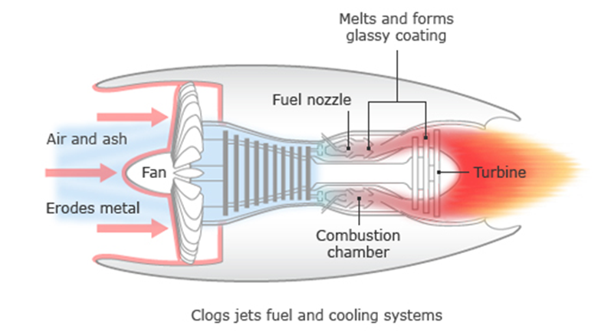
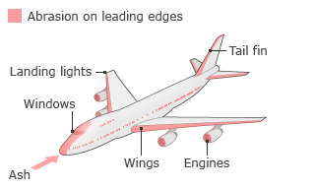
Why the danger to aircraft?
Ash is abrasive and glassy. It is particularly dangerous to turbines.
Original safe limit for flying was: zero ash! As layers couldn’t be forecast, all NW European airspace was closed
On 22 April a new ‘safe limit’ of 2000 μg m⁻³ was introduced, later raised to 4000 μg m⁻³ . Forecasting ash loading is a very difficult problem.
Images from BBC website

Slide 30
Did the aviation authorities over-react?
Not according to Gisalson et al, PNAS May 2011
‘The particles of explosive ash that reached Europe in the jet stream were especially sharp and abrasive over their entire size range, from sub-millimeter to tens of nanometers. Edges remained sharp even after a couple of weeks of abrasion in stirred water suspensions.’

Slide 31
But the normal distribution is the most important distribution in statistics
Because many instruments have instrumental noise that results in a measurement being normally distributed (e.g. instrumental noise can be due to many factors).
Processes that depend on sum of many factors also tend to be normally distributed
  Heights of people, IQ of people
  Bouguer anomaly (effectively density of ground)
  Freezing temperature of cloud drops (depends on what is in them).
Can easily use properties of normal distribution to apply to log-normally distributed data. But we will not use the lognormal distribution in this course

Slide 32
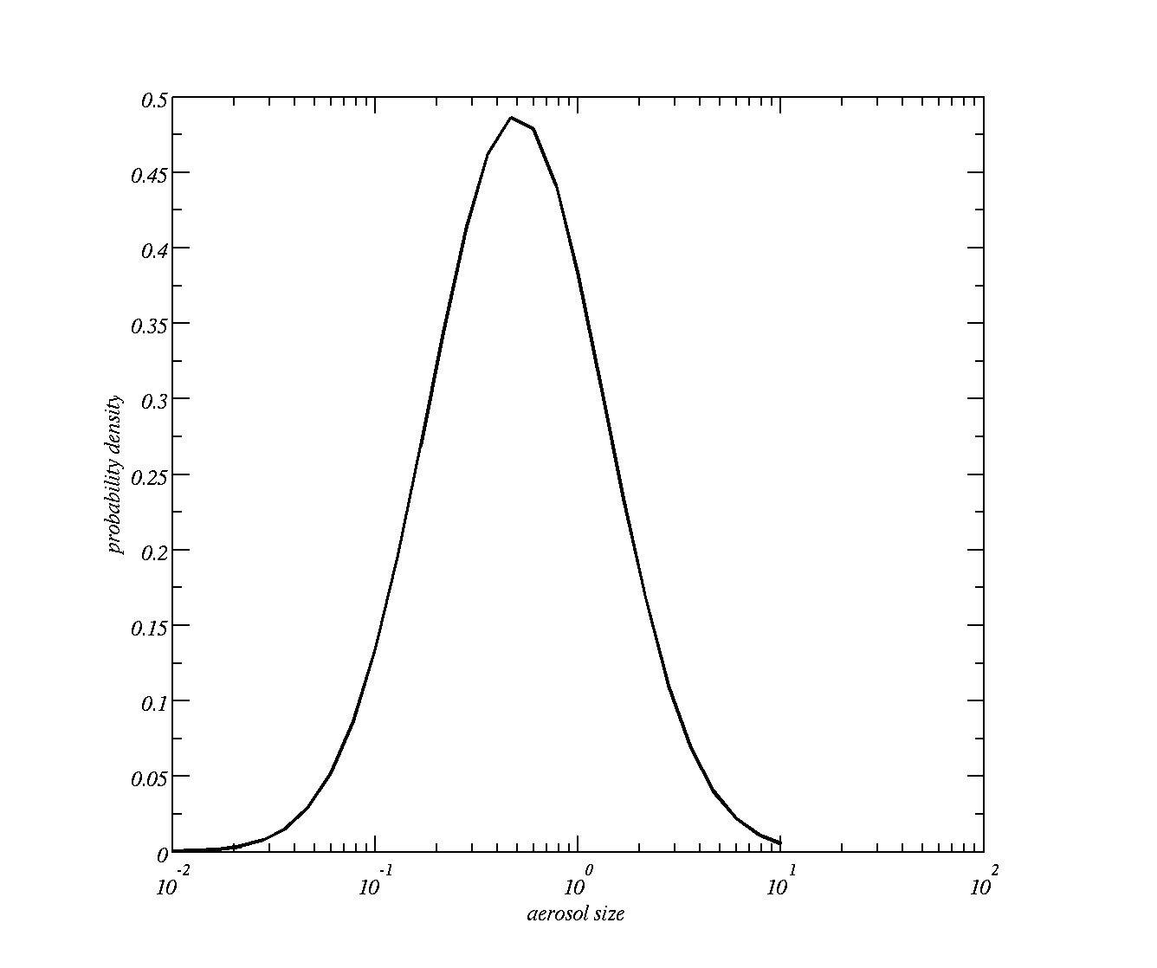
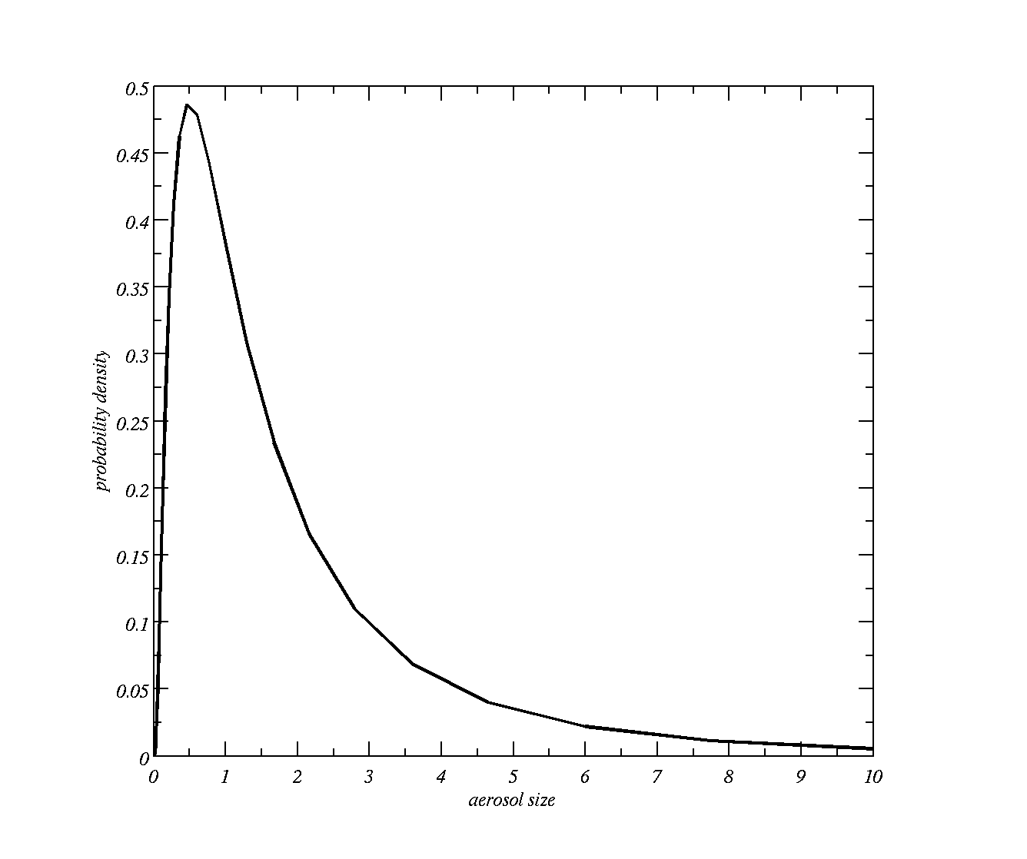
Aerosols tend to be log-normally distributed
Log normal distribution log-linear axes
That is bell shaped if we take the log of the size
A log normal distribution results if the variable is the product of a large number of independent, identically-distributed variables in the same way that a normal distribution results if the variable is the sum of a large number of independent, identically-distributed variables.

Slide 33
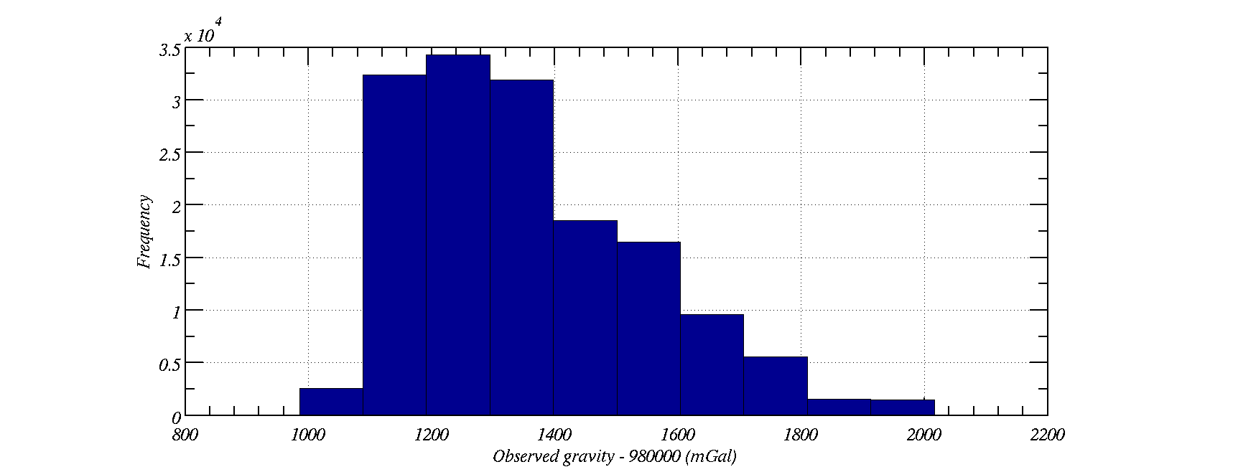
Histogram of observed gravity over the UK
(also log-normally distributed)
Positively skewed
i.e. every so often it is higher than most of the values
observed gravity over the UK is log-normally distributed. E.g. product of rock density; amount of rock below surface; etc.
Gravity (or density) anomalies are the sum of many variables => normally distributed.

Slide 34
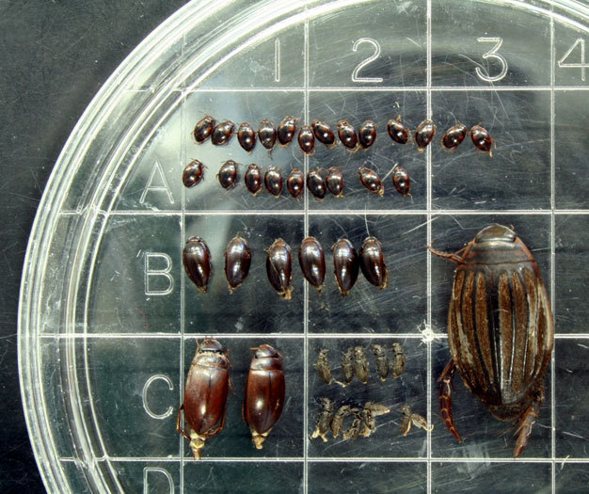
Other log-normally distributed variables
Geology and mining:
  Ga, Co, Cu content in diabase.
  Gold / Uranium content in sections
Human medicine:
  Latency periods of diseases; survival times after cancer diagnosis
Environment:
  Rainfall amount; air pollution
Ecology:
  Species abundance,

