Slide 1
Environmental Modelling
Week 4: Gaussian Plume Modelling
Prof. Paul Connolly
Centre for Atmospheric Science

Slide 2
Contents
This week
  Download code
  Run interpreted code to solve analytical model on grid points.
  Look at model output and interpret results
Scenario we are modelling
Lagrangian approach vs the Eulerian approach
The importance of lapse rate
Stacks
  Geometry
  Assumptions
  Analytical solution
Equations of the model

Slide 3
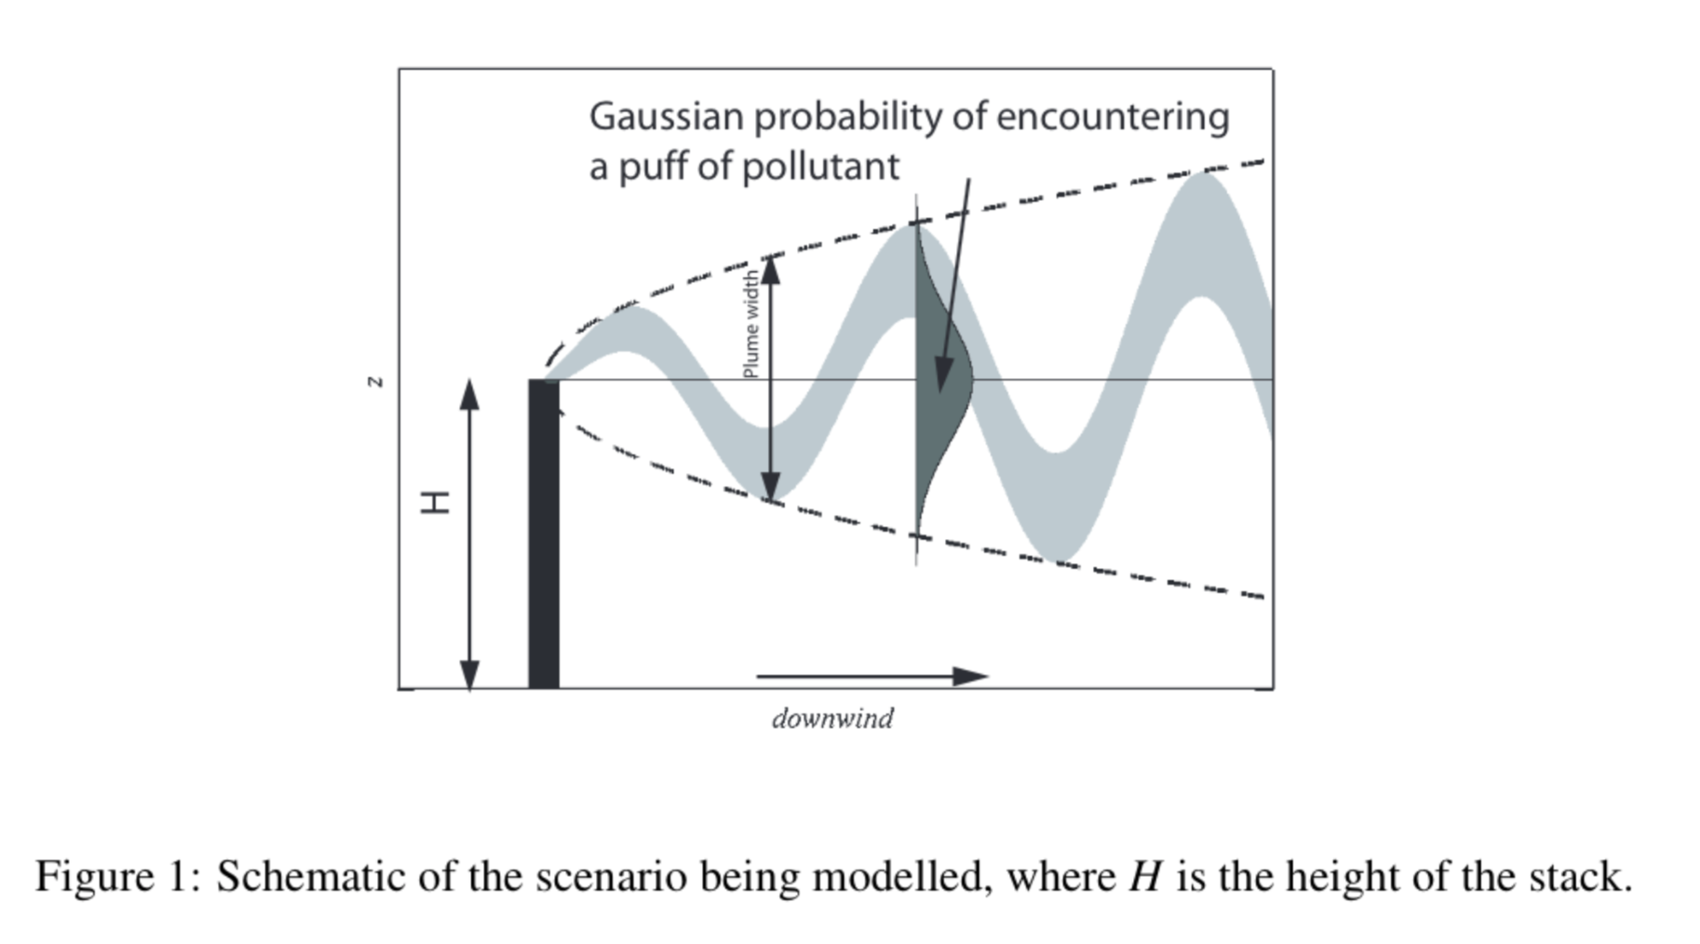
Dispersion of pollution from stacks

Slide 4
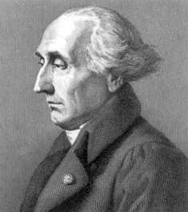
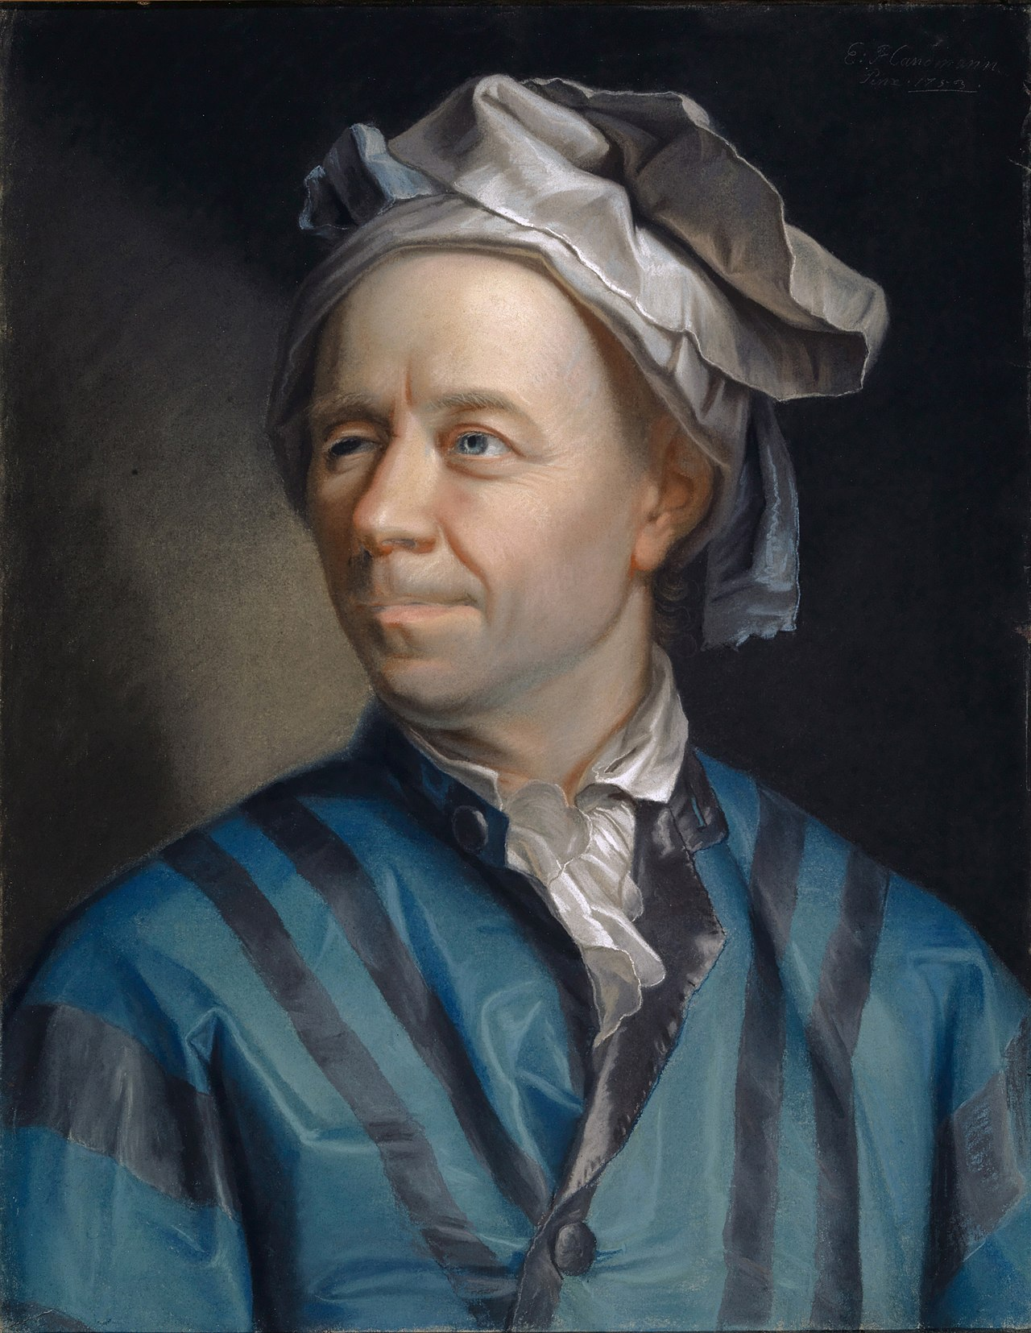
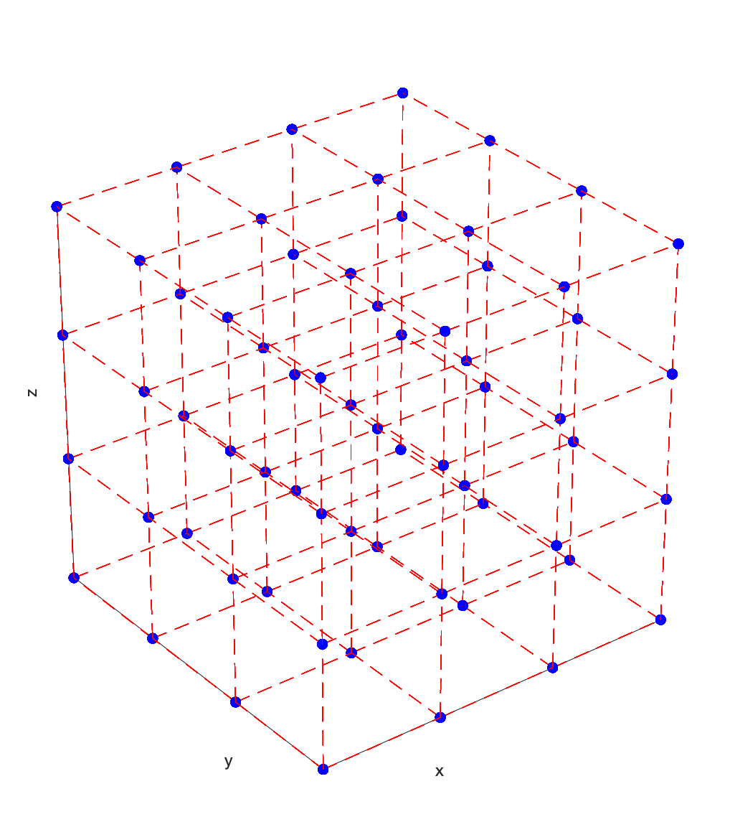
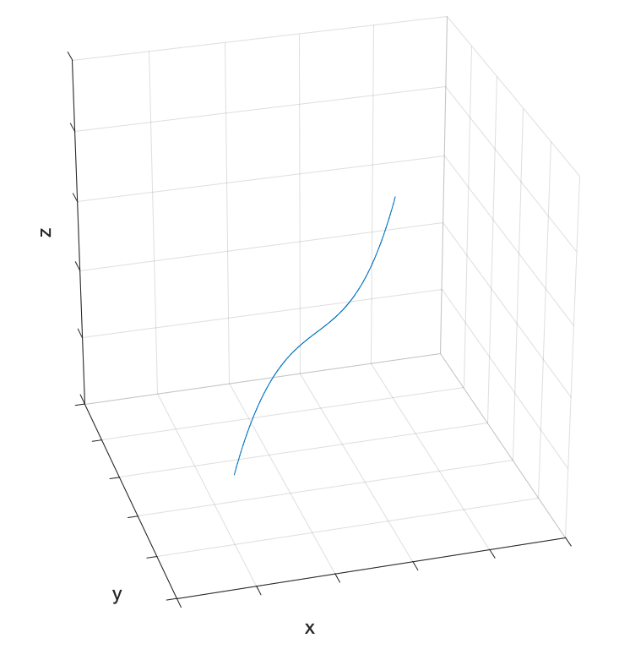
Lagrangian and Eulerian models
Lagrangian:
can be 1d, 2d, 3d;
x, y, z can take on any value and model variables defined at these coordinates.
e.g. positions of planets in solar system; position of parcel in atmosphere
Eulerian:
can be 1d, 2d, 3d;
x, y, z are fixed in space and model variables defined at these positions
This week we will use the Eulerian approach
Joseph-Louis Lagrange:
1736-1813
Lenard Euler:
1707-1783

Slide 5
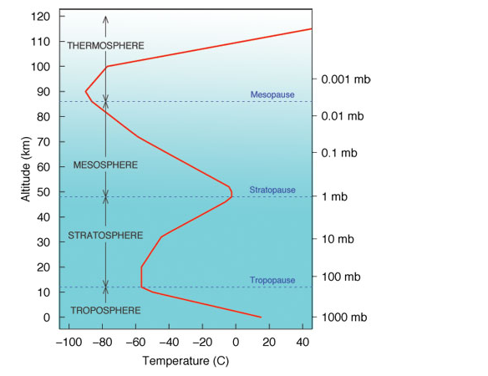
Lapse rate
In the troposphere rising dry air cools at 10 degC per kilometre, moist air cools at 6 degC per kilometre, but the air itself may have a different lapse rate
Above tropopause, lapse rate is governed by other processes, such as the break down of ozone by UV
In the troposphere, lapse rate is very important because it governs the vertical stability.

Slide 6
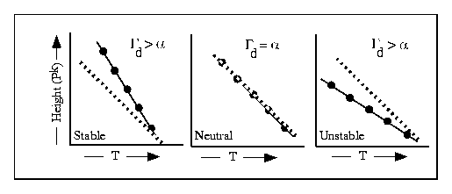
Vertical stability is related to the environmental lapse rate
Solid line = atmosphere, α
Dashed line = path a parcel of air would take, Γ_{d}

Slide 7
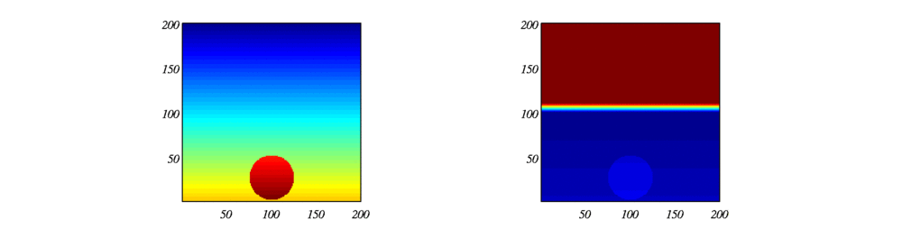
Simulation of rising blob of warm air
Colour is proportional to temperature (modelled)
Colour is proportional to the temperature:
What is happening here?

Slide 8

Stacks in Industry
Emissions from industrial stacks are regulated to protect human and environmental health
Industrial facilities are required to obtain permits to emit into the atmosphere and to demonstrate their compliance with regulations
In the process of applying for permits, dispersion models are generally used to assess the impact of point source emission

Slide 9
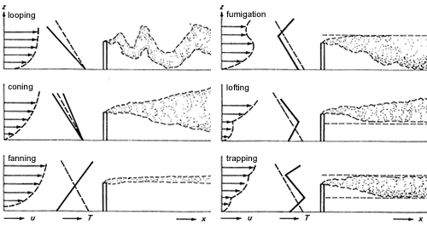
We will model these…
We won’t model these…
Typical Velocity, and Plume Shapes
Solid line is environmental temperature, dashed line is temperature of a parcel of air

Slide 10
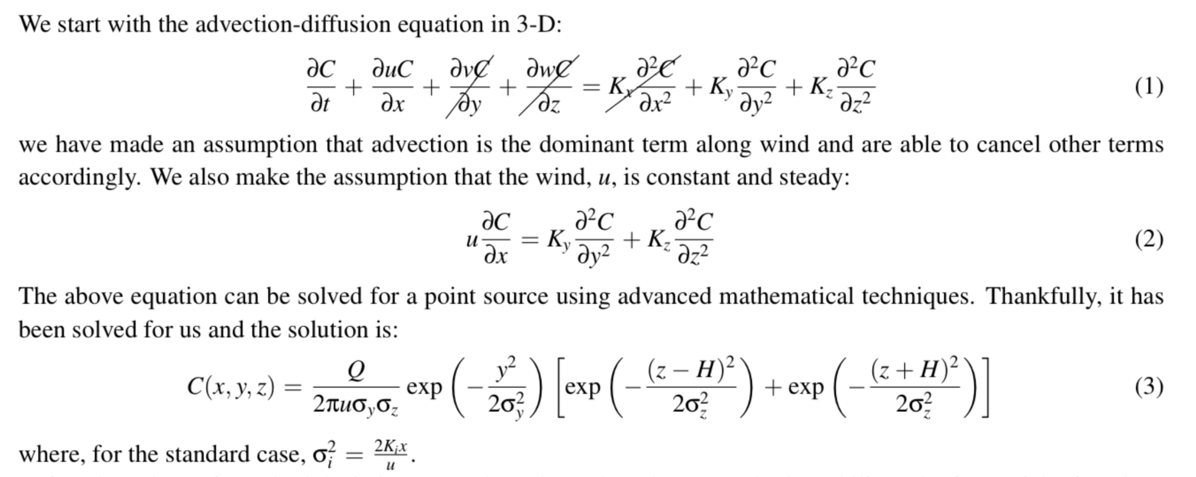
Analytical solution downwind

Slide 11
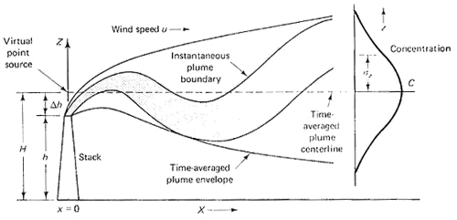
Geometry of plume

Slide 12
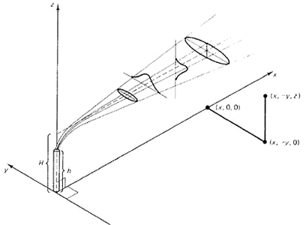
3-D view

Slide 13
Main points
This week we will be using ipython to run the simulations.
  It’s an analytical solution that doesn’t take too much computational power
Quite different assumptions this week – Eulerian grid, rather than Lagrangian path.
More unstable air the more dispersion there is.
  We often need to take both atmospheric dispersion and the behaviour of particulate (e.g. RH) in the atmosphere into account to explain PM
Dispersion, distance, positioning, and emissions govern how much pollution there is at ground level.
We will calculate these things ourselves in the practical synchronous session

