Slide 1
Week 3: Box and Parcel Models in Atmospheric Science
Prof. Paul Connolly
Centre for Atmospheric Science

Slide 2
Contents
Parcel Models
Assumption
Theory
1st indirect effect of aerosols on clouds
Geoengineering Scheme: Marine Cloud Brightening
Aerosol Particles
Kelvin Effect
Droplet growth from water vapour
Bin / Sectional assumption
Initialisation: aerosol ‘modes’ / size distributions
System of Equations to solve
Time permitting
Run compiled code to solve system of ODEs
Look at model output for different initial conditions

Slide 3
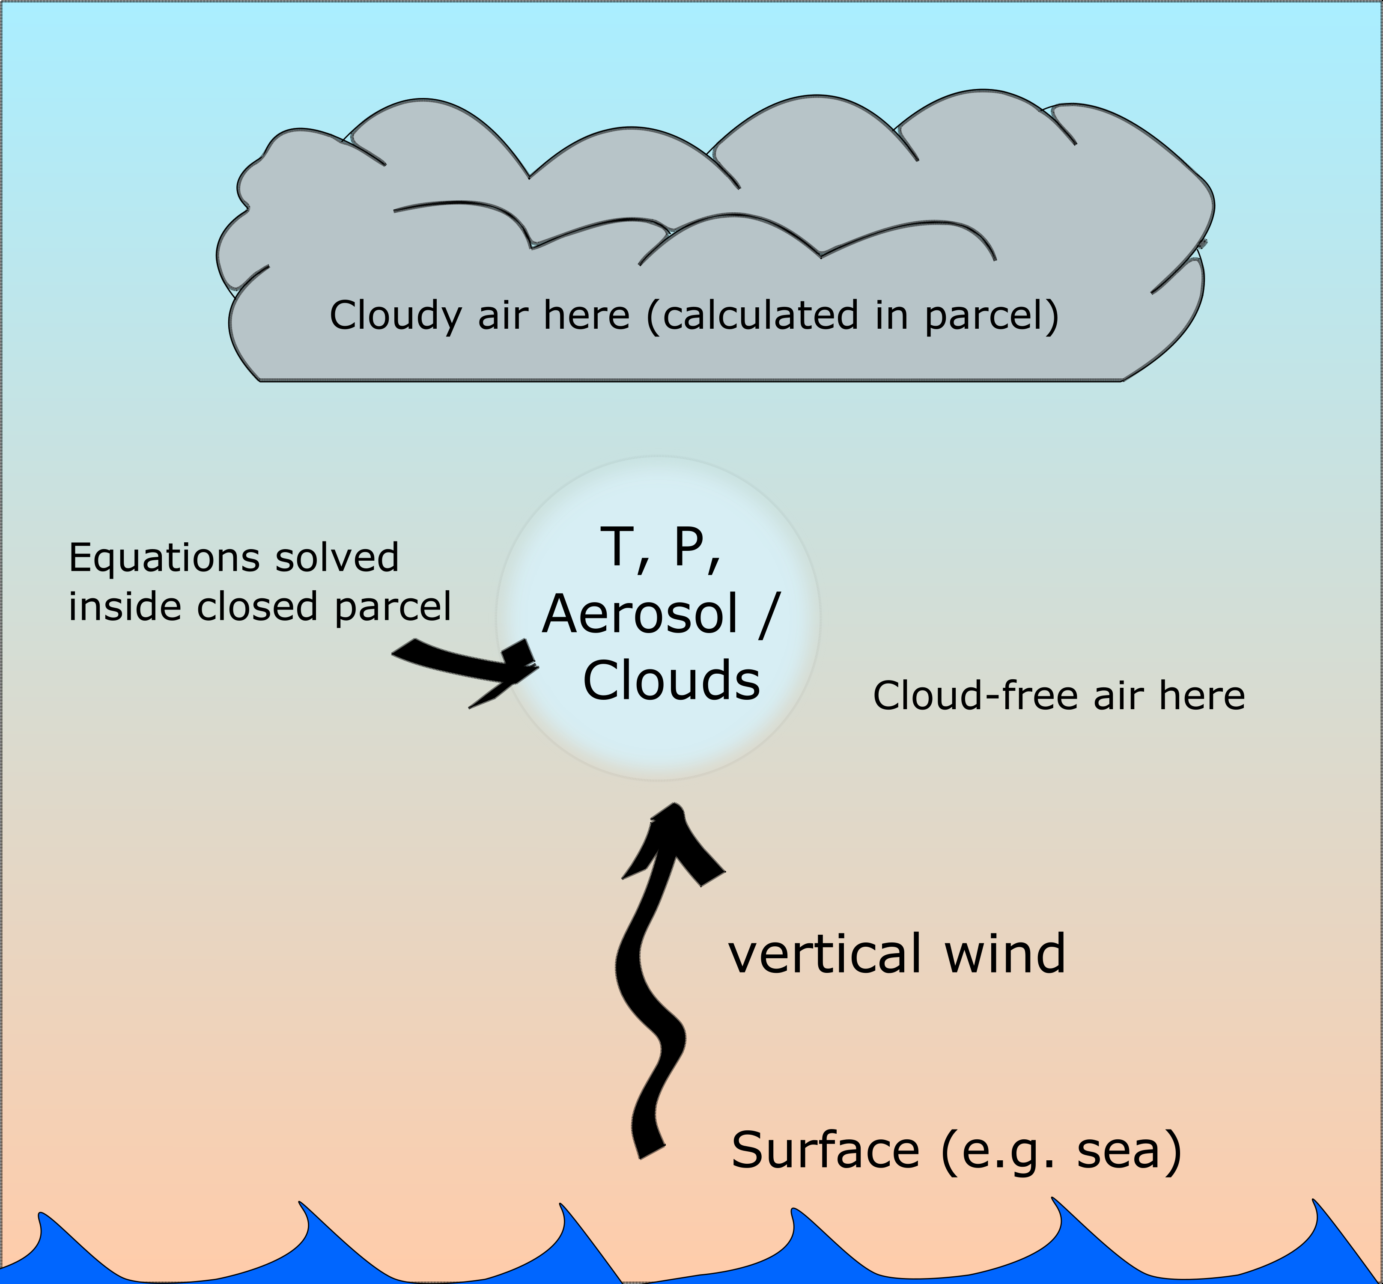
Parcel Models
A parcel model simulates the properties of air along a path
1st order Ordinary Differential Equations govern the rates of change of properties of air inside the parcel
If we assume that no exchange of heat occurs between the environment and the parcel, we call it ‘adiabatic’.
We assume that the properties of atmosphere at a given height is the same as the properties in the parcel at the same height

Slide 4
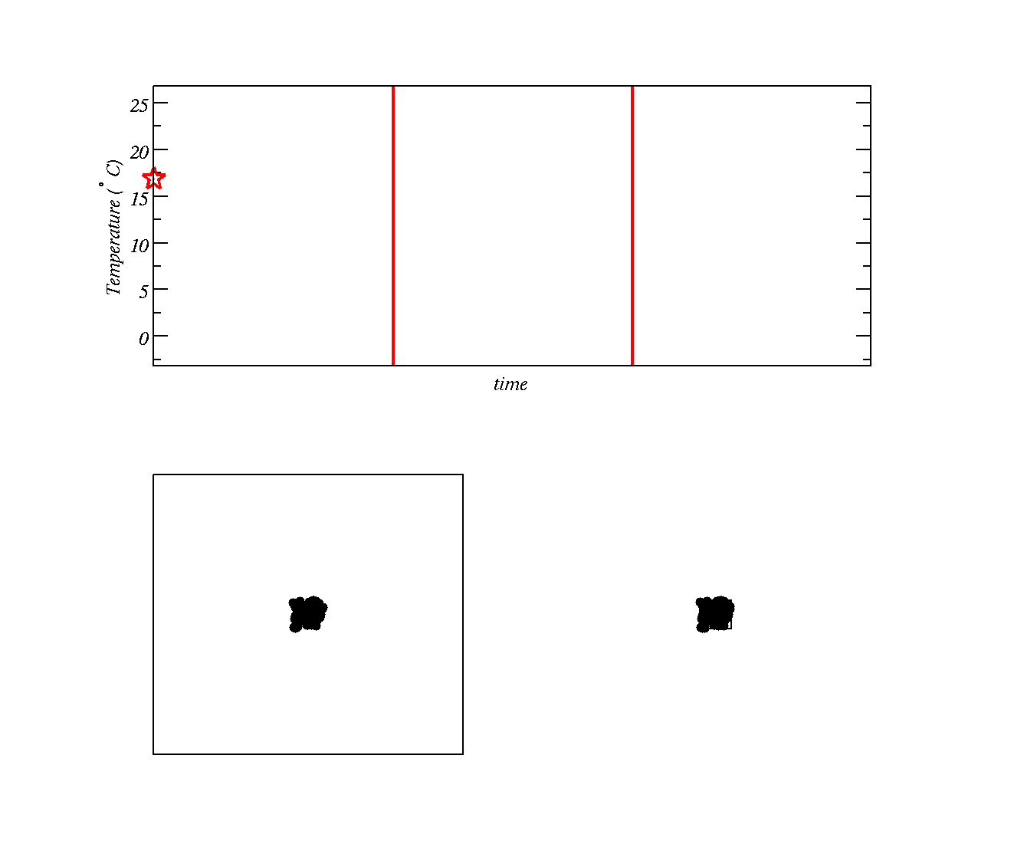
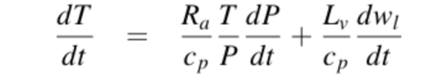
Consider just the air in a ‘closed’ container
Using Kinetic Theory how does the speed (Kinetic Energy) of molecules affect their temperature?
There is a law describing how energy and work are related
Allow gas to expand here
Gas stops expanding
Two boxes with gas at high temperature (molecules moving around fast)
Second box has molecules crammed into a smaller space (higher pressure)

Slide 5
Consider just the air in a ‘closed’ container
Allow gas to expand here
Gas stops expanding
We are going to allow the gas molecules in second box to `push’ against the surrounding air and slow down as a result (temperature is reduced)

Slide 6
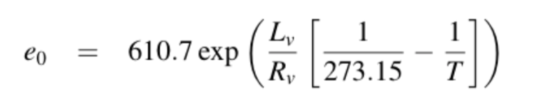
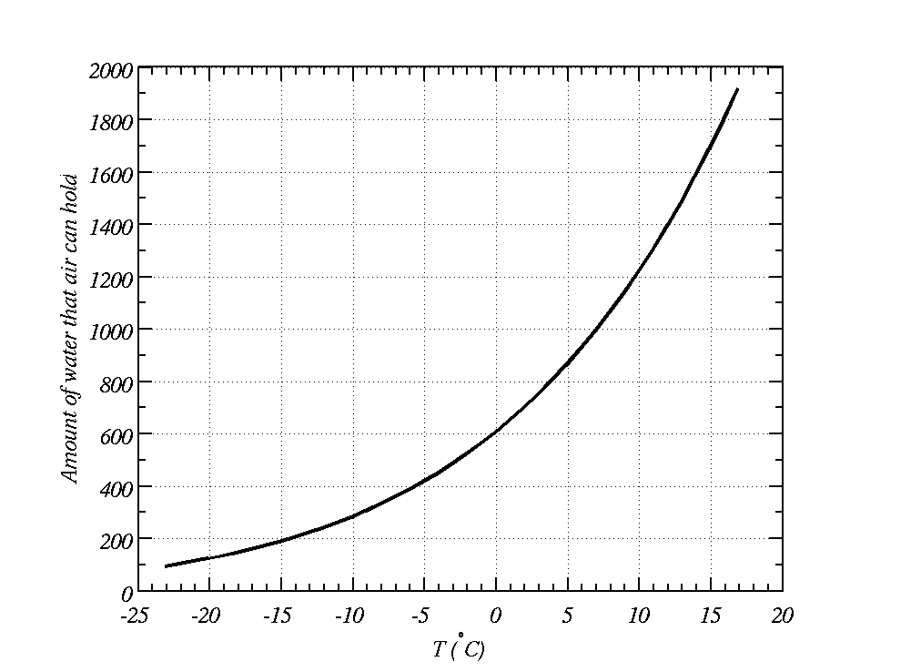
Now consider the water vapour
Described by the ‘Clausius-Clapeyron equation’
Cools during the night
This much water in the air
Equilibrium vapour pressure (Pa)
Over a flat water surface
?
Water exists as liquid and vapour here
Water exists as vapour here

Slide 7
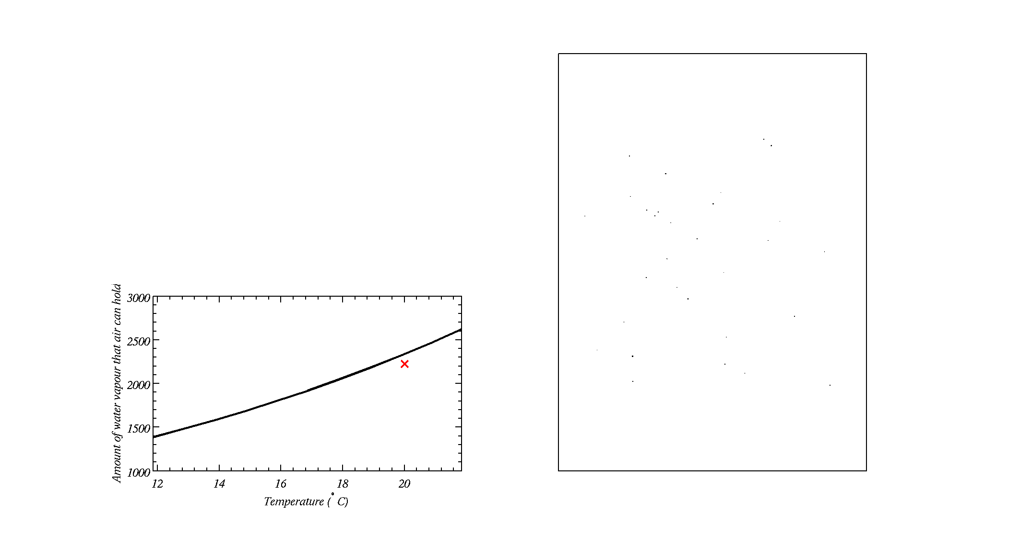
Now consider aerosol particles
Box with cloud condensation nuclei in it
As the air cools during the expansion, water vapour eventually condenses onto aerosol particles known as Cloud Condensation Nuclei (a type of small particle suspended in air) and forms a cloud
Some small particles do not act as Cloud Condensation Nuclei
Amount of water in the air

Slide 8
Now consider aerosol particles
Box with cloud condensation nuclei in it
As the air cools during the expansion, water vapour eventually condenses onto aerosol particles known as Cloud Condensation Nuclei (a type of small particle suspended in air) and forms a cloud
Some small particles do not act as Cloud Condensation Nuclei
Amount of water in the air

Slide 9
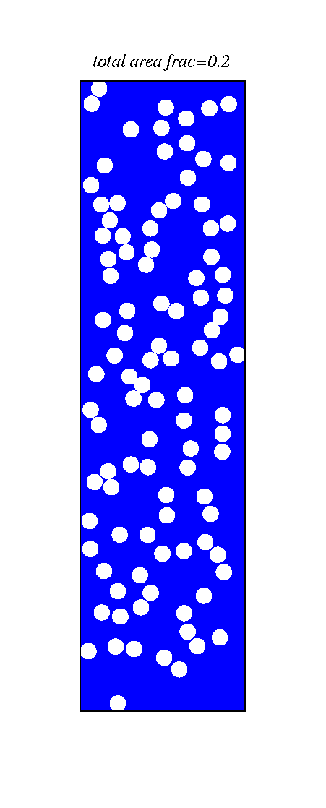
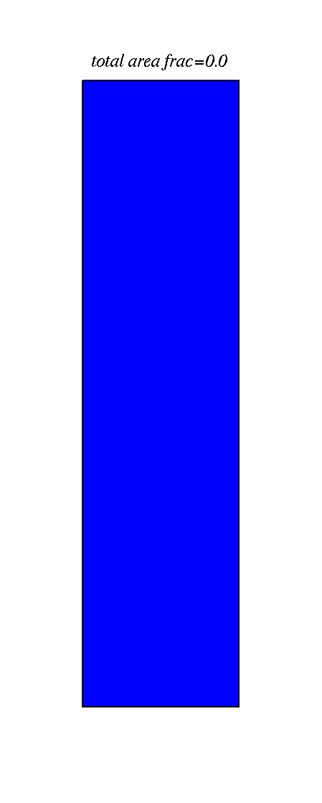
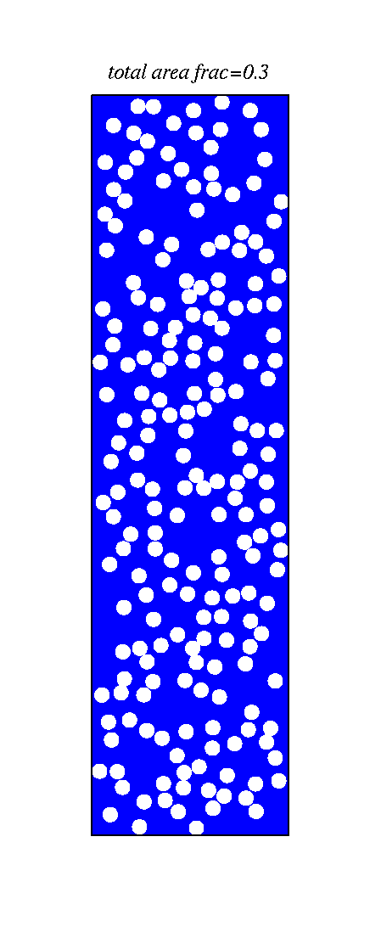
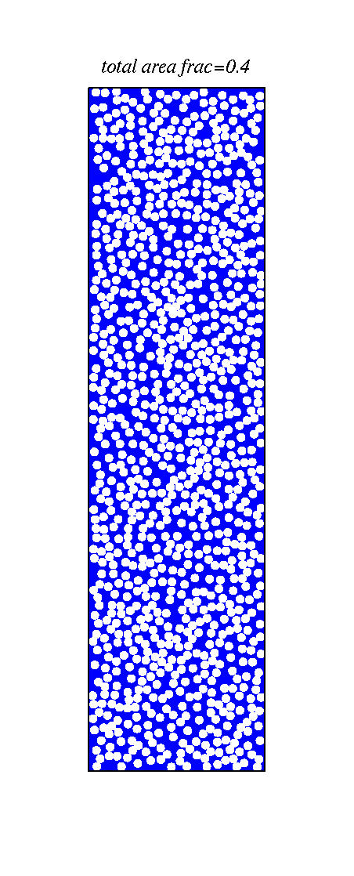
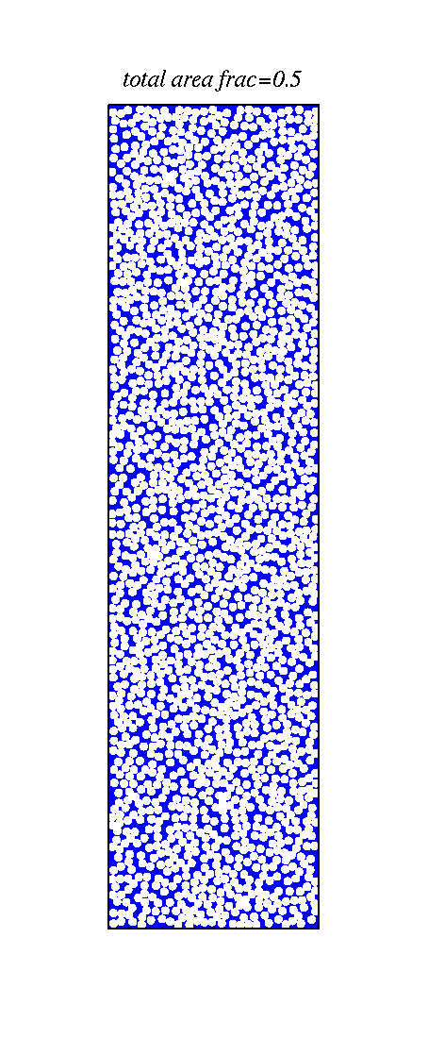
The number of cloud condensation nuclei is important to how much sun-light is reflected what do you notice?
Ocean - blue
This gives rise to the 1st indirect effect of aerosols on clouds (Twomey, 1989)

Slide 10
Some observational analysis by our Centre
slide courtesy of Prof. Grant Allen

Slide 11
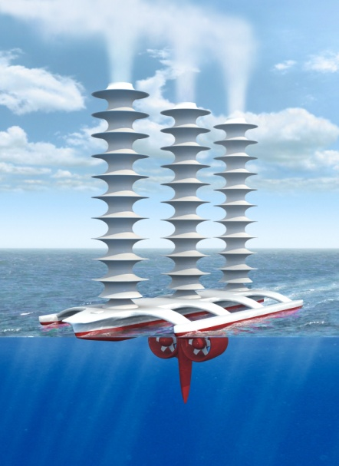
Latham’s geoengineering scheme (a way of combating global warming?)
Technique (Latham, Nature, 1990)
To disseminate natural sea water droplets at ocean surface into the boundary layer.
These drops evaporate and leave behind aerosol particles, which ascend via thermals and go into the cloud
Switching off the sprayers returns to the status quo within a week or so.
Support for idea
Natural droplet creation at ocean surface
NaCl drops are effective CCN
How does it work? As we will show, it depends a lot on the size of the aerosol particles.

Slide 12
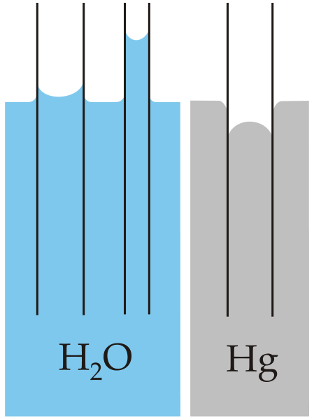
`Capillary action’ in pure water
A `wetting’ tube negative curvature
A `non-wetting’ / hydrophobic tube positive curvature

Slide 13
Why is the vapour pressure over a curved surface higher than flat?
Curved surface: intermolecular forces from adjacent molecules (long range) are missing; hence, net force normal to surface is less; hence high vapour pressure needed
Flat surface: intermolecular forces act over one hemisphere; hence, molecules thermal energy needs a low vapour pressure from above to stop it escaping
There is some theory that allows us to calculate the ratio of water vapour pressure between a curved and flat surface…

Slide 14
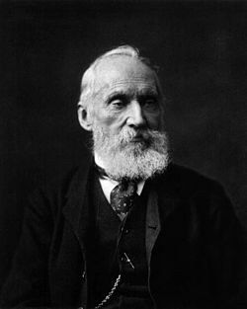
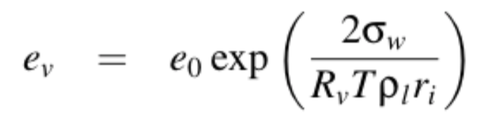
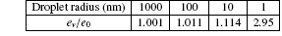
Kelvin’s equation used to calculate the equilibrium vapour pressure over a water drop
Lord Kelvin (1824-1907)
In the atmosphere, e_{v}/e₀ rarely exceeds 102% (e_{v}/e₀=1.02)
Hence aerosols with dry size radius smaller than about 50 nm are not effective CCN
e₀ = equilibrium vapour pressure over flat surface
e_{v} = equilibrium vapour pressure over a drop

Slide 15
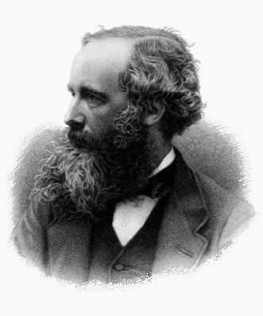
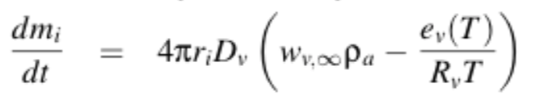
Among his many achievements (e.g. Electromagnetic theory, 1864), Maxwell (1870) was the first to combine the laws of diffusion of mass and heat to write down the particle growth equations in the continuum regime
For liquid water to condense onto aerosol particles the actual water vapour pressure must be higher than the equilibrium vapour pressure.
So it is generally ‘easier’ for water to condense onto larger aerosol particles.
There is a theory that describes how fast water condenses onto aerosol particles.
James Clerk Maxwell (1831–1879)
Diffusion of vapour to a growing drop
(liberating latent heat)
m_{i}

Slide 16
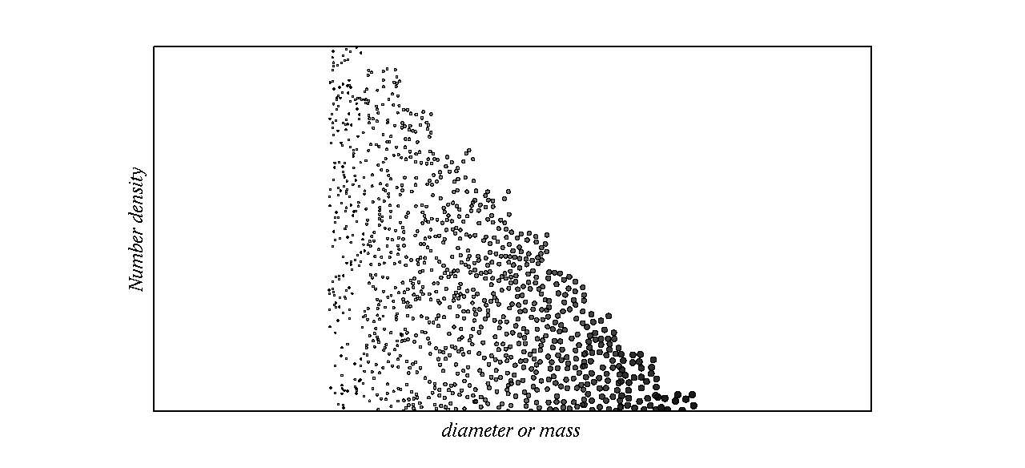
Representation of particle size
N₁
N₂
Individual `bins’ can grow or shrink
N_{n}
D₁, D₂,…,D_{n}
It is too computationally expensive to solve a differential equation for each aerosol particle
Therefore, we divide aerosol particles into size or mass categories and solve the growth of the category centre.
This is called the ‘bin’ or ‘sectional’ approach

Slide 17
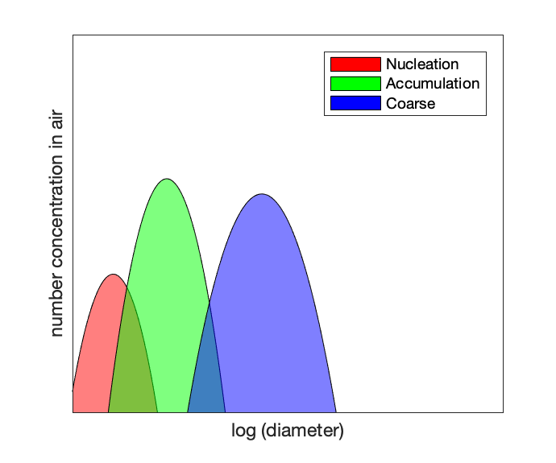
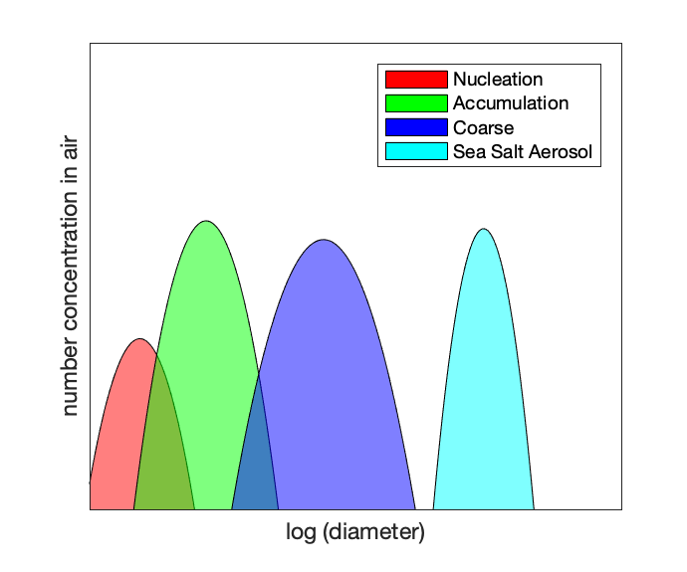
Aerosol size distributions
D_{m}
D_{m}
N
N
D_{m}
lnσ
lnσ
lnσ
N
Aerosol sizes tend to ‘clump’ into modes. They can be approximated by the log-normal distribution
Log-normal is defined by 3 variables: total area, centre, and width.
Background aerosol tends to have 3 modes as above.
Chemically they can be organics, salts, etc
They may act as CCN
Geoengineering attempts to add sea salt aerosol to the background which can serve as more efficient CCN – and hopefully increase cloud drops.

Slide 18
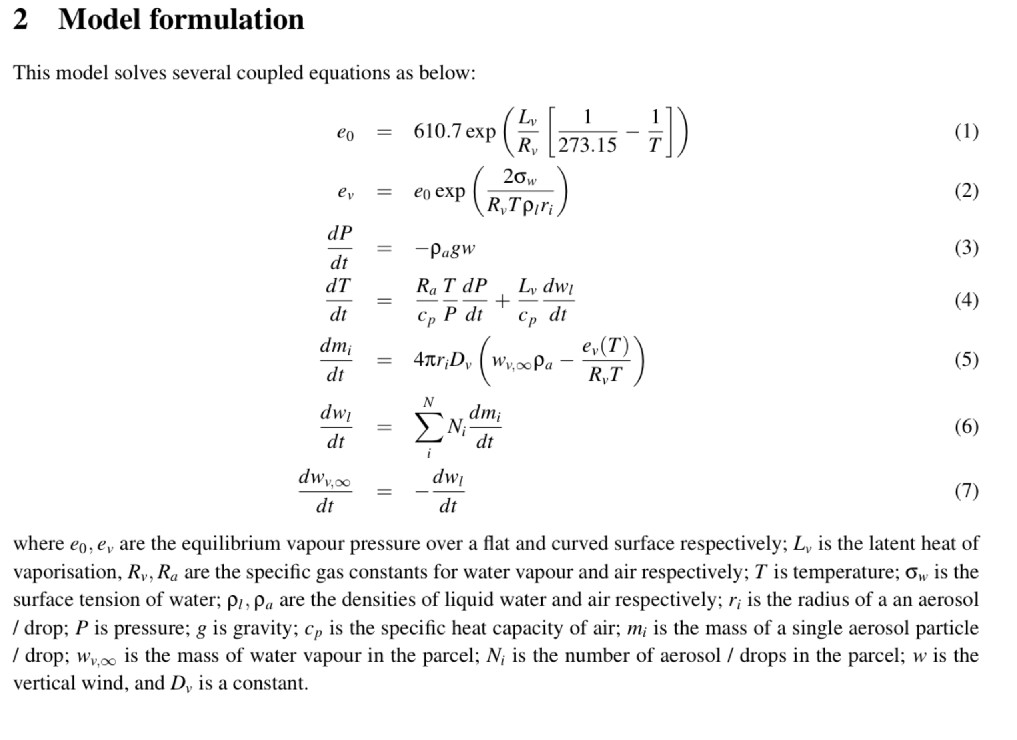
System of equations
Note that equation 5 is solved for at least 60 size ‘bins’. So there are ~64 first order ODEs to solve.

Slide 19
Main points
Parcel models calculate the properties of a small parcel of air as it moves along a path in the atmosphere – usually in the vertical – by solving ODEs.
Change in variables like pressure, give rise to changes in other variables (e.g. temperature).
Water condenses when the water vapour pressure over a surface is high enough, but this pressure must be higher over a curved surface.
We split particle sizes into many categories (or size bins) to make the calculations manageable.
Aerosols are distributed approximately according to several lognormal distribution.
Time permitting:
We will each log-in to a server computer using SSH and SFTP
We will run a parcel model to investigate marine cloud brightening
We will try
a simulation without adding sea spray – default.png
a simulation adding 1000/cc sea spray particles: 1000_wide.png
a simulation adding 1000/cc sea spray particles with a narrow distribution: 1000_narrow.png
a simulation adding 100/cc sea spray particles: 100_narrow.png

Slide 20
Exercise
Open up a CMD window (or terminal on Mac)
Type e.g.:
ssh avhkl@130.88.66.57
Repeat but type, e.g.:
sftp avhkl@130.88.66.57
To run the model type (in ssh window):
./run.sh namelist.in default.png
./run.sh namelist-a.in 1000_wide.png
./run.sh namelist-b.in 1000_narrow.png
./run.sh namelist-c.in 100_narrow.png
To get these files type (in sftp window)
get /tmp/avhkl/default.png
get /tmp/avhkl/1000_wide.png
get /tmp/avhkl/1000_narrow.png
get /tmp/avhkl/1000_narrow.png

