Slide 1
Meteorology and Atmospheric Physics lecture 1
Questions to think about:
Why does a cloud form in the atmosphere?
What is a cloud (at the microscopic level)?
How much water vapour can air `hold’?
How does the air temperature affect how much water vapour it can `hold’?
Dr Paul Connolly, reader

Slide 2
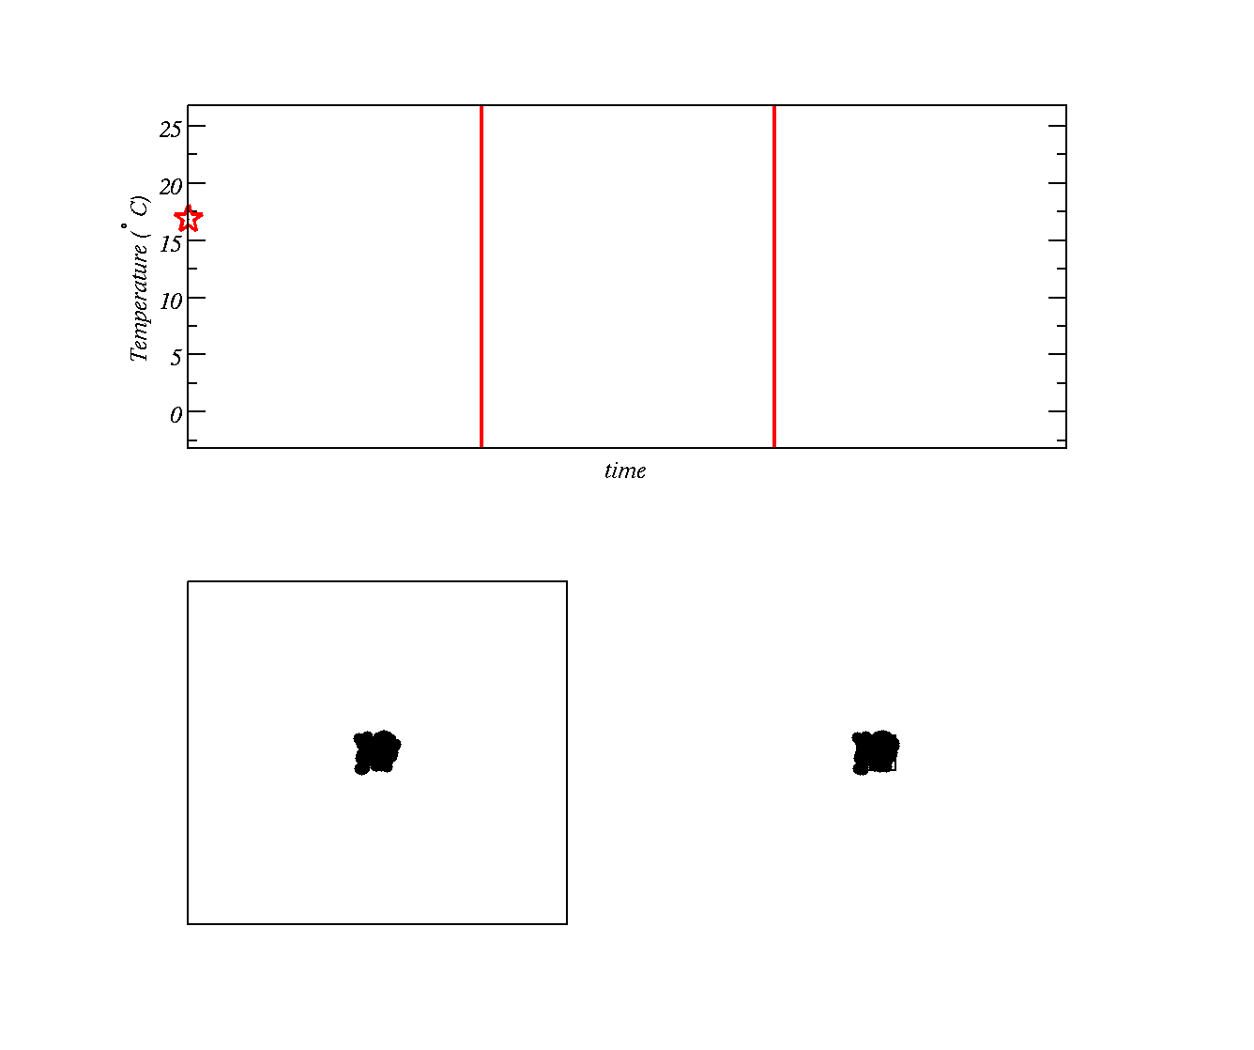
Gas `pushes’ against air around it and gas molecules slow down
Using Kinetic Theory how does the speed (Kinetic Energy) of molecules affect their temperature?
Do you know a law describing how energy and work are related?
Allow gas to expand here
Gas stops expanding
Two boxes with gas at high temperature (molecules moving around fast)
Second box has molecules crammed into a smaller space (higher pressure)

Slide 3
Gas `pushes’ against air around it and gas molecules slow down
Allow gas to expand here
Gas stops expanding
We are going to allow the gas molecules in second box to `push’ against the surrounding air and slow down as a result (temperature is reduced)

Slide 4
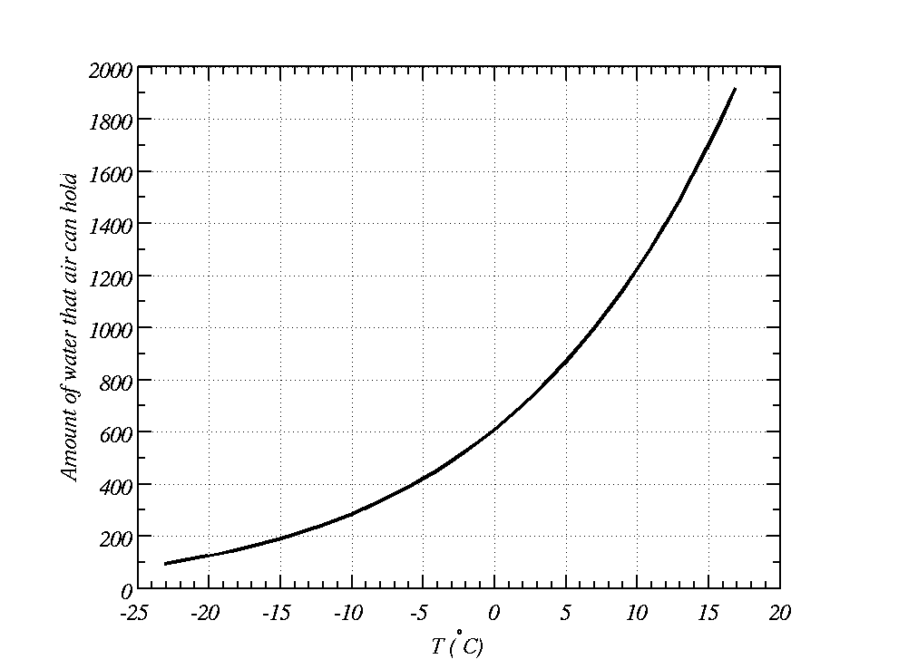
Warm air holds more water vapour than cold air
Described by the Clausius-Clapeyron equation
Cools during the night
This much water in the air
Saturation vapour pressure (Pa)
?
Water exists as liquid and vapour here
Water exists as vapour here

Slide 5
Warm air holds more water vapour than cold air we don’t talk about the pressure of condensed water, we talk about the condensed mass (or mixing ratio)
How can we relate the two?
Saturation vapour pressure (Pa)
Water exists as liquid and vapour here
Water exists as vapour here
Does condensation affect the temperature of air? How? Why?

Slide 6
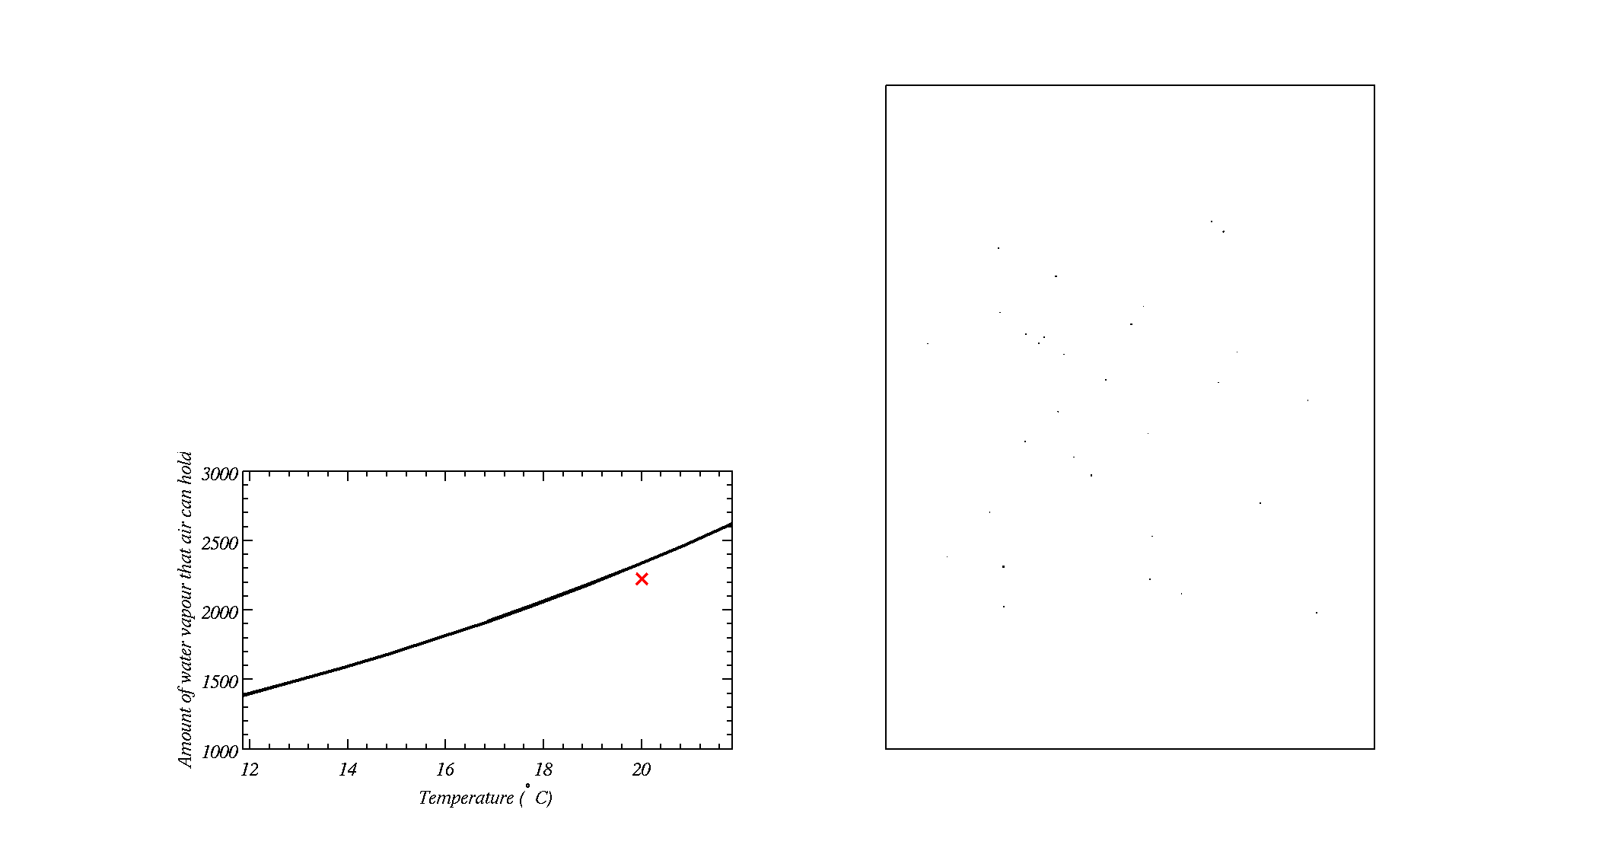
Cloud Condensation Nuclei
Box with cloud condensation nuclei in it
As the air cools during the expansion, water vapour eventually condenses onto Cloud Condensation Nuclei (a type of small particle suspended in air) and forms a cloud
Some small particles do not act as Cloud Condensation Nuclei
Amount of water in the air

Slide 7
Cloud Condensation Nuclei
Box with cloud condensation nuclei in it
As the air cools during the expansion, water vapour eventually condenses onto Cloud Condensation Nuclei (a type of small particle suspended in air) and forms a cloud
Some small particles do not act as Cloud Condensation Nuclei
Amount of water in the air

Slide 8
7 steps to make a cloud in a chamber
Close the large valve on the chamber
Open the screw cap
Put water in the chamber
Strike a match, blow out and put in the chamber – aerosols / cloud condensation nuclei
Close the screw cap
Pump air into the chamber
Open the large valve on the chamber
Key point is that the thermodynamics of air are important and we also need particles!
GEOS model of aerosols

Slide 9
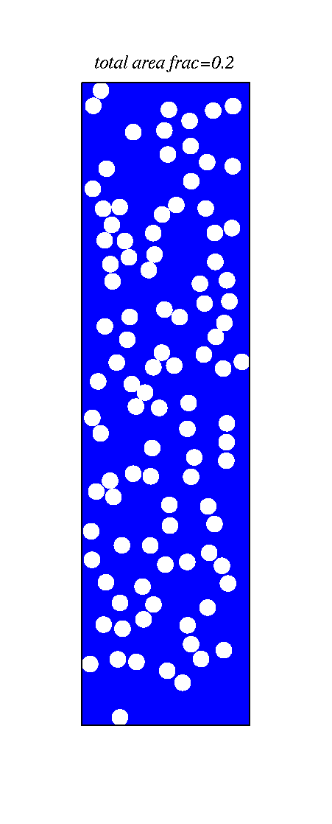
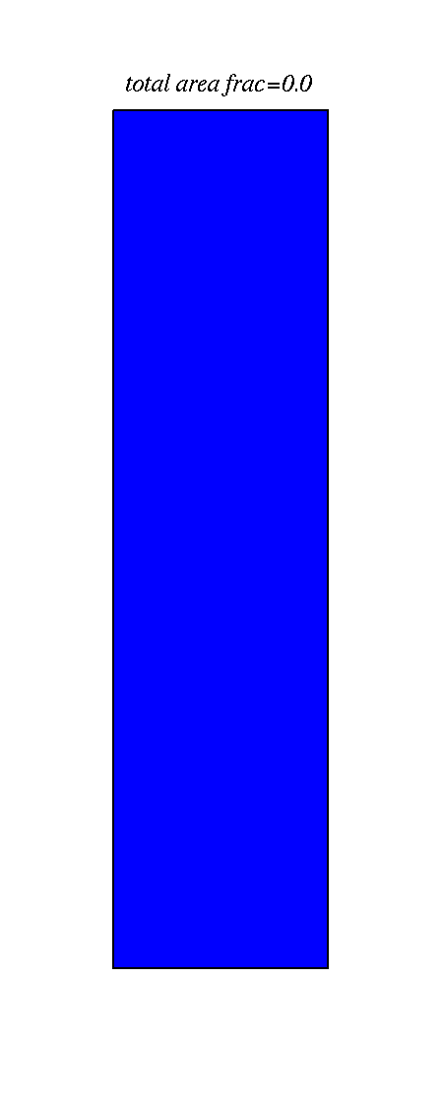
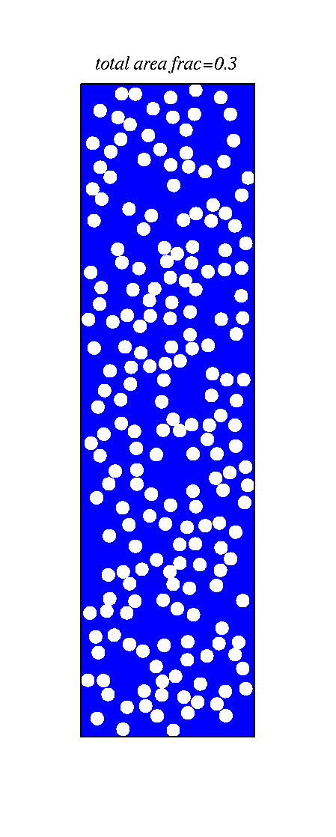
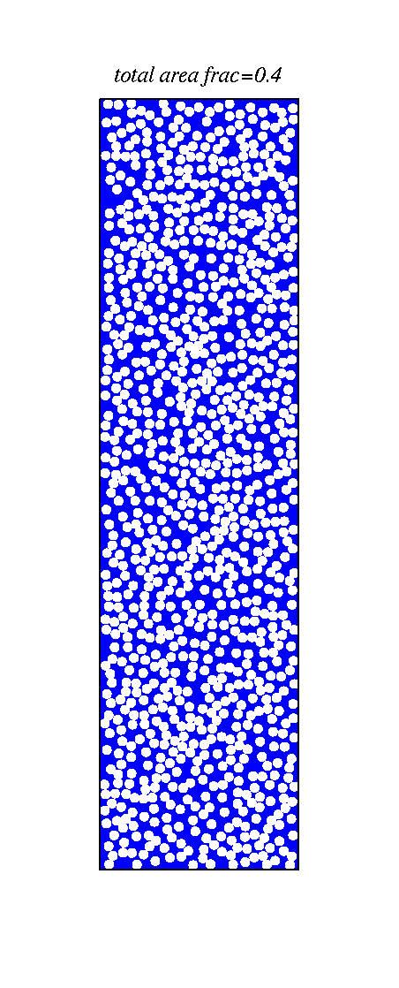
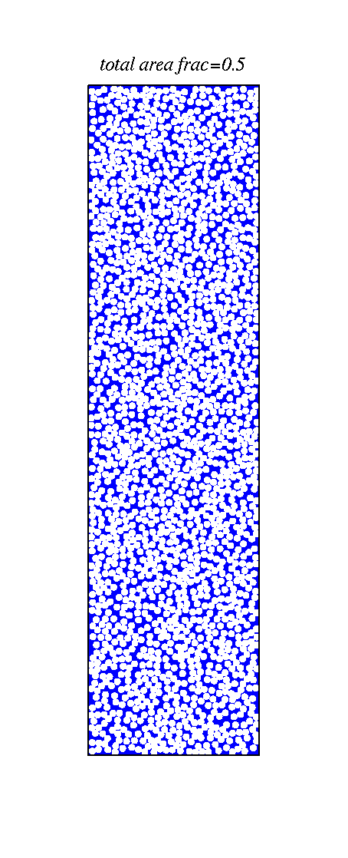
The number of cloud condensation nuclei is important to how much sun-light is reflected what do you notice?
Ocean - blue

