Slide 1
Meteorology and Atmospheric Physics lecture 2
Recap:
Why does a cloud form in the atmosphere? air saturates with water vapour and condensation takes place on aerosol particles
What is a cloud (at the microscopic level)? an ensemble of droplets (or ice crystals suspended in air)
How much water vapour can air `hold’? described by the clausius clapeyron equation
How does the air temperature affect how much water vapour it can `hold’? lower T=>lower saturation vapour pressure
Dr Paul Connolly, reader

Slide 2
Meteorology and Atmospheric Physics lecture 2
Things to think about:
Are there any situations in the atmosphere where parcel theory describes the clouds well? Yes! Where?
Not all aerosol particles grow into cloud drops, why?
Are all cloud particles the same size, typically? Details wait until next lecture! Weather forecasting models need to `know’ about the size and phase of cloud particles so they can be used to predict radiation transfer, precipitation and visibility
Dr Paul Connolly, reader

Slide 3
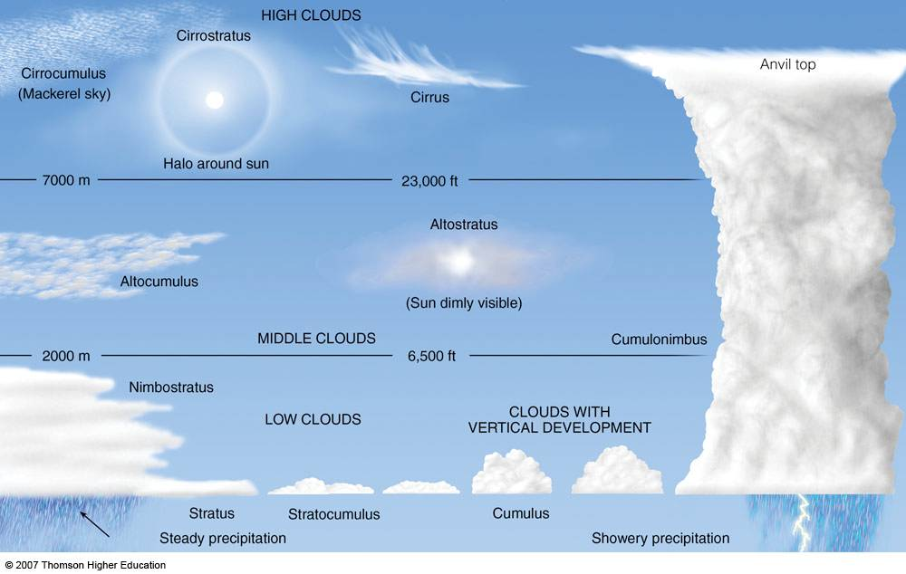
Types of clouds

Slide 4
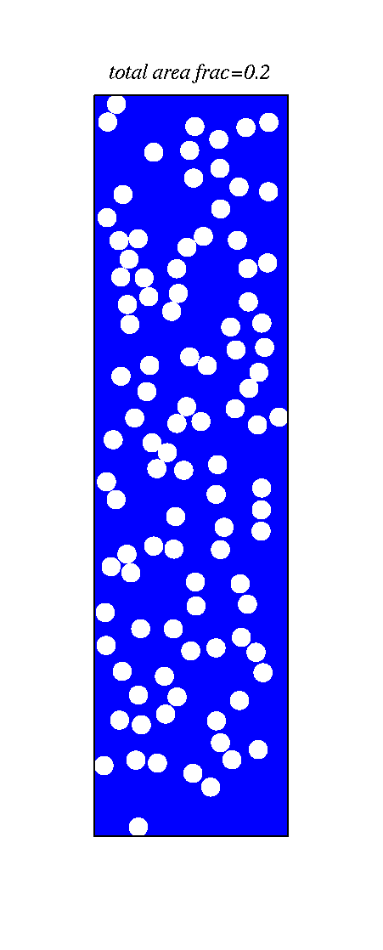
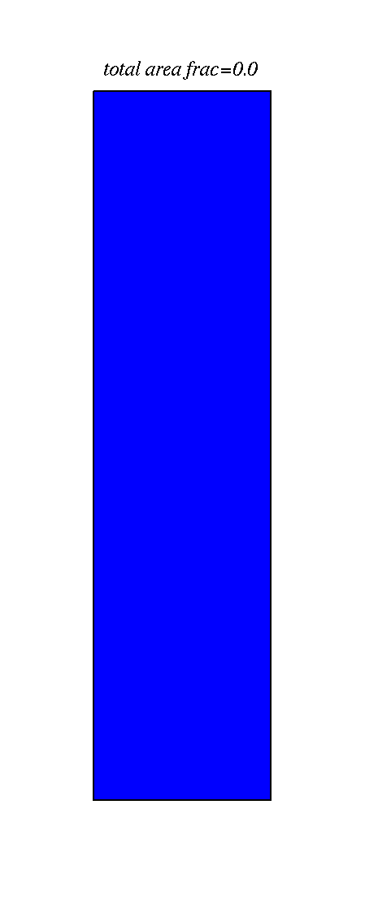
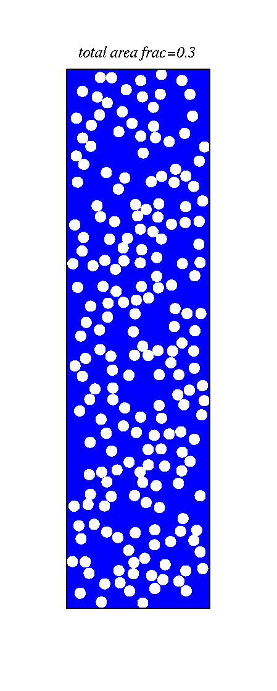
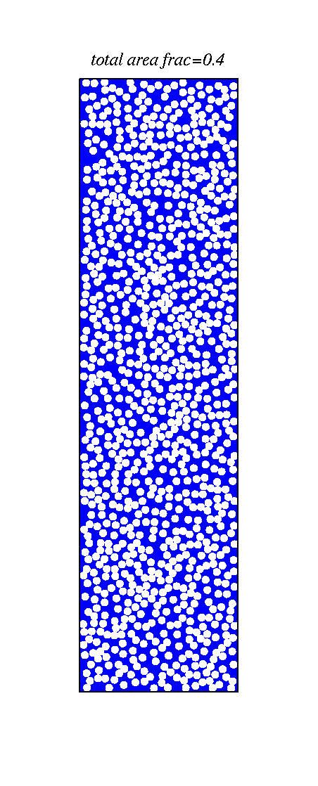
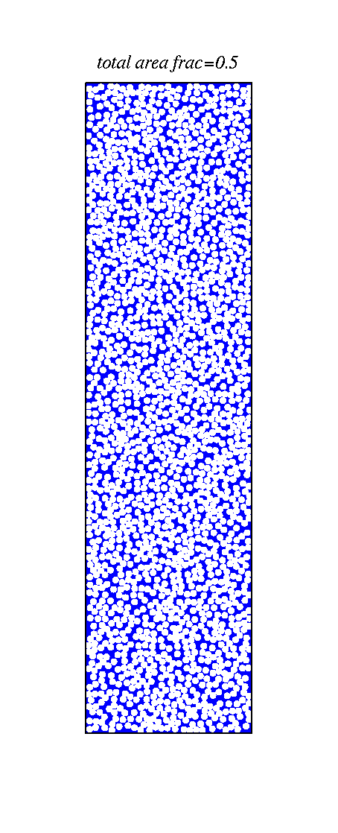
The number of cloud condensation nuclei is important to how much sun-light is reflected what do you notice?
Ocean - blue

Slide 5

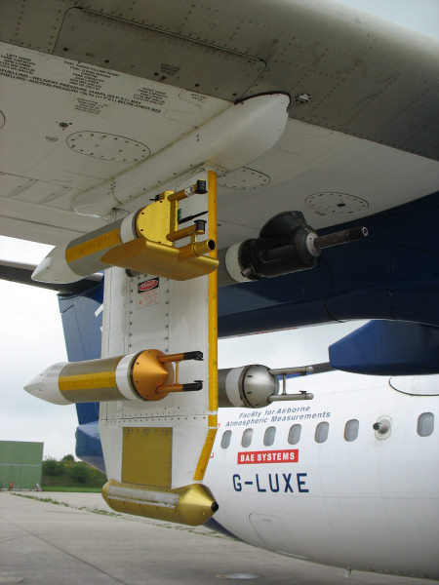
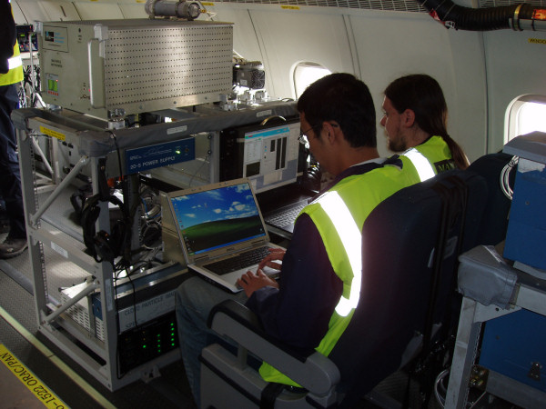
We use aircraft to investigate the properties of clouds

Slide 6
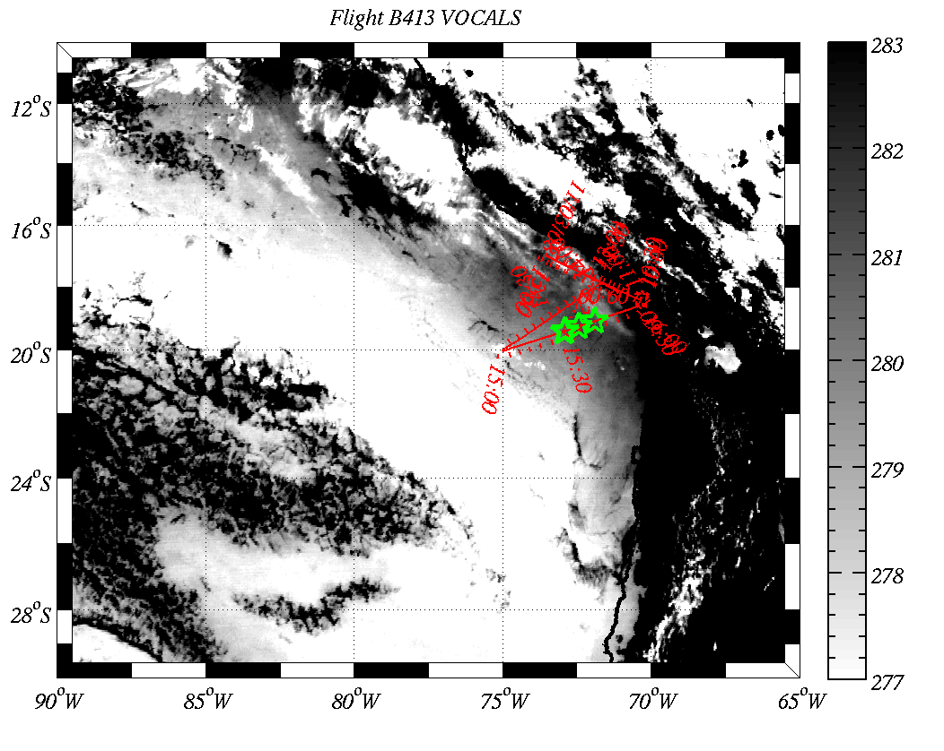
Stratocumulus sampled with research aircraft

Slide 7
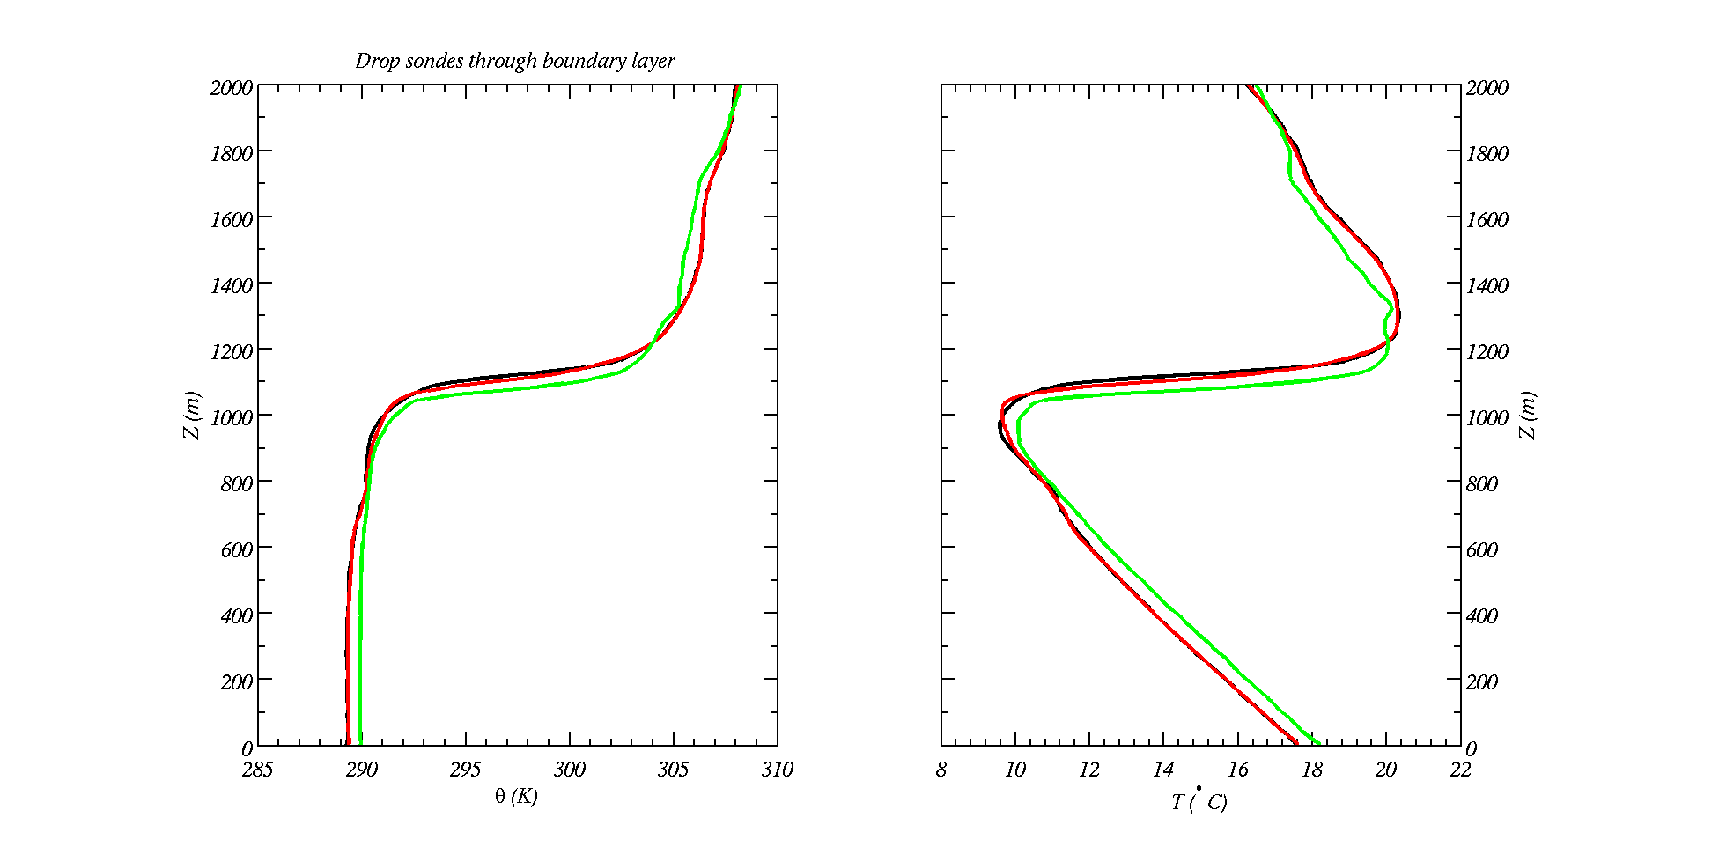
Drop-sonde measurements in Sc
Potential temperature conserved until cloud base reached – then moist adiabatic

Slide 8
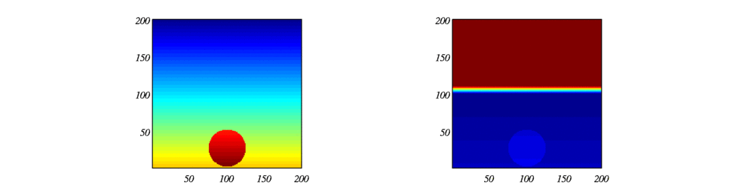
Parcel theory is an approximation
Simulation of rising blob of warm air
Colour is proportional to temperature (modelled)
Unconditionally unstable:
Conditionally unstable:
What is happening here?

Slide 9
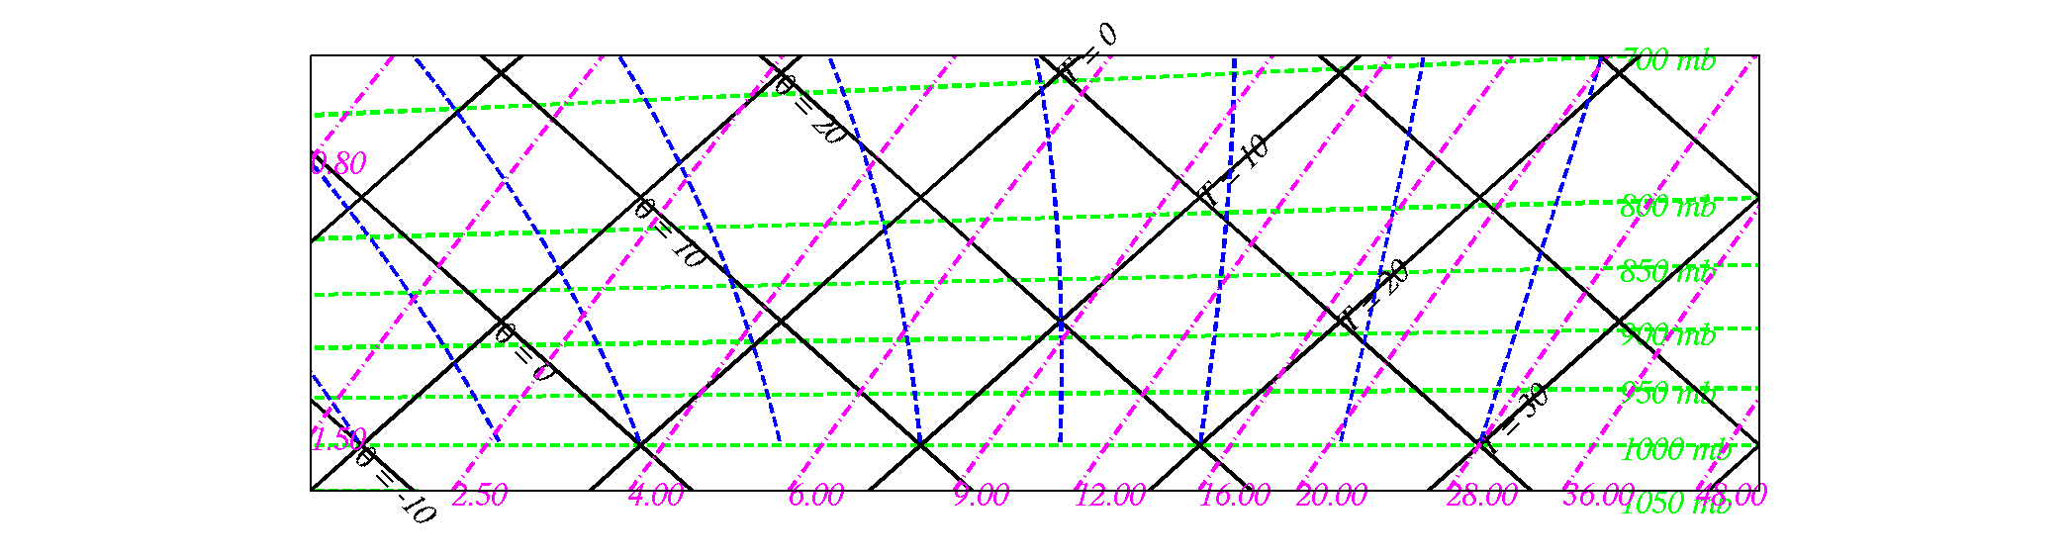
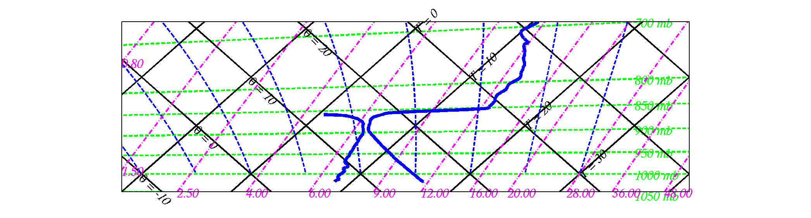
Drop-sonde data on a tephigram for stratocumulus cloud (schematic)
T_{ct}=6C, s.m.r.=6.7 g kg⁻¹
T_{cb}=7C, m.r.=6.9 g kg⁻¹
T at ground = +16.5 C
Td at ground = +8.4 C
Cloud base T=+7 C, P=900 h Pa
Cloud top P=870 h Pa
http://130.88.66.117/~mccikpc2/utilities/adiabatic01.html
Username: inuit
Password: Gras-Ellenbach

Slide 10
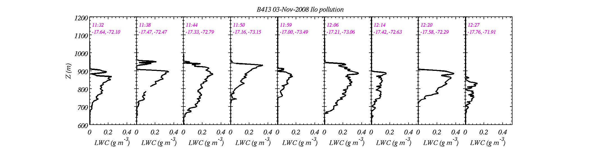
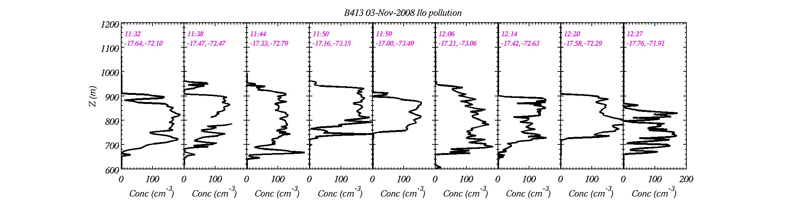
Aircraft measurements in cloud
Liquid water content increases with height
-Consistent with parcel theory – except near the top where mixing occurs
Drop number concentrations constant with height
-Consistent with little or no precipitation
-What governs the number of cloud drops?

Slide 11
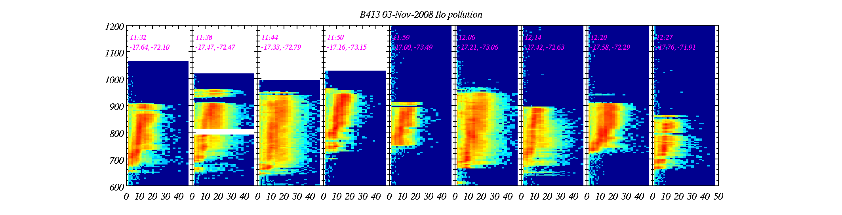
Clouds contain cloud drops that are distributed in size
Height (m)
Size (um)
Stratocumulus cloud particle size increases with height (more water mass on the particles)
Sizes ~10-30 micrometres, but the distribution extends to larger sizes…

Slide 12
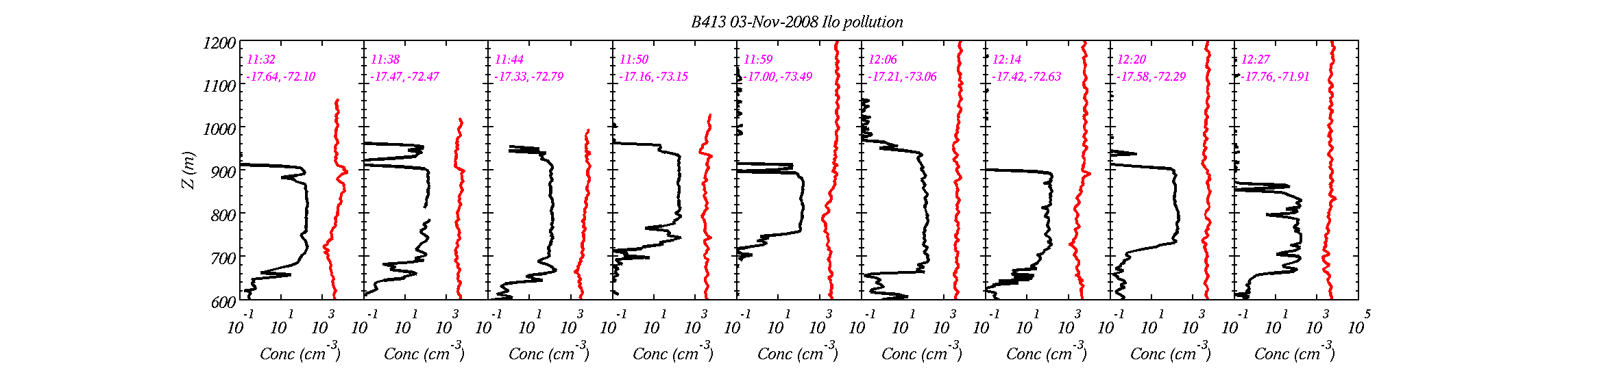
Air typically contains more aerosol particles than cloud drops
Cloud drop conc
total aerosol particle conc
This implies that not every aerosol particle grows into a cloud drop, but what determines whether they do?

Slide 13
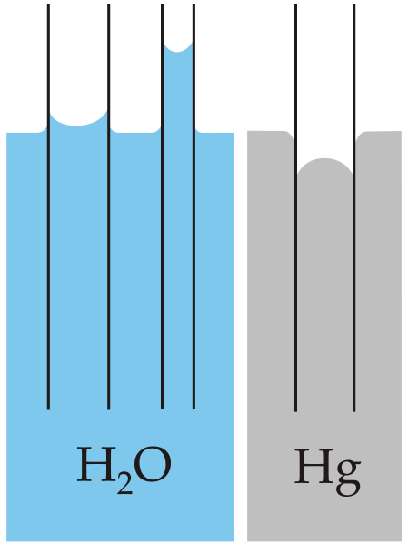
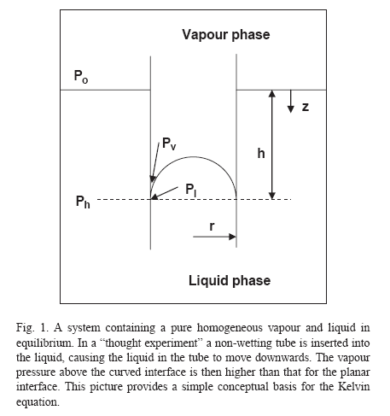
Consider a `thought experiment’
`Capillary action’ in action
Insert a capillary tube (that is non-wetable) into water. Because the vapour pressure over curved surface is higher than flat the liquid will sink below the level of the flat water surface.
The increase in pressure has to be `supplied’ by the additional weight of the vapour and the pressure increase due to the surface cohesion.
The surface tension force along the circle connecting the hemisphere to the bulk water is directed downward and is balanced by the repulsion of molecules inside (as they are squashed together)
A `wetting’ tube negative curvature
A `non-wetting’ / hydrophobic tube positive curvature

Slide 14
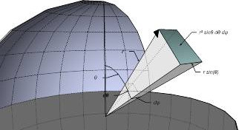
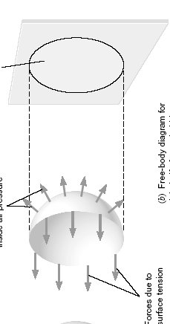
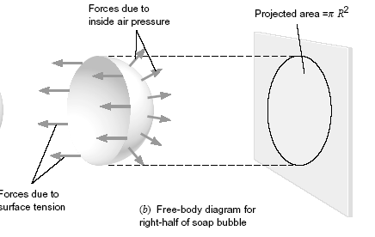


Balance of forces for the drop
θ
cosθ
sinθ

Slide 15
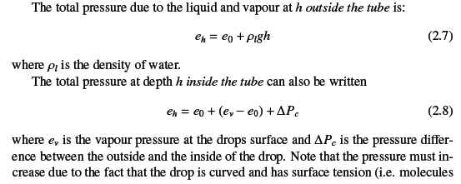
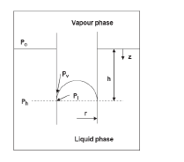
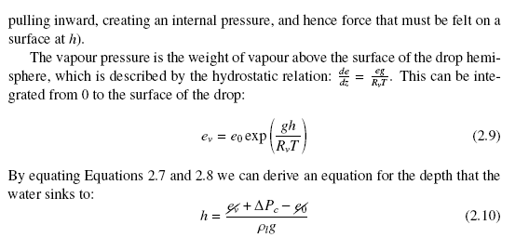
Water vapour pressure over curved surface
e₀
e_{v}
e_{h}

Slide 16
Why is the vapour pressure over a curved surface higher than flat?
Text books say, “Because as the drop gets smaller the Laplace pressure builds up and causes it to evaporate”
I prefer:
Curved surface: intermolecular forces from adjacent molecules (long range) are missing; hence, net force normal to surface is less; hence high vapour pressure needed
Flat surface: intermolecular forces act over one hemisphere; hence, molecules thermal energy needs a low vapour pressure from above to stop it escaping

Slide 17
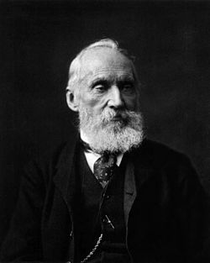
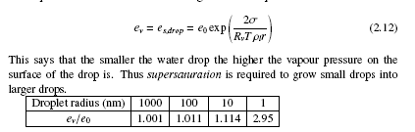
Kelvin’s equation
Lord Kelvin (1824-1907)
In the atmosphere, super-saturation rarely exceeds 2% (e_{v}/e₀=1.02)
Hence aerosols with dry size smaller than about 50 nm are not effective CCN
Supersaturation is defined as e_{v}/e₀-1

Slide 18
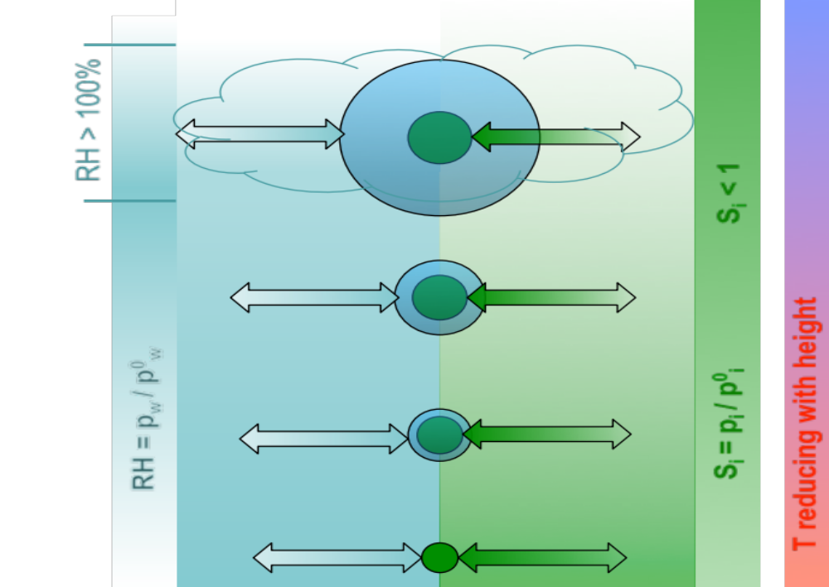
Recent research problem
Organic Semi-volatile co-condensation
An effect not previously considered
Difficult to quantitatively predict the number of cloud drops that form in clouds.
Traditionally solute mass is considered to be constant during this process
Available semi-volatile organics condense as the size of the drop increases
Increases number of drops in clouds
work with Dave Topping and Gordon McFiggans

Slide 19
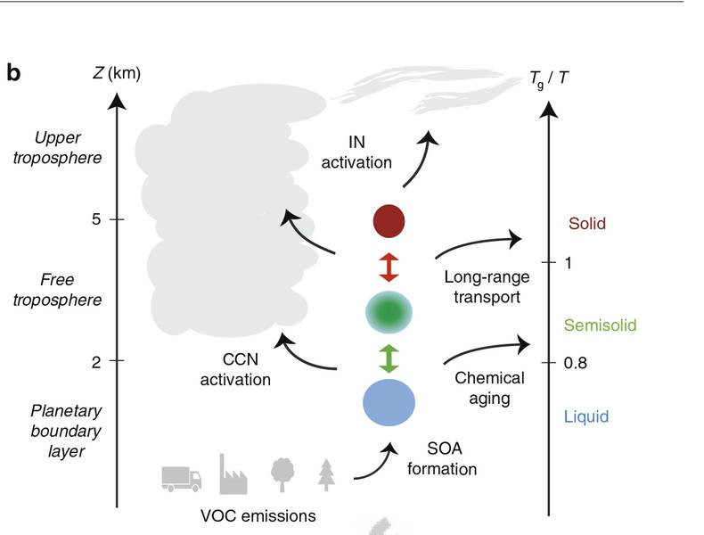
An example of what is not known the impact of aerosol phase state
Only recently have we discovered that aerosol particles can transition to ultra-viscous particles under certain conditions in the atmosphere.
At the present time we do not know how these particles behave in the atmosphere
See Shiraiwa et al. Nature (2017)

Slide 20
Points to take home
The concept of saturation vapour over a liquid surface
Ditto over an ice surface
Saturation ratio and super-saturation of water vapour.
Why is size important for the growth of aerosol particles into cloud drops – Kelvin’s equation.

Slide 21


Slide 22
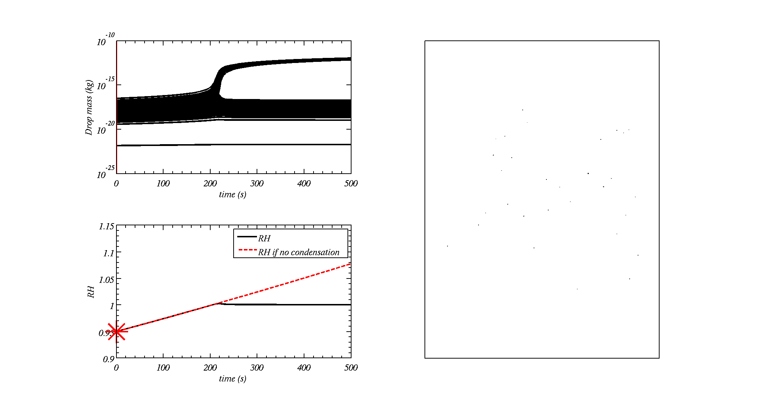
Model simulation of cloud formation
Particle mass (kg)

Slide 23
Model simulation of cloud formation
Cloud condensation nuclei of different sizes
Particle mass (kg)

Slide 24
Formation of cloud drops
Water vapour super-saturation is required to grow aerosols into cloud drops
This is because it takes energy to form a surface that is highly curved so water molecules must be `forced’ towards the particles by a strong gradient in water vapour.
The super-saturation is needed to overcome the energy to form a curved surface

