Slide 1
Meteorology and Atmospheric Physics lecture 3
Recap:
Vapour pressure over a liquid drop is higher than over a plane surface. How can this be? Do curved surfaces attract more vapour molecules towards them?
Size is important when it comes to cloud condensation nuclei. Smaller particles require a higher vapour pressure for them to exist (and grow into cloud drops). – Lord Kelvin
Why do cloud drops form and grow?
  What are the molecules doing in order for them to grow?
  Why do gases move towards a drop?
As cloud drops grow are they warmer, the same T or colder than the surrounding air?
  Warmer due to latent heat release.
Today we will talk about some important contributions from Fourier, Fick, Gauss, Maxwell.
Sizes and fall-speeds of rain drops
Dr Paul Connolly, reader

Slide 2
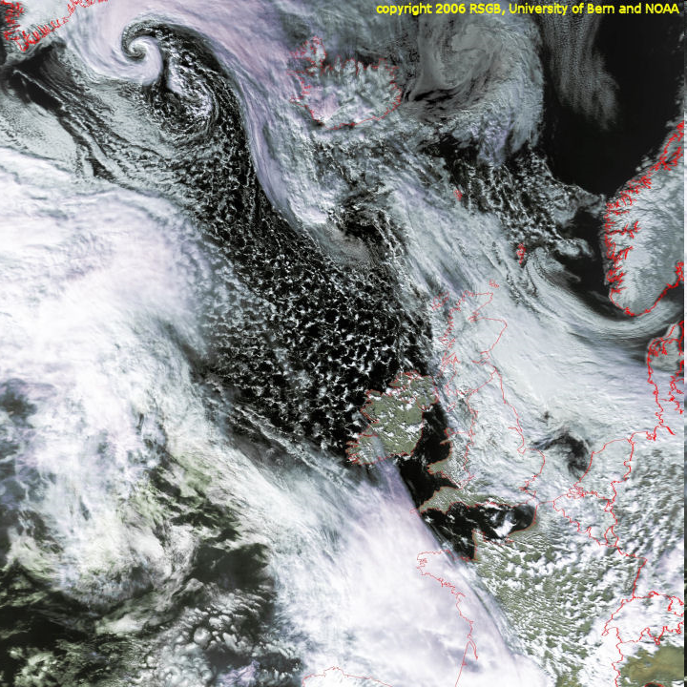
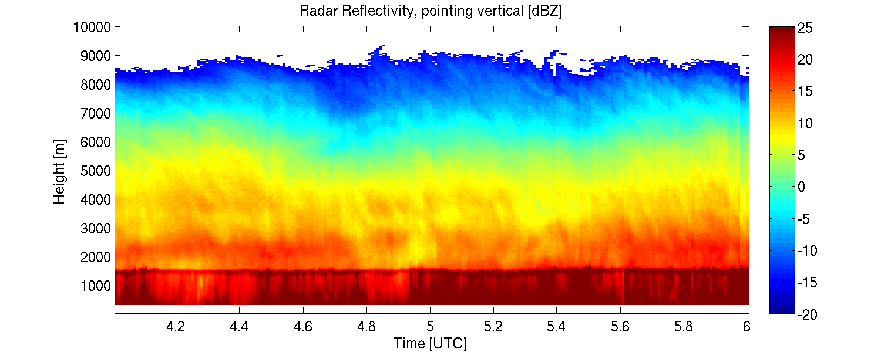
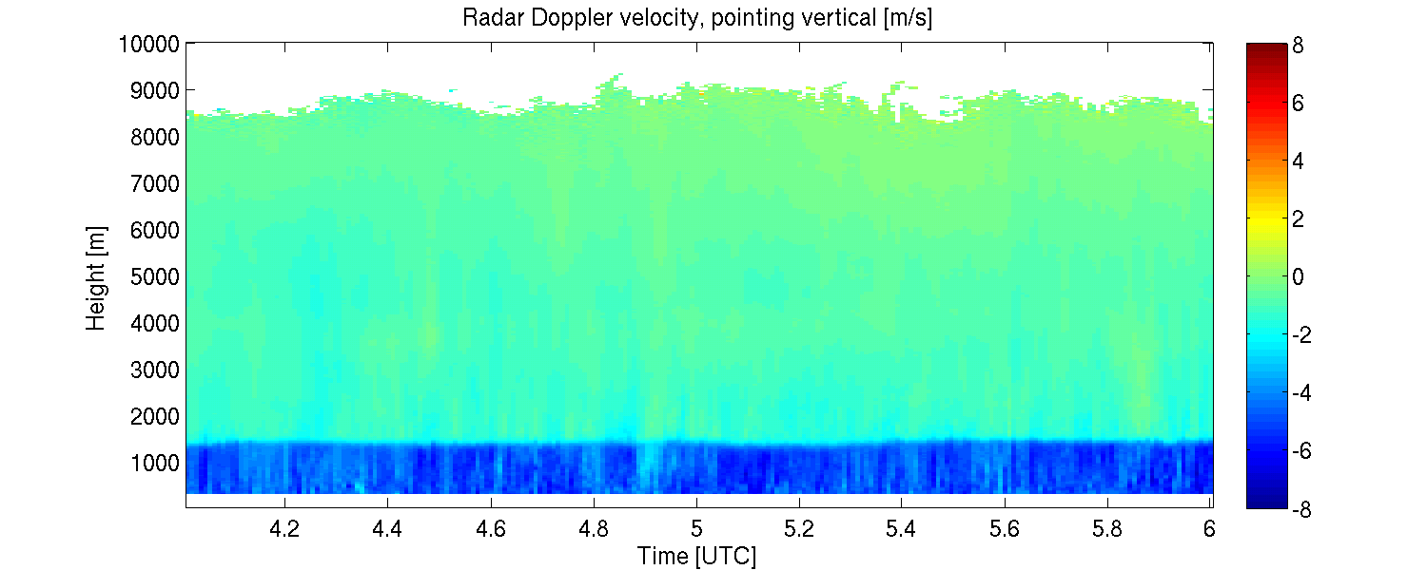
Nimbostratus associated with a warm front
University of Reading
(Dr Chris Westbrook)

Slide 3
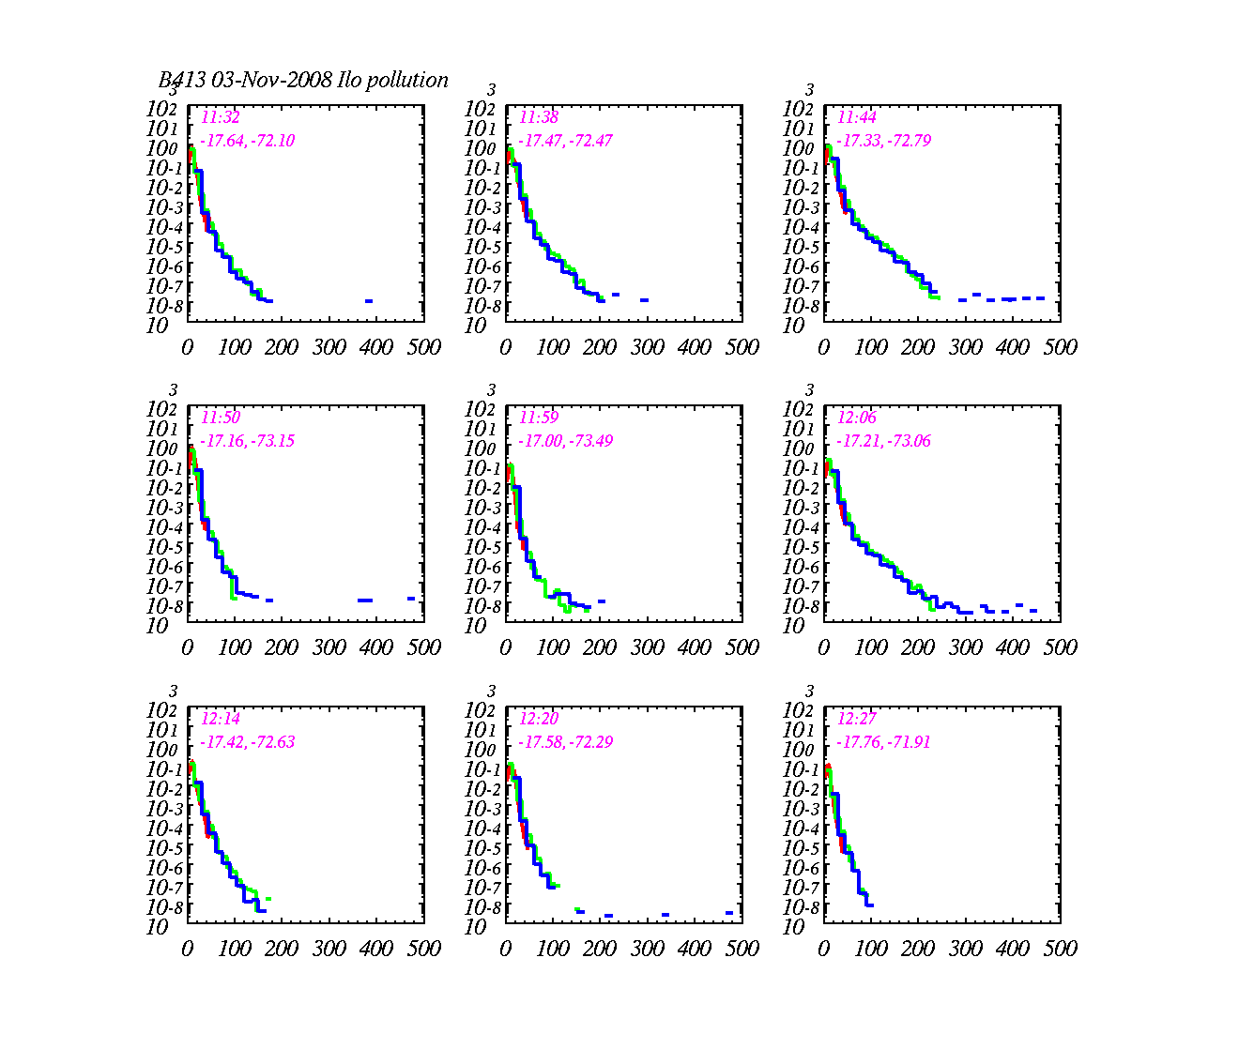
Particle size distributions measured in stratocumulus clouds
dN/dD (cm⁻³ μm⁻¹)
Diameter (μm)
Notes:
Not used

Slide 4
A word on saturation
Paradox: water in sub-saturated conditions doesn’t immediately evaporate into the vapour phase – why?
Vapour pressure at flat surface is always equal to saturation vapour pressure over that surface (liquid or ice)
Vapour
Liquid
Explanation: Cup of water takes a long time to evaporate, even when relative humidity is low.
This is because diffusion of the water molecules away from the surface must occur (which is very slow). So molecules escape into a transition layer (very thin), where they slowly diffuse away.
But surfaces in the atmosphere aren’t usually flat, they are spheres of varying curvatures.

Slide 5
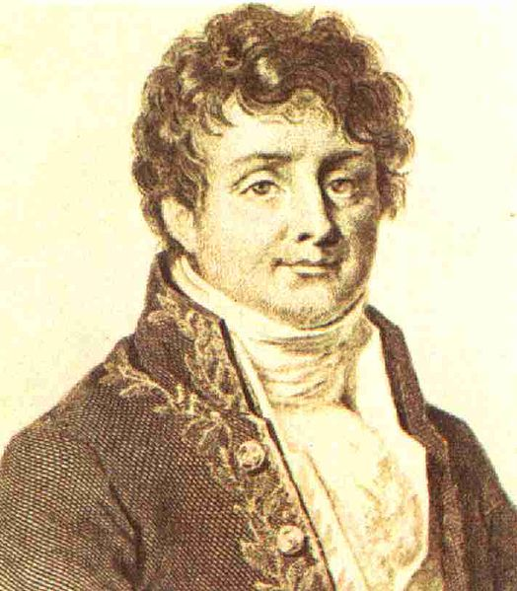
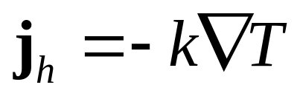
Heat conduction: `Diffusion’ of heat
In 1822 Fourier presented his work on heat flow in Théorie analytique de la chaleur (The Analytic Theory of heat), in which he based his reasoning on Newton's law of cooling, namely, that the flow of heat between two adjacent molecules is proportional to the extremely small difference of their temperatures.
Jean Baptiste
Joseph Fourier (1768-1830)
Fourier believed that keeping the body wrapped up in blankets was beneficial to the health. He died in 1830 when in this state he tripped and fell down the stairs at his home
Science World Wolfram. http://scienceworld.wolfram.com/biography/Fourier.html. Retrieved 2009-05-06

Slide 6
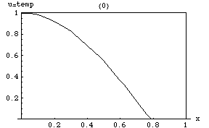
Heat transfer `smooths out gradients’
Heat is transferred from warm to cold regions.
For liquid surfaces growing by condensation (warmed by latent heat) it is transferred away

Slide 7
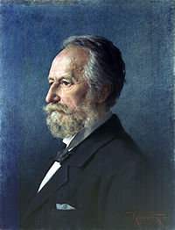
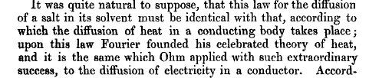
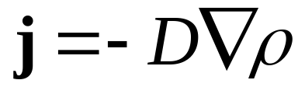
Diffusion of mass
Philosophical magazine (1855)
Fick's law of diffusion
Adolf Eugen Fick (3 September 1829, Kassel, Hesse-Kassel – 21 August 1901) was a German physiologist. He started to study mathematics and physics, but then realized he was more interested in medicine. He earned his doctorate in medicine at Marburg in 1851.
In 1855 he introduced Fick's law of diffusion, which governs the diffusion of salts in water and vapour molecules in air
Adolf Eugen Fick (1829-1901)
Fick managed to double-publish his law of diffusion, as it applied equally to physiology and physics.
Notes:
Diffusion of

Slide 8
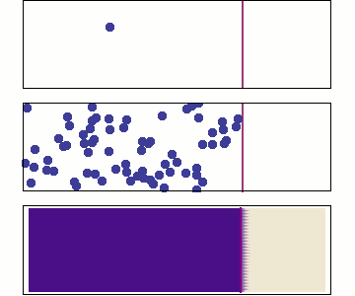
Diffusion `smooths out’ gradients
When we apply both Fourier’s law and Fick’s law we make use of continuity or the divergence theorem
Vapour is transferred from regions of high concentration to low concentration

Slide 9
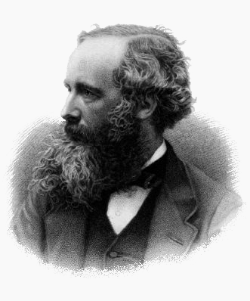
Among his many achievements (e.g. Electromagnetic theory, 1864), Maxwell (1870) was the first to combine the laws of diffusion of mass and heat to write down the particle growth equations in the continuum regime
This assumed that the vapour density in moist air is continuous (no sharp jumps) right up to the drop surface.
When the particles have radii comparable to the mean free path of air it becomes unrealistic
James Clerk Maxwell (1831–1879)
Diffusion of vapour to a growing drop
(liberating latent heat)
Diffusion of heat from a drop

Slide 10
Main points
Laws of diffusion of heat and mass describe the growth of a droplet from the vapour.
Supersaturation is required for drop growth
The growing drop is warmer than its surroundings by a fraction of a degree K.
This does not fully describe the growth of cloud drops in the atmosphere => other processes occur

Slide 11
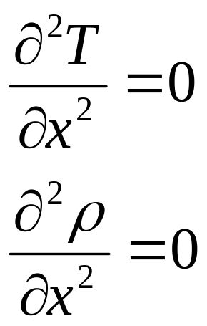
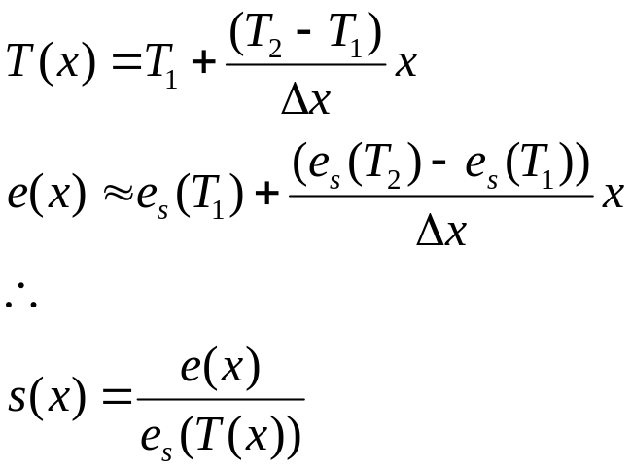
Schematic of a continuous flow diffusion CCN counter
Warm plate
Filter particles > ~1. microns
Water coating
Count particles > ~1. microns
Δx
Water coating
Cool plate
From Fourier’s law
Fick’s 2nd law of diffusion

Slide 12
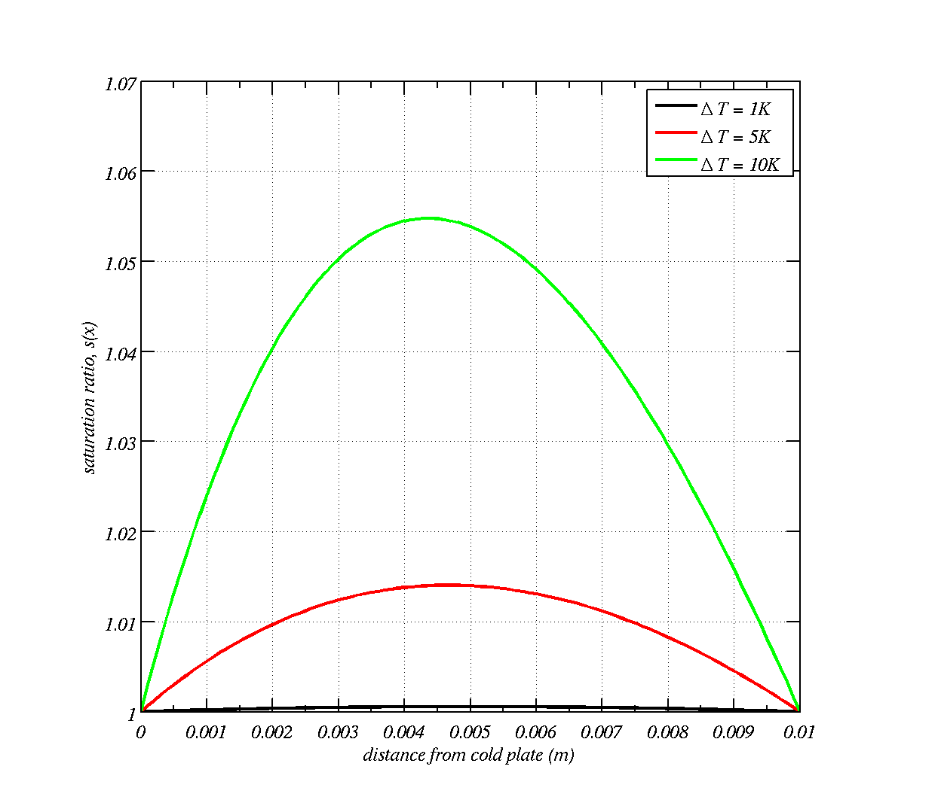
Saturation ratio between the plates

Slide 13
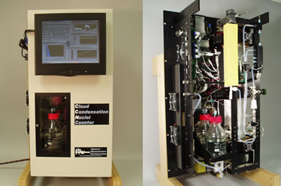
Instrument to measure CCN
http://www.dropletmeasurement.com/products/airborne/ccn.html

