Slide 1
Meteorology and Atmospheric Physics lecture 4
Recap:
For liquid drops to grow from water vapour what must the water vapour molecules do? They must move towards the drop and become incorporated into the drop.
What laws describe how the molecules (and heat) move? Laws of diffusion of mass and heat conduction (Fick and Fourier). Note that the transfer of heat by conduction occurs by the movement of molecules too (are these the same molecules of water vapour that diffuse to the drop?)
A drop is in a vapour field with ambient vapour pressure equal to e and temperature T. What is the vapour pressure at the drops surface?
How are cloud and precipitation particles (hydrometeors) distributed in size?
  Are there more `small’ particles that `large’ particles? Or vice-versa.
  How do you think we know how the shape of the size distribution?
  Why are `moments’ of a distribution important for modelling (forecasting) clouds and precipitation?
  Why are they important to radiation budget?
Some example applications are shown.
Dr Paul Connolly, reader

Slide 2
Atmospheric modelling at different scales
Years+
Global models:
(NWP, ECHAM, WRF, UM, GLOMAP)
Laboratory
Months
Meso-scale models:
(COSMO / WRF / UKV)
Time-scale
Weeks
Days
Large Eddy Simulation
Process models
Hours
kms
10s kms
100s kms
global
Spatial-scale

Slide 3
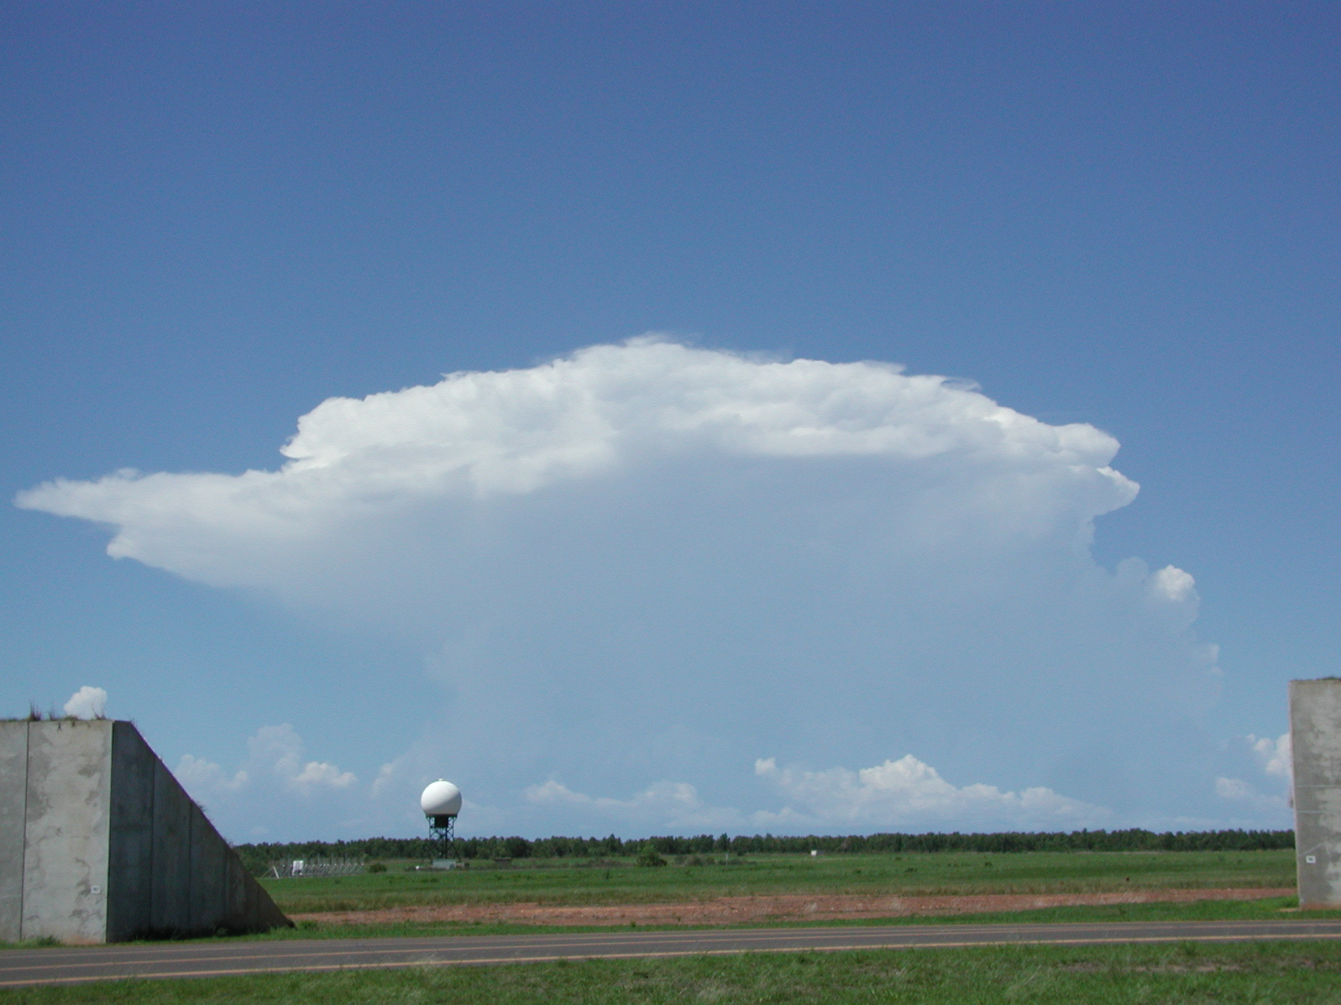
But it isn’t that simple...
This cloud has dimensions ~50 km x 50 km x 15 km.
The drop number concentration is ~100x10⁶ m⁻³.
Therefore the number of cloud drops ~50000²x15000X100x10⁶ ~ 4x10²¹
If we want to simulate the cloud by storing the positions: x, y, z and diameters of these drops at double precision (8 bytes) on a computer we will need
  9x10²² bytes of memory or 90 zetta bytes!
  Tinahe-2 (Milky way-2), the largest supercomputer has 1.4 Peta bytes of memory 1.4x10¹⁵ (8 orders of magnitude too little).
Clearly a different approach is needed!

Slide 4
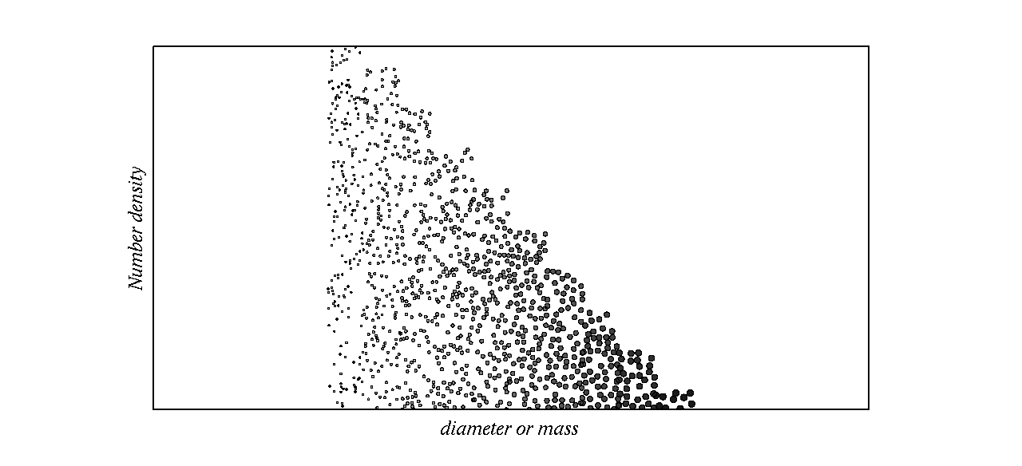
Representation of particle size
N₁
N₂
Individual `bins’ can grow or shrink
N_{n}
D₁, D₂,…,D_{n}
Either represent using bin or bulk
Bin: accurate growth theory can be used, but expensive
Bulk: cheap (requires ~2 variables, total mass and number), less accurate.

Slide 5
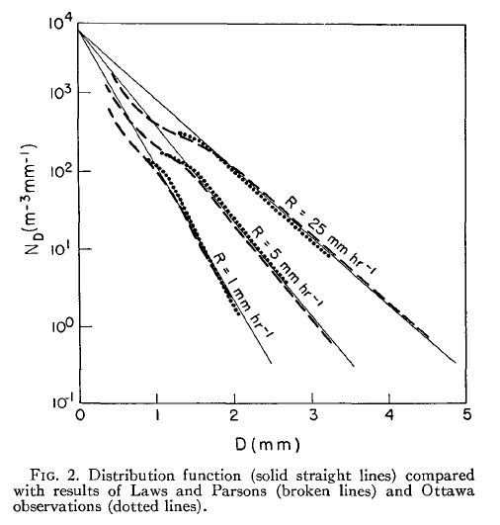
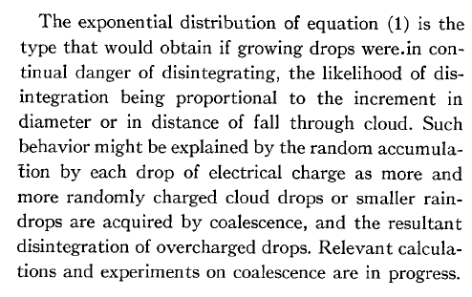
Marshall and Palmer (1948)
Journal of Meteorology
In fact this has been proven to be wrong!
Will talk about why small particles are present later in the course

Slide 6
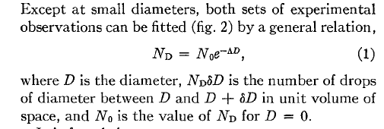
Parameterisation of particle size distributions
Weather forecast models use this method -> cheaper than the binned method
Marshall-Palmer distribution
Marshall and Palmer (1948)

Slide 7
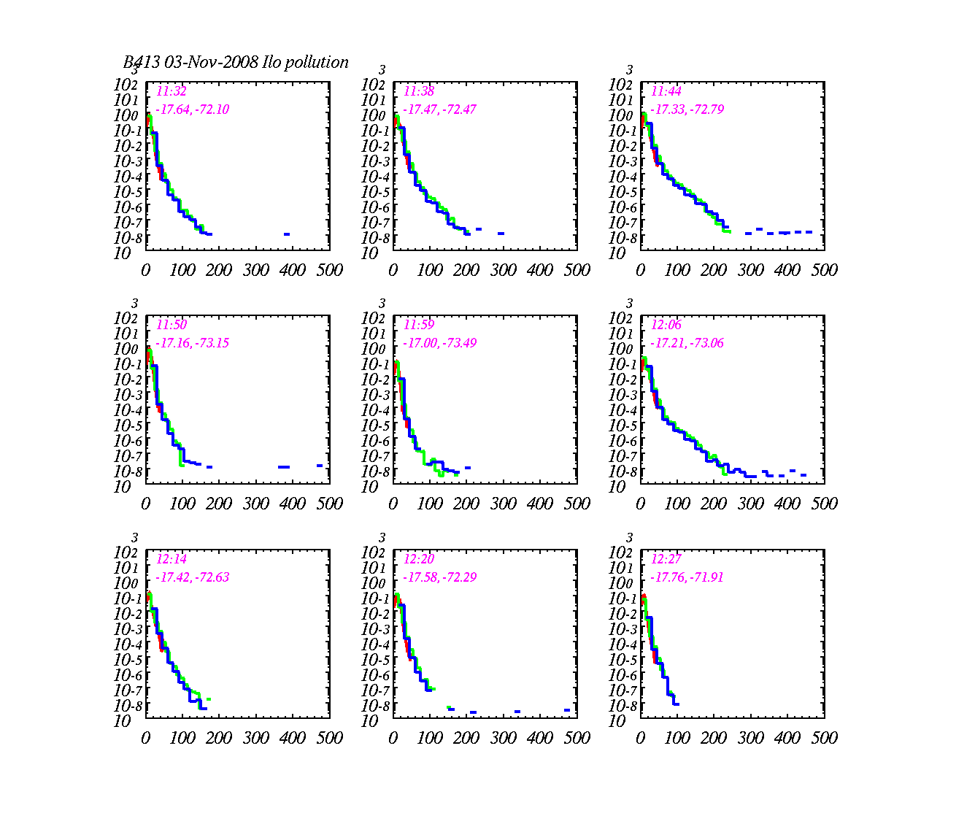
Particle size distributions measured in stratocumulus clouds
dN/dD (cm⁻³ μm⁻¹)
Diameter (μm)

Slide 8
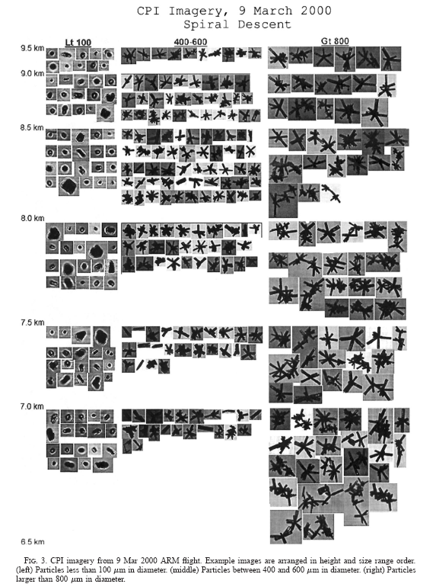
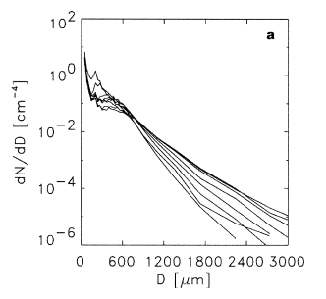
Field and Heymsfield (2003, JAS)
Ice size distributions also tend toward exponential.

Slide 9
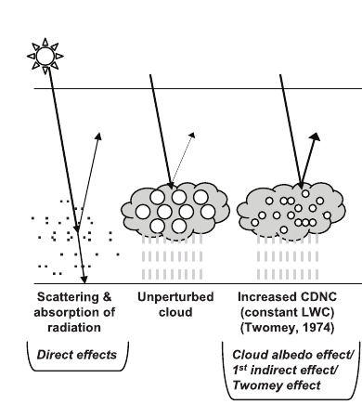
Twomey in (1987) showed that:
Polluted stratocumulus clouds reflect more light.
First indirect effect
More particles => more scattering, more reflected light.
This increases the cloud albedo.

Slide 10
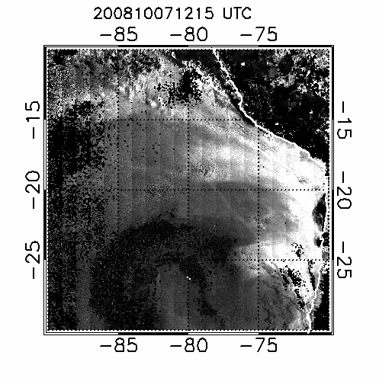
Our observations in the field show this works

Slide 11
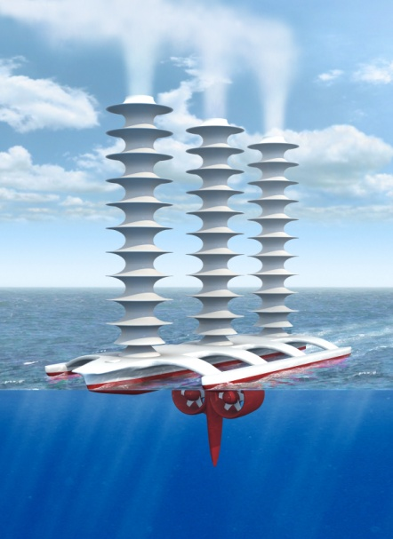
Latham’s geoengineering scheme
(a way of combating global warming?)
Technique (Latham, Nature, 1990)
To disseminate natural sea water droplets at ocean surface into the boundary layer.
These ascend via thermals to enter the cloud and increase the number of drops within the cloud
Switching off the sprayers returns to the status quo within a week or so.
Support for idea
Natural droplet creation at ocean surface
NaCl drops are effective CCN
Ship tracks, fires already show that it works…

Slide 12
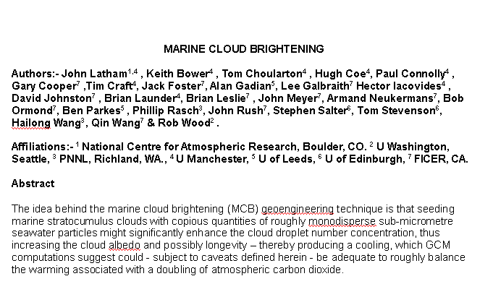
Philosophical Transactions of the Royal Society

Slide 13
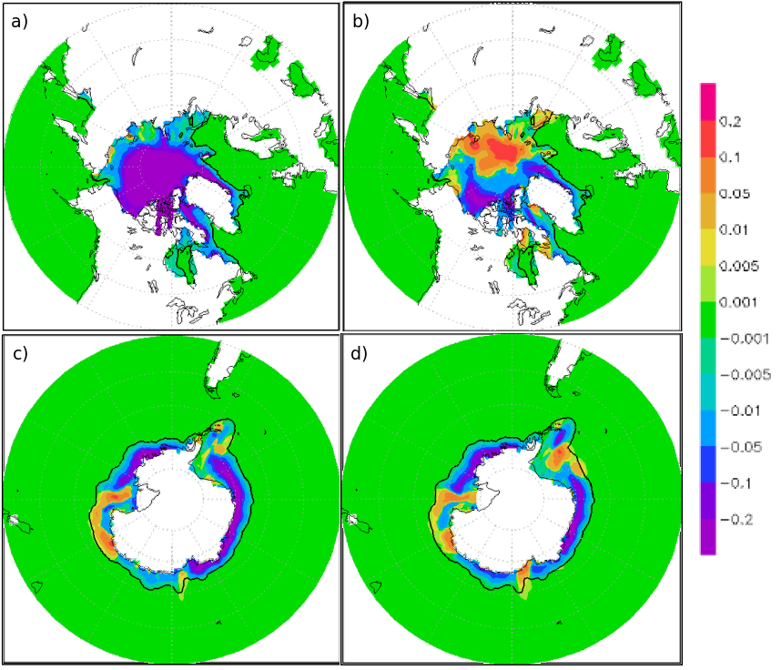
Modelled difference in minimum sea ice
(Red=increase, blue=decrease)
Left: difference between sea ice height in 2090 for doubling CO₂ and keeping it constant.
Right: difference between sea ice height in 2090 for doubling CO₂ with cloud geoengineering and keeping it constant without geoengineering.
Met Office Hadley Climate model.

Slide 14
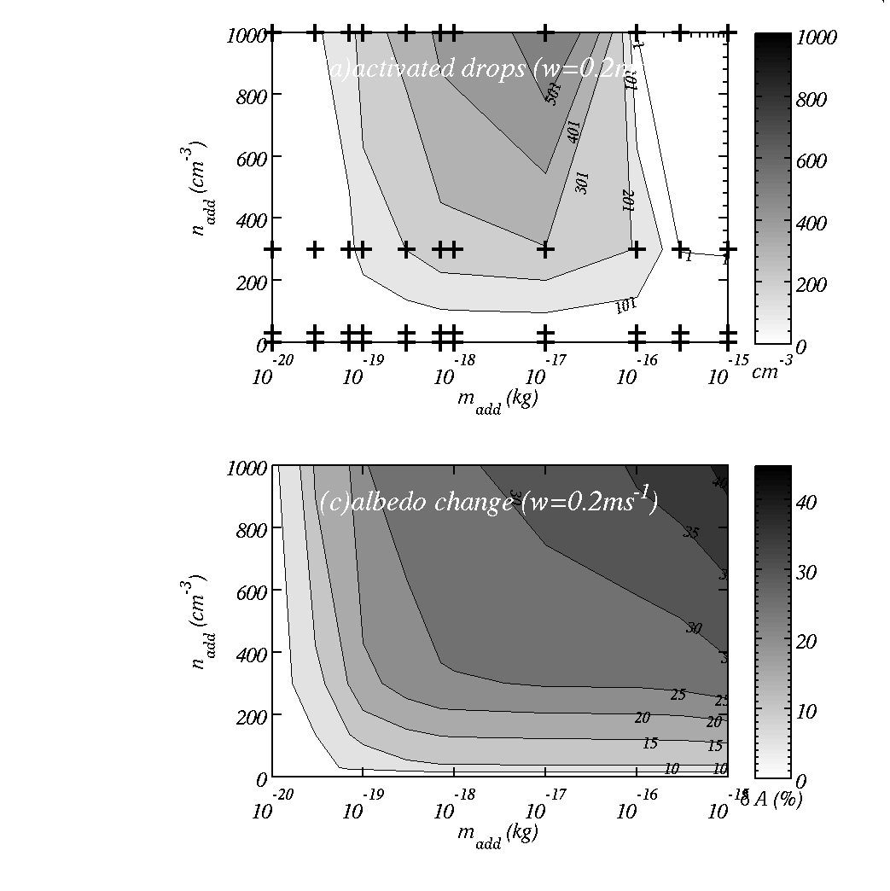
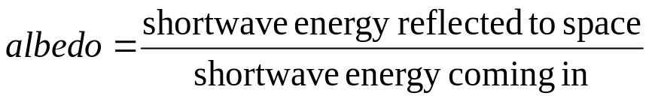
In regions of low aerosol concs.
Top: cloud droplet number for different CCN mass and concentrations.
Bottom: absolute change in albedo
Summary: a change of up to about 0.4 in the albedo – huge!

Slide 15
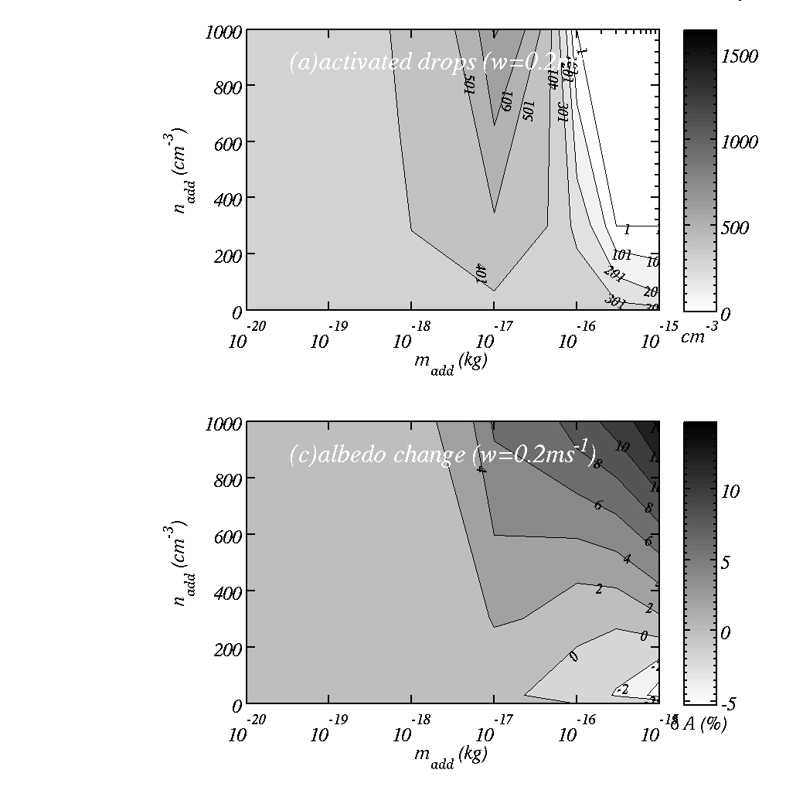
In regions of high aerosol concs.
Top: cloud drop number concentration for different CCN mass and concentrations.
Bottom: change in albedo.
Summary: we have to be careful.

Slide 16
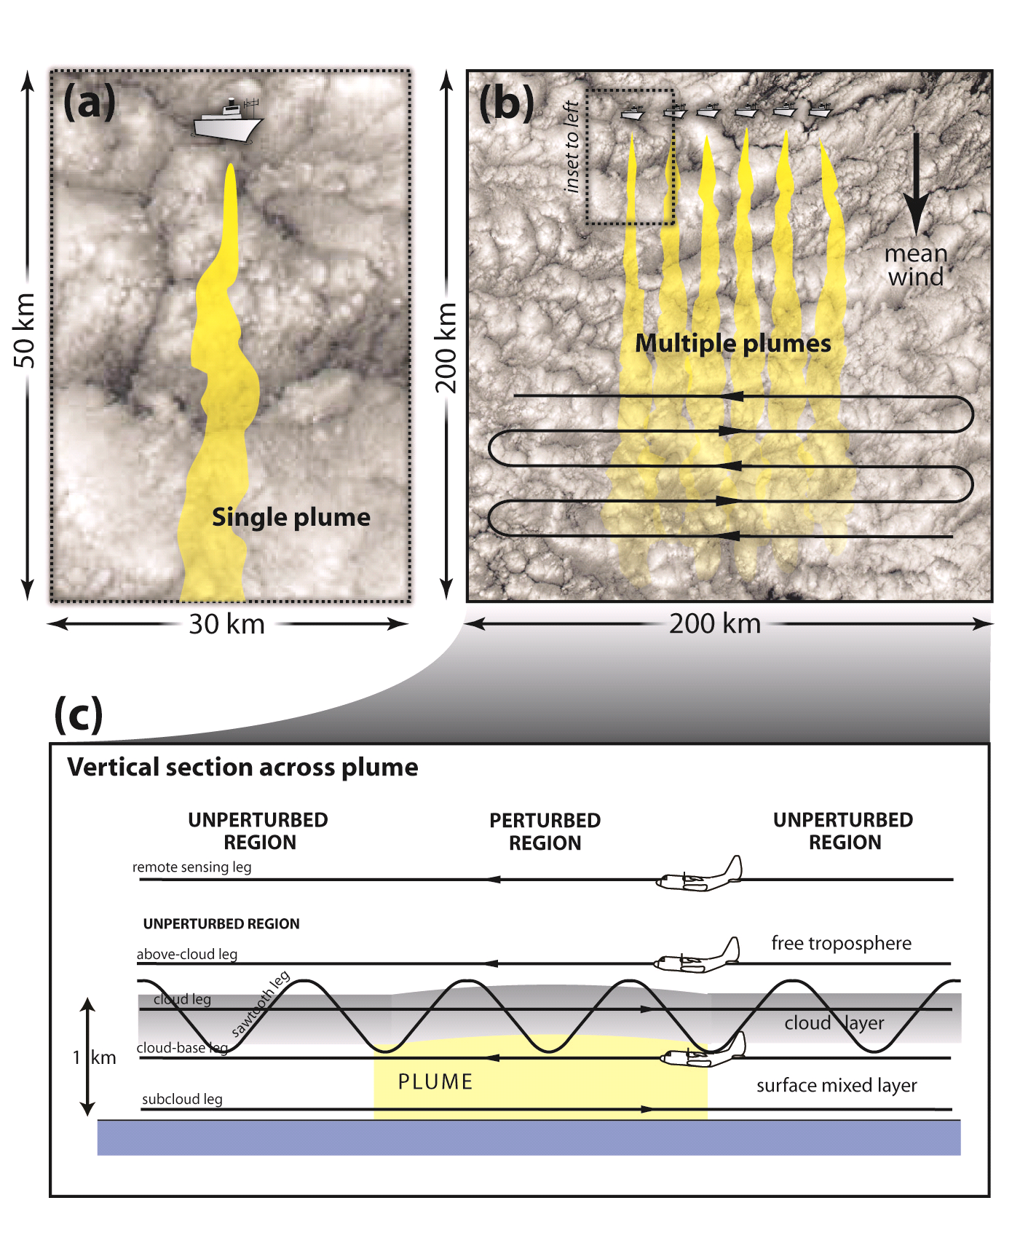
Experiment to test feasibility
Single plume: can we see if from aircraft measurement?
Multiple plumes: can we see a signal from satellite?
Is it the right signal?

Slide 17
Main points
Observations often show that cloud particle size distributions are exponentials.
Moments of the distribution are used in defining physics processes within weather forecast models.
  Albedo
  Growth rates
  Precipitation

Slide 18


Slide 19
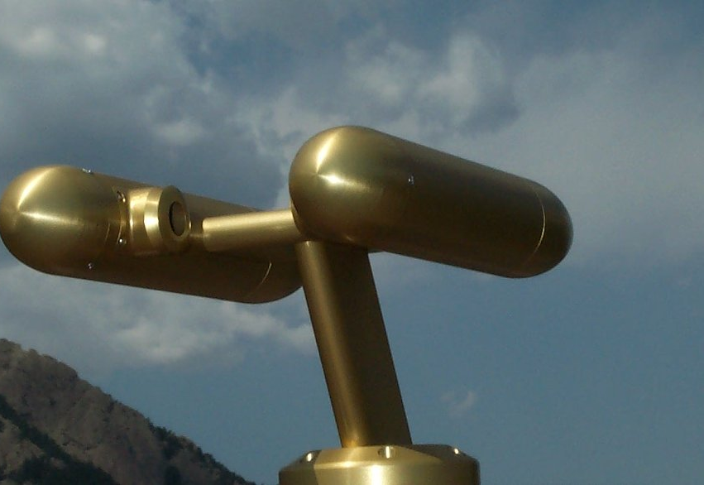
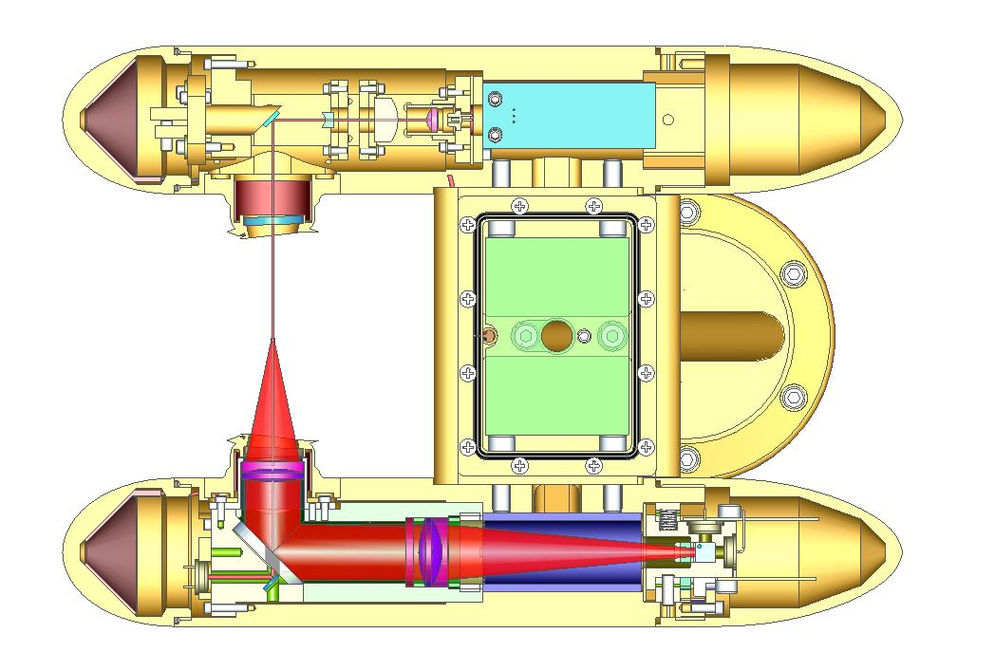
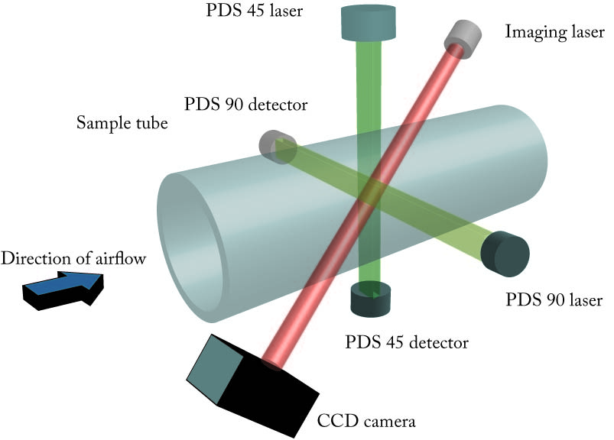
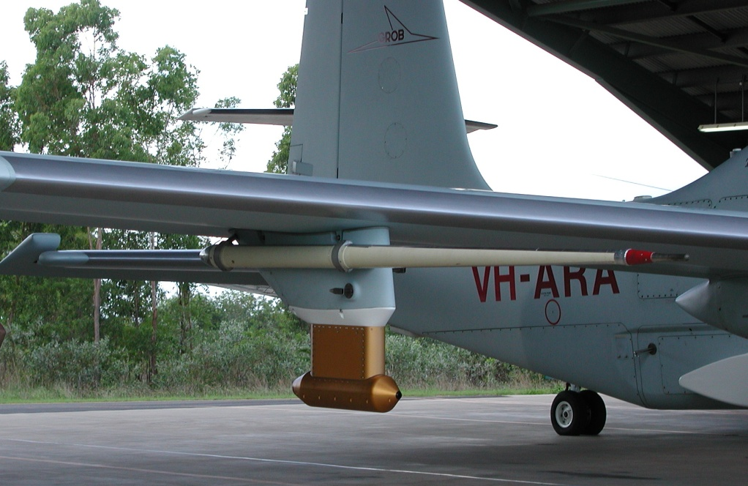
Some examples of cloud probes
Cloud Droplet Probe (CDP)
Cloud Particle Imager (CPI)

Slide 20
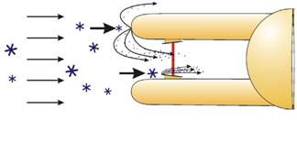
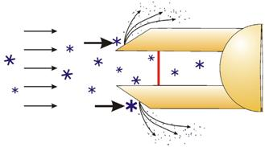
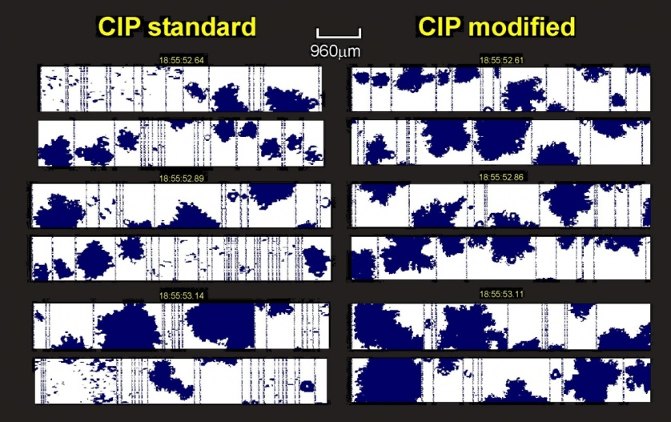
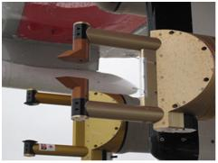
Shattering problems
Original design CIP:
Cloud Imaging Probe
new design
Flight test
Click here to see a video of a probe with an inlet in a wind tunnel

