Slide 1
Meteorology and Atmospheric Physics lecture 5
Recap:
There are more `small’ particles in a cloud than `large’ particles An exponential distribution which depends on two parameters can be used to describe it.
Why are the moments of a distribution important for modelling / forecasting clouds? Moments of a distribution are used to calculate the physical processes within a model (e.g. 1st moment: vapour growth; 2nd moment: radiative properties; 5th moment: precipitation rate).
Why is geoengineering clouds most effective in conditions with low aerosol concentrations? Because for a given cloud water content the radiative properties ~M₀^{(1/3)}. However, because of Kelvin’s effect the size is also important.
Today: what temperature does liquid water freeze at?
  What causes ice to form in the atmosphere?
  Why is it important?
Dr Paul Connolly, reader

Slide 2
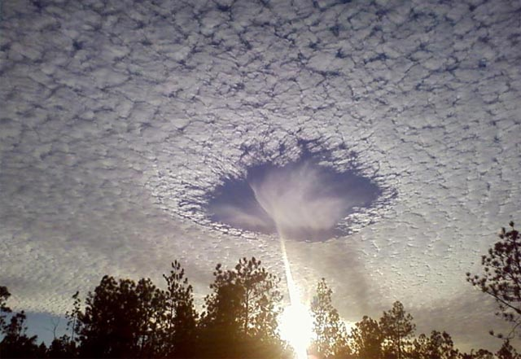
What is happening here and why?

Slide 3
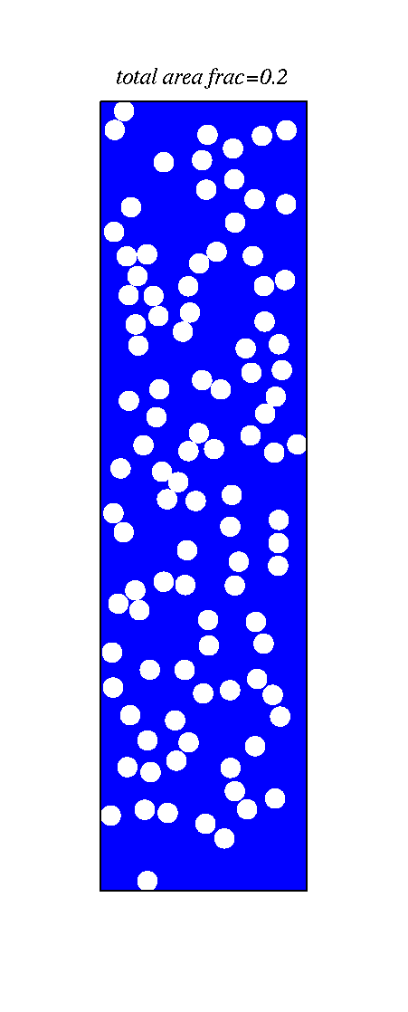
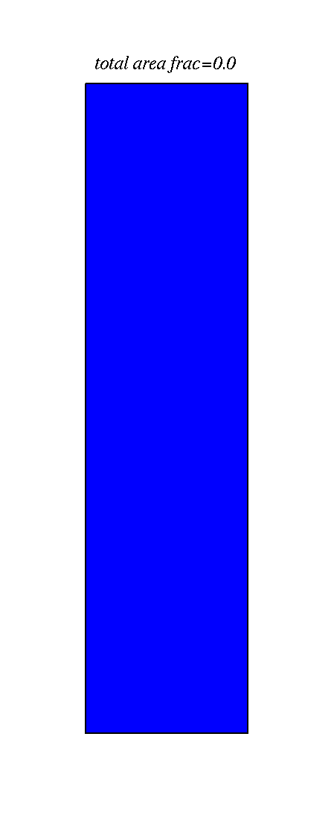
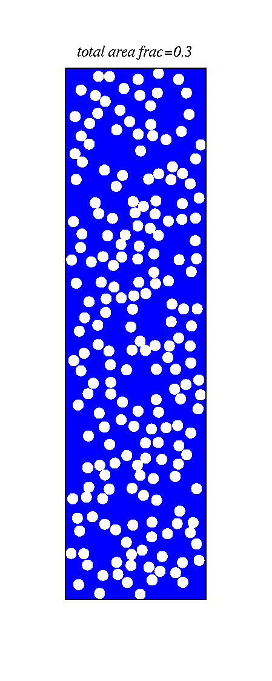
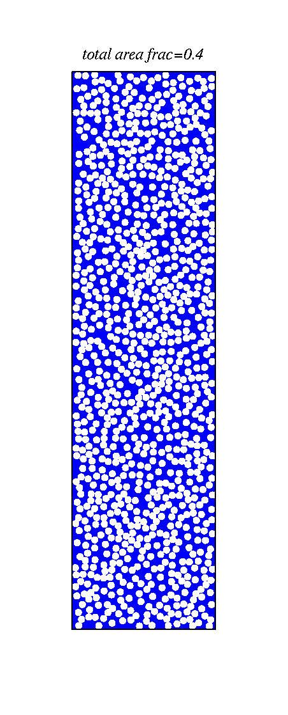
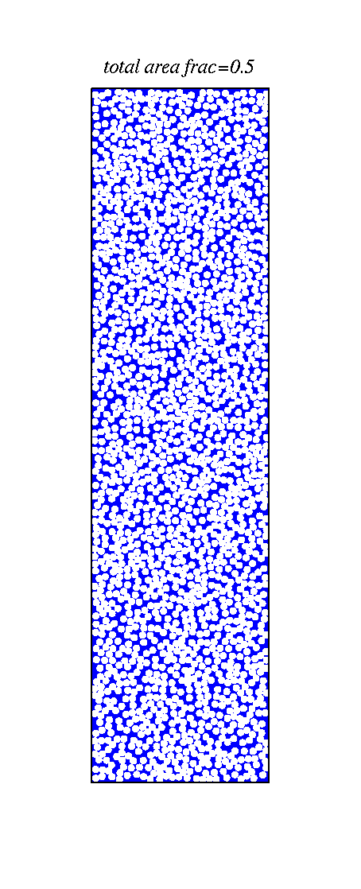
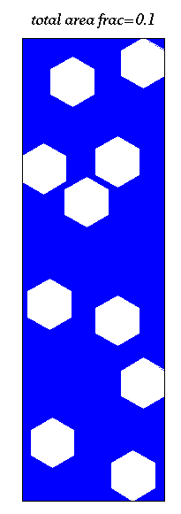
Clouds with different amounts of aerosol, same amount of condensed water – albedo effect
Ocean - blue
Because there are typically much less IN than CCN ice formation modifies the albedo of clouds

Slide 4
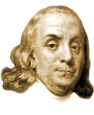
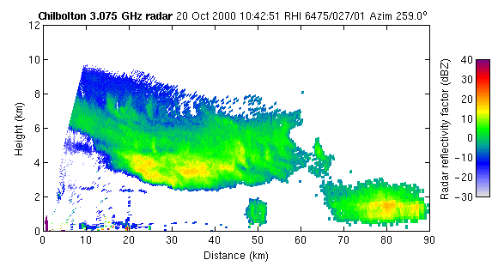
Ice clouds lead to precipitation
Benjamin Franklin (1784)
  “much of what is rain, when it arrives at the surface of the earth, might have been snow, when it began its descent…”
University of Reading (Dr R. Hogan)

Slide 5
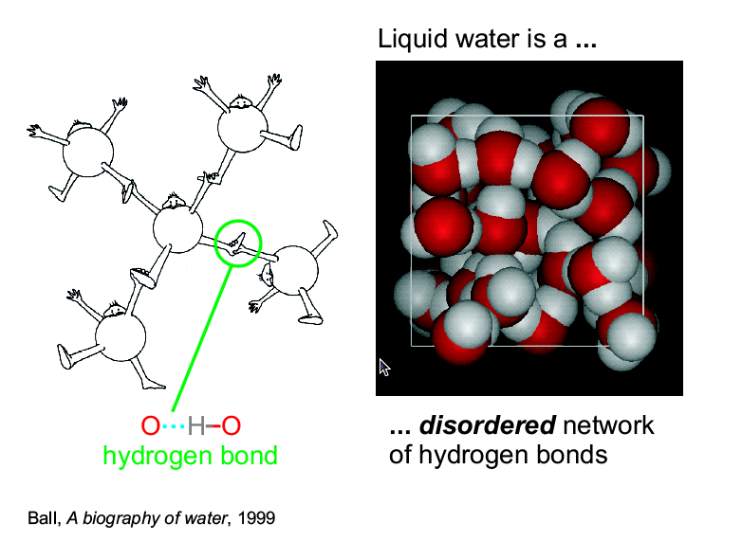

Slide 6
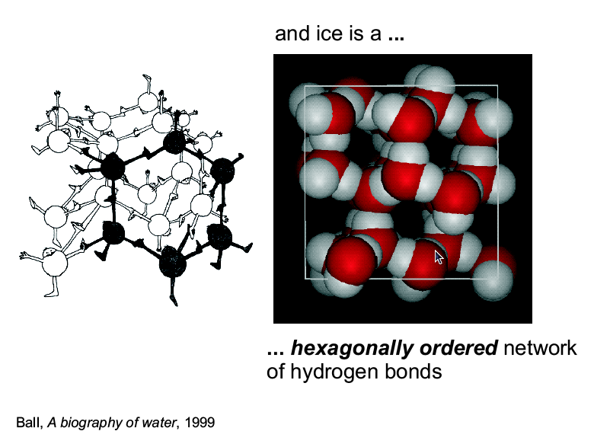
To allow the ordered network of H-bonds to form we need to slow down the motion of water molecules or…

Slide 7
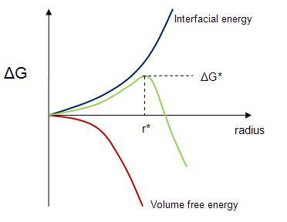
Homogeneous nucleation of ice in supercooled water
It takes energy to form a surface of ice – the larger the surface the larger the energy required (interfacial energy). Balloon on a tap analogy?
Energy is reduced through an increase in the volume of the ice `germ’ as the liquid molecules must slow down. We need to do positive work to speed them up again.
When the sum of these two effects decreases with size, the ice `germ’ will grow into an ice particle.
Key: the larger the volume of liquid water and the lower the temperature, the more likely an ice `germ. will be able to form
Does not happen in pure water until around -35 deg C. But a lot of the atmosphere is -35<T<0C! = > heterogeneous ice nucleation

Slide 8
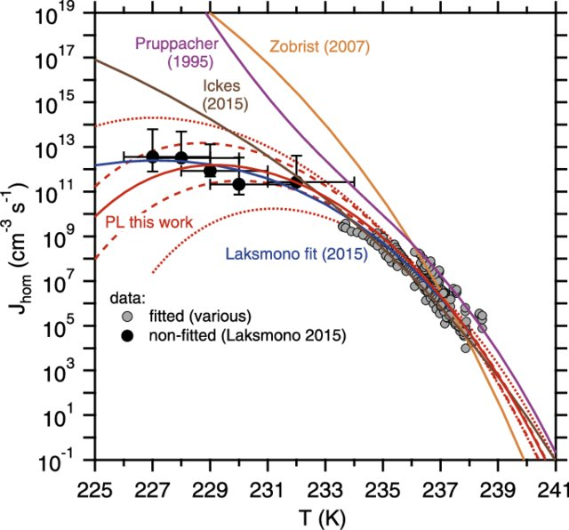
Homogeneous nucleation rate
Koop and Murray (ACP, 2016)

Slide 9
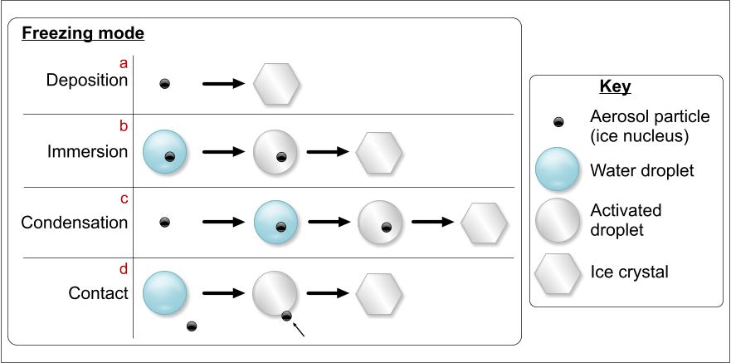
Freezing modes of heterogeneous IN
Important pathway
Dust particles, biological particles (pollen, etc) are “good” ice nuclei.

Slide 10
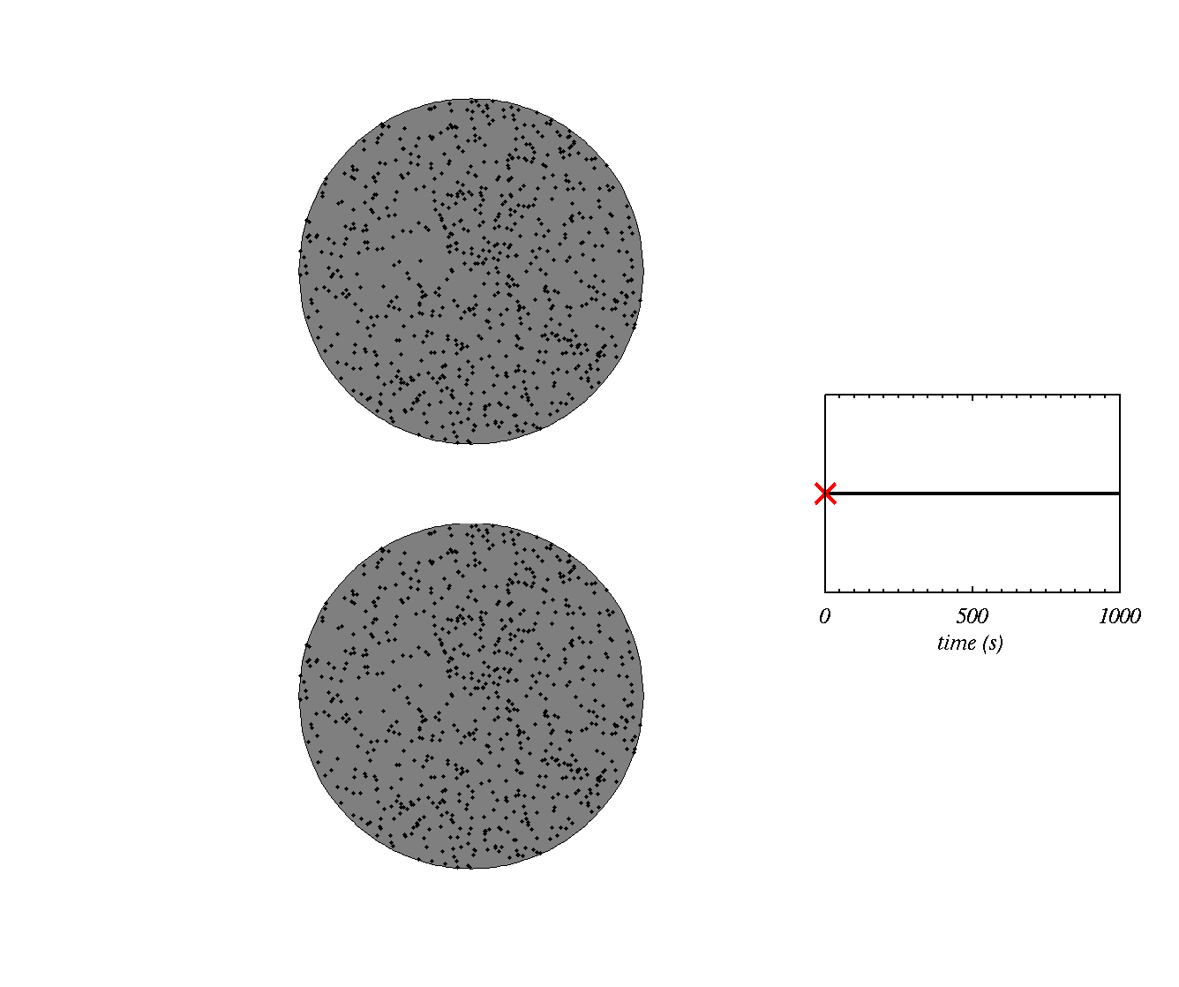

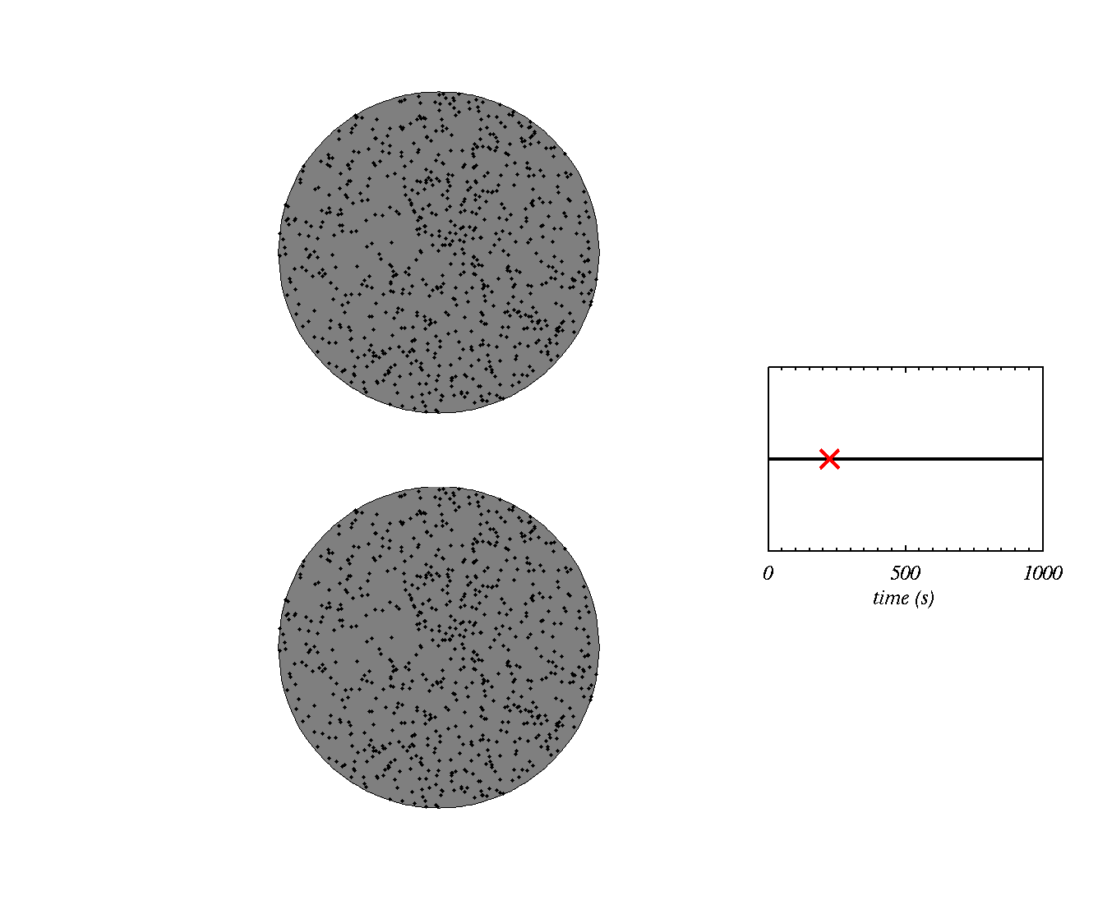
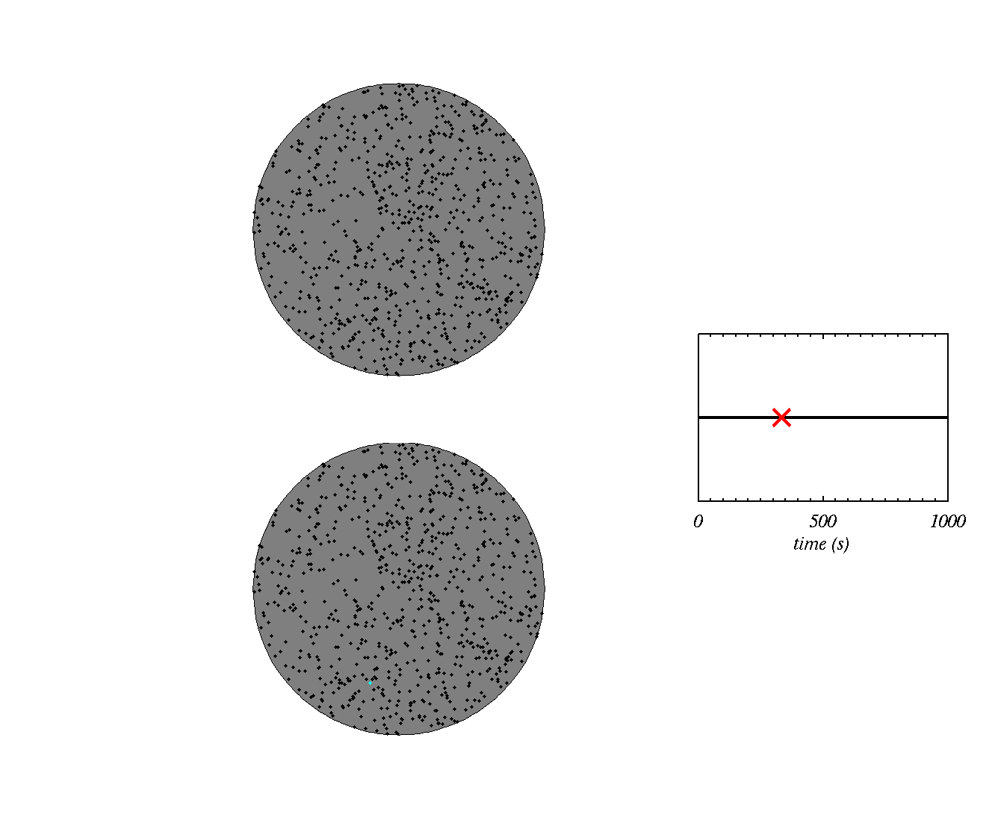

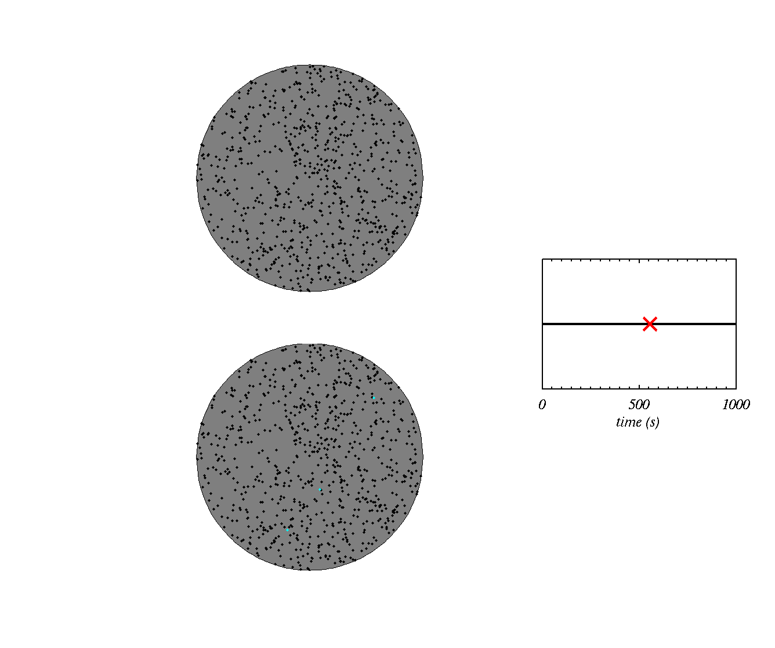




Stochastic hypothesis
Ice is nucleated later at the higher temperature
e.g. T=255K
Two dust particles, one at high T, one at low T
e.g. T=240K
Ice is nucleated when the first site is activated
Typically predicts freezing rates that are too high

Slide 11
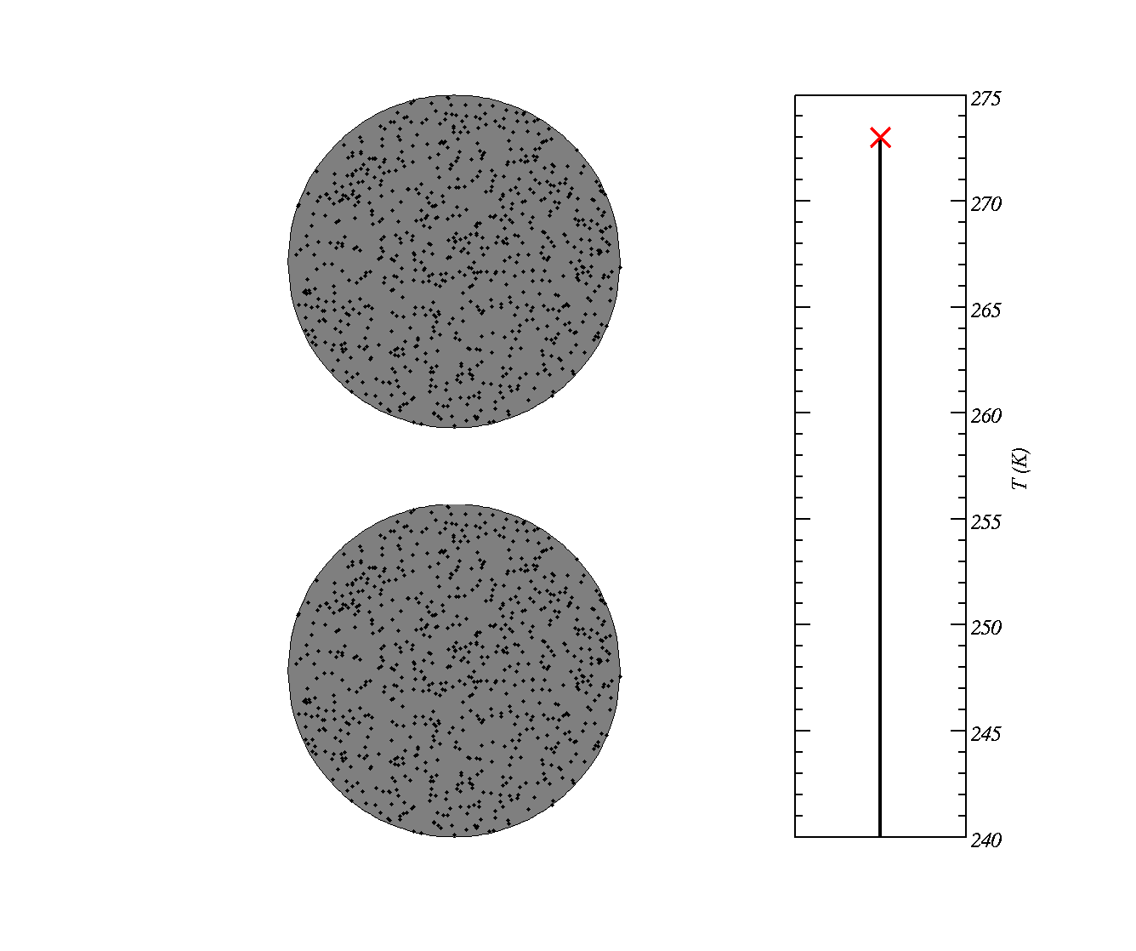
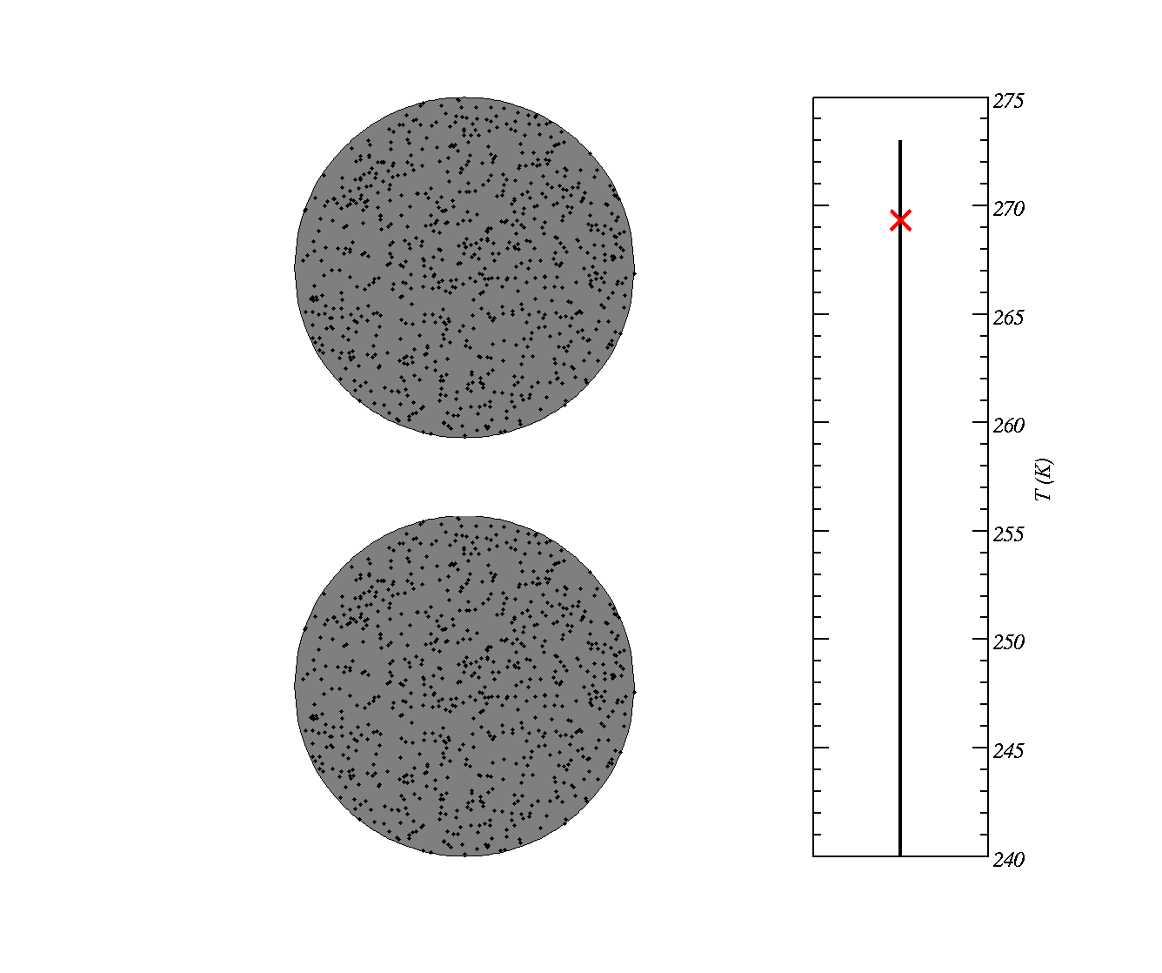
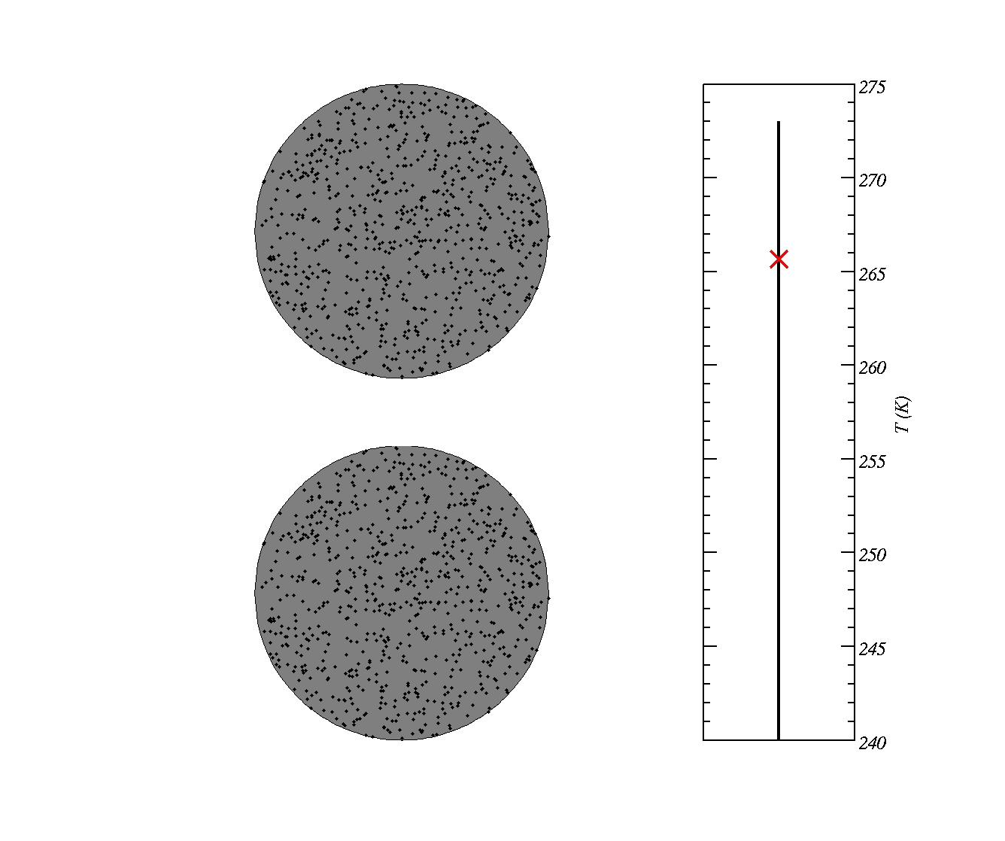
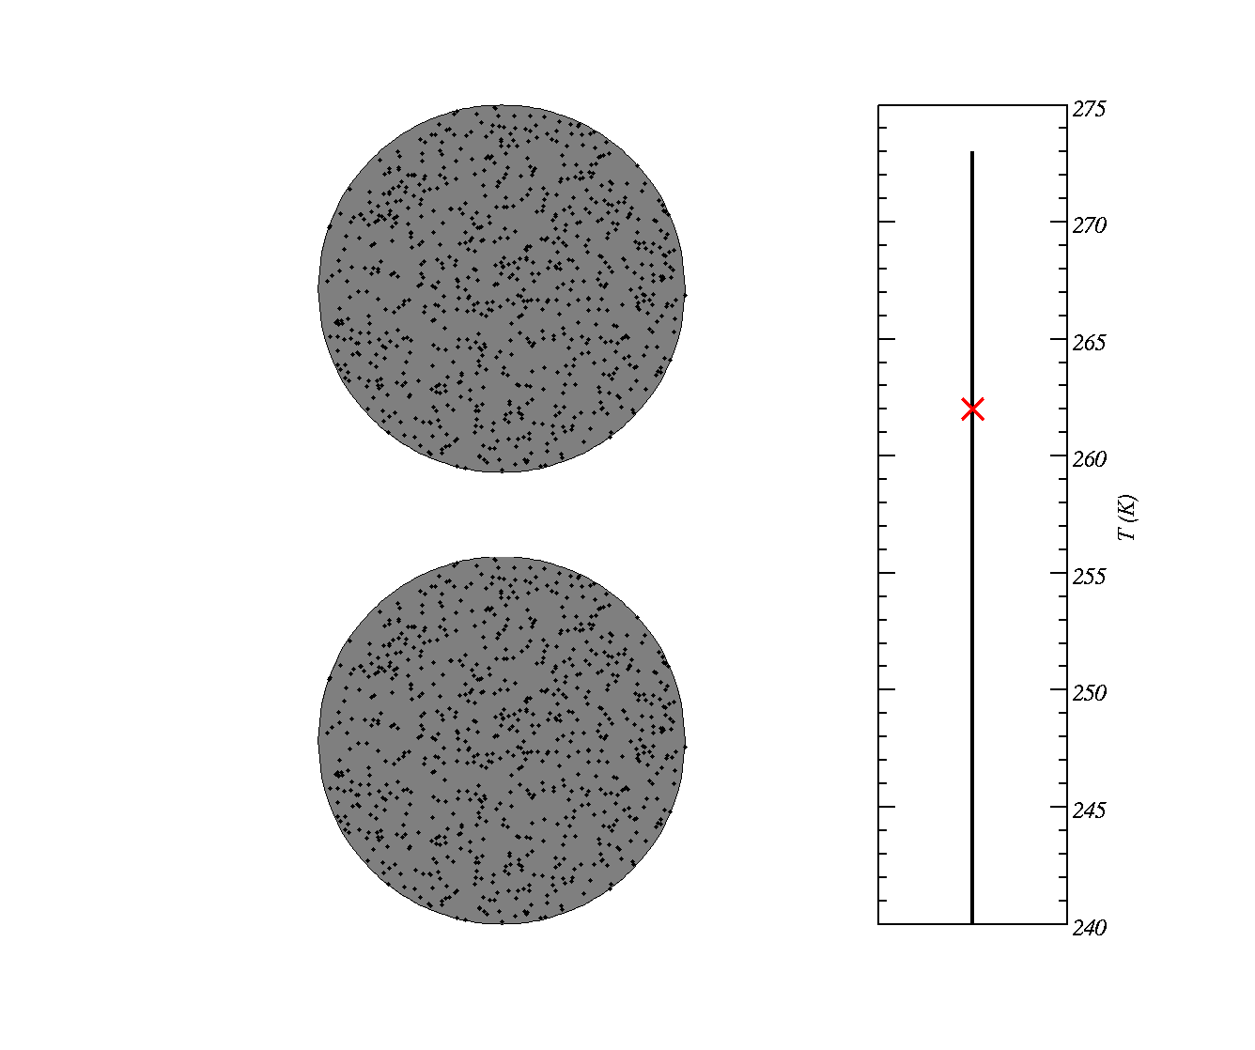

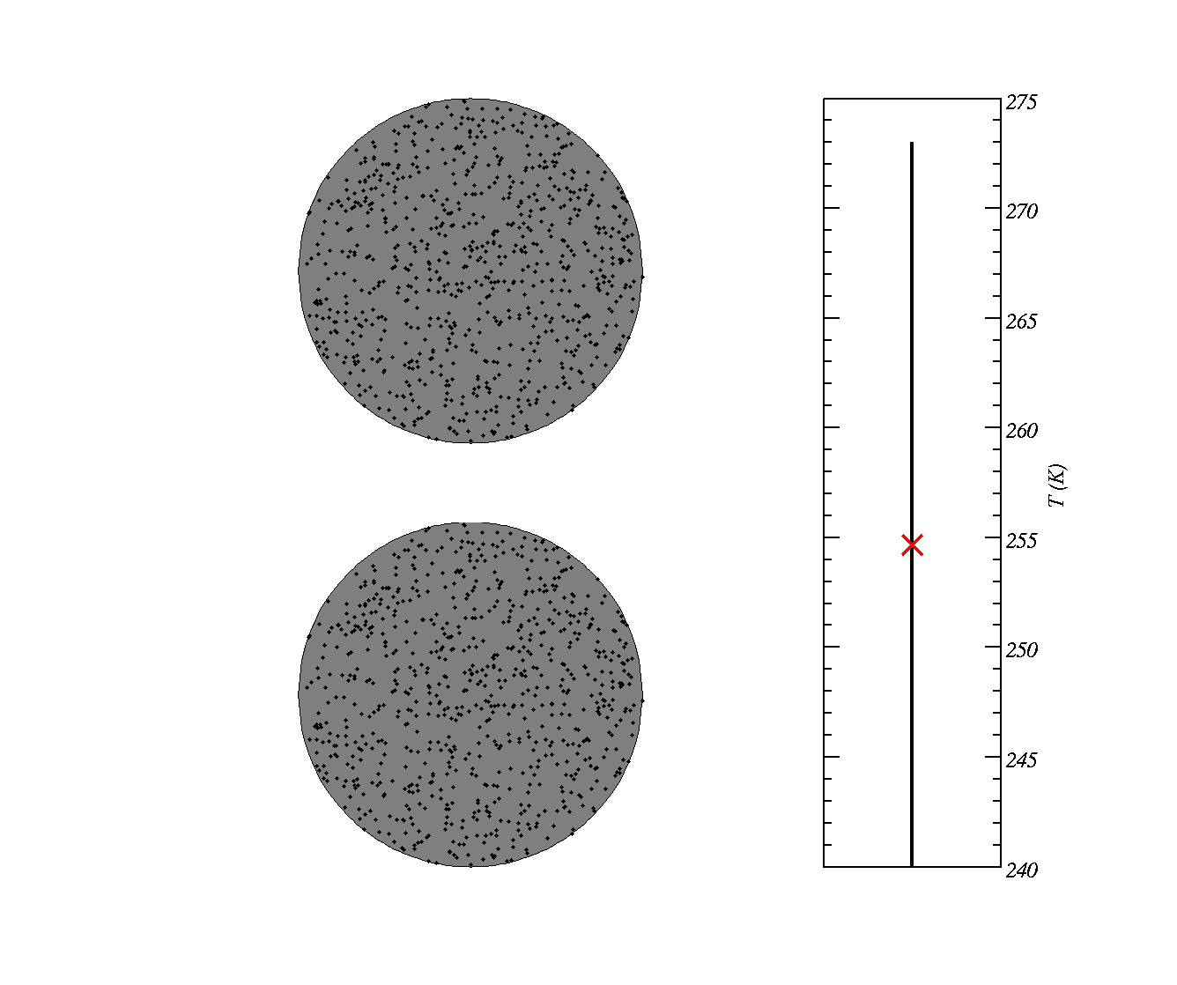

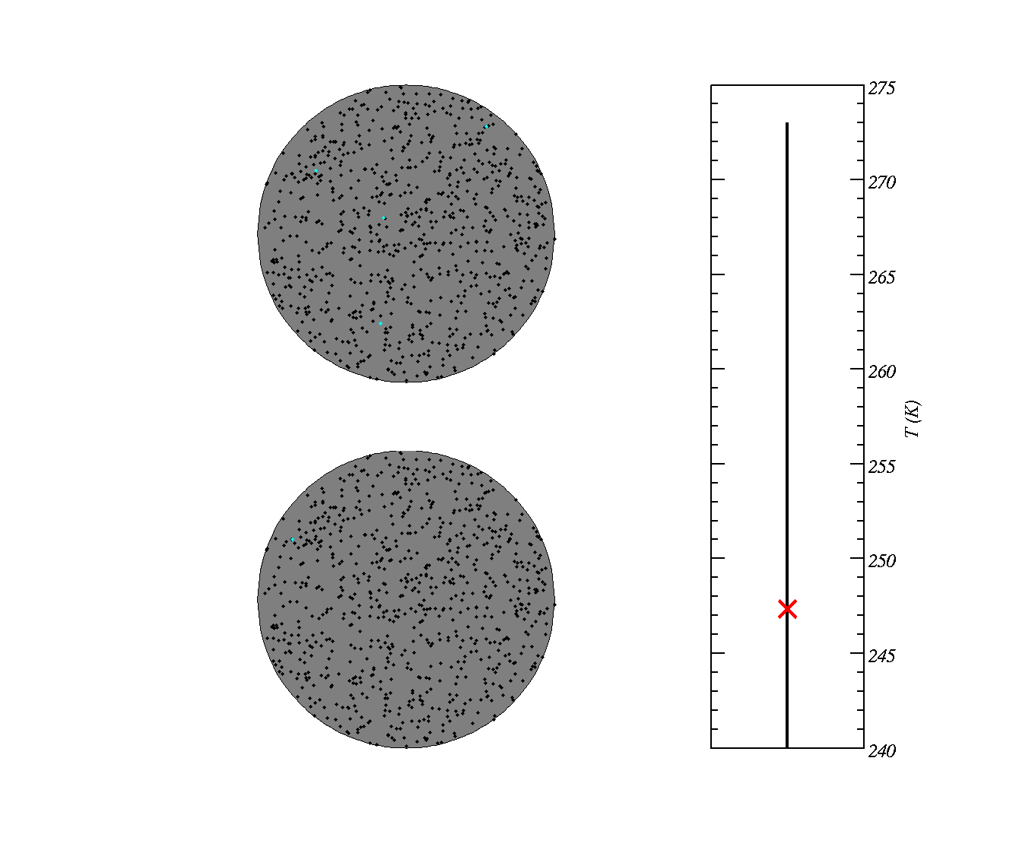
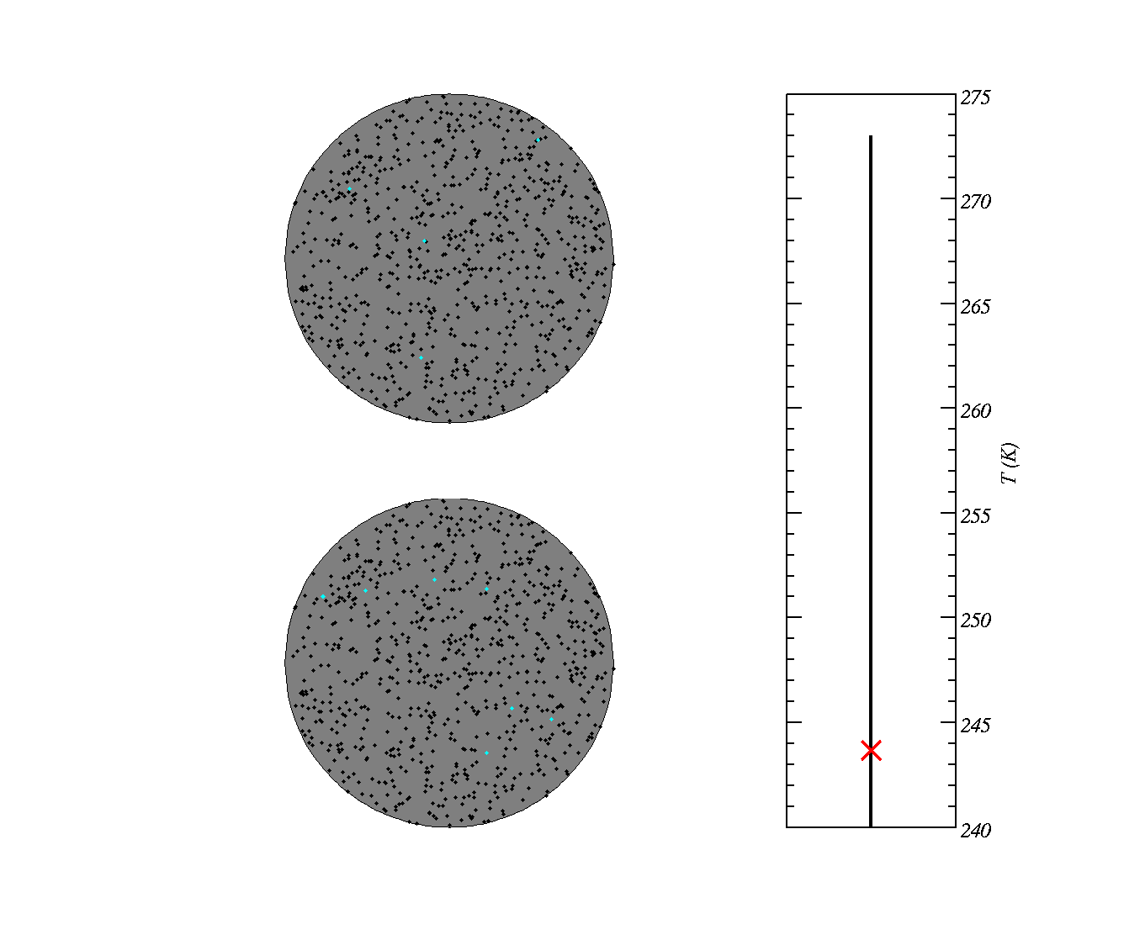
Singular hypothesis
site becomes active at well defined temperature
Two dust particles with potential ice-active sites
Typically predicts freezing rates that are in good agreement with data.

Slide 12
Quantifying heterogeneous ice nuclei
We often use a concept call the Ice-Active Surface Site Density concept.
n_{s}(T) is a function that describes the number of ice nuclei per unit surface area on a particle.
The product of n_{s}(T) and the particle surface area tells us how many ice nuclei there are on a particle.
n_{s}(T) gets larger as the temperature decreases
This is a `singular’ theory.

Slide 13
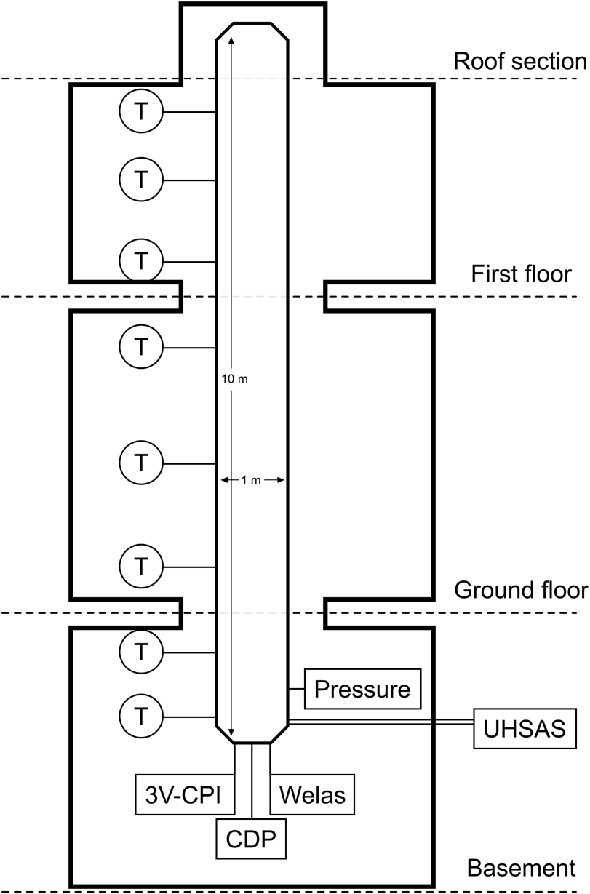
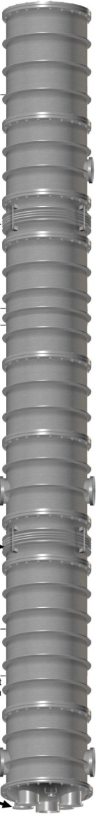
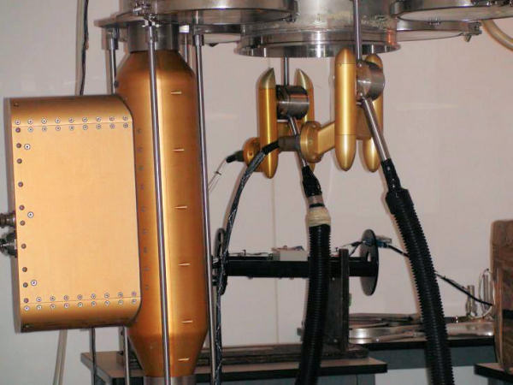
Manchester Ice Cloud Chamber
10 m length, 1 m diameter tube situated in cold rooms on three floors
Clean by evacuating and re-filling, perform background experiment.
Refill with aerosol, and lower pressure to make cloud, sample the aerosol and cloud with:
  3VCPI (3VCloud Particle Imager): images 20<D<2000 μm
  CDP (Cloud Droplet Probe) : particle concentrations 1<D<50 μm
  WELAS optical particle sensor: particle concentrations 0.5<D<40 μm
  UHSAS (Ultra High Sensitivity Aerosol Spectrometer) : particle concentrations 0.055<D<1 μm

Slide 14
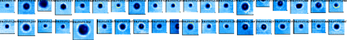
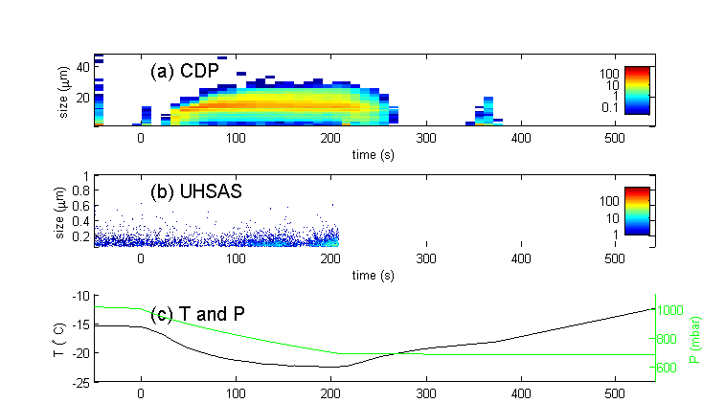
Results (with salt particles @ -15C)
CPI images
A closed `mode’ of droplets forms as measured with the CDP
UHSAS detects background aerosol particles
Pressure reduction results in lowering of temperature.

Slide 15
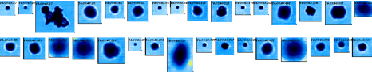
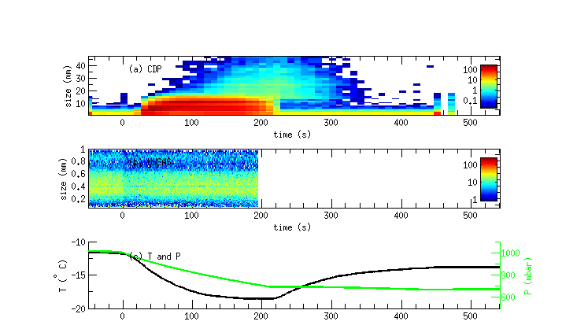
Mineral dust particles @ -12C
A closed `mode’ of droplets forms as measured with the CDP, ice grows out of it.
UHSAS detects dust aerosol particles, with mode at 400 nm.
We calculate the number of ice active sites by dividing the number of ice crystals by the aerosol surface area.

Slide 16
Main points
Ice is not nucleated in pure water until T<-38°C.
Ice nuclei are required to nucleate ice for −38C<T<0C
Historically there are two ways of thinking about ice nucleation (singular / stochastic), but singular is a good approximation for heterogeneous ice nucleation.
Ice crystals leads to changes in the radiative properties of clouds, their lifetime and leads to precipitation.
Notes:
http://www.youtube.com/watch?v=Vlqgih0Rpag&feature=related

