Slide 1
Meteorology and Atmospheric Physics lecture 5
Recap:
There are more `small’ particles in a cloud than `large’ particles An exponential distribution which depends on two parameters can be used to describe it.
Why are the moments of a distribution important for modelling / forecasting clouds? Moments of a distribution are used to calculate the physical processes within a model (e.g. 1st moment: vapour growth; 2nd moment: radiative properties; 5th moment: precipitation rate).
Why is geoengineering clouds most effective in conditions with low aerosol concentrations? Because for a given cloud water content the radiative properties ~M₀^{(1/3)}. However, because of Kelvin’s effect the size is also important.
Today: what temperature does liquid water freeze at?
  What causes ice to form in the atmosphere?
  Why is it important?
Dr Paul Connolly, reader

Slide 2
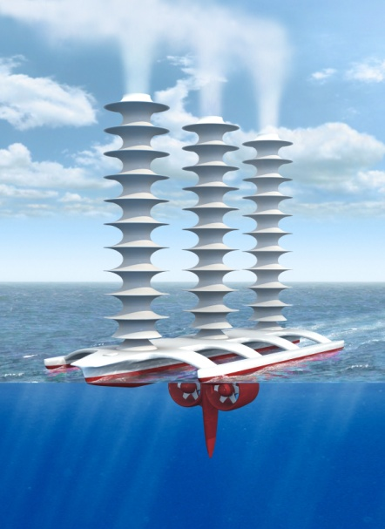
Reiterate: Latham’s geoengineering scheme
Technique (Latham, Nature, 1990)
To disseminate natural sea water droplets at ocean surface into the boundary layer.
These ascend via thermals to enter the cloud and increase the number of drops within the cloud
Switching off the sprayers returns to the status quo within a week or so.
Support for idea
Natural droplet creation at ocean surface
NaCl drops are effective CCN
Ship tracks, fires already show that it works…

Slide 3
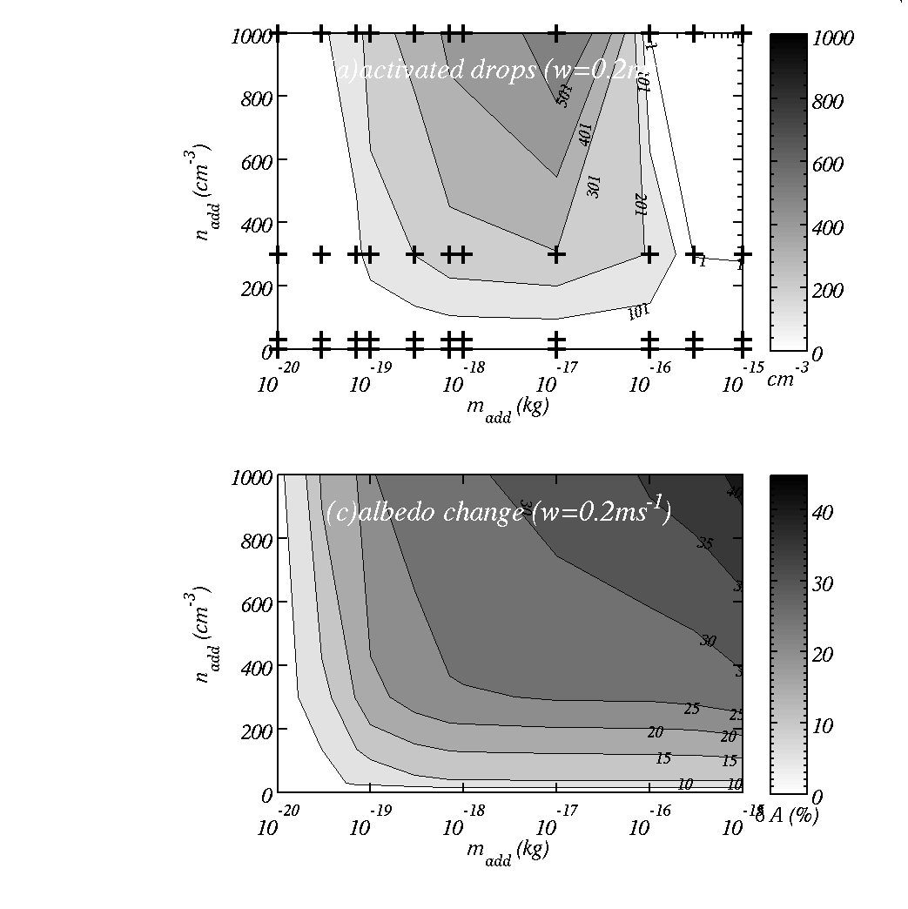
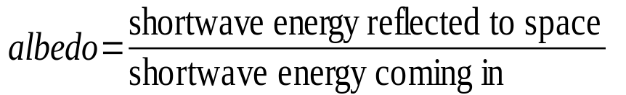
In regions of low aerosol concs.
Top: cloud droplet number for different individual salt masses (particle sizes) and concentrations.
Bottom: absolute change in albedo
Summary: a change of up to about 0.4 in the albedo – huge!

Slide 4
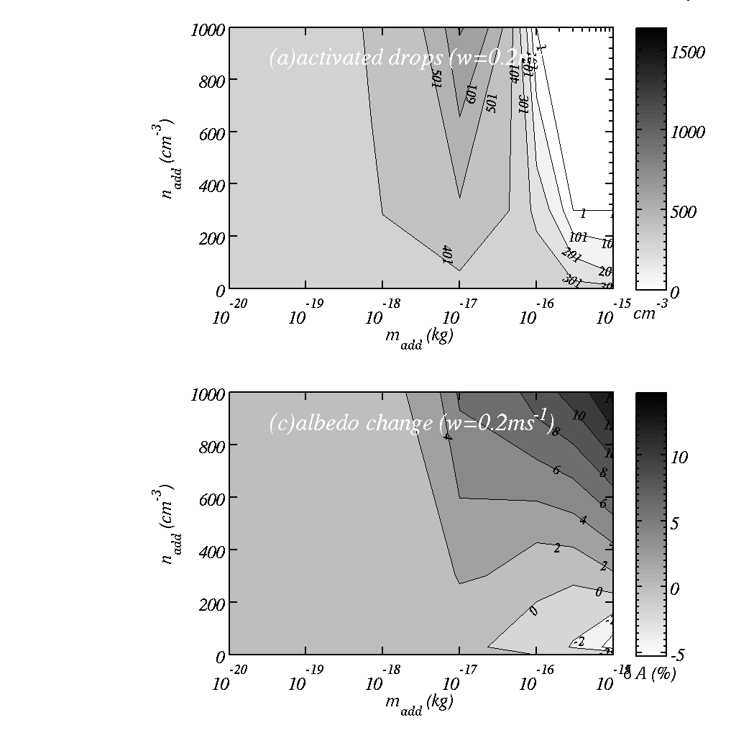
In regions of high aerosol concs.
Top: cloud drop number concentration for different individual salt masses (particles sizes) and concentrations.
Bottom: change in albedo.
Summary: we have to be careful, since particles that are large and few in number will cause a warming effect.

Slide 5
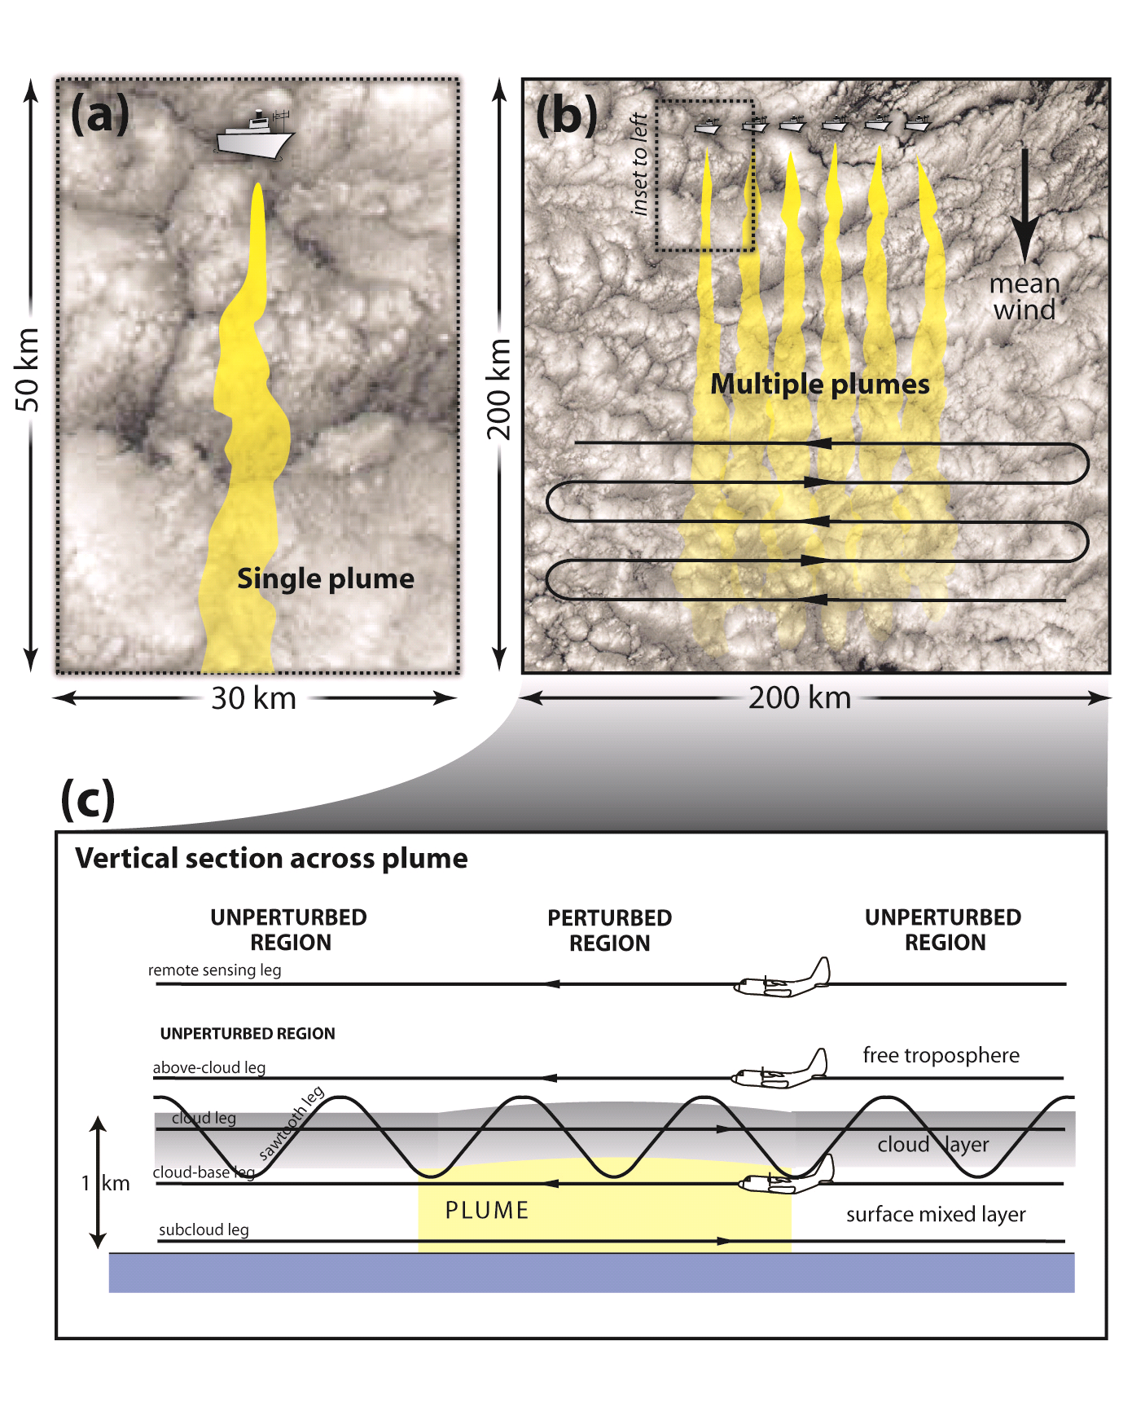
Experiment to test feasibility
Single plume: can we see if from aircraft measurement?
Multiple plumes: can we see a signal from satellite?
Can we get the desired result?

Slide 6
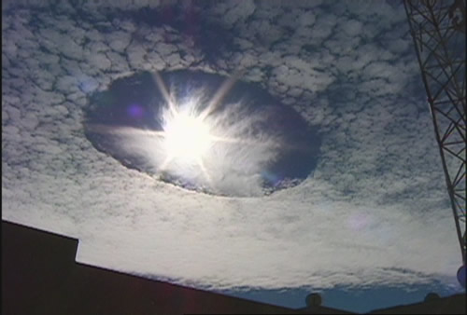
`Hole punch’ clouds

Slide 7
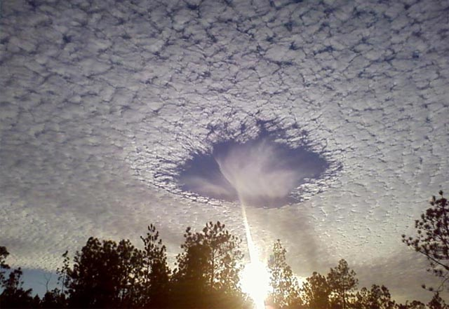
What is happening here and why?

Slide 8
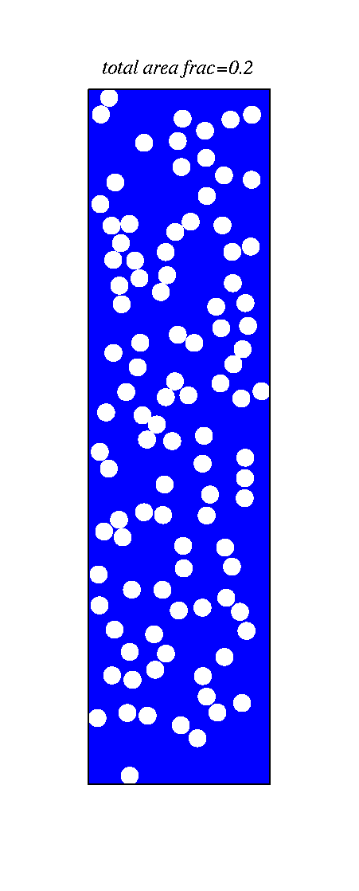
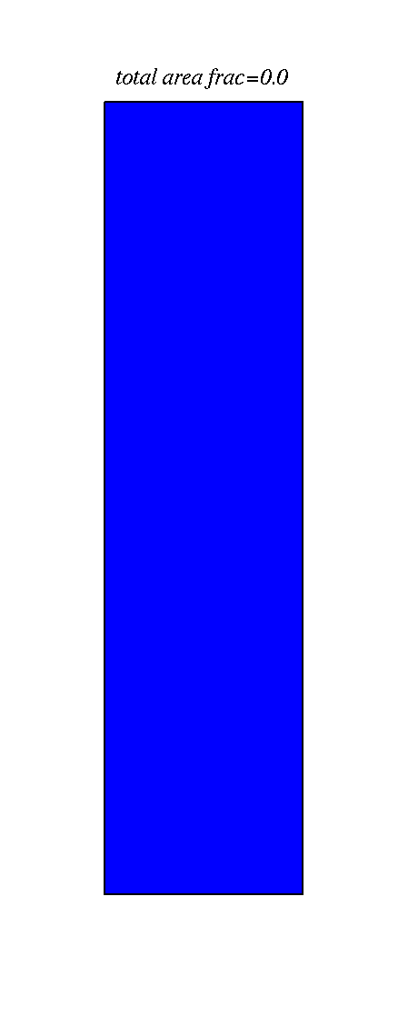
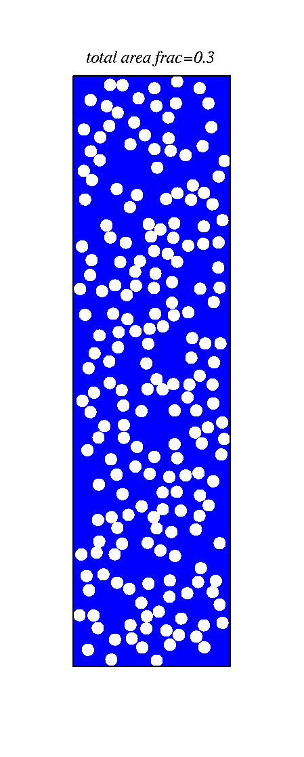
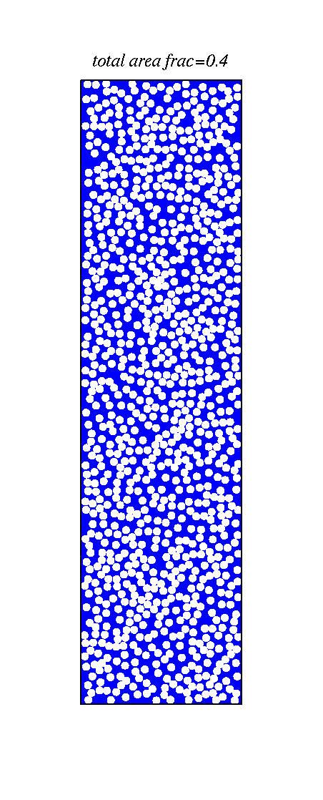
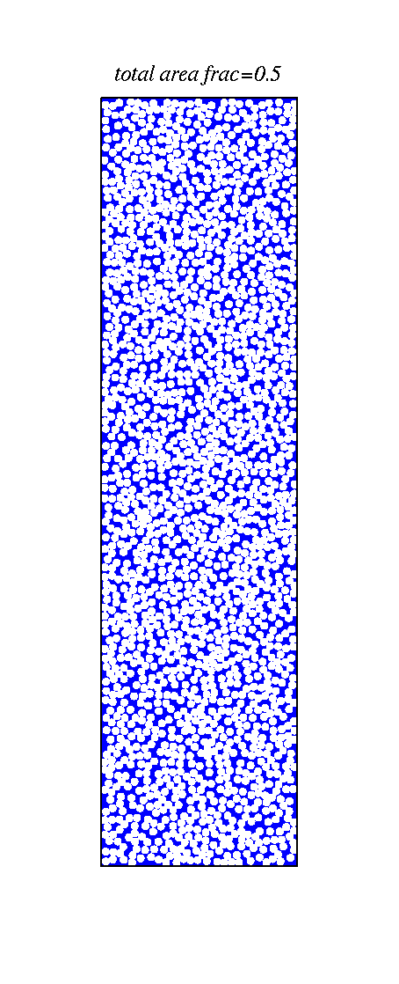
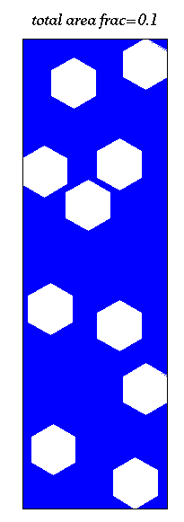
Clouds with different amounts of aerosol, same amount of condensed water – albedo effect
Ocean - blue
Because there are typically much less IN than CCN ice formation modifies the albedo of clouds

Slide 9
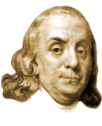
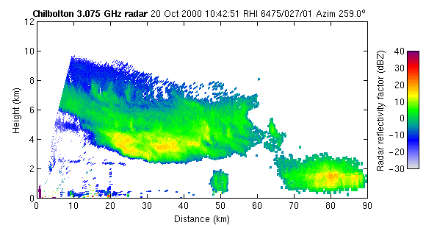
Ice in clouds also leads to precipitation
Benjamin Franklin (1784)
  “much of what is rain, when it arrives at the surface of the earth, might have been snow, when it began its descent…”
University of Reading (Dr R. Hogan)

Slide 10
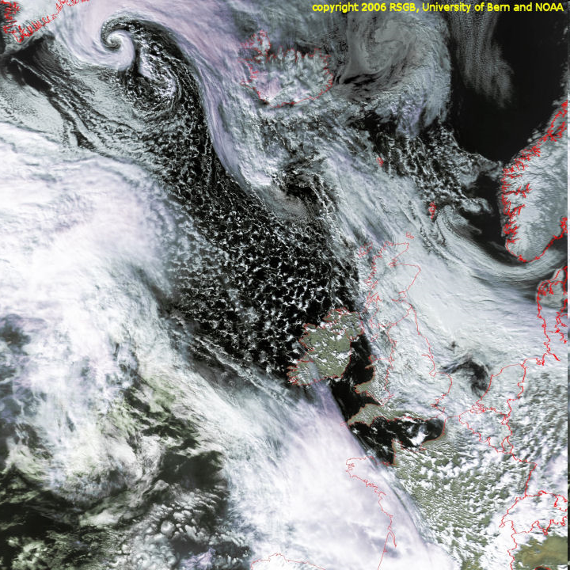
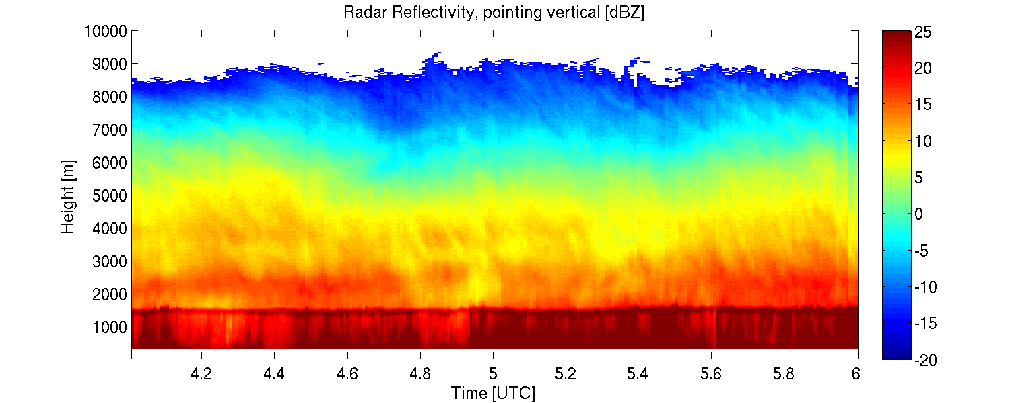
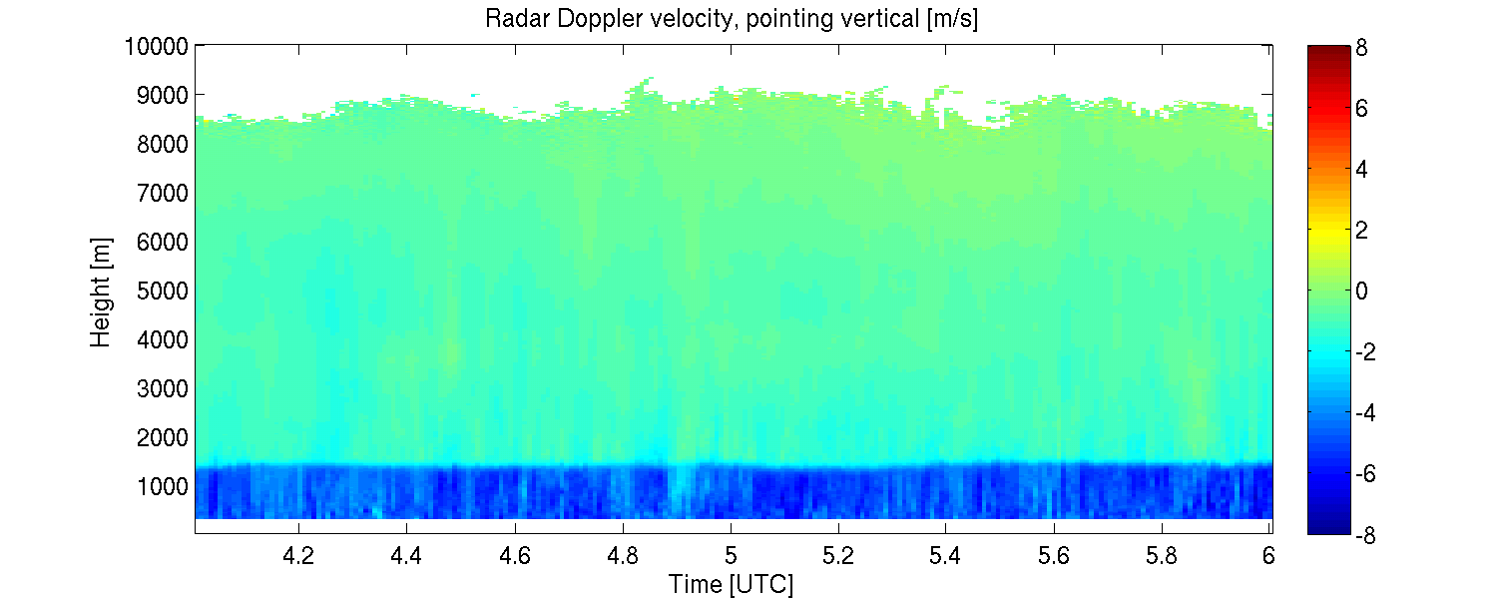
Nimbostratus associated with a warm front
University of Reading
(Dr Chris Westbrook)

Slide 11
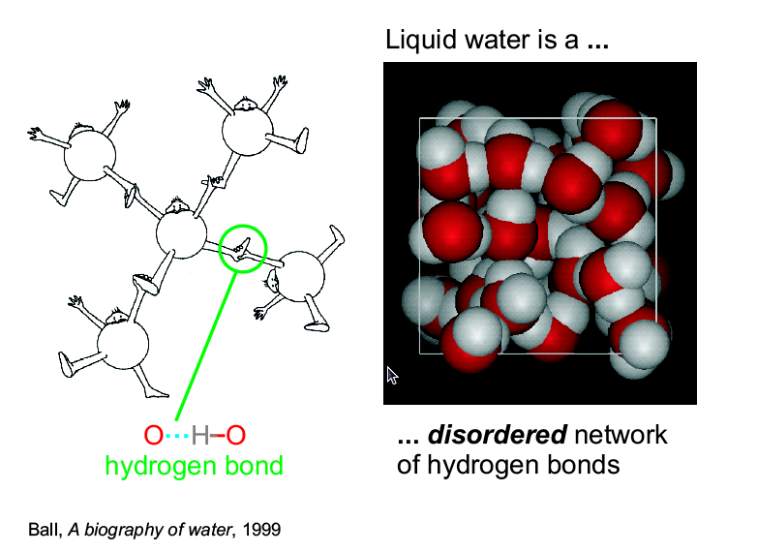

Slide 12
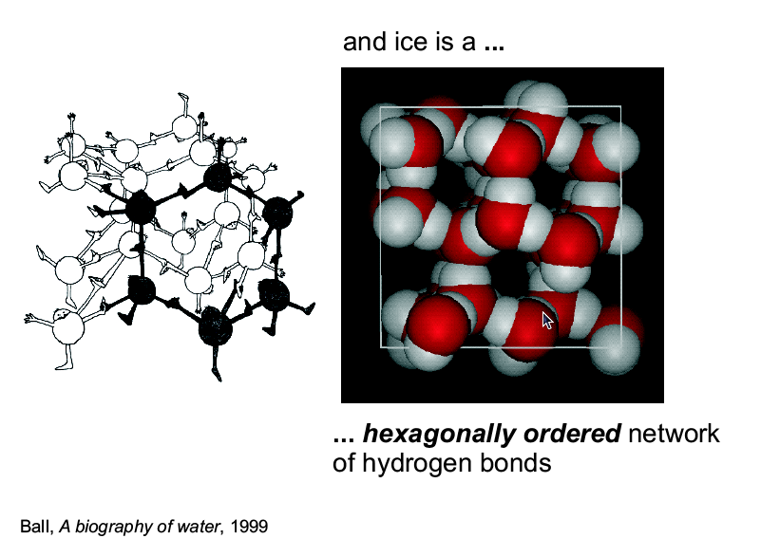
To allow the ordered network of H-bonds to form we need to slow down the motion of water molecules or…

Slide 13
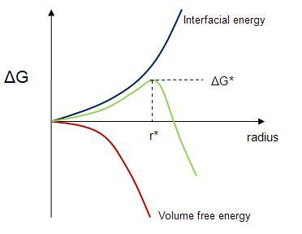
Homogeneous nucleation of ice in supercooled water
Slowing (cooling down) the liquid water molecules means they are more likely to form an ordered network of H-bonds.
  There is less thermal motion to disrupt the ordering of molecules
It takes energy to form a surface of ice – the larger the surface the larger the energy required (interfacial energy)
Energy is reduced through an increase in the volume of the ice `germ’ as the liquid molecules must slow down. We need to do positive work to speed them up again.
When the sum of these two effects decreases with size, the ice `germ’ will grow into an ice particle.
Key: the larger the volume of liquid water and the lower the temperature, the more likely an ice `germ. will be able to form

Slide 14
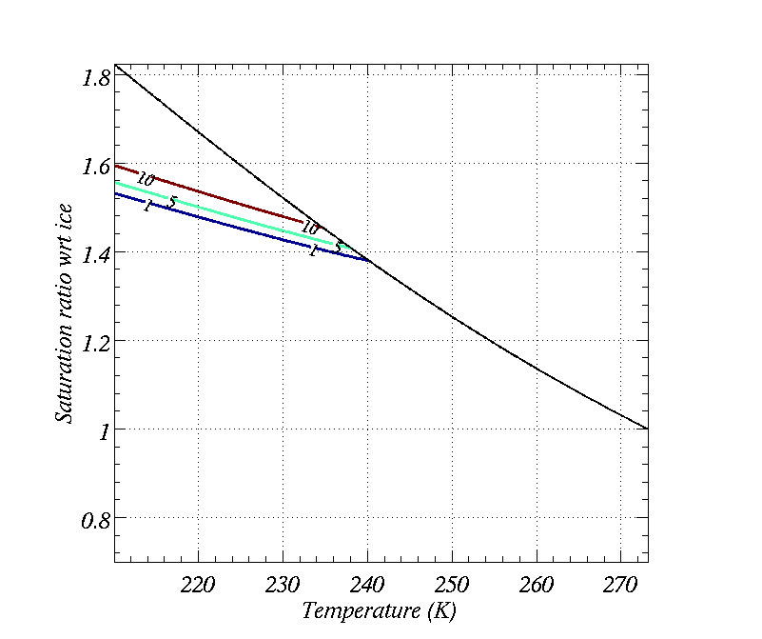
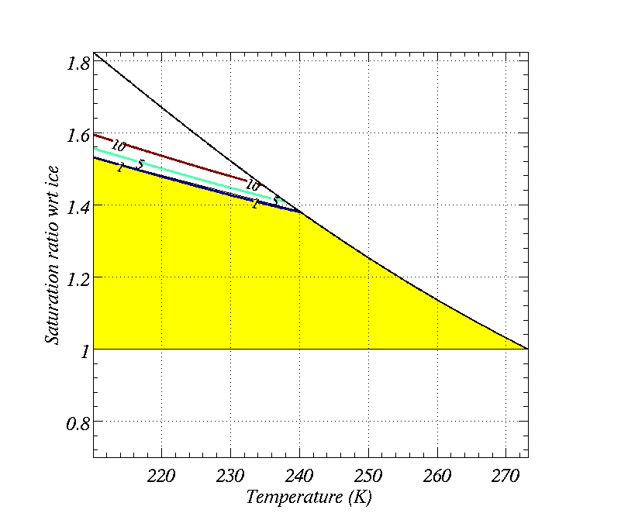
Schematic ice nucleation
`Thresholds’ for homogeneous nucleation in supercooled aqueous solutions – doesn’t matter what the solution is – larger, less concentrated solutions nucleate ice more readily
Saturation wrt ice @ water saturation
Heterogeneous ice nucleation generally takes place below water saturation and below the `Homogeneous’ threshold, but above ice saturation (i.e. in the yellow part)

Slide 15
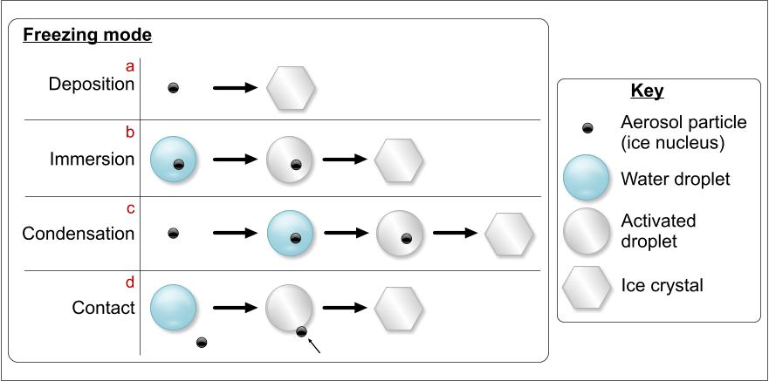
Freezing modes of heterogeneous IN

Slide 16
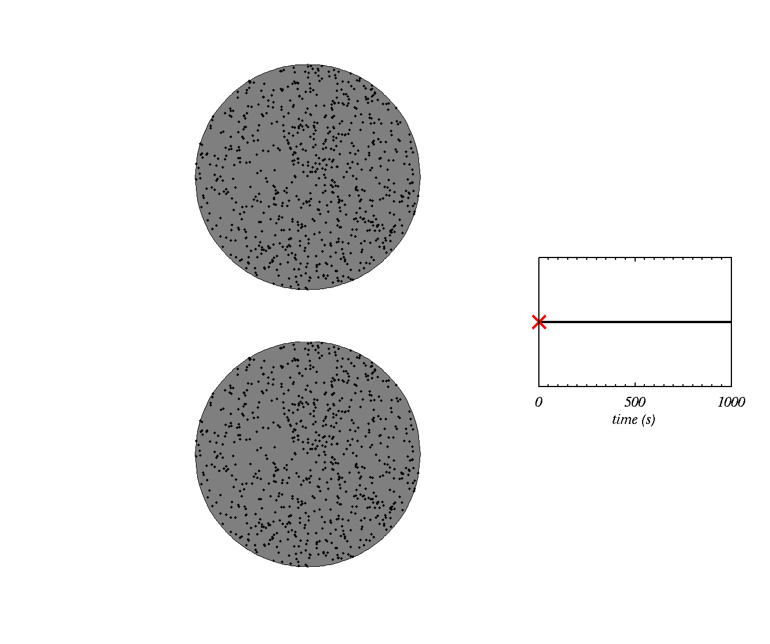

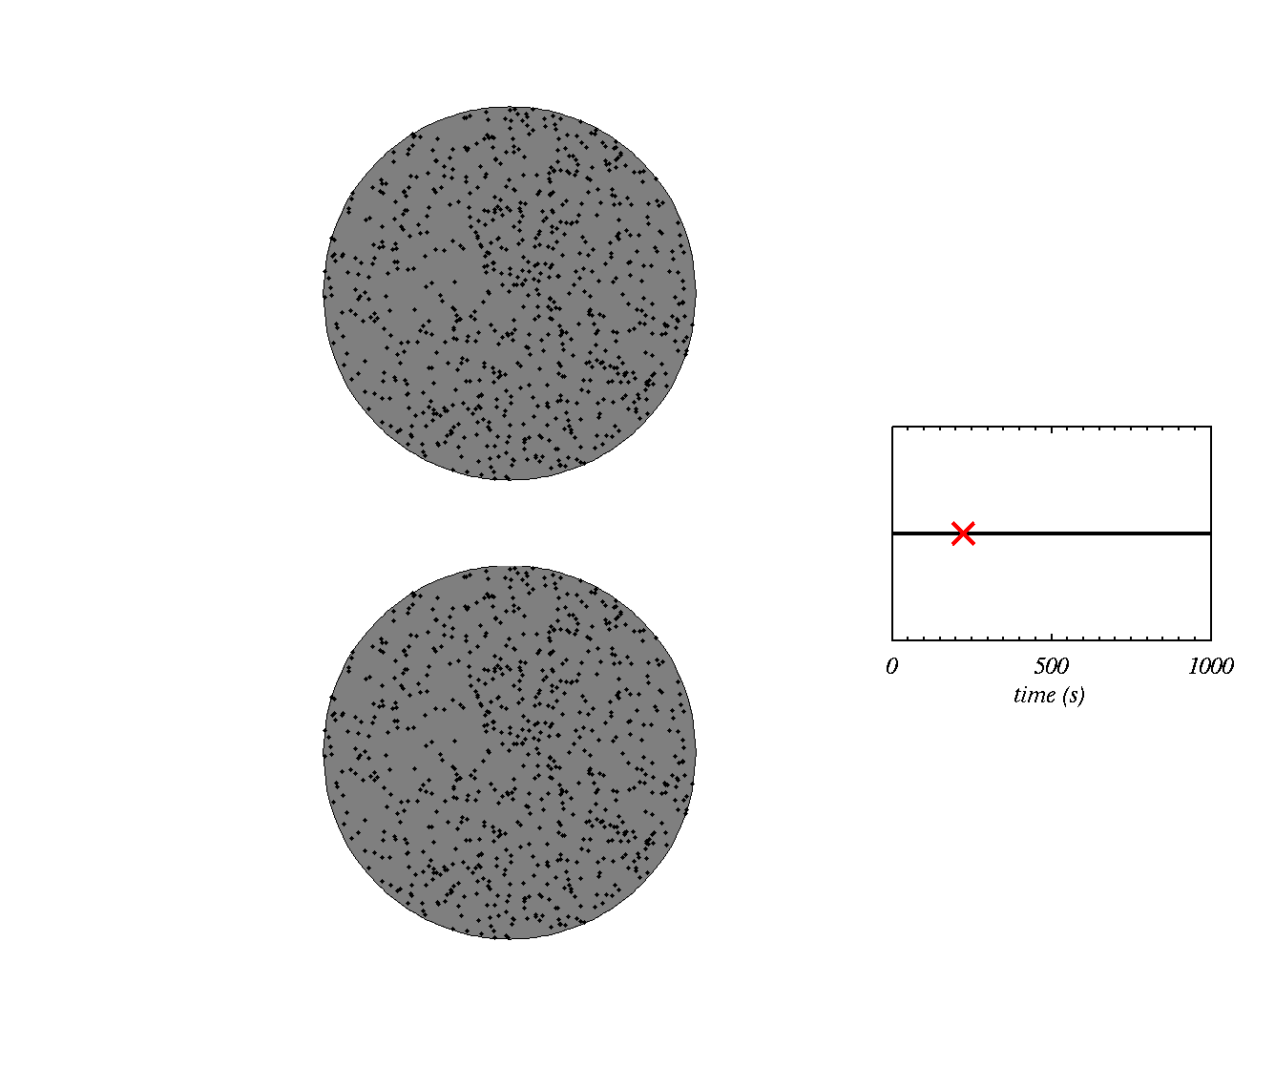
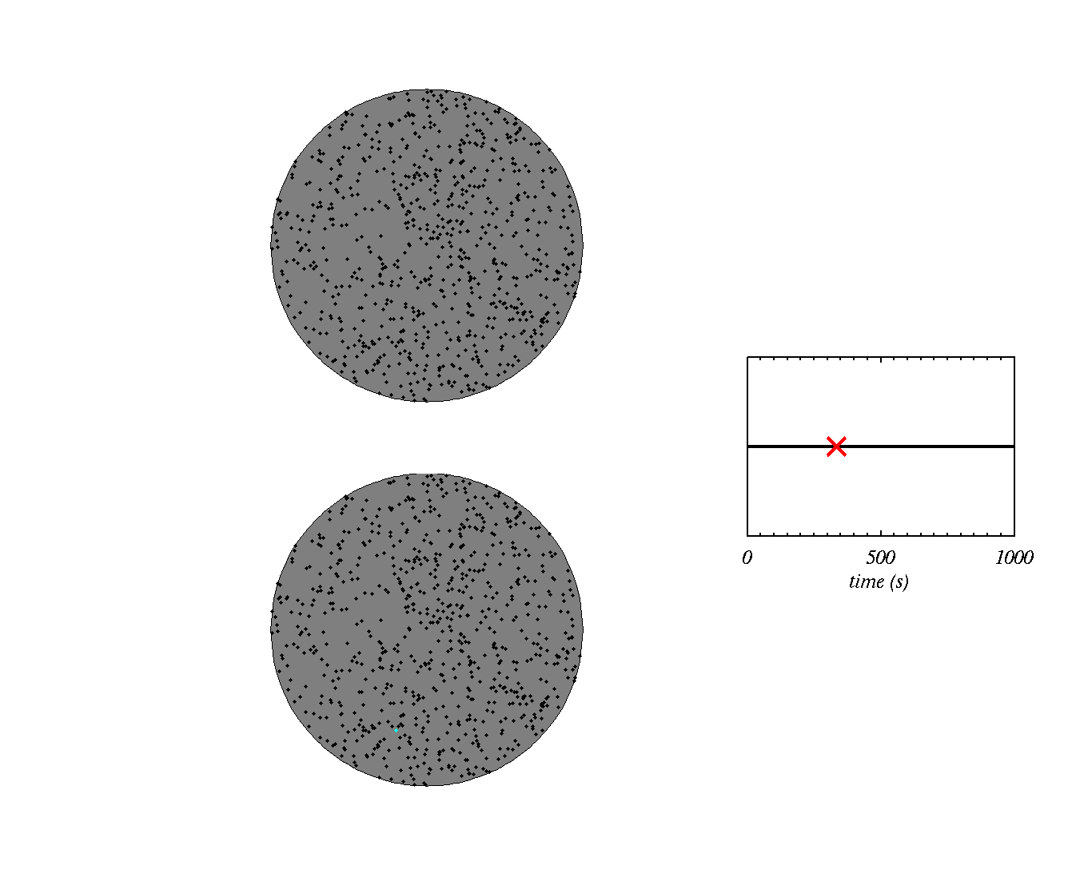

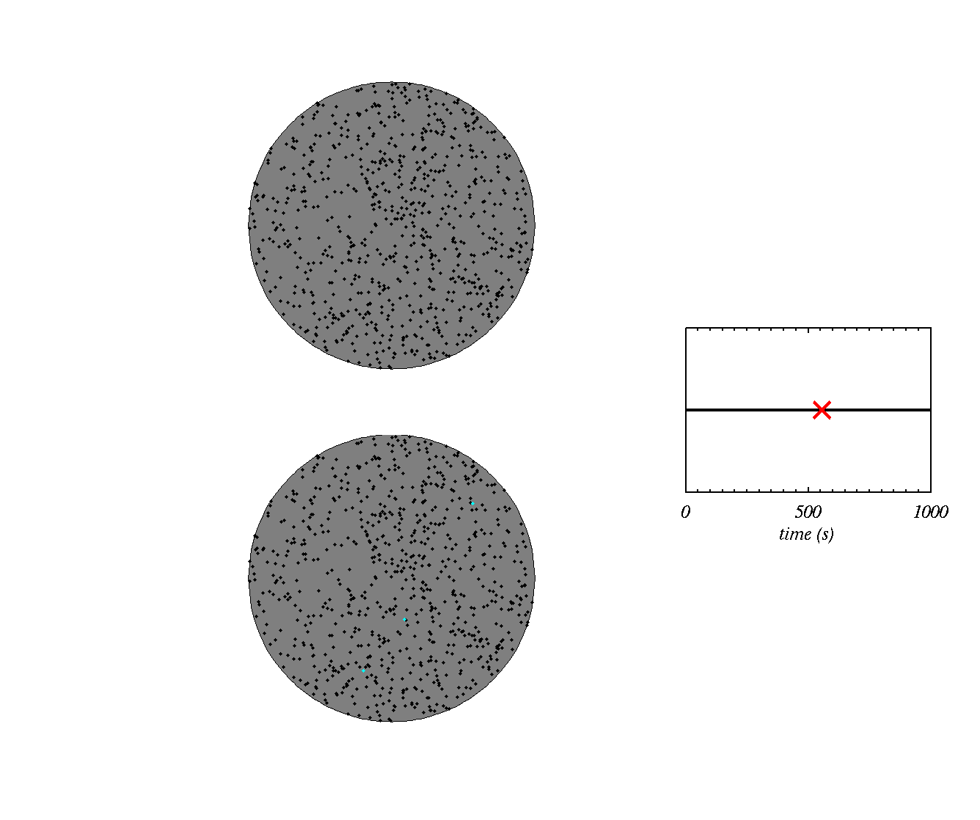




Stochastic hypothesis
Ice is nucleated later at the higher temperature
e.g. T=255K
Two dust particles, one at high T, one at low T
e.g. T=240K
Ice is nucleated when the first site is activated
Typically predicts freezing rates that are too high

Slide 17
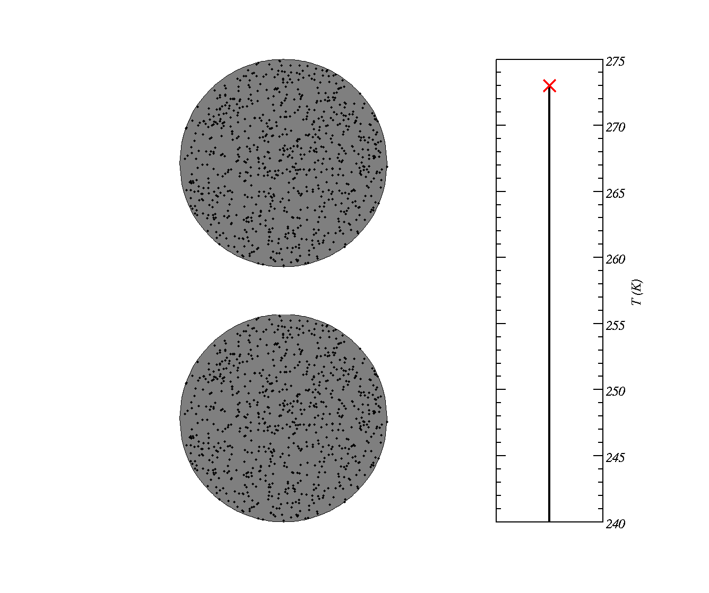
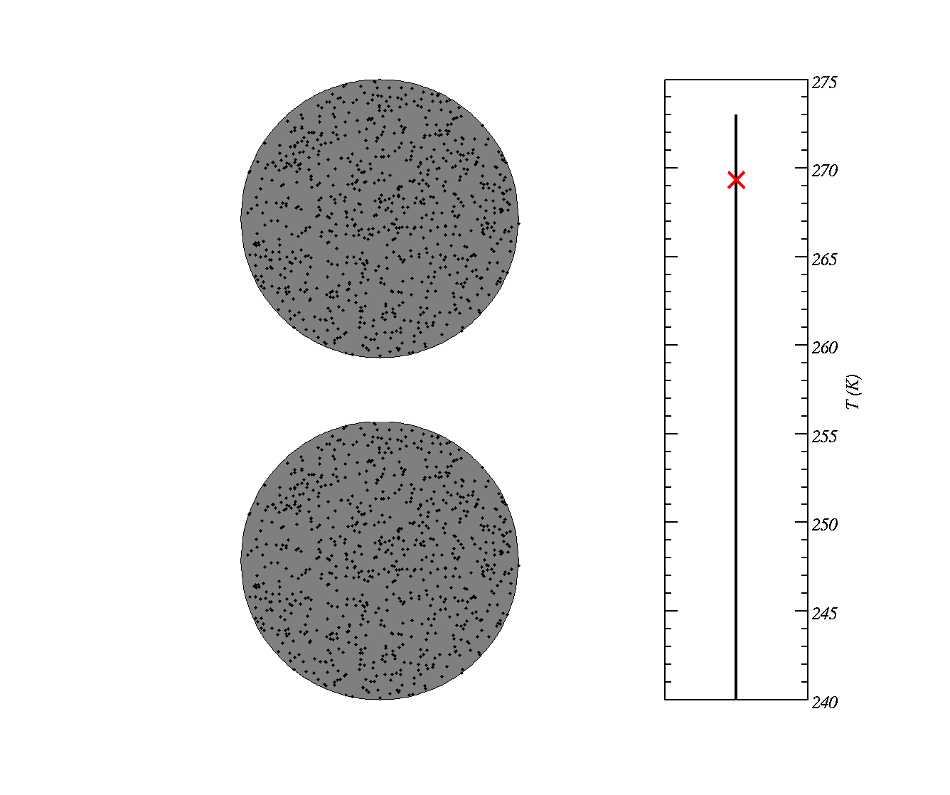
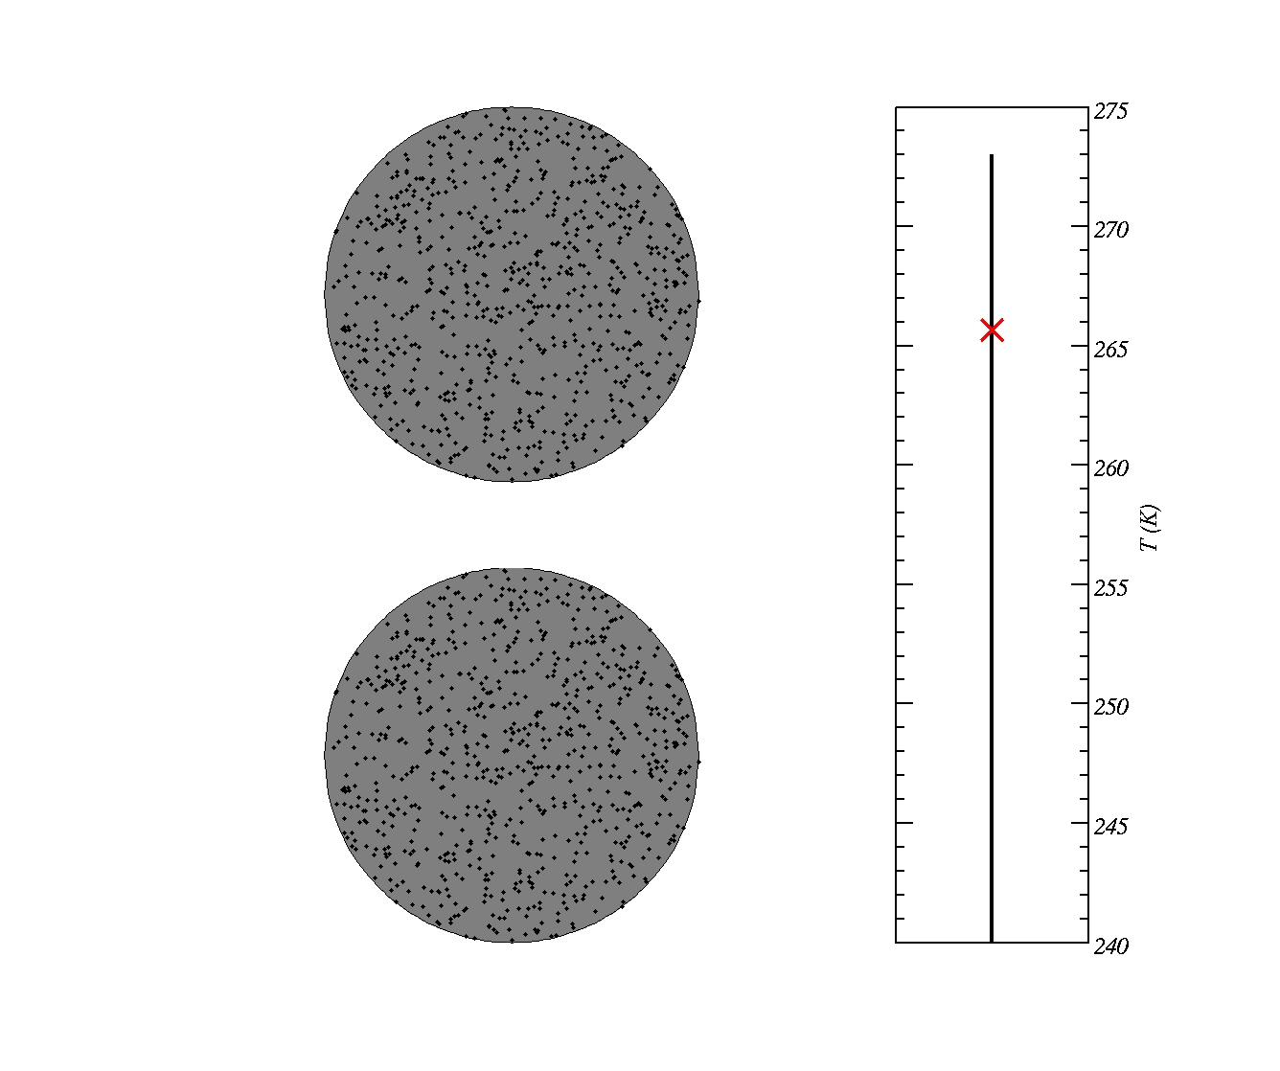
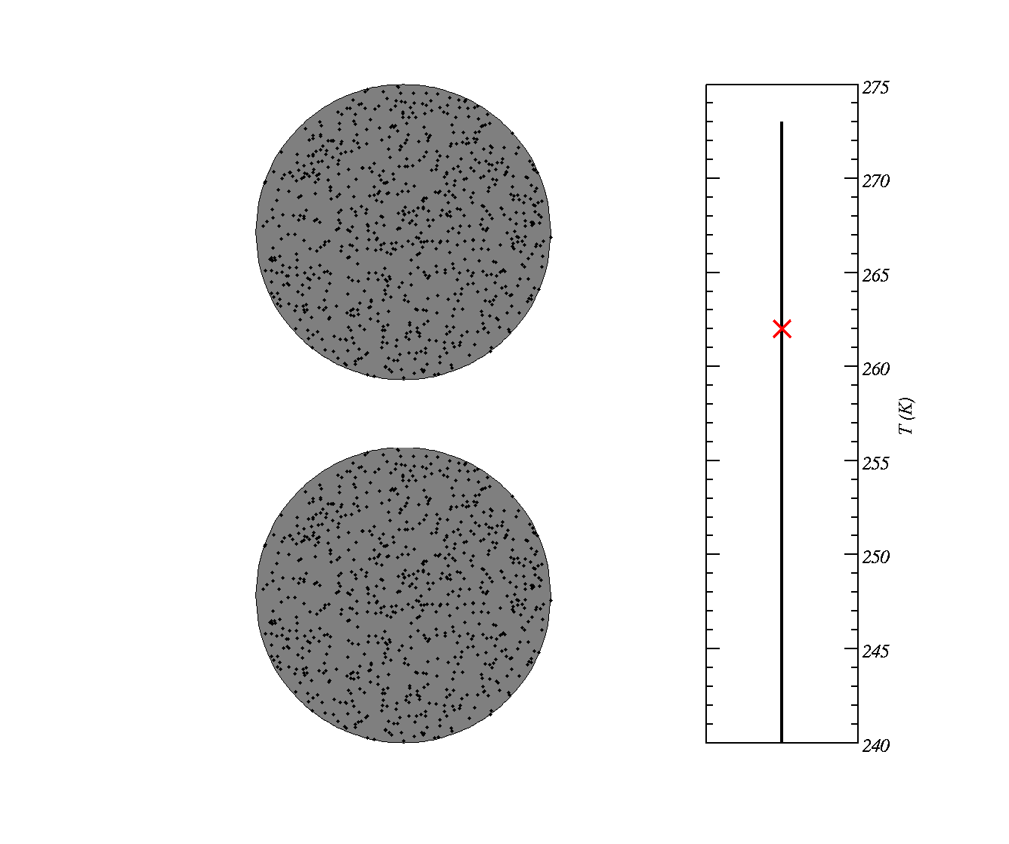

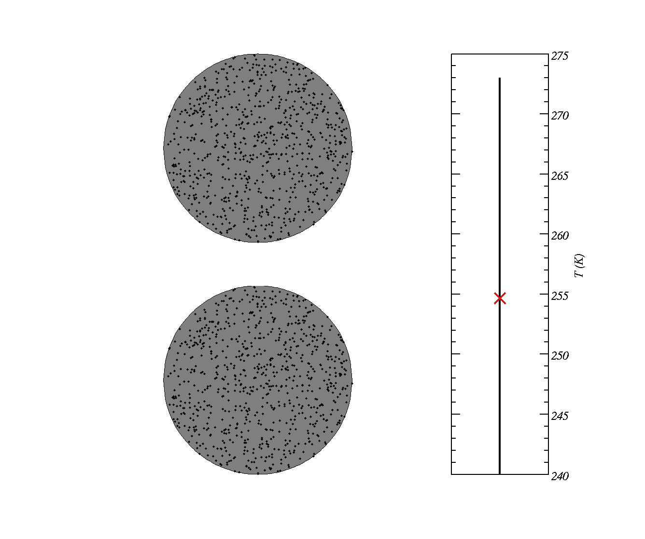

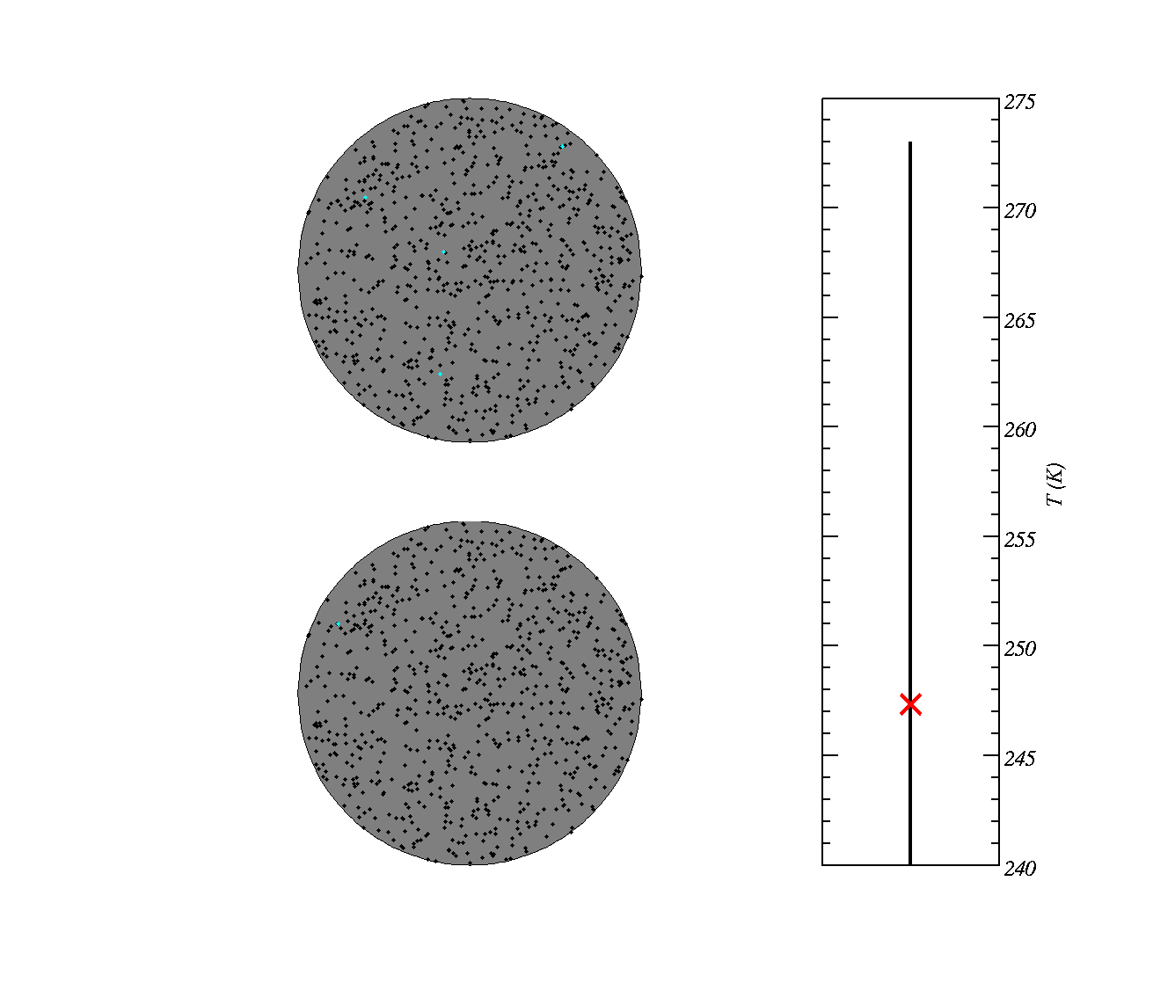
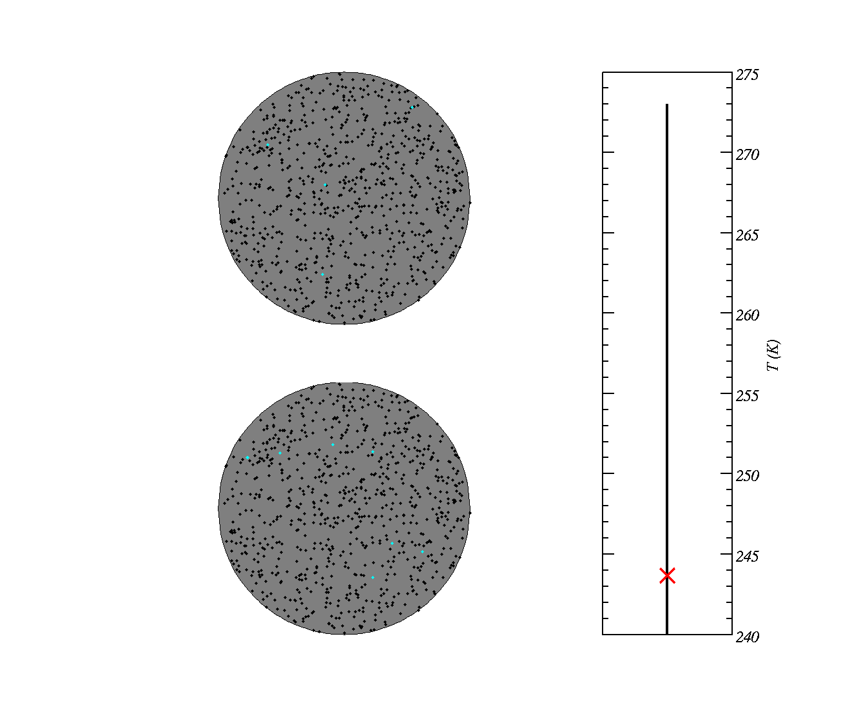
Singular hypothesis
site becomes active at well defined temperature
Two dust particles with potential ice-active sites
Typically predicts freezing rates that are in good agreement with data.

Slide 18
Main points
Ice is not nucleated in pure water until T<-35°C.
Ice nuclei are required to nucleate ice for −35C<T<0C
Historically there are two ways of thinking about ice nucleation (singular / stochastic).
Ice crystals leads to changes in the radiative properties of clouds, their lifetime and leads to precipitation.
http://www.youtube.com/watch?v=Vlqgih0Rpag&feature=related

Slide 20
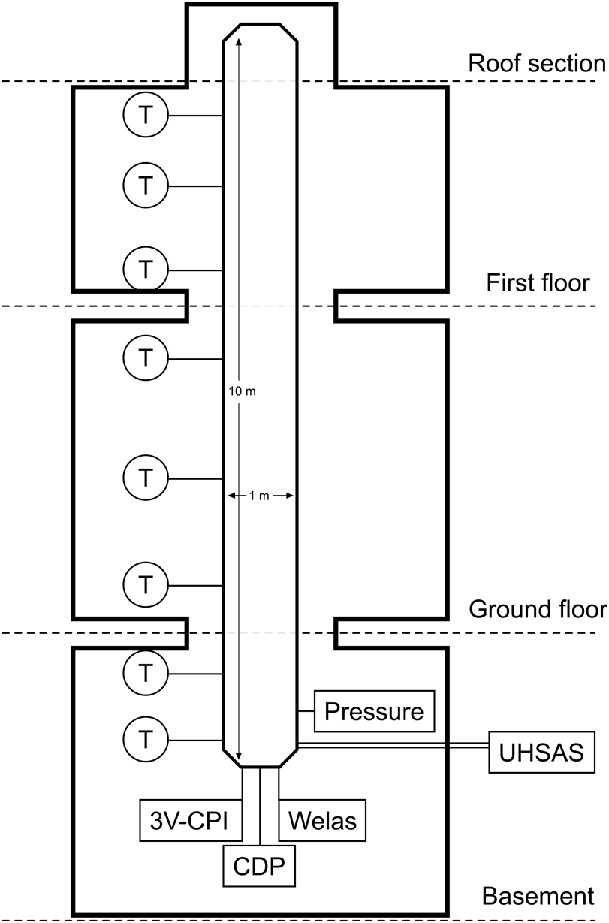
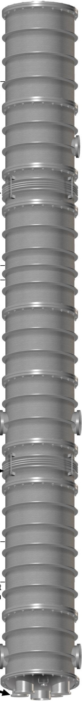
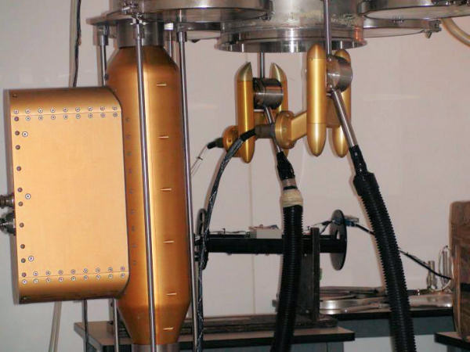
Manchester Ice Cloud Chamber
10 m length, 1 m diameter tube situated in cold rooms on three floors
Clean by evacuating and re-filling, perform background experiment.
Refill with aerosol, and lower pressure to make cloud, sample the aerosol and cloud with:
  3VCPI (3VCloud Particle Imager): images 20<D<2000 μm
  CDP (Cloud Droplet Probe) : particle concentrations 1<D<50 μm
  WELAS optical particle sensor: particle concentrations 0.5<D<40 μm
  UHSAS (Ultra High Sensitivity Aerosol Spectrometer) : particle concentrations 0.055<D<1 μm

Slide 21
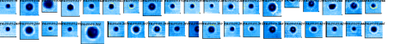
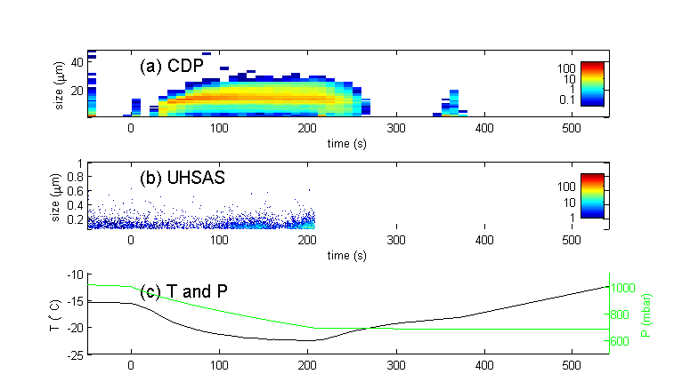
Results (with salt particles @ -15C)
CPI images
A closed `mode’ of droplets forms with the CDP
UHSAS detects background aerosol particles
Pressure reduction results in lowering of temperature.

Slide 22
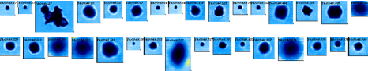
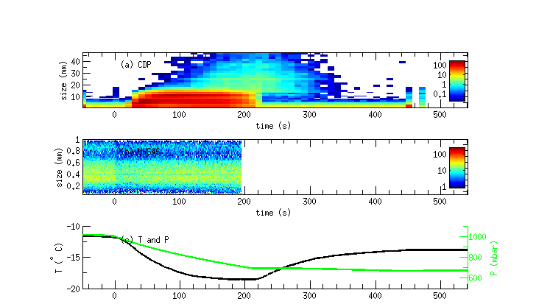
Mineral dust particles @ -12C
A closed `mode’ of droplets forms with the CDP, ice grows out of it, B-F process acts ~ 50s
UHSAS detects dust aerosol particles, with mode at 400 nm.
We calculate the number of ice active sites by dividing the number of ice crystals by the aerosol surface area.

Slide 23
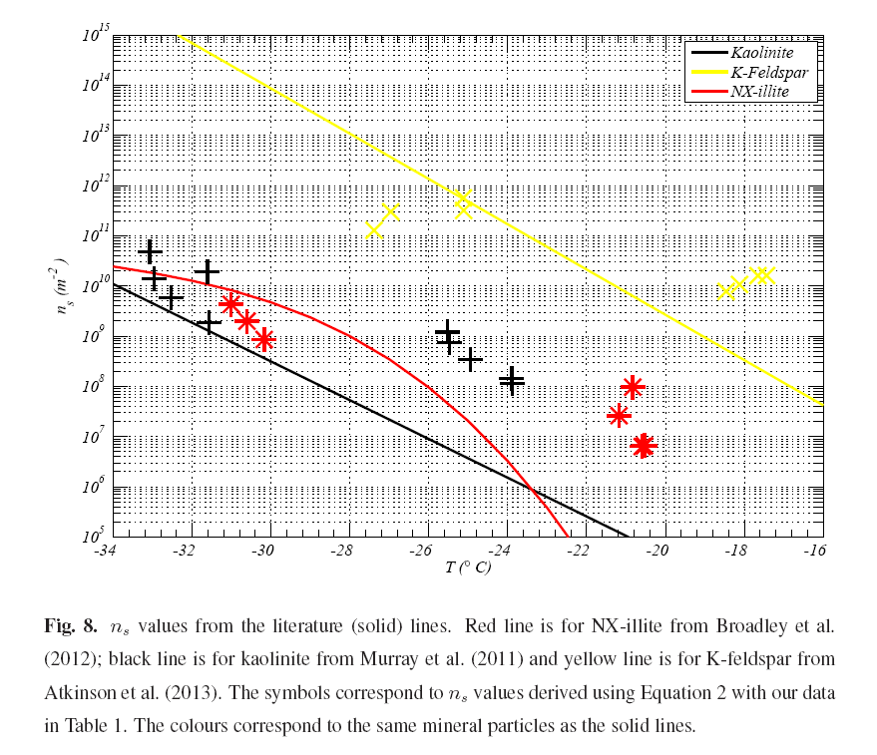
Number of ice active sites per unit area

Slide 24
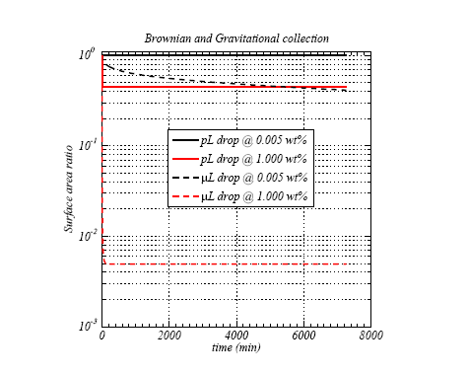
When clays are mixed into colloid they aggregate,which reduces the surface area at high concentrations

