Slide 1
Meteorology and Atmospheric Physics lecture 6
Recap:
What temperature does ice form in the atmosphere: it depends! But T<0C at S_{i}>0.
What causes ice to form in the atmosphere? Ice nucleation!
  Homogeneous nucleation: T must be less than -35C and S_{i} must be greater than some threshold. Does not need to be at water saturation.
  Heterogeneous nucleation: T must be less than 0C and S_{i} must be above 0C.
  To form an `interface’ costs energy; when molecules slow down energy is released.
  There comes a point where the energy available due to increasing the volume of the new phase far exceeds the energy required for forming the interface => nucleation
Why is ice formation in the atmosphere important?
  Affects the radiative properties of the cloud
  Leads to precipitation / changes life time of cloud.
Today: once nucleated how do ice crystals grow?
  What must happen to vapour molecules for ice crystal to grow
Dr Paul Connolly, reader

Slide 2
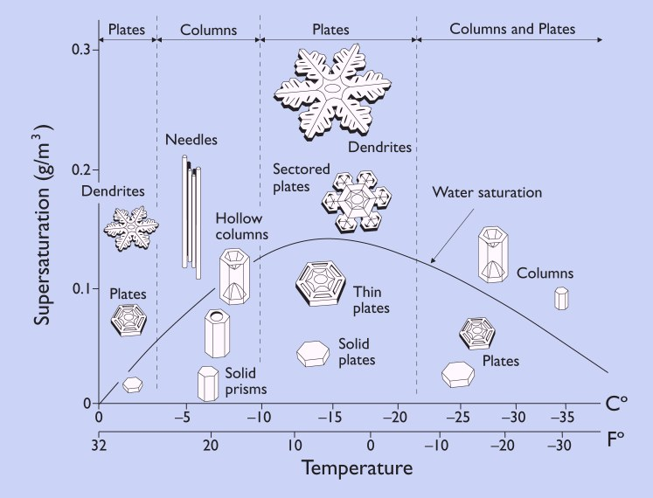
Vapour growth: Morphology
This has been established for ~75 years, but as yet we do not completely understand the physics behind the transitions in `habit’.
What causes this diversity in ice morphology?
The formation of needles in a very narrow temperature range is very hard to explain
Vapour excess ρ∞ - ρ_{s}

Slide 3
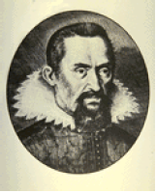
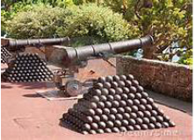
Why do snowflakes have six sides?
Johannes Kepler asked this question in 1611
He linked the shape of a snowflake to the most efficient way of stacking canon balls.
Had to wait nearly 300 years before the tools were invented to test these ideas

Slide 4
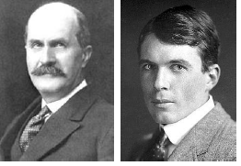
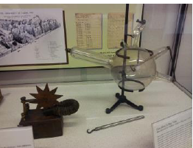
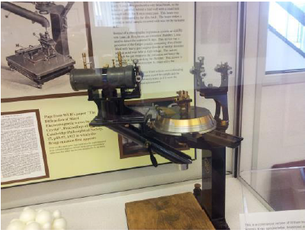
X-ray diffraction
Braggs won Nobel prize for their work on X-ray diffraction confirming crystal structure

Slide 5
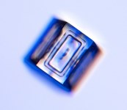
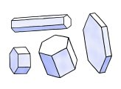
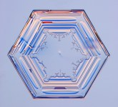
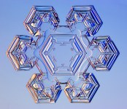
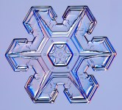

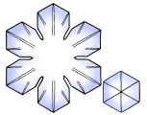

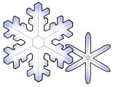

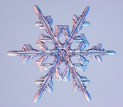
Types of `vapour grown’ snow crystal
Simple prisms: the most simple crystals, can either be plates or short columns.
Stellar plates: six broad arms that form a star shape. Form at -2C and -15C.
Sectored plates:Stellars often show ridges that point to the corners. These are called Sectored plates.
Stellar dendrites: Most popular type of crystal (Snowflake?). Plates that have branches and side branches.
See http://www.its.caltech.edu/~atomic/snowcrystals/

Slide 6

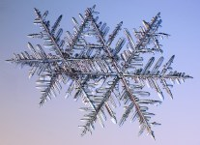
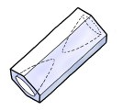
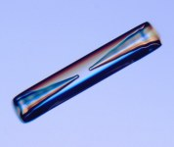
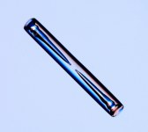

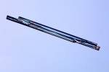
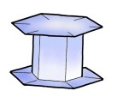
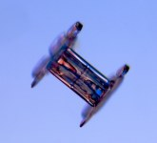

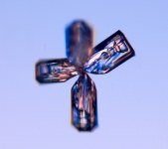
Types of `vapour grown’ snow crystal
Fern-like dendrites: are quite large >5mm and are a result of further branching. Best powder snow.
Hollowed columns: high supersaturation: rarefaction
Needles: Form at -5C
Capped columns: form when a column falls into a regime where plates grow
Bullet rosettes: form high in the atmosphere T<-42C.
See http://www.its.caltech.edu/~atomic/snowcrystals/

Slide 7
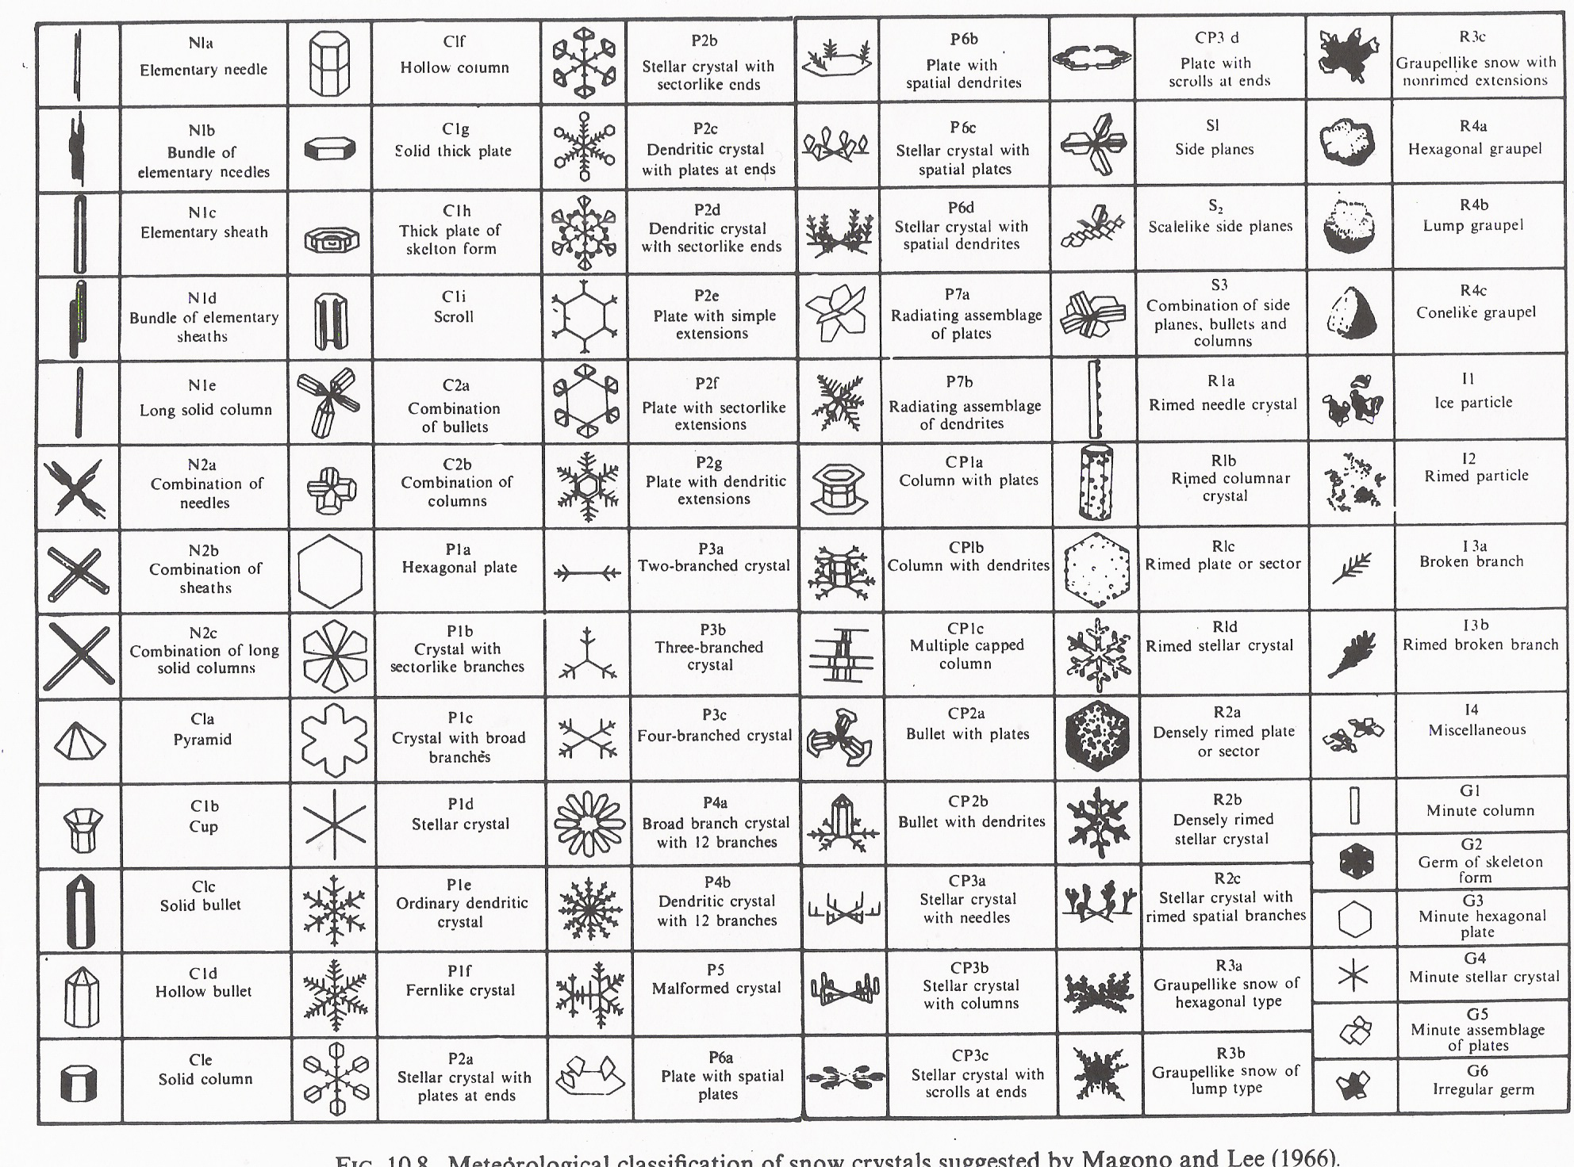
Magono and Lee classifications

Slide 8
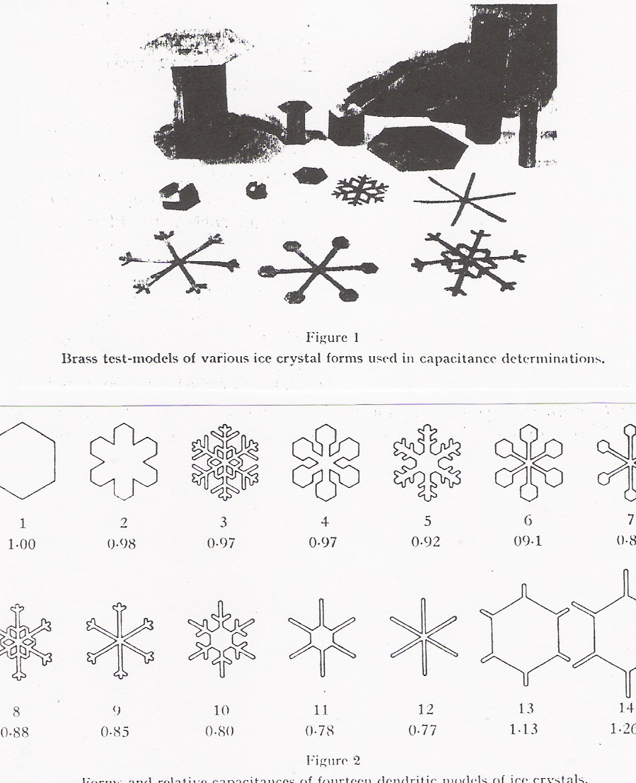
Electrostatic analogy, McDonald (1963)
In order to describe how ice crystals grow for different supersaturations we need to know a crystals electrostatic capacitance.
McDonald did this in 1963 by constructing brass models, placing charge on them and measuring the potential: Q=CV.
He came up with factors to multiply the capacitance of a hexagon (C=2a/π) by, to get the capacitance of more complex geometries

Slide 9
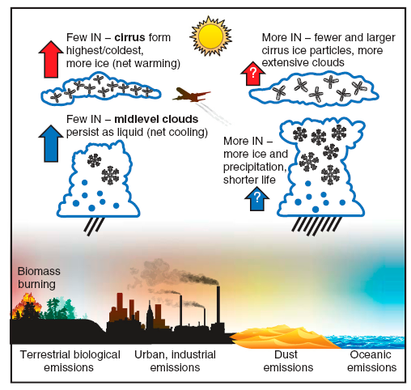
Ice nucleation / growth processes in clouds
More IN result in fewer and larger cirrus ice particles?
This is because heterogeneous IN compete with homogeneous nucleation, which is faster.
More IN result in more and ice and precipitation in a mixed phase Cu?
This is because more IN result in more ice
DeMott et al. 2010, PNAS

Slide 10
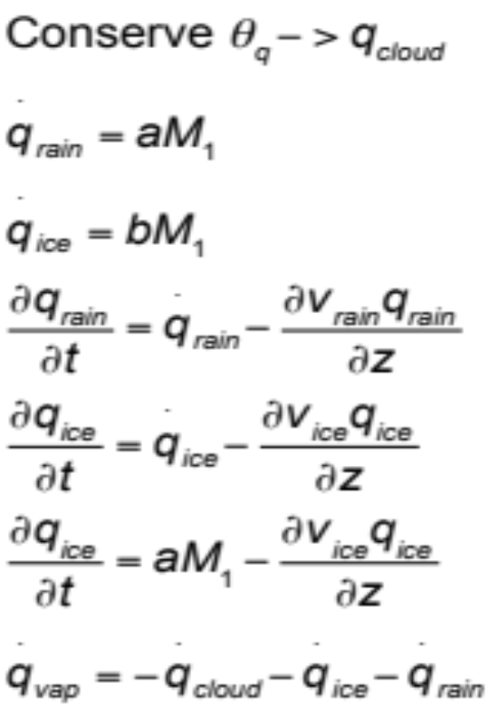
Simple Cloud Model
1-D cloud model
Solves bulk cloud microphysics in layers in the vertical
Condensation conserves moist potential temperature
Rain and ice crystal growth proportional to the first moment

Slide 11
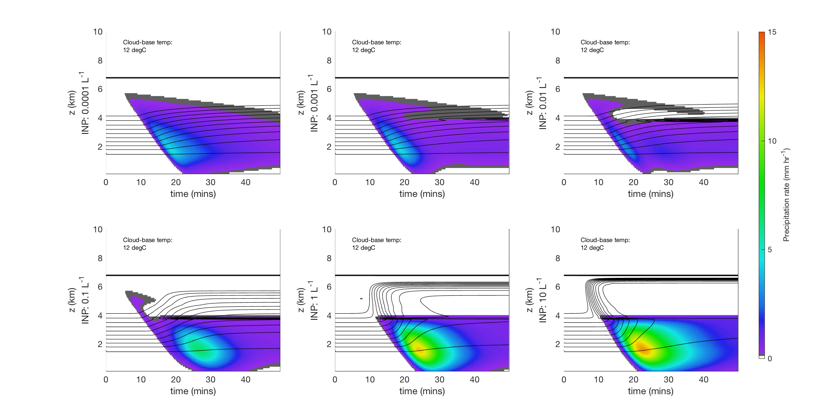
Simple Cloud Model mid-level Cu
What happens to cloud above 4km? What is happening to temperature contours?

Slide 12
Main points
Formation of ice in clouds leads to fewer larger particles than in a drop cloud. Because they grow faster than drops.
Ice crystal shapes are complex. There are many `habits’, that depend on temperature and supersaturation.
Ice crystals grow much faster than liquid drops and this can lead to precipitation
  Ice crystal growth rates are described using Maxwellian growth theory, with some modifications (e.g. electro-static capacitance via Gauss’ law).

Slide 13
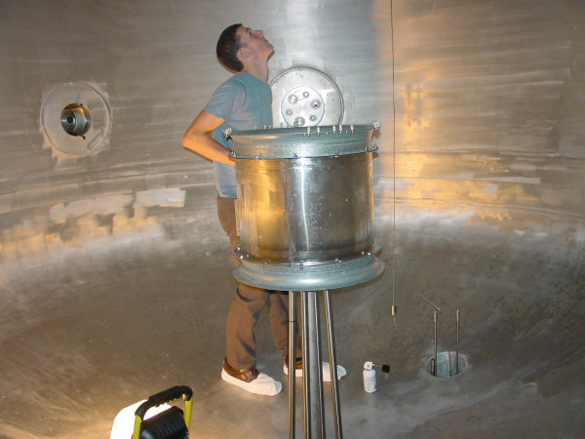
AIDA cloud chamber in Germany large chamber for studying ice nucleation
Me during PhD!

Slide 14
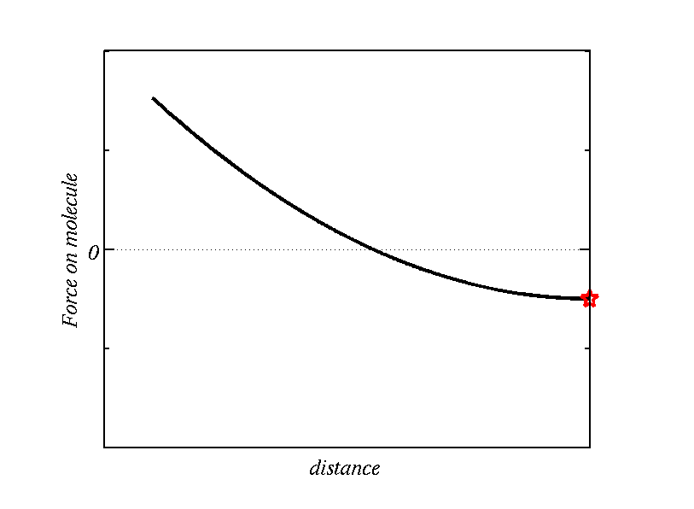
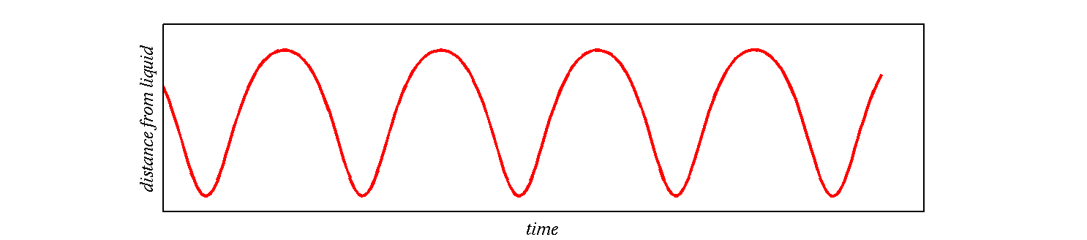
Langmuirs’ theory
Vapour molecule does work against repulsive force and slows down, but upon finding itself in a region with a strong repulsive force is sped up and accelerated out
Elastic collision

Slide 15
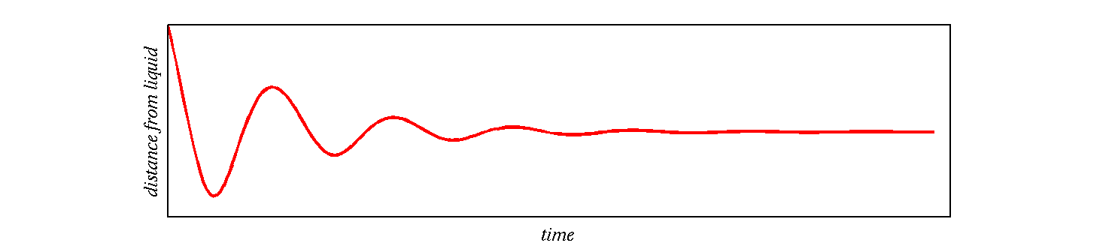
Langmuirs’ theory
Dissipation (i.e. non-conservative) to surrounding molecules
The smaller the drop the lower the chance for dissipation to occur – as there are less molecules to do the dissipation

Slide 16
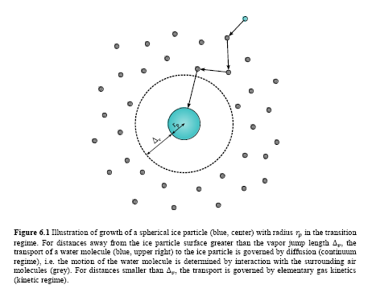


We now know from the work of
NA Fuchs (1959)
Continuum regime (droplet sizes much larger than the mean free path of air)
Kinetic regime (droplet sizes smaller than the mean free path of air)
α is called the accommodation coefficient and is unknown
Notes:
Fyooks.
From Langmuir: when the approaching vapour molecule encounters a surface where there are a lot of molecules in the solid that are able to dissipate its ke, it is very likely to be incorporated into the solid. When the particle becomes smaller, the collision has more chance of being elastic.

Slide 17
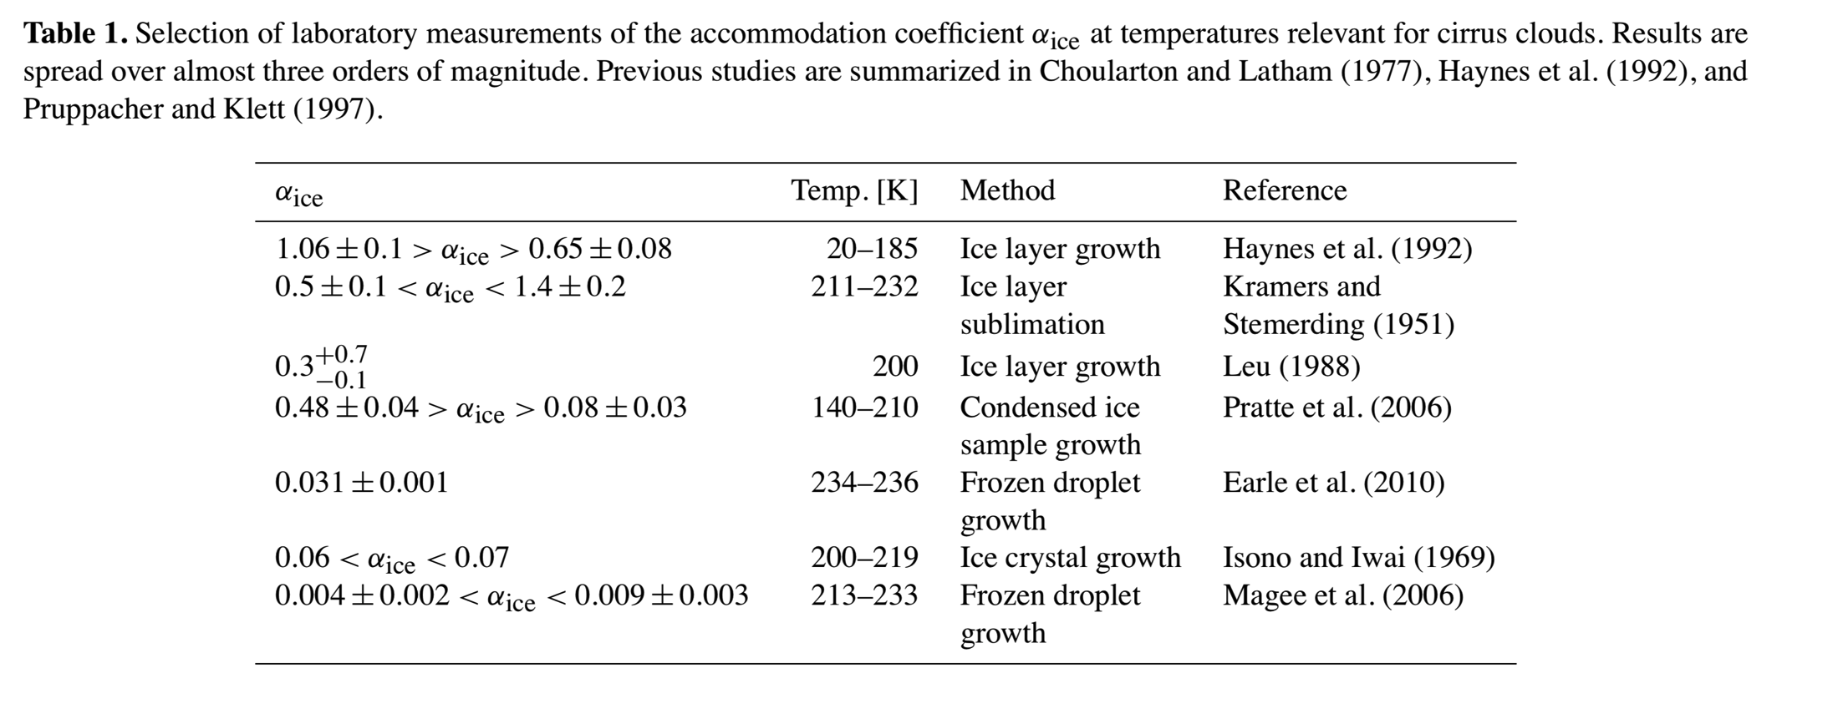
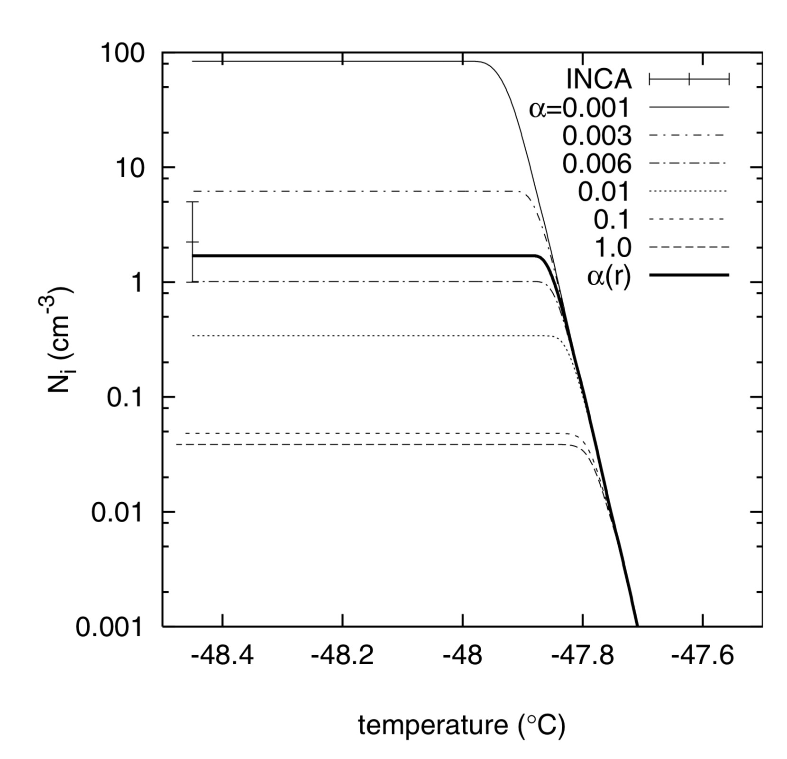
The accommodation coefficient
Modelled sensitivity of ice crystal number to the mass accommodation coeffiicent (Gieren’s et al.(2003)

