Slide 1
Meteorology and Atmospheric Physics lecture 7
Recap:
At temperatures below 0 degC ice crystals grow at a faster rate than liquid drops at the same conditions: the vapour pressure over an ice surface is lower than over a liquid surface (ice is more stable at T<0C).
Ice crystals also have a range of `habits’ that depend on supersaturation of water vapour and temperature. We don’t really know all the reasons why we get these different habits.
Today: what processes describe how liquid drops and ice crystals behave in mixed phase clouds. Specifically we look at the supersaturation.
Need to be able to explain, with reference to the physics, why mixed phase clouds are sometimes persistent and sometimes not.
Dr Paul Connolly, reader

Slide 2
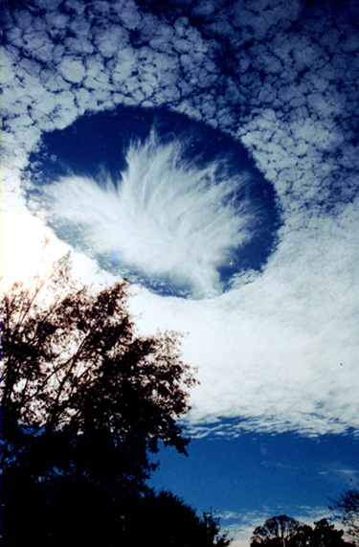
Growth of liquid and ice particles from the vapour
Mixed phase cloud in the laboratory:
http://www.youtube.com/watch?v=-UXpJ3KRO_s
In this video a nebuliser is used to make a supercooled cloud inside a freezer.
A torch is used to highlight the cloud.
Ice is artificially `nucleated’ by using a syringe with a rubber bung! Adiabatic expansion cools the air to below homogeneous freezing limit.
Also: here is some time-lapse of a mixed phase thunderstorm:
http://www.youtube.com/watch?v=dknfK0R9jSA

Slide 3
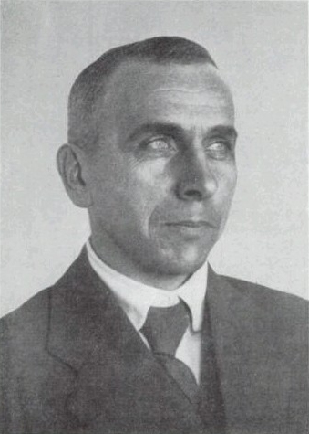
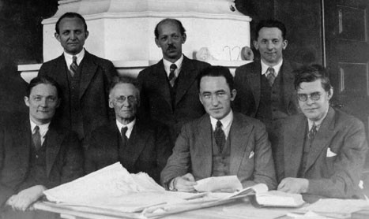
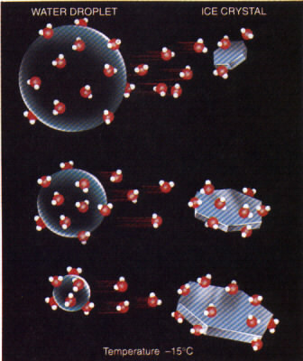
Wegener-Bergeron-Findeison process
Link to nucleation: as we have said there are much fewer ice nuclei than there are cloud condensation nuclei. This means that when ice is nucleated in the cloud the water mass on the many drops is transferred to much fewer ice crystals, which then precipitate - > rain
Tor Bergeron – Swedish (1891-1977)
Developed Wegener’s theory in the 1930s with Findeison.
Alfred Wegener – German (1880-1930)
1911 published classic text book: thermodynamik der atmosphäre
c1930…
“Almost every real raindrop and all snowflakes originate around an ice crystal” (Bergeron)
“Clouds which are formed entirely of water particles cannot produce the drops of which normal rain is composed, only the small drops of drizzle” (Findeison)

Slide 4
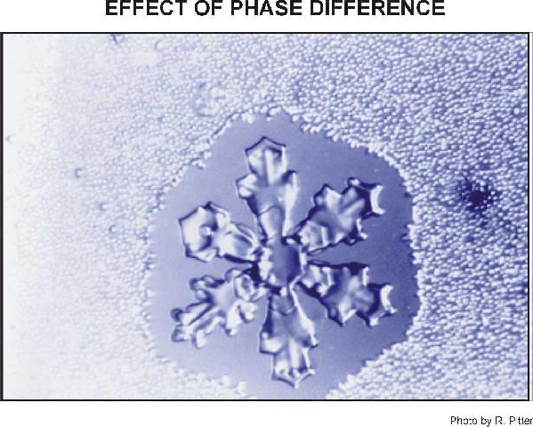
Growth of ice from water vapour
Ice particles grow at the expense of water droplets
Ice particle enters water cloud
Cloud is supersaturated with respect to ice
Diffusion of water vapour onto ice particle
Cloud will become sub-saturated with respect to water
Water droplets evaporate to increase water vapour
Notes:
Cloud ParametrizationClouds 1

Slide 5
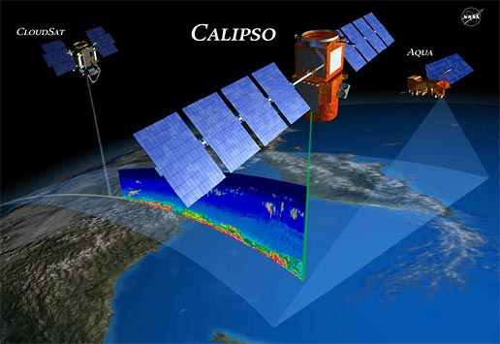
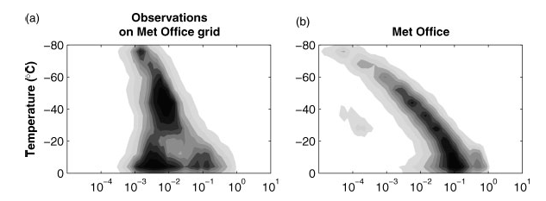
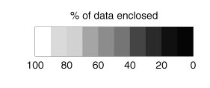
Weather models struggle to get the correct ice water content
Comparisons between satellite retrievals from CALIPSO and CLOUDSAT to the Met Office model shows the Met Office has too much ice.
This is, in part, due to a mis-representation of the B-F process.
Delanoe, et al. (2011, QJRMS)

Slide 6

Equation describing supersaturation in a cloud parcel
Expansion (and thus cooling) of the air parcel.
Reduction of water vapour due to condensation and release of latent heat
Reduction of water vapour due to sublimation and release of latent heat

Slide 7
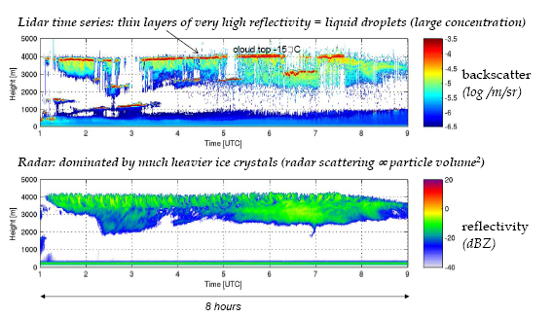
LIDAR and RADAR observations show that mixed phase clouds are very persistent
(examples from Chilbolton Observatory)
Persistent liquid water at the tops of clouds is very important radiatively as much more reflective than ice clouds.
Liquid water (red on lidar) persists for very long time. Why doesn’t the cloud completely glaciate?
But Bergeron’s theory predicts that cloud should glaciate within less than 1 hour – paradox?
Slide from C. Westbrook Reading

Slide 8
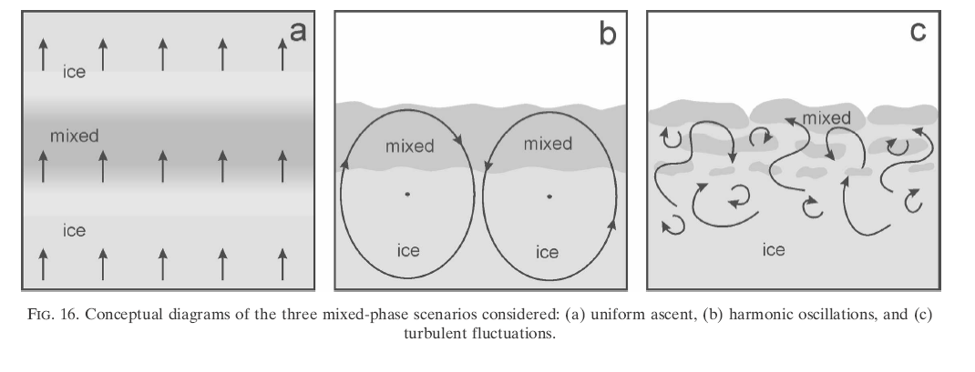
Turbulent motions / overturning in mixed phase clouds – resolving the paradox
Of course the weather models ~1.5-30 km finite difference grid spacing do not resolve the small scale turbulent motions which can affect things tremendously!
Essentially what happens is that during the upward motions the air cools and becomes supersaturated, but the ice crystals do not completely remove the supersaturation.
During the downward motion the air becomes sub-saturated so that the drops and ice crystals evaporate so the crystals never grow too large to deplete liquid water – for harmonic motions a limit cycle can be reached
Korolev and Field (2008)

Slide 9
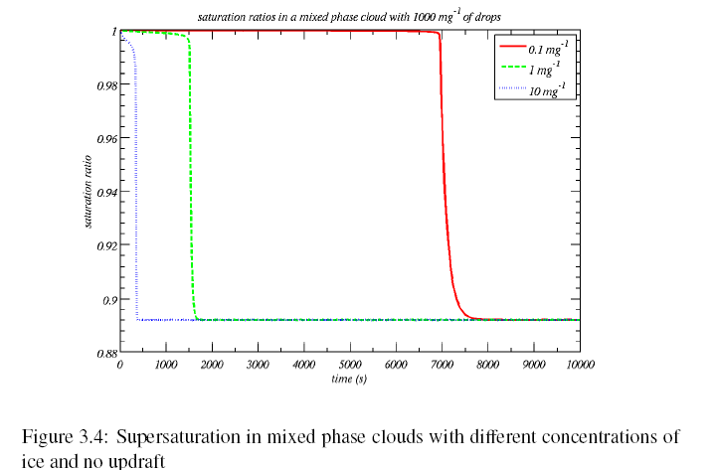
Glaciation time scale: parcel with no vertical motion
Glaciation time-scale
Glaciation time-scale
Ice saturation. (ice can exist, but not liquid)

Slide 10
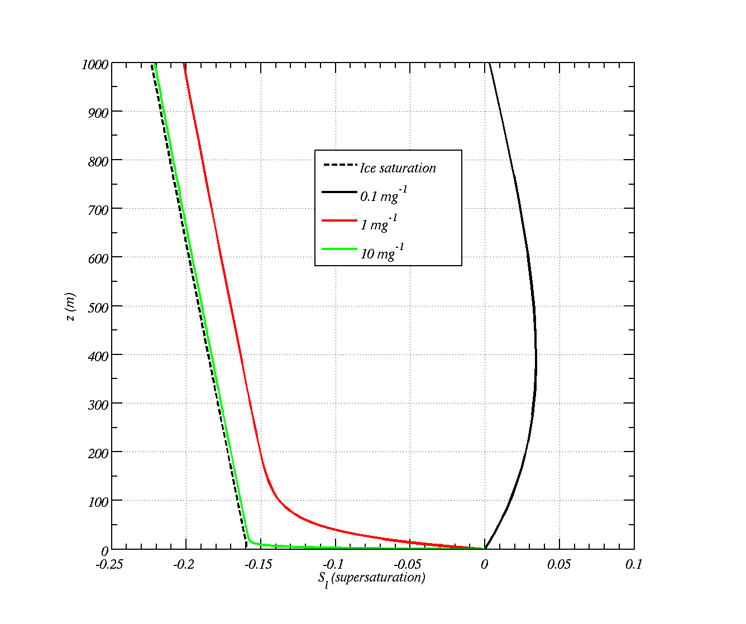
Constant vertical wind:
Ice clouds (starting with 100 μm radius at -13 C) 1 m s⁻¹ updraft
The more crystals there are the closer the parcel is to the ice saturation line.
Why does S_{l} in case with 0.1 mg⁻¹ increase and then decrease? (note there are no CCN)
Why does S_{l} tend towards the ice saturation line?
Why does S_{l} decrease fastest when ice concentration is highest?

Slide 11
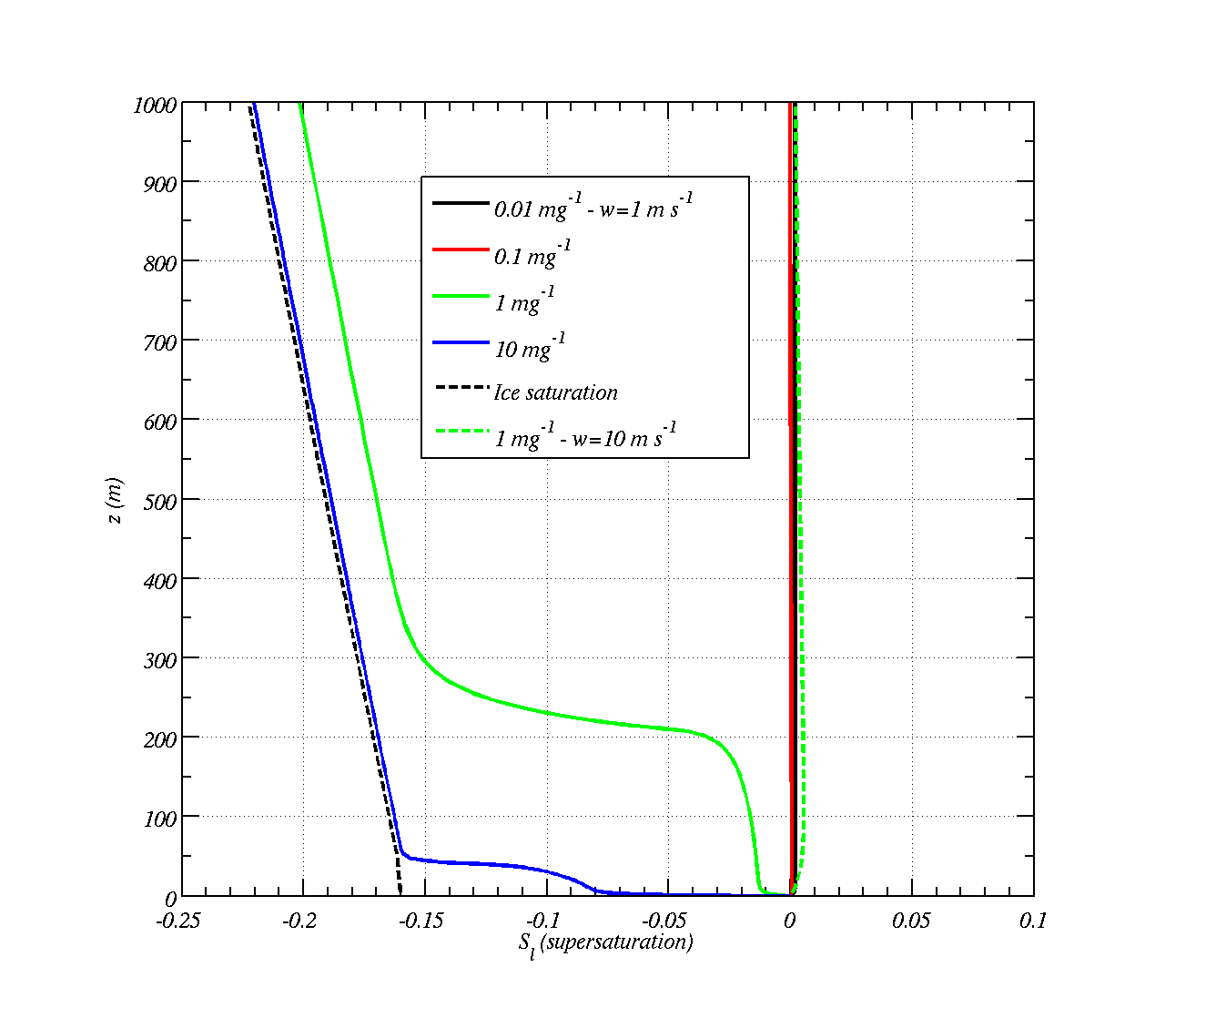
Constant vertical wind:
Mixed-phase clouds
Similar to previous slide, but with a reservoir of liquid water in the parcel
What happens?
Why does S_{l} in the 1 mg⁻¹ case at 10 m s⁻¹ not decrease?

Slide 12
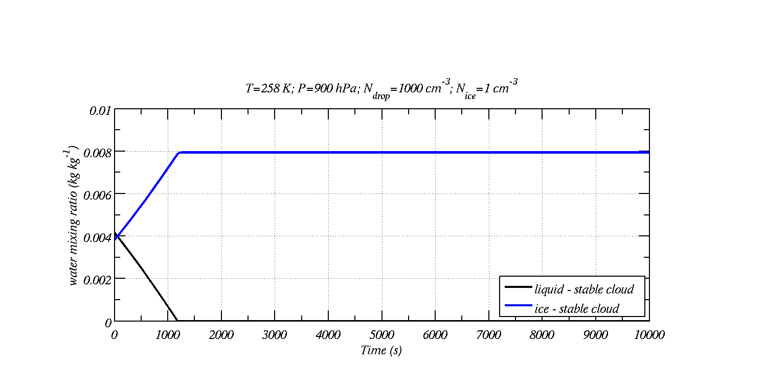
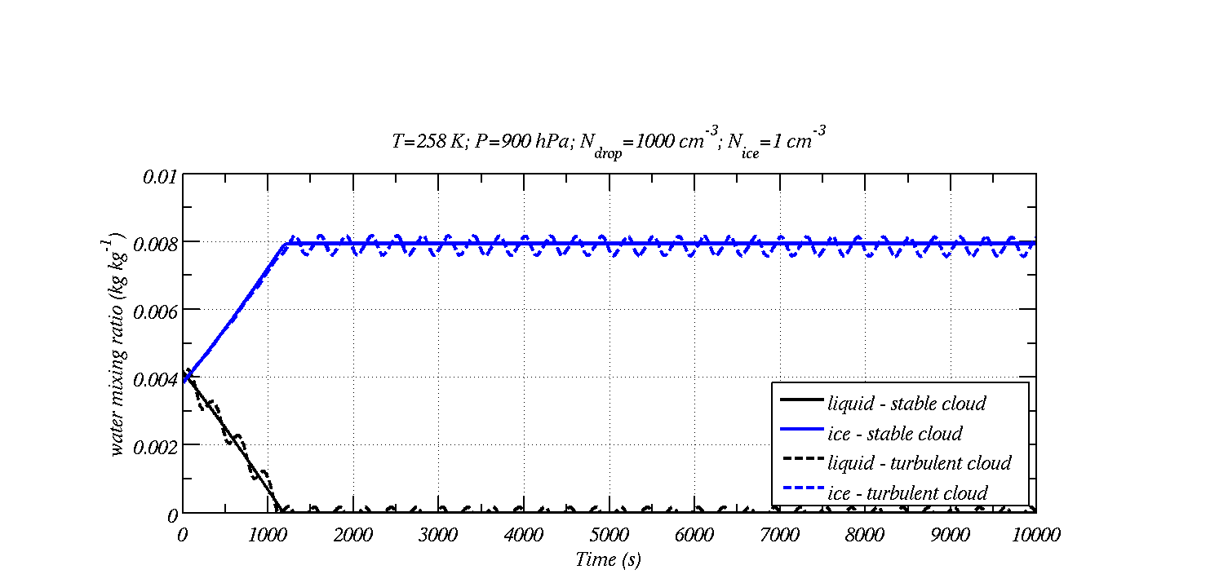
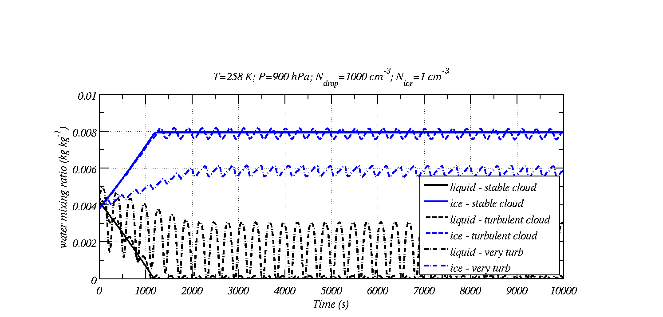
Effect of turbulence on maintaining clouds
Stable cloud: Bergeron-Findeisen process acts ~20 minutes
Turbulence can maintain liquid water.

Slide 13
Main points
In a mixed-phase cloud under static conditions the Bergeron-Findeison process acts
  Drops evaporate at the expense of ice crystals.
  Usually this leads to a reduction in the albedo / reflectivity and the formation of precipitation.
Vertical motions can affect the supersaturation, such that if the vertical wind is high enough droplets will grow and ice crystals will grow in a mixed phase cloud.
The effect of turbulence / vertical motions on the growth of drops and ice crystals in the atmosphere is important: it can lead to liquid clouds appearing very persistent.

