Slide 1
Meteorology and Atmospheric Physics lecture 8
Recap:
In a stable mixed-phase cloud the Bergeron-Findeisen process results in ice crystals growing at the expense of drops: the vapour pressure over an ice surface is lower than over a liquid surface (ice is more stable at T<0C).
Vertical wind (turbulence) affects the glaciation of the cloud. i.e. the Bergeron-Findeison process may not act in a cloud with strong vertical motions.
Today: delve a little more into supersaturation to quantitatively analyse the supersaturation in a cloud.
Mixed-phase clouds behave very differently to ice clouds (liquid water is important to the clouds properties (albedo, lifetime, thunderstorm electrification, etc).
Dr Paul Connolly, reader

Slide 2
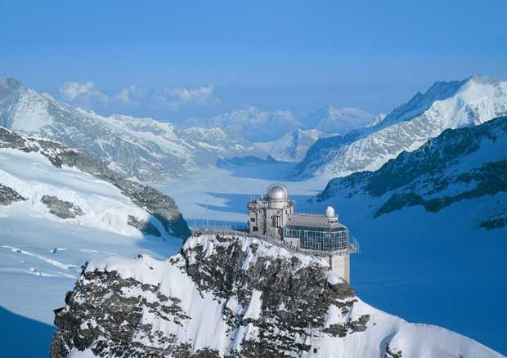
Observatory, Jungfraujoch ∼3583m (asl) (46.55°N, 7.98 °E)
Some might recognise it from the Clint Eastwood film:
The Eiger Sanction

Slide 3
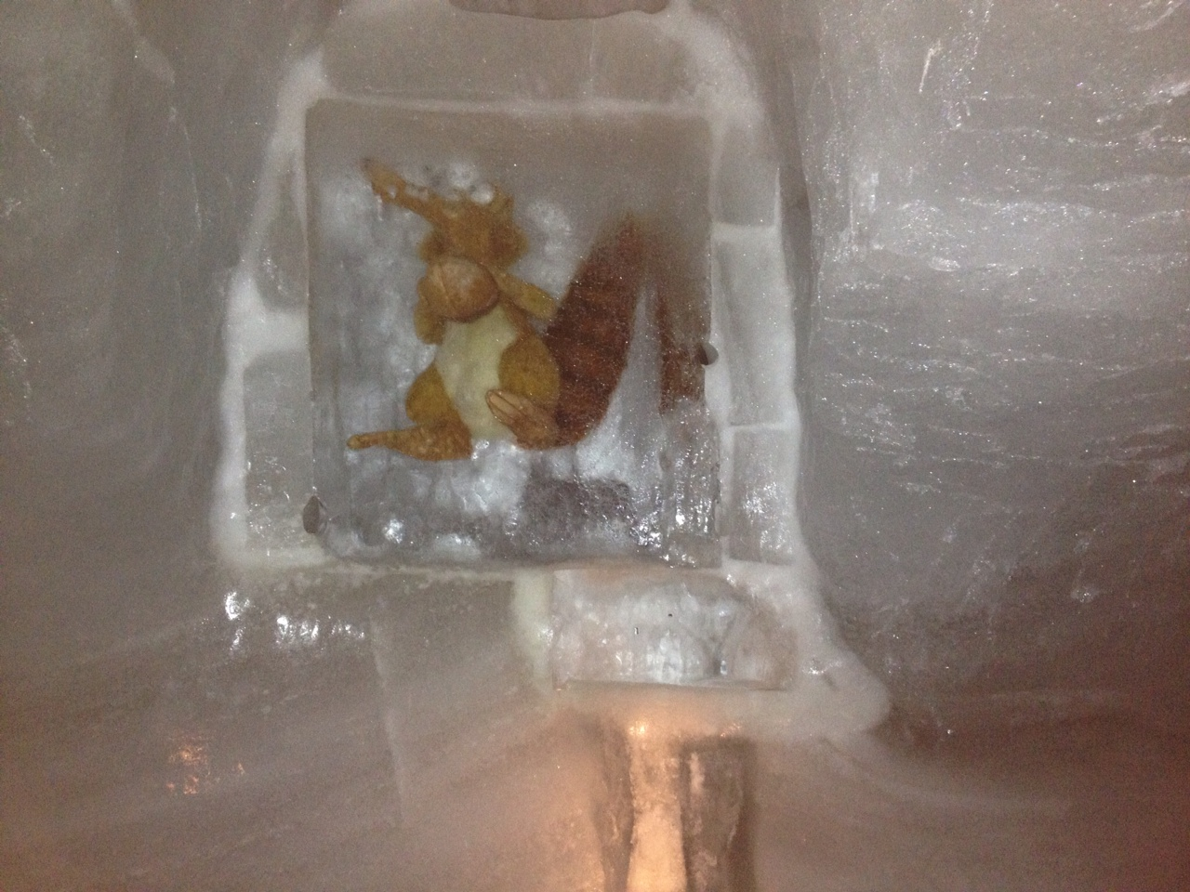
Buried deep within the glacier…

Slide 4
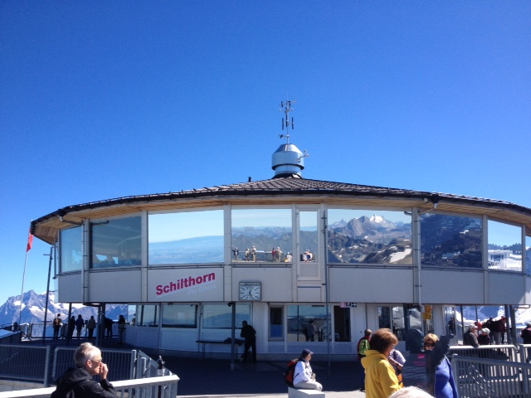
The `upwind’ site some might recognise it from the James Bond film
On her Majesty’s secret service

Slide 5

The restaurant is top notch…(honest!)

Slide 6
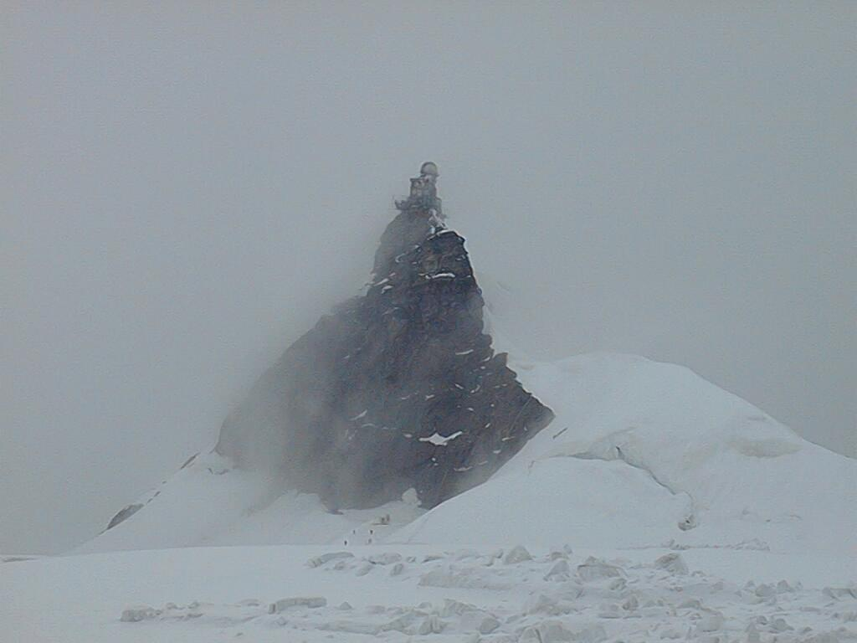
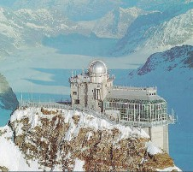
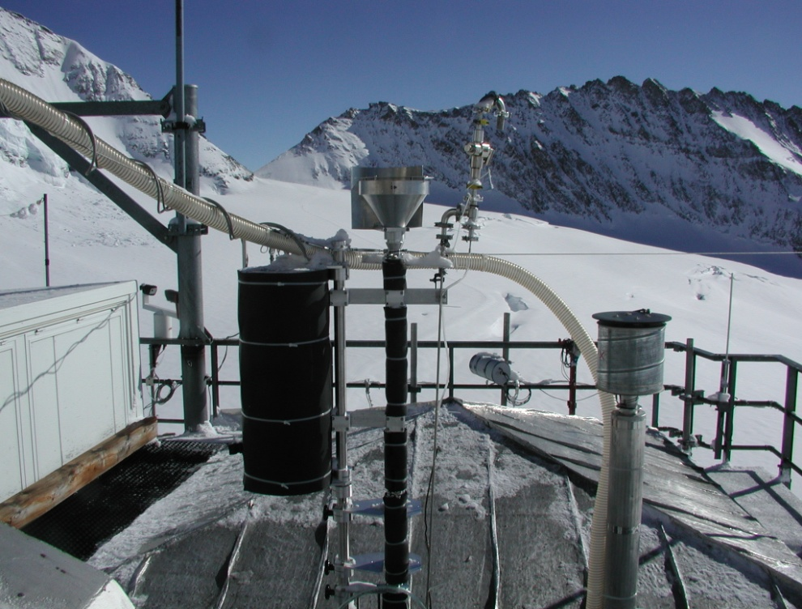
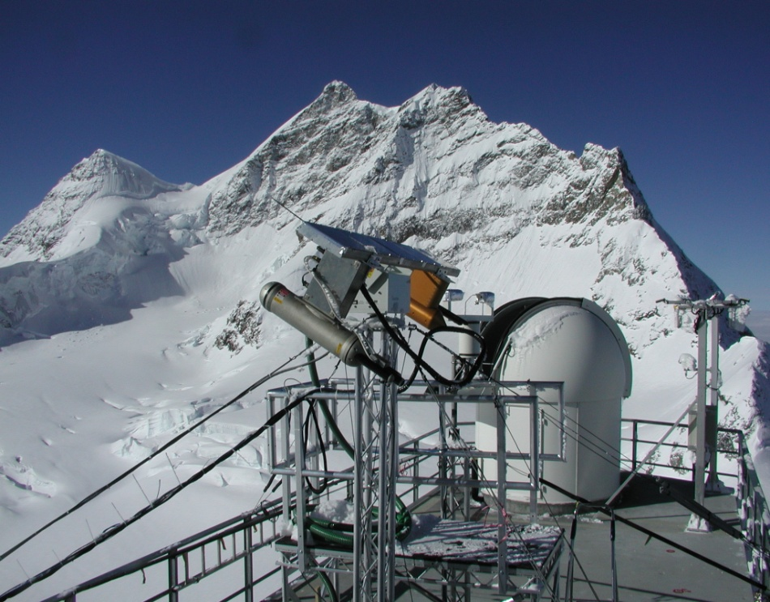
The Sphinx laboratory “In-cloud”
The Sphinx on the Jungfraujoch
Aerosol Inlets
Microphysics Platform
CVI
Interstitial
Total

Slide 7
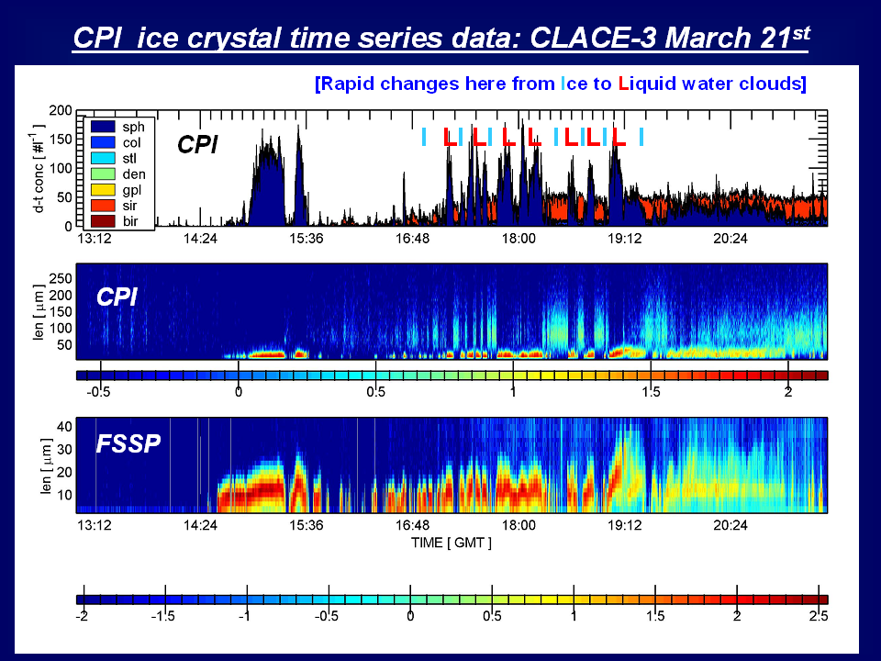
The bursts of liquid water are coincident with a gust in the vertical wind.
To a satellite or radar structure on these kinds of scales would be smoothed out and the cloud would appear to be a long-lived mixed phase cloud.
Log(conc)

Slide 8
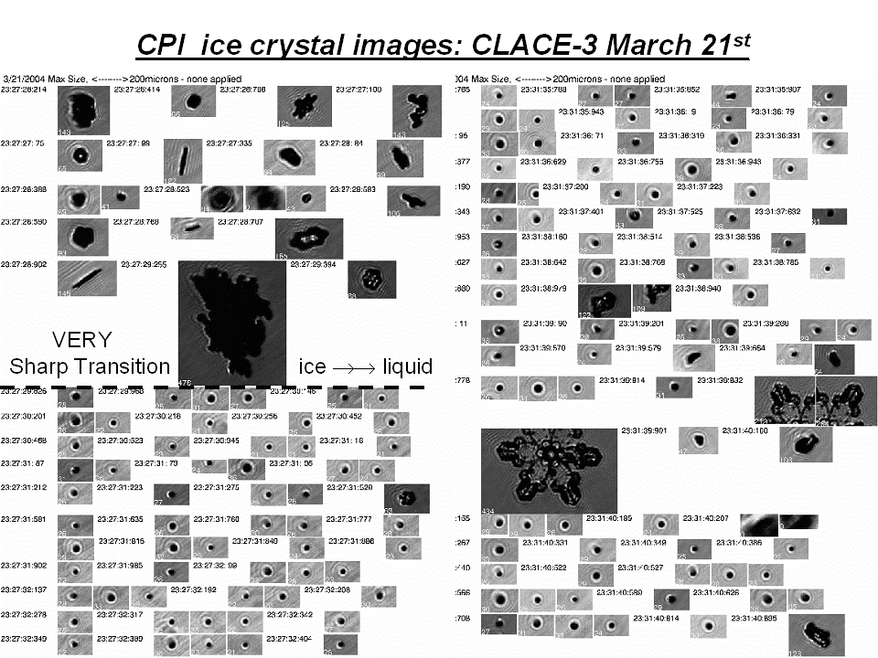

Slide 9

Equation describing supersaturation in a cloud parcel
Expansion (and thus cooling) of the air parcel.
Reduction of water vapour due to condensation and release of latent heat
Reduction of water vapour due to sublimation and release of latent heat

Slide 10
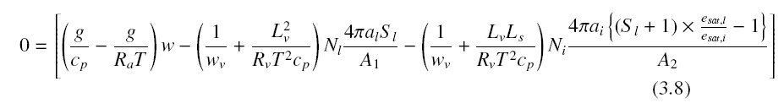

Steady-state supersaturation
Set lhs to zero
A₁ and A₂ are constants in the denominator of the drop and ice growth equations
because as we derived previously:
Drops:
+ similar for ice crystals, so the total condensation rate is Nxdm/dt

Slide 11

Steady-state supersaturation
Where a₀, b_{l}, b_{1,u} and b_{2,I} are quasi-constants containing T and P
As an exercise see if you can derive them – in your own time!

Slide 12
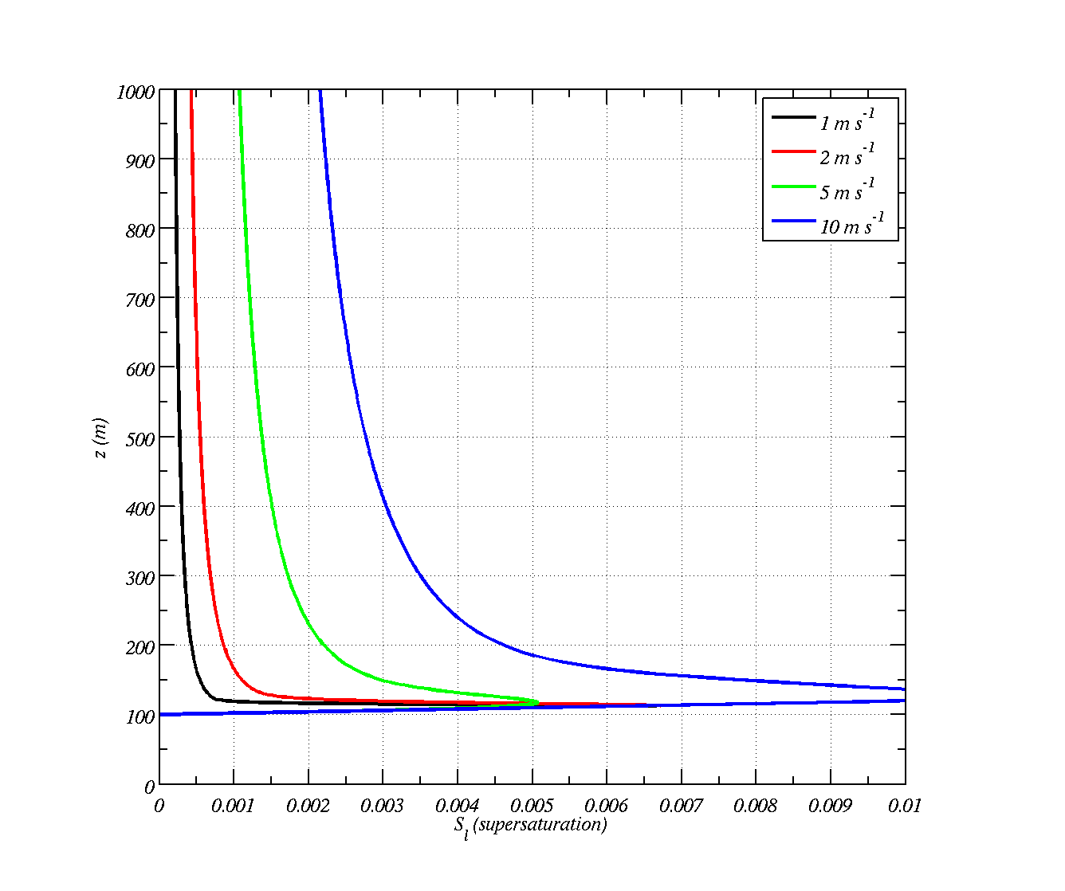

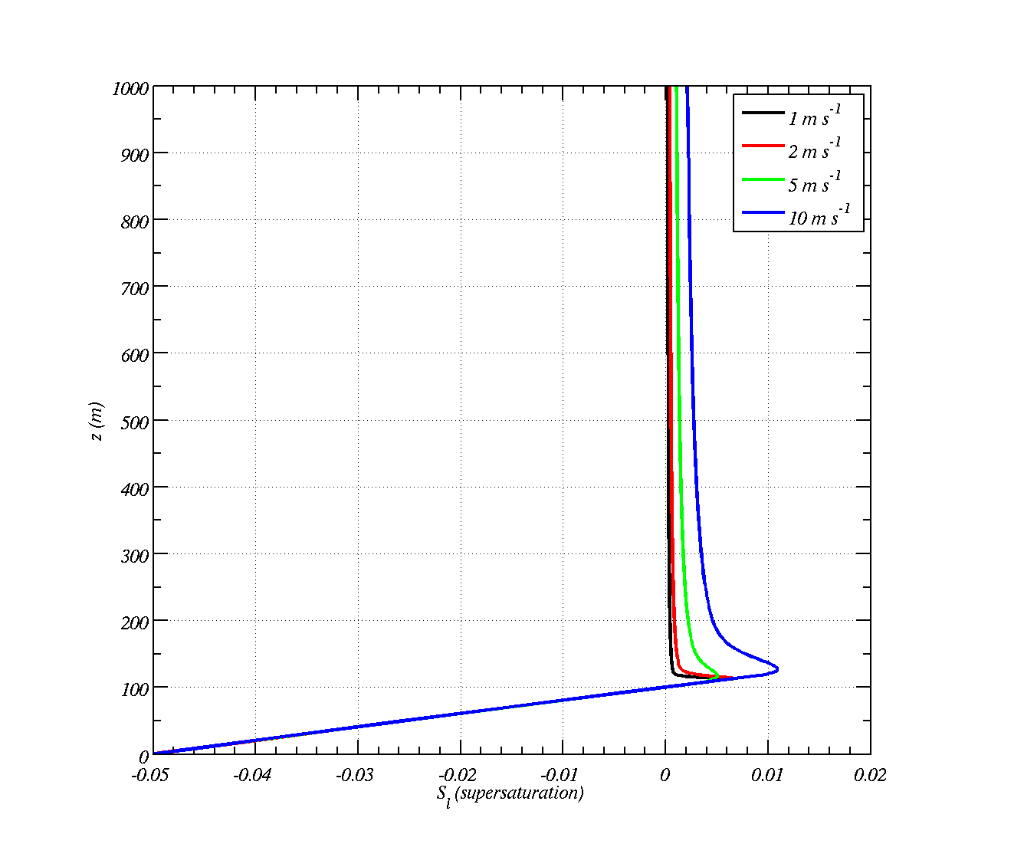
Liquid only clouds, 1000 cm⁻³, r=0.1 μm
There is a peak in supersaturation just at cloud base. This is where the aerosols start to take on enough water to grow into cloud drops
Approaches steady-state supersaturation
1 m /s=0.00014
2 m/s=0.0003
5 m/s=0.0007
10 m/s=0.0015
Cloud base supersaturation is important. The higher it is the more cloud particles activate – Kelvin’s equation

Slide 13
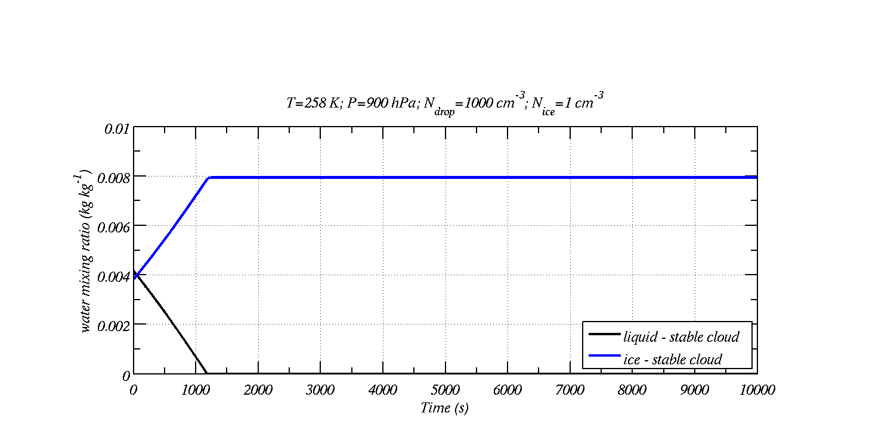
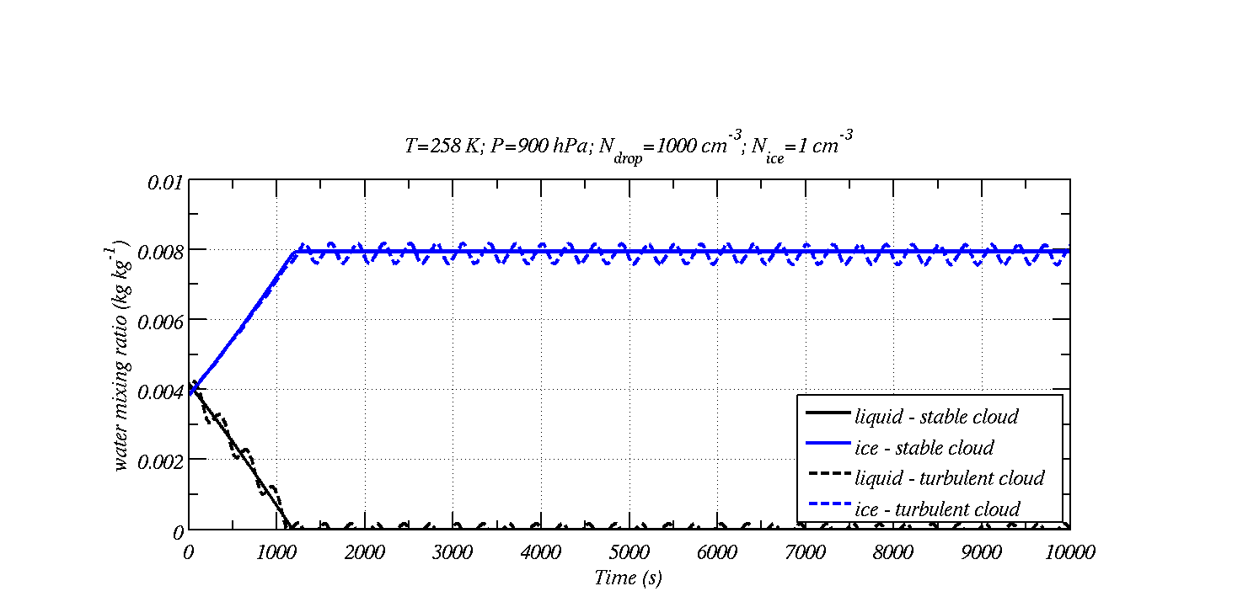
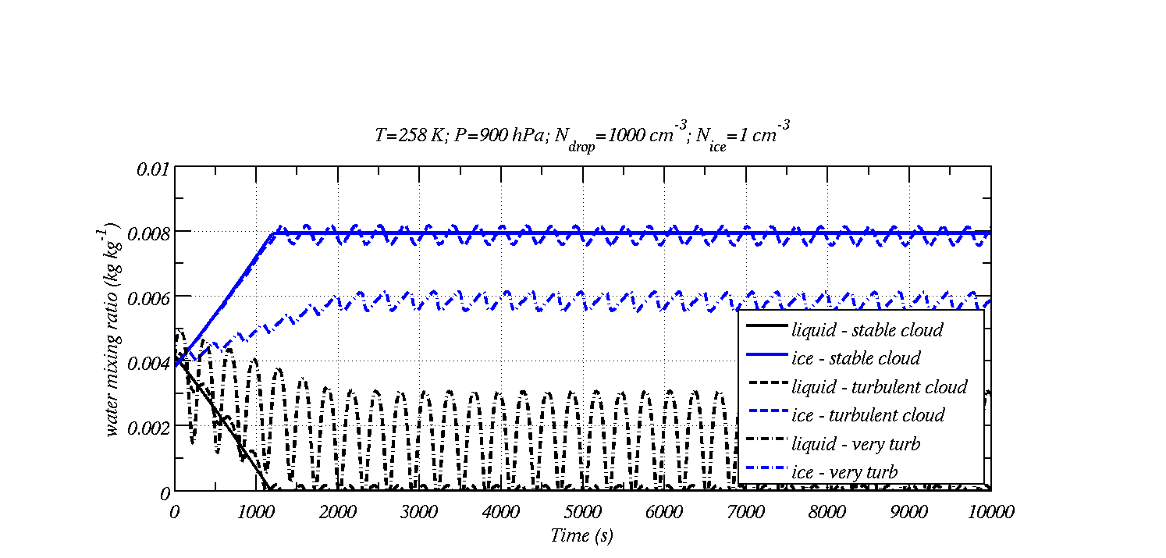
Effect of turbulence on maintaining clouds
Stable cloud: Bergeron-Findeisen process acts ~20 minutes
Turbulence can maintain liquid water.

Slide 14
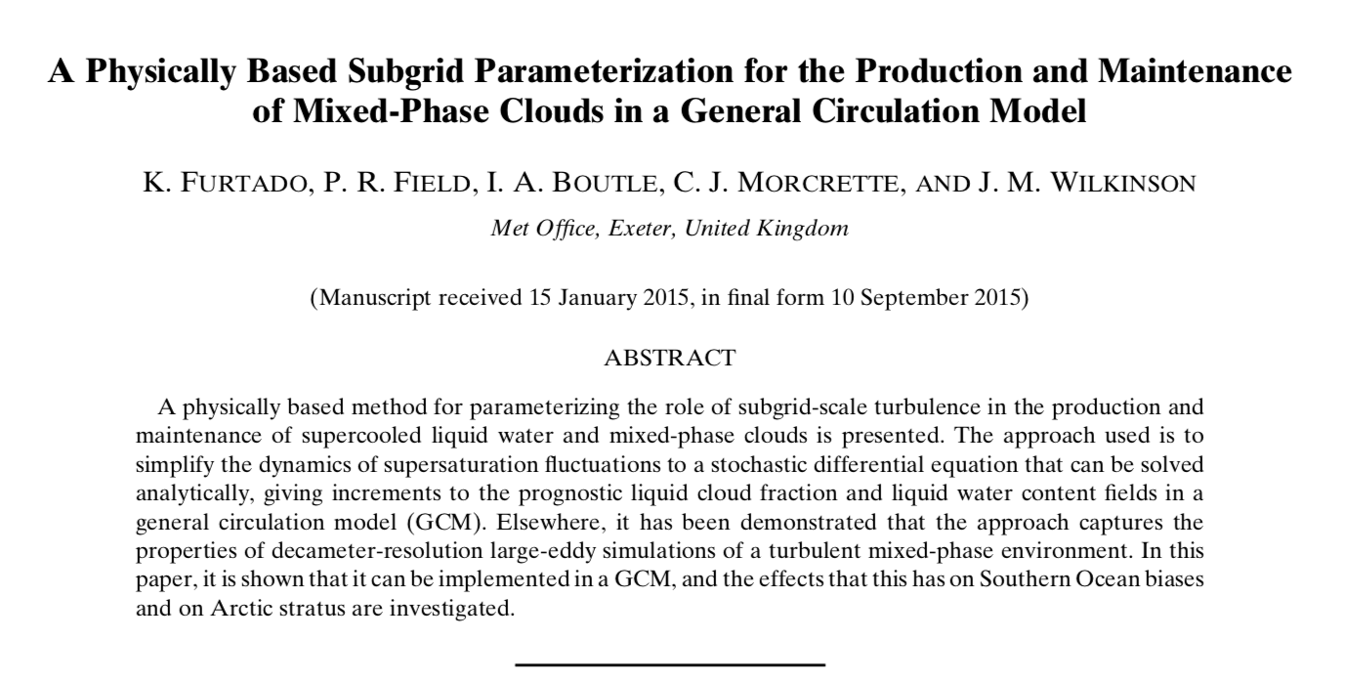
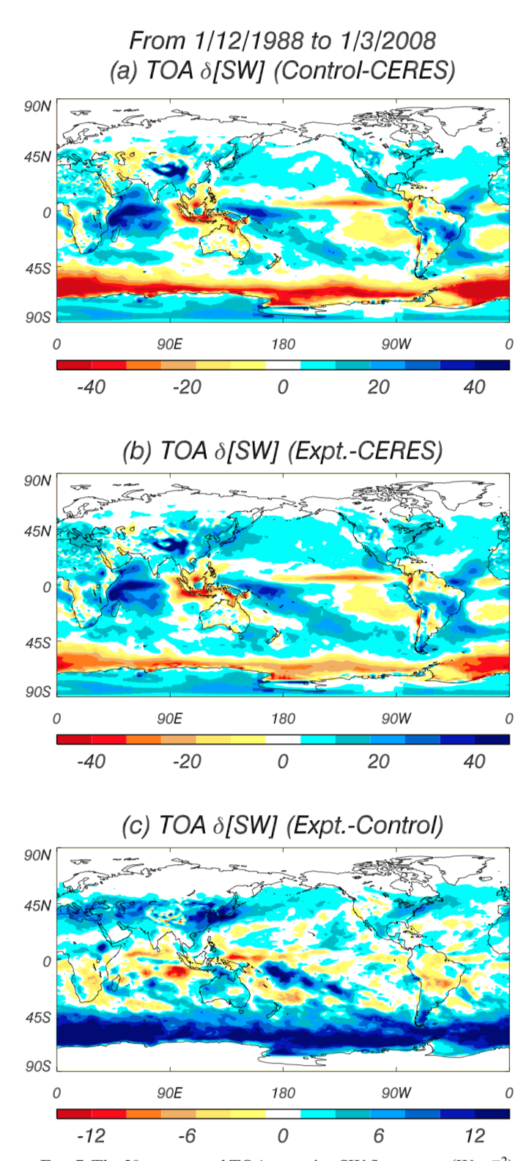
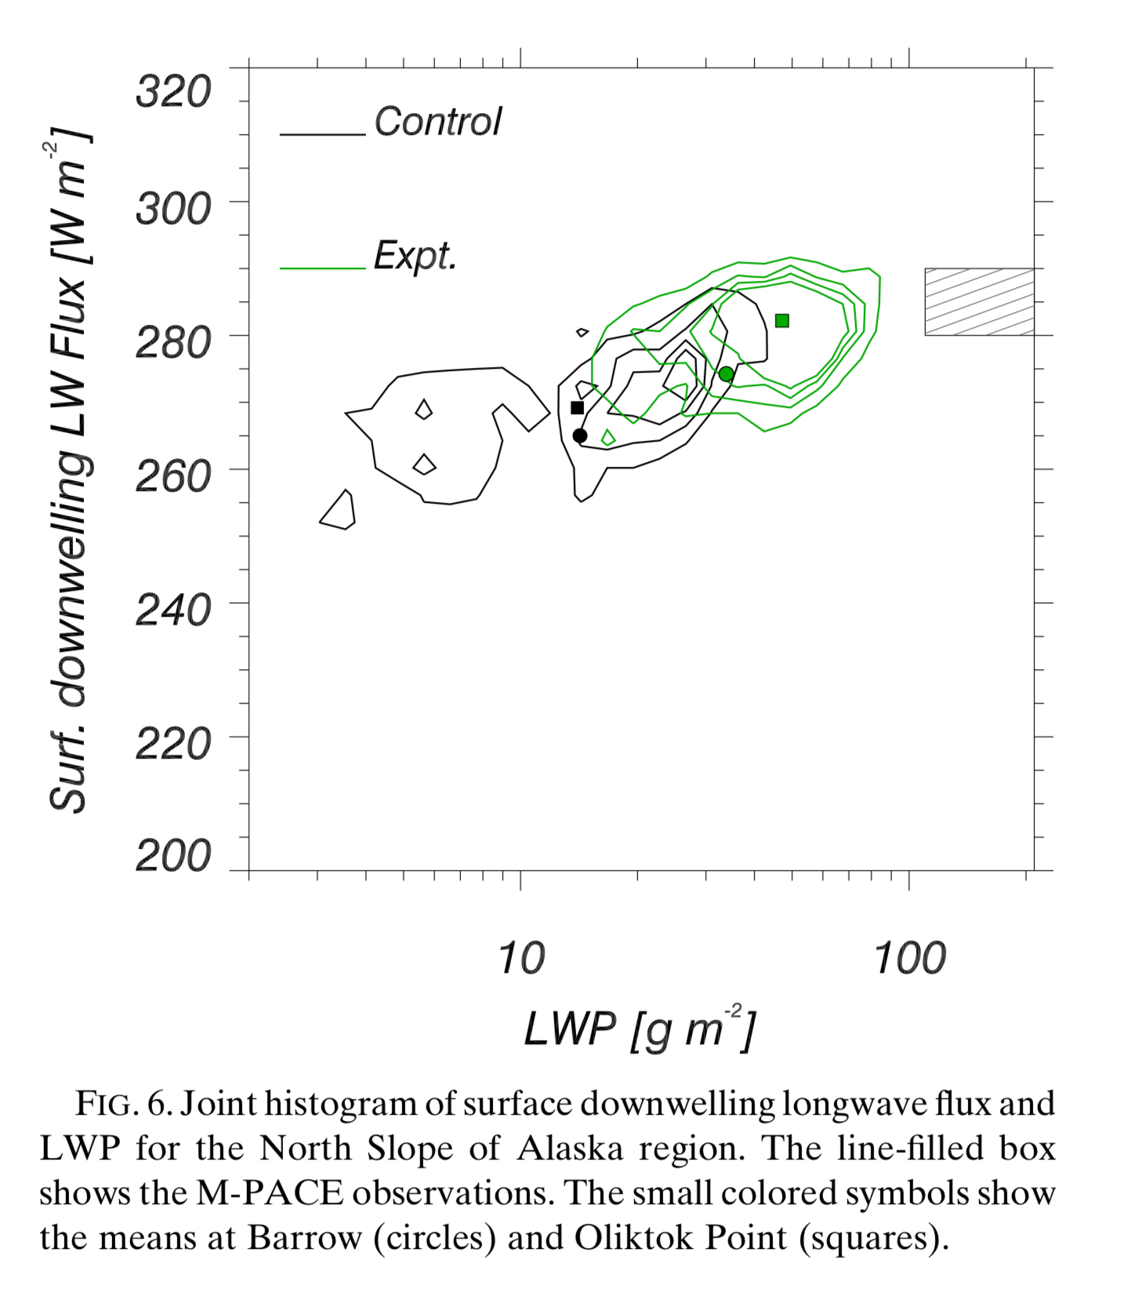
Climate-scale simulations
Arctic Case study

Slide 15
Main points
In a liquid only cloud with upward vertical motions in the air currents, the air will always be supersaturated wrt water vapour, the steady-state supersaturation is.
  Proportional to the updraft speed
  Inversely proportional to the 1st moment of the drop size distribution
In an ice cloud with no vertical wind, the steady-state supersaturation is ice saturation.
In a ice cloud with upward vertical motions in the air currents the air will be supersaturated wrt ice (it may also be supersaturated wrt liquid)
  The lower the 1st moment of the ice size distribution, the higher the supersaturation
  The higher the updraft the higher the supersaturation.
In a mixed phase cloud with a vertical wind if the updraft (cooling) term exceeds the ice growth term there can be long-lived mixed phase clouds.
Turbulence (rapid upward and downward motions) can create what appear to be very long-lived mixed phase clouds.

