Slide 1
Meteorology and Atmospheric Physics lecture 9
Recap:
In a liquid only cloud: the supersaturation is proportional to updraft speed and inversely proportional to the 1st moment of the drop distribution
Ice cloud with vertical motion. Supersaturated wrt ice (could also be supersaturated wrt liquid, but this would also cause the formation of liquid water => mixed phase cloud).
Mixed phase cloud can be long lived. If a threshold updraft speed (cooling term) is exceeded.
Turbulence can create the appearance of a very long-lived mixed phase cloud. In fact, in-cloud turbulence creates lots of interesting phenomena
Today: cloud microphysics of a mixed-phase cloud; hydrodynamics of cloud particle growth: collision and coalescence; riming and aggregation.
Dr Paul Connolly, reader

Slide 2
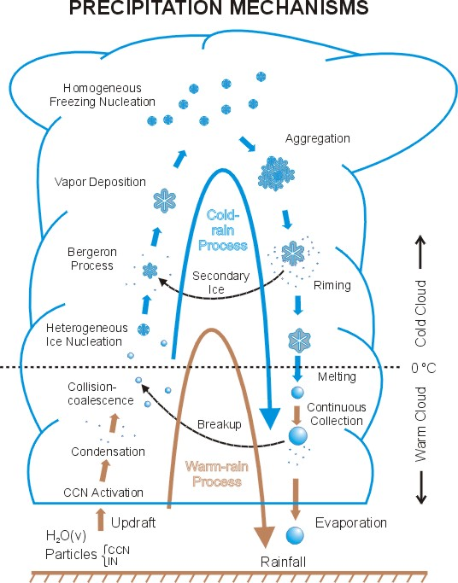
Mixed-Phase Cloud Microphysics
Cold Cloud Processes
Warm Cloud Processes
Platnick
Notes:
Wang and Olsen.

Slide 3
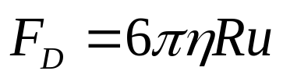
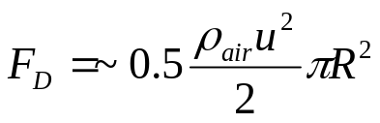
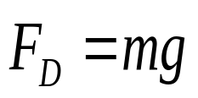
Collision-Coalescence
(Particle terminal fall-speeds)
F_{D}
mg
Laminar regime (i.e. Stokes flow, Re <~1)
Turbulent regime (i.e. high Reynolds number, drag coefficient = 0.5)
At terminal velocity
Results in either
  u(D)=aD² or;
  u(D)=aD^{0.5}
Note that gravitational forces completely dominate over Brownian motion (ratio is ~10⁸)

Slide 4
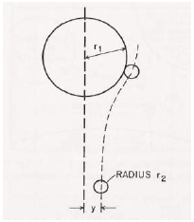
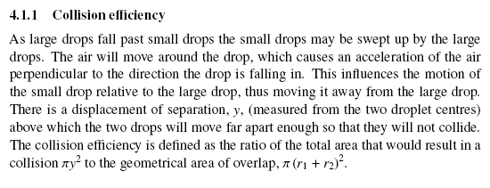

The collision kernel
It can be larger than unity, what does this mean?

Slide 5
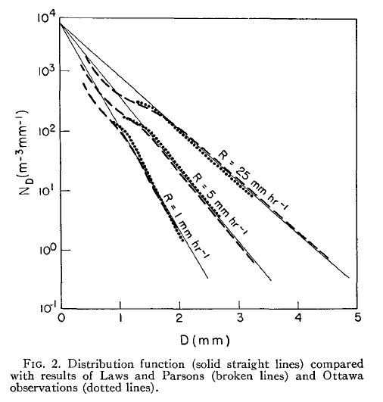
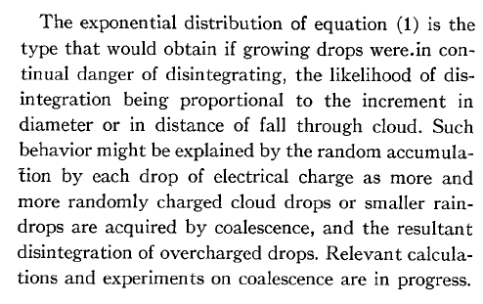
Observations show exponential rain drop Spectra
Marshall and Palmer (1948)
Journal of Meteorology

Slide 6
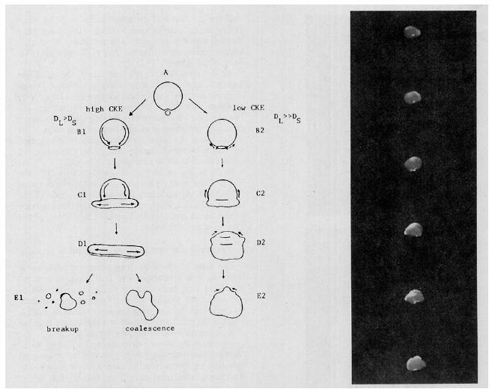
Some-times colliding drops break-up via `bag’ / ‘disk’, ‘sheet’ or ‘filament’ breakup
http://www.youtube.com/watch?v=3lxOFufnQZg&feature=youtu.be
Rain-drops also break-up aerodynamically when they get large enough
Low and List (1982); Emersic and Connolly (2011)

Slide 7
Mixed-Phase Cloud Microphysics
Cold Cloud Processes
Warm Cloud Processes
Platnick
Notes:
Wang and Olsen.

Slide 8
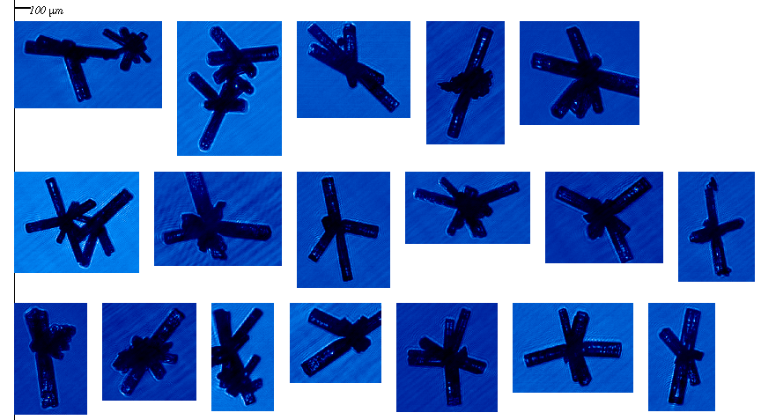
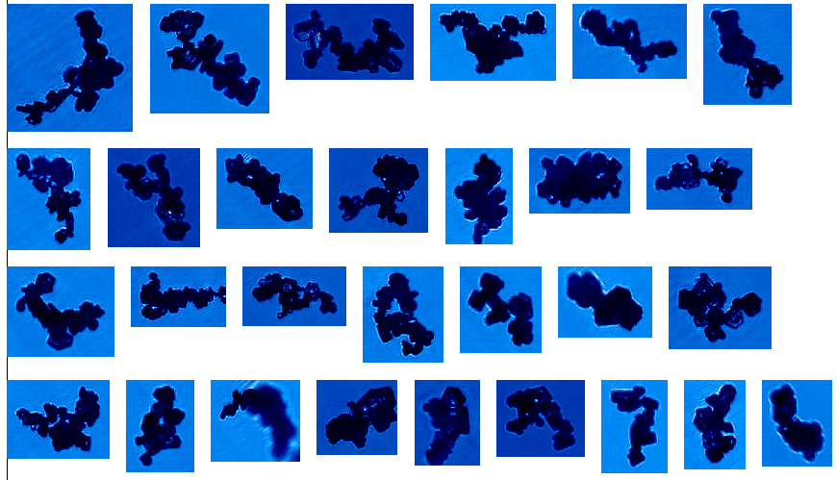
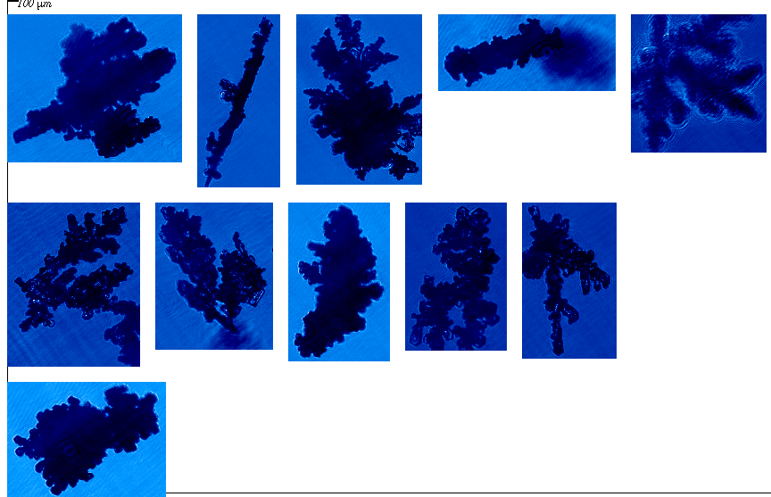
What about snow flakes?
Pristine habits rare – 90% of the time they are aggregates
One idea is that there needs to be a layer of liquid on the surface of ice, which can solidify. It’s origin is still debated...Problem was worked on by Faraday, James Thomson (lord Kelvin’s brother) and others

Slide 9
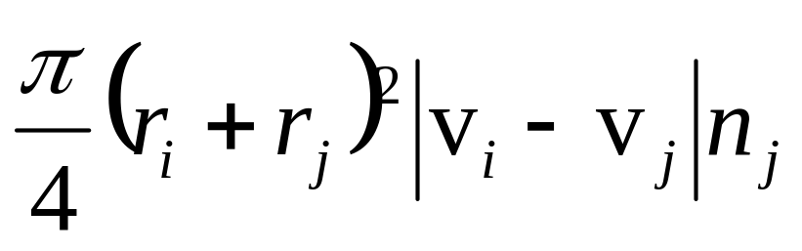
Efficiency of aggregation
(kernels are the same form as for coll-coal)
Aggregation rate = number of sticking events per second between i and j.
If all collisions resulted in a sticking event
r_{i}
r_{j}
v_{i}
v_{j}
Aggregation efficiency, Ea, number of sticking events divided by number of collisions
So multiply Ea by the collision rate to get the aggregation rate
Notes:
Volume of air swept out multiplied by total number per unit volume that it will encounter

Slide 10
How does ice stick to ice? (summary)
Pressure is responsible for melting ice and forming the ice bond – Thomson (1856).
Pressure not required, but liquid-like layer – Faraday (1860) – still not resolved!
Sintering (molecular diffusion) strengthens a ‘neck’ between two crystals, but liquid-like layer responsible for initial bridging.
Interlocking may be responsible for crystals coming in contact (Ohtake, 1969)

Slide 11
Mixed-Phase Cloud Microphysics
Cold Cloud Processes
Warm Cloud Processes
Platnick
Notes:
Wang and Olsen.

Slide 12
Physical Mechanism for secondary ice
Rimer approaches liquid drop with diameter > 25μm
Pressure relieved by cracking shell and ejected splinters
Rimer contacts liquid drop and they stick
Ice shell forms
Ice shell thickens
and builds internal pressure
Choularton et al. 1978

Slide 13
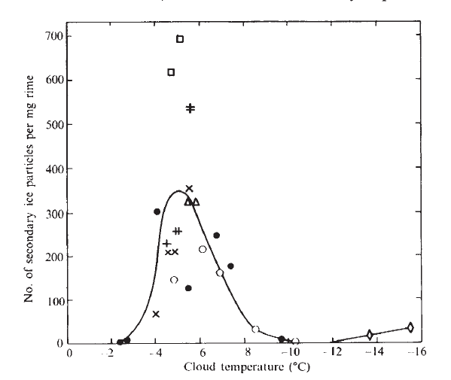
“Goldilocks” zone for splinter production
Droplets spread out when the hit the surface (Macklin and Payne 1967) – don’t form ice shell
Temperature optimal for splinters
Ice shell too strong to break from internal pressure (Griggs and Choularton 1983)
Dong and Hallett 1989
Suggest temperature gradient between drop and ice causes droplet fracturing in goldilocks zone, and this gets less effective at cold temperatures
Dong and Hallett 1989
Suggest spreading due to wetting rather than kinetic energy

Slide 14
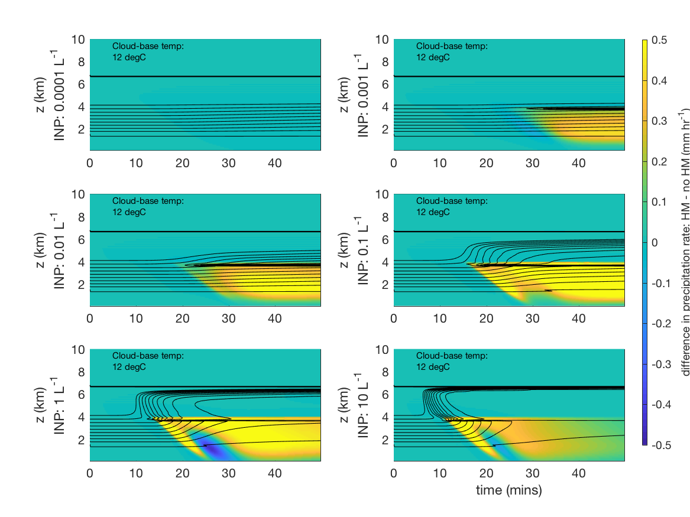
Simple Cloud Model Calculation
1-D column, different amount of INPs
Calculate the difference: HM – no HM in precipitation
When INP low, no difference
When INP high, secondary ice gives more precipitation

Slide 15
Main points
Gravitational settling explains why drops and snowflakes collide and coalesce or aggregate.
Drops and snowflakes can also break-up during collisions when they get large.
The collection processes can lead to precipitation formation much faster than single phase vapour growth alone.
Rain:
  Warm rain process: collision and coalescence of drops
  Cold rain process: mixed phase cloud; ice grows faster than drops; aggregate, fall (maybe they will melt and fall as rain).

Slide 16
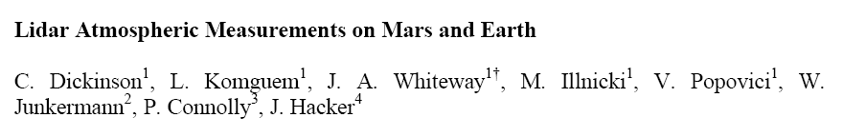
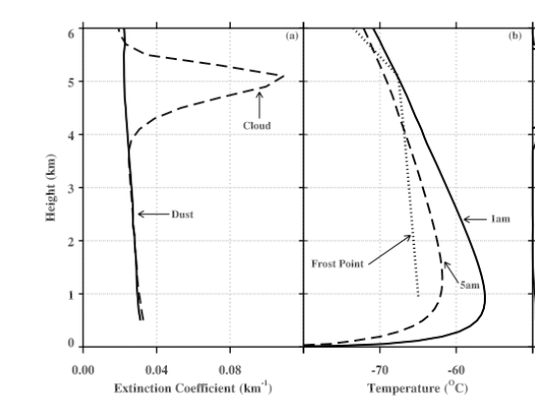
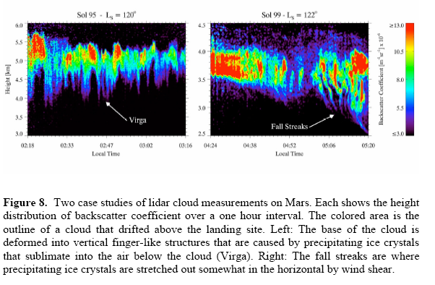
Question: where do you think these clouds are?

Slide 17
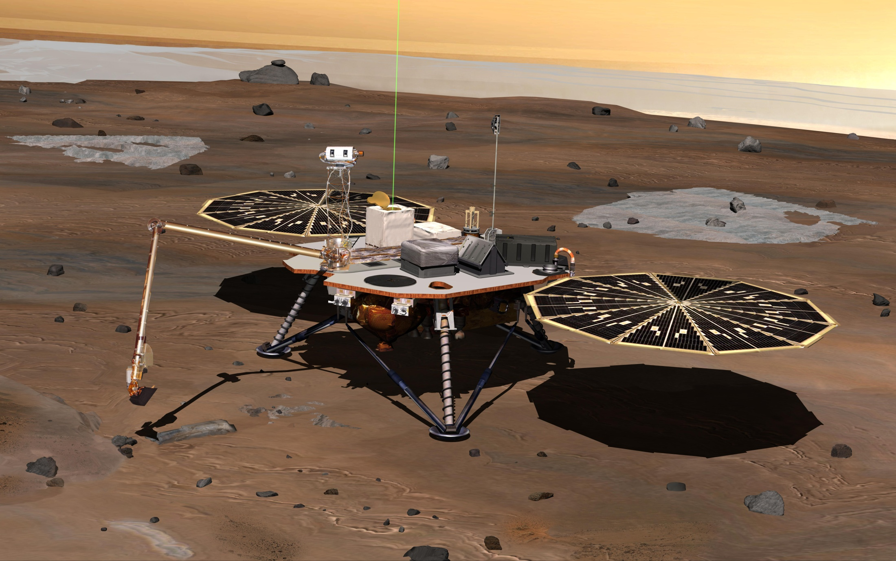
Data were taken by the Phoenix Lander on Mars
The mission responded to evidence returned from NASA's Mars Odyssey orbiter in 2002 indicating that most high-latitude areas on Mars have frozen water mixed with soil within arm's reach of the surface
The vertical green line in this illustration shows how the weather station on Phoenix used a laser beam from a lidar instrument to monitor dust and clouds in the atmosphere.

Slide 19
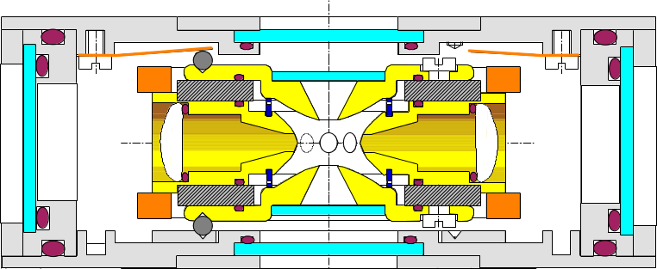
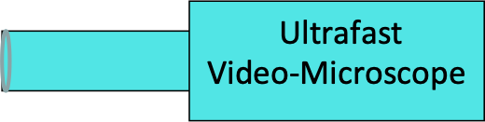
Visualization of the splintering process:
New experiments: T.Leisner et al.
Experimental Setup
Ice
particles
DMA
aerosol generator
+ neutralizer
AC/DC power supply
Droplet position
Droplet injection
Droplet sizing
Temperature control
Humidity control
Condensation
Particle counter
aerosol
electrometer
Notes:
The experimental setup comprises of an standard electrodynamic levitator housed in a cold cell and equipped with temperature- and humidity control. Individual droplets are injected with the help of an piezo- driven nozzle and are observed by light scattering and ultrafast microscopy. Heterogeneous ice nuclei are dispensed from and dry ice generator. An aerosol system allows the exposition of the droplets to an controlled aerosol flow. The freezing process is analyzed by ultrafast video- microscopy.
Prof. Dr. Max Mustermann | Musterfakultät

Slide 20
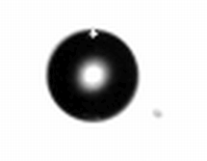
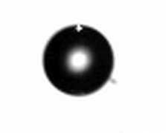
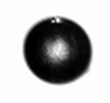
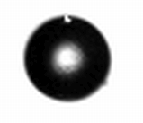
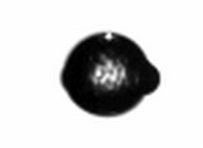
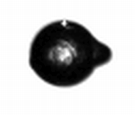
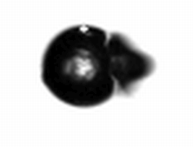
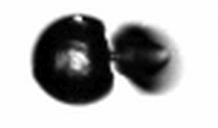
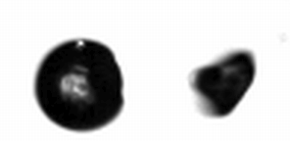
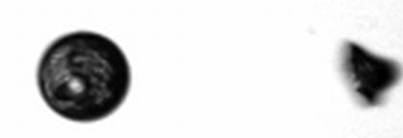
Complete breakup
-.12 ms
0 ms
1.4 ms
10.7 ms
699.8 ms
867.07 ms
867.10 ms
867.14 ms
867.23 ms
867.41 ms

Slide 21
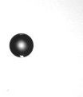

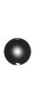
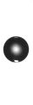
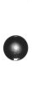


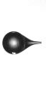
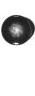
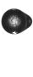
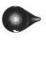
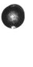


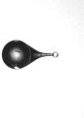
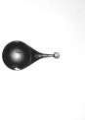
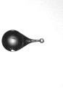


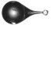
Spicules and bubbles
0ms
0,39ms
0,51ms
1,0ms
1,36ms
1,87ms
16,06ms
286,03ms
372,1ms
490,59ms
601,19ms
640,1ms
655,07ms
656,51ms
656,56ms
656,94ms
657,8ms
657,88ms
657,95ms
657,99ms

Slide 22
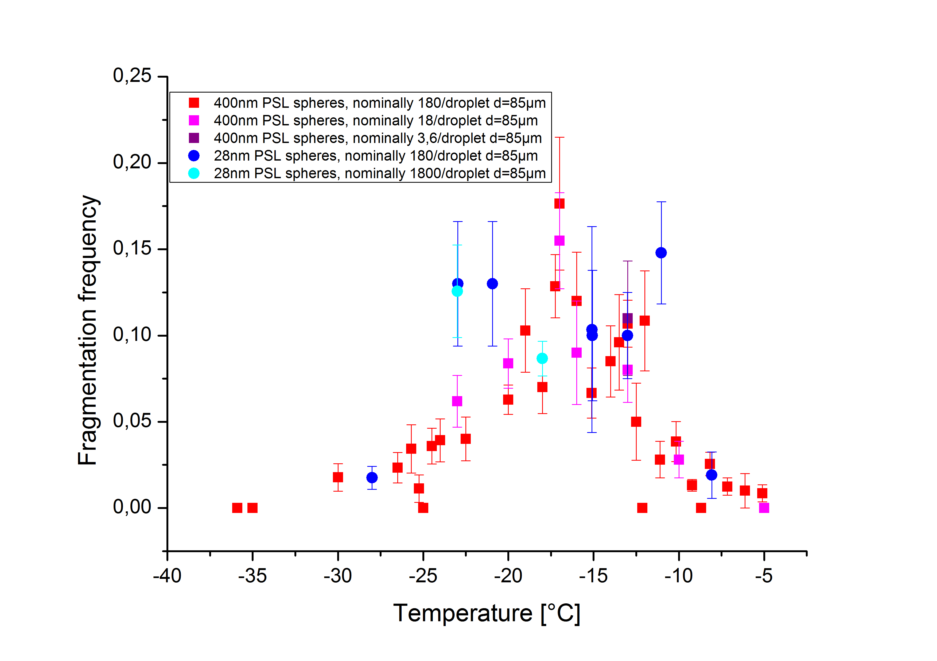
Results: Fragmentation frequency
Visualization of the splintering process:
New experiments: T.Leisner et al.

