Slide 1
Meteorology and Atmospheric Physics lecture 10 / practice questions
Recap:
Growth by collisions leads to a broadening of the drop distribution: However, drops also `break-up’ in high momentum collisions, high enough to overcome surface tension.
Various types of break-up: `bag’, `sheet’ `filament’. These lead to exponential distributions in clouds.
Snowflakes also form by the collection of other snowflakes (aggregation); and graupel or hail forms when ice crystals grow by the collection of drops (riming)
Today:
briefly talk about graupel / hail growth and secondary ice production
Go through some practice exam questions
Dr Paul Connolly, reader

Slide 2
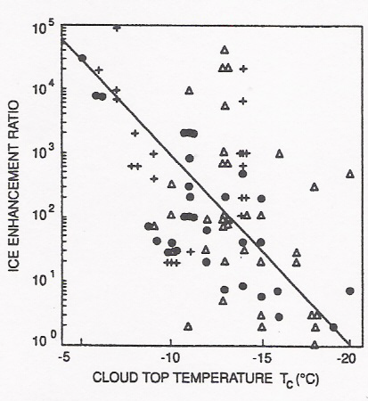
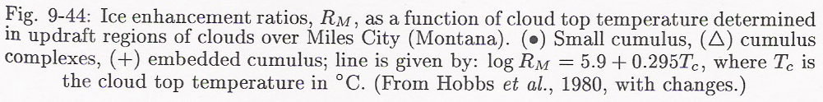
Ice Multiplication
Sometimes there is reasonable agreement between the numbers of ice crystals and ice nuclei detected. For example, where ice crystal concentrations range up to 10 per litre in shallow stratocumulus and stratus with small droplets < 25 μm, so there is no riming of the ice crystals. There is good agreement also in wintertime continental cumuli and cap clouds. All these cases of reasonable agreement between crystal and IN counts (to within x10) are in clouds with small droplets.
But there are many clouds where crystals outnumber IN. The figure shown here is the result of ice nucleus and ice crystal measurements in cumulus clouds plotted against cloud top temperature. The Ice Enhancement Factor is the Crystal to IN ratio. Most crystals will be initiated at the coldest temperatures in the cloud - hence cloud top temperature is plotted in the graph. The ratio ranges from 1 at -20°C to 10⁵ at -5°C.

Slide 3
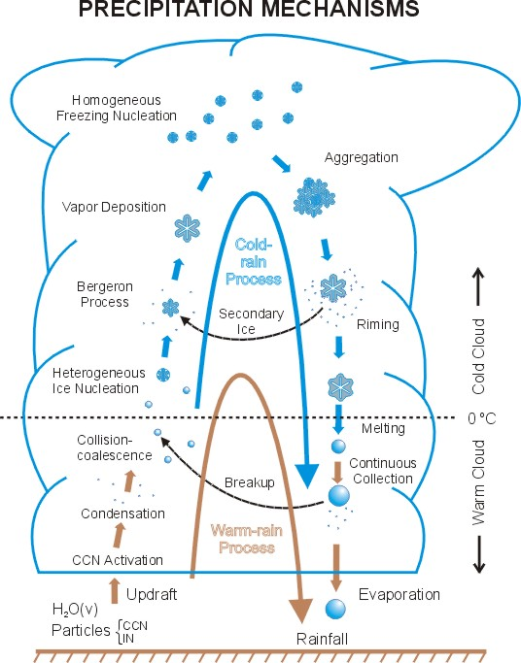
Ice production/growth interplay in clouds
Cold Cloud Processes
Warm Cloud Processes
Platnick
Notes:
3
Wang and Olsen.

Slide 4
Where secondary ice production “lies”
Cold Cloud Processes
Warm Cloud Processes
Platnick
Notes:
4
Wang and Olsen.

Slide 5
First: you need ice and some droplets
Cold Cloud Processes
Warm Cloud Processes
Platnick
Notes:
5
Wang and Olsen.

Slide 6
Riming: key towards secondary ice
Cold Cloud Processes
Warm Cloud Processes
Platnick
Notes:
6
Wang and Olsen.

Slide 7
Secondary ice production
Cold Cloud Processes
-12°C
Warm Cloud Processes
Platnick
Notes:
7
Wang and Olsen.

Slide 8
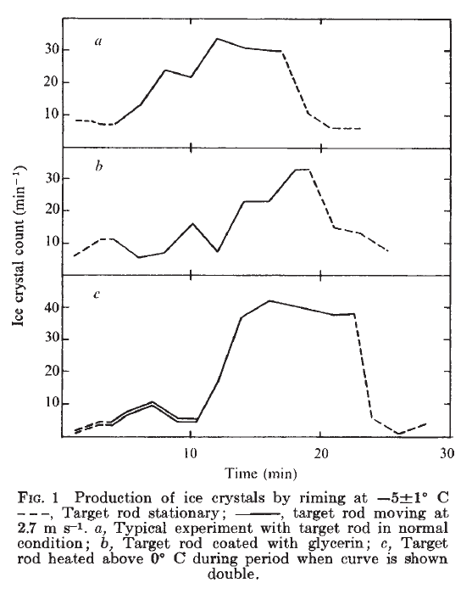


Pioneering work of Hallett & Mossop
Cold room -4.5C
0.24cm
30cm
1.7m
V<3 m/s
1.5m
1.5m
Hallett and Mossop 1974

Slide 9
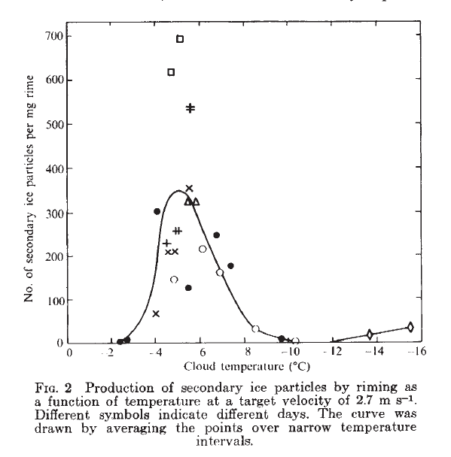
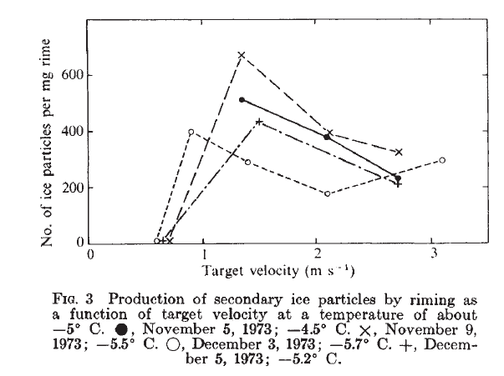
Pioneering work of Hallett & Mossop
Hallett and Mossop 1974
Mossop and Hallett (1974): production of splinters requires presence of droplets >25 μm diameter.
Splinter production is proportional to the rate at which these large droplets are collected.

Slide 10
Physical Mechanism for splinter production
Rimer approaches liquid drop with diameter >25μm
Choularton et al. 1978

Slide 11
Physical Mechanism for splinter production
Rimer approaches liquid drop with diameter >25μm
Rimer contacts liquid drop and they stick
Choularton et al. 1978

Slide 12
Physical Mechanism for splinter production
Rimer approaches liquid drop with diameter >25μm
Rimer contacts liquid drop and they stick
Ice shell forms
Choularton et al. 1978

Slide 13
Physical Mechanism for splinter production
Rimer approaches liquid drop with diameter >25μm
Rimer contacts liquid drop and they stick
Ice shell forms
Ice shell thickens
and builds internal pressure
Choularton et al. 1978

Slide 14
Physical Mechanism for splinter production
Rimer approaches liquid drop with diameter > 25μm
Pressure relieved by cracking shell and ejected splinters
Rimer contacts liquid drop and they stick
Ice shell forms
Ice shell thickens
and builds internal pressure
Choularton et al. 1978

Slide 15
“Goldilocks” zone for splinter production
Droplets spread out when the hit the surface (Macklin and Payne 1967) – don’t form ice shell

Slide 16
“Goldilocks” zone for splinter production
Droplets spread out when the hit the surface (Macklin and Payne 1967) – don’t form ice shell
Ice shell too strong to break from internal pressure (Griggs and Choularton 1983)

Slide 17
“Goldilocks” zone for splinter production
Droplets spread out when the hit the surface (Macklin and Payne 1967) – don’t form ice shell
Temperature optimal for splinters
Ice shell too strong to break from internal pressure (Griggs and Choularton 1983)

Slide 18
“Goldilocks” zone for splinter production
Droplets spread out when the hit the surface (Macklin and Payne 1967) – don’t form ice shell
Temperature optimal for splinters
Ice shell too strong to break from internal pressure (Griggs and Choularton 1983)
Dong and Hallett 1989
Suggest temperature gradient between drop and ice causes droplet fracturing in goldilocks zone, and this gets less effective at cold temperatures
Dong and Hallett 1989
Suggest spreading due to wetting rather than kinetic energy

Slide 19
Visualization of the splintering process:
New experiments: T.Leisner et al.
Experimental Setup
Ice particles
DMA
aerosol generator
+ neutralizer
AC/DC power supply
Droplet position
Droplet injection
Droplet sizing
Ultrafast
Video-Microscope
Temperature control
Humidity control
Condensation
Particle counter
aerosol
electrometer
Notes:
The experimental setup comprises of an standard electrodynamic levitator housed in a cold cell and equipped with temperature- and humidity control. Individual droplets are injected with the help of an piezo- driven nozzle and are observed by light scattering and ultrafast microscopy. Heterogeneous ice nuclei are dispensed from and dry ice generator. An aerosol system allows the exposition of the droplets to an controlled aerosol flow. The freezing process is analyzed by ultrafast video- microscopy.
Prof. Dr. Max Mustermann | Musterfakultät
19

Slide 20
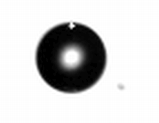
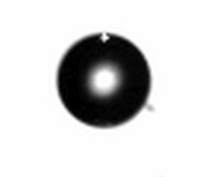
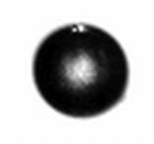
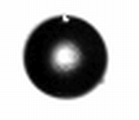
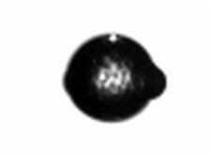
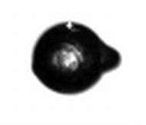
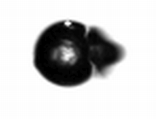
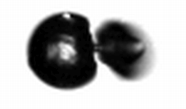
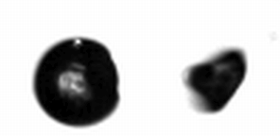
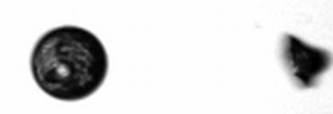
Complete breakup
-.12 ms
0 ms
1.4 ms
10.7 ms
699.8 ms
867.07 ms
867.10 ms
867.14 ms
867.23 ms
867.41 ms

Slide 21
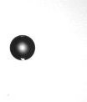

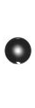

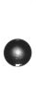


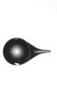
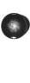

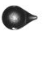
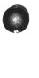


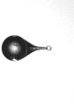
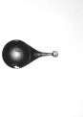
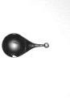


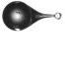
Spicules and bubbles
0ms
0,39ms
0,51ms
1,0ms
1,36ms
1,87ms
16,06ms
286,03ms
372,1ms
490,59ms
601,19ms
640,1ms
655,07ms
656,51ms
656,56ms
656,94ms
657,8ms
657,88ms
657,95ms
657,99ms

Slide 22
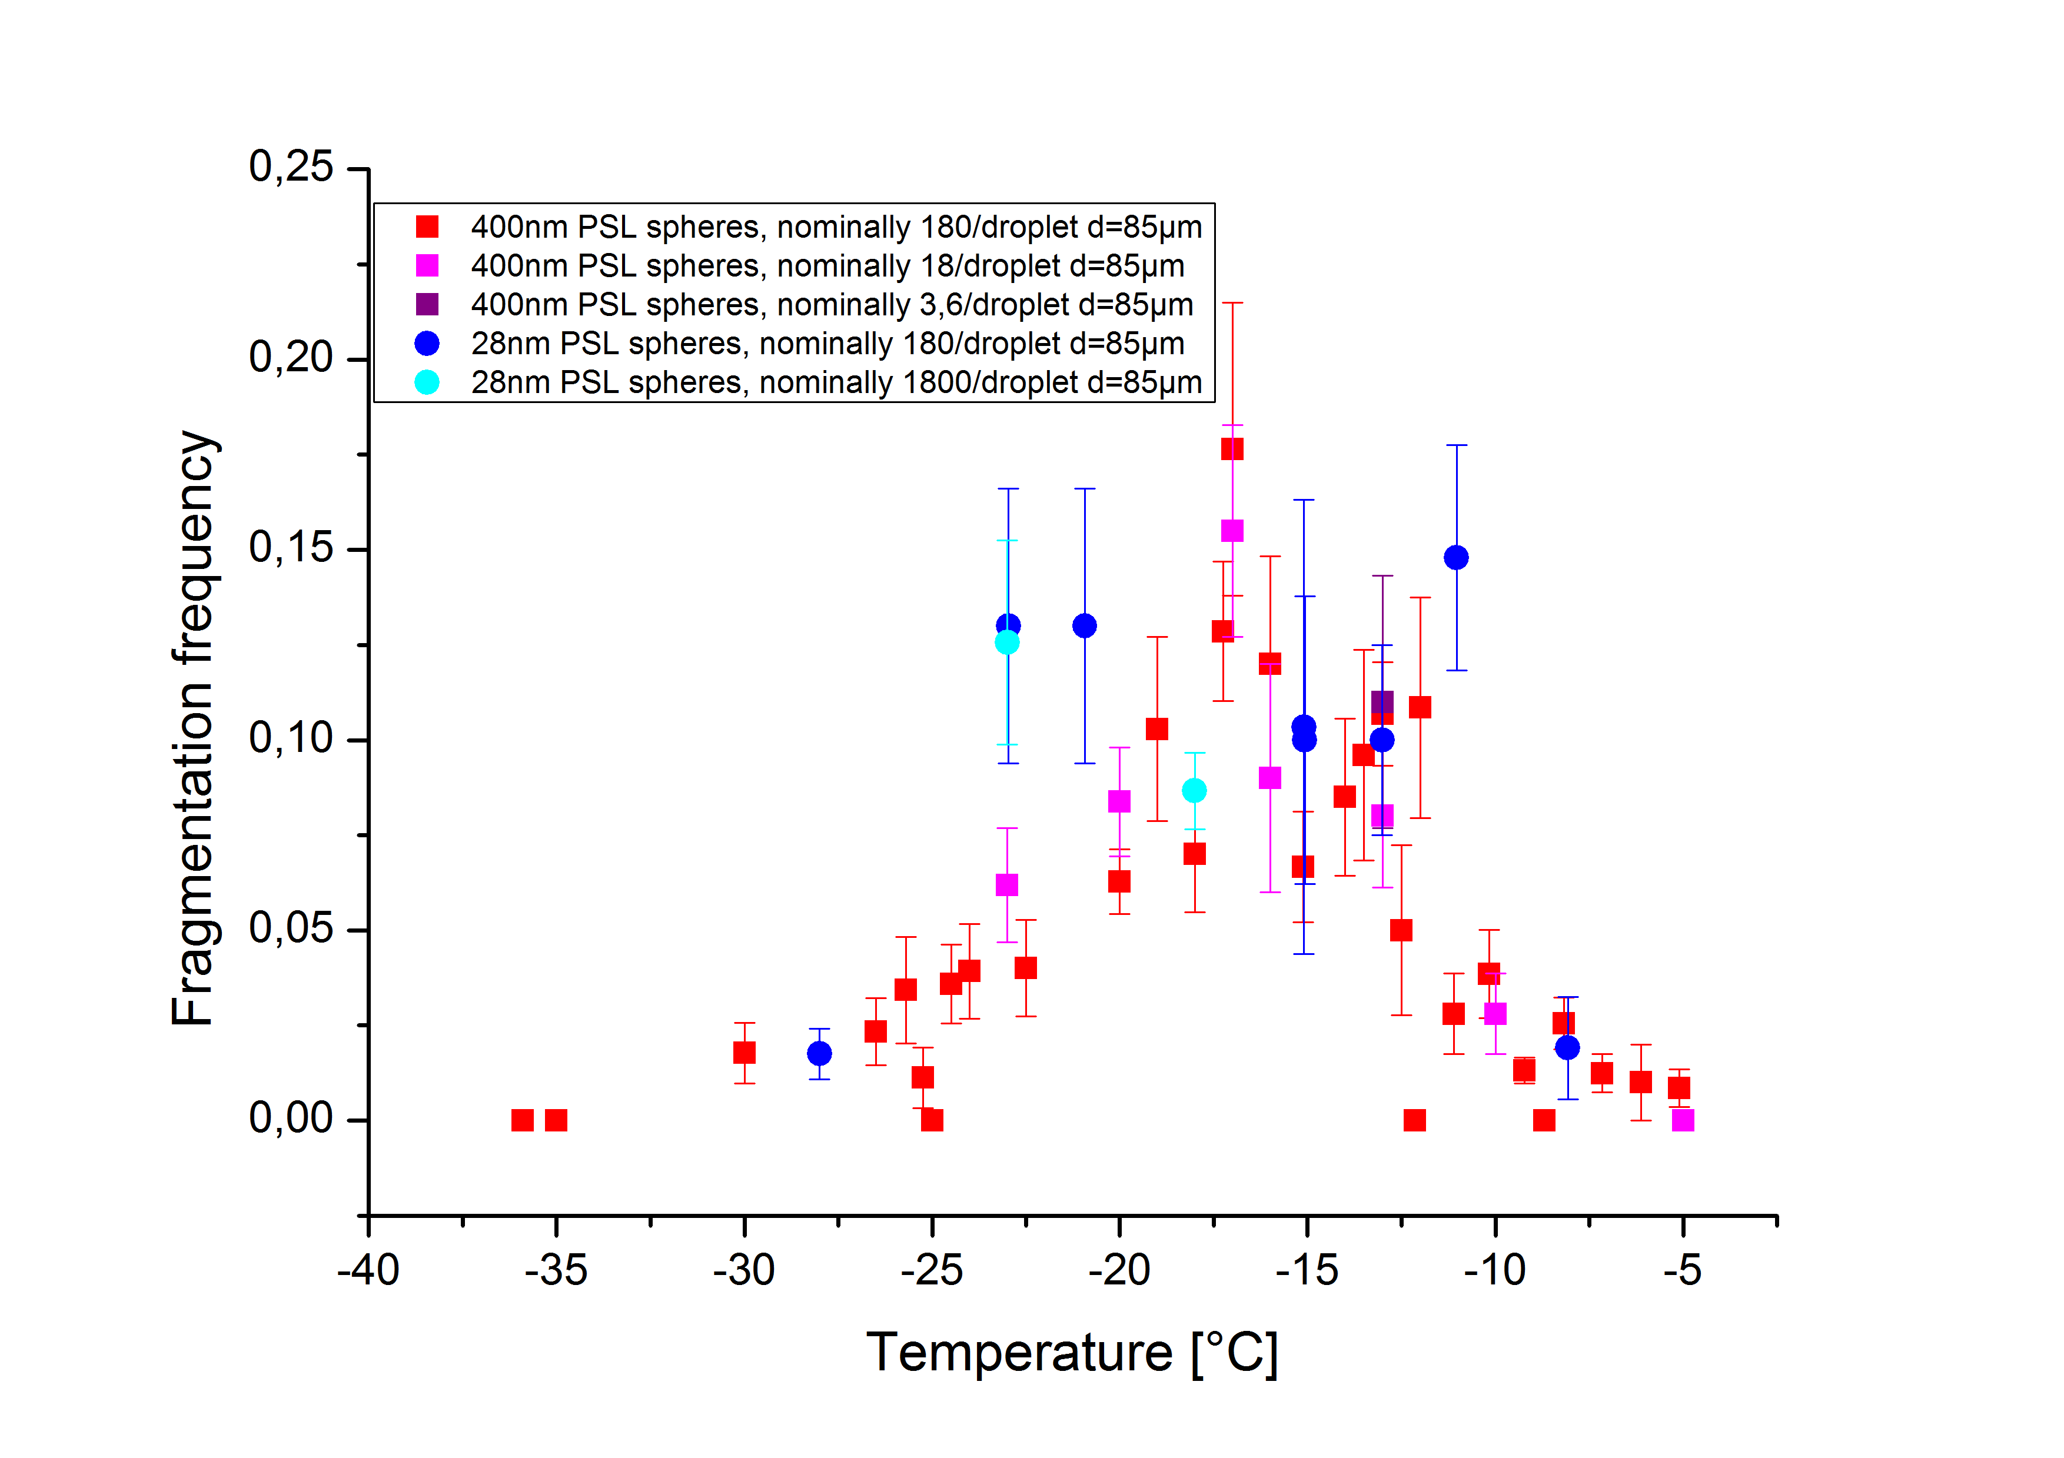
Results: Fragmentation frequency
Visualization of the splintering process:
New experiments: T.Leisner et al.

Slide 23
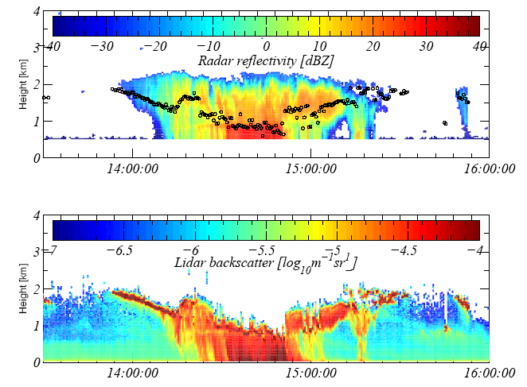
HM process in cloud over southern England

Slide 24
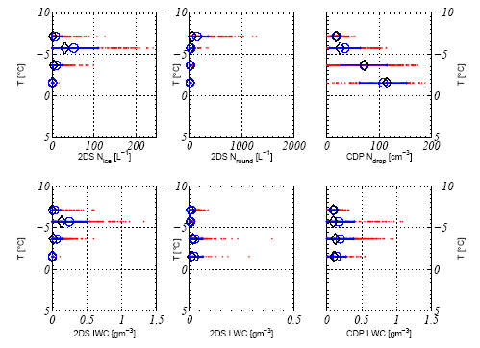
In-situ aircraft observations
Number of ice nuclei were measured to be ~10⁻² L⁻¹ at -10C

Slide 25
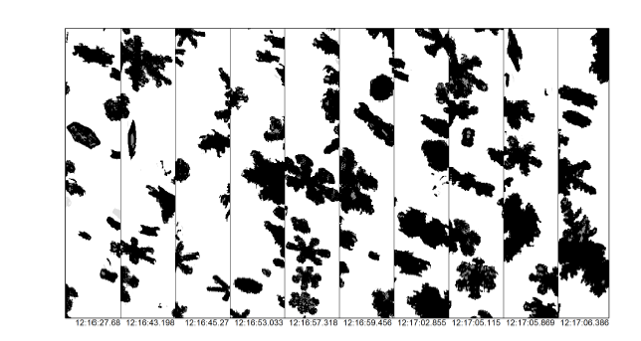
Snow falling into the convection

Slide 26
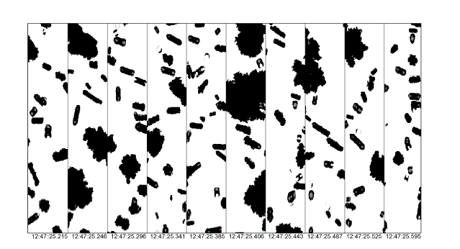
Graupel and columns in the H-M zone

Slide 27
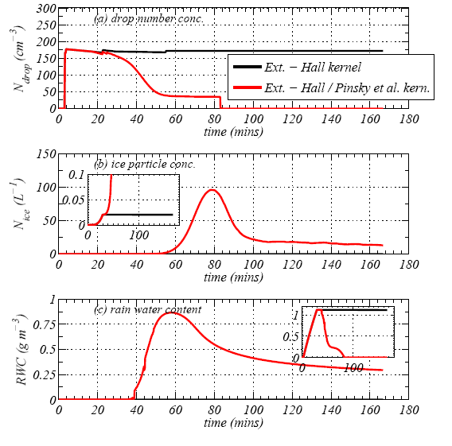
Warm rain is significant to the Hallett-Mossop process
Model simulations from Crawford et al (ACP, 2012)
Even 10⁻² L⁻¹ of ice nuclei can result in ~100 L⁻¹ of ice crystals due to the H-M process
Simulation without rain
Simulation with rain
The process of warm rain formation can be crucial to switching on the H-M process as it only takes a few rain drops to freeze and then they can fall through the cloud and collect liquid water. If this happens between -3 and -8C many ice splinters will be generated

Slide 28
Main points
Ice crystal concentrations can be amplified by secondary ice production within cloud that contain pre-existing ice.
We don't know all the mechanisms. One is the H-M process, which happens within a narrow temperature range, but can turn out to be very important for ice concentrations in the cloud.
Warm rain is significant as it can lead to large hail stones very quickly.
Good luck!

Slide 30
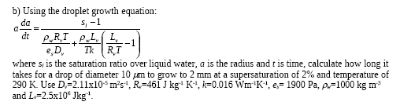
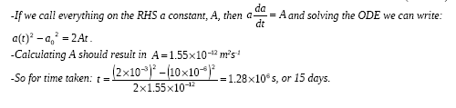
Example on drop growth by diffusion:

Slide 31

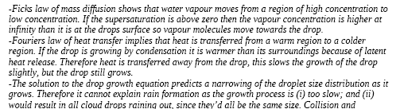
Further drop growth question:

Slide 33

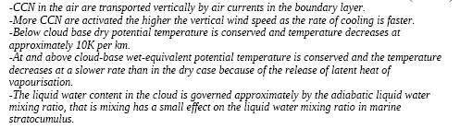
`Explaining’ question

Slide 35
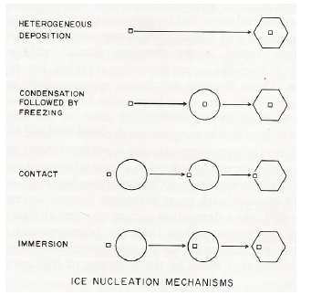
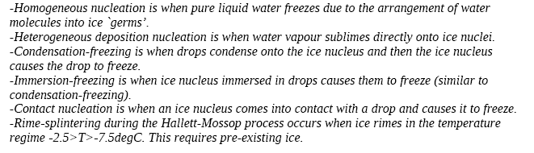
Ice nucleation
Explain the ice nucleation modes clearly and concisely…
Explain any discrepancies between the measured IN and any other ice formation pathways, referencing any equations that describe the processes.

