Slide 1
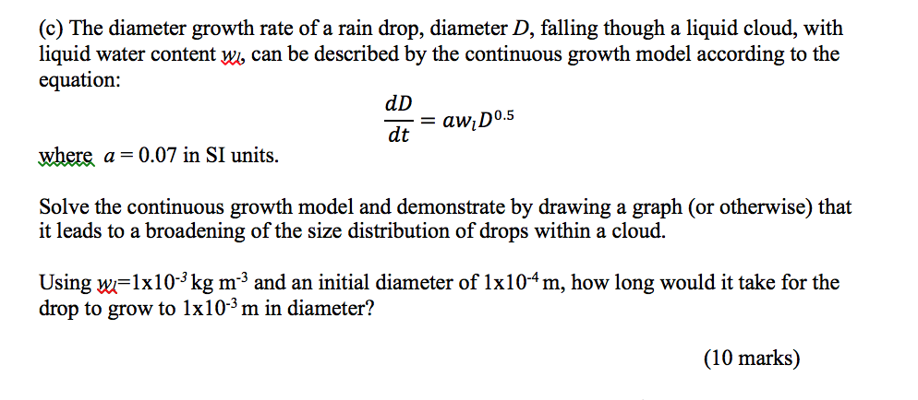
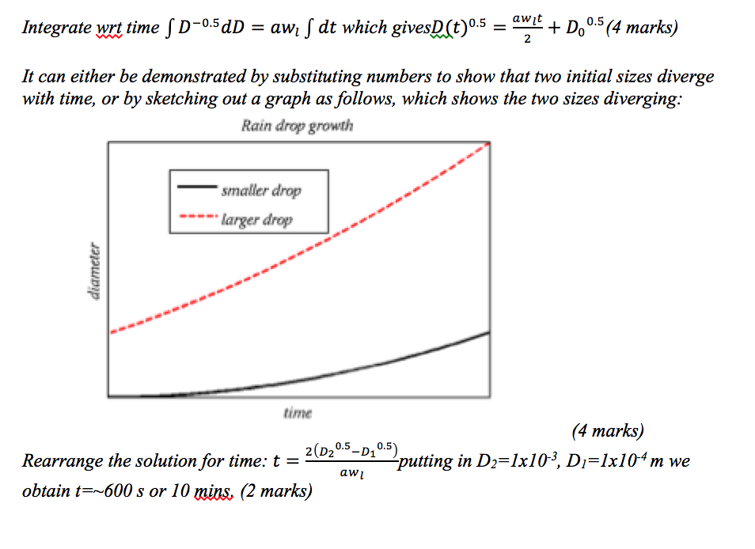

Slide 3



Slide 5



Slide 7
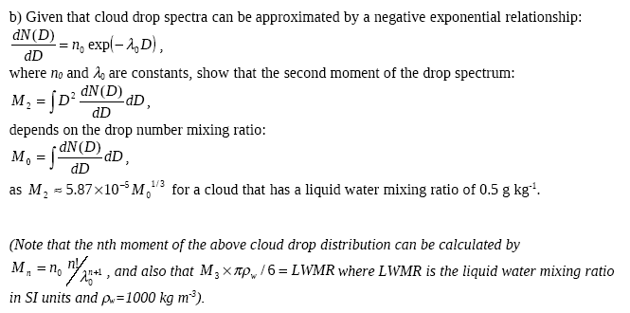
8 Marks

Slide 8
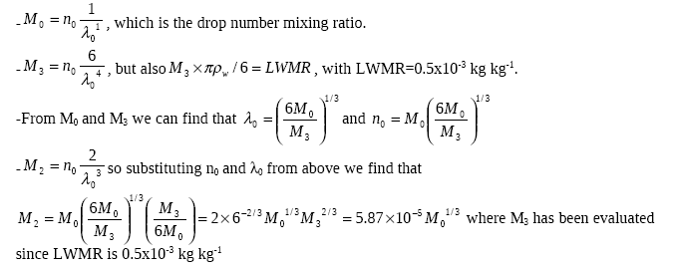

Slide 10
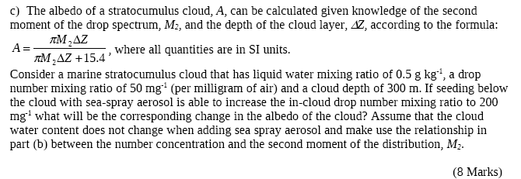


Slide 12
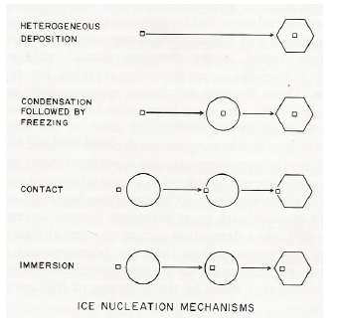

Ice nucleation
Explain the ice nucleation modes clearly and concisely…
Explain any discrepancies between the measured IN and any other ice formation pathways, referencing any equations that describe the processes.

