Slide 1
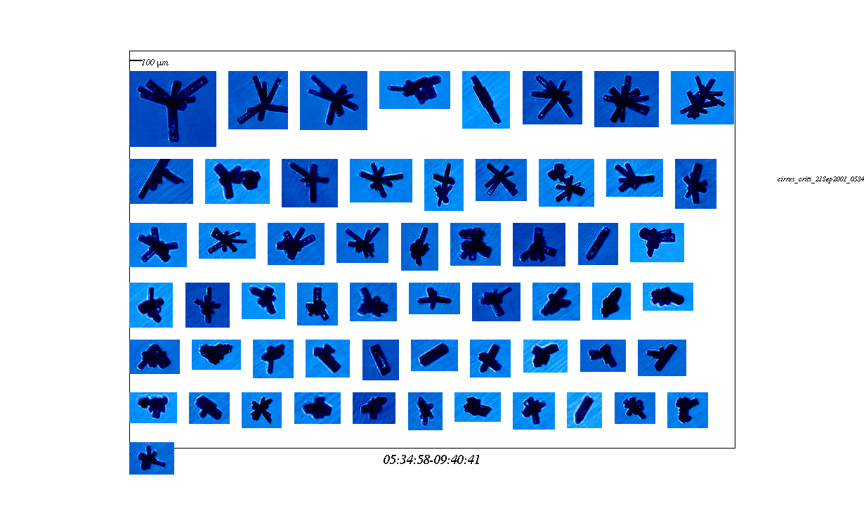
ICE CRYSTALS FROM CIRRUS, T<-40C (EMERALD-1)

Slide 2
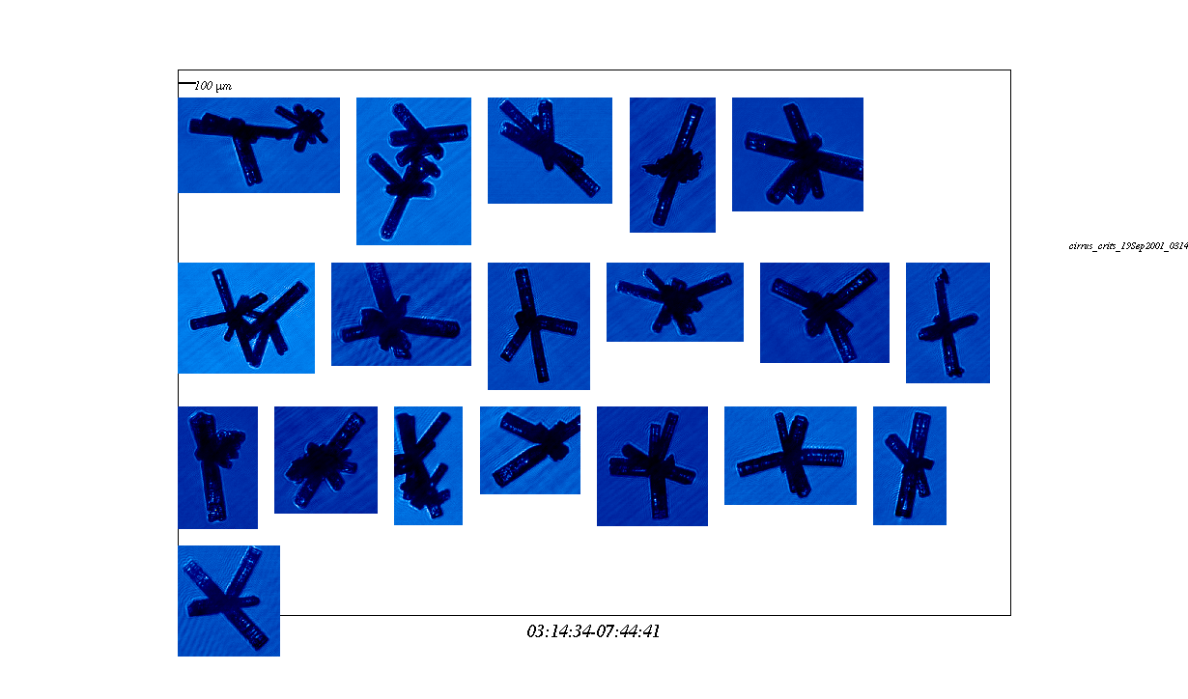
ICE CRYSTALS FROM CIRRUS, T<-40C (EMERALD-1)

Slide 3
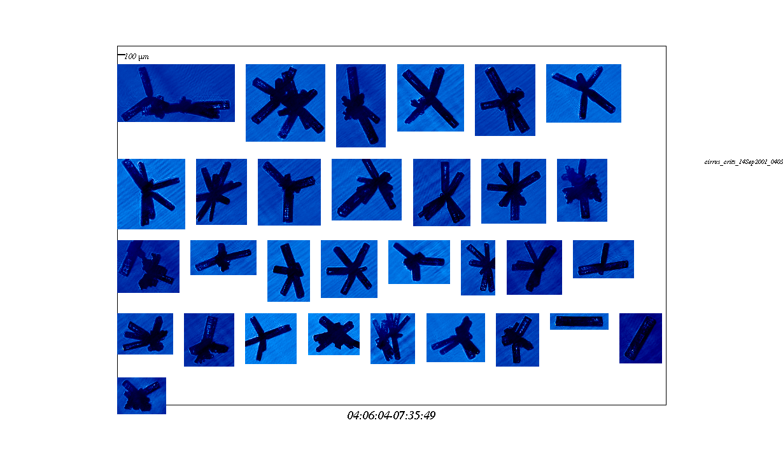
ICE CRYSTALS FROM CIRRUS, T<-40C (EMERALD-1)

Slide 4
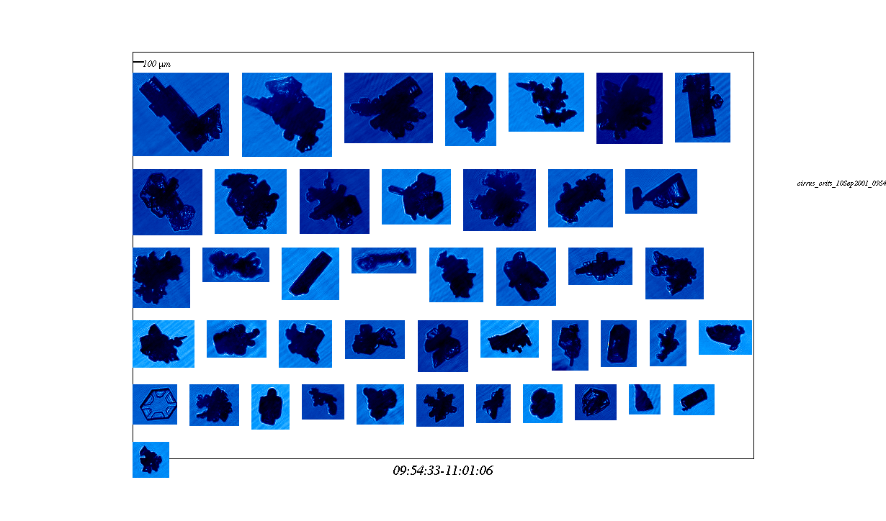
ICE CRYSTALS FROM WARM CIRRUS, T>-40C (EMERALD-1)

Slide 5
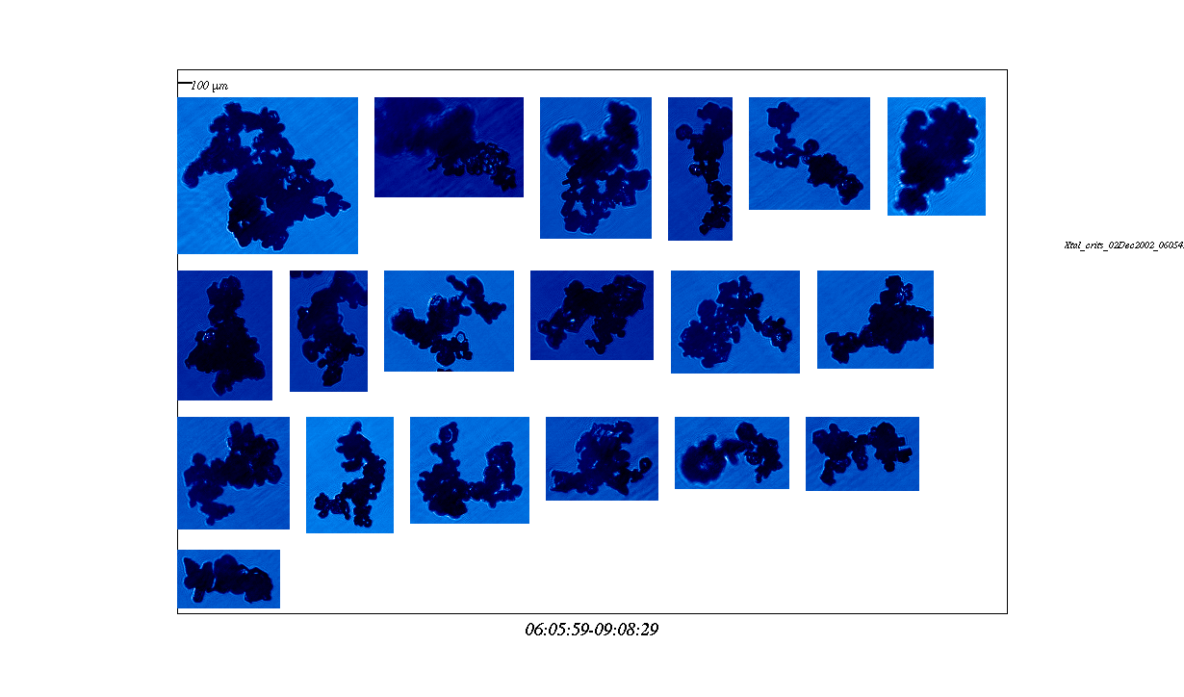
ICE CRYSTALS FROM ANVIL CIRRUS (EMERALD-2)

Slide 6
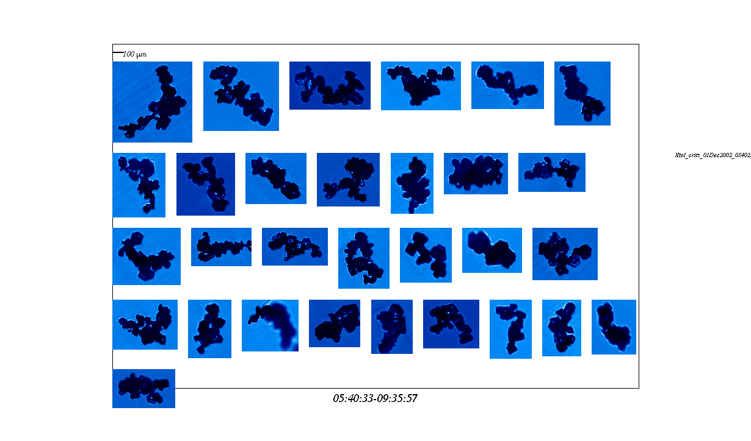
ICE CRYSTALS FROM ANVIL CIRRUS (EMERALD-2)

Slide 7
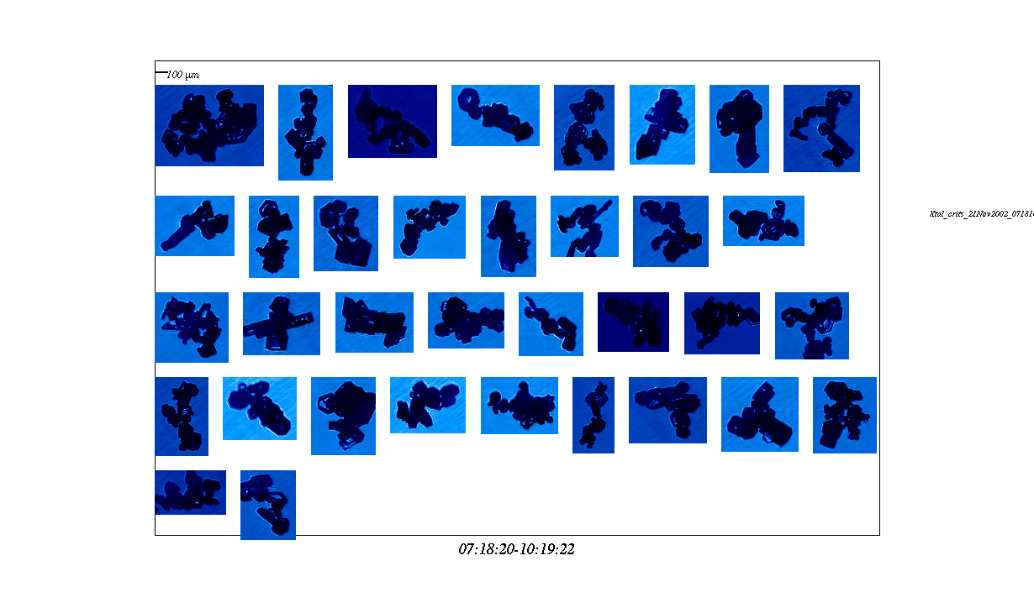
ICE CRYSTALS FROM ANVIL CIRRUS (EMERALD-2)

Slide 8
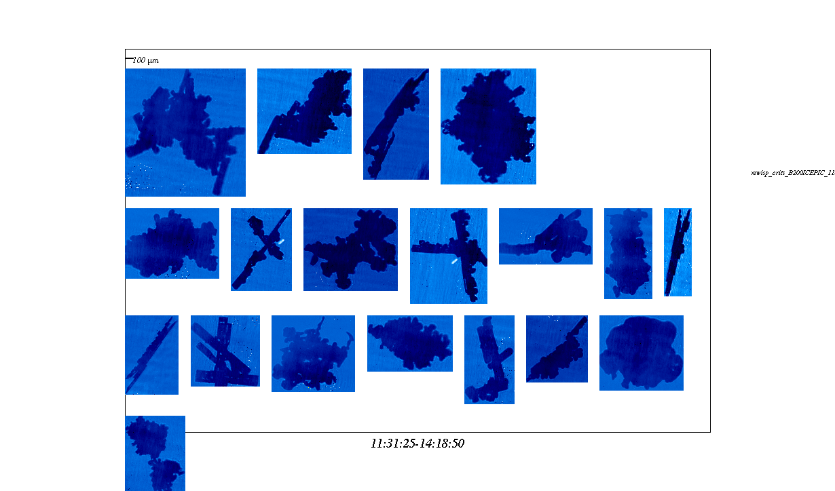
ICE CRYSTALS FROM CUMULUS, T>-15C (ICEPIC)

Slide 9
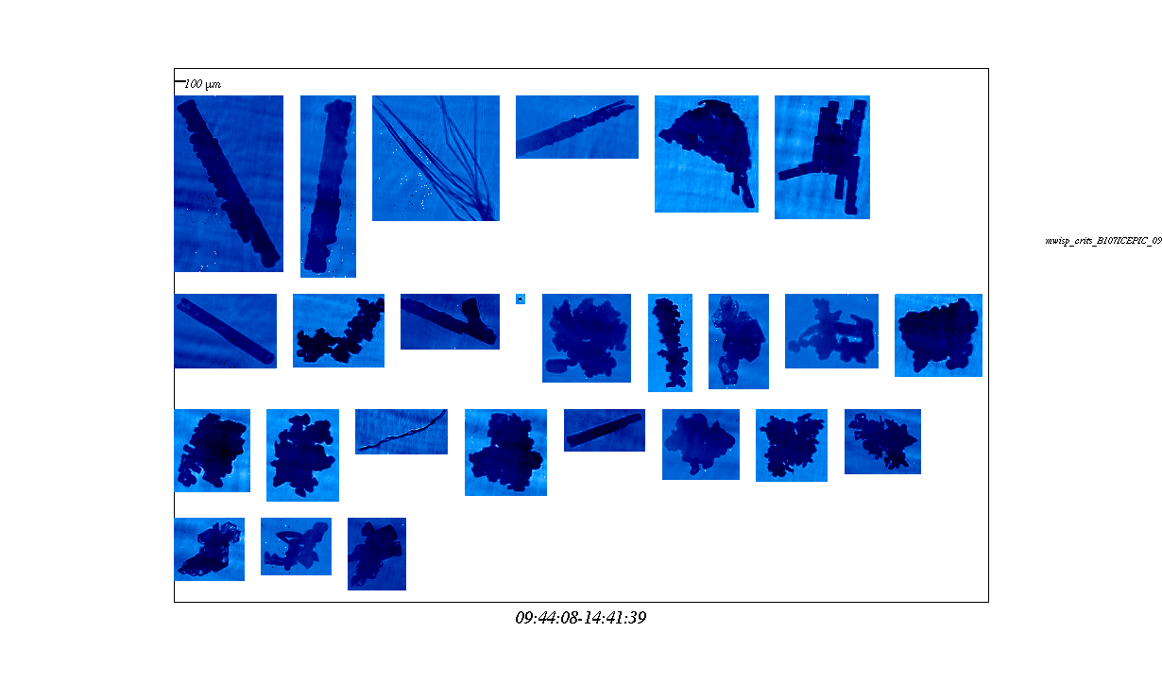
ICE CRYSTALS FROM CUMULUS, T>-15C (ICEPIC)
Often see `wind blown’ material

Slide 10
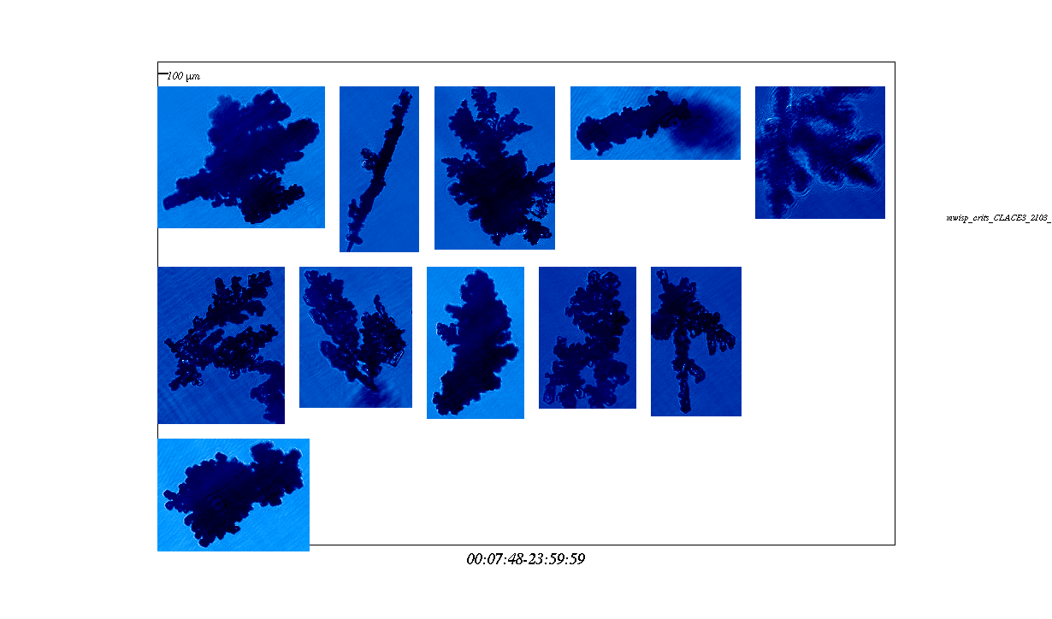
ICE CRYSTALS IN MIXED PHASE, T>-15C (CLACE)

Slide 11
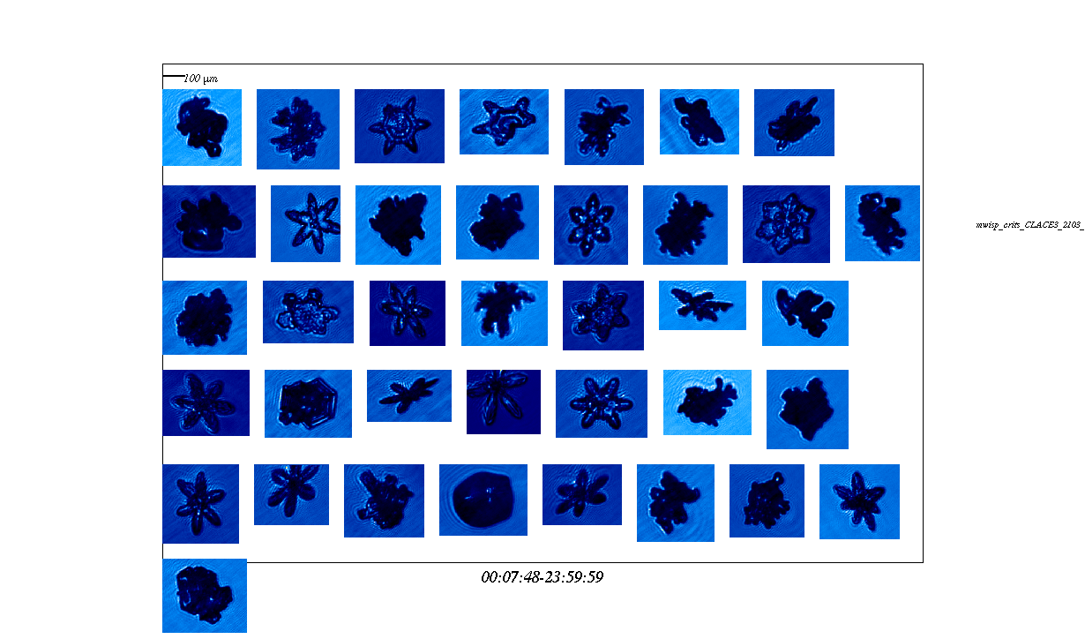
ICE CRYSTALS IN MIXED PHASE, T<-15C (ICEPIC)

