Slide 1
Measuring and Predicting 2 Week 4: Single Column Modelling
Prof. Paul Connolly
Centre for Atmospheric Science

Slide 2
Contents
This week
Download code
Run compiled code to numerically solve ODE - PDE model
Look at model output and interpret results
Scenario we are modelling
Cloud and Precipitation Processes Primer
Lagrangian approach vs the Eulerian approach
The advection equation (a Partial Differential Equation, PDE)
Details of the Model
Solving ODEs and PDEs together
‘Conserved’ variables
Potential temperature
Water vapour
Equations of the model

Slide 3
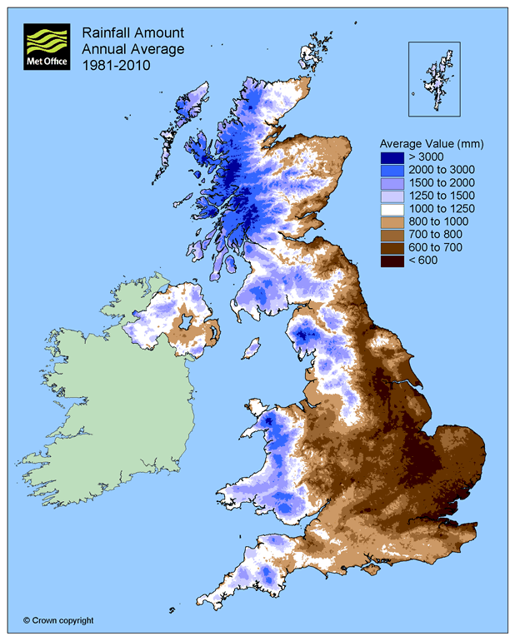
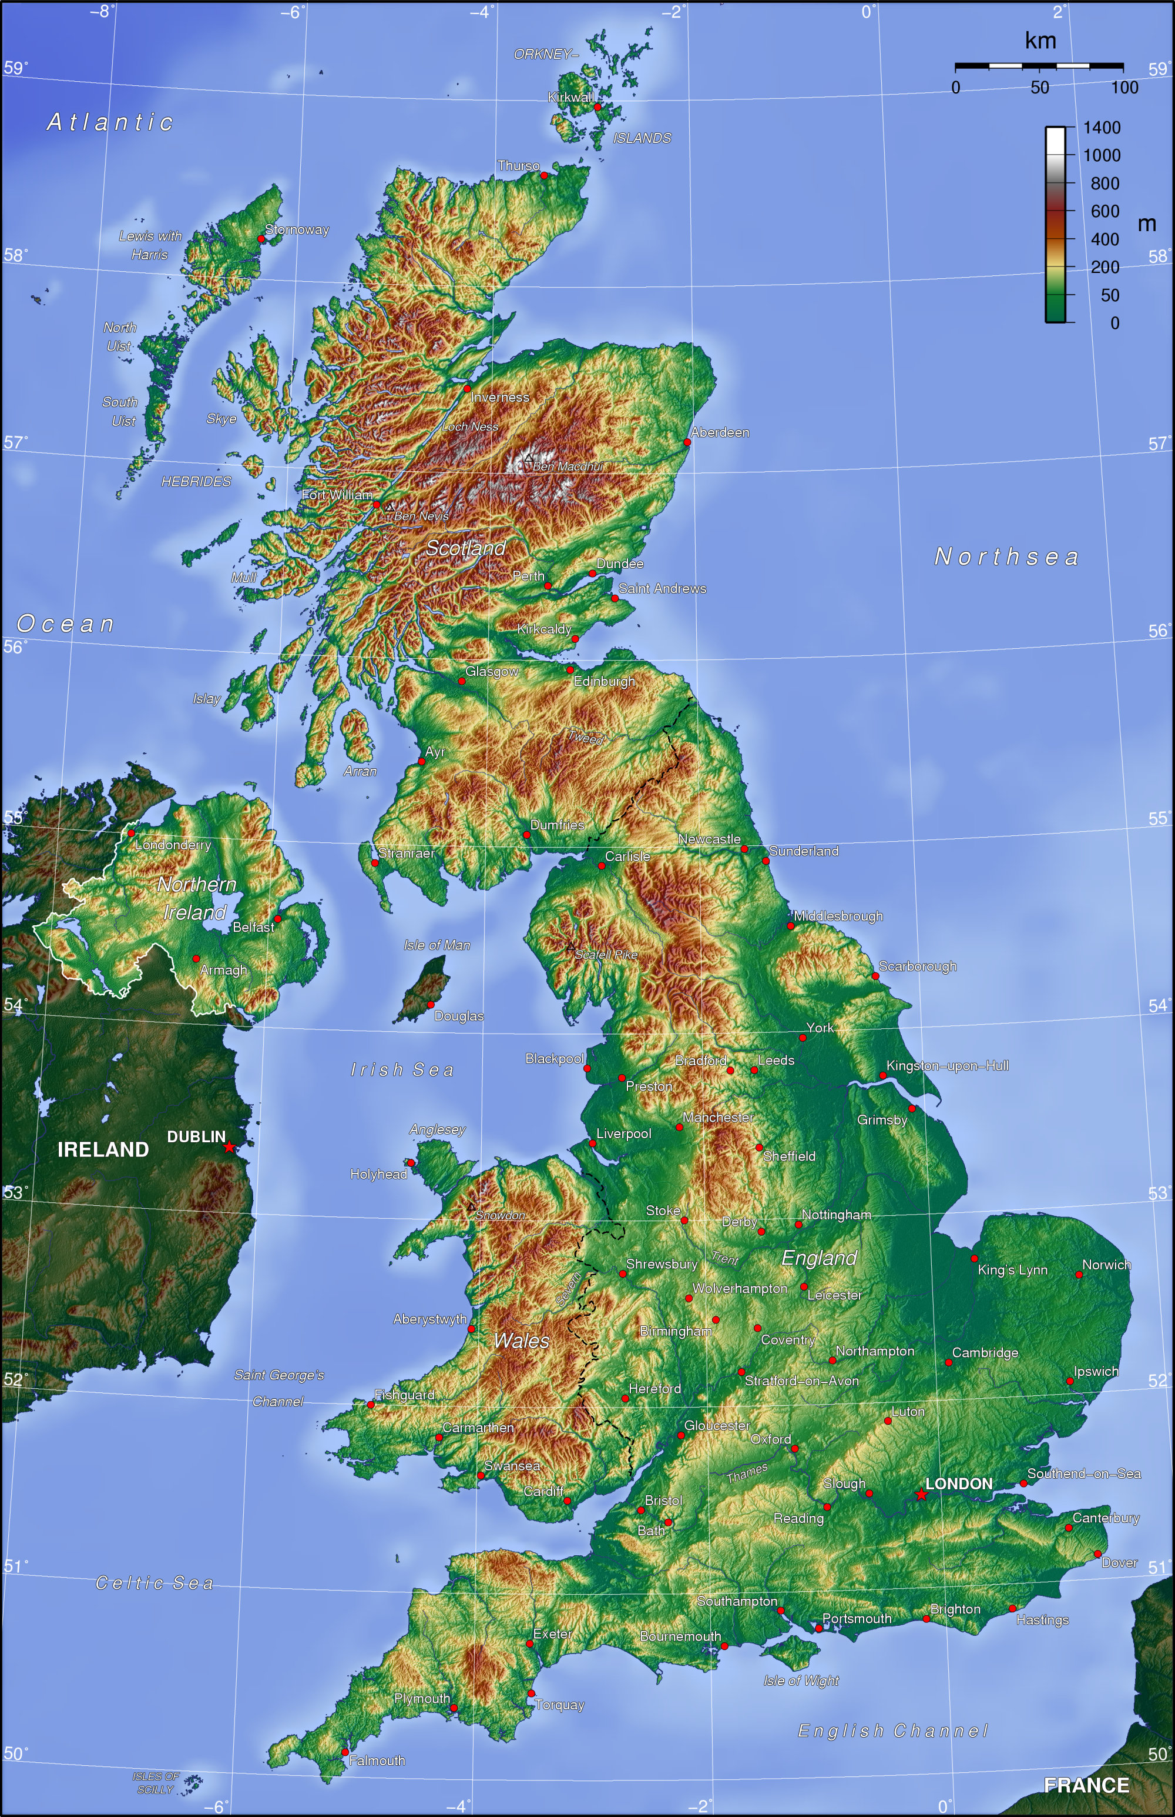
UK precipitation and orography
Wind direction

Slide 4
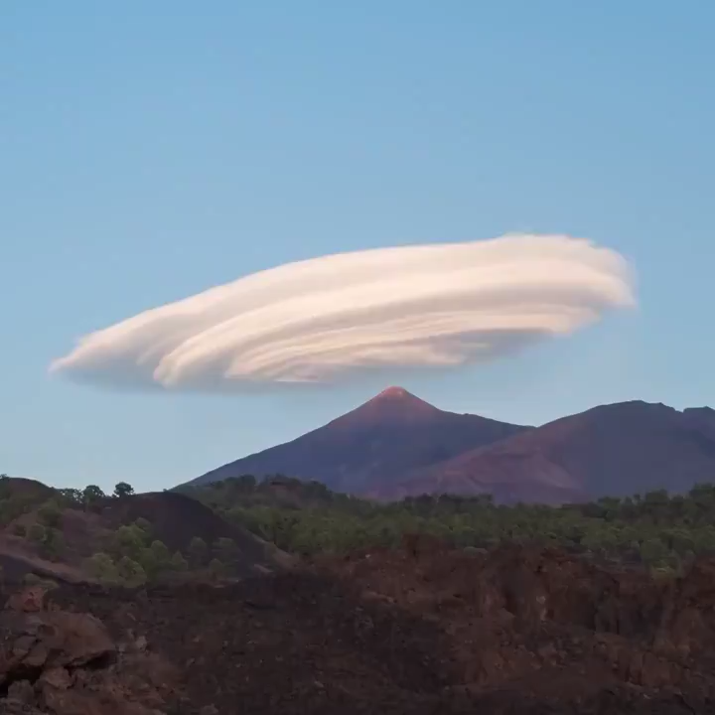
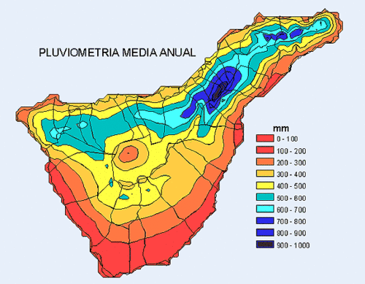
Orographic clouds over Mt.Teide
Wind direction

Slide 5
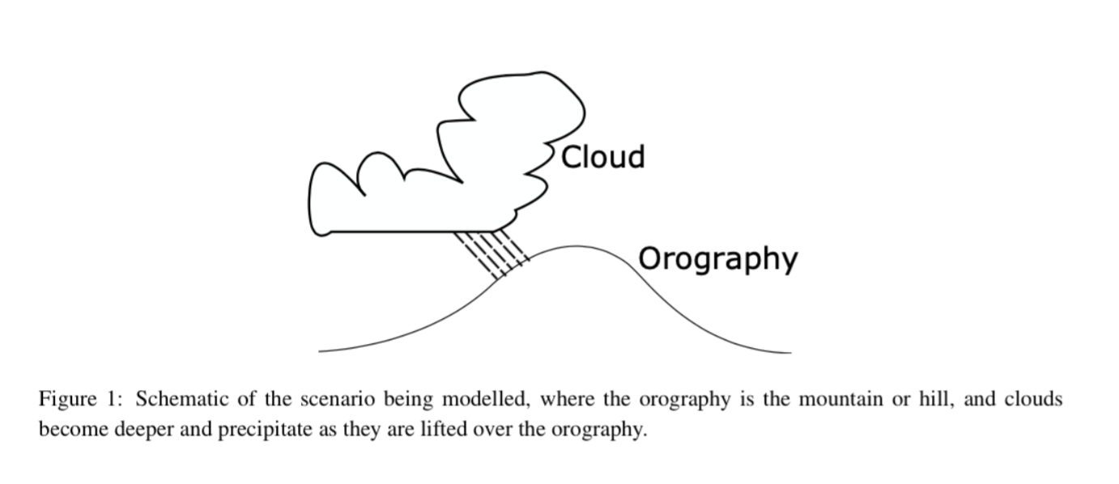
The scenario we are modelling this week
the vertical coordinate is very important…

Slide 6
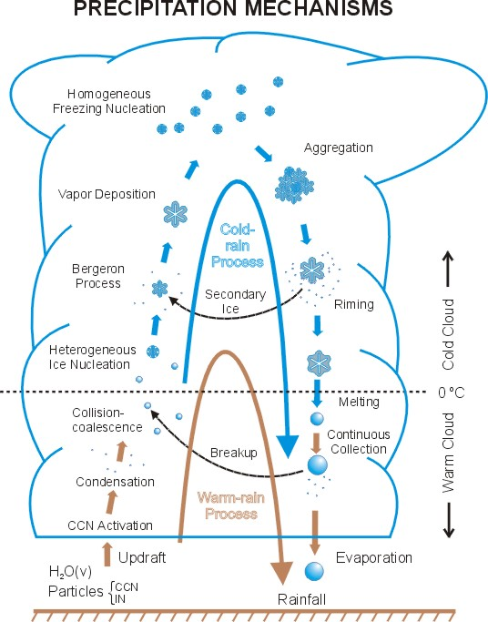
Cloud and Precipitation Processes
Cold Cloud Processes
The vertical coordinate is important!
Warm Cloud Processes
Platnick
Notes:
6
Wang and Olsen.

Slide 7
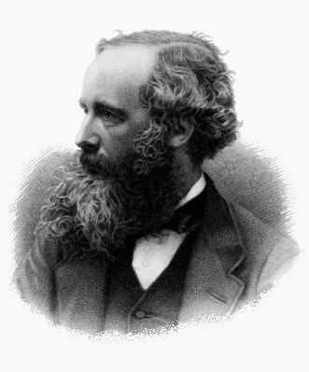
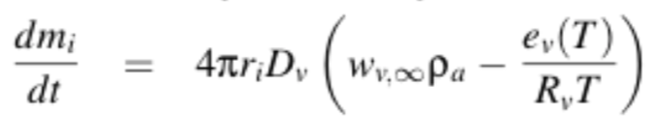
Condensation
We talked about the condensation and evaporation of water vapour onto droplets in week 3. We are able to grow small drops this way.
It is described by an Ordinary Differential Equation (ODE).
It is important to increase the size of aerosol particles into drops, but it would take 10s of days to grow an aerosol particle into a rain-drop sized particle!
There must be other important processes
James Clerk Maxwell (1831–1879)
Diffusion of vapour to a growing drop
(liberating latent heat)
m_{i}

Slide 8
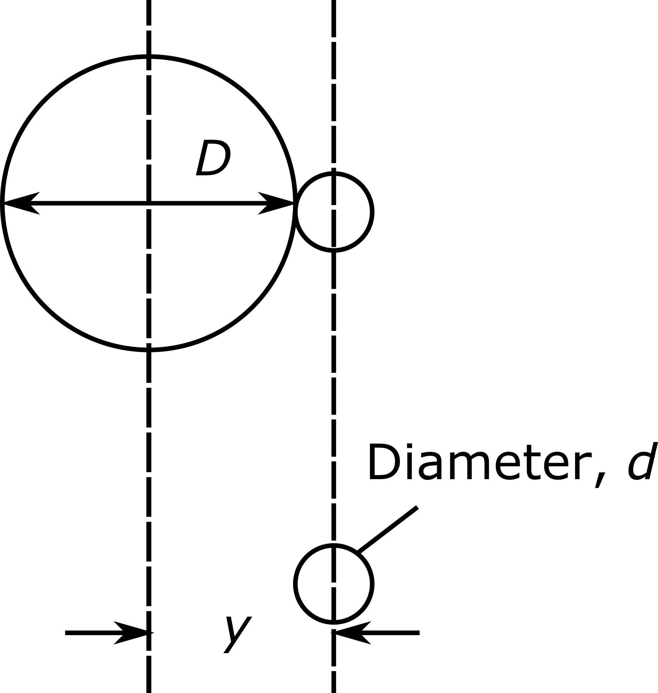
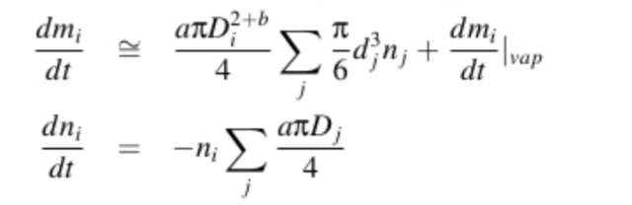
“Warm”-rain process
If some droplets become slightly larger than others they will fall faster through the air.
If a smaller drop is in the path of this larger drop the larger drop will collide and coalesce with it
The larger drop grows and collect the smaller drop
This is referred to as the “warm-rain” process because it does not include ice
An ODE describes how a drop of mass, m_{i} grows due to this process.
If a drop is collected, the number of them also decreases.
This is more efficient the larger the drops
Can lead to rain in ~20 minutes

Slide 9
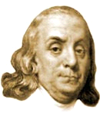
“Cold” rain process
Benjamin Franklin (1784)
“much of what is rain, when it arrives at the surface of the earth, might have been snow, when it began its descent…”
University of Reading (Dr R. Hogan)

Slide 10
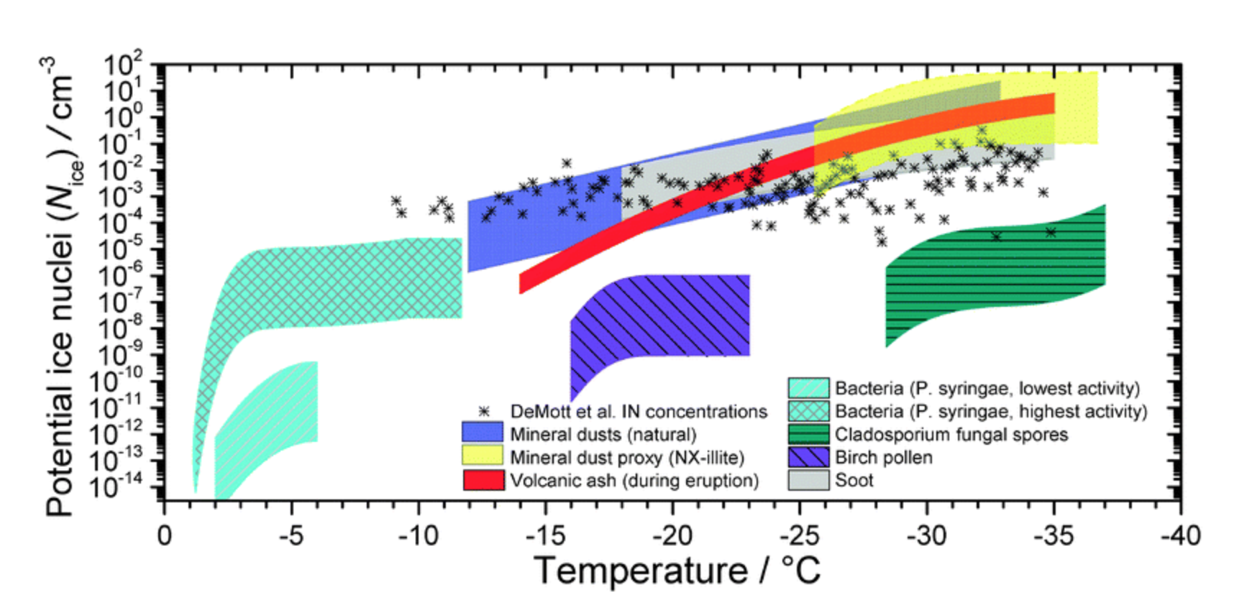
The formation of ice crystals requires “rare” aerosol particles
Murray et al, 2012, CSR
Similar to Cloud Condensation Nuclei (CCN) for liquid
We have Ice Nucleating Particles (INP) for the ice phase
Dust from the deserts is an important INP in the atmosphere
There are ODEs to describe the rate of ice crystal formation and growth

Slide 11
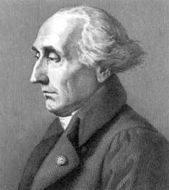
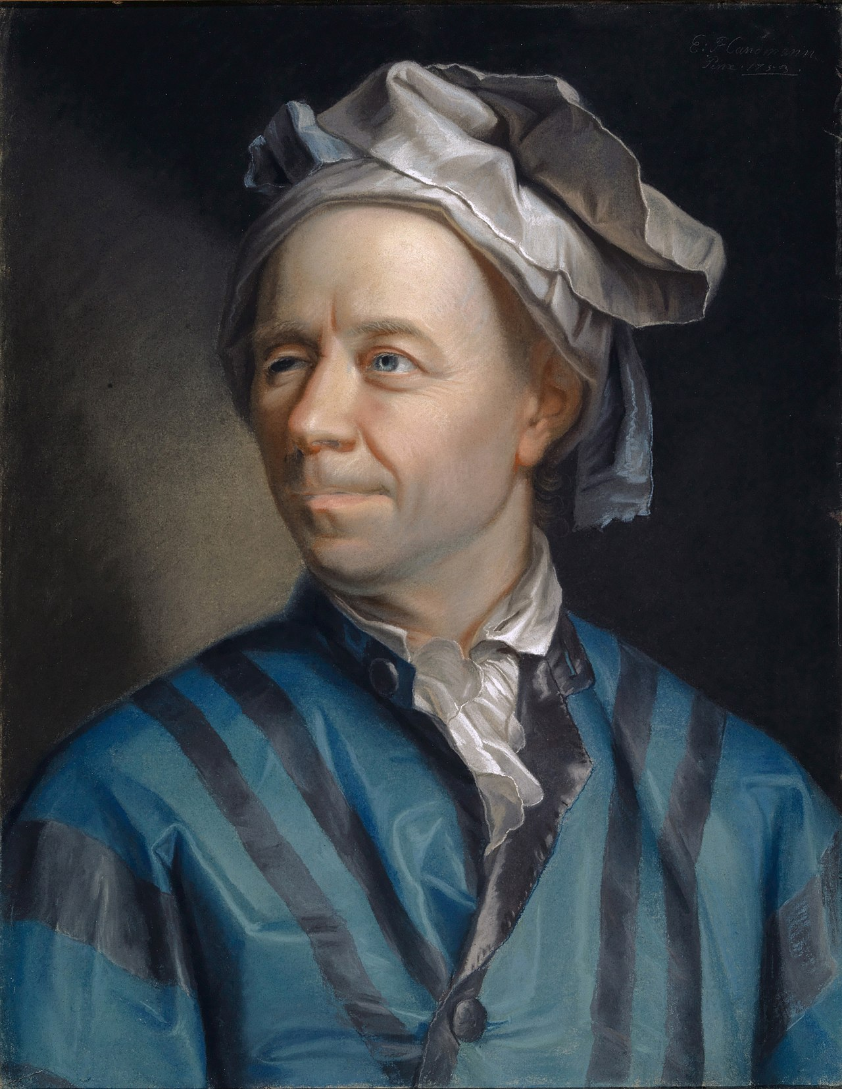

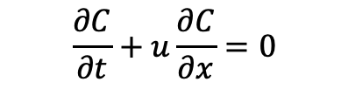
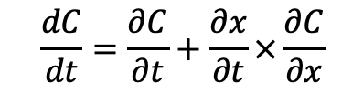

Lagrangian and Eulerian models part 2
Lagrangian:
If a variable is conserved in a parcel, its rate-of-change in a frame of reference that follows the parcel is zero
Eulerian:
We can represent a conserved variable in a frame of reference that does not move (i.e. on fixed grid points)
Apply the chain rule
Joseph-Louis Lagrange:
1736-1813
Lenard Euler:
1707-1783
$$\frac{dC}{dt}=\frac{∂C}{∂t}+\frac{∂x}{∂t}×\frac{∂C}{∂x}$$
$$\frac{∂x}{∂t}$$
but is just the velocity, u.
so the equation for a conserved variable in the Eulerian framework is (also known as advection):
so the equation for a conserved variable in the Lagrangian framework is:
$$\frac{dC}{dt}=0$$
$$\frac{∂C}{∂t}+u\frac{∂C}{∂x}=0$$

Slide 12



Numerical diffusion, and stability of the advection eq
The advection equation usually requires that the time-step used is sufficiently small. You must choose the time-step such that
is less than 1, otherwise the solution is unstable
This requirement is known as the CFL criterion.
Still does not solve the artificial spreading in the solution known as ‘numerical diffusion’
CFL=$0.6$
CFL=$v\frac{∆t}{∆x}$
CFL=$1.2$

Slide 13
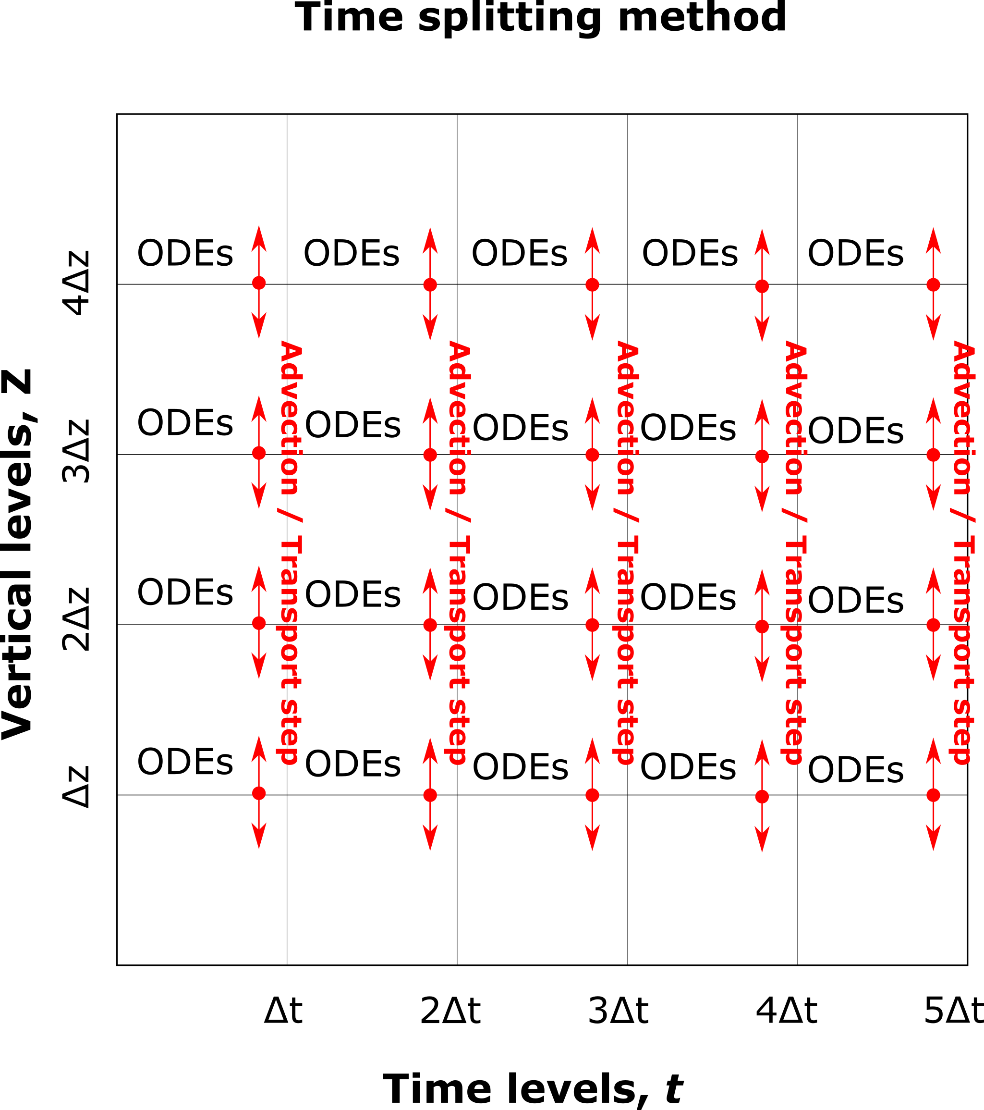
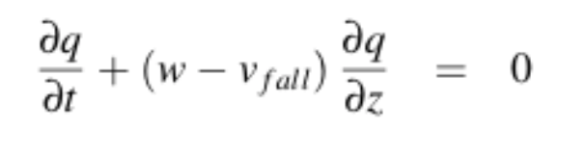
Details of the model Solve ODEs for fixed ‘parcels’ and transport variables between layers
Each vertical level has its own set of ODEs
Solve ODEs over 1 time-step, Δt
Then transport variables by solving advection Partial Differential Equation (PDE)
Velocity is based on fall-speed of rain-drops: -v_{fall}
and movement of air updraft, w
Advection equation
Repeat

Slide 14
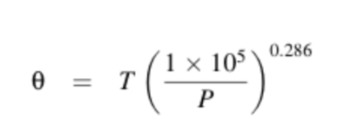

Conserved variables
We apply the advection equation to conserved variables. i.e. variables that don’t change along a path (in the Lagrangian sense)
After the advection step ODEs may alter these conserved variables.
e.g. water vapour may condense onto droplets or ice particles.
Cloud drops may evaporate into water vapour.
There is an important conserved variable that atmospheric models use which is called potential temperature, θ.
It is a property of air that does not change when the air is advected to a region of different pressure. It does change due to condensation however, and this is calculated in the ODE step.
We can advect θ with the air and then rearrange to find the new temperature, T.

Slide 15
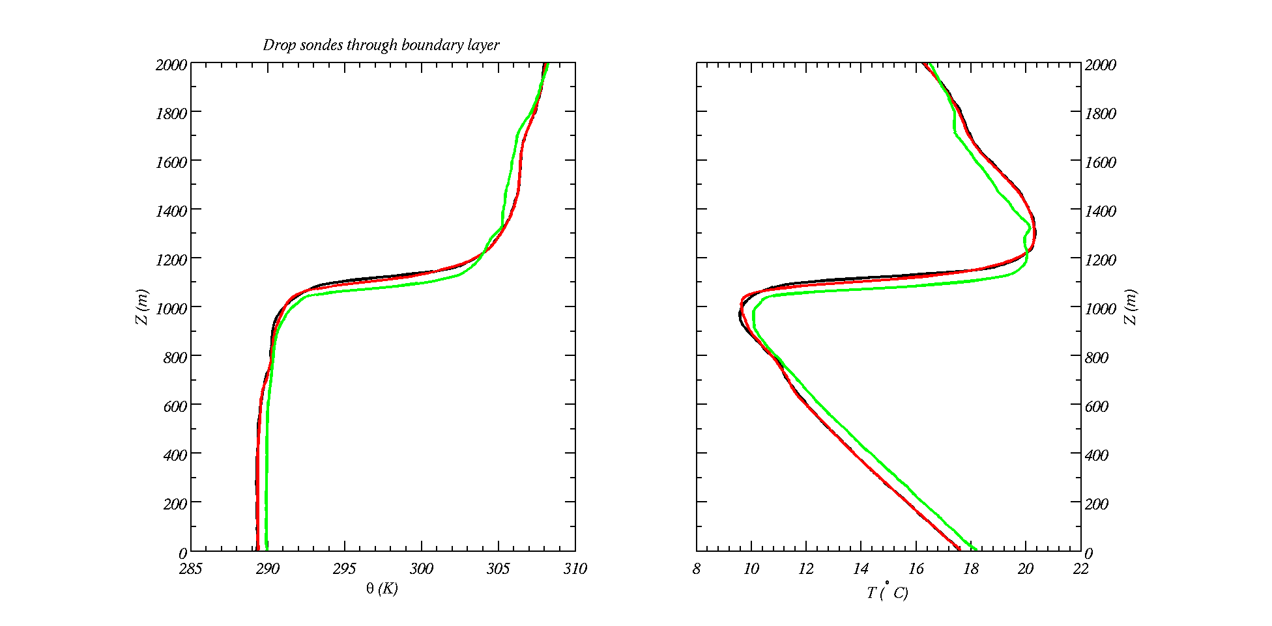
Conserved variables Measurements in atmosphere
In this location air thermals (parcels) are rising from the ground to 1000m. Clouds are forming at 700m
Note the temperature lapse rate (right) shows 10 degC per km.
Potential temperature (left) is a constant from the ground up to cloud base.

Slide 16
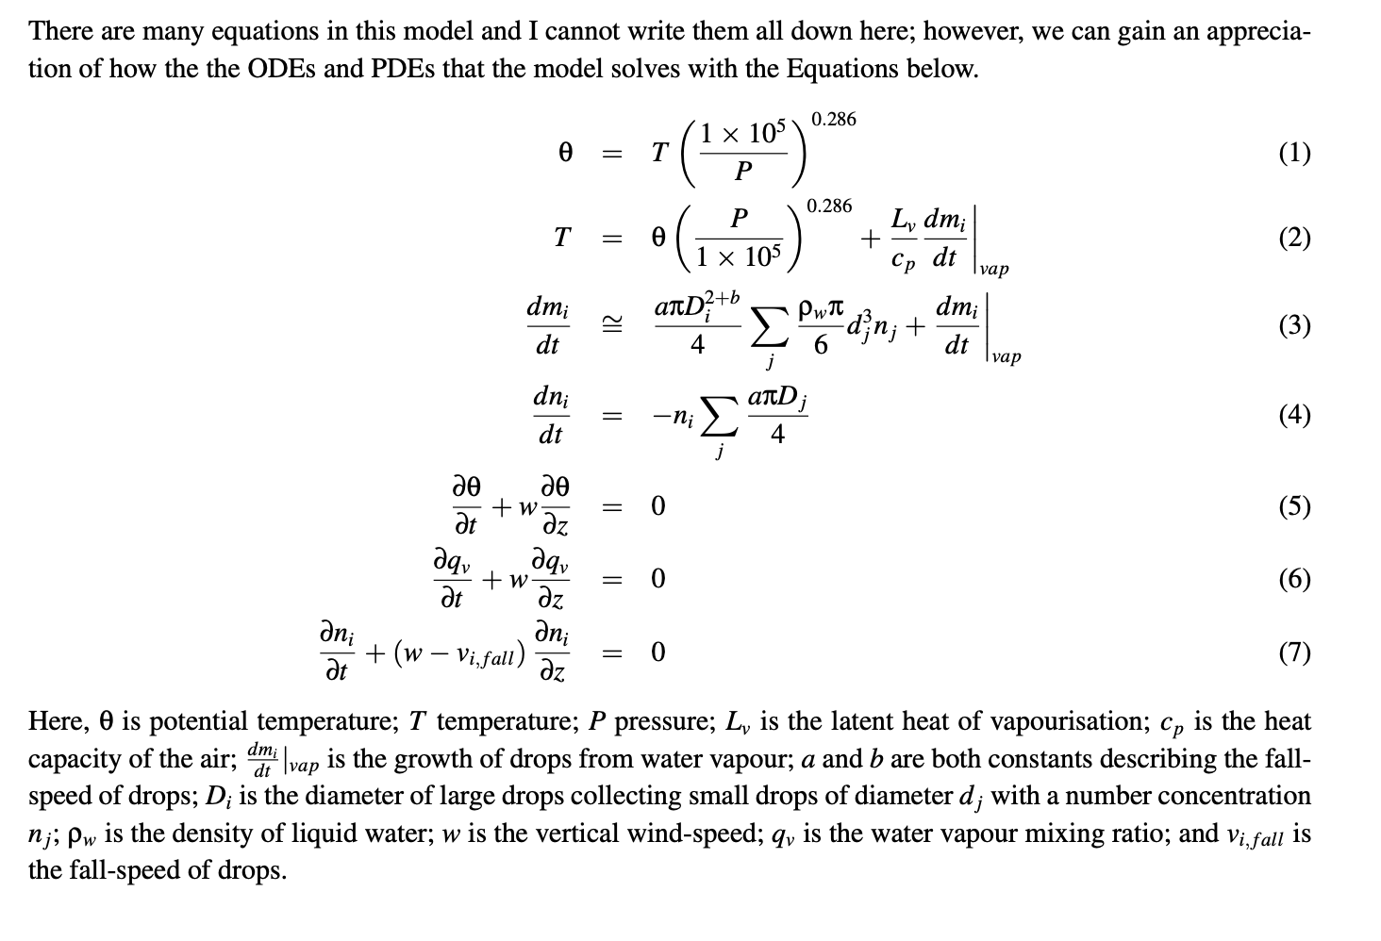
Equations of the model

Slide 17
Main points
This week we are actually solving ODEs at many levels and PDEs between levels to run the simulations.
More expensive, so we’ll be using compiled code (FORTRAN)
Cloud and Precipitation processes are important. You will learn about these in other modules. But:
Condensation – too slow for rain
Warm-rain – drops collide and coalesce – fast!
Warm-rain is dependent on the number of cloud drops – which we found depends on the number of aerosol particles (week 3).
Cold-rain – nucleation and growth of ice particles which can fall as snow or rain (if they melt)
Cold-rain depends on ice nucleating particles – these can be rare. Desert dust is an important INP.
Advection / or Transport equation
This is a partial differential equation and we are solving it on an Eulerian grid
Has problems such as numerical diffusion and stability considerations
Time-splitting method: if we are solving ODEs and PDEs together we can use time-splitting.
We will calculate these things ourselves in the practical synchronous session

