Slide 1
Measuring and Predicting
Practical 1: thermodynamics, visibility, particulate matter, some info on turbulent dispersion / diffusion
Dr Paul Connolly
Centre for Atmospheric Science

Slide 2
Topics covered
Broad-brush climate model.
Pressure, temperature basics – ideal gas law
Lapse rate in the atmosphere
Water vapour in the atmosphere
  Relative humidity
  Mass mixing ratio
Relative humidity over an aerosol particle
Visible range and how it can be modified by aerosols and humidity
Particulate matter and how it depends on aerosols and humidity
Turbulent Dispersion / Diffusion Gaussian Plume modelling.

Slide 3
Why are these topics important?
Relative humidity and aerosols (particles in the air) are important to the forecasting of weather and air quality.
Climate and weather: They affect both climate, visibility and the mass of aerosol in the atmosphere (particulate matter or PM).
  “the uncertainties relating to aerosol radiative forcings remain large”, Intergovernmental Panel on Climate Change
Health effects: In the UK PM are continuously measured by air quality monitoring stations and local councils can receive fines under EU legislation if limits are exceeded.
  “Increased levels of fine particles in the air as a result of anthropogenic particulate air pollution "is consistently and independently related to the most serious effects, including lung cancer” Ole Raaschou-Nielsen et al (July 10, 2013)
  WHO estimates ~5% mortality from cancer due to PM2.5.

Slide 4
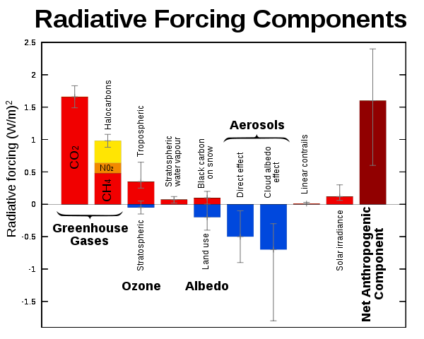
Climate: radiative forcing
Intergovernmental Panel on Climate Change

Slide 5
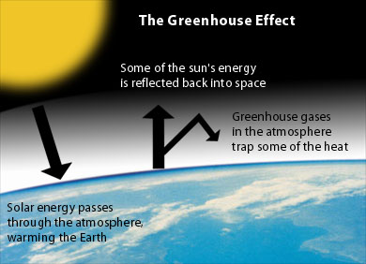
(e.g. by clouds)
www.environmentalsociety.ca/issues/climate/international-issues.html
Notes:
Write albedo=energy reflected/energy incident on board

Slide 6
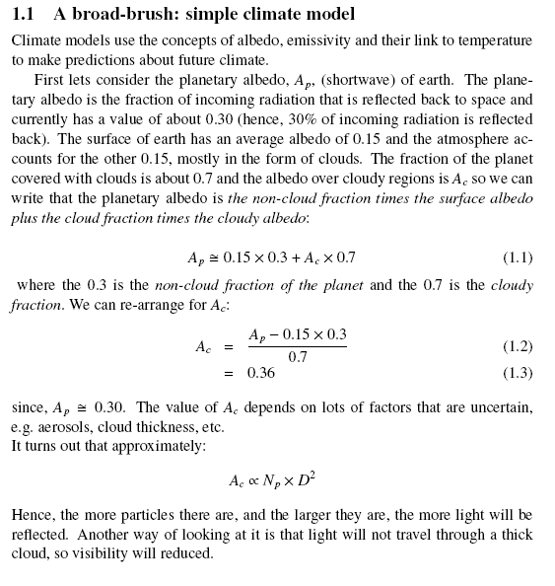

Slide 7
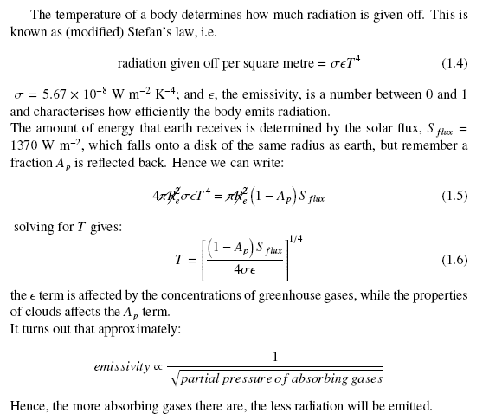

Slide 8
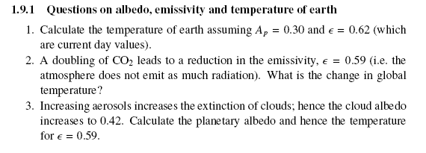

Slide 9
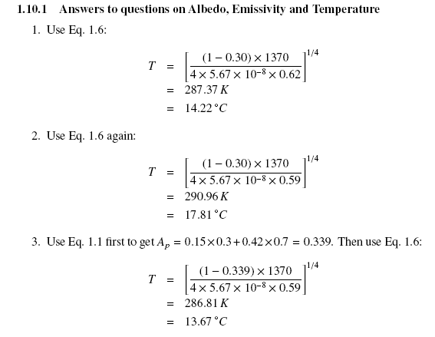

Slide 10
Climate sim
A simple climate model can do a very good job at reproducing the global temperature:
  http://personalpages.manchester.ac.uk/staff/paul.connolly/teaching/climatesim/index.html

Slide 11
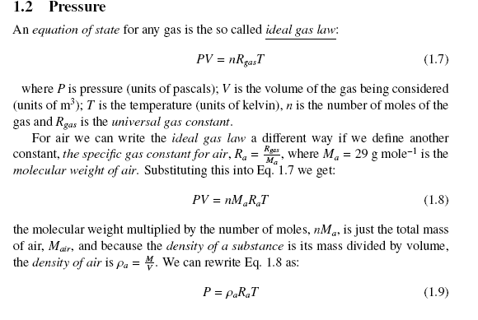

Slide 12
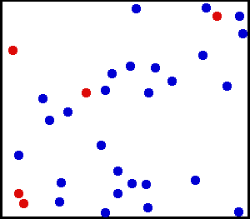
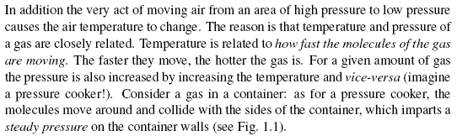
Pressure and temperature are related

Slide 13
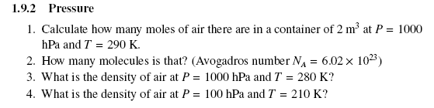
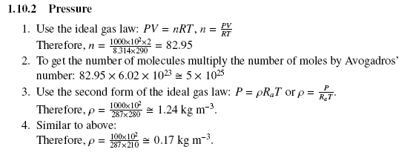

Slide 14
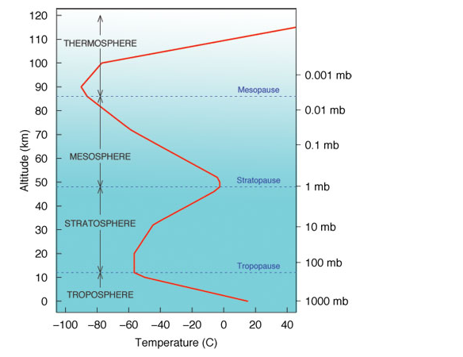
Lapse rate
Rising dry air cools at 10 degC per kilometre, moist air cools at 6 degC per kilometre, but the air itself may have a different lapse rate
Above tropopause, lapse rate is governed by other processes, such as the break down of ozone by UV
In the troposphere, lapse rate is very important because it governs the vertical stability.

Slide 15
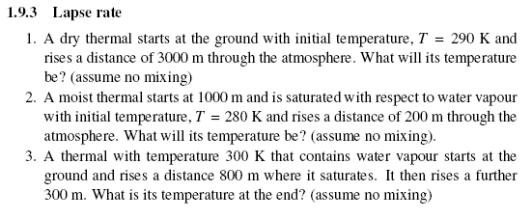
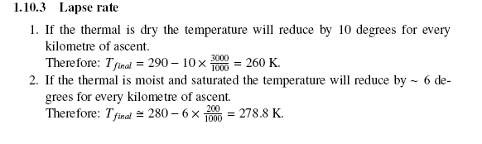


Slide 16
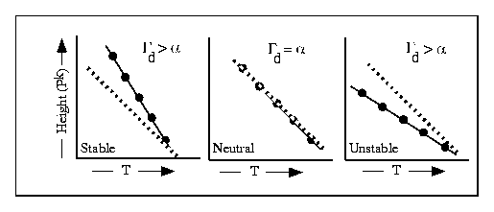
Vertical stability is related to the environmental lapse rate
Solid line = atmosphere, α
Dashed line = path a parcel of air would take, Γ_{d}

Slide 17
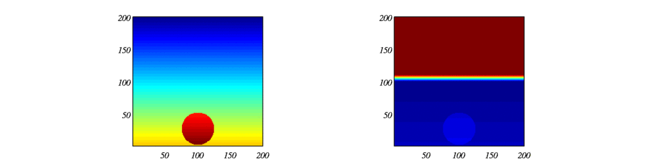
Simulation of rising blob of warm air
Colour is proportional to temperature (modelled)
Unconditionally unstable:
Conditionally unstable:
What is happening here?

Slide 18
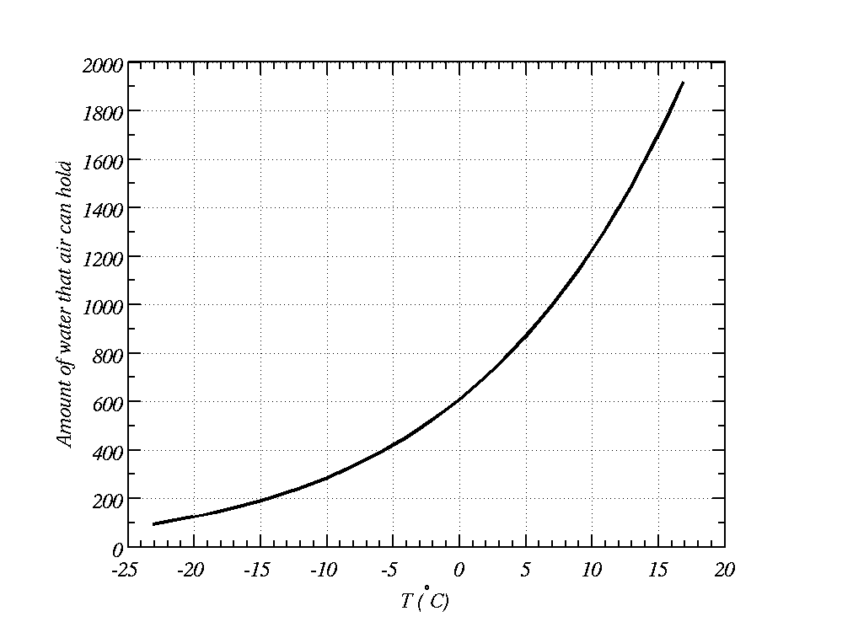
Warm air holds more water vapour than cold air
Cools during the night
This much water in the air
Saturation vapour pressure (Pa)
?
Water exists as liquid and vapour here
Water exists as vapour here

Slide 19
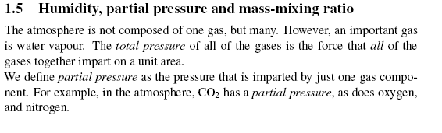
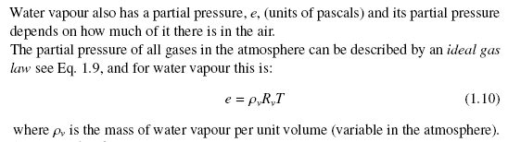

Slide 20
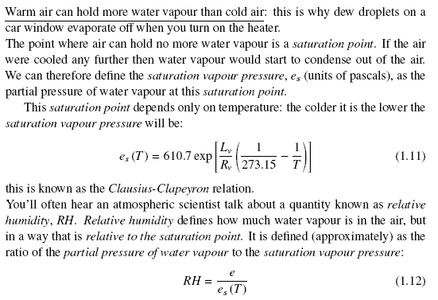

Slide 21
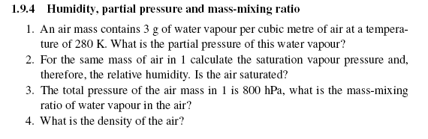
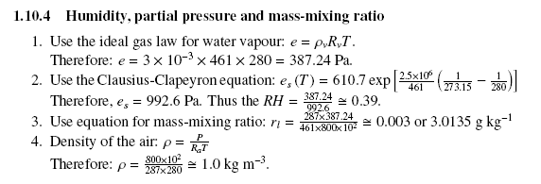

Slide 22
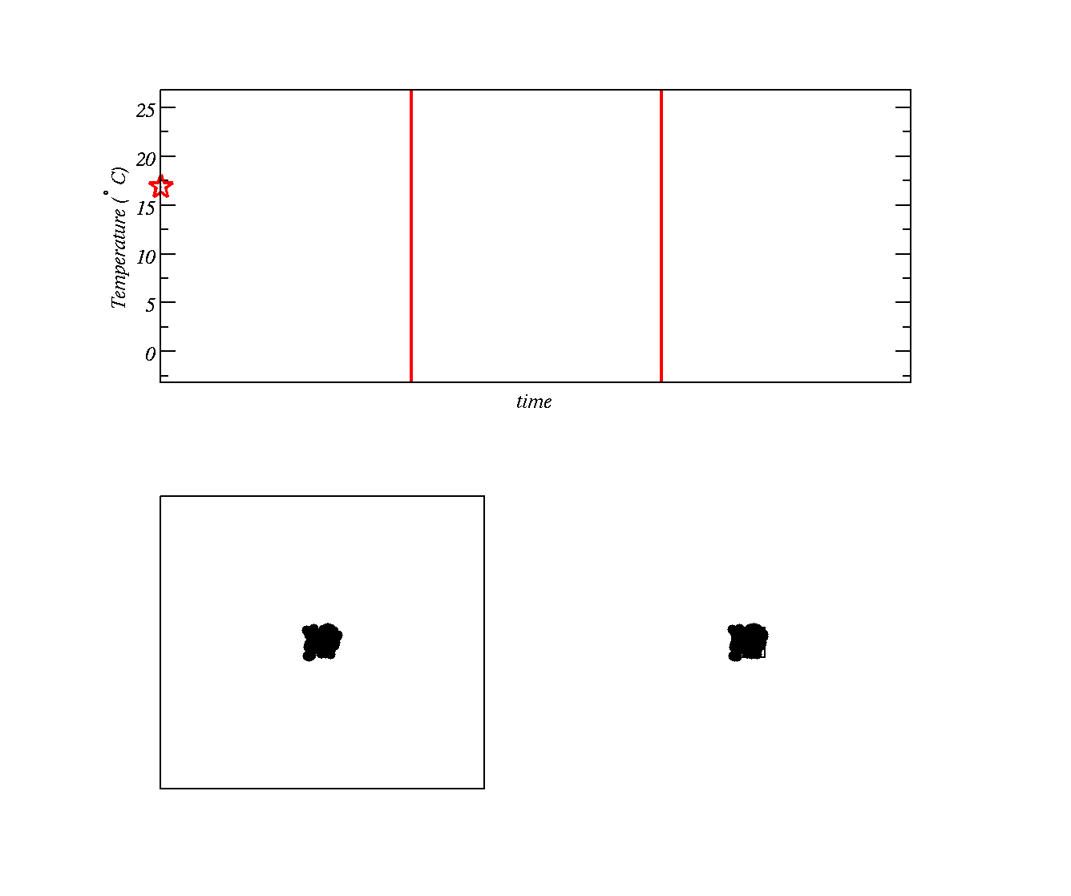
As pressure decreases the molecules must occupy more volume. The gas `pushes’ against air around it and gas molecules slow
Using Kinetic Theory how does the speed (Kinetic Energy) of molecules affect their temperature?
Do you know a law describing how energy and work are related? i.e. what will happen to the energy of the gas molecules as they do work on the surroundings?
Allow gas to expand here
Gas stops expanding
Two boxes with gas at high temperature (molecules moving around fast)
Second box has molecules crammed into a smaller space (higher pressure)

Slide 23
As pressure decreases the molecules must occupy more volume. The gas `pushes’ against air around it and gas molecules slow
Allow gas to expand here
Gas stops expanding
We are going to allow the gas molecules in second box to `push’ against the surrounding air and slow down as a result (temperature is reduced)

Slide 24
Now, how can we make a cloud?
Lets discuss how you might use the equipment to make a cloud.
Key point:
  Humidity needs to increase so that particles swell up.

Slide 25
Choose 6 steps and put them in the correct order
Close the screw cap
Put water in the chamber
Pump air into the chamber
Strike a match, blow out and put in the chamber
Close the large valve on the chamber
Open the large valve on the chamber
Open the screw cap

Slide 26
Choose 7 steps and put them in the correct order
Close the large valve on the chamber
Open the screw cap
Put water in the chamber
Strike a match, blow out and put in the chamber – aerosols / cloud condensation nuclei
Close the screw cap
Pump air into the chamber
Open the large valve on the chamber
GEOS model of aerosols

Slide 27
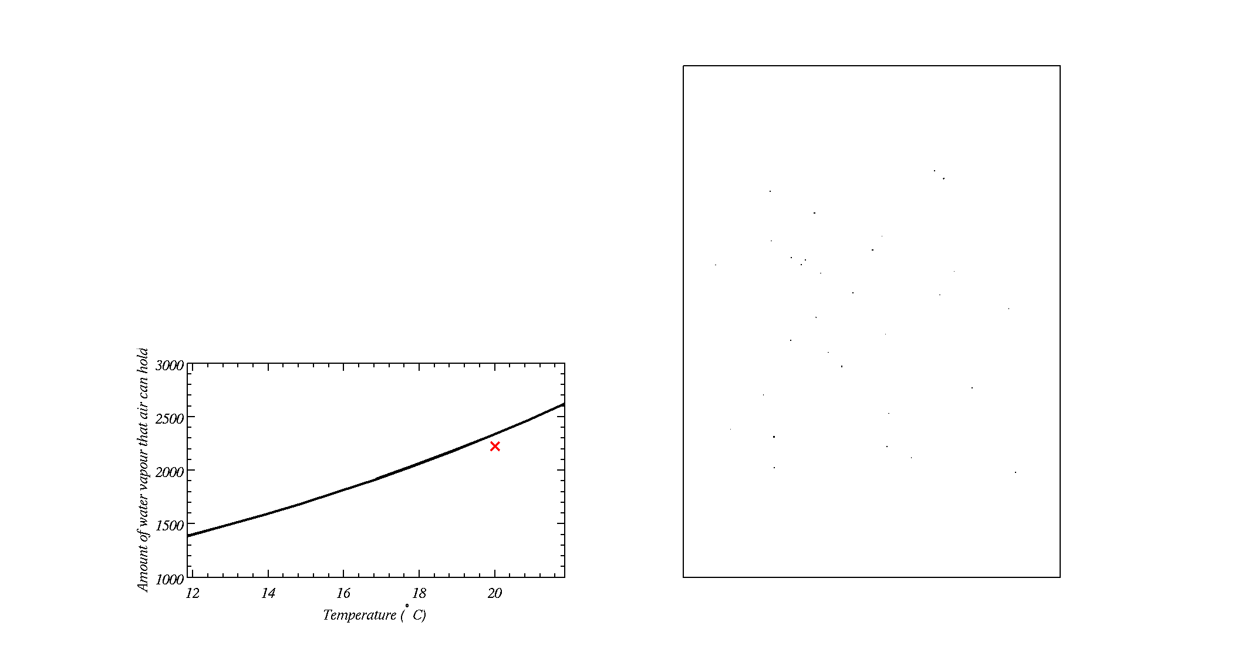
Cloud Condensation Nuclei
Box with cloud condensation nuclei in it
As the air cools during the expansion, water vapour eventually condenses onto Cloud Condensation Nuclei (a type of small particle suspended in air) and forms a cloud
Some small particles do not act as Cloud Condensation Nuclei
Amount of water in the air

Slide 28
Cloud Condensation Nuclei
Box with cloud condensation nuclei in it
As the air cools during the expansion, water vapour eventually condenses onto Cloud Condensation Nuclei (a type of small particle suspended in air) and forms a cloud
Some small particles do not act as Cloud Condensation Nuclei
Amount of water in the air

Slide 29
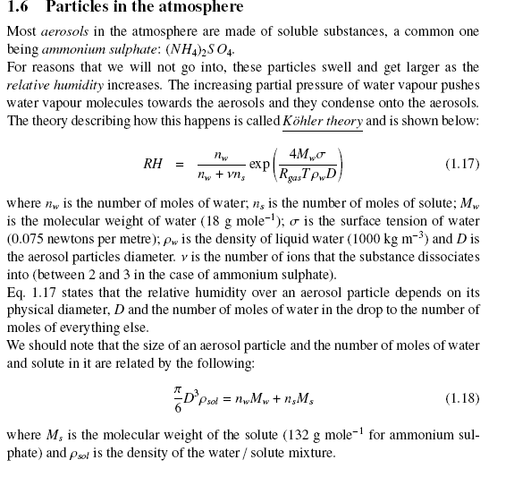

Slide 30
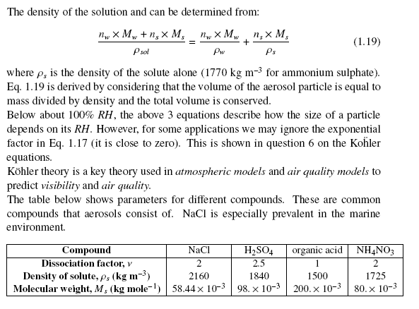

Slide 31

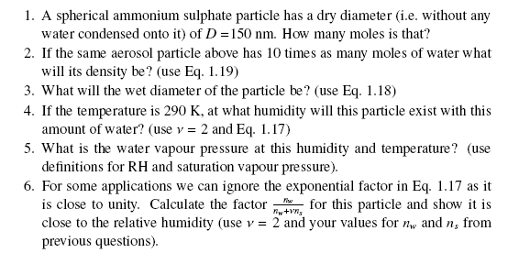

Slide 32
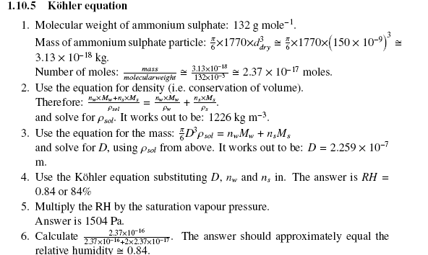

Slide 33
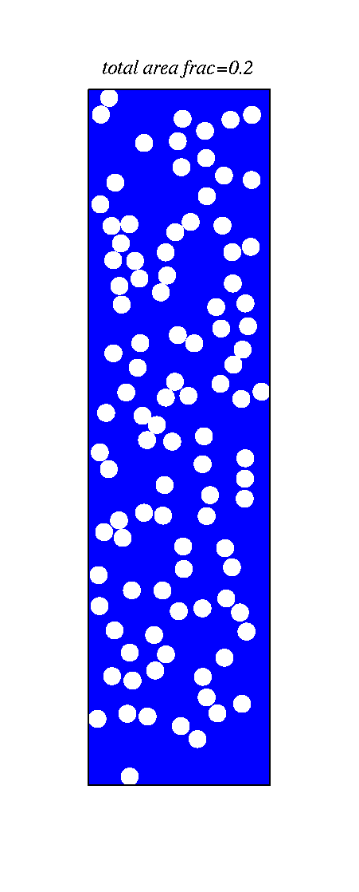
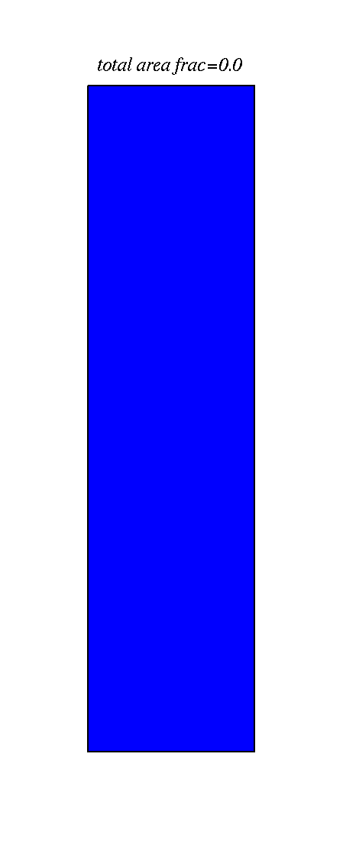
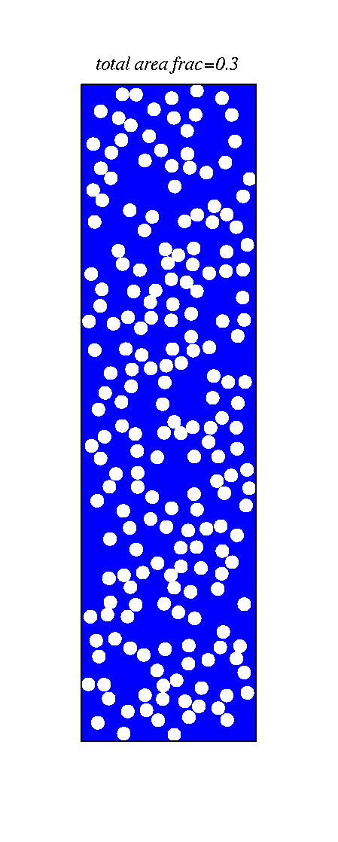
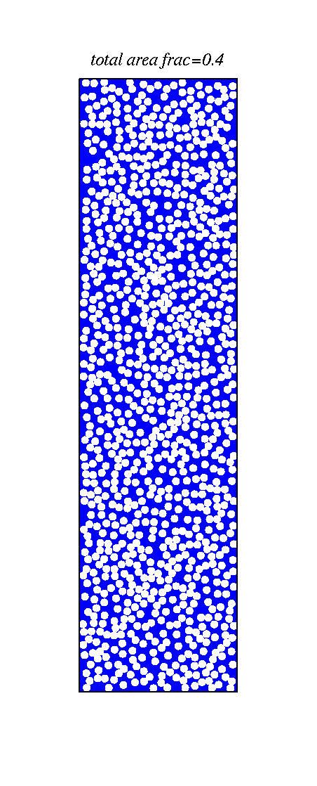
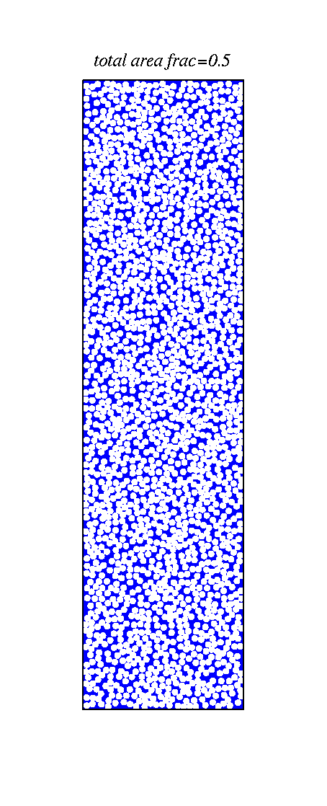
The number of cloud condensation nuclei is important to how much sun-light is reflected what do you notice?
Ocean - blue

Slide 34
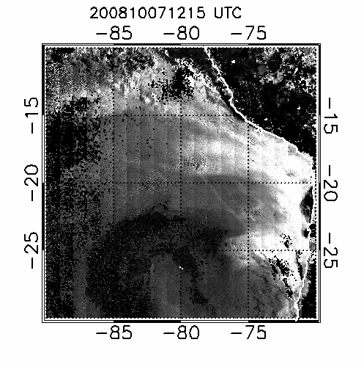
What do you think the `straight’ features are?

Slide 35
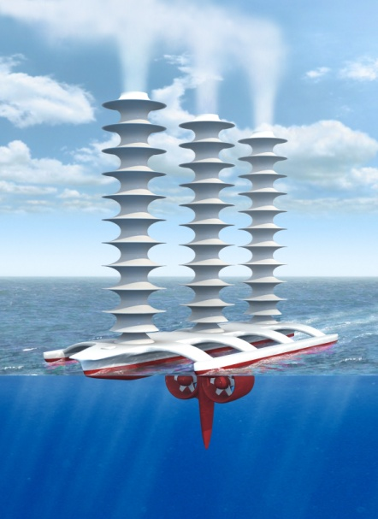
Latham’s geoengineering scheme
(a way of combating global warming?)
Technique (Latham, Nature, 1990)
To disseminate natural sea water droplets at ocean surface into the boundary layer.
These ascend via thermals to enter the cloud and increase the number of drops within the cloud
Switching off the sprayers returns to the status quo within a week or so.
Support for idea
Natural droplet creation at ocean surface
NaCl drops are effective CCN
Ship tracks, fires already show that it works…

Slide 36
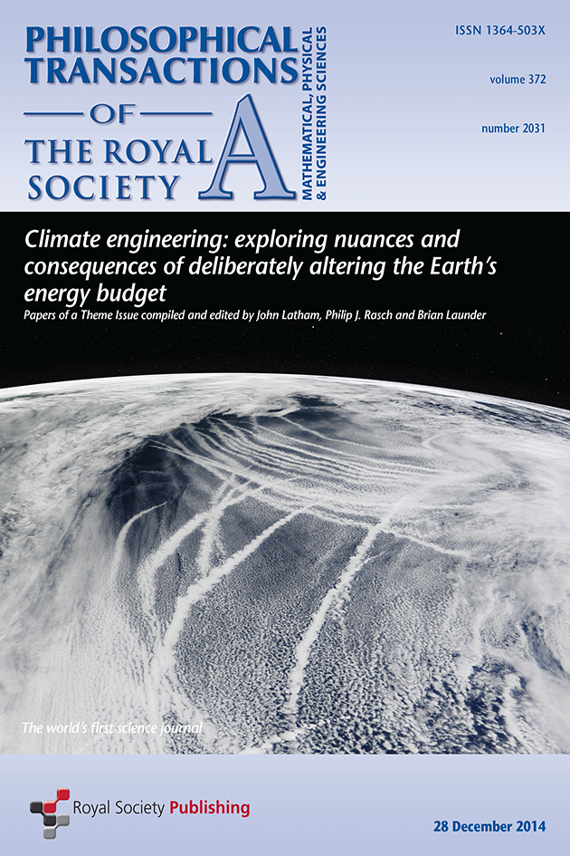

Slide 37
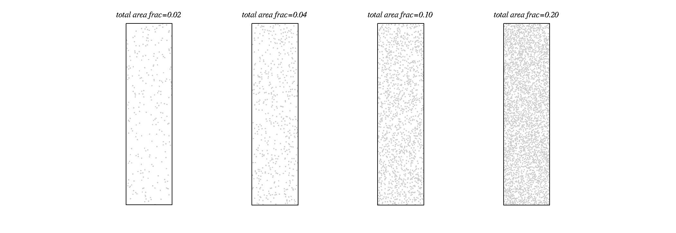
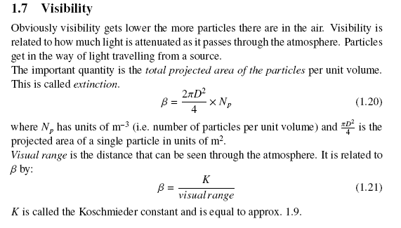
Visibility, increase the number of aerosols, what do you notice?

Slide 38
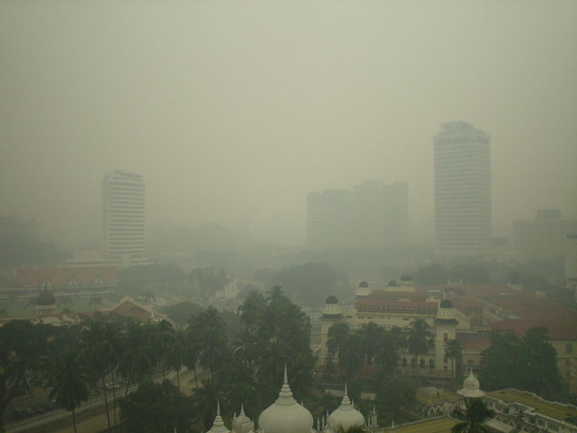
Visibility

Slide 39
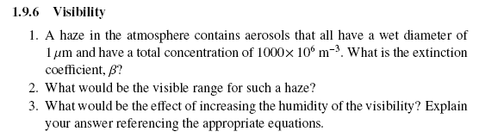
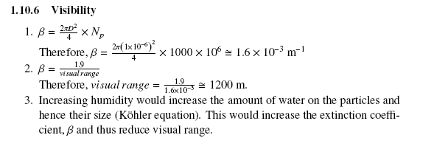

Slide 40
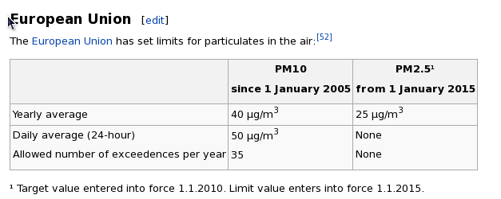
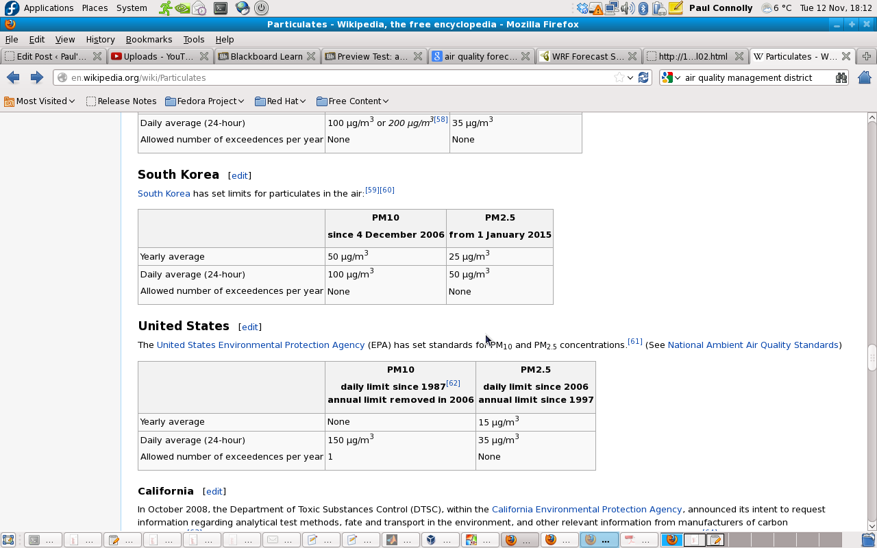
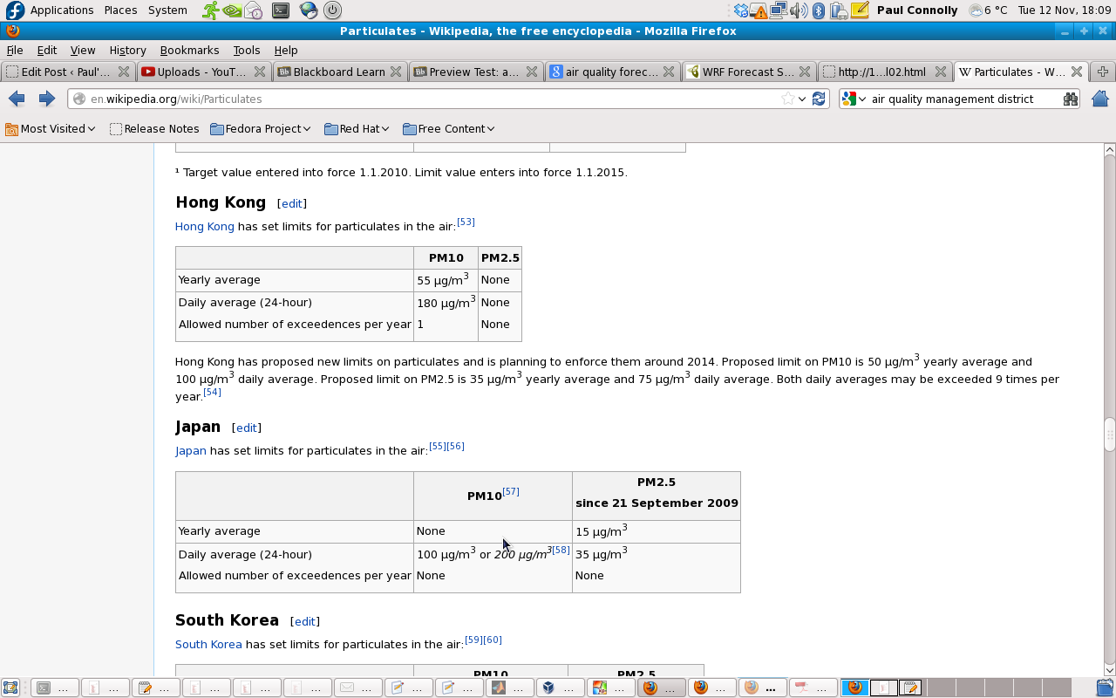
Some limits for particulate matter

Slide 41
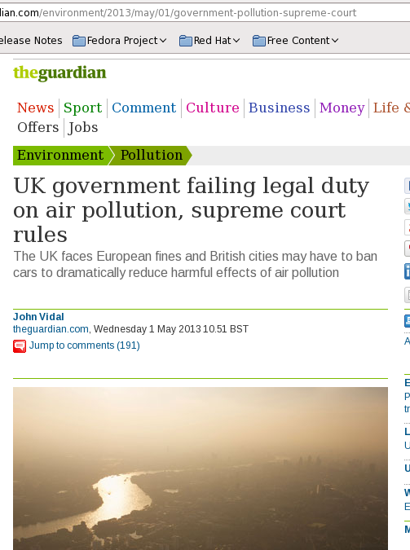
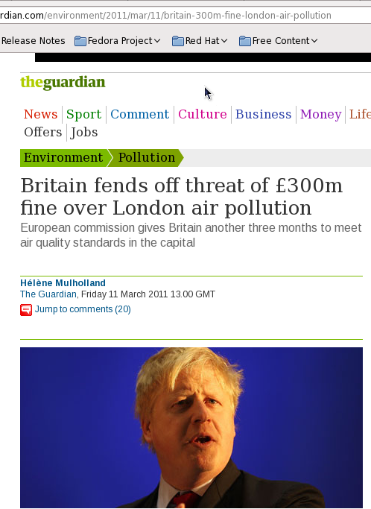
Fines for the UK

Slide 42

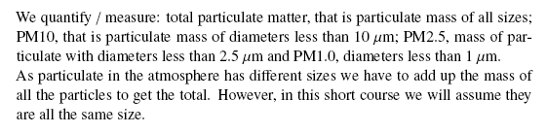
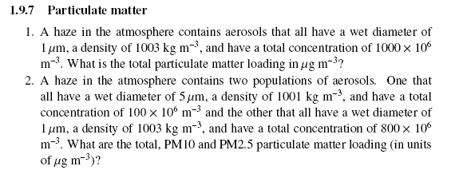

Slide 43
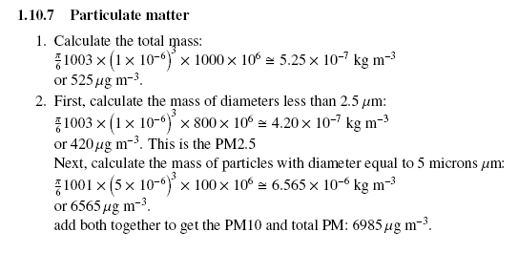

Slide 44

Stacks in Industry
Emissions from industrial stacks are regulated to protect human and environmental health
Industrial facilities are required to obtain permits to emit into the atmosphere and to demonstrate their compliance with regulations
In the process of applying for permits, dispersion models are generally used to assess the impact of point source emission

Slide 45
Dispersion Model
A dispersion model is essentially a computational procedure for predicting concentrations downwind of a pollutant source
Routinely used in:
Environmental impact assessments
Risk analysis
Emergency planning

Slide 46
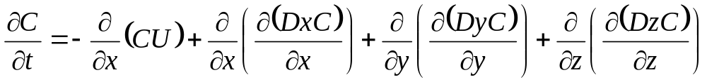


Advection-diffusion
Where;
x = along- wind coordinate measured in wind direction from the source
y = cross-wind coordinate direction
z = vertical coordinate measured from the ground
C(x,y,z) = mean concentration of diffusing substance at a point (x,y,z) [kg/m3]
Dy,Dz = mass diffusivity in the direction of the y- and z- axes [m2/s]
U = mean wind velocity along the x-axis [m/s]
Time rate of change and advection of the cloud by the mean wind
Turbulent diffusion of material relative to the center of the pollutant cloud.
( the cloud will expand over time due to these terms.)

Slide 47

Assumptions
Mass transfer due to bulk motion in x-direction far out shadows the contribution due to mass diffusion. That is the second term on the right side of Equation is far smaller than the first term and may be dropped from the equation
We are primarily interested in the steady-state solution to the dispersion of the pollutants in the atmosphere. Hence the quantity is zero
Even though the wind speed does vary in the three coordinate directions, the variation is relatively small. Therefore it is appropriate to assume that the wind speed U is constant
The major transport direction due to the wind is chosen to lie along the x-axis
Dx, Dy and Dz are constant
Analytical solution to advection-diffusion for a point source is…

Slide 48



The general equation to calculate the steady state concentration of an air contaminant in the ambient air resulting from a point source is given by:
Where;
c(x,y,z) = mean concentration of diffusing substance at a point (x,y,z) [kg/m³]
x = downwind distance [m],
y = crosswind distance [m],
z = vertical distance above ground [m],
Q = contaminant emission rate [mass/s],
= lateral dispersion coefficient function [m],
= vertical dispersion coefficient function [m],
U = mean wind velocity in downwind direction [m/s],
H = effective stack height [m].

Slide 49

Plume Boundary

Slide 50

Plume Dispersion by Gaussian Distribution and Coordinate System

Slide 51

We will model these…
We won’t model these…
Typical Velocity, and Plume Shapes

Slide 52


Slide 53
Main points
Warm air holds more water vapour than cold air (Clausius-Clapeyron relation)
Lowering pressure can lead to cooling of the air and hence increases the relative humidity.
Visibility and particulate matter in the atmosphere are affected by the ambient conditions, such as P, T and relative humidity.
More unstable air the more dispersion there is.
  But we need to marry our understanding of how particles behave under humid conditions to understand particulate matter and visibility.
We will do some predictions on the computers tomorrow.

