Slide 1
Measuring and Predicting
Practical 1: thermodynamics, visibility, particulate matter, some info on turbulent dispersion / diffusion
Dr Paul Connolly
Centre for Atmospheric Science

Slide 2
Topics covered
Broad-brush climate model.
Pressure, temperature basics – ideal gas law
Lapse rate in the atmosphere
Water vapour in the atmosphere
  Relative humidity
  Mass mixing ratio
Relative humidity over an aerosol particle
Visible range and how it can be modified by aerosols and humidity
Particulate matter and how it depends on aerosols and humidity
Turbulent Dispersion / Diffusion Gaussian Plume modelling.

Slide 3
Why are these topics important?
Relative humidity and aerosols (particles in the air) are important to the forecasting of weather and air quality.
Climate and weather: They affect both climate, visibility and the mass of aerosol in the atmosphere (particulate matter or PM).
  “the uncertainties relating to aerosol radiative forcings remain large”, Intergovernmental Panel on Climate Change
Health effects: In the UK PM are continuously measured by air quality monitoring stations and local councils can receive fines under EU legislation if limits are exceeded.
  “Increased levels of fine particles in the air as a result of anthropogenic particulate air pollution "is consistently and independently related to the most serious effects, including lung cancer” Ole Raaschou-Nielsen et al (July 10, 2013)
  WHO estimates ~5% mortality from cancer due to PM2.5.

Slide 4
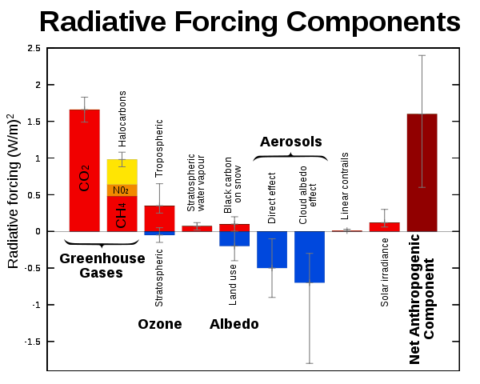
Climate: radiative forcing
Intergovernmental Panel on Climate Change

Slide 5
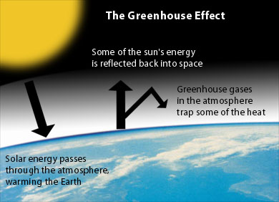
(e.g. by clouds)
www.environmentalsociety.ca/issues/climate/international-issues.html
Notes:
Write albedo=energy reflected/energy incident on board

Slide 6
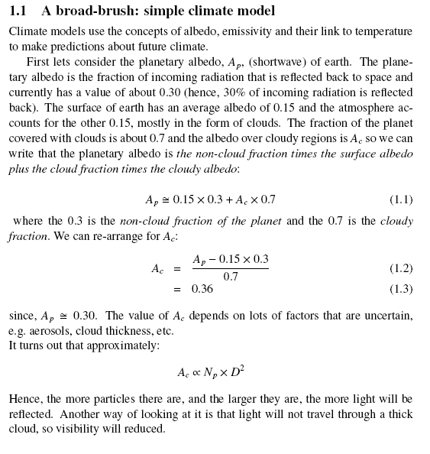

Slide 7
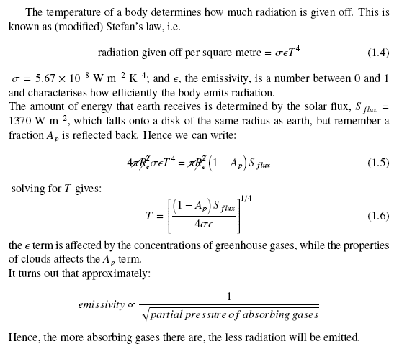

Slide 8
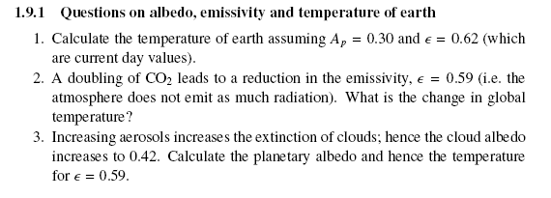

Slide 9
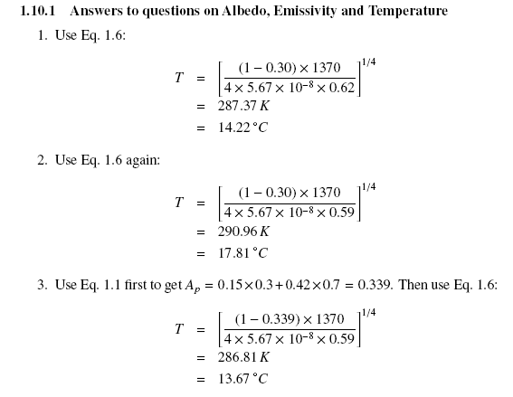

Slide 10
Climate sim
A simple climate model can do a very good job at reproducing the global temperature:
  http://personalpages.manchester.ac.uk/staff/paul.connolly/teaching/climatesim/index.html

Slide 11
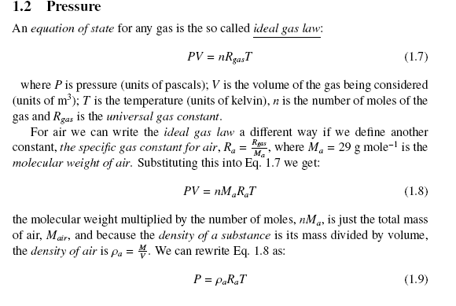

Slide 12
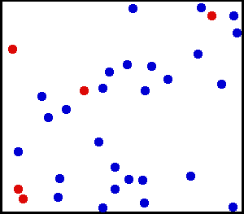
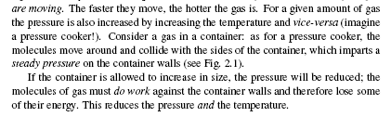
Pressure and temperature are related

Slide 13
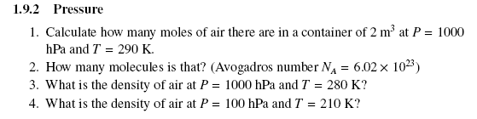
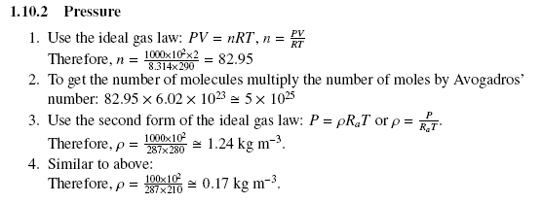

Slide 14
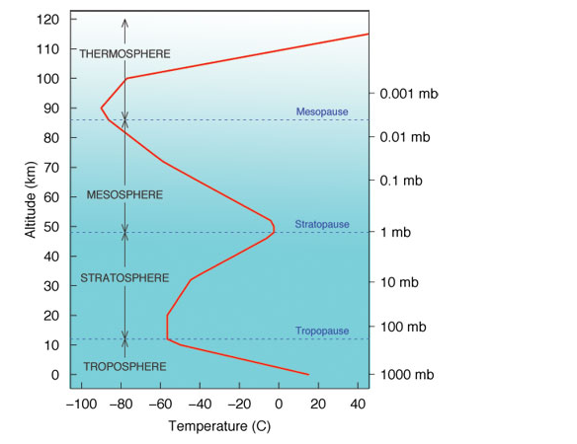
Lapse rate
In the troposphere rising dry air cools at 10 degC per kilometre, moist air cools at 6 degC per kilometre, but the air itself may have a different lapse rate
Above tropopause, lapse rate is governed by other processes, such as the break down of ozone by UV
In the troposphere, lapse rate is very important because it governs the vertical stability.

Slide 15
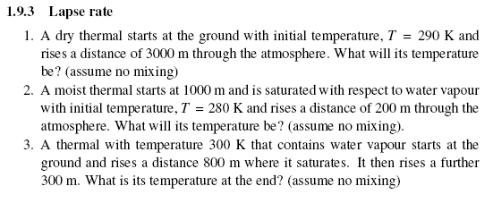
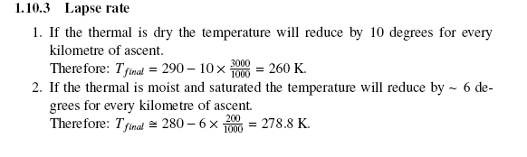


Slide 16
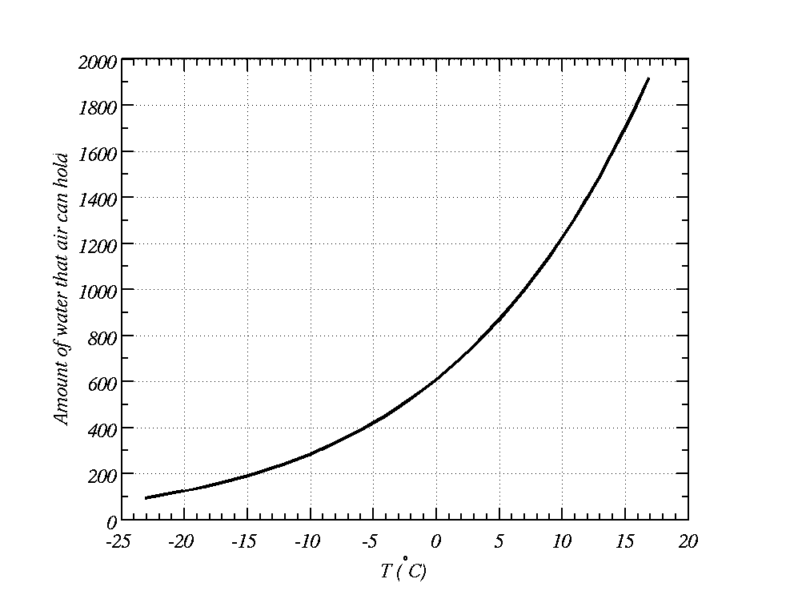
Warm air holds more water vapour than cold air
Cools during the night
This much water in the air
?
Water exists as liquid and vapour here
Water exists as vapour here

Slide 17
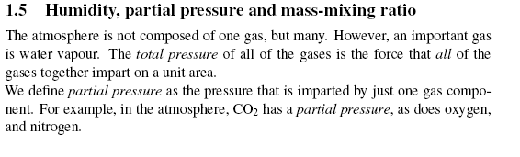
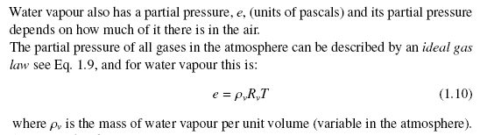

Slide 18
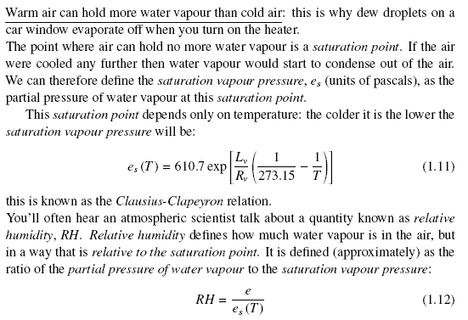

Slide 19
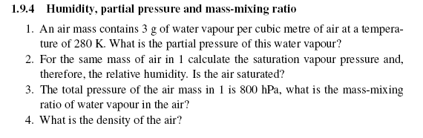
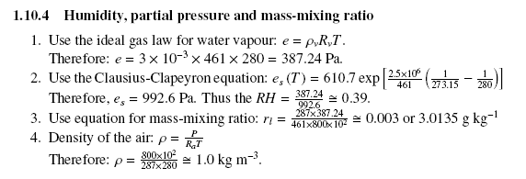

Slide 20
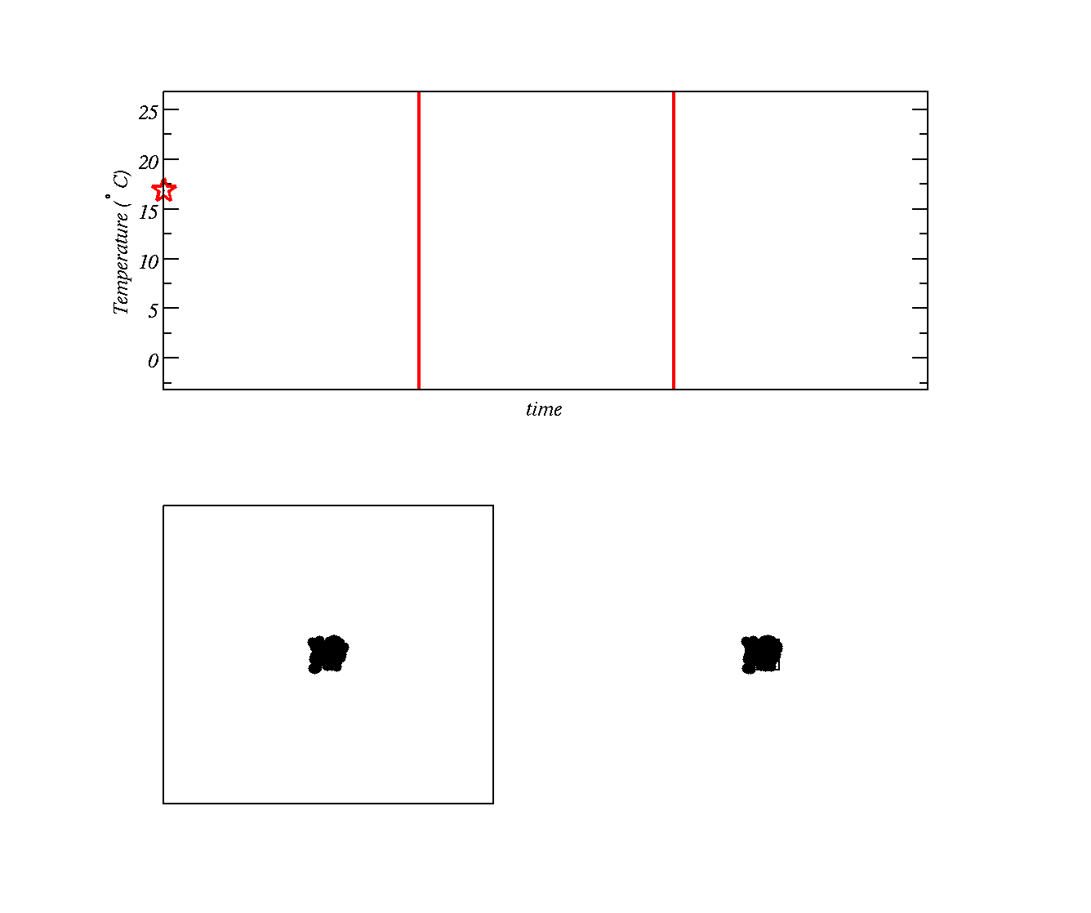
As pressure decreases the molecules must occupy more volume. The gas `pushes’ against air around it and gas molecules slow
Using Kinetic Theory how does the speed (Kinetic Energy) of molecules affect their temperature?
Do you know a law describing how energy and work are related? i.e. what will happen to the energy of the gas molecules as they do work on the surroundings?
Allow gas to expand here
Gas stops expanding
Two boxes with gas at high temperature (molecules moving around fast)
Second box has molecules crammed into a smaller space (higher pressure)

Slide 21
As pressure decreases the molecules must occupy more volume. The gas `pushes’ against air around it and gas molecules slow
Allow gas to expand here
Gas stops expanding
We are going to allow the gas molecules in second box to `push’ against the surrounding air and slow down as a result (temperature is reduced)

Slide 22
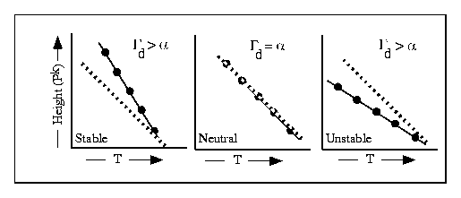
Vertical stability is related to the environmental lapse rate
Solid line = atmosphere, α
Dashed line = path a parcel of air would take, Γ_{d}

Slide 23
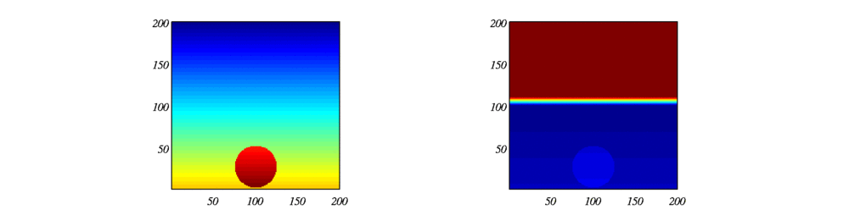
Simulation of rising blob of warm air
Colour is proportional to temperature (modelled)
Colour is proportional to the temperature:
What is happening here?

Slide 24
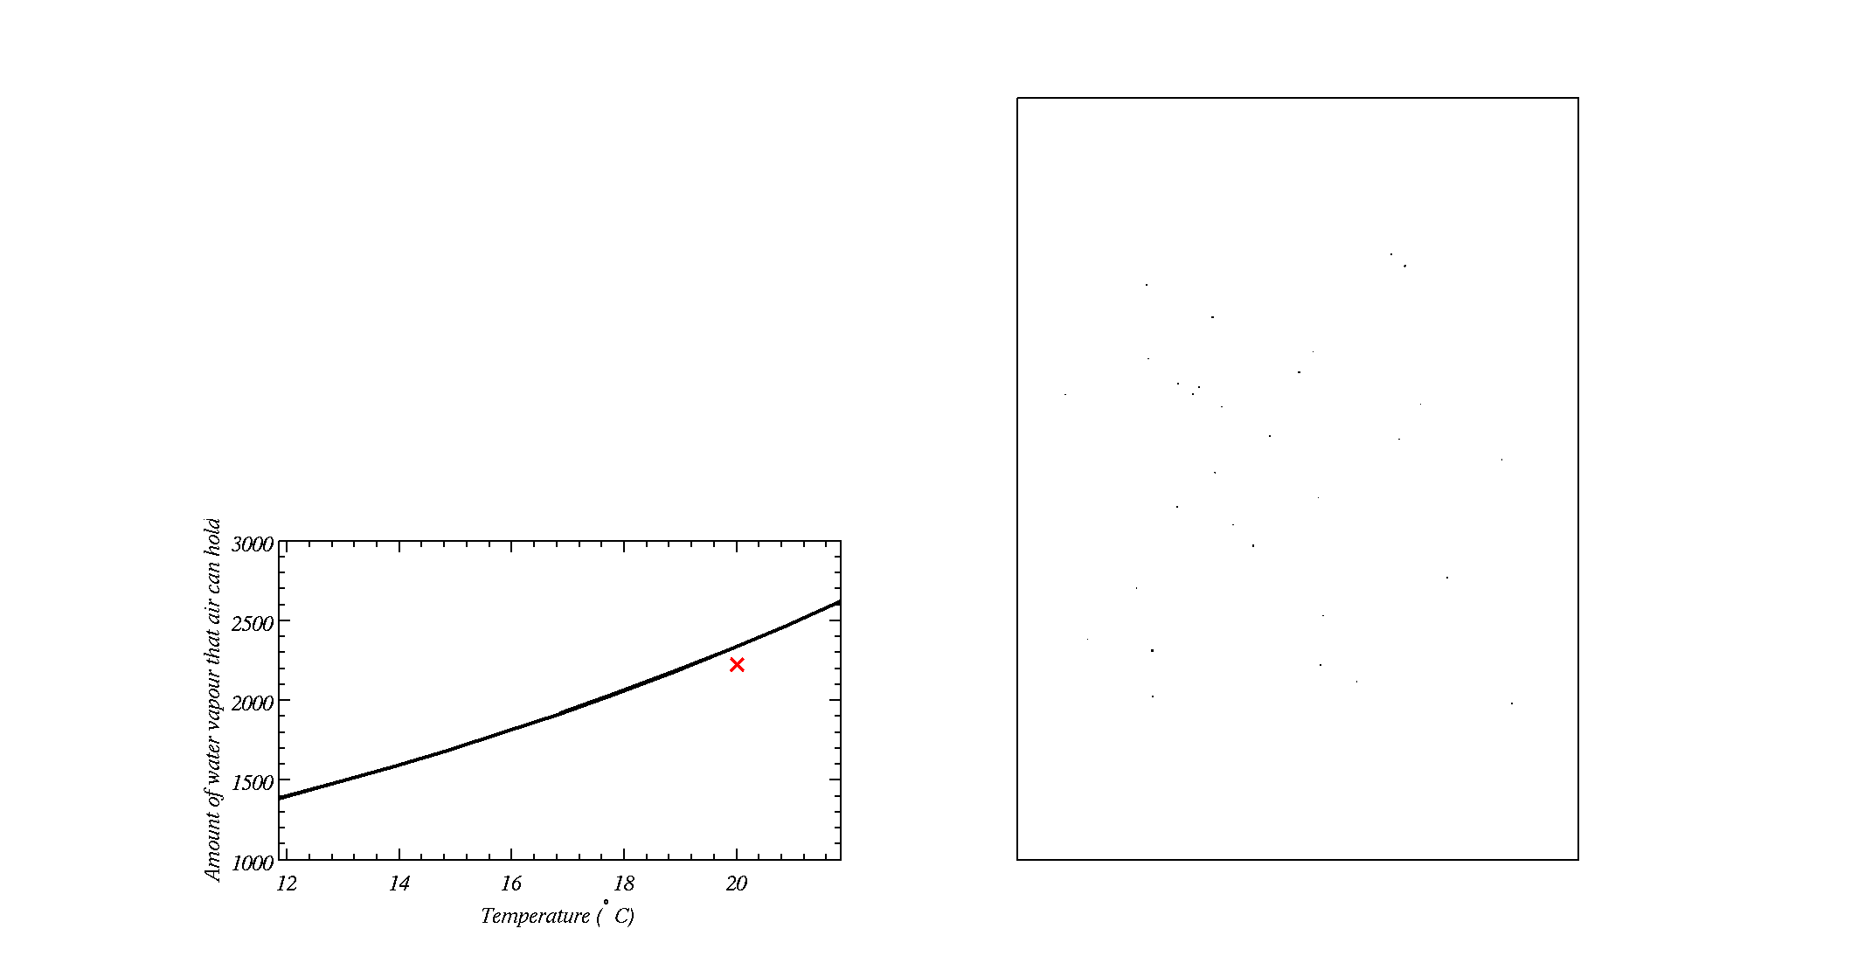
Cloud Condensation Nuclei
Box with cloud condensation nuclei in it
As the air cools during the expansion, water vapour eventually condenses onto Cloud Condensation Nuclei (a type of small particle suspended in air) and forms a cloud
Some small particles do not act as Cloud Condensation Nuclei
Amount of water in the air

Slide 25
Cloud Condensation Nuclei
Box with cloud condensation nuclei in it
As the air cools during the expansion, water vapour eventually condenses onto Cloud Condensation Nuclei (a type of small particle suspended in air) and forms a cloud
Some small particles do not act as Cloud Condensation Nuclei
Amount of water in the air

Slide 26
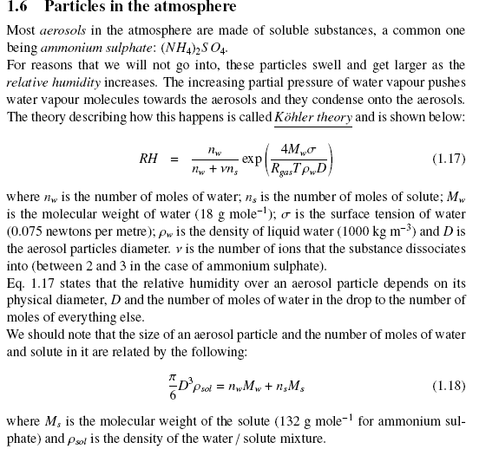

Slide 27
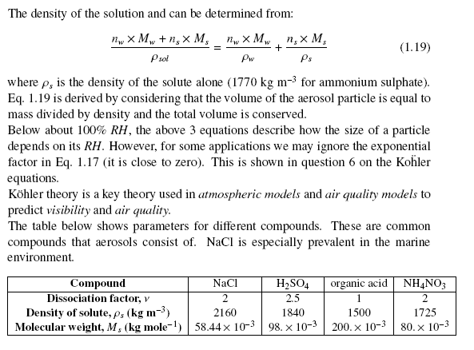

Slide 28

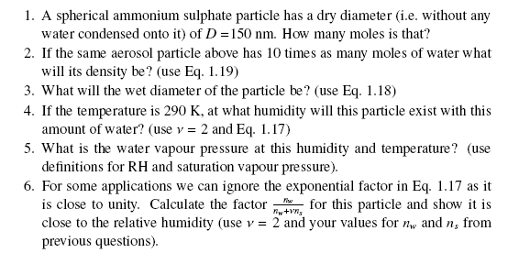

Slide 29
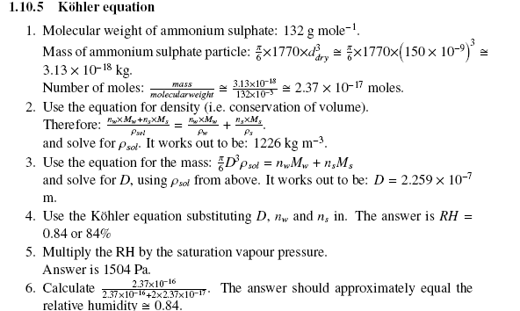

Slide 30
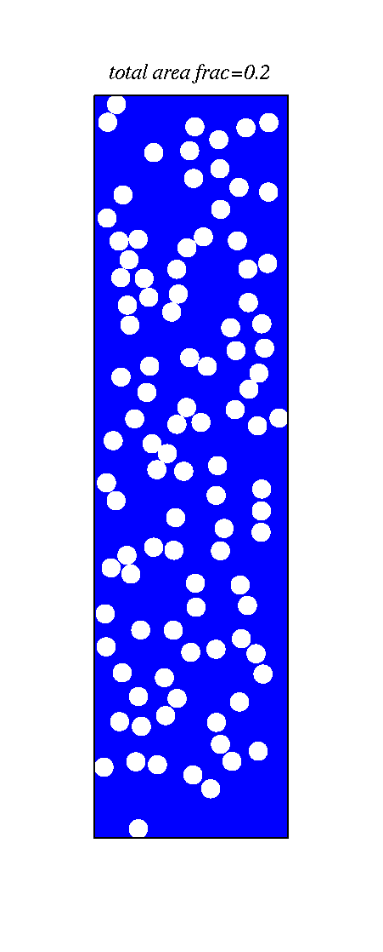
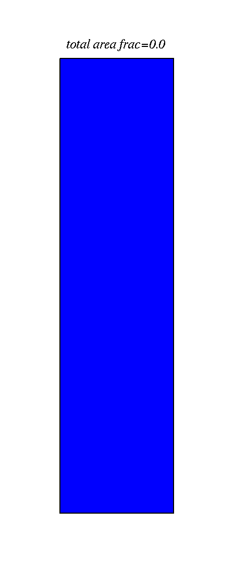
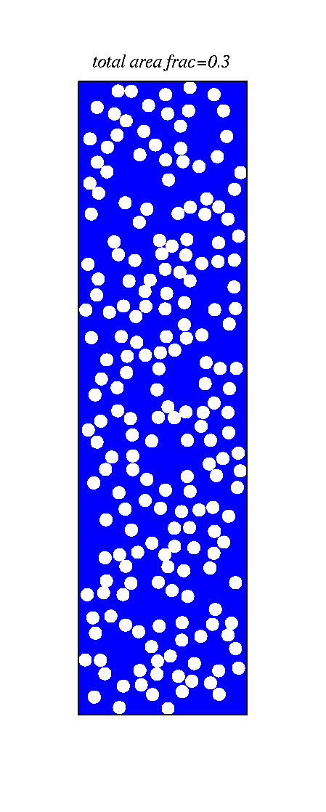
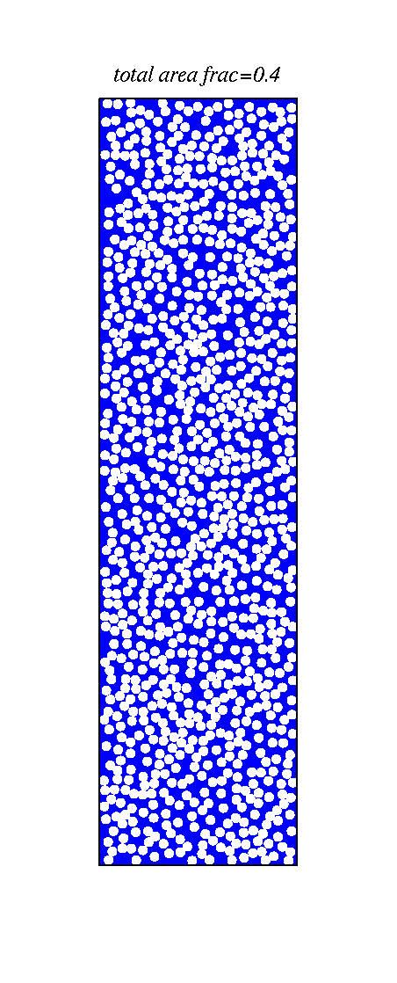
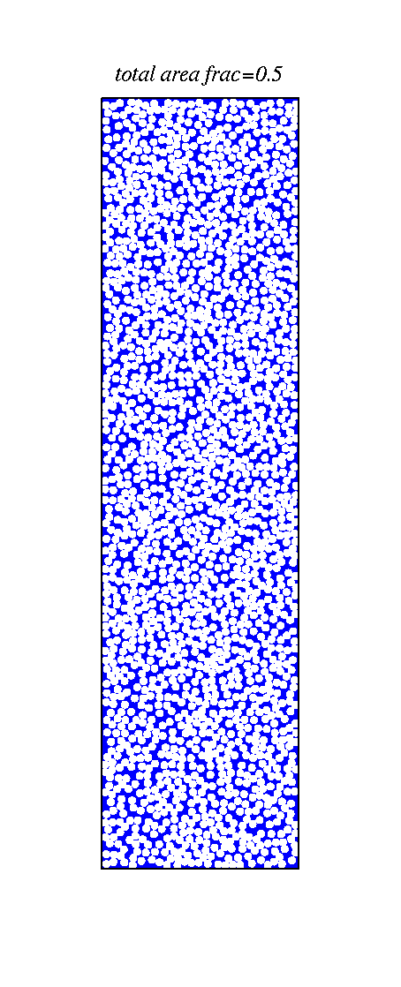
The number of cloud condensation nuclei is important to how much sun-light is reflected what do you notice?
Ocean - blue

Slide 31
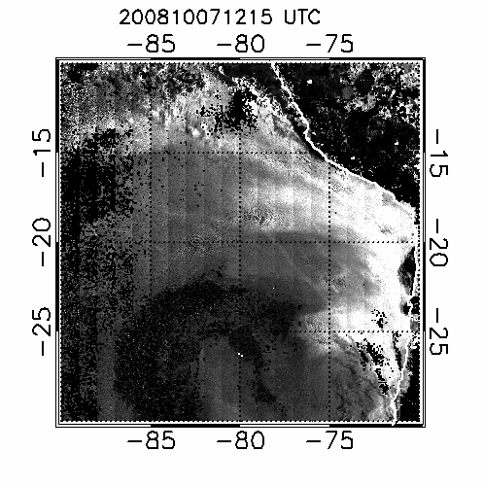
What do you think the `straight’ features are?

Slide 32
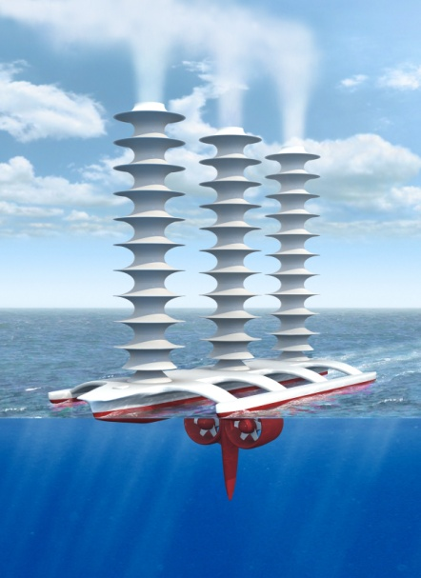
Latham’s geoengineering scheme
(a way of combating global warming?)
Technique (Latham, Nature, 1990)
To disseminate natural sea water droplets at ocean surface into the boundary layer.
These ascend via thermals to enter the cloud and increase the number of drops within the cloud
Switching off the sprayers returns to the status quo within a week or so.
Support for idea
Natural droplet creation at ocean surface
NaCl drops are effective CCN
Ship tracks, fires already show that it works…

Slide 33
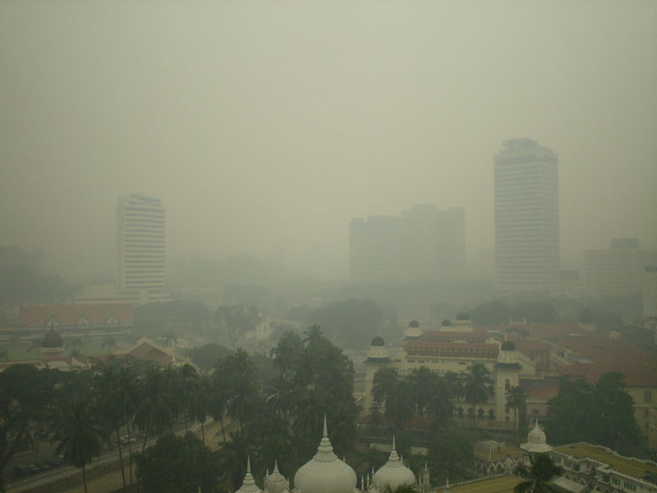
Visibility

Slide 34
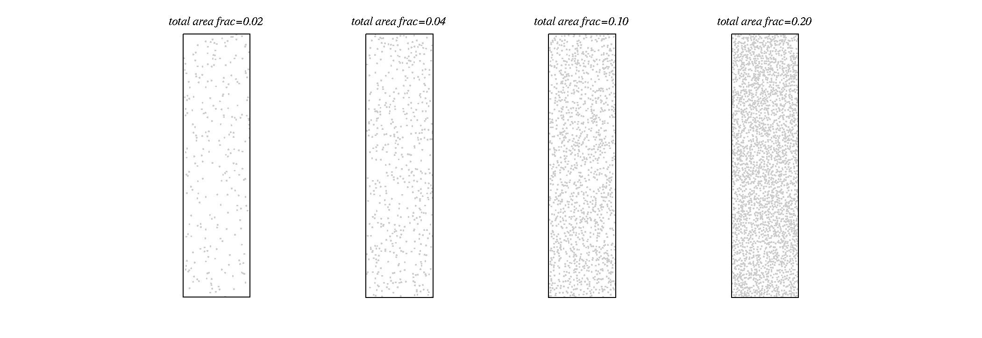
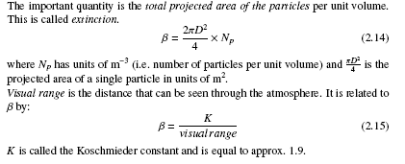
Visibility, increase the number of aerosols, what do you notice?

Slide 35
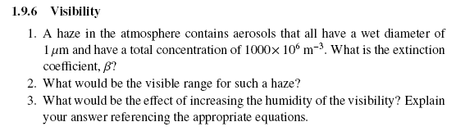
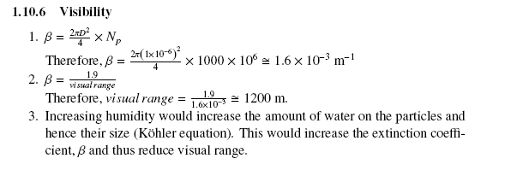

Slide 36
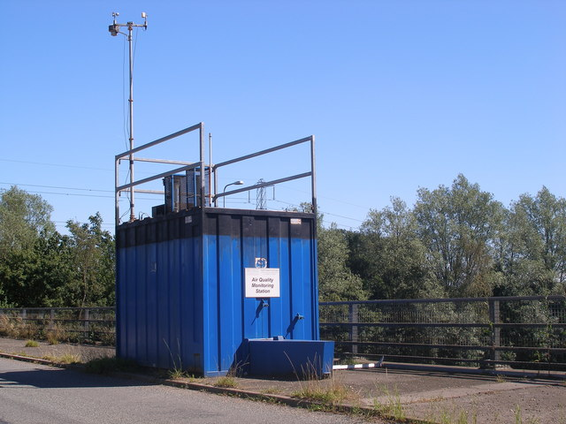
An air quality monitoring station in the UK

Slide 37
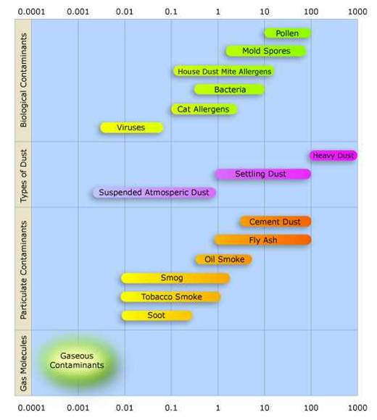
micrometres

Slide 38
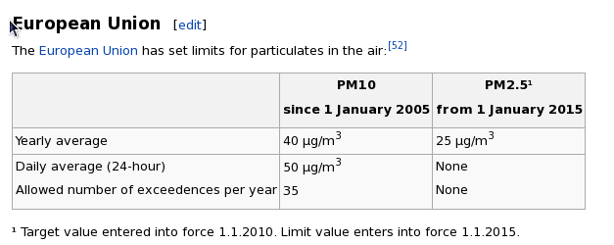
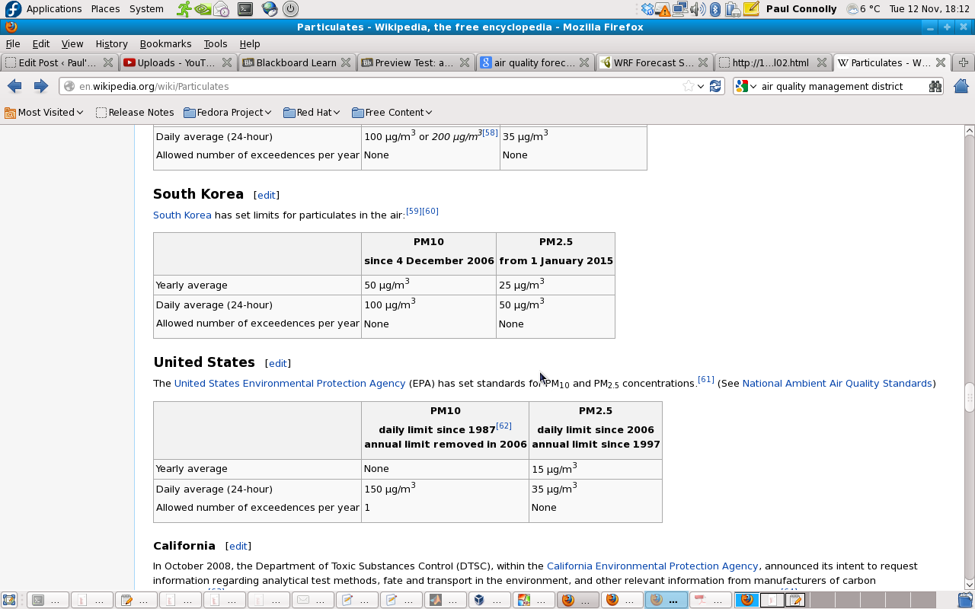
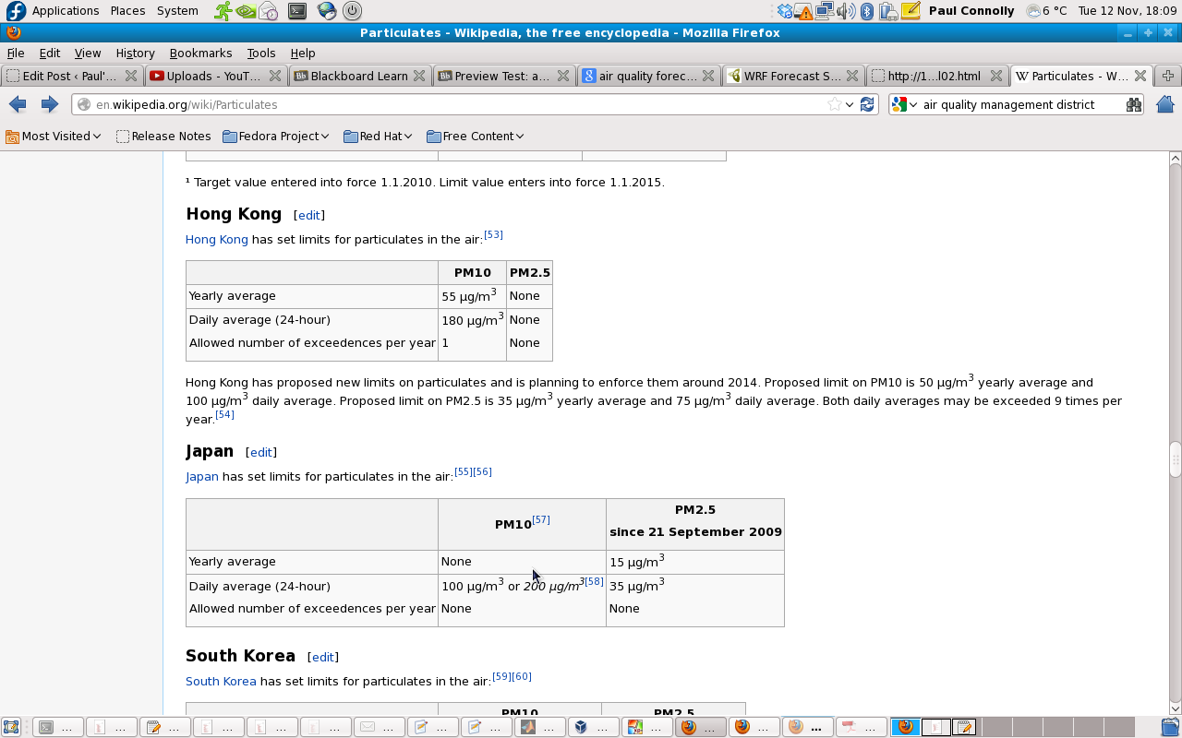
Some limits for particulate matter

Slide 39
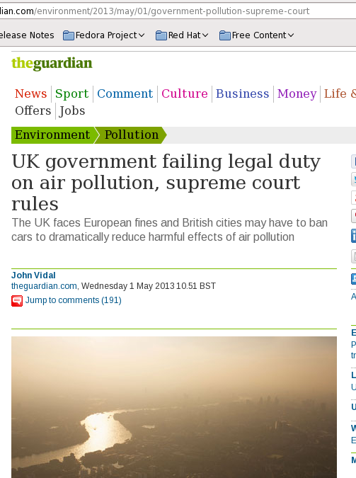

Fines for the UK

Slide 40

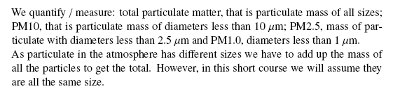
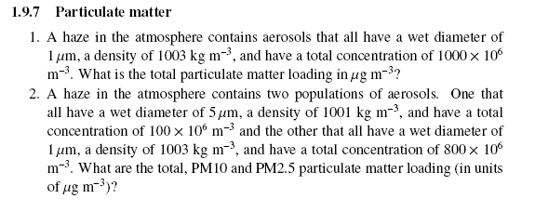

Slide 41
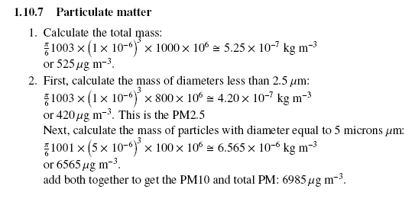

Slide 42

Stacks in Industry
Emissions from industrial stacks are regulated to protect human and environmental health
Industrial facilities are required to obtain permits to emit into the atmosphere and to demonstrate their compliance with regulations
In the process of applying for permits, dispersion models are generally used to assess the impact of point source emission

Slide 43
Dispersion Model
A dispersion model is essentially a computational procedure for predicting concentrations downwind of a pollutant source
Routinely used in:
Environmental impact assessments
Risk analysis
Emergency planning

Slide 44
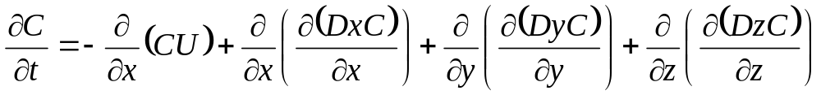


Where;
x = along- wind coordinate measured in wind direction from the source
y = cross-wind coordinate direction
z = vertical coordinate measured from the ground
C(x,y,z) = mean concentration of diffusing substance at a point (x,y,z) [kg/m3]
Dy,Dz = mass diffusivity in the direction of the y- and z- axes [m2/s]
U = mean wind velocity along the x-axis [m/s]
Time rate of change and advection of the cloud by the mean wind
Turbulent diffusion of material relative to the center of the pollutant cloud.
( the cloud will expand over time due to these terms.)

Slide 45

Assumptions
Mass transfer due to bulk motion in x-direction far out shadows the contribution due to mass diffusion. That is, the second term on the right side of Equation is far smaller than the first term and may be dropped from the equation
We are primarily interested in the steady-state solution to the dispersion of the pollutants in the atmosphere. Hence the quantity is zero
Even though the wind speed does vary in the three coordinate directions, the variation is relatively small. Therefore it is appropriate to assume that the wind speed U is constant
The major transport direction due to the wind is chosen to lie along the x-axis
Dy and Dz are constant

Slide 46



The general equation to calculate the steady state concentration of an air contaminant in the ambient air resulting from a point source is given by:
Where;
c(x,y,z) = mean concentration of diffusing substance at a point (x,y,z) [kg/m³]
x = downwind distance [m],
y = crosswind distance [m],
z = vertical distance above ground [m],
Q = contaminant emission rate [mass/s],
= lateral dispersion coefficient function [m], function of Dy
= vertical dispersion coefficient function [m], a function of Dz
U = mean wind velocity in downwind direction [m/s],
H = effective stack height [m].

Slide 47

Plume Boundary

Slide 48

Plume Dispersion by Gaussian Distribution and Coordinate System

Slide 49

We will model these…
We won’t model these…
Typical Velocity, and Plume Shapes
Solid line is environmental temperature, dashed line is temperature of a parcel of air

Slide 50
Main points
Warm air holds more water vapour than cold air (Clausius-Clapeyron relation)
Lowering pressure can lead to cooling of the air (temperature of a parcel) and hence this increases the relative humidity.
Visibility and particulate matter in the atmosphere are affected by the ambient conditions, such as P, T and relative humidity.
More unstable air the more dispersion there is.
  We often need to take both atmospheric dispersion and the behaviour of particulate in the atmosphere into account to explain visibility / PM
We will do some predictions on the computers tomorrow.

Slide 51


