Slide 1
Measuring and Predicting
Practical 2: atmospheric dynamics
Motivation: last week we said that turbulence / fluid motions mix pollutants in the atmosphere. This week we will learn about what causes some of these fluid motions
Dr Paul Connolly
Centre for Atmospheric Science

Slide 2
Topics covered
Forces and motion
  Newton’s laws, circular motion
Equation of motion in atmosphere
  Acceleration
  Pressure gradient
  Coriolis effect
Balanced flow
  Geostrophic wind
  Gradient wind
  Lows and highs
Vorticity
Waves
  Gravity waves and Tsunamis
  Jets / barotropic instability
  Rossby waves
  Equatorial waves
  Kelvin waves

Slide 3
Why are these topics important?
Climate science
  Computer predictions of air motions is fundamental to more advanced climate model calculations. People want to know which regions are going to be affected by wind / rain / droughts / heat waves.
High impact weather
  Winter snow cost UK economy £ 1.2 billion a day in 2009
  Hurricane Freidhelm (known in Scotland as “Bawbag”), December 2011
    Cost UK economy £100 million in one day!
  Hurricane Katia, September 2011
    Cost UK £100 million.

Slide 4
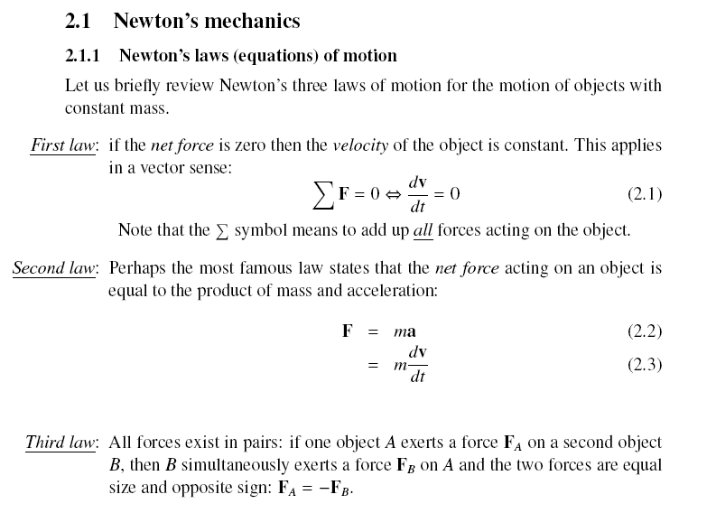
Review of some basics:
Newton’s laws of motion

Slide 5
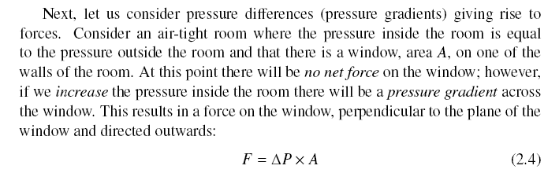
Review of some basics:
Pressure, force and area
Wall
Low pressure
Window
High pressure
Force
Wall

Slide 6
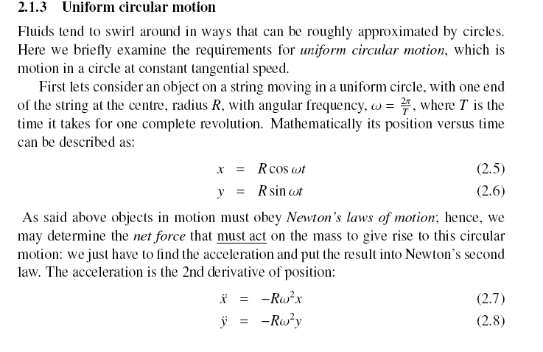
Review of some basics:
Circular motion

Slide 7
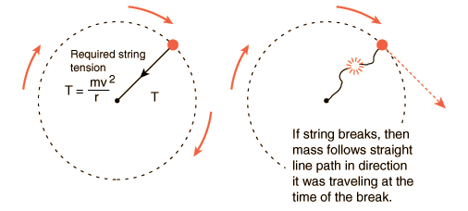
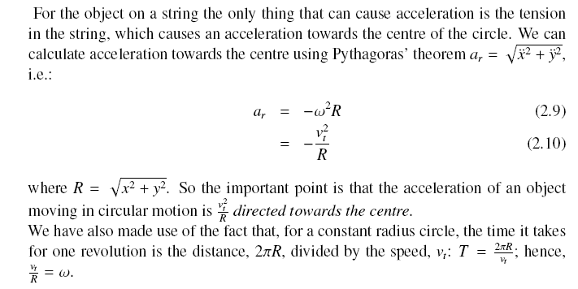
Object, mass m, on string

Slide 8
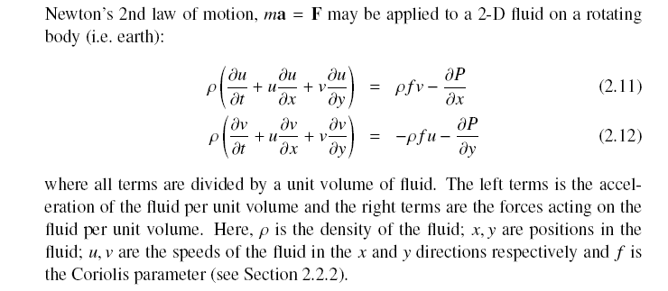
Equation of motion in atmosphere
ma
=
F

Slide 9
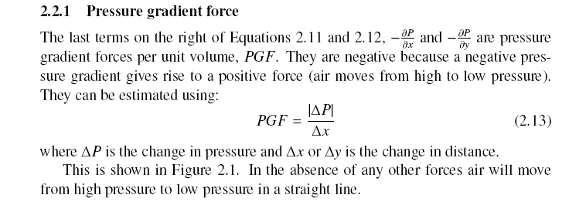
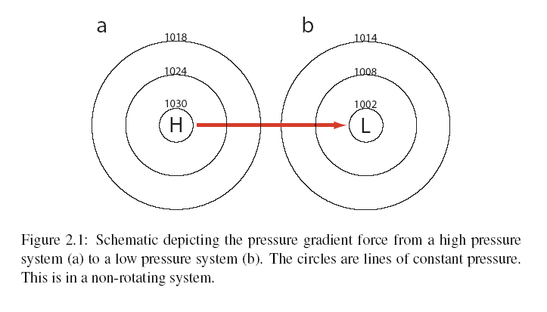
Pressure gradient

Slide 10
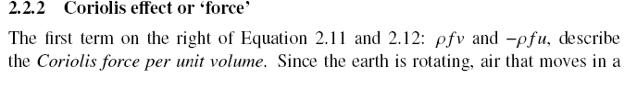
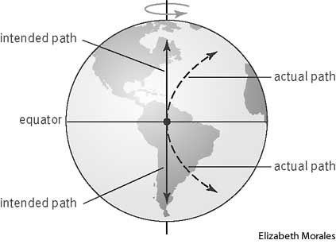

Coriolis effect
Looking down on earth from space (upper part of the picture), the black ball moves in a straight line (it obeys Newton!).
However, the observer (red dot) who is standing on earth (rotating) sees the object as following a curved path due to the Coriolis force.
wikipedia
http://www.nc-climate.ncsu.edu/edu/k12/.coriolis
The Coriolis parameter:

Slide 11
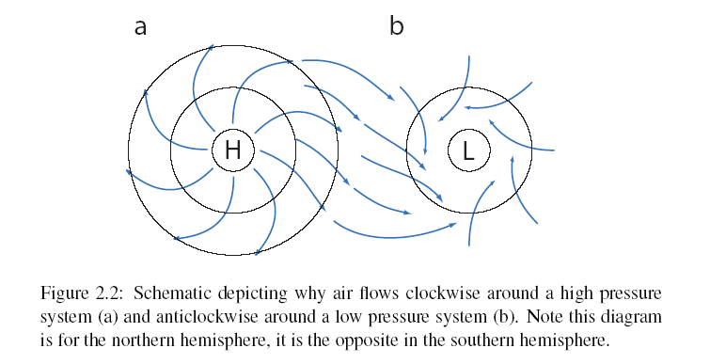
Air flow around highs and lows

Slide 12
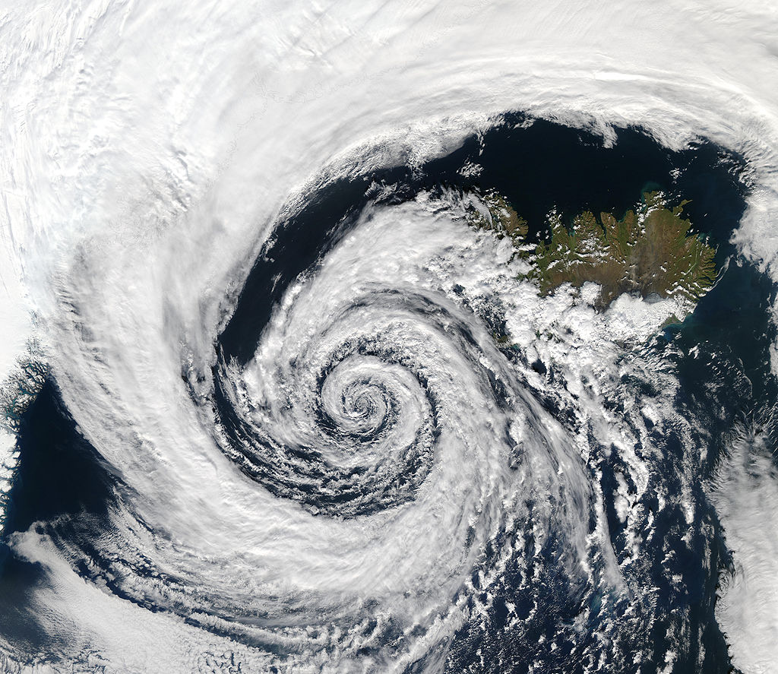

Slide 13
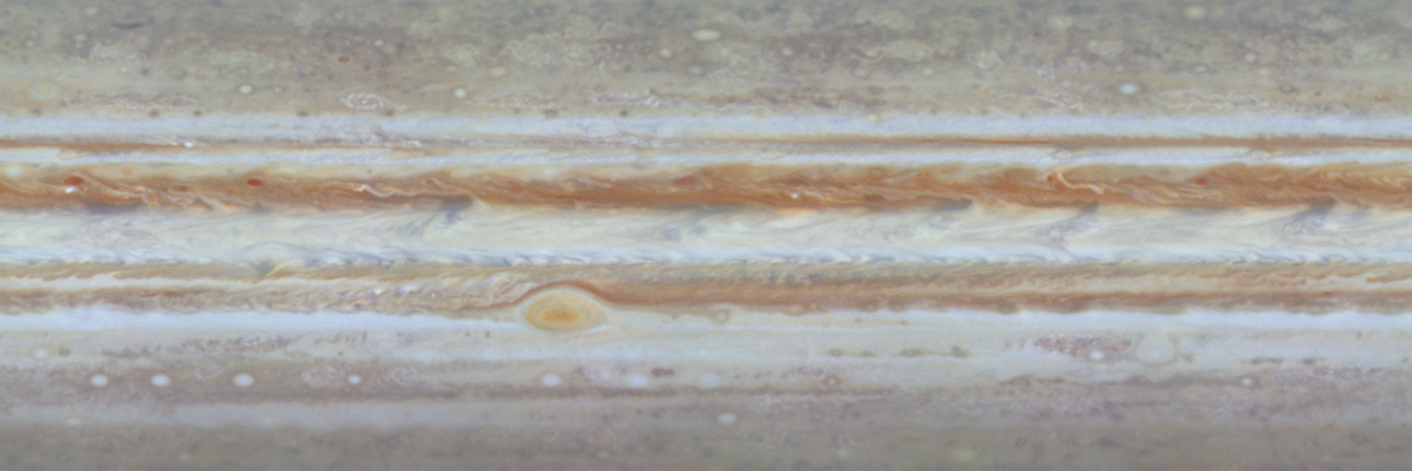
Jupiter’s red spot
Anti-cyclone, but rotates anti-clockwise like a cyclone – but it is in the southern hemisphere.
It `feeds off’ smaller scale motions
very persistent (at least 350 years old!)
You will model something like this in the practical.

Slide 14
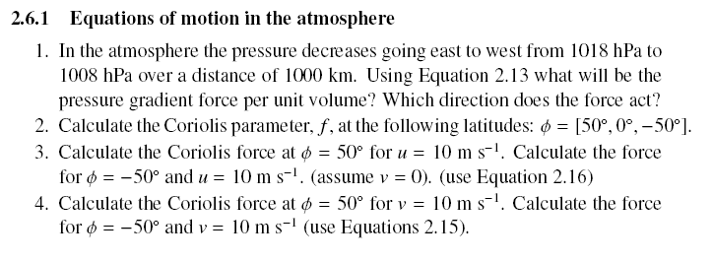
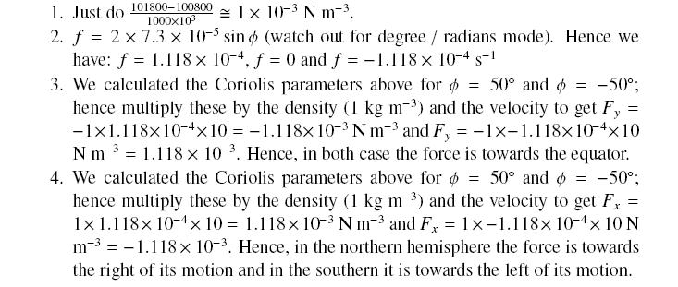

Slide 15
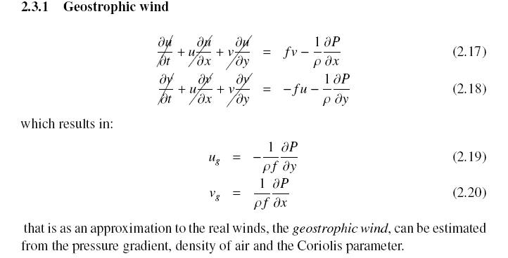
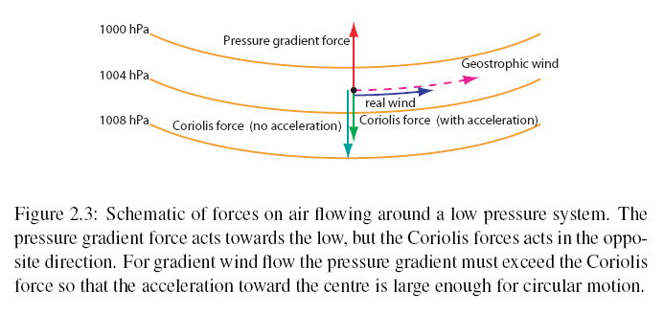
Balanced flow
Geostrophic wind blow parallel to lines of constant pressure!

Slide 16
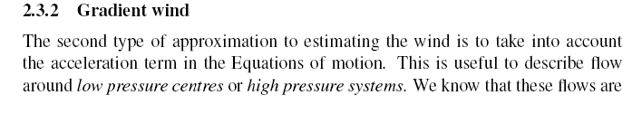
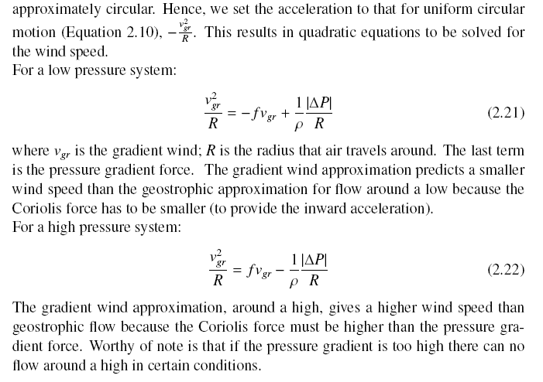
Balanced flow

Slide 17
Flow around a low

Slide 18
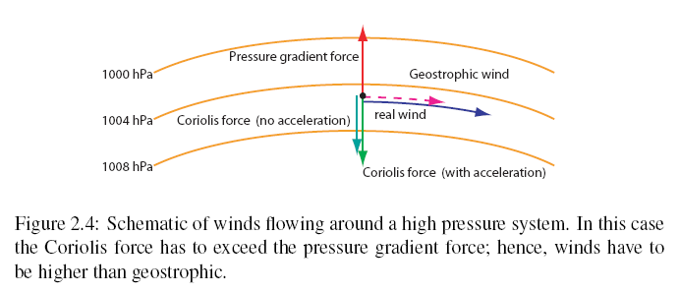
Flow around a high

Slide 19
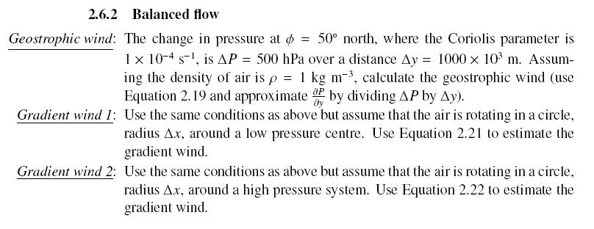
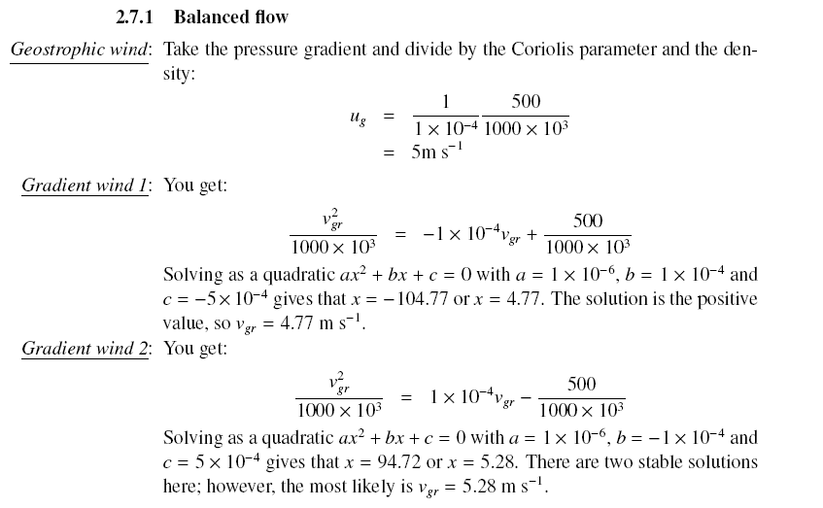

Slide 20
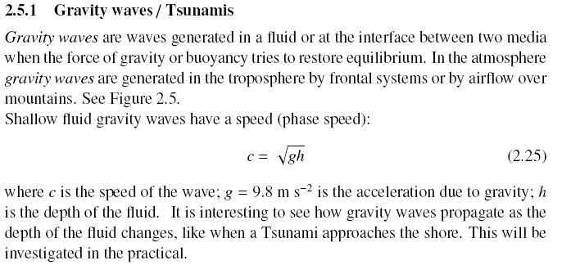
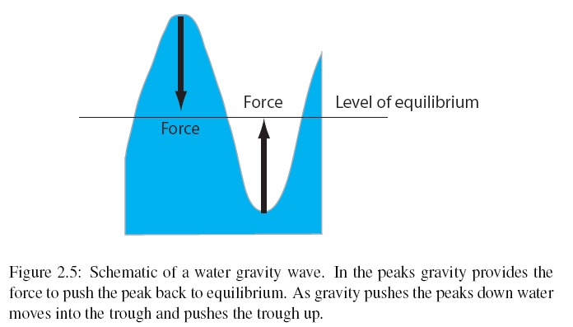
Gravity waves
http://science.nasa.gov/media/medialibrary/2008/03/19/19mar_grits_resources/tama_gw_070506.mpeg

Slide 21
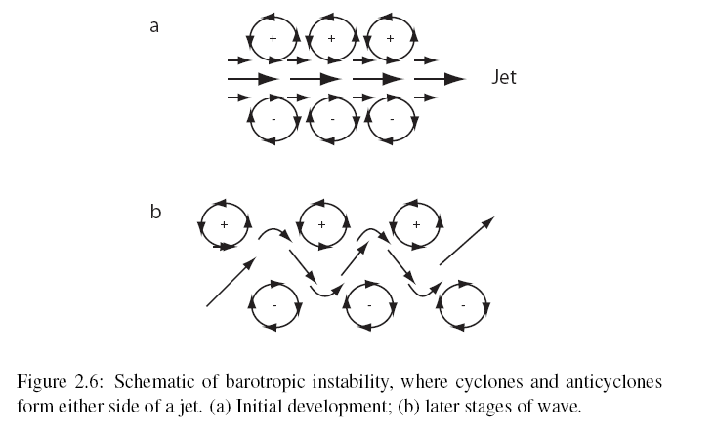
Barotropic instability
(just strong wind shear, e.g. jet streams)

Slide 22
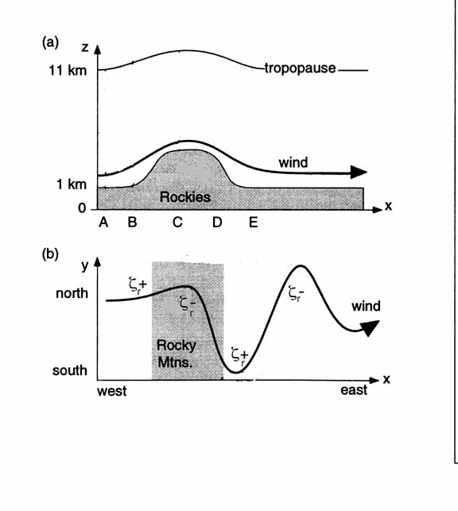
Orographic Rossby waves
Vorticity is the sum of the earth’s rotation, and the local rotation of the air, ζ_{r}.
Air at high latitudes has high rotation due to earth’s spin, so as it moves north it must reduce its local rotation to maintain total vorticity
This gives rise to waves known as Rossby waves.

Slide 23
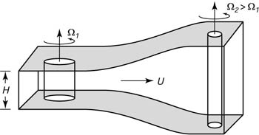
Rossby wave: vortex stretching and compression
Compressing the vortex: leads to a reduction in the spin of the air =>air will rotate clockwise in the northern hemisphere, move south
Stretching the vortex: leads to an increase in the spin of the air =>air will rotate anitclockwise in the northern hemisphere, move north

Slide 24
Equatorial waves
https://www.youtube.com/watch?feature=player_embedded&v=WKP-X_puQak

Slide 25
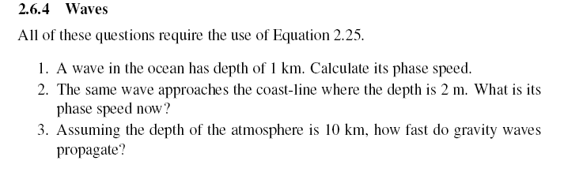
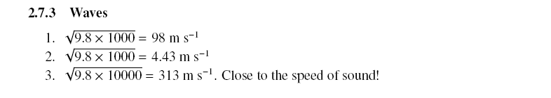

Slide 26
Main points
Equation of Motion (understand the terms)
Balanced flow:
  Geostrophic flow
  Gradient flow
Vorticity – just need to understand that positive vorticity is an aniticlockwise rotation and vice-versa.
Waves
  Gravity waves – gravity is the restoring force
  Barotropic instability – break down of shear vorticity into rotational vorticity
  Orographic Rossby waves – conservation of vorticity maintains the wave
  Equatorial waves – lots of mixing (diffusion!). Rossby / gravity wave at the equator.
    Also the Kelvin wave – not covered in detail, but for the practical: it travels east!
We will do some predictions on the computers tomorrow.

