Slide 1

UNIVERSITY OF MANCHESTER
SCHOOL OF EARTH & ENVIRONMENTAL SCIENCES (SEES)
Drs Bart van Dongen & Paul Connolly
WELCOME
Environmental Science
Notes:
Talk outline
Introduce yourself and mention your role in the environment programme. Mention your arsenic work- most will have heard me talk about you.
This lecture is an opportunity to inform the students about new developments at the School and to give details of the week’s events.

Slide 2
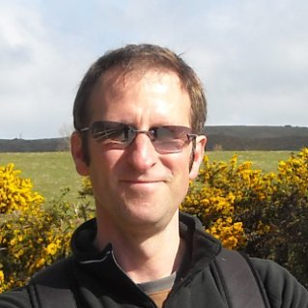
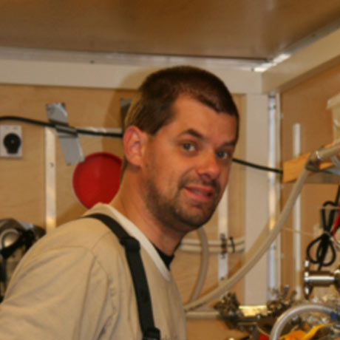
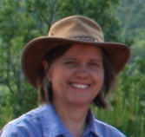
Key People
Head of School
Prof. Kevin Taylor
(geochemistry)
Programme Director
Dr. Bart van Dongen
(organic geochemistry)
Director of Teaching
Dr. Merren Jones
(sedimentology)
Education Officers
Ms. Angela Entwistle
Mr. Mike Turner
Administrator
Ms. Carol Jeffries

Slide 3
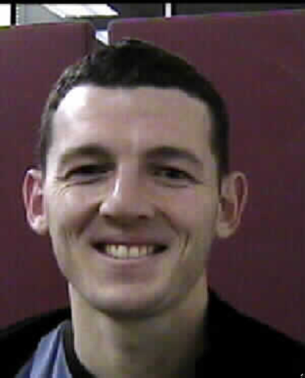
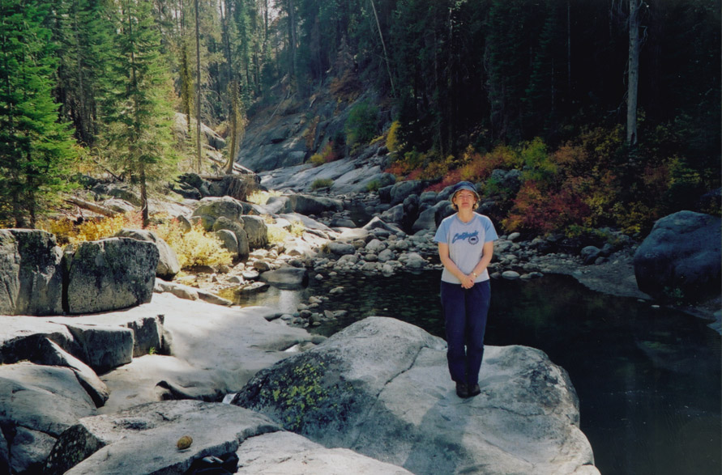
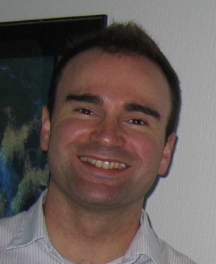

Key People 2
Year 1 coordinator
Dr Paul Connolly
(Atmospheric Physicist)
Year 2 coordinator
Dr. Clare Robinson
(Fungal expert)
Director of Teaching
Dr. Robert Sanson
(Paleontologist)
Careers Officer Environmental Sciences
Dr Grant Allen
(Atmospheric Scientist)

Slide 4


New Developments at SEES
the Committee of Heads of Environmental Sciences (CHES), the education committee of IES, has accredited all Environmental Science undergraduate programs at UoM.
A programme accredited by CHES is assured to meet high standards, contain a strong component of practical, field and theoretical activities, and has excellent opportunities for training, work experience and links to the professional environmental sector.
Consequences for you:
Access to an active community which champions environmental disciplines both academically and professionally.
You can apply for free Student Membership of the Institution.

Slide 5
More New Developments at SEES
Due to restructuring of the University 15 academic staff have moved from Life Sciences to join our environmental chemists and physicists
New “School of Earth and Environmental Sciences”.
Consequences for you:
More choice in terms of 3rd Year Undergraduate Dissertation topics,
More bioscience based teaching on our residential field trips,
More holistic educational experience for our environmental students at all levels.

Slide 6
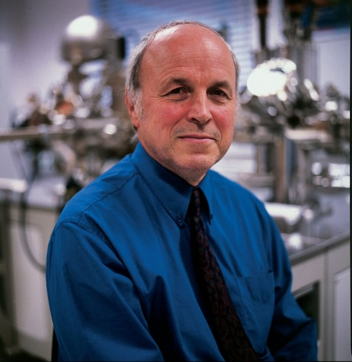
Canada honours leading Manchester earth scientist
September 2016
The Royal Society of Canada has bestowed a rare honour on Professor David Vaughan (Research Professor of Mineralogy), by electing him as a ‘Foreign Fellow’.
Prof Vaughan is The Founding Director of the University’s Williamson Research Centre for Molecular Environmental Science.

Slide 7
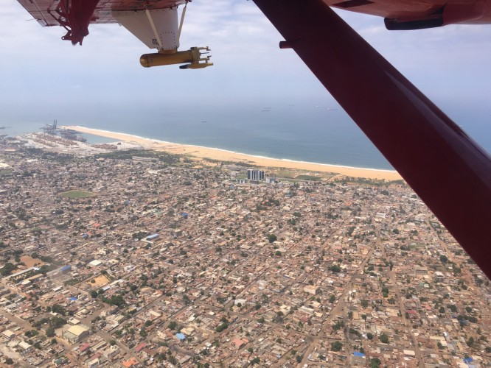
Scientists take to the skies to track West African pollution
September 2016
Scientists, including a team from Manchester, have for the first time, investigated the impacts of natural & manmade emissions on the West African atmosphere.
Aircrafts, carrying instruments to collect atmospheric data, were used to track air pollution from the big coastal cities as it streams inland reaching the forests and Sahara.
They detected particles for the burning of charcoal, rubbish and agricultural waste, in the atmosphere over a number of urban areas, contributing to concerns of the rise in pollution across the region.

Slide 8
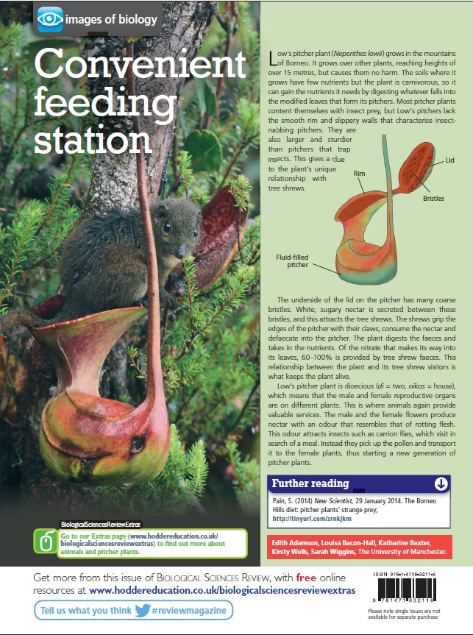
1st Year Student Brings Biology to Life with Award-winning Poster
July 2016
As part of the ‘Biodiversity’ module in their first year, students produced electronic posters, simplifying complex biological concepts and making them accessible to younger
Their work was entered into a competition to be published by Biological Science Review – a magazine aimed at A-level Biology Students.
The winning entry, designed by Louisa Bacon (BSc Environmental Science) was published in April, reaching more than 10,000 readers worldwide!
Louisa’s poster explains how the resilient pitcher plant, native to Borneo, serves as a ‘convenient feeding station’ in the wild.

Slide 9
BP STEM scholarship for 1st year environmental science student
March 2016
Grace MacMillan, a first year environmental science Student, was awarded a BP STEM Scholarship.
Only 8 for the whole university
She is awarded £5000 per year and an interview for an internship or job.

Slide 10
First days can be overwhelming…
Student support office (Carol Jeffries—Mike Turner—Angela Entwistle)
Next: me, or Dr Connolly, or Prof. Taylor
After settled in, your Advisor will become your second point of reference
I have an open door policy……

Slide 11
…..And again-
Welcome to Manchester!
This is a challenging but rewarding programme.
I am glad to welcome you and help you get started on this next stage in your education
We are extremely proud of our environmental students and all they go on to accomplish in their careers.
For example, …………
Notes:
You might want to add your favorite success story here- Anju Nihalani? Alex Stark? Pete Morris?

Slide 12
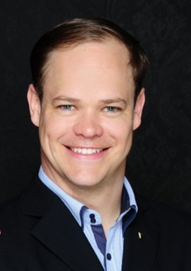
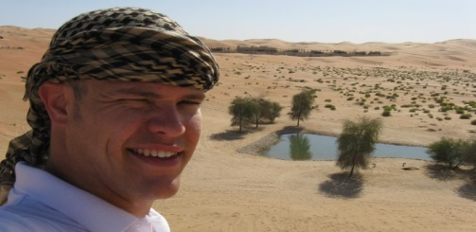
Alexander Bergfeld, BSc Environmental Sciences, 2008
“The degree in Environmental Sciences helped me to find a job in my field of interest, leading to me building solar parks and artificial oases in the desert of the United Arab Emirates.
Manchester was a highly recommendable experience for me. The lecturers were always very warm and welcoming and absolute experts in their fields. The field trip to Tenerife helped me to further strengthen my base in understanding the coherence of environmental processes, an aspect which I often used in my later projects.”
My most recent activity is the establishment of Ad Solem Acceleration where I and a team of experts offer support in the establishment of business acceleration and innovation programs and help companies survive in times of digitalization and globalization.”

Slide 13
Paul Connolly
Reader in Atmospheric Physics
First Year Coordinator, Environmental Science.
Office number, 3.08, Simon Building
Email paul.connolly@manchester.ac.uk

Slide 14
Overview
Your degree
Marks, credits, etc
Term dates
University...start with welcome!
Time-table
“My Manchester”
Exercise
Communication
Feedback
Summary / questions

Slide 15
Your degree.
A BSc orBEng is 3 years, an MEarthSci or MEng is 4 years.
Each year is 120 credits.
Most modules are 10 credits.
Make sure you are registered for the right number of credits.
Degree grades are 1st, 2i, 2ii, 3rd and fail.
Marks are gained for coursework and exams.
70% or higher corresponds to a first.
60% or higher is a 2i
50% or higher is a 2ii
40% or higher is a 3rd
less than 40% is a fail.
Details in the programme handbooks and general handbooks.

Slide 16
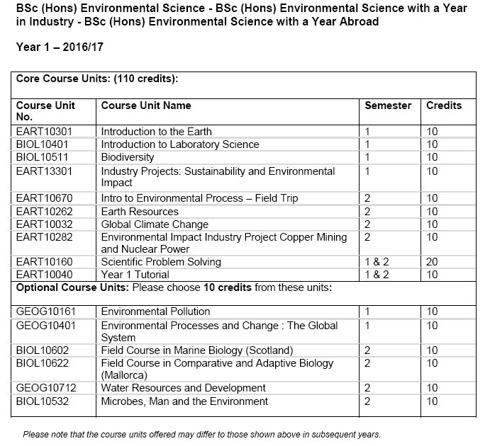

Notes:
Hence, you should pick one optional module..if interested, flag straight away and I will check if it is available.

Slide 17
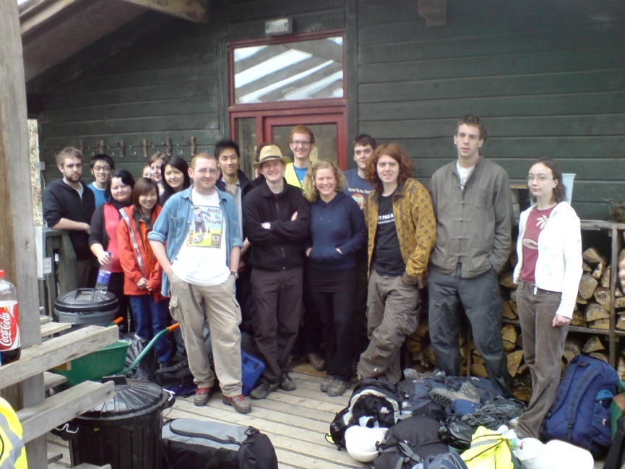
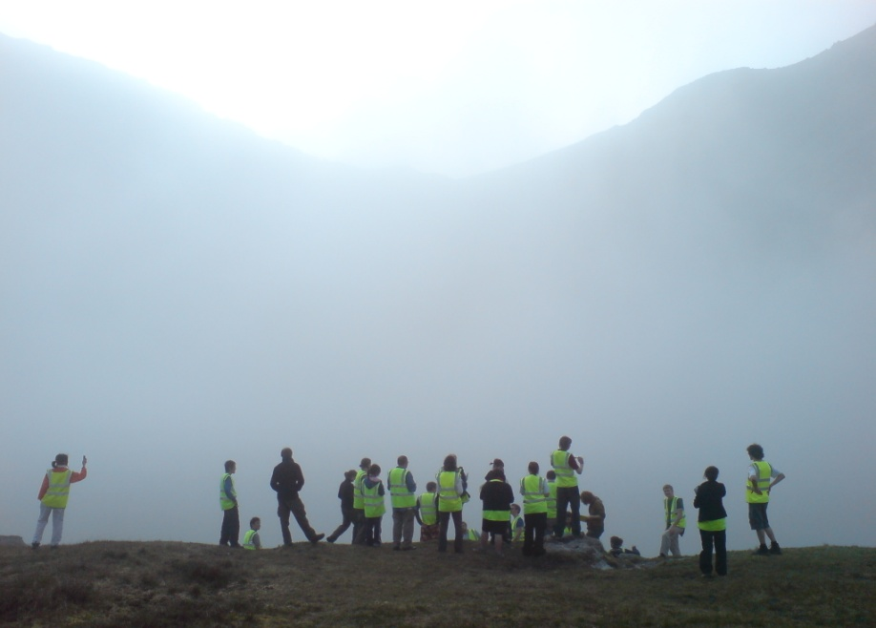
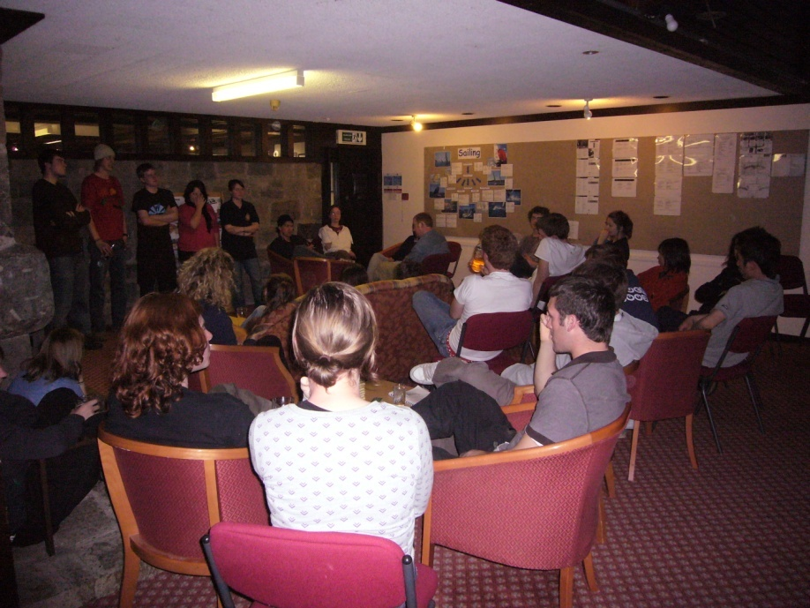
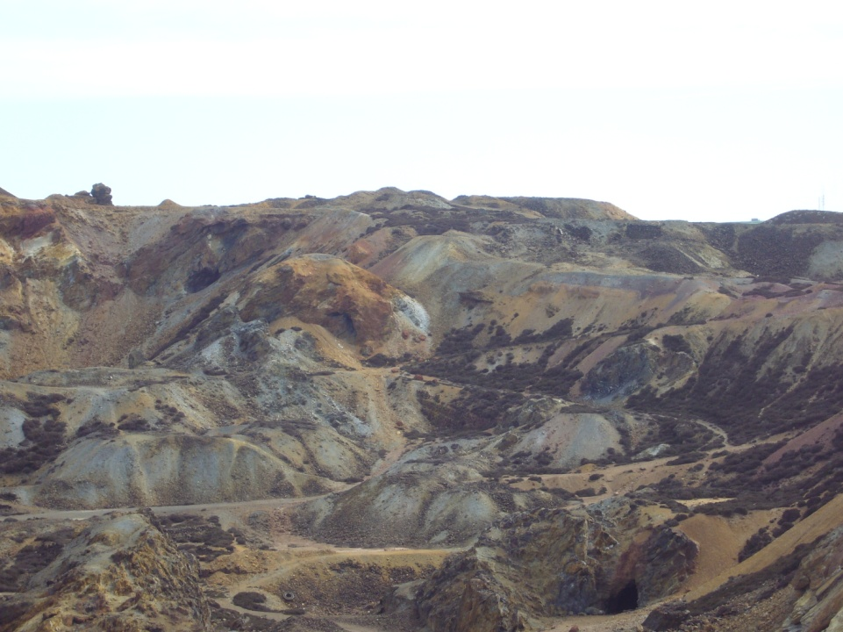
First year field trip
Outside the Eco cabins at the Centre for Alternative Technology
Students looking at the glacial features at Cadair Idris
Students giving presentations of their work in the evenings
Fieldwork at Parys Mountain looking at the problem of AMD
Notes:
Problem solving, alternative energy, you will also do field work in each year
17

Slide 18
University…
As you move through university study…
Some tasks become less strictly defined.
Graduates don’t get detailed instructions for each task.
You are more often expected to find your own learning resources.
Graduates don’t get handed a list of references to read.
Schedule your own time, etc.
Our aim is to help you develop as independent learners.
WE ARE STILL HERE TO HELP!

Slide 19
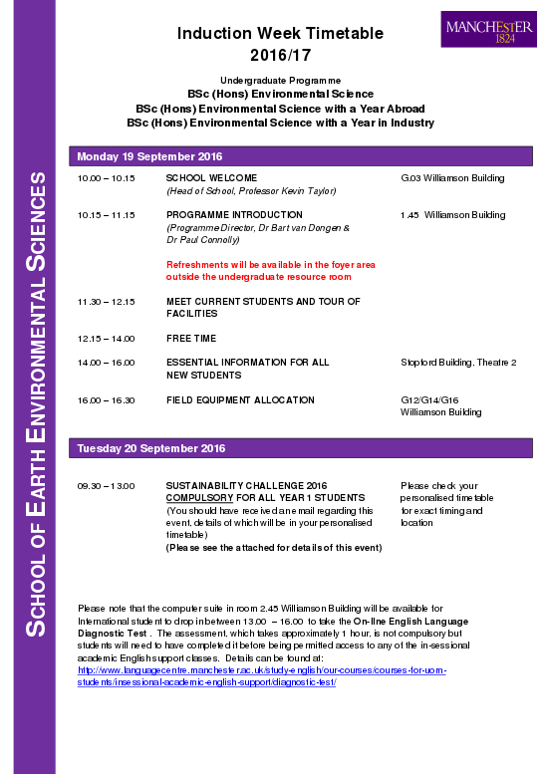
How do I get to Stopford?
What is my personalized time-table and how do I check it?

Slide 20
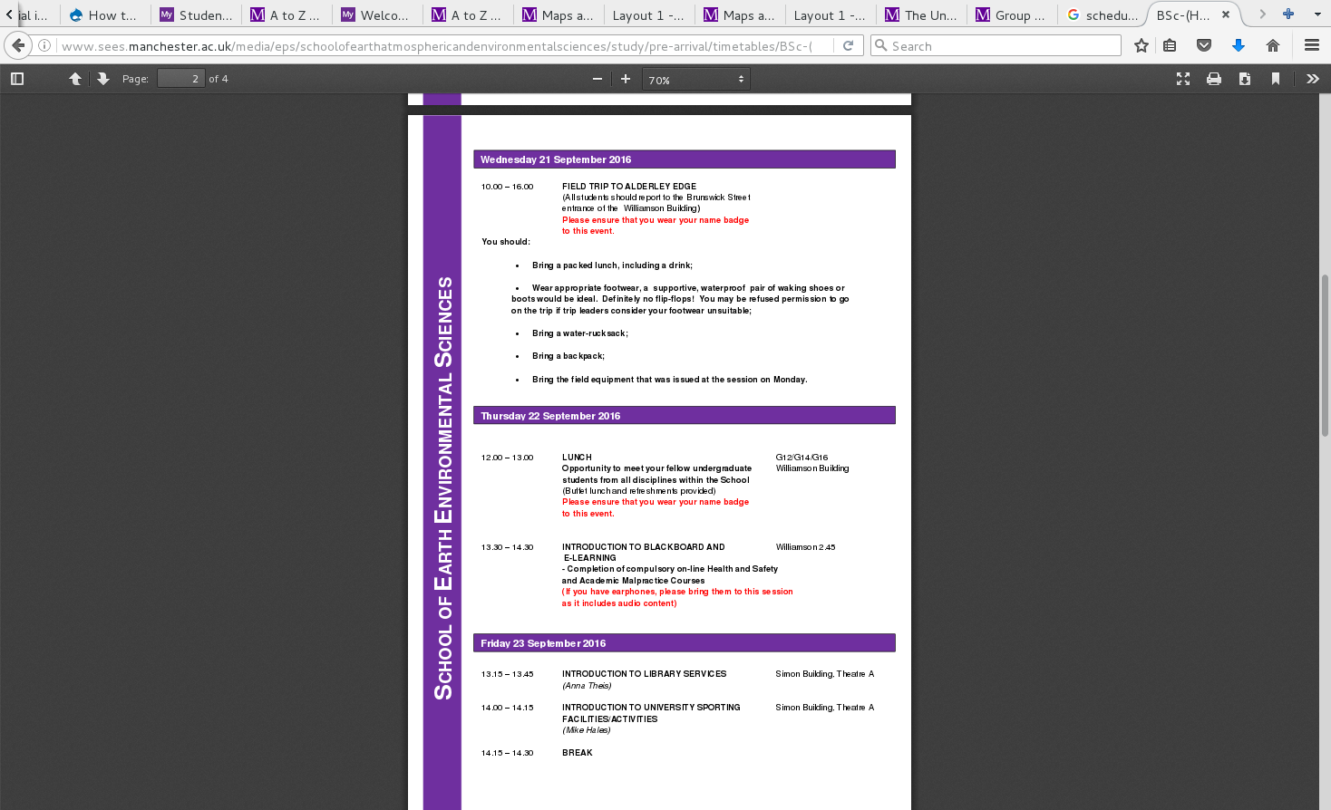
How do I get to Simon Building?

Slide 21
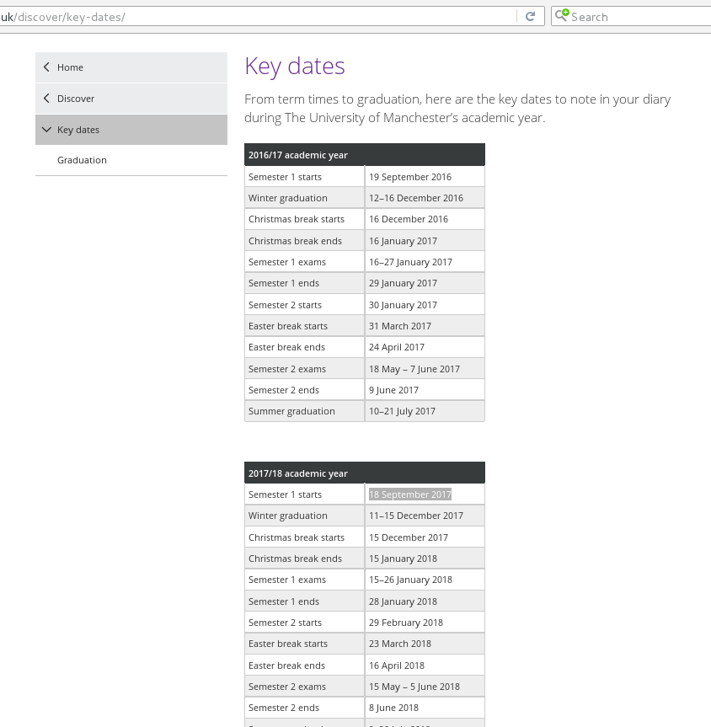
Tactical Google
Google: University of Manchester Key Dates
http://www.manchester.ac.uk/discover/key-dates/

Slide 22
Overview
Your degree
Marks, credits, etc
Term dates
University...start with welcome!
Time-table
“My Manchester”
Exercise
Communication
Feedback
Summary / questions

Slide 23
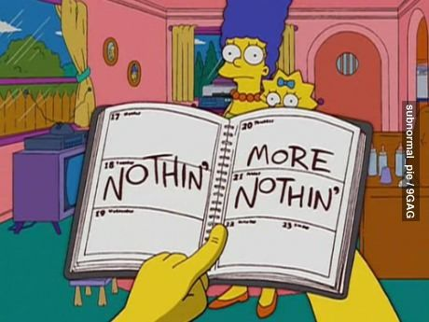
Time-table – complex, so check each week

Slide 24
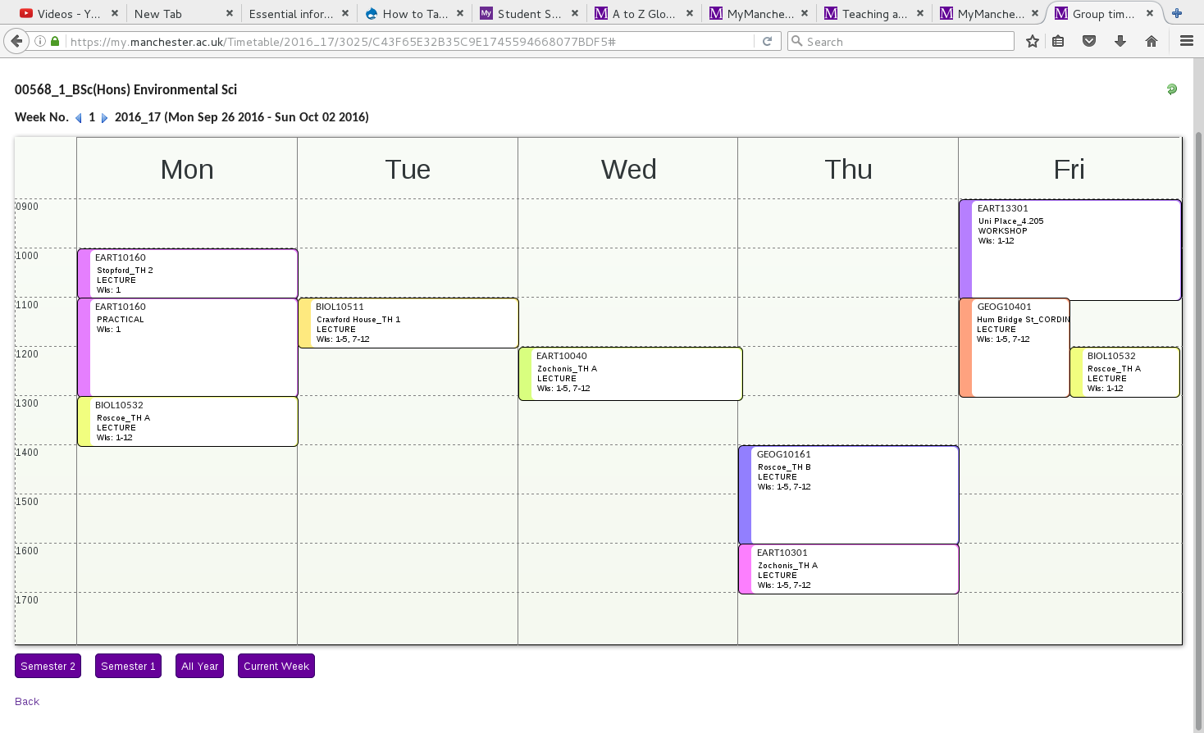
Time-table – complex, so check each week
Industry projects
Environmental Processes and change
Can be slightly different each week, you need to check!
Biodiversity
Tutorial
Environmental Pollution
Microbes, Man and the Environment
Introduction to the Earth
Scientific Problem Solving
Notes:
Time-table will not be your Schedule. As well as this you will want to schedule study time.

Slide 25
Overview
Your degree
Marks, credits, etc
Term dates
University...start with welcome!
Time-table
“My Manchester”
Exercise
Communication
Feedback
Summary / questions

Slide 26
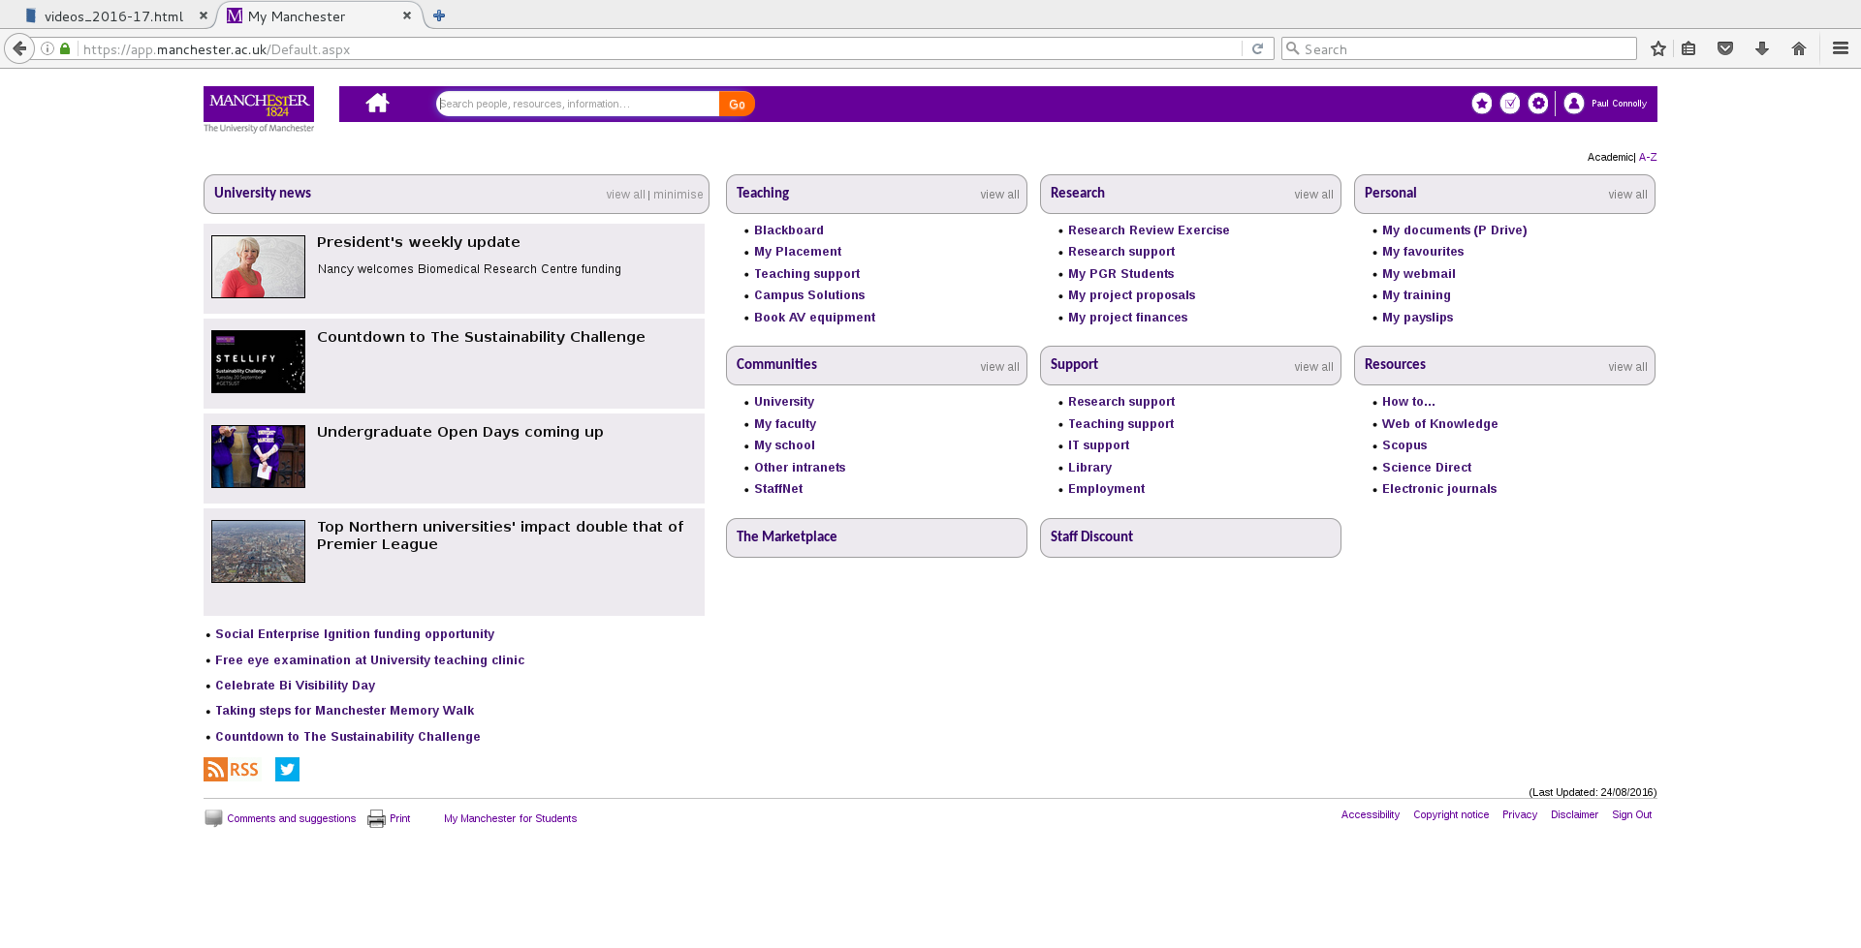
My Manchester https://my.manchester.ac.uk/ (e.g. Time-table)
Click on the A-Z

Slide 27
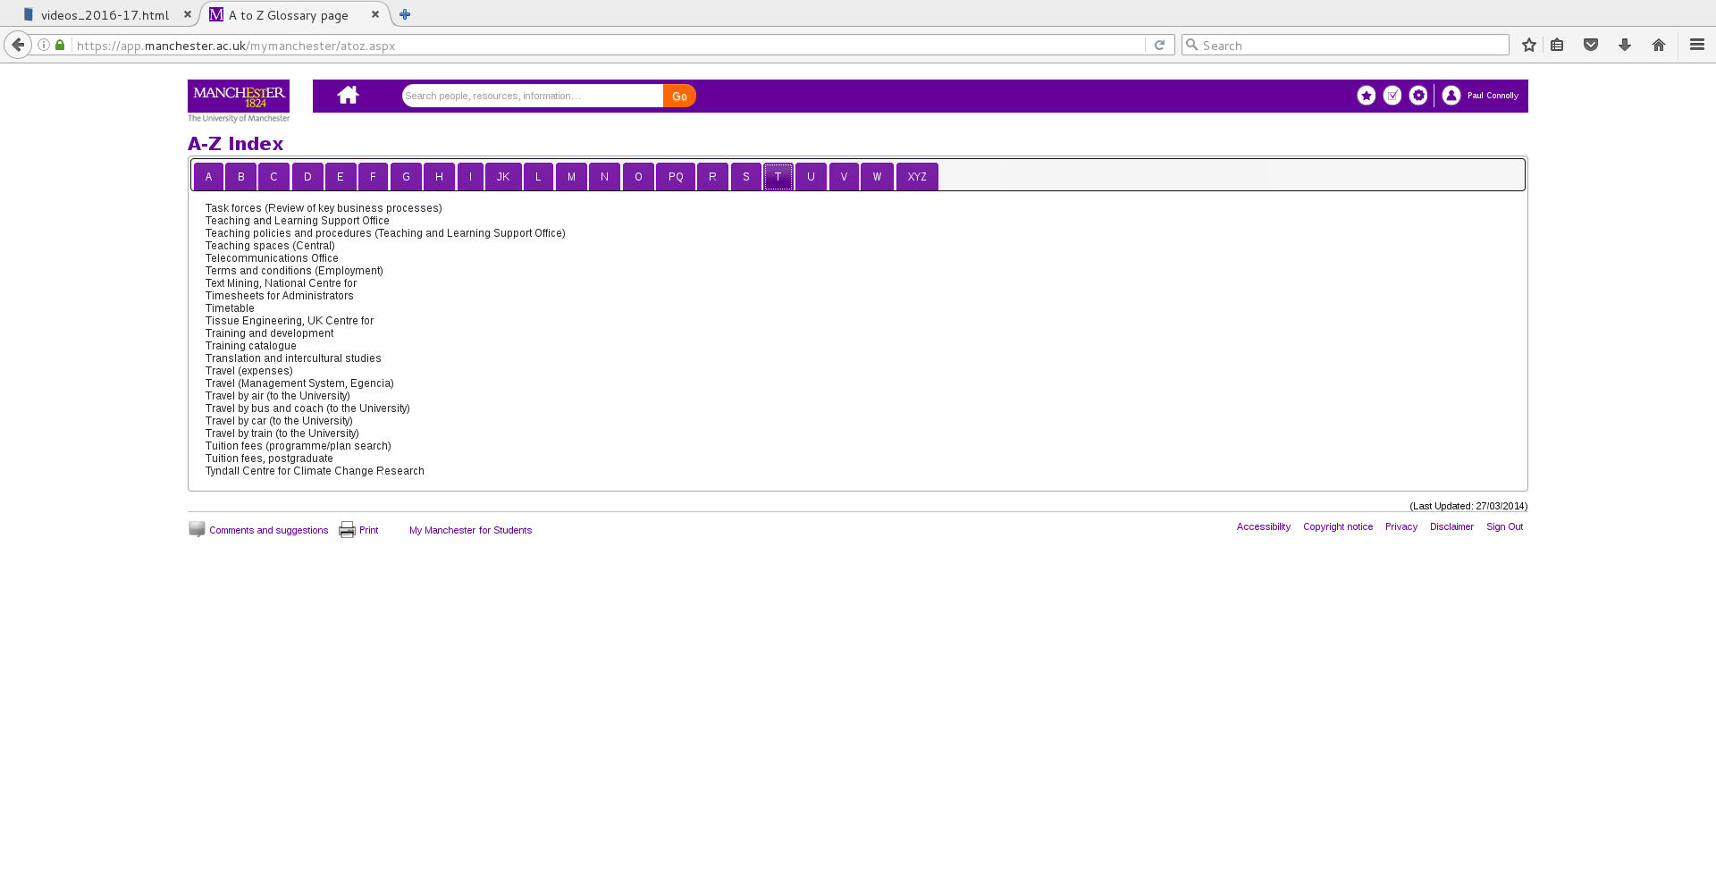
My Manchester https://my.manchester.ac.uk/ (e.g. Time-table)
e.g. Time-table here

Slide 28
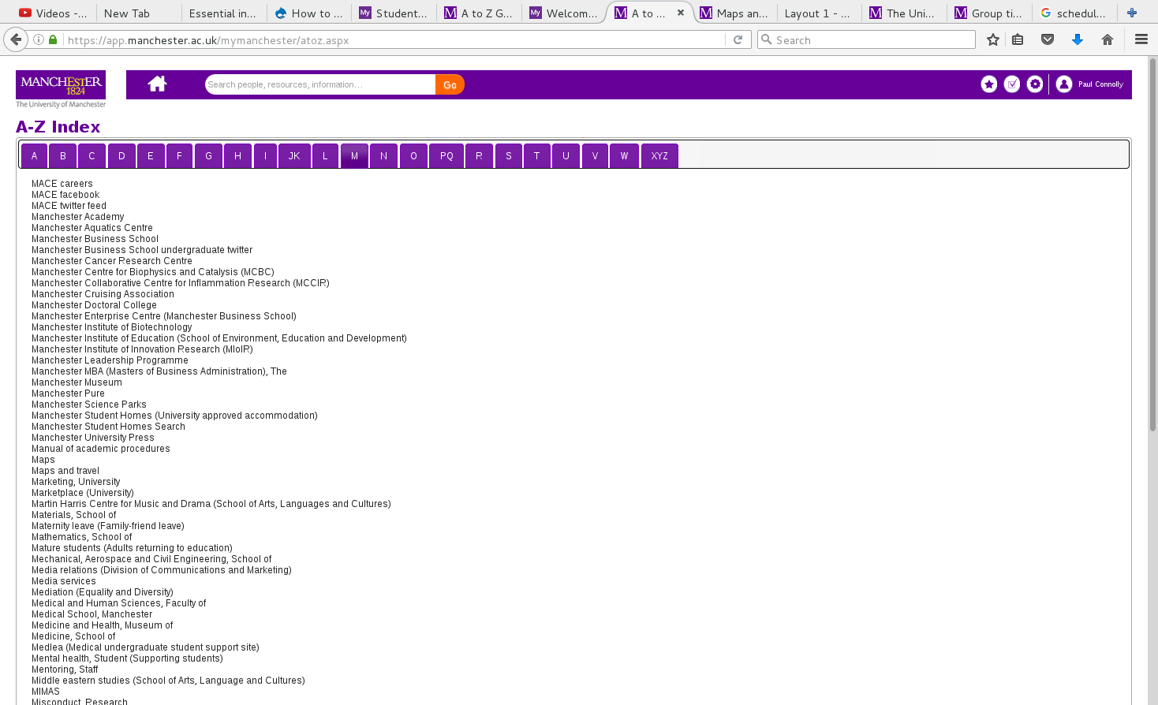
My Manchester https://my.manchester.ac.uk/ (e.g. Map)
e.g. Maps

Slide 29
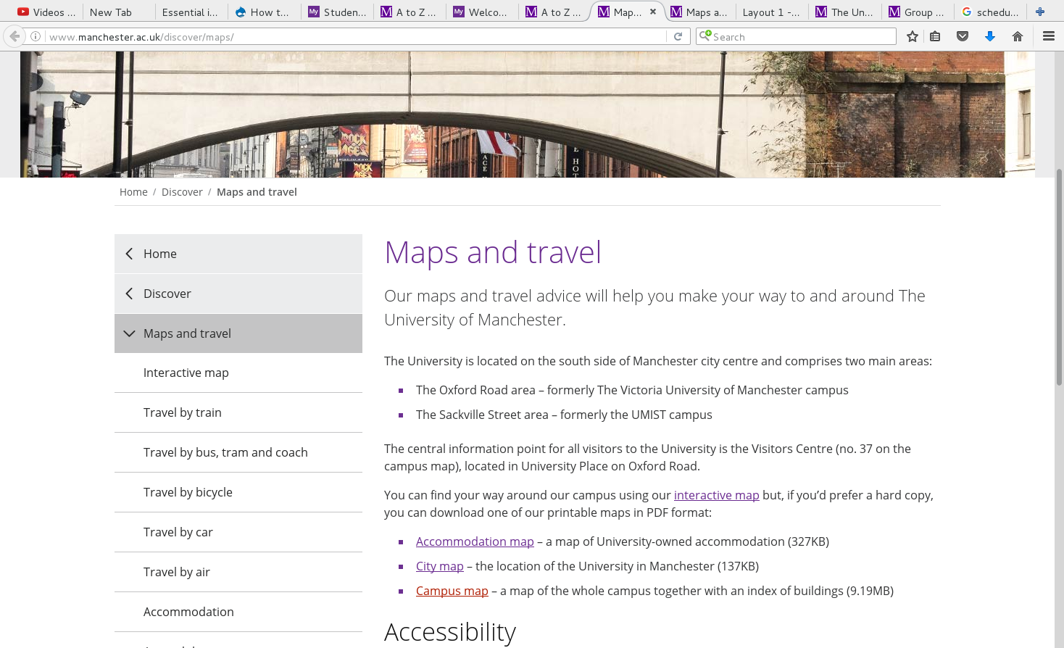
My Manchester https://my.manchester.ac.uk/ (e.g. Map)
e.g. Maps

Slide 30
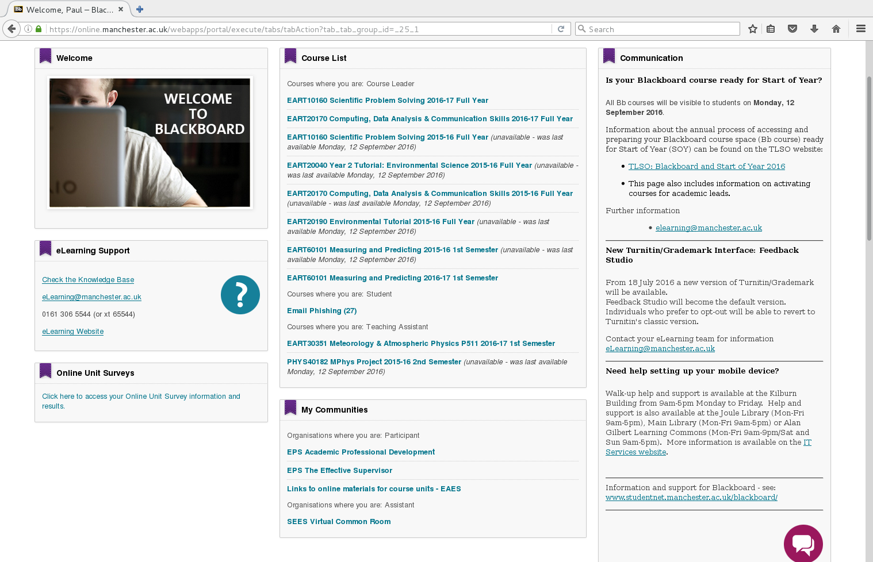
Blackboard (find from My Manchester A-Z)
Course materials
School material, including programme and general handbooks

Slide 31
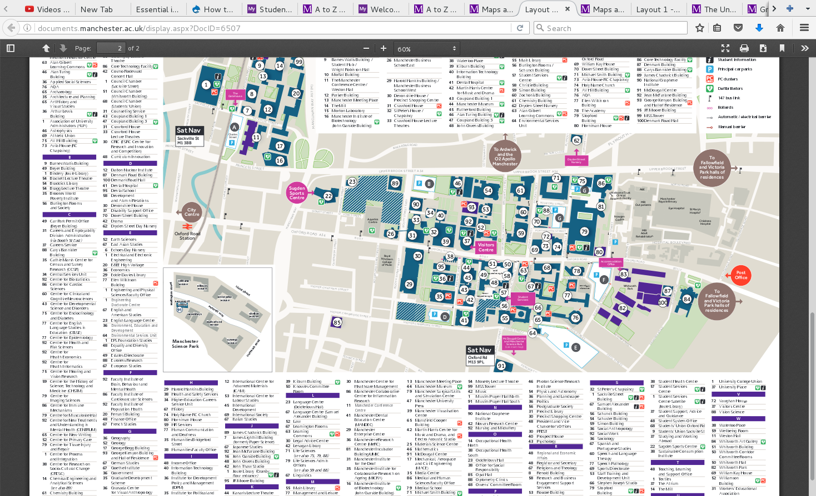
My Manchester https://my.manchester.ac.uk/ (e.g. Map)

Slide 32
Overview
Your degree
Marks, credits, etc
Term dates
University...start with welcome!
Time-table
“My Manchester”
Exercise
Communication
Feedback
Summary / questions

Slide 33
Exercises before the end of the week
Use “My Manchester” to find and bookmark the following:
Time-table link
Campus Map
Blackboard link and take a quick look at each module
Find and download the programme handbook on the Virtual Common Room.
Send me an email by Friday, saying hi and whether you have done this or not:
Paul.connolly@manchester.ac.uk

Slide 34
Overview
Your degree
Marks, credits, etc
Term dates
University...start with welcome!
Time-table
“My Manchester”
Exercise
Communication
Feedback
Summary / questions

Slide 35
How we communicate with you
Noticeboard
University email: CHECK DAILY
Letter
Blackboard
https://blackboard@manchester.ac.uk
You have a contract with us. As part of this you have agreed that once we email you something you are aware of it.

Slide 36
You must communicate with us
Email earth.support@manchester.ac.uk
Phone
Undergraduate Office 1.42
Letter

Slide 37
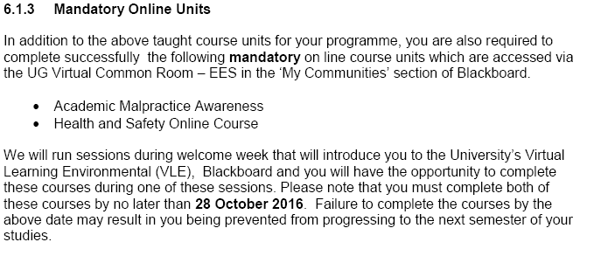

Slide 38
10:00 – 4:00 pm Fieldtrip – please bring sturdy footwear, waterproofs and a packed lunch
Bus will leave at 10 AM Sharp, so be on time.

Slide 40
Overview
Your degree
Marks, credits, etc
Term dates
University...start with welcome!
Time-table
“My Manchester”
Communication
Feedback
Summary / questions

Slide 41
We value your feedback
Staff-student liaison repsinvited to come along and ask questions / raise any issues in an informal setting.
Course Unit Evaluation Questionnaires
Personal Advisory Sessions

Slide 42
Please watch the notice boards and your email for updates or changes during the first few weeks of term
Especially watch for information concerning advisory sessions
Staff will be organizing these during the first week of teaching

Slide 43
Overview
Your degree
Marks, credits, etc
Term dates
University...start with welcome!
Time-table
“My Manchester”
Communication
Feedback
Summary / questions

Slide 44
To summarise
Follow the welcome week pack
Complete the task I set by Friday, this week
Attend the field course on Wednesday
Any questions?
Notes:
http://www.studentsupport.manchester.ac.uk/

