Slide 1
Environmental Science program induction
Dr. Paul Connolly

Slide 2
Today I will talk about…
Who am I?
Environmental Science at Manchester…
Some highlights of the degree
Some general points:
How to succeed / fail
Support
Course Representation
Awards
Communication / Feedback
Specific Information you will need right now
Structure
Term dates
Marks / Credits
Time-table
An Exercise to help
Concluding remarks

Slide 3
Who am I?
Dr. Paul J. Connolly
Reader in Atmospheric Science
First Year Coordinator, Environmental Science.
Office number, 3.08, Simon Building
Email paul.connolly@manchester.ac.uk

Slide 4


New Developments at SEES
Your degree is accredited!
the Committee of Heads of Environmental Sciences (CHES), the education committee of IES, has accredited all Environmental Science undergraduate programs at UoM.
A programme accredited by CHES is assured to meet high standards, contain a strong component of practical, field and theoretical activities, and has excellent opportunities for training, work experience and links to the professional environmental sector.
Relevance for you:
Access to an active community which champions environmental disciplines both academically and professionally.
You can apply for free Student Membership of the Institution.

Slide 5
More New Developments at SEES
Due to restructuring in the University 15 academic staff have moved from Life Sciences to join our environmental chemists and physicists
New “School of Earth and Environmental Sciences”.
Relevance for you:
More choice in terms of 3rd Year Undergraduate Dissertation topics,
More “bioscience” based teaching on our residential field trips,
More holistic educational experience for our environmental science students at all levels.

Slide 6
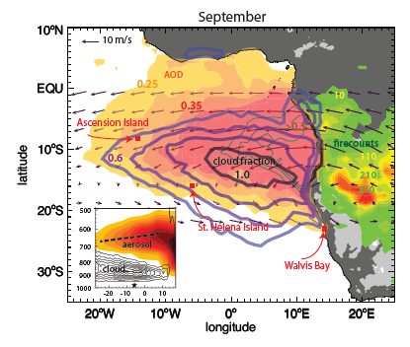
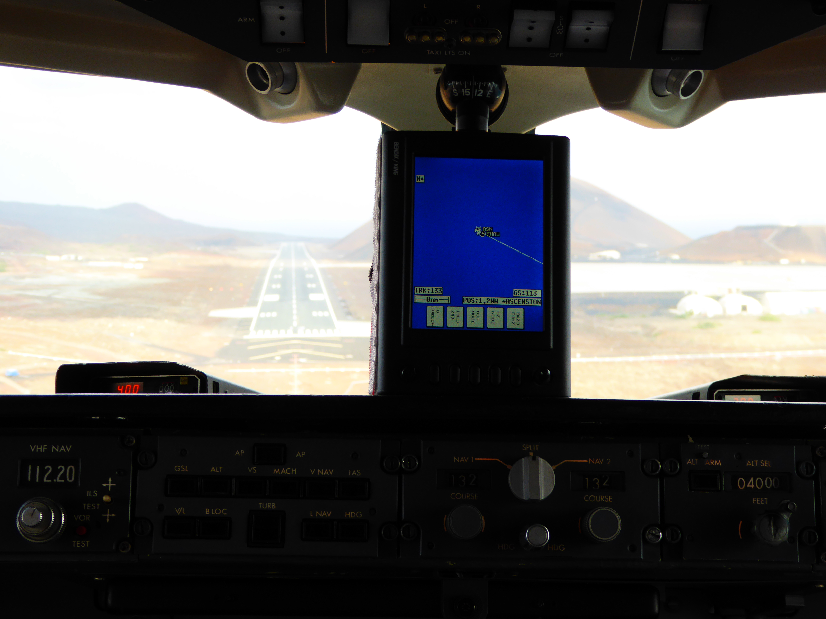
Env Science at Manchester: Scientists take to the skies to discover the role of African Biomass Burning
August and September 2017
Scientists, including a team from Manchester, have for the first time, investigated the impacts of African biomass burning aerosol on the tropical south Atlantic Ocean region.
Aircraft, carrying instruments to collect atmospheric data, were used to track biomass burning from Africa and observe it above and below low lying marine cloud.
The dark absorbing particles heat the air. Above cloud this stabilises the cloud re-enforces it, below cloud heating may enhance evaporation and reduce cloud. Both effects change climate and are very hard to quantify.

Slide 7
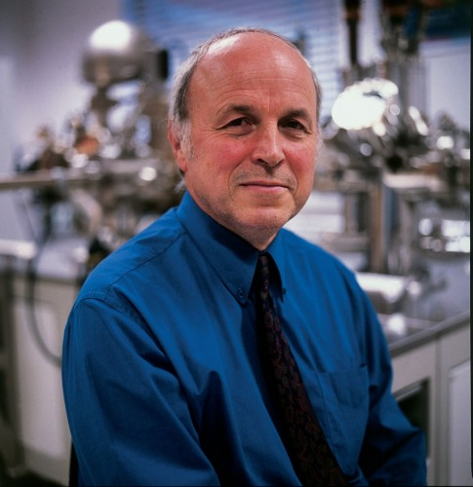
Env Science at Manchester: Canada honours leading Manchester earth scientist
The Royal Society of Canada has bestowed a rare honour on Professor David Vaughan (Research Professor of Mineralogy), by electing him as a ‘Foreign Fellow’.
Prof Vaughan is The Founding Director of the University’s Williamson Research Centre for Molecular Environmental Science.

Slide 8
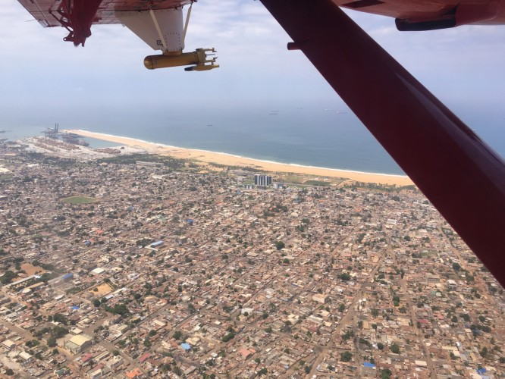
Env Science at Manchester: Scientists take to the skies to track West African pollution
Scientists, including a team from Manchester, have for the first time, investigated the impacts of natural & manmade emissions on the West African atmosphere.
Aircrafts, carrying instruments to collect atmospheric data, were used to track air pollution from the big coastal cities as it streams inland reaching the forests and Sahara.
They detected particles for the burning of charcoal, rubbish and agricultural waste, in the atmosphere over a number of urban areas, contributing to concerns of the rise in pollution across the region.

Slide 9
…..And again-
Welcome to Manchester!
This is a challenging but rewarding programme.
I am glad to welcome you and help you get started on this next stage in your education
We are extremely proud of our environmental students and all they go on to accomplish in their careers.
For example, …………
Notes:
You might want to add your favorite success story here- Anju Nihalani? Alex Stark? Pete Morris?

Slide 10

Env Science at Manchester: 1st Year Student Brings Biology to Life with Award-winning Poster
As part of the ‘Biodiversity’ module in their first year, students produced electronic posters, simplifying complex biological concepts and making them accessible to younger
Their work was entered into a competition to be published by Biological Science Review – a magazine aimed at A-level Biology Students.
The winning entry, designed by Louisa Bacon (BSc Environmental Science) was published in April, reaching more than 10,000 readers worldwide!
Louisa’s poster explains how the resilient pitcher plant, native to Borneo, serves as a ‘convenient feeding station’ in the wild.

Slide 11
Env Science at Manchester: BP STEM scholarship for 1st year environmental science student
Grace MacMillan, a first year environmental science Student, was awarded a BP STEM Scholarship.
Only 8 for the whole university
She is awarded £5000 per year and an interview for an internship or job.

Slide 12
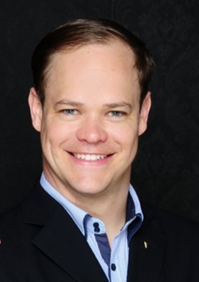
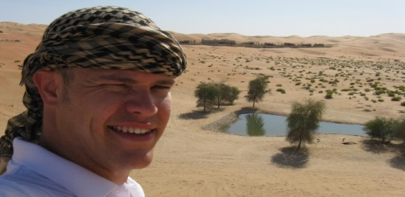
Alexander Bergfeld, BSc Environmental Sciences
“The degree in Environmental Sciences helped me to find a job in my field of interest, leading to me building solar parks and artificial oases in the desert of the United Arab Emirates.
Manchester was a highly recommendable experience for me. The lecturers were always very warm and welcoming and absolute experts in their fields. The field trip to Tenerife helped me to further strengthen my base in understanding the coherence of environmental processes, an aspect which I often used in my later projects.”
My most recent activity is the establishment of Ad Solem Acceleration where I and a team of experts offer support in the establishment of business acceleration and innovation programs and help companies survive in times of digitalization and globalization.”

Slide 13
Highlights: field work
There is field work in every year. We only ask that you pay for food

Slide 14
Today I will talk about…
Who am I?
Environmental Science at Manchester…
Some highlights of the degree
Some general points:
How to succeed / fail
Support
Course Representation
Awards
Communication / Feedback
Specific Information you will need right now
Structure
Term dates
Marks / Credits
Time-table
An Exercise to help
Concluding remarks

Slide 15
The Key to success
Your University education is about becoming a self-motivated learner. Your education is primarily your responsibility
Attend lectures, and tutorials
Be on time and stay awake!
Take notes, conduct follow up reading from reliable sources, ASK QUESTIONS
Organize your time – be prepared
Participate and take responsibility
Develop a love of learning and enjoy yourself

Slide 16
And how to fail:
Missing lectures, practicals or tutorials.
Forgetting to turn up to exams.
Failing to hand in assessed work on time
Relying too heavily on a single source of information, or failing to express ideas in your own words.
Working too closely with someone else so that neither of you submit your own, independent answers.
Not letting us know if you are ill.
Not telling us if you have family or other problems that keep you away from University.
Changing your address and not telling us how to contact you.
Telling your parents not to forward any mail we send to your home address.
Booking holidays for periods of required attendance, resit periods or periods that overlap with field courses.
Relying on last-minute revision rather than keeping up with course material.
Keeping your problems to yourself.

Slide 17
Student support
You will be assigned a Professional Development group for year 1 (EART10040)
You will also be assigned a personal tutor throughout your time at Manchester. Meeting should be held at least once per semester
You personal tutor should be your first point of call if you have any general concerns about your studies or are in need of pastoral support
Support for mitigating circumstances and disability (DASS): via the student office (Williamson 1.42), mitigation officer: Dr.Alison Pawley, disability officer: Dr.Margaret Hartley
Student Services Centre:
http://www.studentnet.manchester.ac.uk/crucial-guide/ssc-contact- details/
Make use of support – contact us as soon as possible if you feel personal circumstances or disability might affect your studies

Slide 18
Student representation
Each year group will elect a year representative (student union to organize)
Year representatives will meet once per semester with the programme team to raise and discuss concerns by the students, and to find solutions to address them
It is the representatives’ duty to properly report students’ concerns to the programme team, and report back the results of the discussion to all students.
If you want to feedback your issues effectively, this can be a useful way of doing it.

Slide 19
Rewarding Success
First Year
Best overall performance in Single Honours and with Programmes (Medal)
Best overall performance in Environmental Science and Environmental Studies (Medal)
outreach activity the student has contributed to during their first year.
Second Year
Best overall performance in Environmental Science and Environmental Studies (Medal)
Mineralogical Society Student Award
Third Year
Best overall performance in Environmental Programmes (Medal)
Best Environmental Project (Medal)
Most service to the School over 3 and 4 years (Medal)

Slide 20
How we communicate with you
Noticeboard
University email: CHECK DAILY – this is the preferred mode of contact. Mitigation may be rejected if students do not check and respond to email.
Letter
Blackboard system
You have a contract with us. As part of this you have agreed that once we email you something you are aware of it.

Slide 21
Your feedback is absolutely vital to us! (and taken very seriously)
Course Unit Evaluation Questionnaires
Personal Advisory Sessions
Staff-student liaison board “reps” invited to come along and ask questions / raise any issues in an informal setting.
Anybody interested in putting themselves forward as a representative let me know ASAP please! Also if you’d like more information let me know.

Slide 22
Today I will talk about…
Who am I?
Environmental Science at Manchester…
Some highlights of the degree
Some general points:
How to succeed / fail
Support
Course Representation
Awards
Communication / Feedback
Specific Information you will need right now
Structure
Term dates
Marks / Credits
Time-table
An Exercise to help
Concluding remarks

Slide 23
Today I will talk about…
Who am I?
Environmental Science at Manchester…
Some highlights of the degree
Some general points:
How to succeed / fail
Support
Course Representation
Awards
Communication / Feedback
Specific Information you will need right now
Structure
Term dates
Marks / Credits
Time-table
An Exercise to help
Concluding remarks

Slide 24
Structure: staffing
Head of Teaching SEES
Dr. Merren Jones
Program Director SEES
Dr. Bart van Dongen
Year 1 coodinator
Dr. Paul Connolly
Year 2 coodinator
Dr. Clare Robinson
Year 3 coodinator
Dr Robert Samson
Year abroad / year in industry:
Dr. Greg Holland
Careers Officer
Dr Julian Mecklenburgh
Personal & Academic Tutors

Slide 25
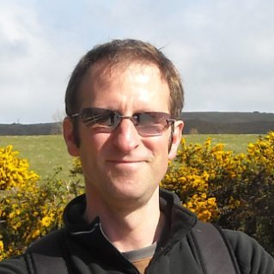
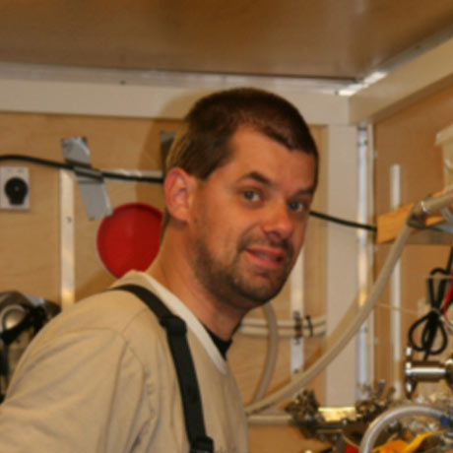
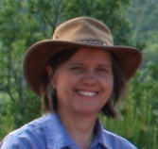
Structure: key people
Head of School
Prof. Kevin Taylor
(geochemistry)
Programme Director
Dr. Bart van Dongen
(organic geochemistry)
Director of Teaching
Dr. Merren Jones
(sedimentology)
Education Officers
Ms. Angela Entwistle
Mr. Mike Turner
Administrator
Ms. Carol Jeffries

Slide 26
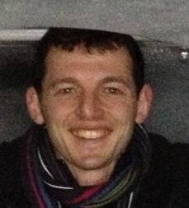
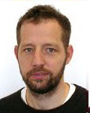
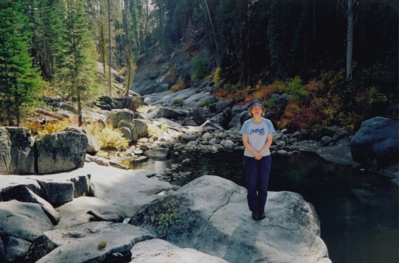
Structure: Key People 2
Year 1 coordinator
Dr. Paul Connolly
(Atmospheric Science)
Year 2 coordinator
Dr. Clare Robinson
(Fungal expert)
Year 3 coordinator
Dr. Robert Samson
(Paleontologist)
Careers Officer
Dr. Julian Mecklenburgh
(Structural Geologist)

Slide 27
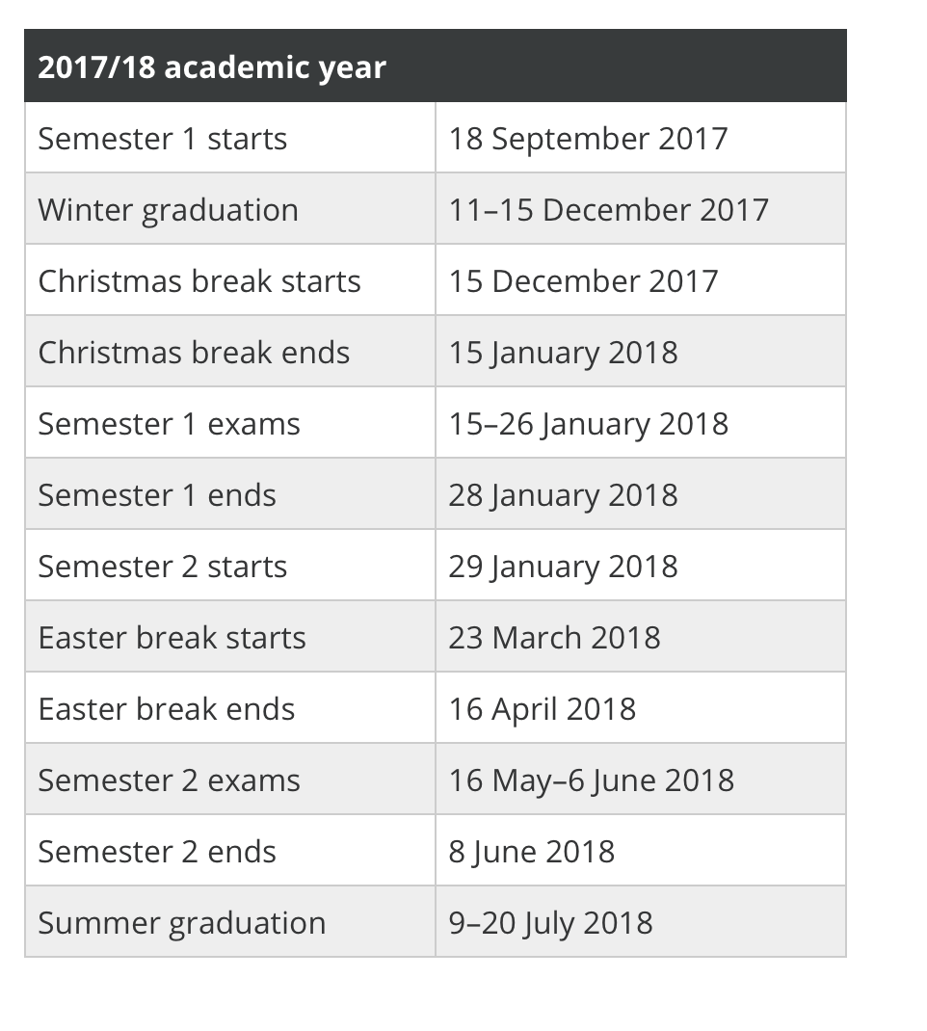
Term dates: Google can help!
Google: University of Manchester Key Dates
http://www.manchester.ac.uk/discover/key-dates/
Which periods do you need to be at the University?
When is it acceptable to be away?

Slide 28
Marks
A BSc or BEng is 3 years, an MEarthSci or MEng is 4 years.
Each year is 120 credits.
Most modules are 10 credits.
Make sure you are registered for the right number of credits.
Year weightings (BSc):
Year 1: 10%
Year 2: 30%
Year 3: 60%
Degree grades are 1st, 2i, 2ii, 3rd and fail.
*Marks are gained for coursework and exams.
70% or higher corresponds to a first.
60% or higher is a 2i
50% or higher is a 2ii
40% or higher is a 3rd
less than 40% is a fail.
Details in the programme handbooks and general handbooks.

Slide 29

Credits / modules
Year 1
Code | Title | Core/Optional | Credits | Semester
EART10301 | Introduction to the Earth | C | 10 | 1
EART13301 | Earth Resources Projects: Origins, Technology, Sustainability and Environmental Impact | C | 10 | 1
BIOL10401 | Introduction to Laboratory Science | C | 10 | 1
EART10040 | Year 1 Environmental Tutorial | C | 10 | 1 & 2
EART10160 | Scientific Problem Solving | C | 20 | 1 & 2
EART10670 | Environmental Field Trip | C | 10 | 2
EART10032 | Global Climate Change | C | 10 | 2
EART10282 | Envi. Impact Industry Project Copper Mining and Nuclear Power | C | 10 | 2
EART10602 | Introduction to Ecology | C | 10 | 2
 | Total Level 1 Core Credits |  | 100
Options - Choose 20 credits, at least 10 credits must be in Semester 1
BIOL10511 | Biodiversity | O | 10 | 1
GEOG10711 | River Catchment Science & Management | O | 10 | 1
EART10321 | Chemistry of the Earth | O | 10 | 1
BIOL10602 | Field Course in Marine Biology | O | 10 | 2
BIOL10622 | Field Course in Comparative and Adaptive Biology (Mallorca) | O | 10 | 2
BIOL10532 | Microbes, Man and the Environment | O | 10 | 2 | If you choose this, you will have to do the Monday lecture via Podcast
EART10122 | British Stratigraphy and Geological Maps | O | 10 | 2
Notes:
Hence, you should pick one optional module..if interested, flag straight away and I will check if it is available.

Slide 30
Term dates: Google can help!
Google: University of Manchester Key Dates
http://www.manchester.ac.uk/discover/key-dates/

Slide 31
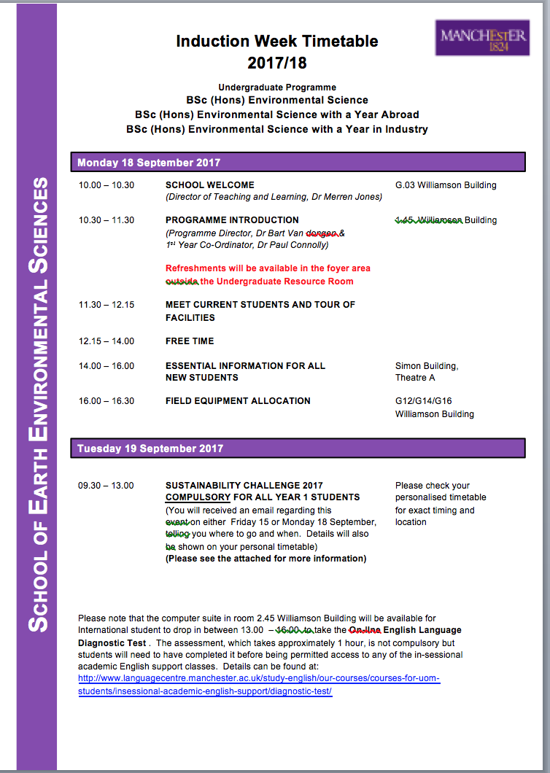
Time-table
How do I get to Simon theatre A?
What is my personalized time-table and how do I check it?

Slide 32
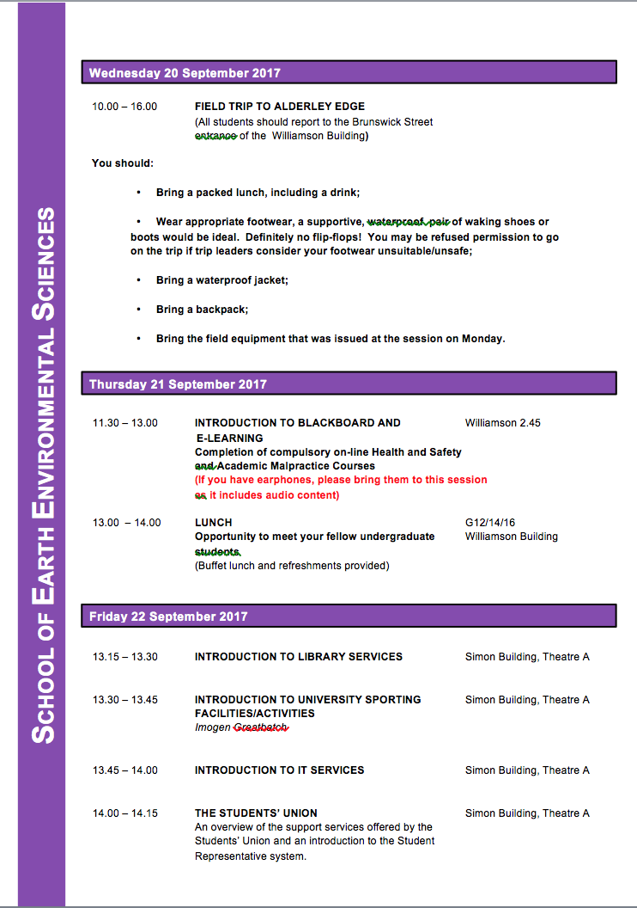
Time-table
Questions on field trip?
Mandatory!!

Slide 33
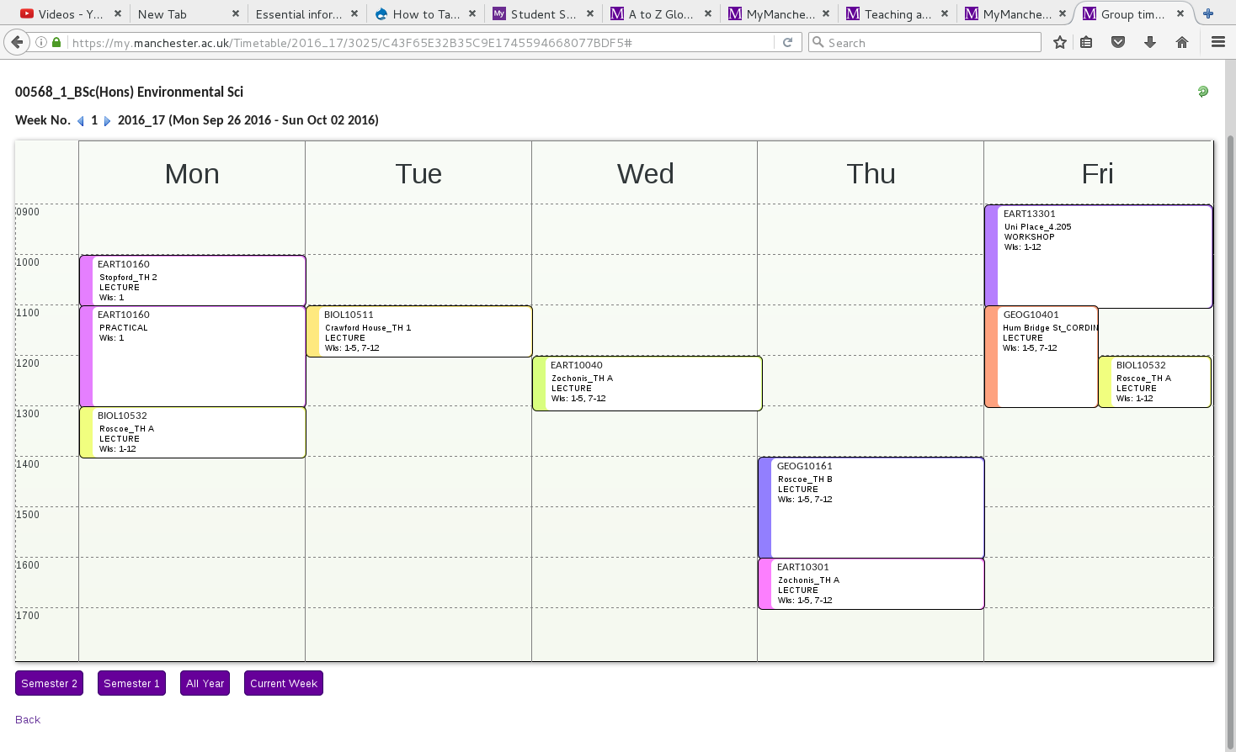
Time-table – complex, so check each week
Industry projects
Environmental Processes and change
Can be slightly different each week, you need to check!
Biodiversity
Tutorial
Environmental Pollution
Microbes, Man and the Environment
Introduction to the Earth
Scientific Problem Solving
Notes:
Time-table will not be your Schedule. As well as this you will want to schedule study time.

Slide 34
Today I will talk about…
Who am I?
Environmental Science at Manchester…
Some highlights of the degree
Some general points:
How to succeed / fail
Support
Course Representation
Awards
Communication / Feedback
Specific Information you will need right now
Structure
Term dates
Marks / Credits
Time-table
An Exercise to help
Concluding remarks

Slide 35
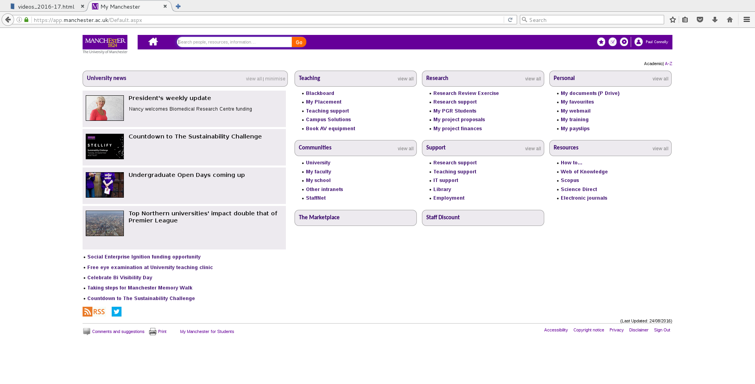
My Manchester https://my.manchester.ac.uk/ (e.g. Time-table)
Click on the A-Z

Slide 36
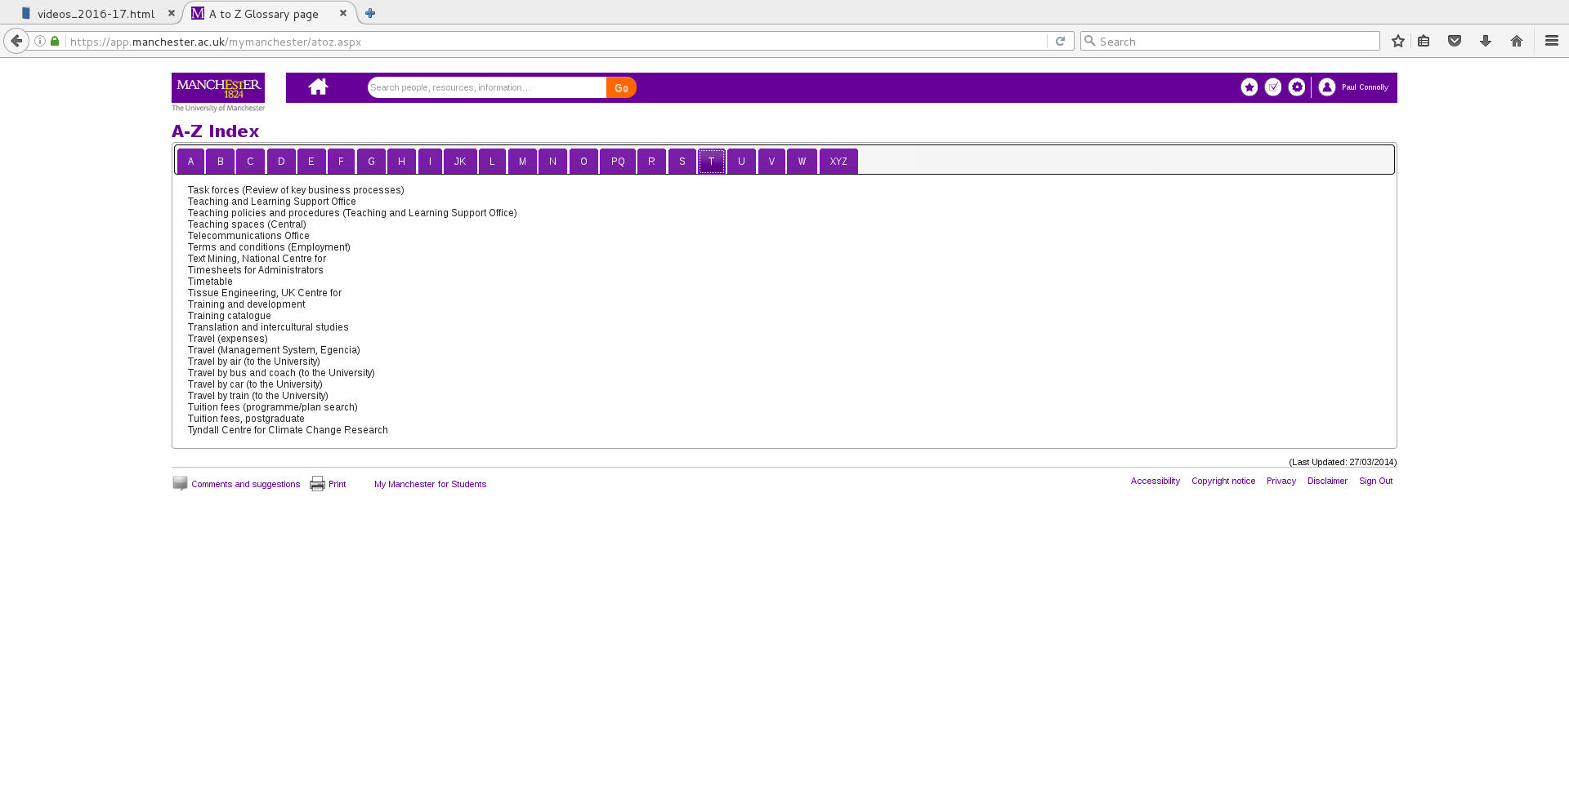
My Manchester https://my.manchester.ac.uk/ (e.g. Time-table)
e.g. Time-table here

Slide 37
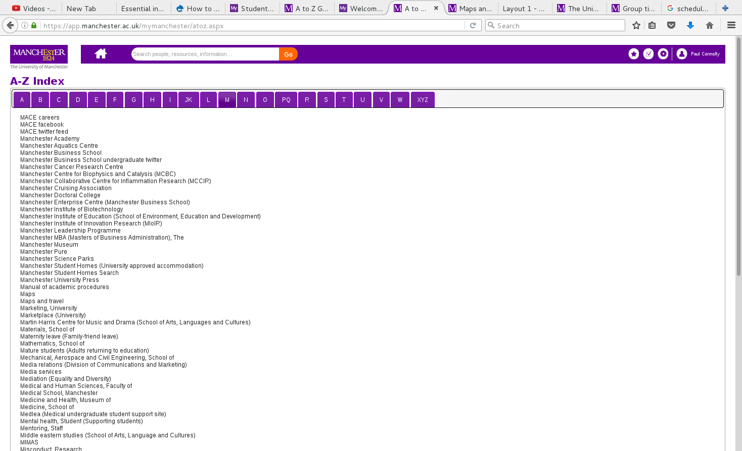
My Manchester https://my.manchester.ac.uk/ (e.g. Map)
e.g. Maps

Slide 38
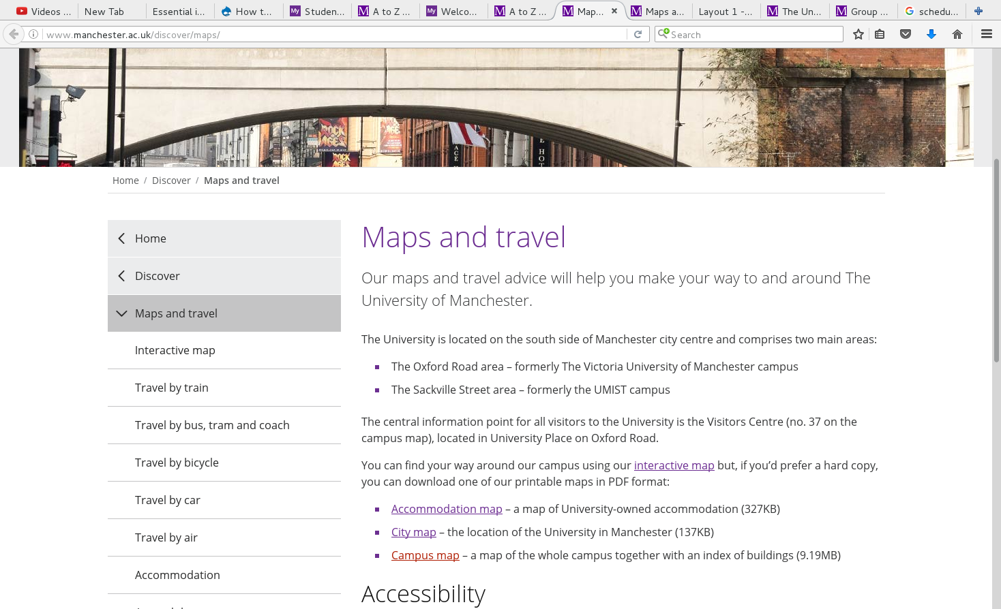
My Manchester https://my.manchester.ac.uk/ (e.g. Map)
e.g. Maps

Slide 39
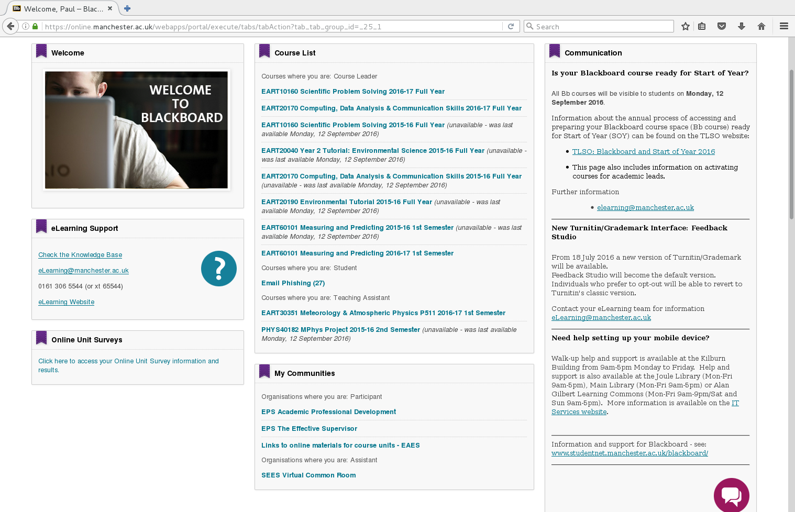
Blackboard (find from My Manchester A-Z)
Course materials
School material, including programme and general handbooks

Slide 40
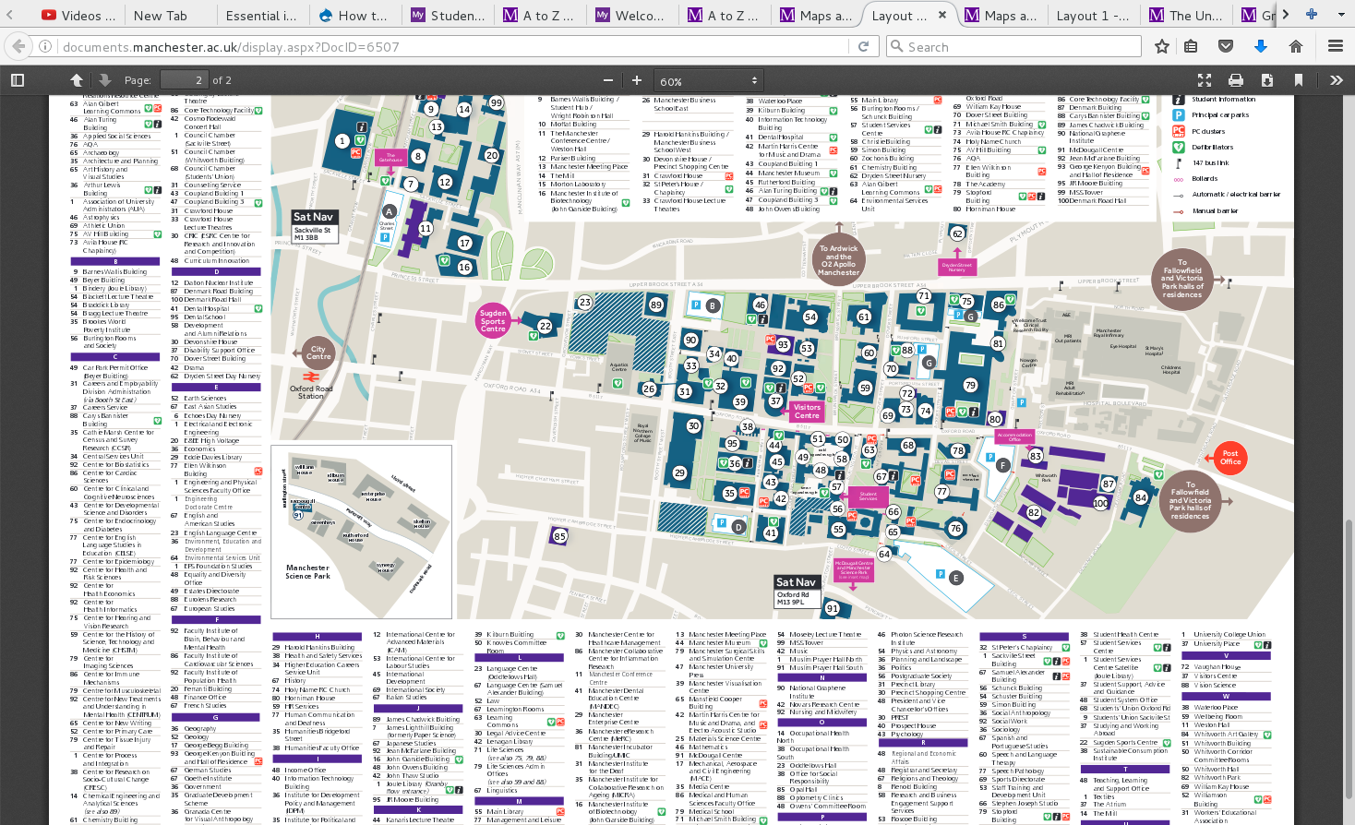
My Manchester https://my.manchester.ac.uk/ (e.g. Map)

Slide 41
Exercises before the end of the week
Use “My Manchester” to find and bookmark the following:
Time-table link
Campus Map
Blackboard link and take a quick look at each module
Find and download the programme handbook on the Virtual Common Room.
Send me an email by Friday, saying hi and whether you have done this or not:
Paul.connolly@manchester.ac.uk

Slide 42
Closing Remarks
Take responsibility of your education and become and independent learner asap
Try to be resilient, if you are struggling after the first attempt, try again! Before asking for help.
No compensation in year 1, i.e. you need to pass all units
Year 1 attendance is monitored
Talk to us
There is a time for learning, and a time for fun
You will forget most of this talk, don’t forget the exercise to find time-table, etc.
Notes:
http://www.studentsupport.manchester.ac.uk/

