Slide 1
Dr Paul Connolly
Reader in Atmospheric Physics
First Year Coordinator, Environmental Science.
Office number, 3.08, Simon Building
Email paul.connolly@manchester.ac.uk

Slide 2
Welcome back!
News: New “Year Abroad / Year in Industry” coordinator: Dr Greg Holland: g.holland@manchester.ac.uk
Information on year abroad / industry
Greg says “schemes are advertised from October, November, so will talk prior to then”
Semester 2 (see handbook):
Modules in semester 2
Microbes, Man, and the Environment 9 weeks clash with EART10160
Tutorials start from week 2
EART field work dates: 24th – 30 April (north wales, Colin Hughes)
Time-table
If my.manchester fails paper time-tables and a working website.
It changes some weeks…e.g. Microbes, Man, and the Environment, biology field course. You will have to check your time-table
Assessments and deadlines for core modules, semester 2
I haven’t input Earth Resources – will do today, or tutorials.
The time-table for results from last semester
March 1st & Exam feedback sessions
Personal tutorials and attendance
Stats on offerred vs accepted.
Need to arrange an appointment after results. Do you know who your personal tutor is?
General attendance and monitoring
Will be monitored with the card readers. If you fail and haven’t attended, you might not be offered a re-sit.
How to raise any issues
Staff-student liaison?
You do not have a 1st year student rep. Liaison did not report any issues.
Please do not wait… raise them before
Feedback
All Blackboard sites for EART modules should have details of how to get feedback.
Talking to lecturer, emailing them, and getting help.
FAQs
Questions?

Slide 3
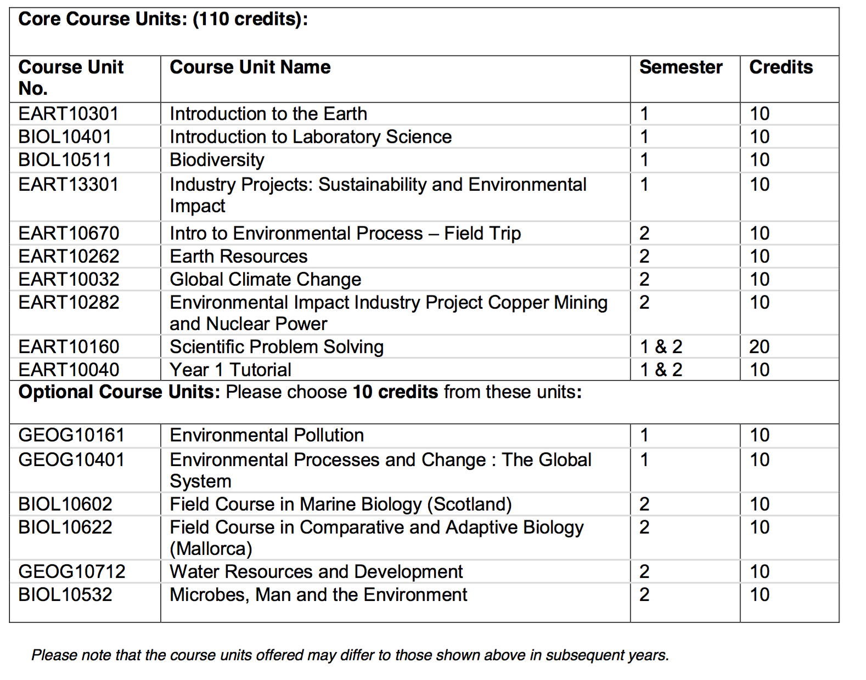
back

Slide 4
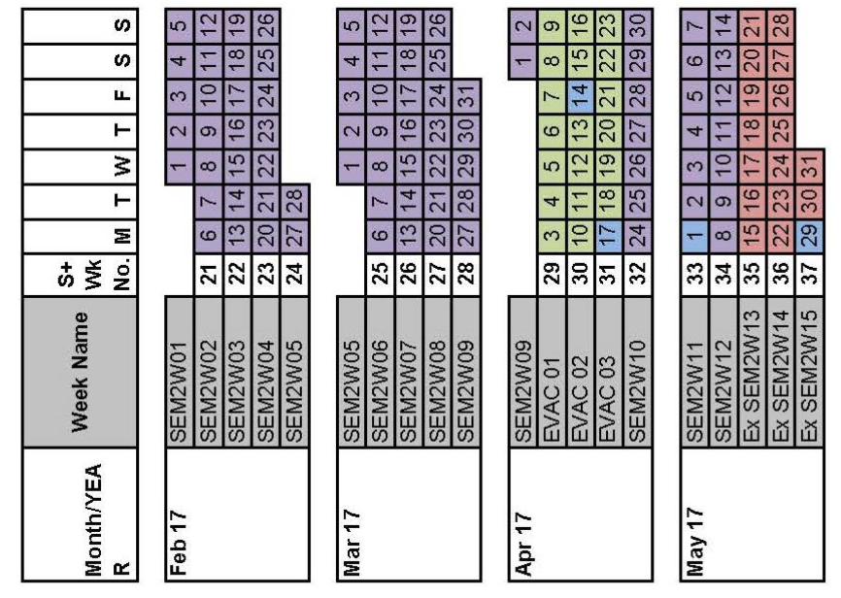
9 weeks now
Then Easter break
3 weeks on return
back

Slide 5
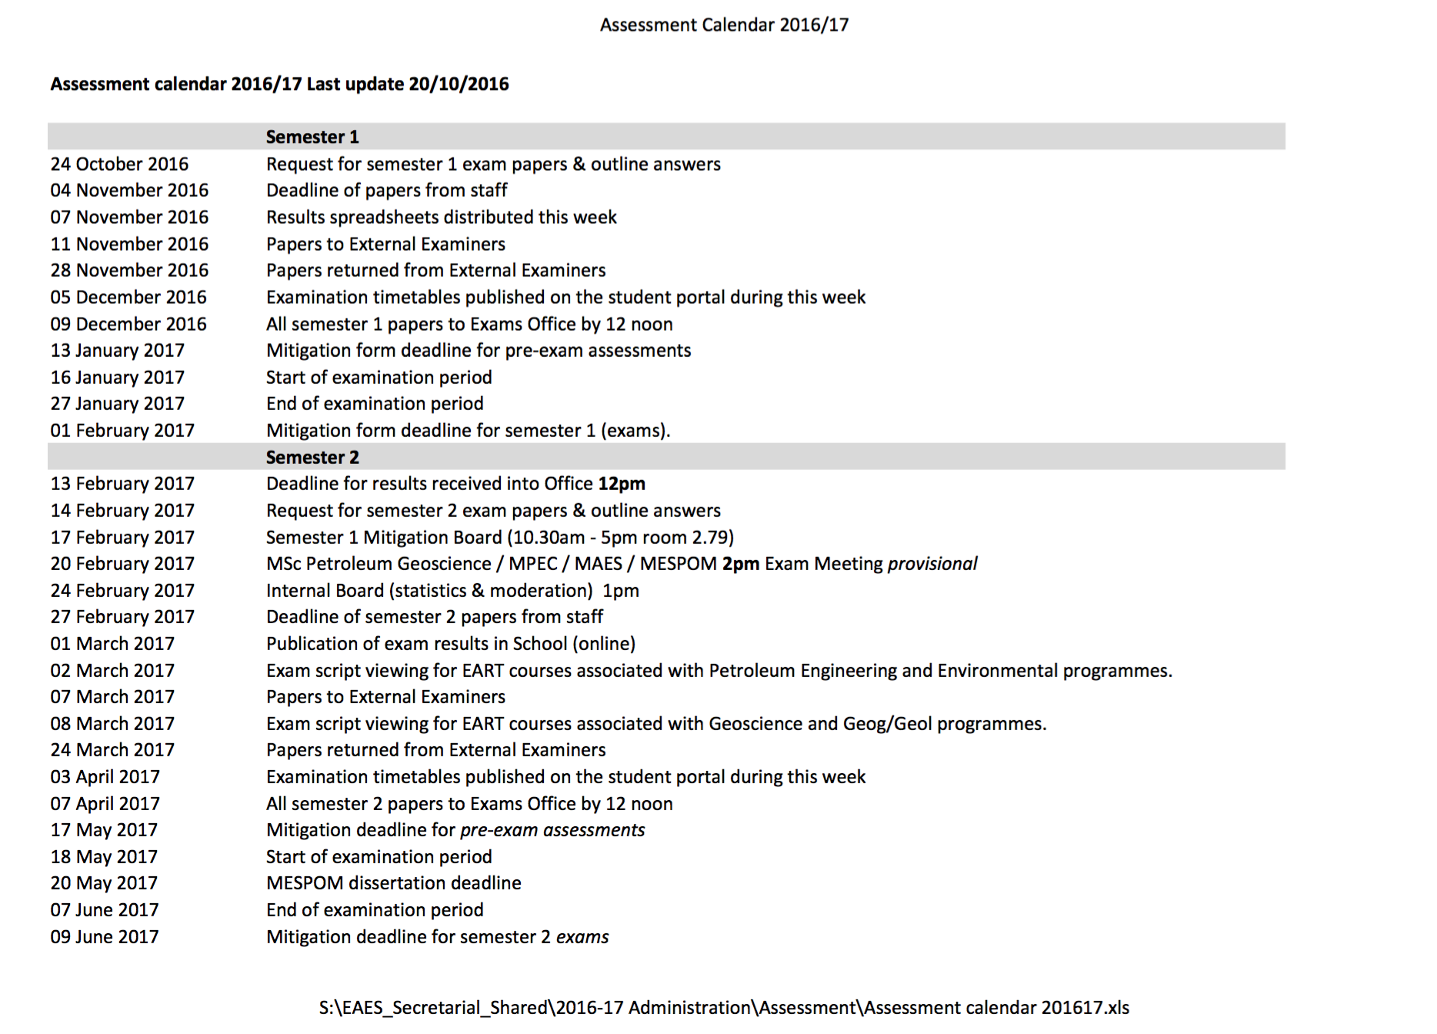
back

Slide 6
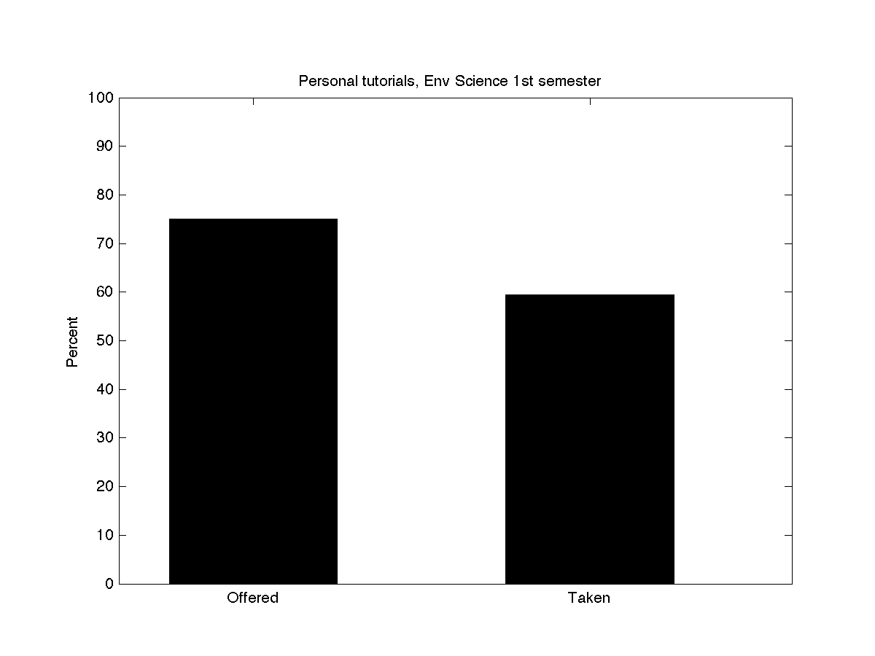
If you aren’t offered a personal tutorial, contact your Personal tutor…
You should reply at the very least.
Ignoring emails will mean an appointment with me, then Bart, then Merren (Head of Teaching)
back

Slide 7
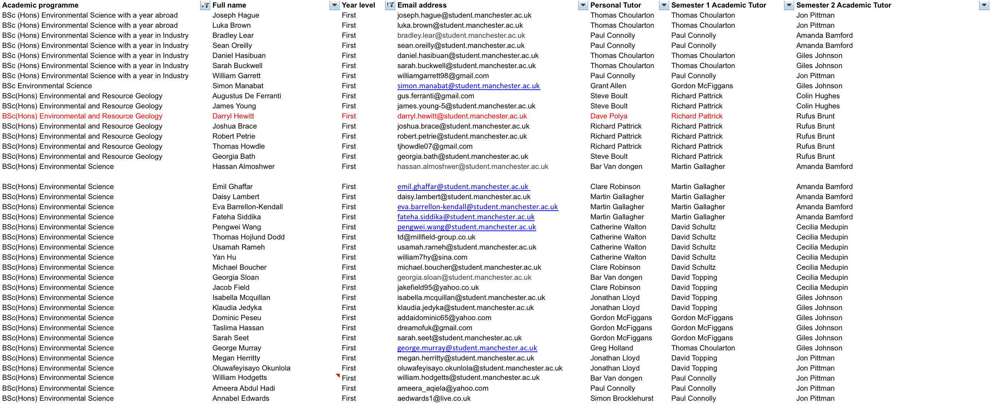
Personal Tutorials
back

