Slide 1
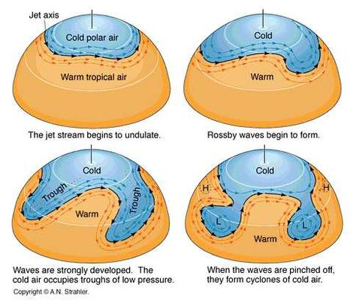
Understanding Rossby Waves atmospheric science activity
Dr Paul Connolly
Centre for Atmospheric Science

Slide 2
Why is it important?
Climate science
  Computer predictions of air motions is fundamental to more advanced climate model calculations. People want to know which regions are going to be affected by wind / rain / droughts / heat waves.
High impact weather
  Winter snow cost UK economy £ 1.2 billion a day in 2009
  Hurricane Freidhelm (known in Scotland as “Bawbag”), December 2011
    Cost UK economy £100 million in one day!
  Hurricane Katia, September 2011
    Cost UK £100 million.

Slide 3
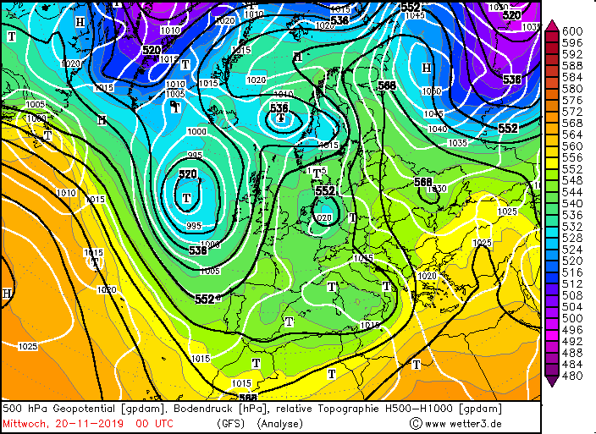
Today’s weather
Note the isobars

Slide 4
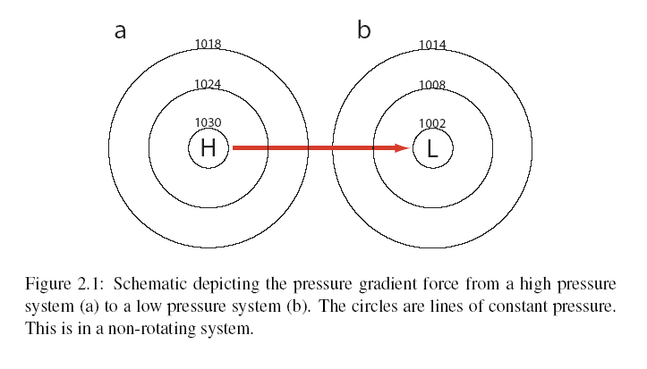
Pressure gradient

Slide 5
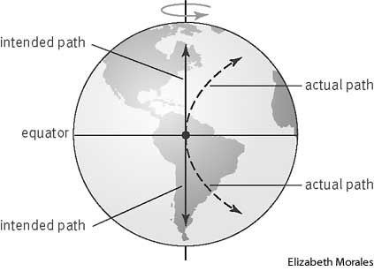
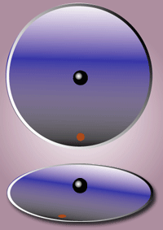
Coriolis effect
Looking down on earth from space (upper part of the picture), the black ball moves in a straight line (it obeys Newton!).
However, the observer (red dot) who is standing on earth (rotating) sees the object as following a curved path due to the Coriolis force.
wikipedia
http://www.nc-climate.ncsu.edu/edu/k12/.coriolis
The Coriolis parameter:

Slide 6
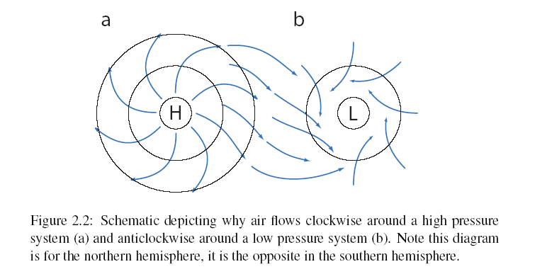
Air flow around highs and lows
Aside if there is time

Slide 7
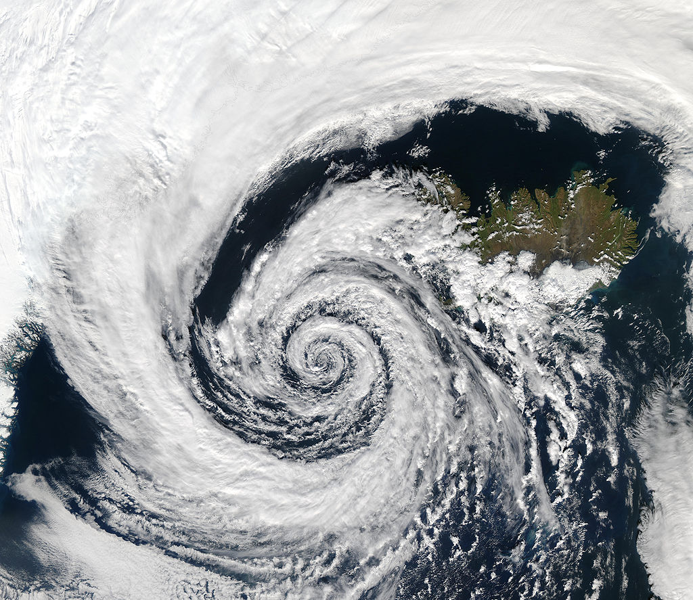

Slide 8
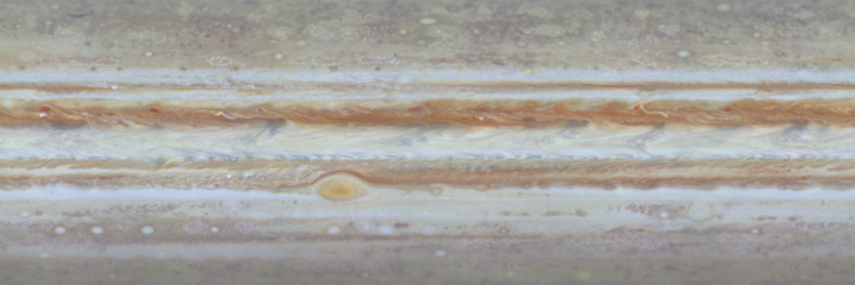
Jupiter’s red spot
Anti-cyclone, but rotates anti-clockwise like a cyclone – but it is in the southern hemisphere.
It `feeds off’ smaller scale motions
very persistent (at least 350 years old!)

Slide 9
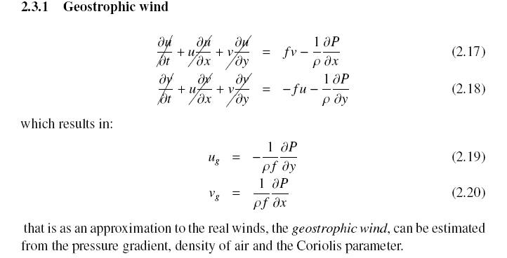
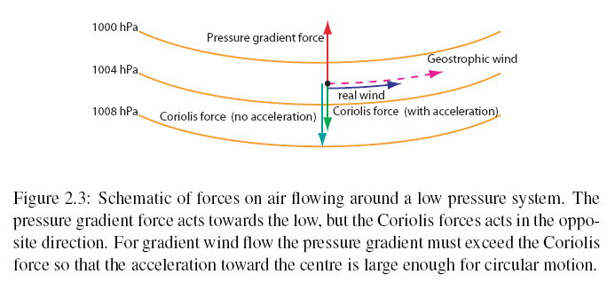
Balanced flow
Geostrophic wind blow parallel to lines of constant pressure!

Slide 10
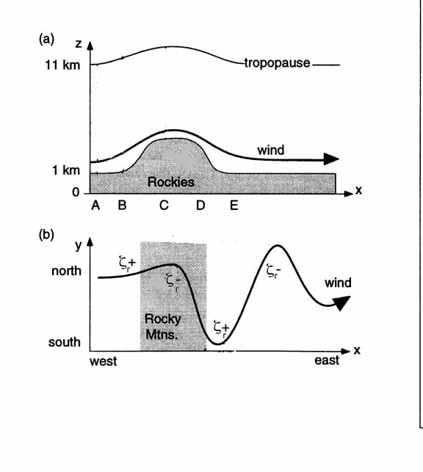
Orographic Rossby waves and vorticity
Vorticity = planet rotation + air rotation
Vorticity is the sum of the earth’s rotation, and the local rotation of the air, ζ_{r}.
Air at high latitudes has high rotation due to earth’s spin, so as it moves north it must reduce its local rotation to maintain total vorticity
This gives rise to waves known as Rossby waves.

Slide 11
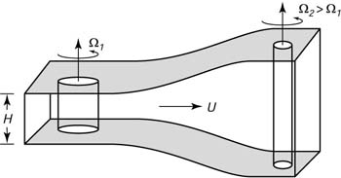
Rossby wave: vortex stretching and compression
Compressing the vortex: leads to a reduction in the spin of the air =>air will rotate clockwise in the northern hemisphere, move south
Stretching the vortex: leads to an increase in the spin of the air =>air will rotate anitclockwise in the northern hemisphere, move north

Slide 12
How important is the change in latitude?
Answer this by conducting 4 simulations…
  https://tinyurl.com/w6m5gu7
Look at your results in different tabs
Discuss them

Slide 13
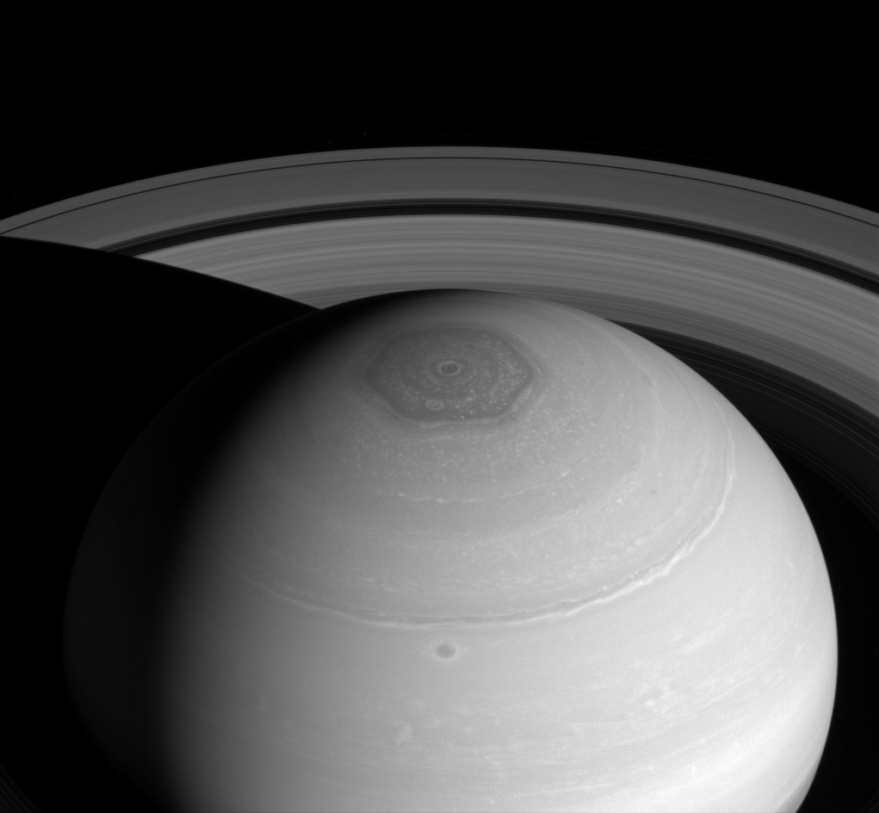
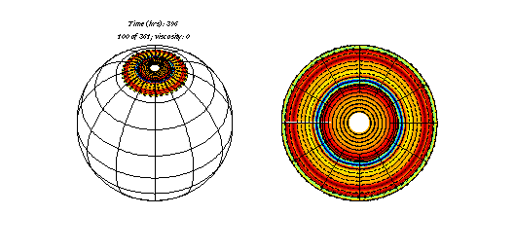
Saturn’s North Polar Hexagon
Can also study phenomena on other planets…

