Slide 1
Measuring and Predicting 2
Week 1: Getting Started and Tools of the Trade
Prof. Paul Connolly
Centre for Atmospheric Science

Slide 2
Contents
This course
  Syllabus
  Assessment
Types of Environmental Model we will use
Tools of the Trade – needed to get started
Secure Shell
  SSH
  SFTP
Linux
Computer code and computer languages
GitHub and Git

Slide 3
Preamble
Preamble …
Notes:
Open the current syllabus in class:
https://uom-maul1609.github.io/paul.connolly.webpages/teaching/eart22001/materials/eart22001_syllabus.pdf

Slide 4
Syllabus and assessment
Open current syllabus
canvas assessment
The idea is to aid your understanding by allowing you to ‘play’ with the models and observe the output.
Notes:
Open the current syllabus in class:
https://uom-maul1609.github.io/paul.connolly.webpages/teaching/eart22001/materials/eart22001_syllabus.pdf

Slide 5
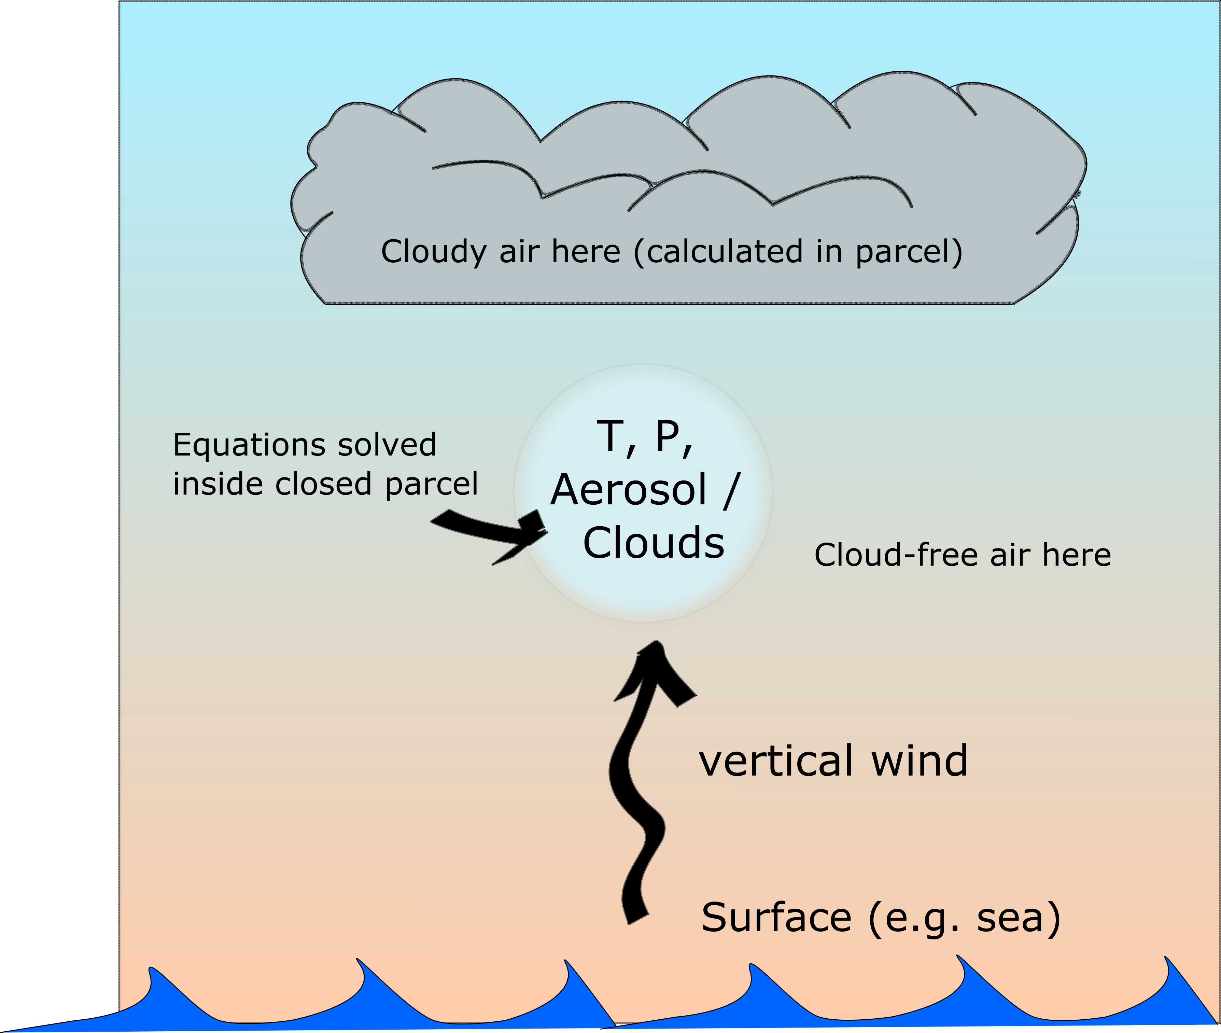
Types of Environmental Model: Ordinary Differential Equations, Parcel Modelling

Slide 6
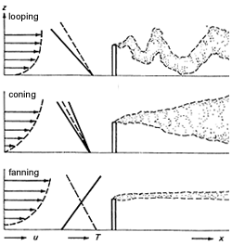
Types of Environmental Model: Empirical, Gaussian Plume / mixing
Solid line is environmental temperature, dashed line is temperature of a parcel of air

Slide 7
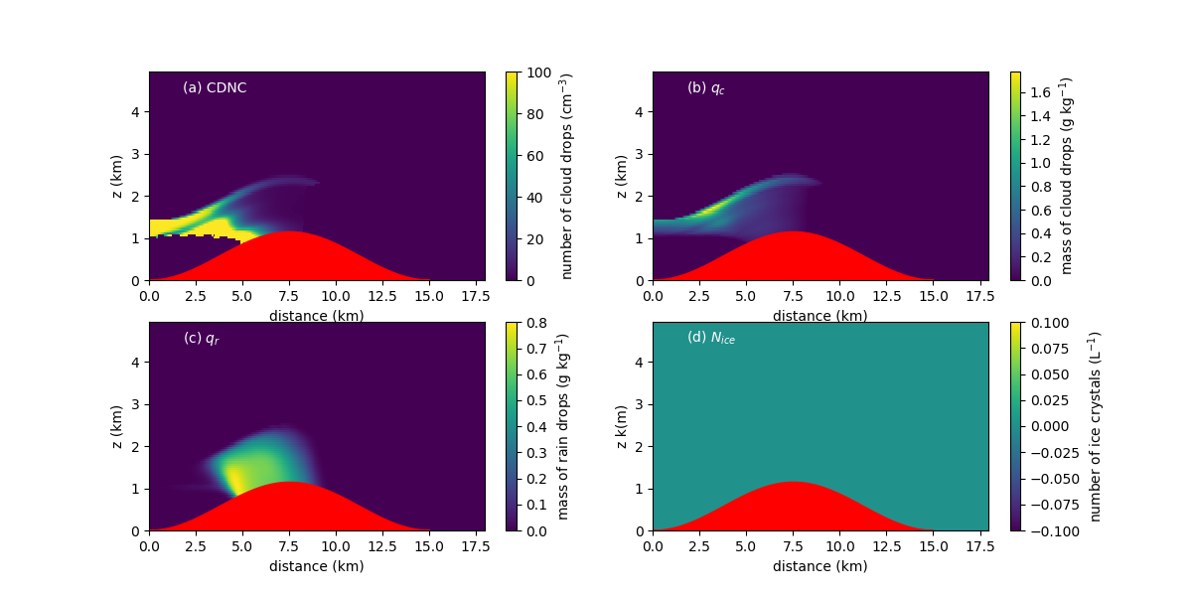
Types of Environmental Model: Reduce Dimension Models, Single Column Model

Slide 8
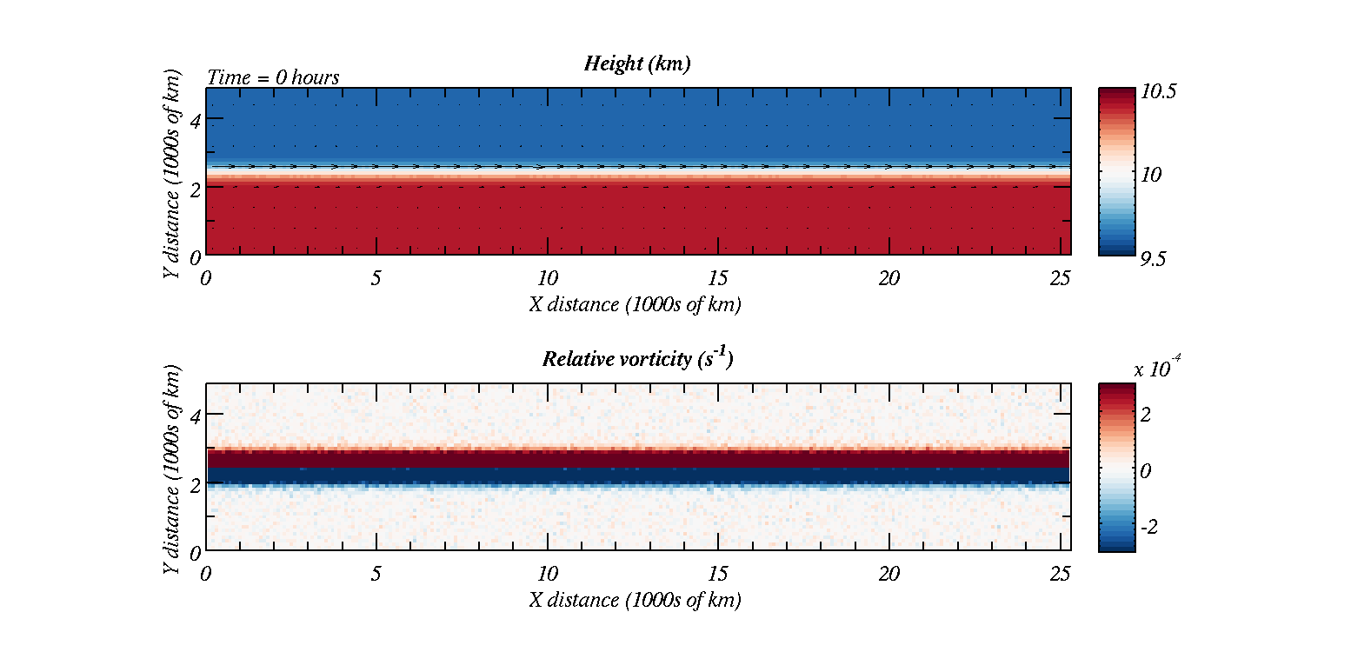
Types of Environmental Model: Shallow Fluid Model / Fluid Dynamics

Slide 9
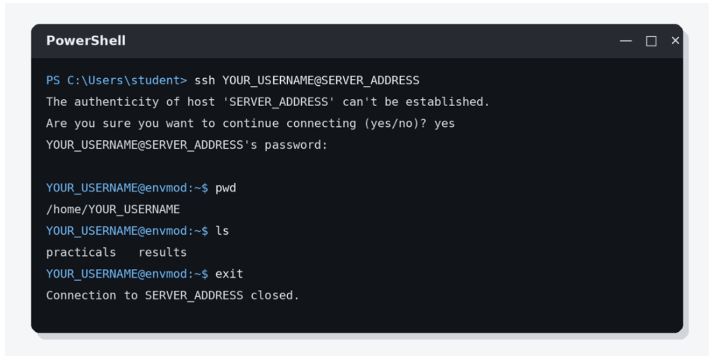
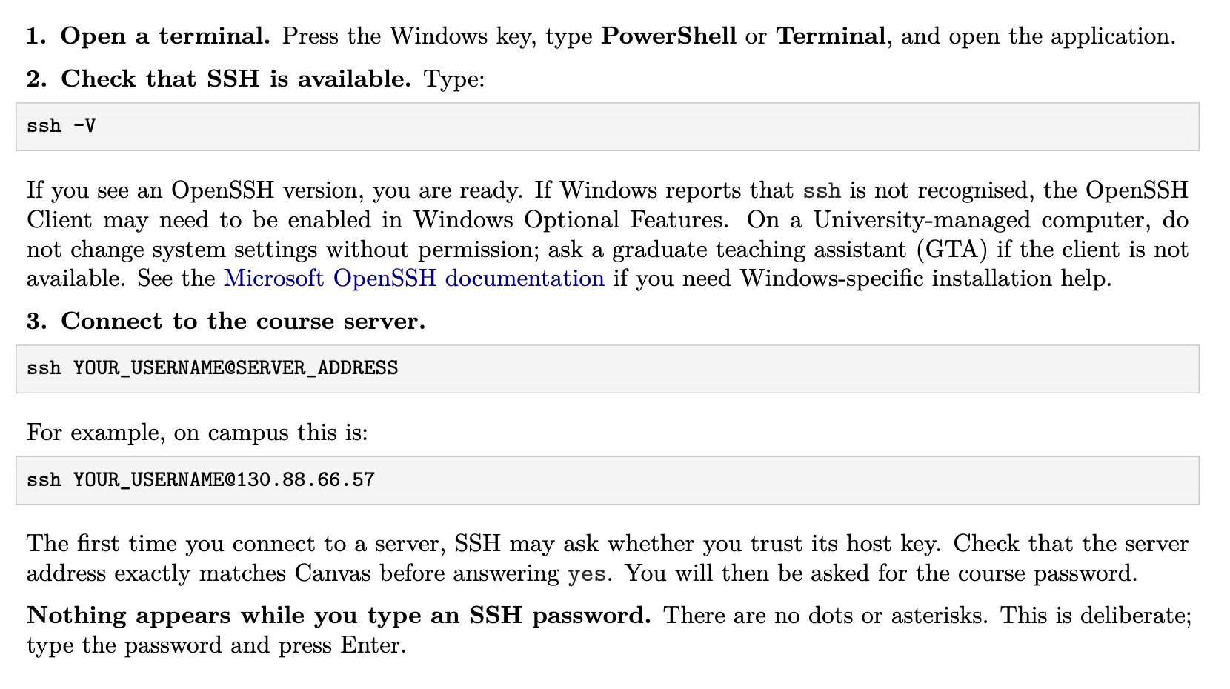
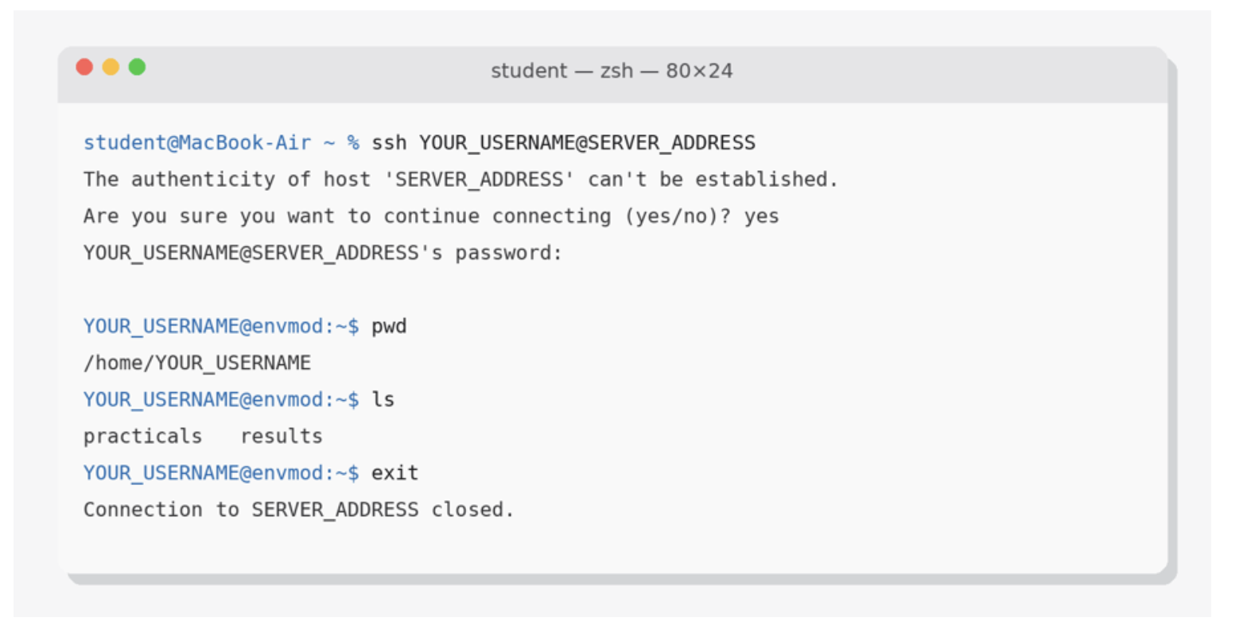
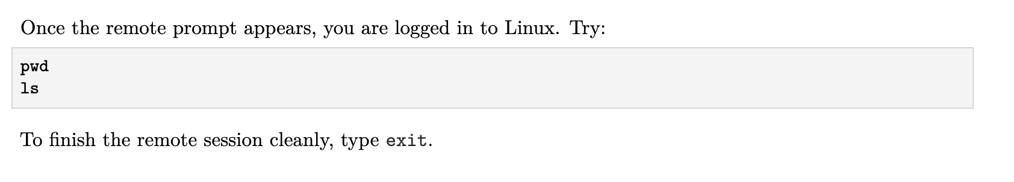
Tools of the Trade: secure shell
Full details…

Slide 10
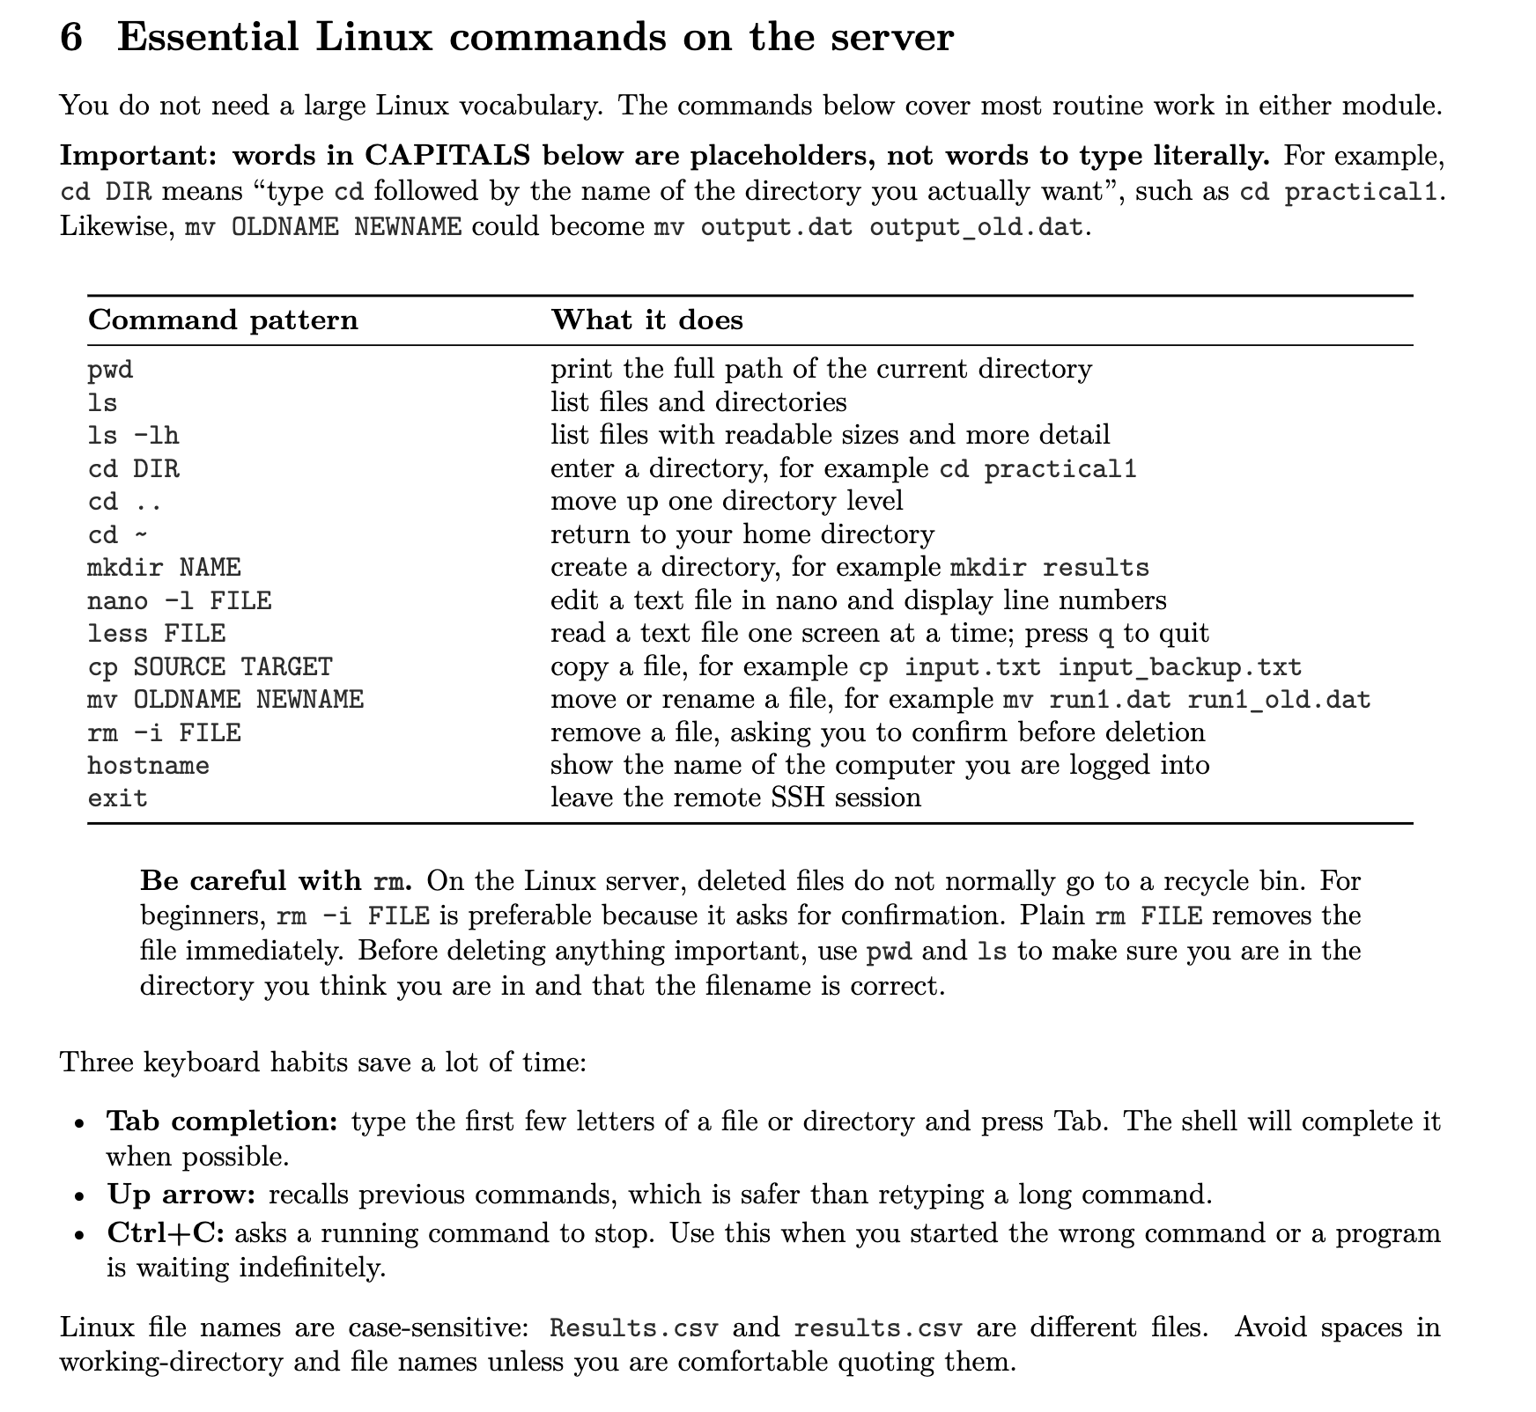
Tools of the Trade: Linux
Full details…

Slide 11
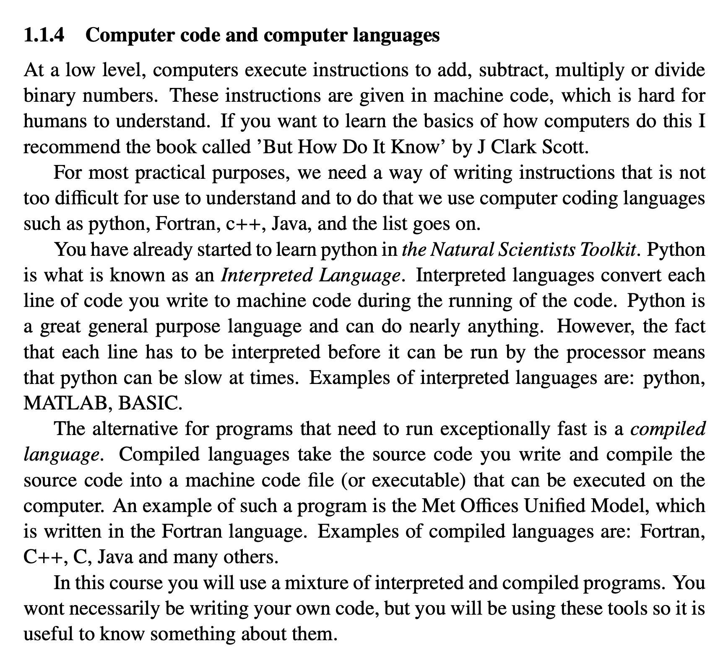
Tools of the Trade: Computer Languages
A task to do together before practical...

Slide 12
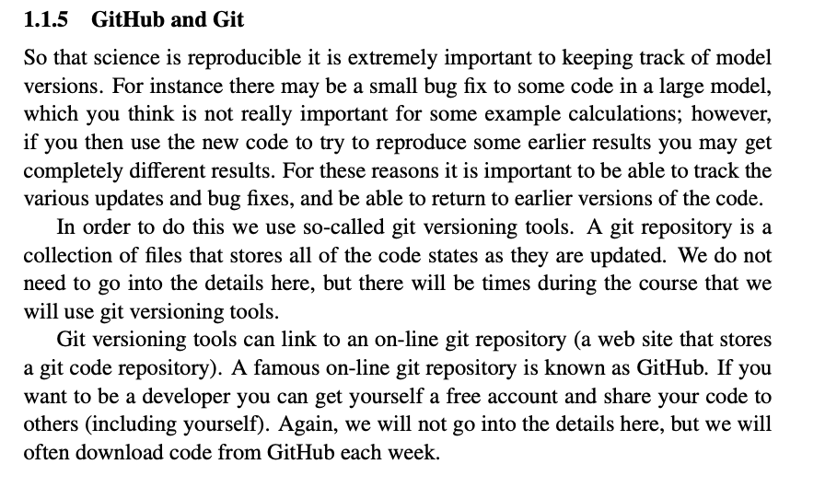
Tools of the Trade: GitHub

Slide 13
Main points
There are some Tools of the Trade you will need to master before being able to use models efficiently in this course.
  These are common tools that someone working in most modelling disciplines will use, so it is useful and you can put them on your CV.
Top marks will be awarded to those who can see how the various modelling approaches fit together and what they can be used for.
Asynchronous activities: watch a recorded lecture of me explaining a modelling approach.
Synchronous activities: work through practical exercises together and discuss the results. Read this before practical and do pre-practical activity
We will learn about a range of modelling techniques and you will be tested online.
Videos will be available online and we will record synchronous activities together.

