Slide 1
TUTORIAL 4 · THURSDAY 29 OCTOBER
Plan the story before you write it
One question · a figure storyboard · a topic-sentence outline
YOU LEAVE WITH
ONE committed question, a 3–5 figure storyboard with a claim under each figure, and your word budget.
Tutorial 4 of 8 · Semester 1
EART29200 · ENSO and cloud cover mini-project · Writing strand

Slide 2
Today's plan
Goal: Leave with one question, a figure storyboard and a topic-sentence outline.
1
Methods: what r tells you; composite vs correlation vs slope
BRING / HAVE READY
Task 3A opening paragraph
Task 3B synthesis paragraph + references
Task 3C: your three candidate questions
Draft figures from notebook §4–5
2
Methods: choosing (and testing) your region
3
Is your question good enough?
4
Storyboard, topic-sentence outline and word budget
Tutorial 4 of 8 · Semester 1

Slide 3
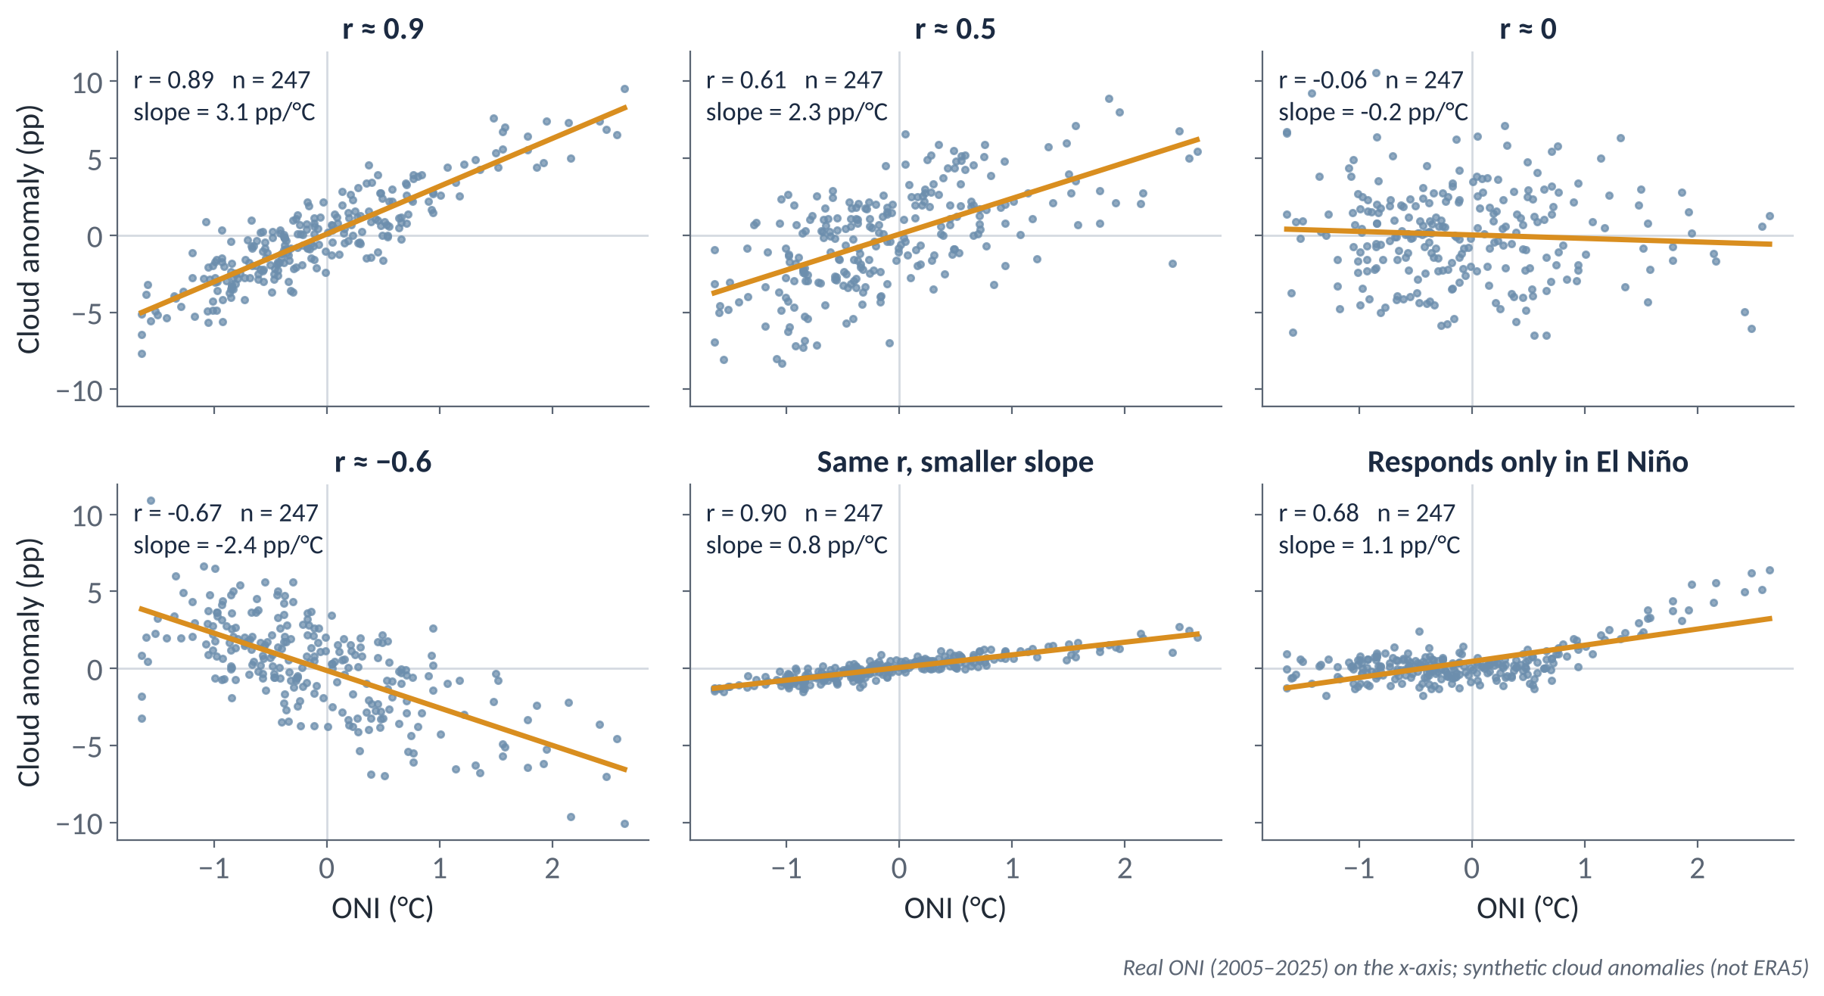
METHODS
What r tells you, and what it doesn't
r: how consistently two things vary together along a straight line, from −1 to +1. No units. R² = r²: the fraction of variance a straight line explains (r = 0.5 → 25%).
r is not the size of the effect; the slope is (pp per °C of ONI). Bottom middle: same r, about a quarter of the slope.
r misses one-sided and curved responses. Bottom right only responds in El Niño, yet r = 0.68 looks respectable. And every r needs its n (Tutorial 5).
Notes:
EXPLANATION
r measures how tightly points cluster around a straight line: +1 is a perfect rising line, −1 a perfect falling line, 0 no straight-line relationship. It has no units. R² is r squared: the fraction of the month-to-month variation that a straight line in ONI accounts for, so r = 0.5 means only 25%. Look at the bottom row. Middle: the same r as the top-left panel but a quarter of the slope; r tells you how consistent a relationship is, and the slope tells you how big it is. Right: the cloud only responds in El Niño, yet r is about 0.7, so a respectable r can hide a one-sided or curved response. Always look at the scatter plot. Every panel prints n; Tutorial 5 explains why that matters.

Slide 4
METHODS
Composite, correlation, slope: three questions
COMPOSITE
CORRELATION r
REGRESSION SLOPE
How different are El Niño and La Niña months, on average?
How consistently does cloud follow the ONI?
How much does cloud change per °C of ONI?
Units: pp
Uses only months beyond the threshold
+ simple; can show asymmetry (by phase)
− few events; depends on the threshold
No units, −1 to +1
Uses every month
+ uses all the information
− says nothing about size; straight lines only
Units: pp per °C
Uses every month
+ gives the size of the effect
− straight line; pulled by extremes (2015–16)
WHEN THEY DISAGREE, THAT'S INTERESTING
A big composite difference but a weak r usually means a few strong events or a one-sided response. Say so plainly. Schultz warns against claiming ‘remarkable similarity’ when, looked at closely, two results differ (§11.12).
Notes:
EXPLANATION
These are three different questions about the same data, so choose the one that matches your question. Composite: how different are El Niño and La Niña months on average? It's in percentage points and uses only months beyond the threshold. Correlation: how consistently does cloud follow the ONI from month to month? It has no units and uses every month. Slope: how much does cloud change per degree of ONI? It's in percentage points per °C and uses every month, but extreme months such as 2015–16 pull on it. If the composite is large but r is weak, there are probably a few big events or a one-sided response. Report that honestly.

Slide 5
METHODS
Choosing your region (and why it matters)
A regional mean can cancel out: a box straddling positive and negative anomalies averages to almost nothing.
Look at the maps first, then choose a box that sits on one coherent signal, for a physical reason.
The notebook has 12 regions (e.g. 4 = Niño 4, 5°S–5°N, 160°E–150°W; 5 = Maritime Continent, 10°S–10°N, 100–150°E). You can add your own in REGIONS.
Sensitivity check: shift the box by 5° and recompute. If the answer flips, say so.
Write the bounds in your Methods.
WHY A BADLY PLACED BOX SEES NOTHING
+4 pp
−4 pp
box mean ≈ 0
clear
signal
Schematic
IN YOUR METHODS, THIS BECOMES
“The Maritime Continent region (MC; 10°S–10°N, 100–150°E) follows the notebook's predefined box.”
Notes:
EXPLANATION
A regional mean only means something if the region contains one coherent signal. In the schematic, a box across a positive and a negative patch averages to about zero, even though both halves have strong signals. So look at the maps first, then choose a box for a physical reason. On the real composite map, the negative Maritime Continent signal and the positive central Pacific signal are only about 30° apart, so a careless 'western Pacific' box would mix them. As a sensitivity check, move your box by 5° and recompute; if the answer changes sign, say so. Put the box bounds in your Methods.

Slide 6
Is your question good enough?
Specific: names a cloud type, region, season or timing.
Answerable: with ERA5 + ONI and the notebook's tools.
Interesting: it has a real ‘however’ (Tutorial 3).
Bounded: 3–5 figures and about 650 words of Results.
Physical: there is a mechanism you can discuss.
Read your best candidate to a partner (20 s). They score it /5 against this list.
NARROWING A QUESTION, ONE RUNG AT A TIME
How does ENSO affect clouds?
too broad
How does ENSO affect high cloud?
+ cloud type
How does high cloud over the central Pacific respond to ENSO?
+ region
Does high cloud over the central Pacific respond to ENSO in the opposite sense to high cloud over the Maritime Continent, and which response is stronger?
+ a testable contrast

Slide 7
Storyboard: one claim under every figure
QUESTION: Does high cloud over the central Pacific respond to ENSO in the opposite sense to the Maritime Continent?
FIG. 1 · CONTEXT
FIG. 2 · TEST
FIG. 3 · QUANTIFY
FIG. 4 · QUALIFY
El Niño − La Niña composite map of high cloud, both regions boxed
Regional anomaly time series with ONI overlaid
Scatter of regional anomaly vs ONI, with r, n and slope
Same, by season (or lag)
THIS FIGURE SHOWS THAT…
THIS FIGURE SHOWS THAT…
THIS FIGURE SHOWS THAT…
THIS FIGURE SHOWS THAT…
High-cloud anomalies have opposite signs in the two boxed regions.
Central Pacific high cloud rises in each El Niño; Maritime Continent high cloud falls.
The Maritime Continent relationship is weaker (r ≈ [ ]) than the central Pacific one (r ≈ [ ]).
The Maritime Continent response is concentrated in [season].
Read only the claims, left to right. Do they answer the question in a sensible order? A claim you can't write means you don't yet know what that figure is for. A step with no figure means a gap. (Example claims are illustrative; yours come from your own analysis.)

Slide 8
Outline in topic sentences
A paragraph has one job, announced by its topic sentence (Schultz ch. 8).
Some authors outline by writing every topic sentence first. Read in order, they should tell the whole story.
This is assert–justify from the proposal tutorials: state the point first, then the detail. Speed-readers get the message; careful readers read on.
In Results, the topic sentence is usually the finding; the rest of the paragraph is the evidence.
2,000 words ≈ 15–18 paragraphs. That's 15–18 topic sentences: about one side of A4.
EXAMPLE: RESULTS OUTLINE
P1 High-cloud anomalies have opposite signs over the central Pacific and the Maritime Continent during El Niño (Fig. 1).
P2 Central Pacific high cloud rises during El Niño and falls during La Niña (Fig. 2).
P3 The Maritime Continent relationship is weaker than the central Pacific one (Fig. 3).
P4 The Maritime Continent response is concentrated in [season] (Fig. 4).
(illustrative; your sentences come from your figures)
Source: Schultz, D. M. (2009) Eloquent Science, American Meteorological Society, ch. 8 ‘Constructing effective paragraphs’; assert–justify from Research Funding Toolkit ch. 10.

Slide 9
Your 2,000-word budget
Introduction
Methods
Results
Discussion
Concl.
spare
350
300
650
450
150
100
~3 ¶
2–3 ¶
4–6 ¶
3–4 ¶
1–2 ¶
HOW TO USE IT
CHECK WITH YOUR TUTOR
A guide, not a rule: but if Methods hits 600 words, something is wrong.
Results gets the most words because it carries the evidence.
Write your budget at the top of each section and check it when you finish.
Over budget in a first draft is normal; you'll cut in January (Tutorial 8).
This budget assumes figure captions, references and the title are outside the 2,000 words. Your tutor will confirm what counts.
Maximum is 2,000 for the final report. Being under is fine if the question is fully answered.
Schultz: a paper ‘should be as long as it needs to be, but no longer’.
Source: Schultz, D. M. (2009) Eloquent Science, American Meteorological Society, §13.8–13.9 on concision and the right length.

Slide 10
Name things once: tag-phrases and lucid repetition
From the proposal tutorials: give regions, methods and variables a short tag-phrase, define it once, then never vary it.
Schultz calls deliberate repetition of key terms lucid repetition. It is how readers keep track.
In English essays you were told to vary your words. In science, varying a term implies a different thing.
Define abbreviations at first use: low-cloud cover (LCC), Oceanic Niño Index (ONI).
SPOT THE PROBLEM
“High cloud over the central Pacific rises during El Niño. In the Niño 4 box, the correlation is 0.8. Cloud near the dateline therefore…”
One region or three? A marker can't tell.
✓ Define “the central Pacific (CP; Niño 4 region, 5°S–5°N, 160°E–150°W)” once, then always write “CP”.
Source: Schultz, D. M. (2009) Eloquent Science, American Meteorological Society, §8.2.1 ‘Repetition’; ‘labelling’ from Research Funding Toolkit ch. 10.

Slide 11
IN-CLASS ACTIVITY · 14 MIN
Commit, storyboard, outline
1
Choose one of your three candidate questions. Write it at the top of the storyboard page in your workbook.
YOU LEAVE WITH
One committed question
A storyboard with a claim per figure
Results topic sentences: the spine of your report
2
Sketch 3–5 figure thumbnails (rough is fine) and label each: context / test / quantify / qualify / compare.
3
Under each, write the claim: “This figure shows that…”. Use [ ] for numbers you don't have yet.
4
Turn the claims into Results topic sentences (P1, P2, …).
PAIR CHECK
5
Swap storyboards. Partner reads only the claims and answers the two questions on the right.
Do the claims, in order, answer the question?
Which figure could be removed without weakening the answer? (If one can, remove it.)

Slide 12
Before Tutorial 5 · Thu 12 Nov
Two weeks (no tutorial on 5 Nov). About 2½ hours of writing; most of your time goes on the figures.
4A · notebook
4B · 60 min
4C · 40 min
Make the storyboard figures
Methods draft, 250–300 words
Full topic-sentence outline
Adapt notebook analyses to your region / level / season
Save draft versions of all 3–5 figures outside Binder
Note the key numbers in your writing log
Use the Methods checklist in the workbook
Data, period, region(s), ONI and thresholds, anomaly, weighting, statistics
Science, not code. Bring it on 12 Nov for a peer check
Every paragraph of all five sections, one sentence each
Mark the word budget beside each section
Check: tags used consistently?
NOTEBOOK STRAND
READ · SCHULTZ (2009) ELOQUENT SCIENCE
Adapt sections 4–5 to your region, cloud level or season (change VARIABLE or REGIONS).
Optional §6 (autocorrelation / lag) only if your question is about timing.
Ch. 6 Brainstorm, outline, first draft
§4.8 Data and methods
§18.3 Picking thresholds

