Slide 1
TUTORIAL 5 · THURSDAY 12 NOVEMBER
Make every figure earn its place
Repeatable methods · captions that stand alone · writing about figures
YOU LEAVE WITH
A peer-checked Methods section, report-ready captions and one result sentence per figure.
Tutorial 5 of 8 · Semester 1
EART29200 · ENSO and cloud cover mini-project · Writing strand

Slide 2
Today's plan
Goal: Leave with report-ready captions and a Methods section someone else could repeat.
1
Peer check: could I repeat your Methods?
BRING / HAVE READY
Task 4B Methods draft (printed or on screen)
Task 4C topic-sentence outline
Your 3–5 draft figures
2
Methods: r isn't enough (coins, n, p, n_eff)
3
Methods: noise maps, year-to-year tests, thresholds
4
Captions, writing about figures, honest colour scales
Tutorial 5 of 8 · Semester 1

Slide 3
IN-CLASS ACTIVITY · 10 MIN
Could I repeat your study?
1
Swap Methods drafts with a partner.
YOU LEAVE WITH
2
Read as if you had to redo the analysis tomorrow with only this text and the notebook.
A ‘guess list’ for your own Methods
A sense of what a complete Methods looks like
3
List every decision you would have to guess: period? region bounds? ONI threshold? anomaly baseline? weighting? cloud variable? months used?
4
Also mark anything that is code, not science (cell numbers, function names, ‘I ran…’).
THE STANDARD
5
Return the list. Don't fix it now; that is Task 5A.
Schultz: a tenet of scientific writing is whether a reader ‘has enough information from the paper to duplicate the study’.
Interpretation (why the cloud changes) belongs in the Discussion, not the Methods.
Source: Schultz, D. M. (2009) Eloquent Science, American Meteorological Society, §4.8 Data and methods.

Slide 4
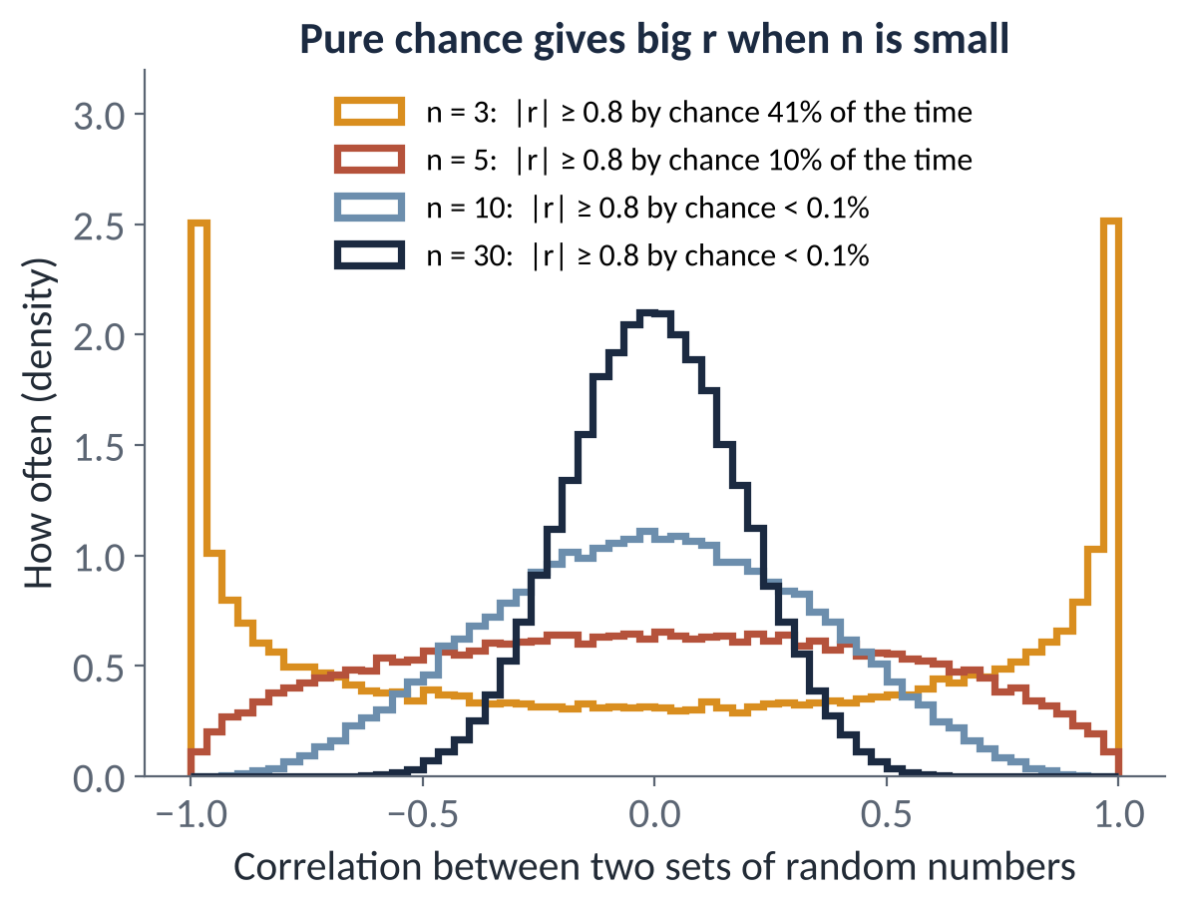
METHODS
Coins in a bucket: r is not enough, n matters
1p
2p
5p
10p
20p
50p
£1
Pull them out at random. What's the chance they come out in perfect order, so that draw order and value have r = 1?
3 coins
1 in 6
17%
5 coins
1 in 120
0.8%
7 coins
1 in 5,040
0.02%
THE POINT
The same perfect r, but a very different chance that it's luck. The p-value combines r and n.
|r| needed for p < 0.05: n = 10 → 0.63 · n = 30 → 0.36 · n = 85 → 0.21 · n = 247 → 0.12
Notes:
EXPLANATION
Put seven coins in a bucket and pull them out at random. The chance they come out in perfect order is one in 7 factorial, one in 5,040, so that would be astonishing. With three coins it's one in six, so it happens all the time. Both give a perfect correlation between draw order and value (r = 1); what differs is how likely that is by chance. That's what a p-value measures: if there were really no relationship, how often would random data give a correlation at least this strong? It depends on both r and n. The histogram shows correlations between pairs of pure random numbers: with 3 points, |r| above 0.8 happens 41% of the time; with 30 points, almost never.

Slide 5
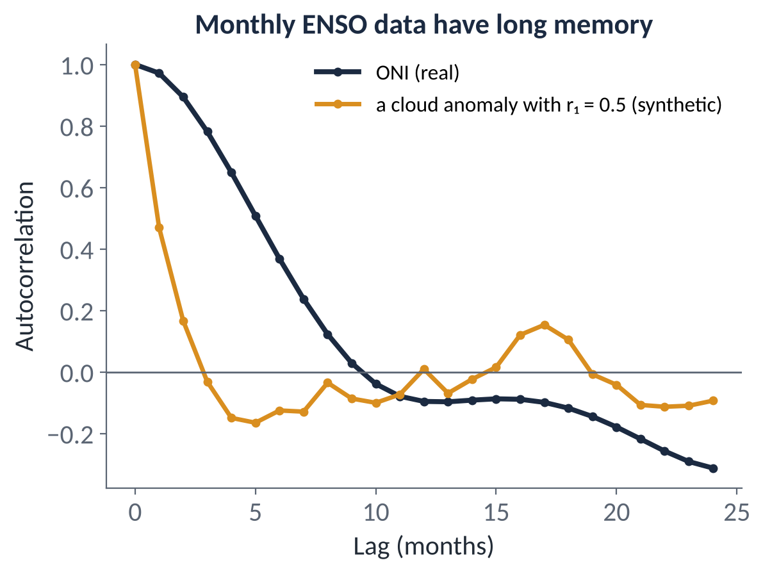
METHODS
Are 247 months independent? Effective n
A p-value assumes independent samples. Monthly ENSO data aren't: the ONI's lag-1 autocorrelation is 0.97.
Effective sample size: n_eff = n (1 − r₁ₓ r₁ᵧ) / (1 + r₁ₓ r₁ᵧ), where r₁ is each series' lag-1 autocorrelation.
With n = 247 months, n_eff ≈ 135, 85 or 31 if the cloud anomaly's r₁ is 0.3, 0.5 or 0.8.
Notebook §6 now prints n and n_eff; its p_adj and 95% range use n_eff. Report those.
CALCULATE IT YOURSELF
t = r √(n − 2) / √(1 − r²), with n − 2 degrees of freedom. Task 5D: compute p with n, then with n_eff.
Notes:
EXPLANATION
n_eff, the effective sample size, is how many independent pieces of information your data really contain, and it's the n to use for a p-value. Think of the coins: a p-value assumes every data point is a fresh coin pulled from the bucket. Monthly ENSO data aren't like that: if the ONI is high this month it's almost certainly high next month (its lag-1 autocorrelation, r1, is 0.97). Counting twelve months of one El Niño as twelve results is like counting the same coin twelve times. The formula is n_eff = n(1 − r1x r1y)/(1 + r1x r1y), where r1x and r1y are each series' month-to-month autocorrelation. If either series has no memory (r1 = 0), n_eff = n; the more memory both have, the smaller n_eff gets. With our 247 months, n_eff is about 135, 85 or 31 if the cloud series' r1 is 0.3, 0.5 or 0.8. Compute the p-value exactly as before but with n_eff instead of n: t = r√(n−2)/√(1−r²), with n−2 degrees of freedom. A correlation that looks highly significant with 247 can be marginal with 31. The notebook's section 6 table prints n and n_eff and uses n_eff for p and the 95% range; Task 5D asks you to do it once by hand. For a single series, as in the year-to-year test on the next slide, the formula simplifies to n(1 − r1)/(1 + r1).

Slide 6
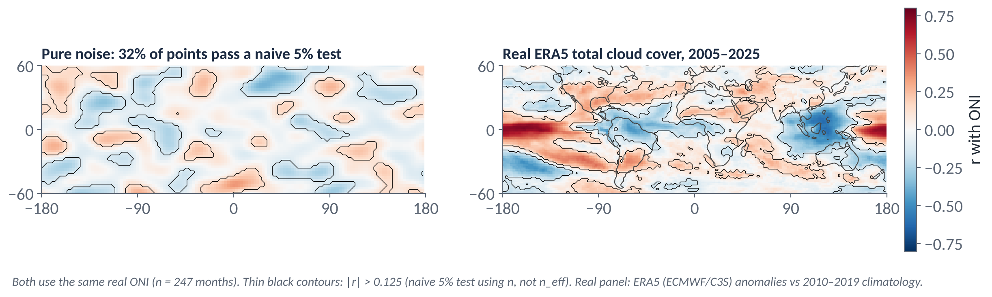
METHODS
Pure noise can draw convincing maps
Left: the real ONI correlated with pure noise that has realistic memory and blobs. 32% of grid points pass a naive 5% test.
Even with no memory at all, 5% pass by chance. A map has thousands of points, so that's hundreds of false ‘signals’ (Wilks 2016).
Right: the real signal is far stronger and sits where the physics says it should. Choose regions for a physical reason, then test them properly. Try it: methods_demos.ipynb §6.
Notes:
EXPLANATION
The left map correlates the real ONI with completely random numbers that have realistic memory in time and blobs in space, like weather. About a third of the map passes a naive 5% significance test. Even with no memory at all, about 1 in 20 grid points would pass by chance, and a map has thousands of points, so that's hundreds of false 'signals'. The right map, from real data, is much stronger and sits where the physics predicts. Lesson: choose your region for a physical reason, then test it properly (with n_eff or the shift test), rather than picking the most impressive blob.

Slide 7
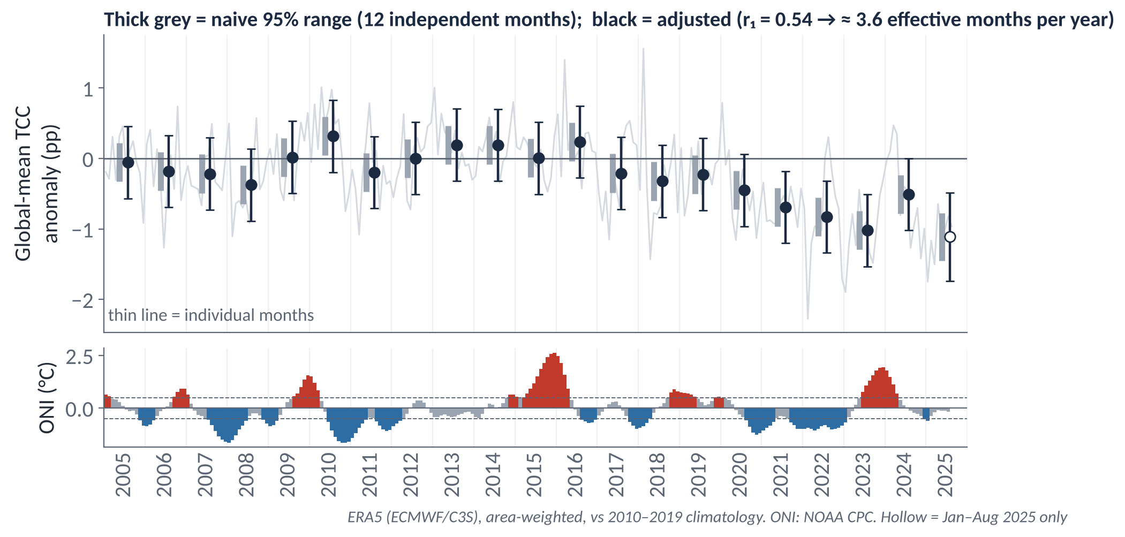
METHODS
Is one year's cloud different from another's?
Compare two years' 12 monthly anomalies with a t-test → p. New notebook section 3b does it for any two years.
Global cloud anomalies have r₁ = 0.54, so 12 months ≈ 3.6 independent months. 2010 vs 2011: naive p = 0.02, adjusted p = 0.24.
190 pairs of complete years → ~10 ‘significant’ by chance. Choose years before looking, for a reason.
Global cloud falls by about 0.4 pp per decade here. Is that real, or a reanalysis artefact? (Cf. record-low albedo in 2023: Goessling et al. 2024.) Trends can masquerade as ENSO signals. Try DETREND = True.
IN YOUR RESULTS, THIS BECOMES
“Global-mean TCC was 0.51 pp higher in 2010 than in 2011, but the difference is not significant once autocorrelation is allowed for (p = 0.24).”
Notes:
EXPLANATION
How to read the figure. The thin grey line is every month of global-mean cloud anomaly. Each black dot is one calendar year's mean of those 12 months. The bottom panel is the ONI on the same time axis, red for El Niño months and blue for La Niña, so you can see which years contain events (most events straddle two calendar years). Each year has two bars: the thick grey bar assumes 12 independent months; the black bar uses n_eff. To compare two years, take each year's 12 monthly anomalies and run a t-test: is the difference in means big compared with the month-to-month scatter? Neighbouring months are correlated (r1 = 0.54 for global cloud), and for one series n_eff = n(1 − r1)/(1 + r1) = 12 × 0.46/1.54 ≈ 3.6 independent months per year. That's why the black bars are about twice as long as the grey ones. Example: 2010 minus 2011 is 0.51 percentage points, with naive p = 0.02 but adjusted p = 0.24, so it's not significant. Don't judge by whether the bars overlap: bars can overlap a little and the difference still be significant, so use the test the notebook prints. Two warnings. With 20 complete years there are 190 possible pairs, so about 10 will look significant by chance; choose your years for a reason before looking. And global cloud drifts down by about 0.4 percentage points per decade, especially after 2019, so years far apart differ partly because of that trend. Notebook section 3b has a DETREND option. Why was 2022–23 so low? Tutorial 7 uses it as a worked example of separating evidence from speculation.

Slide 8
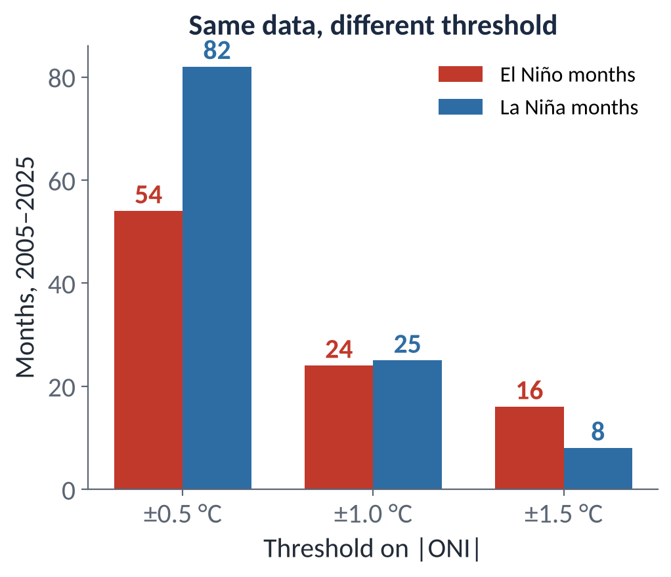
METHODS
Defend your threshold, and test it
Schultz: reviewers will question your thresholds. Defend them by convention or physics (NOAA's ±0.5 °C) or by the data (e.g. top and bottom 25% of ONI months).
Raising the threshold to ±1.0 °C cuts El Niño months from 54 to 24 and La Niña from 82 to 25: stronger events, fewer samples.
Sensitivity test: does your answer survive ±1.0 °C, or leaving out 2015–16? One sentence in Results is the ‘careful treatment of a subtlety’ in the 80%+ band.
Composites: check that most members show the feature, not just one big event (§18.4.4).
ONE SENTENCE IN YOUR RESULTS
“The sign of the composite is unchanged with a ±1.0 °C threshold (24 El Niño, 25 La Niña months).”
Source: Schultz, D. M. (2009) Eloquent Science, AMS, §18.3 Picking thresholds; §18.4.4 composites.
Notes:
EXPLANATION
Every threshold is a choice someone can question, so give a reason for yours: convention (NOAA uses ±0.5 °C), physics, or the data's own distribution (such as the top and bottom quarter of ONI months). Then test it. At ±1.0 °C the El Niño months drop from 54 to 24 and the La Niña months from 82 to 25: stronger events, fewer samples. If the sign and rough size of your answer survive, say so in one sentence. That's the 'careful treatment of a subtlety' the top marking band describes.

Slide 9
A caption that stands alone
WEAK
STRONG
“Figure 2. Correlation map.”
“Figure 2. Correlation between monthly high-cloud-cover anomaly and the ONI at each grid point, January 2005 – July 2025 (n = 247 months). Boxes mark the central Pacific (CP) and Maritime Continent (MC) regions analysed in Figs 3–4. Figure produced by the author using ERA5 (ECMWF / Copernicus Climate Change Service) and ONI (NOAA Climate Prediction Center) data.”
WHAT CHANGED
Essence first (‘Correlation between … and the ONI’), then the period, the regions and links to later figures.
Defines what a positive value means implicitly: higher cloud anomaly when ONI is higher.
Attribution: your figure, their data. Longer, but every word is doing a job.
Source: Schultz, D. M. (2009) Eloquent Science, American Meteorological Society, §11.10; attribution wording from the Student Guide §6.

Slide 10
Describe the science, not the plot
Schultz's example: “Figure 5 shows plots of surface temperature… showing that…” → “The elimination of sea ice… resulted in warmer arctic temperatures (Fig. 5).”
WEAK
STRONG
“Figure 3 shows the time series of low-cloud anomaly and ONI. It can be seen from Figure 3 that there is a relationship between them.”
“High-cloud cover over CP is higher than usual during El Niño and lower during La Niña (Fig. 3); the largest positive anomaly, [ ] percentage points, coincides with the 2015–16 El Niño.” (illustrative)
WHAT CHANGED
The science is the subject of the sentence; the figure is cited indirectly, in brackets, at the end.
Note the obvious first, then the finer point or exception (Schultz §11.11). Don't explain how to read the plot: the caption does that.
Every figure is cited in the text, in numerical order. The text should make sense even without the figures.
Source: Schultz, D. M. (2009) Eloquent Science, American Meteorological Society, §10.1 (Fig. 5 example), §11.11, §11.13–11.14.

Slide 11
METHODS
Honest colour scales
Anomalies, differences and correlations: use a diverging colour map (blue–white–red) centred on zero, with symmetric limits (e.g. −0.8 to +0.8).
Panels you compare must share the same limits, or the eye compares colours that mean different things.
Avoid rainbow (‘jet’) maps: they invent sharp boundaries and fail for colour-blind readers.
Label the colour bar with the variable and units.
✓ DIVERGING, CENTRED ON ZERO
−0.8
0
+0.8
✗ RAINBOW: FALSE BOUNDARIES
✗ NOT CENTRED: zero looks ‘positive’
−0.2
+0.8
Notes:
EXPLANATION
For anything that can be positive or negative (anomalies, differences, correlations), use a two-sided colour scale with white at zero and the same limits on both sides. Otherwise zero looks like a colour, and readers see a signal that isn't there. Panels you're comparing must share the same limits. Avoid rainbow colour maps: they create sharp-looking boundaries where the data change smoothly, and many colour-blind readers can't read them.

Slide 12
IN-CLASS ACTIVITY · 10 MIN
Caption clinic
1
Write a full caption for each figure: what is plotted · units · period/region · threshold/definition · data source. Begin with the essence phrase.
YOU LEAVE WITH
Report-ready captions for all figures (Task 5C)
One result sentence per figure: the seeds of your Results
2
Under each caption, write the one result sentence that will cite it indirectly: science first, “(Fig. n)” last.
3
Swap captions only (no figures!) with a partner.
4
Partner sketches what they think each figure looks like: axes, map, colours, panels.
PAIR CHECK
Is each figure's essence phrase different from the others?
Is the sign convention clear (what does positive mean)?
Is the attribution line there?
5
Compare the sketch with the real figure. Where they differ, the caption is incomplete.

Slide 13
Before Tutorial 6 · Thu 19 Nov
One week. About 2½ hours. This is the week your Results section appears.
5A · 30 min
5B · 90 min
5C · 20 min
5D · 20 min
Revise Methods
Results draft, ~550–650 words
Final captions
Calculate a p-value
Fix every item on your partner's guess list
Remove any code or interpretation
Stay within ~300 words
One paragraph per claim from your storyboard
Topic sentence = the finding; then quantified evidence
Numbers with units, baseline and sample size
All 3–5 figures, one consistent format
Five-point check + attribution
Numbered in the order you cite them
Take r and n for your region from the §5 panel
Compute t and p (workbook / methods_demos §4)
Repeat with n_eff from §6. Which do you report?
NOTEBOOK STRAND
READ · SCHULTZ (2009) ELOQUENT SCIENCE
Finalise 3–5 figures (labels, units, centred colour scales); save them outside Binder. Optional: a ±1.0 °C sensitivity test.
methods_demos.ipynb §3–6; the shift test (§7) for your region; new §3b if you compare years.
§11.10–11.14 Captions; discussing and citing figures
§10.1 Concision (and Table 10.2)

