Slide 1
Tutorial 1 of 6
Tutorial 1 — What are we investigating?
ENSO and cloud cover mini-project
ENSO and cloud cover mini-project - tutorial slides
Notes:
~2 min. Housekeeping: who's who, where the notebook link is, what today's goal is.

Slide 2
ENSO AND CLOUD COVER MINI-PROJECT
Tutorial 1 · Slide 1 of 9
Today's plan
Goal: Get the notebook running and see your first cloud figures.
What you'll do today:
1
Understand the project's shape: explore broadly today, pick ONE focused question later.
2
See why ERA5 (reanalysis) and ENSO are the two ingredients of this project.
3
Launch the notebook on Binder and run it from the top.
4
Look at the first cloud figures and note two patterns that catch your eye.
Tutorial 1 of 6
Notes:
~1 min. Point at it, don't read it aloud -- they can read. Just flag the goal and today's headline action.

Slide 3
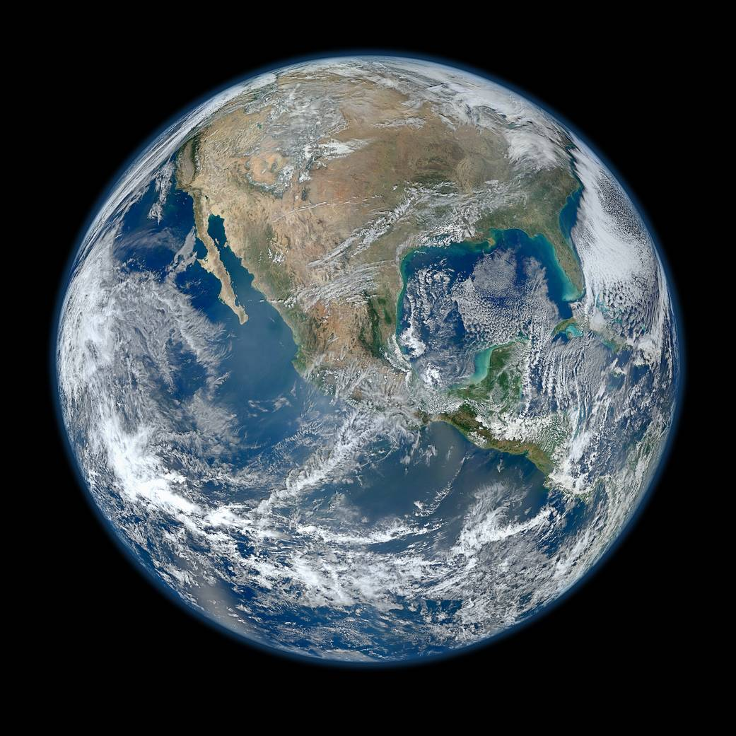
ENSO AND CLOUD COVER MINI-PROJECT
Tutorial 1 · Slide 2 of 9
The bigger picture: Earth's cloud cover from space
This whole project is about explaining patterns like these -- and they're not just pretty pictures: cloud bands like these shift with ENSO and reorganise drought and flood risk for a large part of the planet. Keep that real-world stake in mind as you zoom into specific regions later.
Credit: NASA/NOAA/GSFC/Suomi NPP/VIIRS, Norman Kuring (“Blue Marble” composite, 4 Jan 2012).
Notes:
~1 min. Let it sit for a few seconds before talking -- it's a hook, not a lecture point.

Slide 4
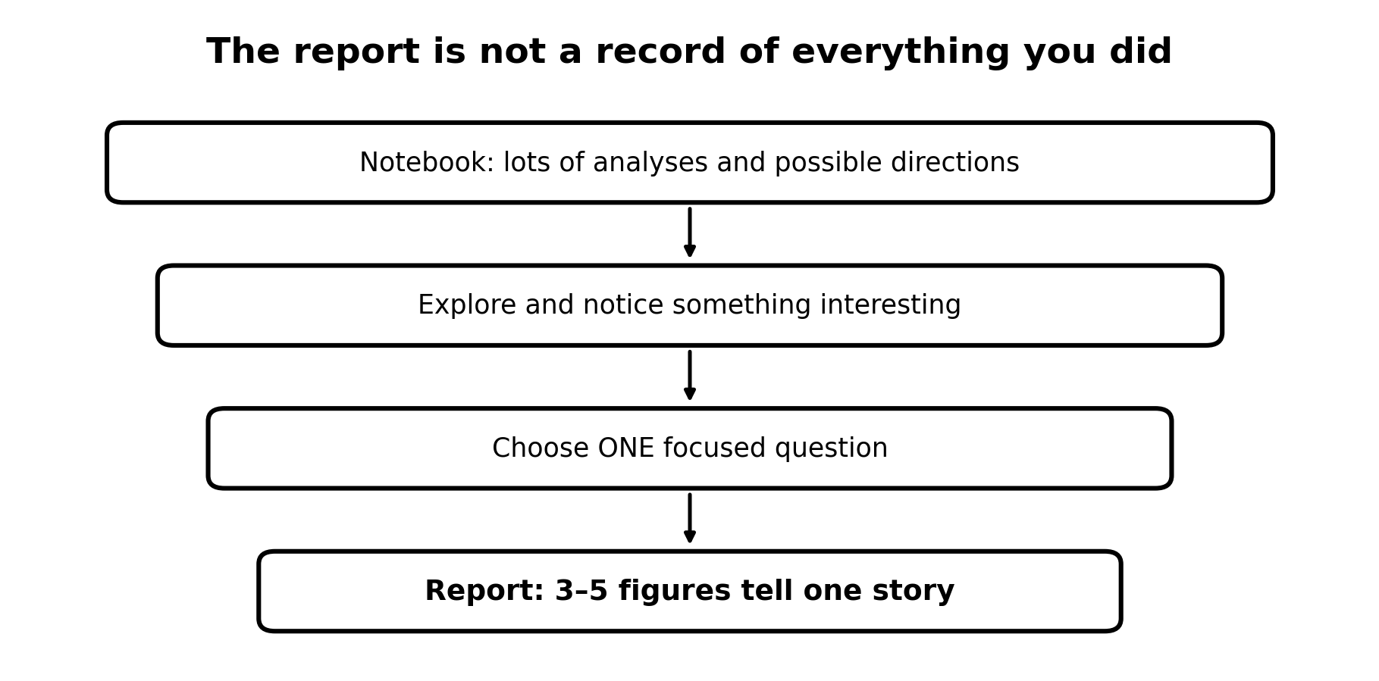
ENSO AND CLOUD COVER MINI-PROJECT
Tutorial 1 · Slide 3 of 9
This is a mini research project, not a checklist
The notebook contains more analyses than you can use in a short report.
Explore first. Then choose an aspect of ENSO/clouds that interests you.
Answer ONE focused question with about 3–5 figures.
You are not expected to write the Python from scratch.
Course-team schematic / teaching material
Notes:
~2 min. Set expectations: this is exploration, not a checklist to complete.

Slide 5
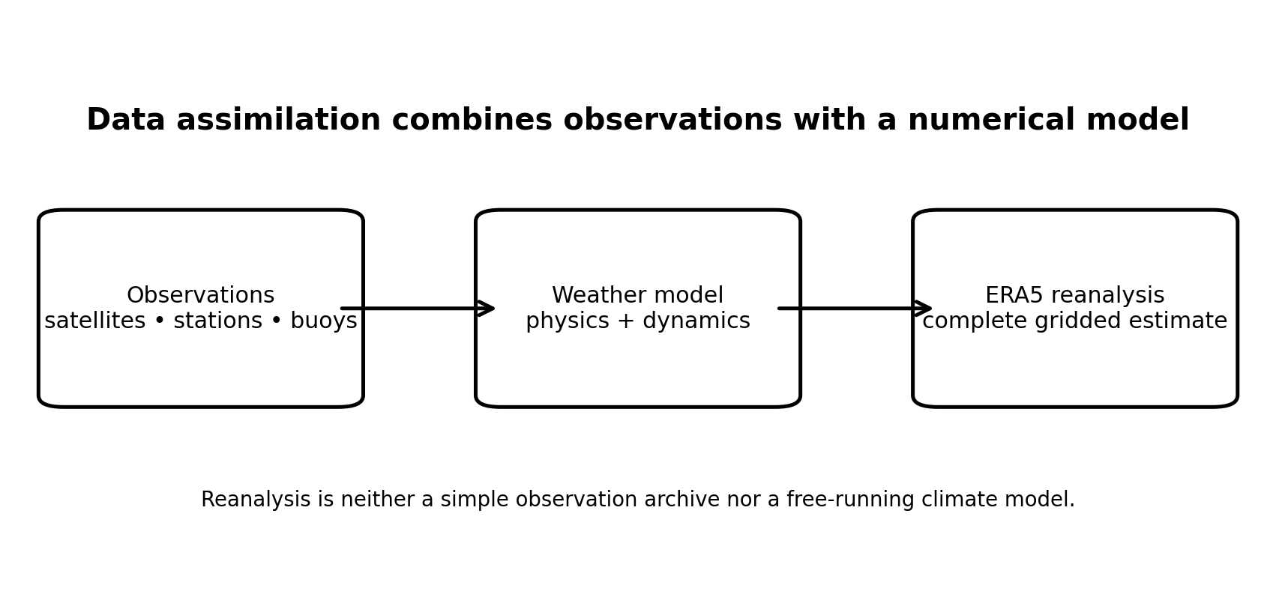
ENSO AND CLOUD COVER MINI-PROJECT
Tutorial 1 · Slide 4 of 9
ERA5: reconstructing the atmosphere
Observations are incomplete in space and time.
A weather model represents atmospheric physics and dynamics.
Data assimilation combines model and observations.
ERA5 gives a complete gridded estimate that we can analyse.
Course-team schematic / teaching material
Notes:
~4 min. ERA5 = observations + model, blended by data assimilation. Check they can say why that's not the same as either raw observations or a free-running model.

Slide 6
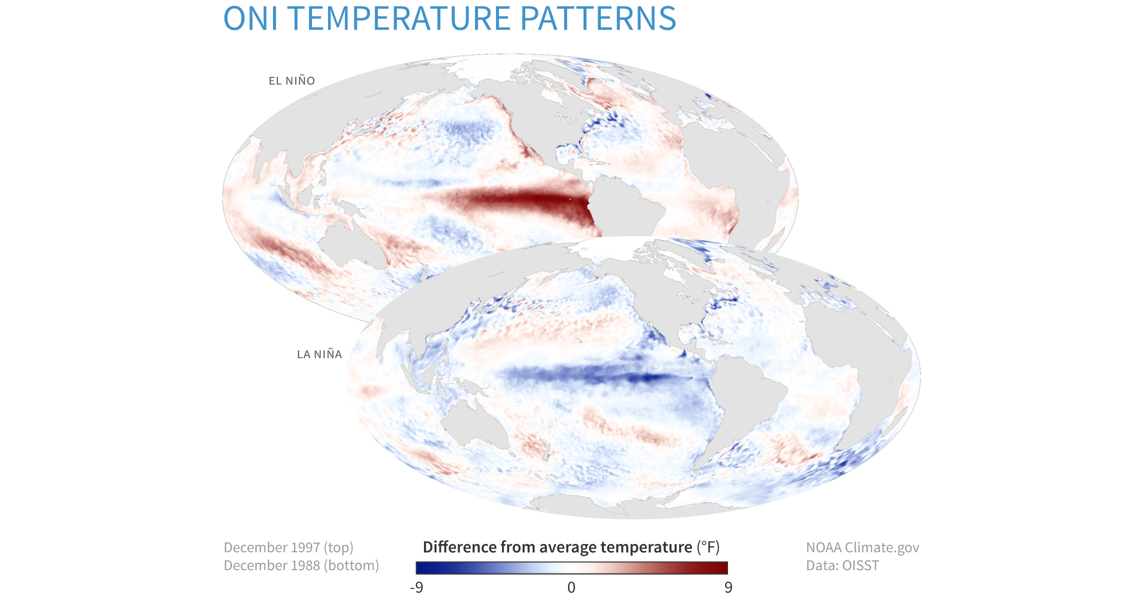
ENSO AND CLOUD COVER MINI-PROJECT
Tutorial 1 · Slide 5 of 9
ENSO is coupled ocean–atmosphere variability
El Niño: anomalously warm central/eastern tropical Pacific.
La Niña: anomalously cool central/eastern tropical Pacific.
The ocean pattern is accompanied by changes in winds, convection and rainfall.
Cloud is therefore a useful atmospheric response to investigate.
Credit: Maps by NOAA Climate.gov, based on data from NOAA's Physical Sciences Laboratory.
Notes:
~4 min. El Nino/La Nina as opposite SST patterns; the ocean signal drags winds/convection/cloud with it.

Slide 7
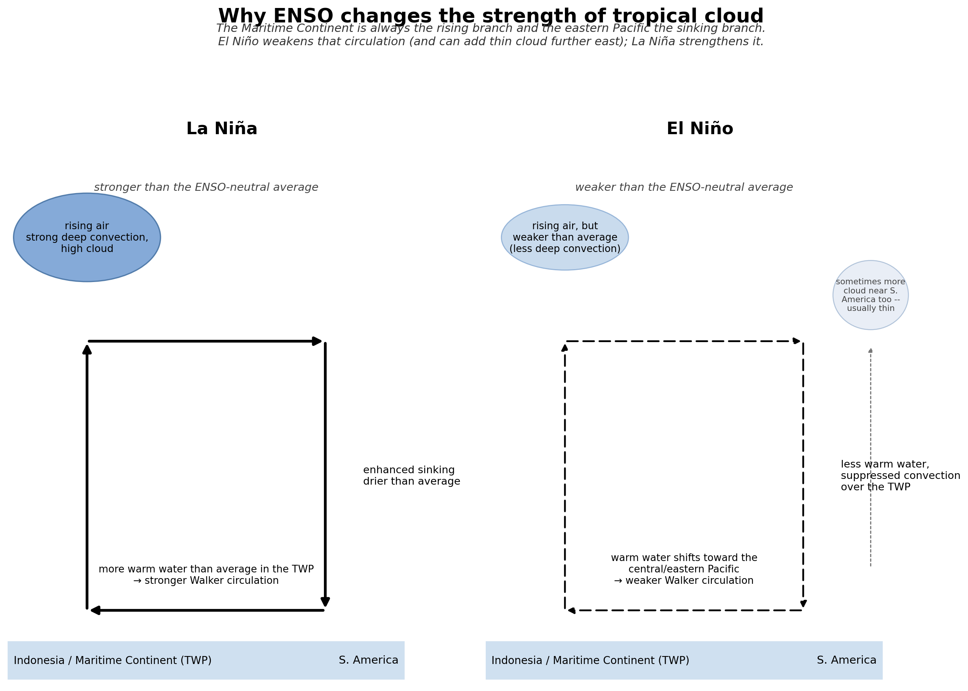
ENSO AND CLOUD COVER MINI-PROJECT
Tutorial 1 · Slide 6 of 9
Why should the clouds change?
Warm SST and atmospheric circulation are coupled.
The Maritime Continent (TWP) stays the Walker cell's rising branch -- El Niño weakens it, La Niña strengthens it.
El Niño can add a little extra, usually thin, cloud further east near S. America -- not a new deep-convection centre.
Low-cloud responses can involve different physics.
Course-team schematic / teaching material
Notes:
~4 min. Walker circulation shift is the mechanistic link from SST to cloud -- this is the 'why' they'll need for their Discussion in December.

Slide 8
ENSO AND CLOUD COVER MINI-PROJECT
Tutorial 1 · Slide 7 of 9
How your report will be marked
Full descriptors are in the handbook (§9). Same scheme every week — know it from day one.
Band | Roughly | What it looks like
40–49% | Pass | Question present but vague/broad; some figures but not well-chosen; reads like a notebook summary rather than an argument.
50–59% | 2:2 | One reasonably specific question, answered with somewhat thin reasoning; figures mostly relevant; attribution present.
60–69% | 2:1 — a solid, competent report | A focused question, clearly and directly answered; 3–5 well-designed figures each earning its place; quantified, physically-interpreted evidence.
70–79% | First | Well-chosen question; figures show real physical insight; consistent Claim → Evidence → Interpretation → Qualification; independent scientific thinking in the Discussion.
80%+ | Exceptional | All of the above, plus something beyond what was directly taught — an original angle or a careful treatment of a subtlety. Rare.
Notes:
~1 min. Don't over-explain -- say 'full detail is in the handbook, we'll use this every week' and move on.

Slide 9
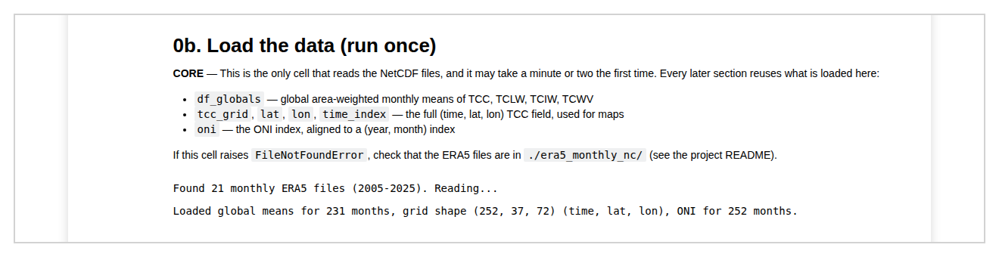
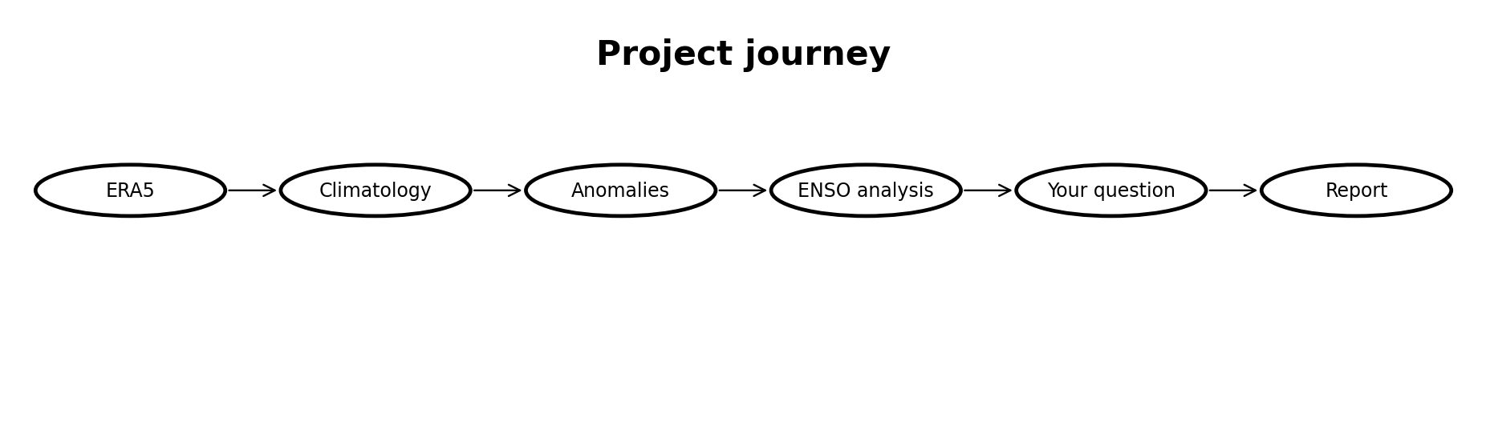
ENSO AND CLOUD COVER MINI-PROJECT
Tutorial 1 · Slide 8 of 9
Today: get something working
Open the project through Binder.
Run the notebook from the top.
Look at the first cloud figures.
Write down two patterns/regions that interest you.
Save your work: Binder sessions are temporary.
What you will actually see when "0b. Load the data" finishes running
Course-team schematic / teaching material
Notes:
~1 min to launch, then hands-on. TOTAL HANDS-ON BUDGET TODAY: ~25 min (open Binder, run notebook top to first cloud figures, write down two patterns). Binder launch is the main time risk -- see tutor note below.

Slide 10
ENSO AND CLOUD COVER MINI-PROJECT
Tutorial 1 · Slide 9 of 9
Sources and attribution
ERA5: ECMWF / Copernicus Climate Change Service.
ENSO and ONI: NOAA Climate.gov and NOAA Climate Prediction Center.
External science-image sources are identified on the relevant slides. Inserted source suggestions are NOAA/NASA public-sector science imagery.
All other diagrams marked as course-team schematics were created specifically for these tutorials.
Notes:
Not presented -- leave on screen while students work; point to it once at the end.

