Slide 1
Tutorial 2 of 6
Tutorial 2 — Making sense of climate data
ENSO and cloud cover mini-project
ENSO and cloud cover mini-project - tutorial slides
Notes:
~1 min. Recap last week's two observations before moving on.

Slide 2
ENSO AND CLOUD COVER MINI-PROJECT
Tutorial 2 · Slide 1 of 5
Today's plan
Goal: Be able to explain cos(latitude) weighting and climatology vs. anomaly, in your own words.
What you'll do today:
1
Run the seasonal-cycle and climatology/anomaly notebook sections.
2
Understand why area weighting (cos(latitude)) matters for global averages.
3
Practice telling climatology apart from anomaly.
4
Note anything that might become your project question.
Tutorial 2 of 6
Notes:
~1 min. Point at it, don't read it aloud.

Slide 3
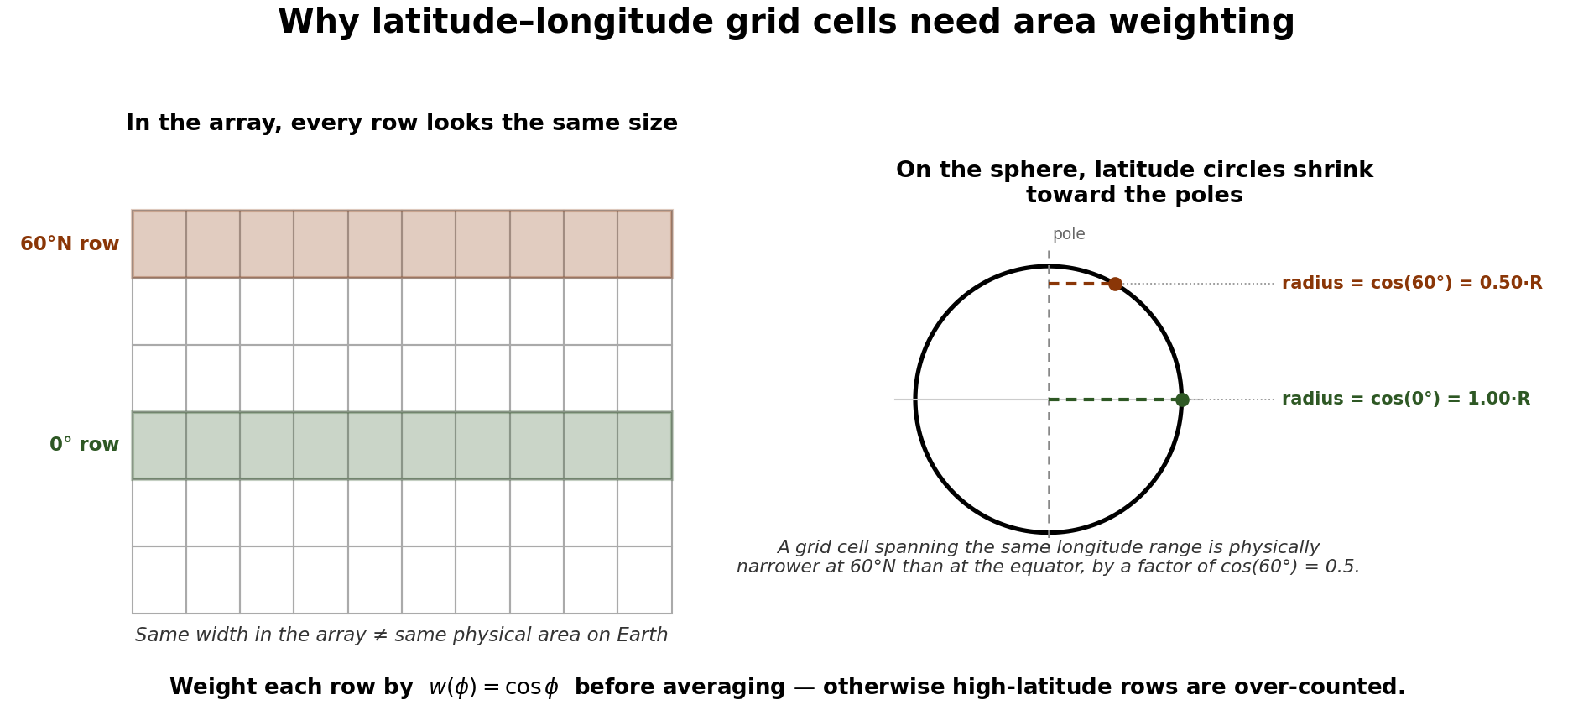
ENSO AND CLOUD COVER MINI-PROJECT
Tutorial 2 · Slide 2 of 5
Why area weighting matters
Latitude–longitude grid boxes shrink towards the poles.
An ordinary average gives high latitudes too much influence.
For a regular lat–lon grid use a weight proportional to cos(latitude).
This matters whenever you average over an area.
Course-team schematic / teaching material
Notes:
~4 min. cos(latitude) weighting -- draw the shrinking grid-box picture if the schematic doesn't land first time.

Slide 4
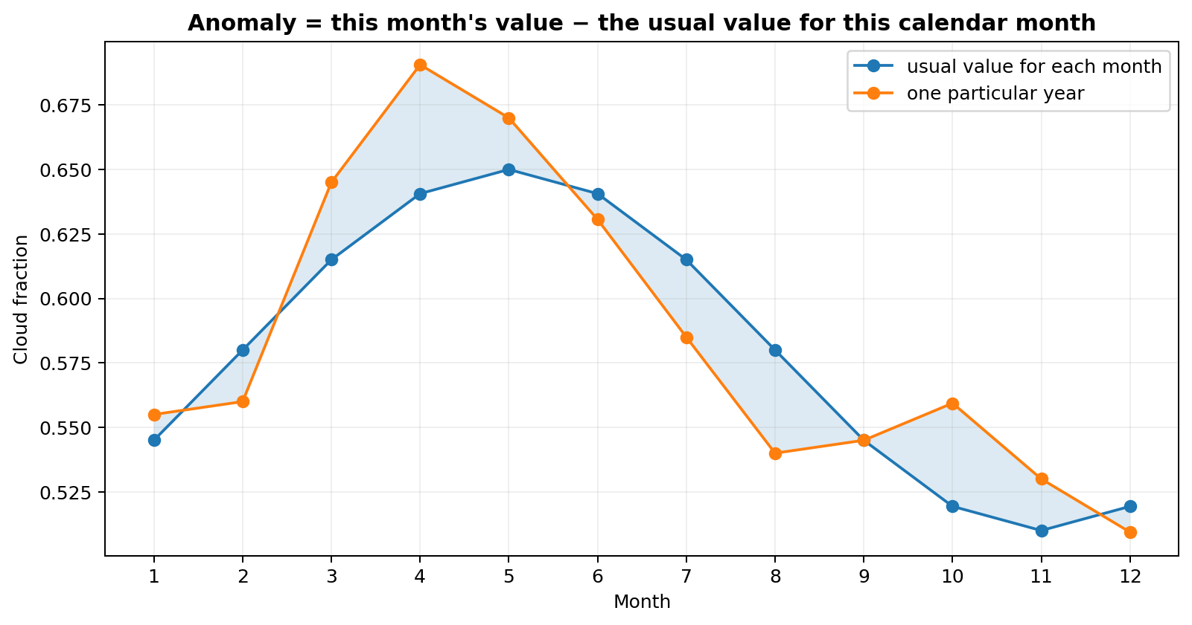
ENSO AND CLOUD COVER MINI-PROJECT
Tutorial 2 · Slide 3 of 5
Climate has a seasonal cycle
Many atmospheric variables have a repeating annual pattern.
A monthly climatology is the usual January, February, …
ENSO is interannual variability, so the normal seasonal cycle can obscure it.
First understand the mean climate; then remove what is 'usual'.
Course-team schematic / teaching material
Notes:
~4 min. Seasonal cycle vs interannual (ENSO) variability -- the distinction they need for section 3.

Slide 5
ENSO AND CLOUD COVER MINI-PROJECT
Tutorial 2 · Slide 4 of 5
Anomaly means 'unusual for this month'
X′(t) = X(t) − monthly climatology.
Positive TCC anomaly = cloudier than usual for that place/month.
Negative = clearer than usual.
Anomaly does not mean the absolute cloud amount is high or low.
Compare your anomaly plot with a neighbour's -- same sign, same timing?
Course-team schematic / teaching material
Notes:
~4 min. Anomaly = value minus climatology for that calendar month. Get one student to say it back in their own words.

Slide 6
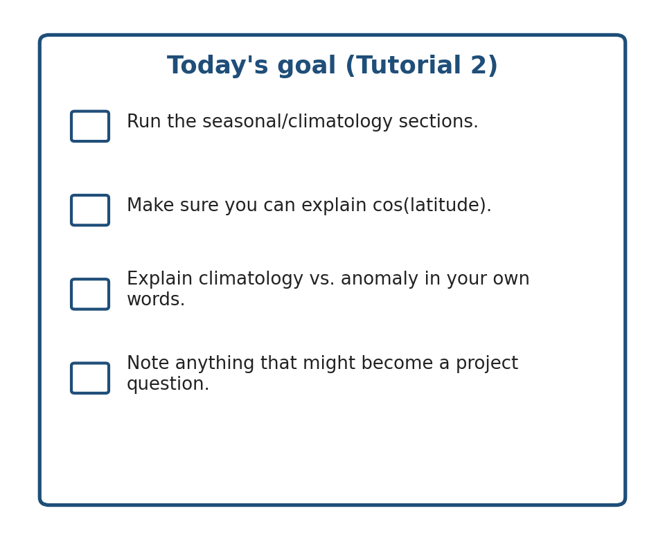
ENSO AND CLOUD COVER MINI-PROJECT
Tutorial 2 · Slide 5 of 5
Today's goal
Run the seasonal/climatology sections.
Make sure you can explain cos(latitude).
Explain climatology versus anomaly in your own words.
Keep a note of anything that might become a project question.
Notes:
~1 min. State today's goal, then hands-on.
Sources: ERA5 (ECMWF/Copernicus) and ENSO/ONI (NOAA Climate.gov, NOAA CPC). Full source list is on the closing slide of Tutorial 1 -- it applies to every week.

