Slide 1
Tutorial 3 of 6
Tutorial 3 — Finding an ENSO signal
ENSO and cloud cover mini-project
ENSO and cloud cover mini-project - tutorial slides
Notes:
~1 min. Recap climatology/anomaly from last week -- today builds on it directly.

Slide 2
ENSO AND CLOUD COVER MINI-PROJECT
Tutorial 3 · Slide 1 of 5
Today's plan
Goal: Find at least one region where cloud responds to ENSO.
What you'll do today:
1
Run the composite (El Niño vs. La Niña) and correlation-with-ONI sections.
2
Compare what composite maps and correlation maps each tell you.
3
Use the numbered regions on the maps to spot 2–3 candidate places/patterns.
4
Start narrowing towards a question.
Tutorial 3 of 6
Notes:
~1 min. Point at it, don't read it aloud.

Slide 3
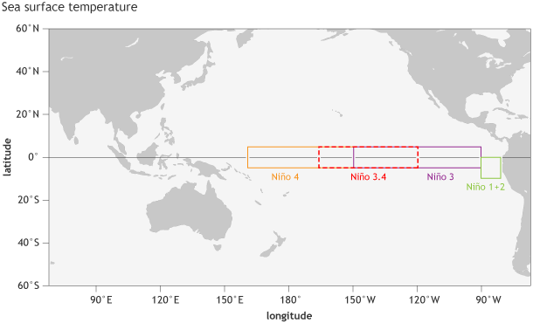
ENSO AND CLOUD COVER MINI-PROJECT
Tutorial 3 · Slide 2 of 5
ONI gives us an ENSO time series
ONI is a 3-month running SST anomaly for Niño 3.4.
Positive values represent warm ENSO conditions; negative values cool conditions.
Historical ONI tables use ±0.5 °C plus persistence to identify warm/cold episodes.
For this project, ONI lets us compare ENSO with cloud anomalies.
Credit: NOAA Climate.gov image by Fiona Martin.
Note: NOAA now uses ONI/RONI for official real-time ENSO monitoring -- the Nino 3.4 box shown here is the classic definition still used in most teaching materials and in this course's dataset.
Notes:
~4 min. ONI as a running SST anomaly; +-0.5C threshold. Mention RONI briefly as the modern operational index.

Slide 4
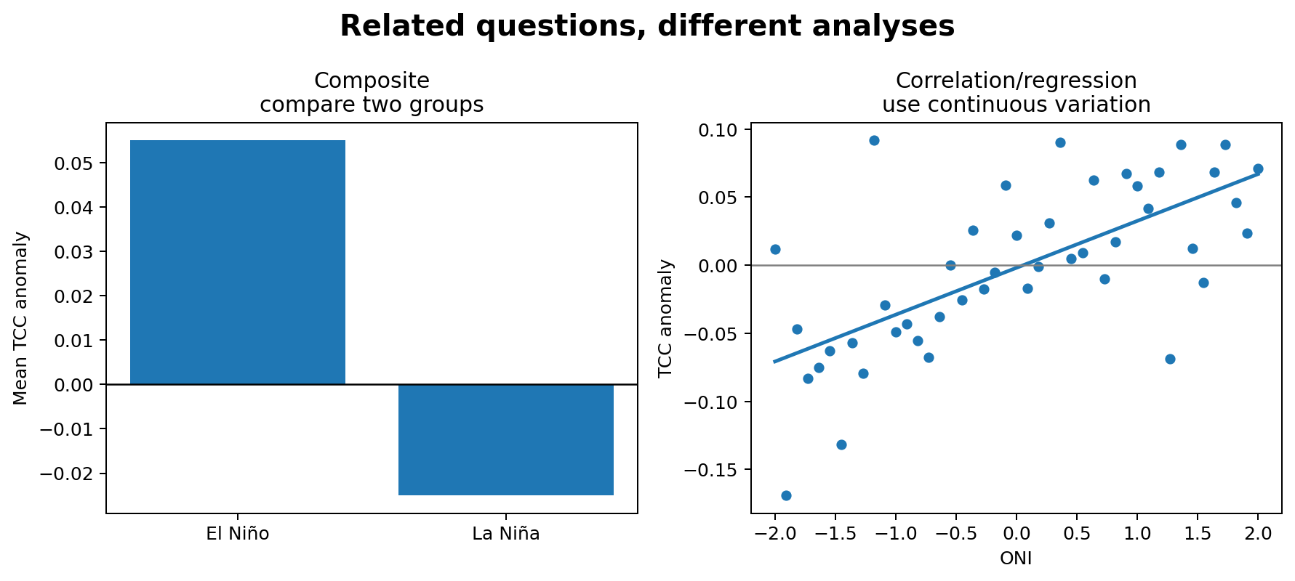
ENSO AND CLOUD COVER MINI-PROJECT
Tutorial 3 · Slide 3 of 5
Composite: compare El Niño and La Niña
Calculate cloud anomalies first.
Average the anomalies in warm ENSO conditions.
Average the anomalies in cool ENSO conditions.
Subtract El Niño − La Niña.
The sign tells you which ENSO phase is cloudier.
Course-team schematic / teaching material
Notes:
~4 min. Composite = compare two groups of months. This is the simpler of the two ideas -- get it solid before correlation.

Slide 5
ENSO AND CLOUD COVER MINI-PROJECT
Tutorial 3 · Slide 4 of 5
Correlation: use continuous variation
r = corr(cloud anomaly, ONI).
Positive r: cloud anomaly tends to increase with ONI.
Negative r: it tends to decrease.
A regression line/R² can quantify the simple linear relationship.
Correlation is not proof of causation.
Course-team schematic / teaching material
Notes:
~4 min. Correlation = continuous relationship. Contrast directly with the composite using the side-by-side figure.

Slide 6
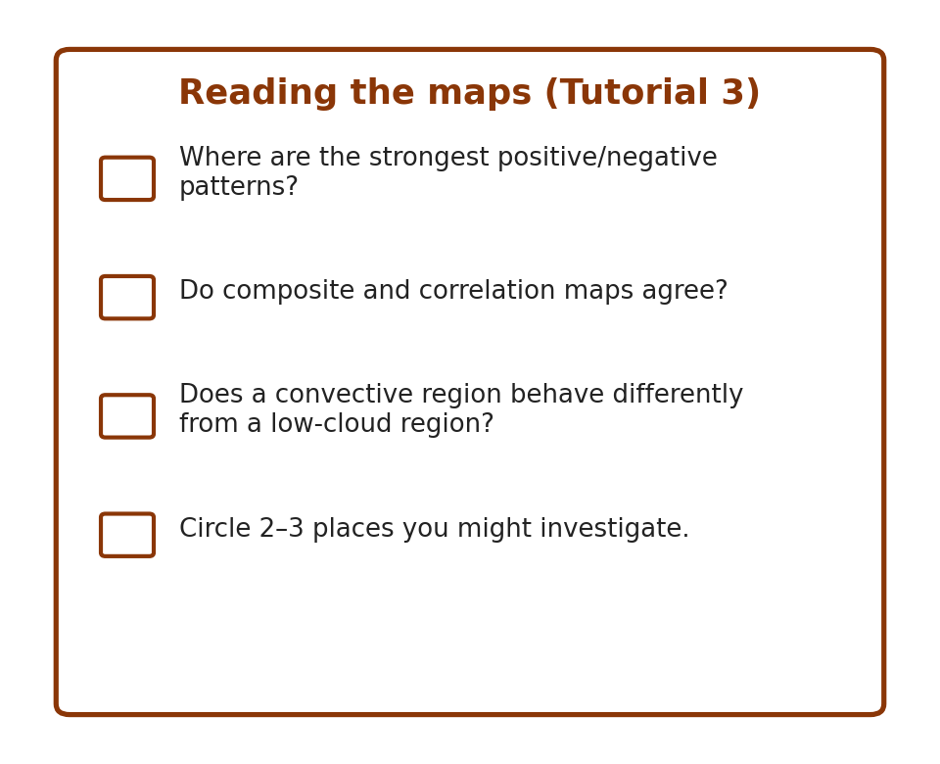
ENSO AND CLOUD COVER MINI-PROJECT
Tutorial 3 · Slide 5 of 5
Use the maps to discover a question
Where are the strongest positive/negative patterns?
Do composite and correlation maps agree?
Does a tropical convective region behave differently from a low-cloud region?
Circle 2–3 places you might want to investigate.
Ask a neighbour which region caught their eye -- did you pick the same one?
Notes:
~2 min. Frame the hands-on: they're looking at the maps to find a region/pattern, not to understand every number.
Sources: ERA5 (ECMWF/Copernicus) and ENSO/ONI (NOAA Climate.gov, NOAA CPC). Full source list is on the closing slide of Tutorial 1 -- it applies to every week.

