Slide 1
Tutorial 4 of 6
Tutorial 4 — Choose what interests you
ENSO and cloud cover mini-project
ENSO and cloud cover mini-project - tutorial slides
Notes:
~1 min.

Slide 2
ENSO AND CLOUD COVER MINI-PROJECT
Tutorial 4 · Slide 1 of 8
Today's plan
Goal: Leave with one written research question and a rough figure plan.
What you'll do today:
1
Explore different cloud levels/regions (low marine cloud vs. deep tropical convection).
2
Optionally explore persistence/lag if it interests you.
3
Narrow from “everything ENSO and clouds” to ONE focused question.
4
Fill in the “Before you leave” card: question, why it interests you, figures needed.
Tutorial 4 of 6
Notes:
~1 min. Point at it, don't read it aloud.

Slide 3
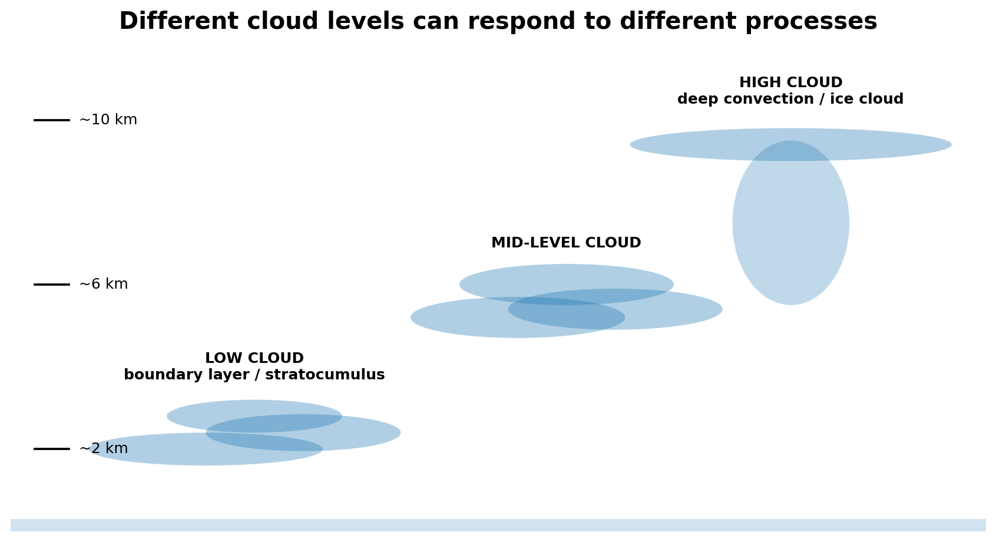
ENSO AND CLOUD COVER MINI-PROJECT
Tutorial 4 · Slide 2 of 8
Different cloud levels, different processes
Low cloud: boundary layer, stability, inversion and subsidence can be important.
High tropical cloud: closely linked to deep convection.
Medium cloud samples another part of the vertical structure.
TCC can hide differences between cloud levels.
Course-team schematic / teaching material
Notes:
~3 min. Different cloud levels = different physics (boundary-layer vs deep convection) -- this is one of the easiest ways to narrow a question.

Slide 4
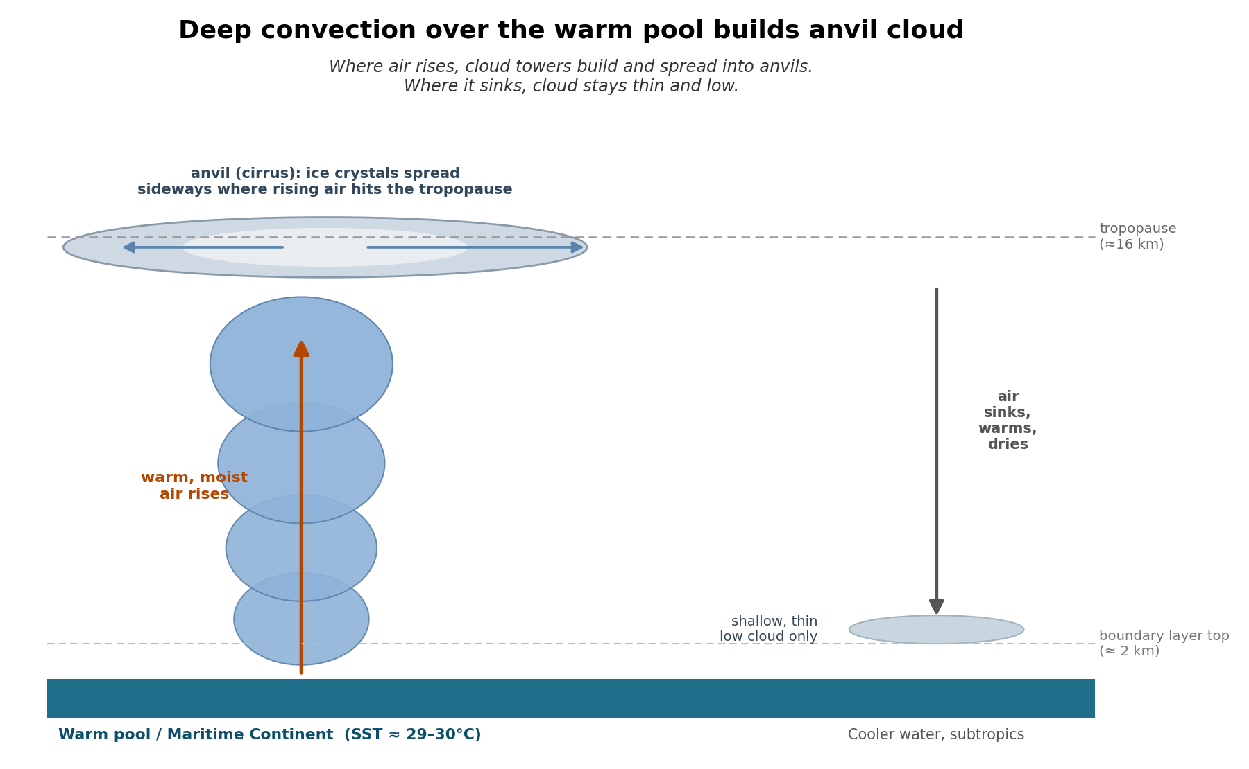
ENSO AND CLOUD COVER MINI-PROJECT
Tutorial 4 · Slide 3 of 8
What deep convection looks like
Notes:
~1 min. Quick, real photos -- let the image land, don't over-narrate.

Slide 5
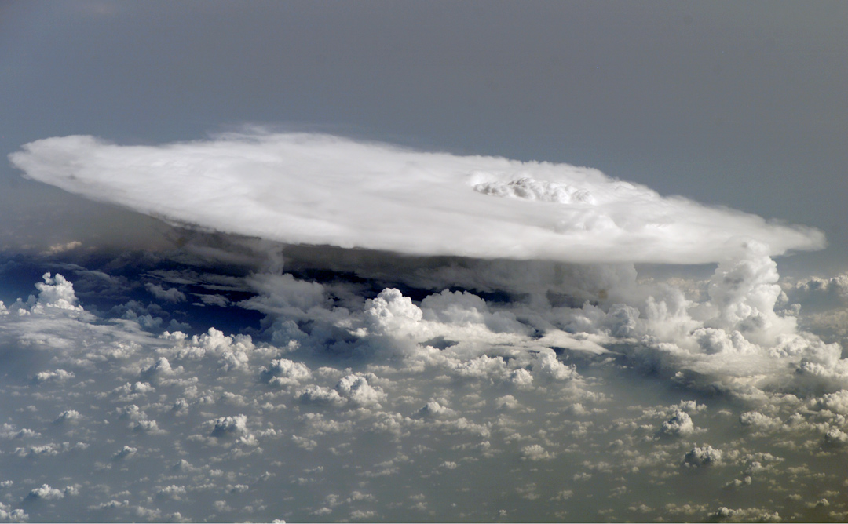
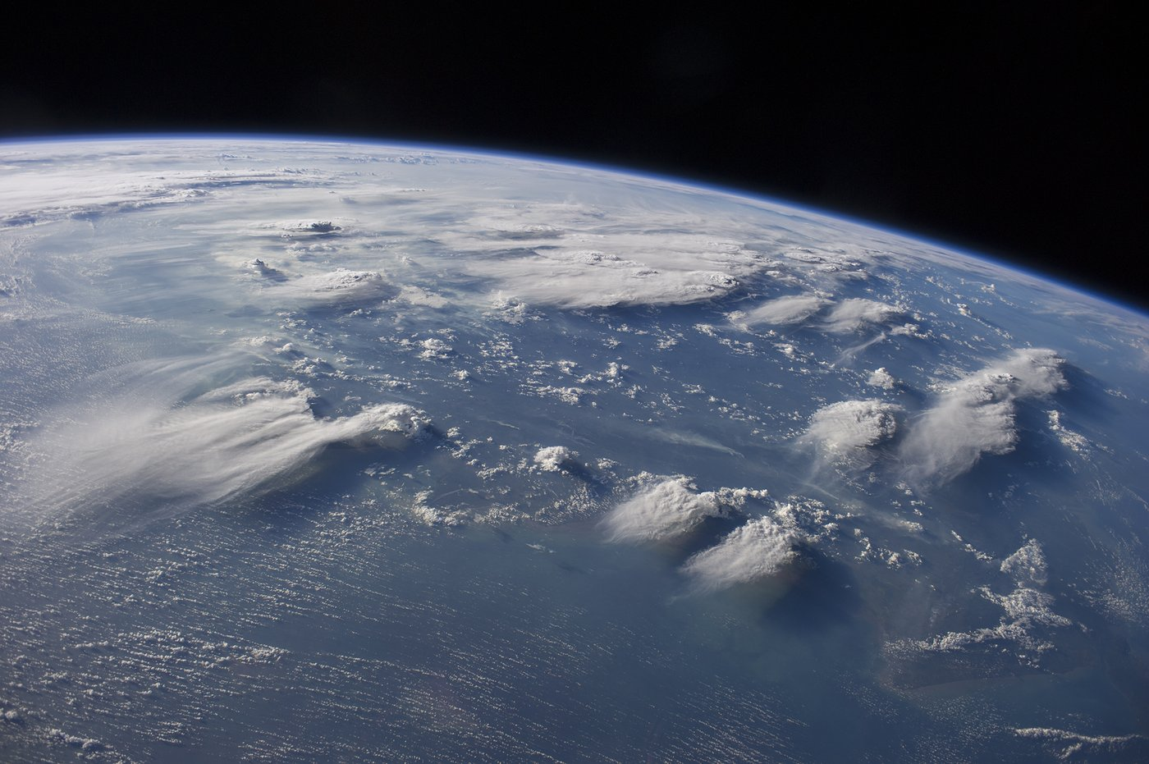
ENSO AND CLOUD COVER MINI-PROJECT
Tutorial 4 · Slide 4 of 8
Anvils, seen from space
Credit: NASA/ISS Crew Earth Observations, Expedition 16 (astronaut photograph ISS016-E-27426, 5 Feb 2008).
Credit: NASA/ISS Crew Earth Observations, Expedition 40 (astronaut photograph ISS040-E-88891, 5 Aug 2014).
Notes:
~1 min. Same -- these are here to make the schematic concrete, not for detailed commentary.

Slide 6
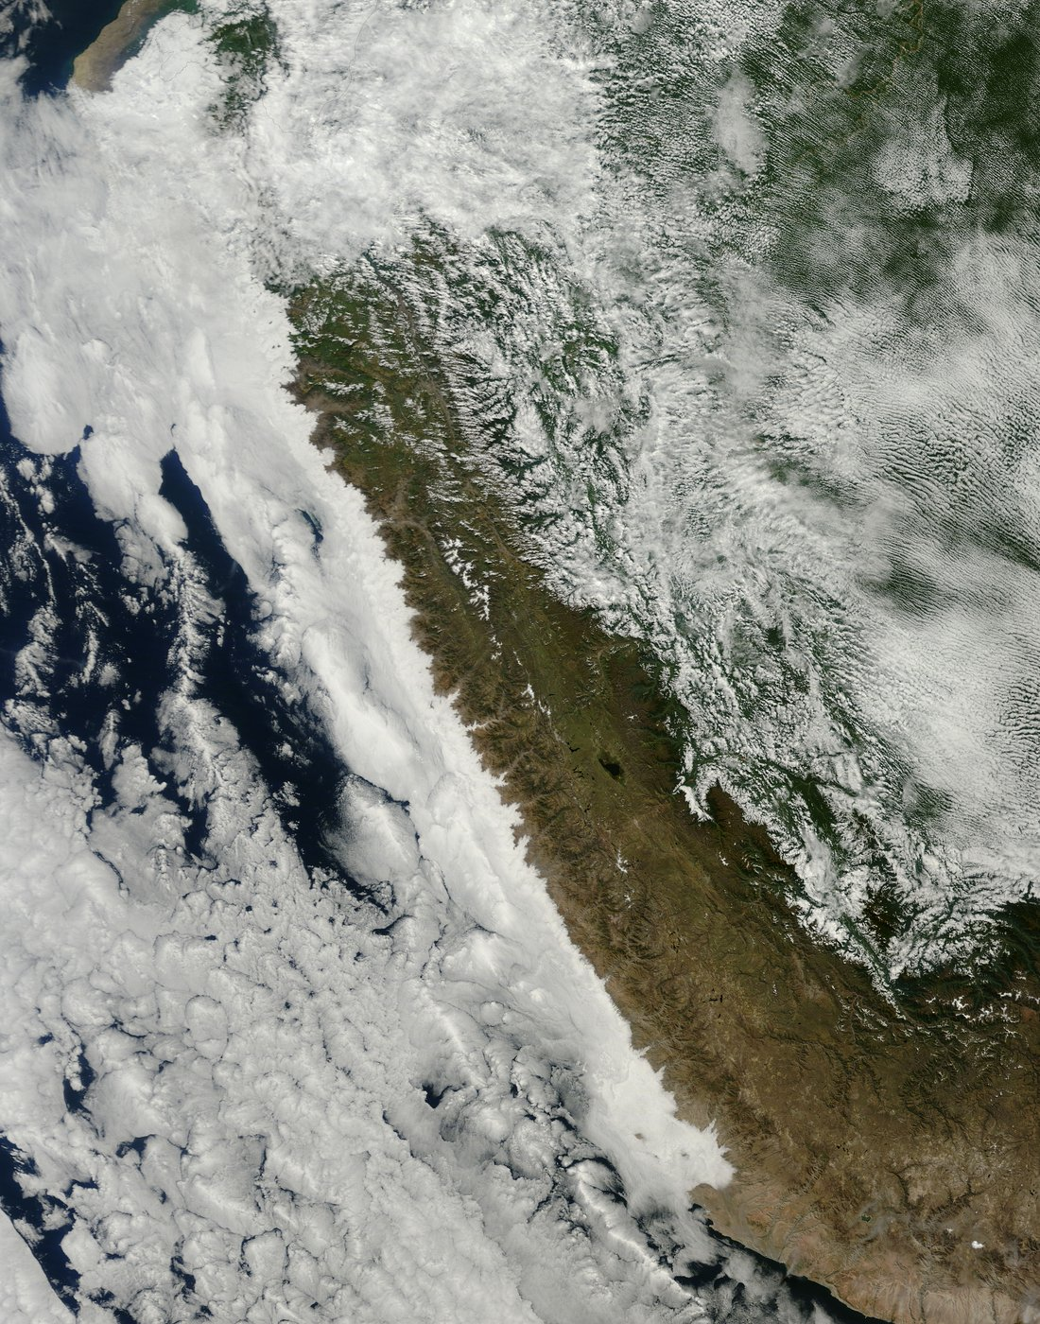
ENSO AND CLOUD COVER MINI-PROJECT
Tutorial 4 · Slide 5 of 8
What does a marine low-cloud deck look like?
Marine stratocumulus covers large areas of subtropical eastern oceans.
The SE Pacific is a natural region for a low-cloud ENSO question.
Satellite imagery makes the scale and texture of these clouds obvious.
Compare this regime with tropical convective cloud.
Credit: NASA Earth Observatory, image by Joshua Stevens/Jeff Schmaltz (VIIRS, Suomi NPP / NOAA-20, 3 Dec 2019).
Notes:
~3 min. Marine stratocumulus as a concrete, visual example of a low-cloud regime.

Slide 7
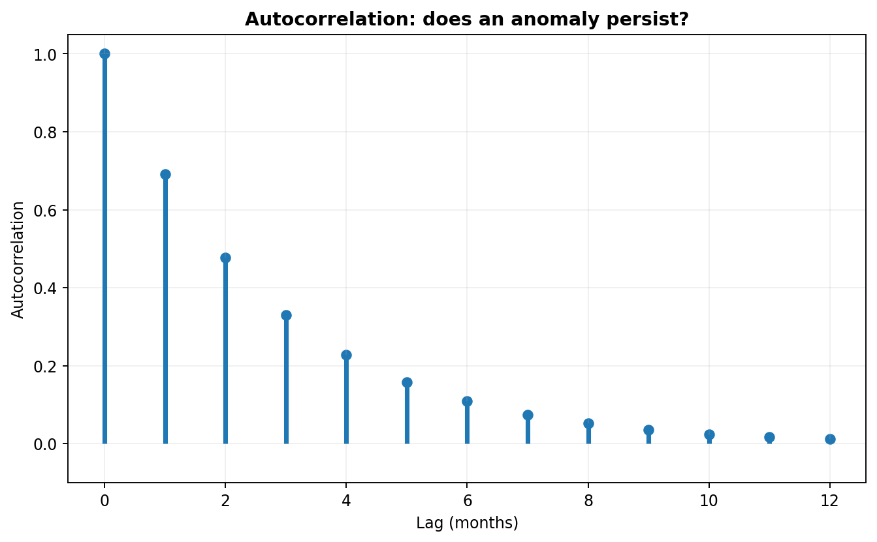
ENSO AND CLOUD COVER MINI-PROJECT
Tutorial 4 · Slide 6 of 8
Optional: persistence and timing
Autocorrelation asks whether anomalies persist from one month to the next.
Lead/lag analysis asks whether the strongest relationship is simultaneous or delayed.
These can make a good project direction.
They are NOT compulsory if your question is about something else.
Course-team schematic / teaching material
Notes:
~3 min. Flag as optional -- only dwell on this if several students are drawn to a timing/persistence question.

Slide 8
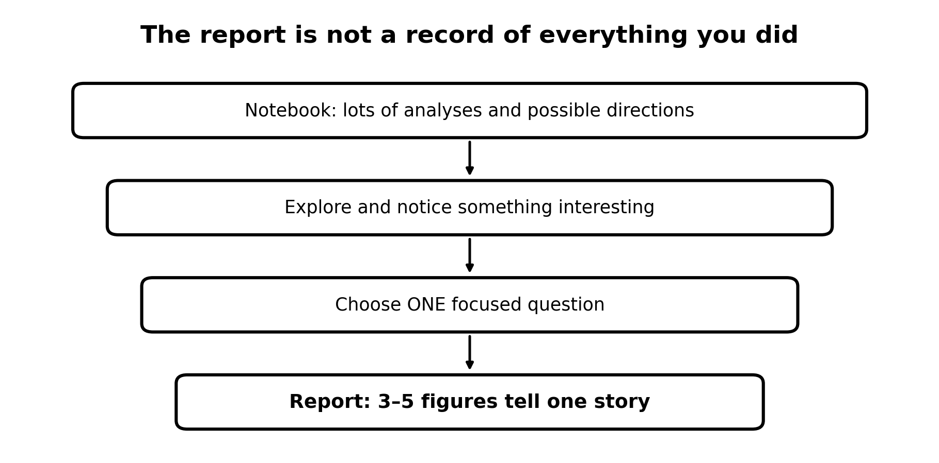
ENSO AND CLOUD COVER MINI-PROJECT
Tutorial 4 · Slide 7 of 8
Narrow the project
Cloud type? Region? Season? Timing?
Write ONE answerable question.
Choose only the notebook analyses that test it.
Plan 3–5 figures before generating more output.
Say your one-sentence question out loud to a neighbour before you write it down.
Course-team schematic / teaching material
Notes:
~2 min. Narrowing checklist: cloud type / region / season / timing -- pick one axis.

Slide 9

ENSO AND CLOUD COVER MINI-PROJECT
Tutorial 4 · Slide 8 of 8
Before you leave
My question is…
I find it interesting because…
The figures I need are…
The notebook sections I can ignore are…
Notes:
~5 min. Active exercise -- have every student write their four lines before hands-on time starts, not during it.
Sources: ERA5 (ECMWF/Copernicus) and ENSO/ONI (NOAA Climate.gov, NOAA CPC). Full source list is on the closing slide of Tutorial 1 -- it applies to every week.

