Slide 1
Tutorial 5 of 6
Tutorial 5 — Build the evidence
ENSO and cloud cover mini-project
ENSO and cloud cover mini-project - tutorial slides
Notes:
~1 min.

Slide 2
ENSO AND CLOUD COVER MINI-PROJECT
Tutorial 5 · Slide 1 of 5
Today's plan
Goal: Produce 3–5 provisional final figures for your report.
What you'll do today:
1
Revisit your question and decide exactly which figures answer it.
2
Learn what makes a figure “good” (units, scale, caption, visible evidence).
3
Understand attribution rules: your figures vs. external data/images.
4
Save 3–5 provisional figures outside Binder, with one result sentence each.
Tutorial 5 of 6
Notes:
~1 min. Point at it, don't read it aloud.

Slide 3
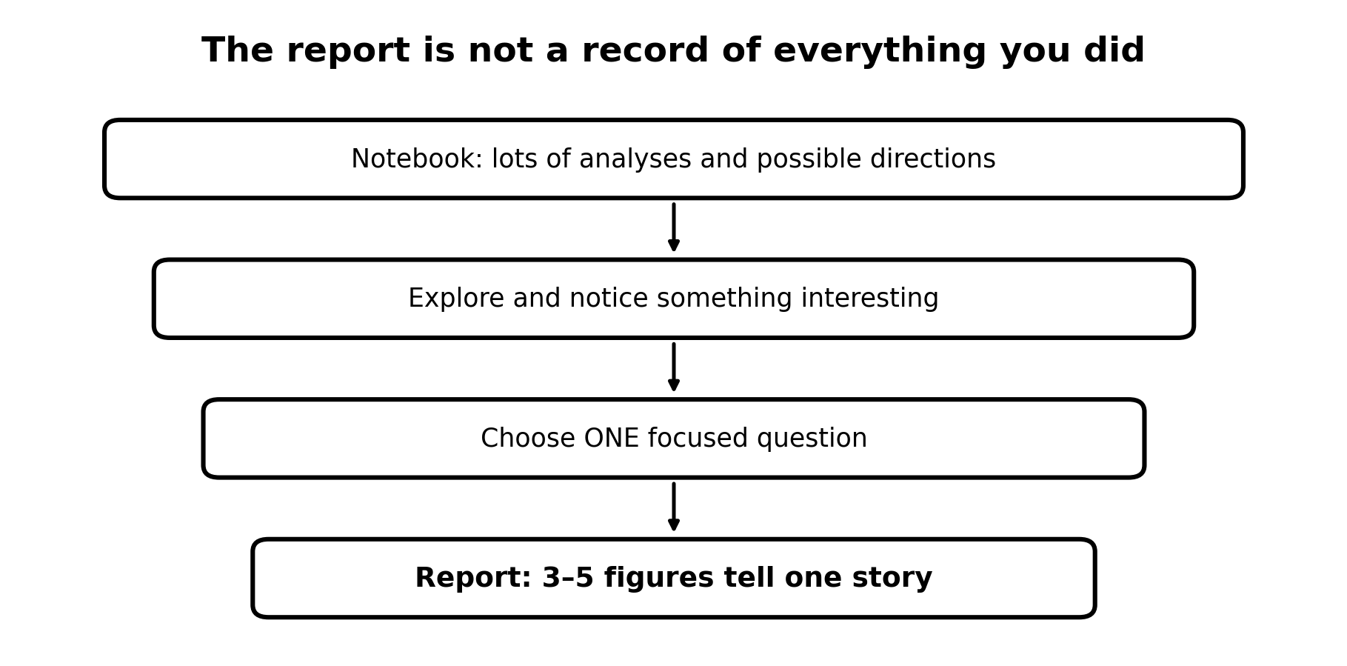
ENSO AND CLOUD COVER MINI-PROJECT
Tutorial 5 · Slide 2 of 5
Your report is not the notebook
The notebook is deliberately broad.
A figure belongs in the report only if it helps answer your question.
Three strong figures can be better than ten weakly connected figures.
Stop when you have enough evidence.
Course-team schematic / teaching material
Notes:
~2 min. Reframe: today is about building evidence for THEIR question, not running more of the notebook.

Slide 4
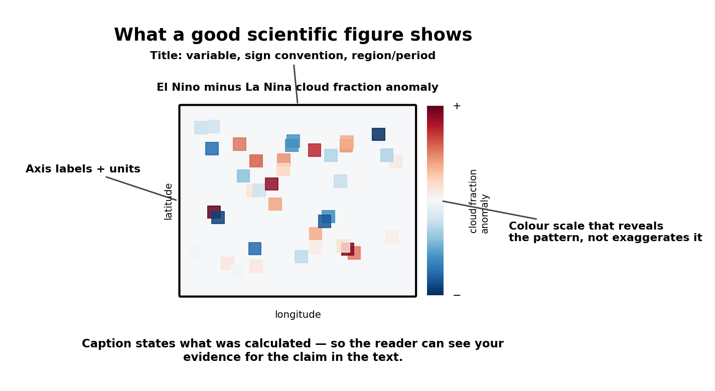
ENSO AND CLOUD COVER MINI-PROJECT
Tutorial 5 · Slide 3 of 5
A good scientific figure
Shows the variable, units and relevant time/space clearly.
Uses axes/colour scales that reveal the pattern without exaggerating it.
Has a caption explaining what was calculated.
Lets the reader see the evidence for the statement in your text.
Show a neighbour your best figure without commentary -- can they tell what it shows?
Notes:
~3 min. What makes a figure report-ready -- units, clear colour scale, an honest caption.

Slide 5
ENSO AND CLOUD COVER MINI-PROJECT
Tutorial 5 · Slide 4 of 5
Your figures; external data
Plots you generate are your own figures.
ERA5 and ONI remain external datasets and should be acknowledged.
Caption example: 'Figure produced by the author using ERA5 … and ONI …'.
External photos/diagrams are different: attribute the creator/source.
Notes:
~2 min. Their plots are their figures; ERA5/ONI are still cited data sources underneath.

Slide 6
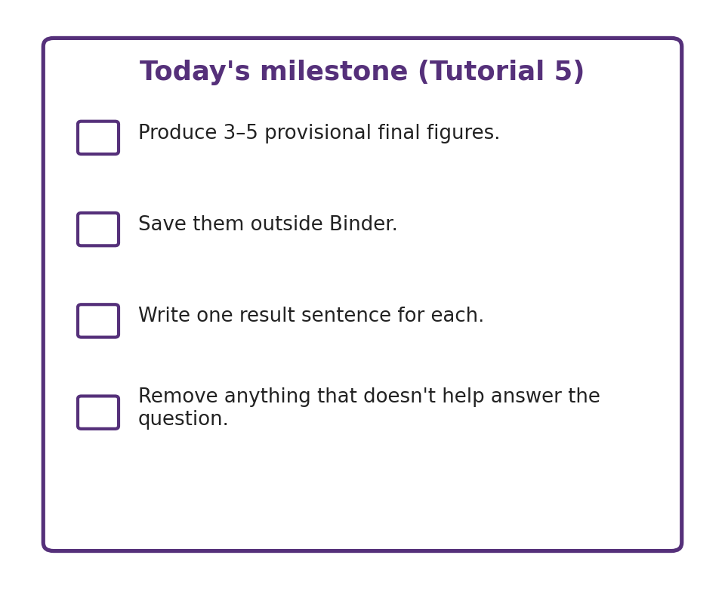
ENSO AND CLOUD COVER MINI-PROJECT
Tutorial 5 · Slide 5 of 5
Today's milestone
Produce 3–5 provisional final figures.
Save them outside Binder.
Write one result sentence for each.
Remove anything that does not help answer the question.
Notes:
~1 min. State the milestone, then hands-on for the rest of the session.
Sources: ERA5 (ECMWF/Copernicus) and ENSO/ONI (NOAA Climate.gov, NOAA CPC). Full source list is on the closing slide of Tutorial 1 -- it applies to every week.

