Slide 1
Tutorial 6 of 6
Tutorial 6 — Write a short scientific story
ENSO and cloud cover mini-project
ENSO and cloud cover mini-project - tutorial slides
Notes:
~1 min.

Slide 2
ENSO AND CLOUD COVER MINI-PROJECT
Tutorial 6 · Slide 1 of 8
Today's plan
Goal: Leave with a structured draft you can finish independently.
What you'll do today:
1
See how a short report is one argument, not a diary of the notebook.
2
Learn the funnel structure for the Introduction and what belongs in Methods.
3
Practice writing around evidence: Claim → Evidence → Interpretation → Qualification.
4
Run the final check against the Conclusion checklist before you leave.
Tutorial 6 of 6
Notes:
~1 min. Point at it, don't read it aloud.

Slide 3
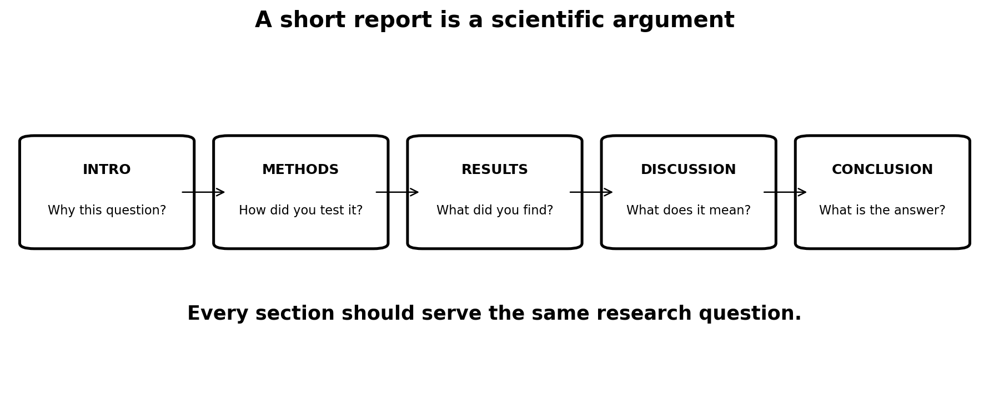
ENSO AND CLOUD COVER MINI-PROJECT
Tutorial 6 · Slide 2 of 8
One question should hold the report together
Do not write 'first I ran this code, then I made this plot'.
Organise around the research question.
Every section and figure should help answer it.
A narrow, well-interpreted report is the aim.
Course-team schematic / teaching material
Notes:
~2 min. The one-sentence test: does this section answer my question?

Slide 4
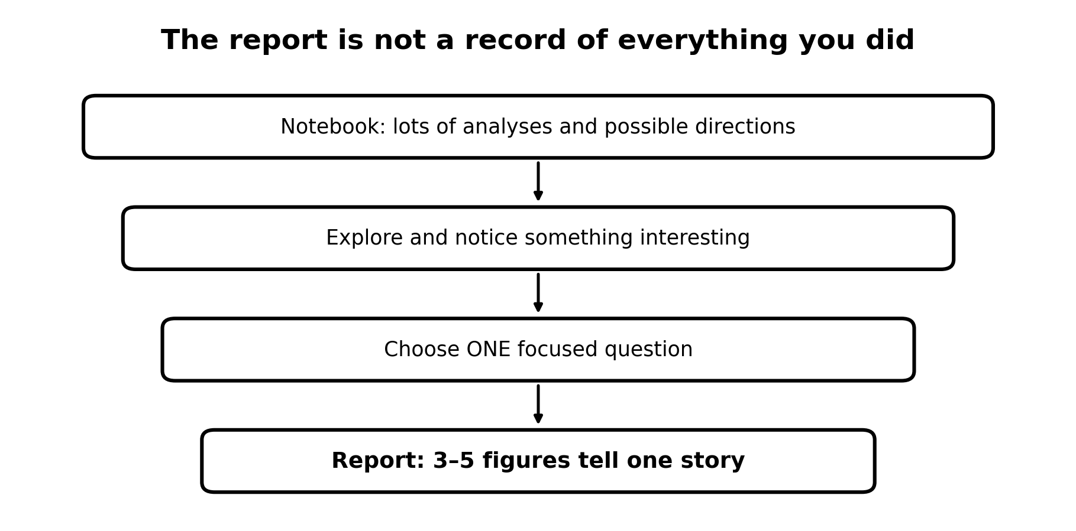
ENSO AND CLOUD COVER MINI-PROJECT
Tutorial 6 · Slide 3 of 8
Introduction: funnel towards the question
What is ENSO?
Why can ENSO alter circulation and clouds?
What is interesting about your chosen cloud type/region/process?
What exactly will you investigate?
Finish with the research question (and hypothesis if useful).
Notes:
~3 min. Funnel structure for the Introduction -- broad ENSO science down to their specific question.

Slide 5
ENSO AND CLOUD COVER MINI-PROJECT
Tutorial 6 · Slide 4 of 8
Methods: science, not Python
ERA5 variable(s), period and region.
ONI and how ENSO is represented.
Anomaly/weighting calculation where relevant.
Composite, correlation, regression or lag ONLY if you use them.
Do not paste code or describe notebook cells.
Notes:
~3 min. Methods describes the science/analysis choices, not Python syntax -- worth saying explicitly, it's the most common slip-up.

Slide 6
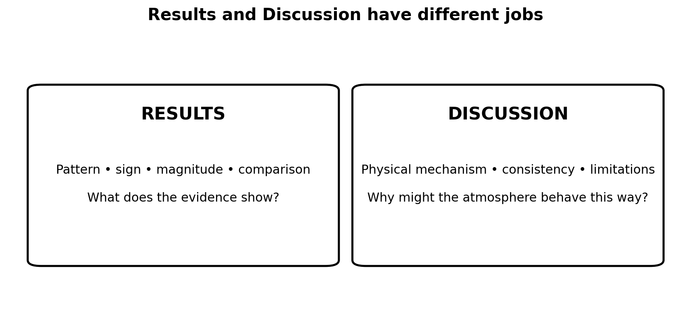
ENSO AND CLOUD COVER MINI-PROJECT
Tutorial 6 · Slide 5 of 8
Results versus Discussion
RESULTS: what pattern, sign, magnitude or relationship did you find?
DISCUSSION: what physical processes could explain it?
Use figures as evidence in Results.
Use atmospheric science to interpret them in Discussion.
Course-team schematic / teaching material
Notes:
~3 min. Results vs Discussion have different jobs -- this is the trickiest distinction; use the two-box figure.

Slide 7
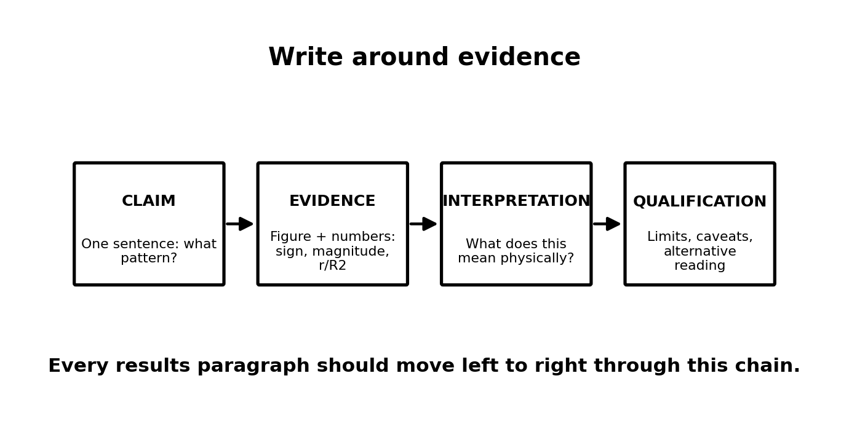
ENSO AND CLOUD COVER MINI-PROJECT
Tutorial 6 · Slide 6 of 8
Write around evidence
Claim → evidence → interpretation → qualification.
Quantify where possible: sign, magnitude, r/R², region.
Avoid narrating every colour on a map.
Compare analyses only when the comparison adds to the answer.
Report numbers with units, a baseline and a sample size, and caption every figure fully (Section 8 checklist).
Notes:
~3 min. Claim -> evidence -> interpretation -> qualification as a paragraph template they can literally follow.

Slide 8
ENSO AND CLOUD COVER MINI-PROJECT
Tutorial 6 · Slide 7 of 8
Remember: how this gets marked
Band | Roughly | What it looks like
40–49% | Pass | Question present but vague/broad; some figures but not well-chosen; reads like a notebook summary rather than an argument.
50–59% | 2:2 | One reasonably specific question, answered with somewhat thin reasoning; figures mostly relevant; attribution present.
60–69% | 2:1 — a solid, competent report | A focused question, clearly and directly answered; 3–5 well-designed figures each earning its place; quantified, physically-interpreted evidence.
70–79% | First | Well-chosen question; figures show real physical insight; consistent Claim → Evidence → Interpretation → Qualification; independent scientific thinking in the Discussion.
80%+ | Exceptional | All of the above, plus something beyond what was directly taught — an original angle or a careful treatment of a subtlety. Rare.
Notes:
~1 min. Quick recap, not a re-teach -- 'same scheme as week 1, here's where you are relative to it'.

Slide 9
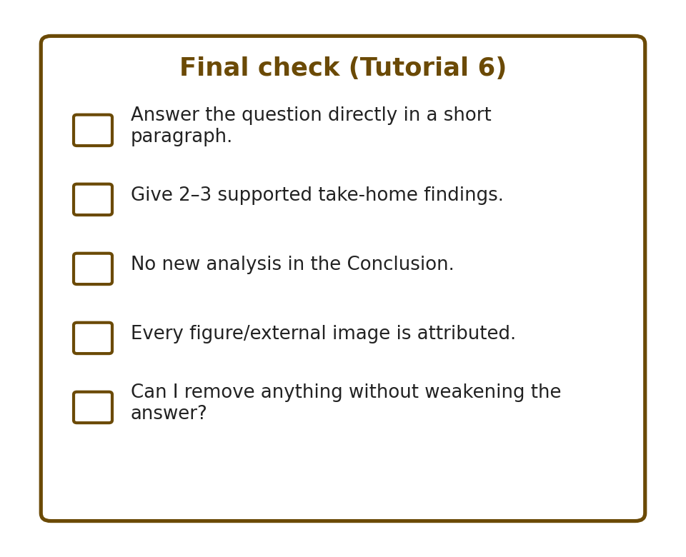
ENSO AND CLOUD COVER MINI-PROJECT
Tutorial 6 · Slide 8 of 8
Conclusion and final check
Answer the question directly in a short paragraph.
Give 2–3 supported take-home findings.
No new analysis in the Conclusion.
Check every figure is referred to and every dataset/external image is attributed.
Ask: can I remove anything without weakening the answer?
Notes:
~2 min. Conclusion check -- no new results, 2-3 supported findings, answer the question directly.
Sources: ERA5 (ECMWF/Copernicus) and ENSO/ONI (NOAA Climate.gov, NOAA CPC). Full source list is on the closing slide of Tutorial 1 -- it applies to every week.

