Slide 1
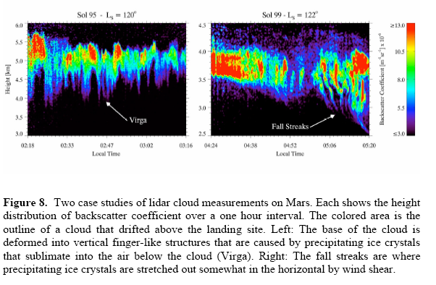
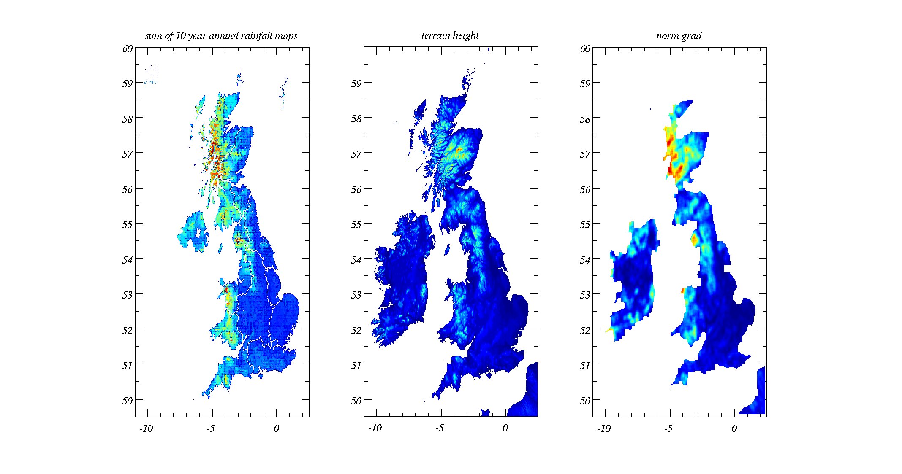
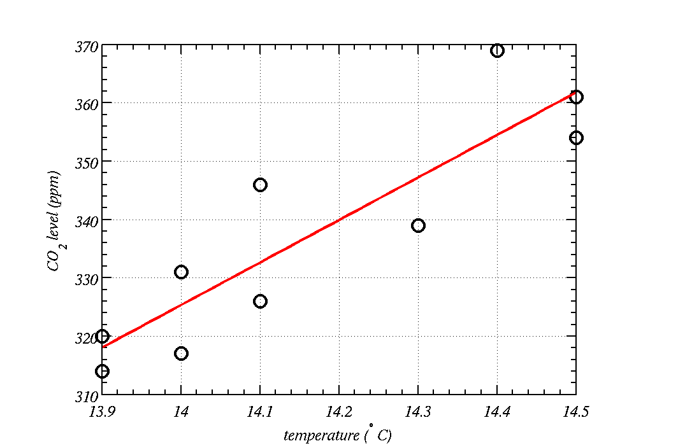
data analysis report
Correlation, regression and error propagation
Prof Paul Connolly

Slide 2
Intended learning outcomes
Know how to assess how well variations in one variable can be used to explain variations in another.
Fit straight lines and curves to data
  Mathematics I am afraid!
Test the hypothesis that your correlation coefficients are real.
Error propagation.

Slide 3
Definitions
The sample correlation coefficient,
  symbol r.
The population correlation coefficient,
  symbol ρ.

Slide 4
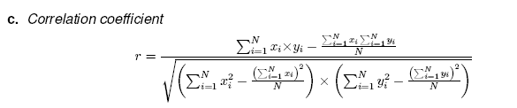
Definition - correlation coefficient
Some values of r:
y
r = +1
y
r = -1
y
r = 0
x
x
x
Perfect
positive
correlation
Perfect
negative
correlation
No
correlation
Ouch! Good we don’t need to know it
MATLAB: corrcoef(x,y)
Or corr2(x,y) can be used
Excel: =correl(range1,range2)

Slide 5
Definition - correlation coefficient
r² is the amount of variation in x and y that is explained by the linear relationship. It is often called the `goodness of fit’
E.g. if an r = 0.97 is obtained then r² = 0.95 so 100x0.95=95% of the total variation in x and y is explained by the linear relationship, but the remaining 5% variation is due to “other” causes.
It is sometimes important to assess whether the correlation could have occurred by chance => hypothesis test.
1.0
0.9
0.8
0.7
0.6
r², fraction of explained
variation
0.5
0.4
0.3
0.2
0.1
0.0
+1.0
+0.5
+0.0
-0.5
-1.0
Correlation coefficient, r

Slide 6
Methodology:
State the null and alternate hypotheses:
  E.g. H₀: ρ=0, H₁: ρ≠0
Calculate a statistic (to be defined): something that if null hypothesis is true is distributed according to a theoretical distribution.
Calculate a critical value from the theoretical distribution.
Assess which is largest: statistic or critical value and
Accept the null if statistic < critical value or reject the null (and hence accept the alternate) if statistic > critical value.
Or calculate the p-value – need a small p-value for significance

Slide 7
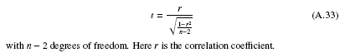
Why does this kind of hypothesis testing work?
Statisticians have found that if you take a random sample of quantitative data, size n, from a population and then another independent sample size n, then calculate the correlation coefficient, r…
will be:
  Distributed according to a t-distribution (if the data are drawn from the same population), with n-2 degrees of freedom
Therefore, if we calculate a value of t from our data that is large, we can say it is unusual.
Notes:
Bucket of 1p, 2p, 5p, 10p…
Randomly sample 4 coins. Put them back, do it again. Could get perfect correlation (rare chance, but possible).

Slide 8
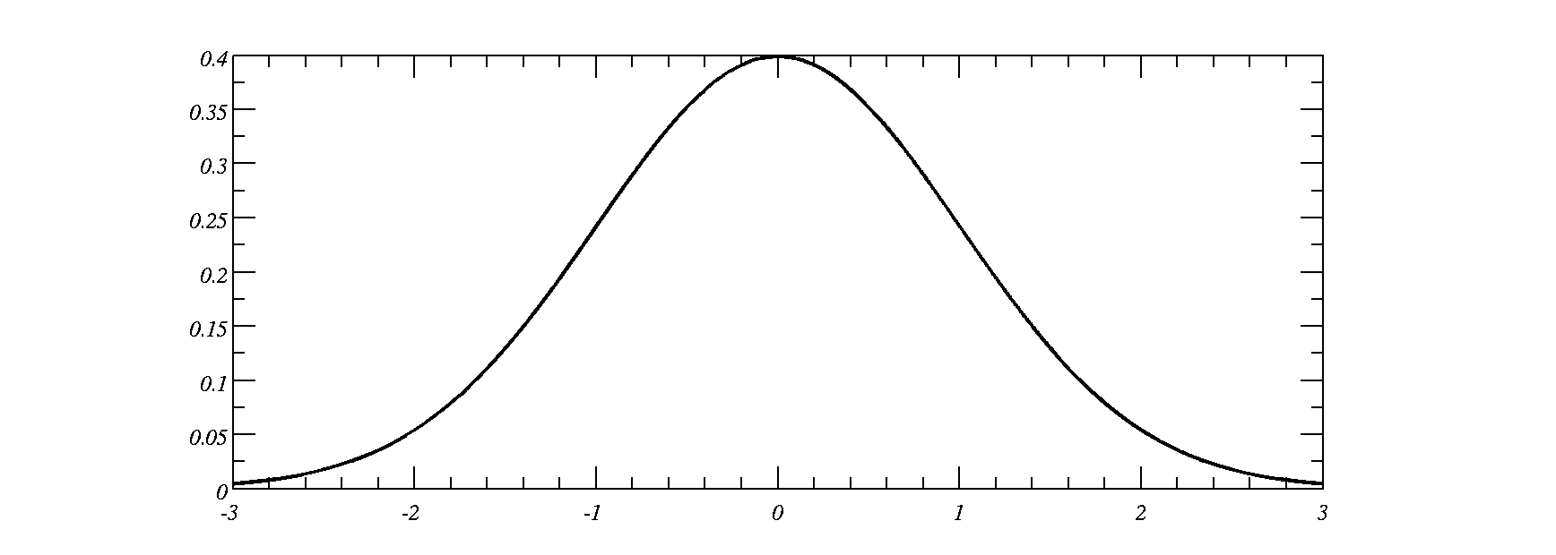
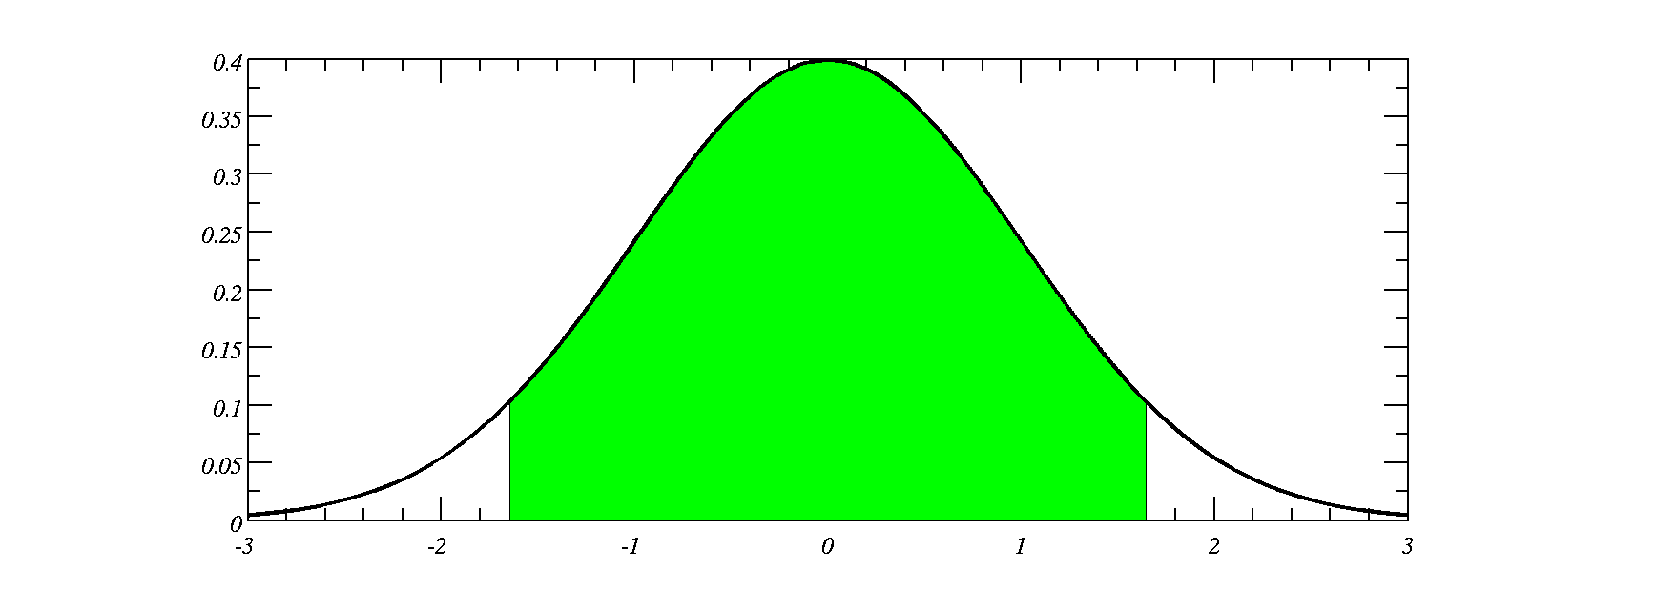
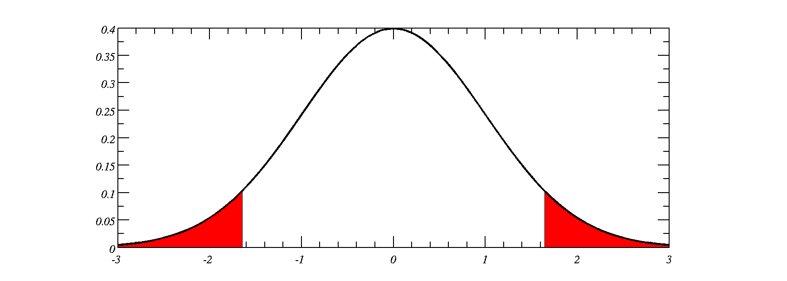
Confidence levels and significance levels
Usually we want to be confident that the statement we make is correct. Unfortunately you can never be 100% confident in anything.
10% chance that the value is in this region
5% in each `tail’.
We call this a 10% significance level
Select a value at random, 90% chance within these bounds.
Thus 90% confidence level
Critical value is the point where the x-axis goes into the red region
Therefore significance level, α=1-confidence level

Slide 9
One-tailed and two-tailed tests
When testing hypotheses of the correlation coefficient we usually only use the two-tailed test
  E.g. CO₂ levels vs temperature have a correlation coefficient that is different to 0.
  If we take limited data sizes we can get high correlation coefficients.

Slide 10
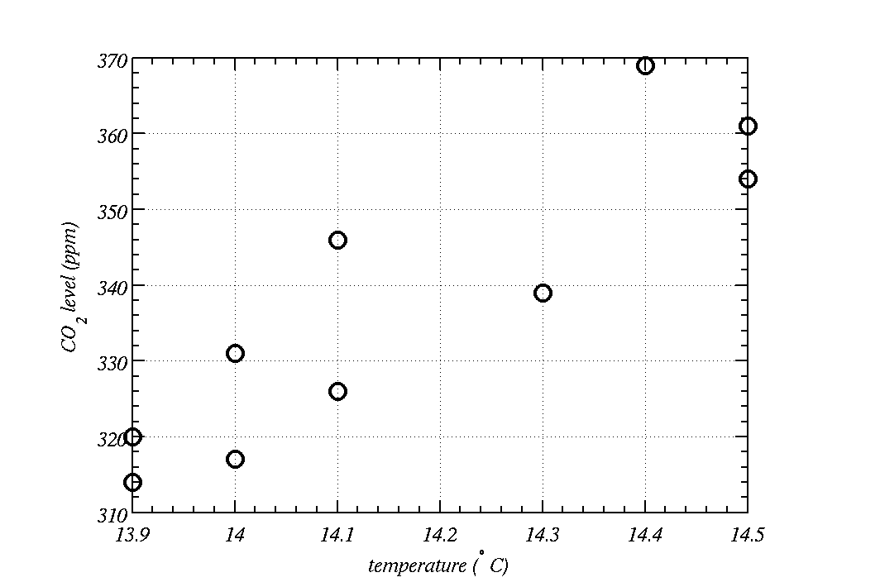
Correlation: CO₂ vs temperature
Question is, given there is only a small amount of data here, is the correlation coefficient significant?
Notes:
CO2 becomes less soluble in water as T increases.

Slide 11
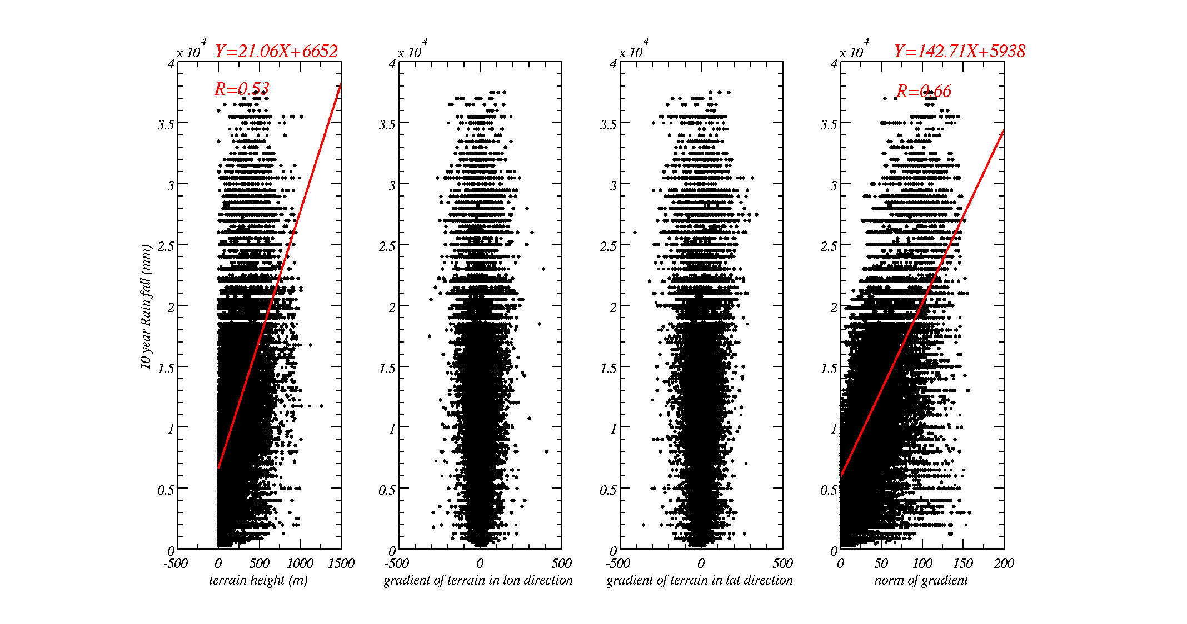
Correlation: rain vs terrain: is rainfall correlated to terrain?
Notes:
Another example

Slide 12

Does chocolate make you clever?

Slide 13
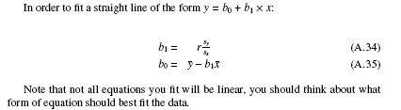
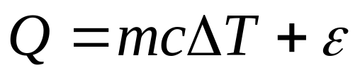
Fitting straight lines
Calculate the correlation coefficient, r, and the standard deviation of y and x
Calculate the mean of x and the mean of y
Heat added to 1 litre of water, Q | Change in temperature, ΔT
… | …
… | ...
ε could be the heat it takes to heat up the apparatus (e.g. kettle filament, etc).

Slide 14

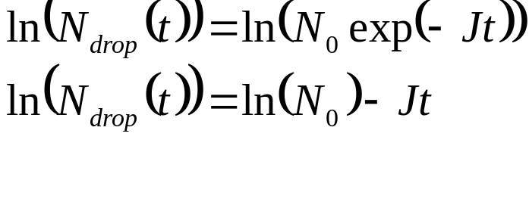
So fitting log of the drop number at time t against t will give a straight line with an intercept of log of N₀ and a slope of –J.
N_{drop} | t |  | log(N_{drop}) | t
… | … |  | … | …
… | ... |  | … | …

Slide 15
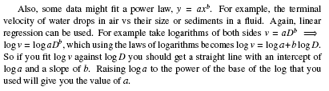
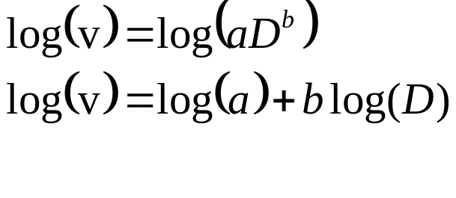
So fitting log of the terminal velocity against log of diameter D will give a straight line with an intercept of log of a and a slope of b.
v | D |  | log(v) | log(D)
… | … |  | … | …
… | ... |  | … | …
Are particles sedimenting due to Stokes’ law:
  non turbulent, v=aD²
or are they in a turbulent flow regime:
  v=aD^{0.5}

Slide 16
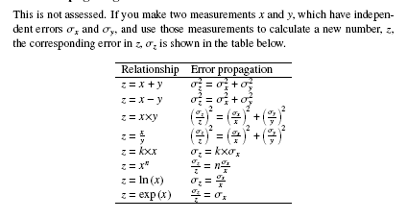
Error propagation

Slide 17
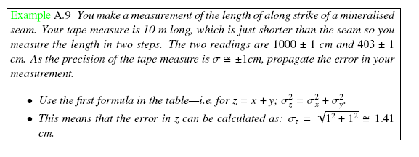

Slide 18
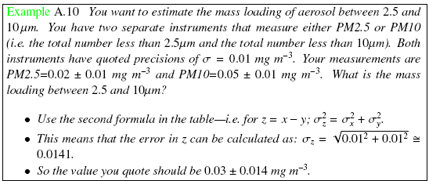

Slide 19
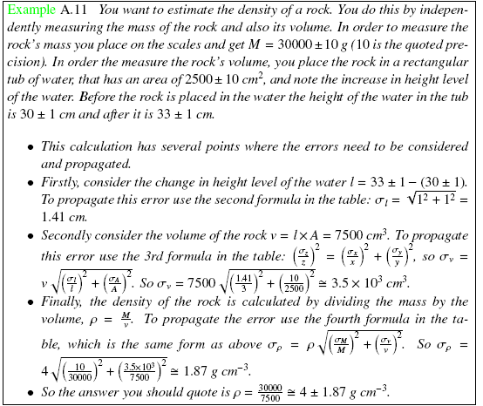
Final answer

Slide 20
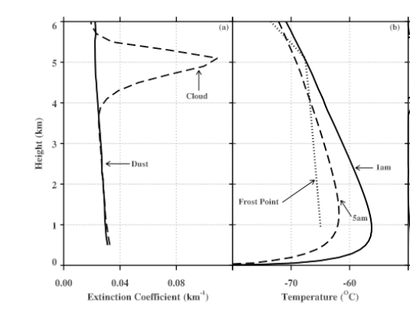
Tomorrows practical: lidar data within clouds that I’ve worked on as part of my research
Notes:
Temperature at 5 km is -65 C.
In the UK temperature at 10 km is -65C, 5 km maybe -15 to -30C
In the tropics 5 km ~0C, 15 km -65C.
Where are these clouds?

Slide 21
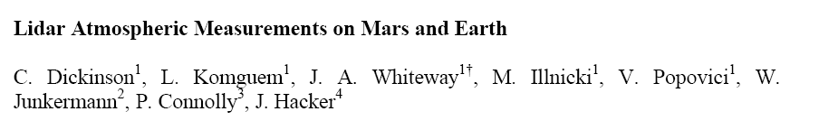
Question was how much water-ice is present in Martian clouds?

Slide 22

Data were taken by the Phoenix Lander on Mars
The mission responded to evidence returned from NASA's Mars Odyssey orbiter in 2002 indicating that most high-latitude areas on Mars have frozen water mixed with soil within arm's reach of the surface
The vertical green line in this illustration shows how the weather station on Phoenix will use a laser beam from a lidar instrument to monitor dust and clouds in the atmosphere.

Slide 23



Airborne measurements on Earth
Ozonesondes (profiles)
ARA Egrett, 10 - 15 km
NERC Dornier
0-5 km

Slide 24

Sampling method:
Grob Egret: sampled cirrus clouds in-situ.
Measurements: Particle microphysics, turbulence, water vapour, temperature, IR fluxes.
Kingair: remotely sensed cirrus clouds from below by airborne LIDAR.

Slide 25
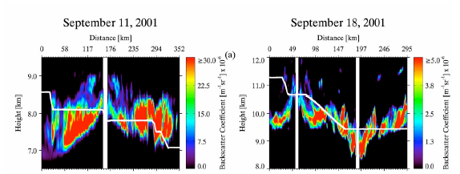
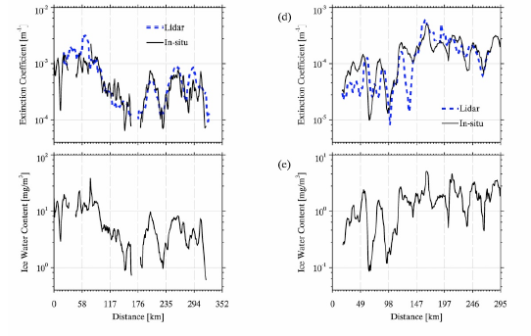
Australian clouds…
Use regression between measured ice water content to extinction in Earth’s clouds and apply this to Martian clouds.
Fly through the clouds with aircraft and sample them

Slide 26
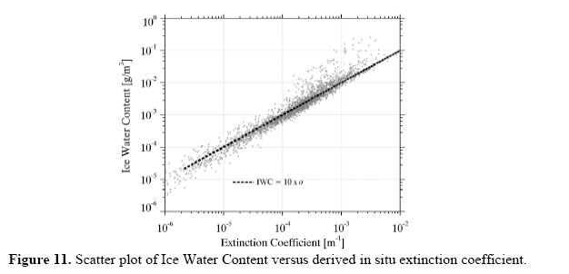
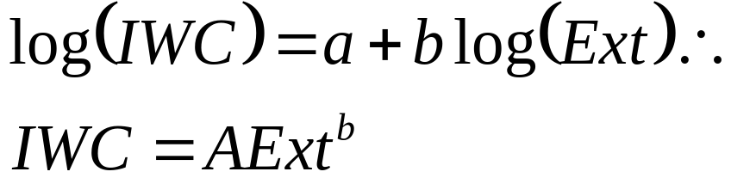
Well-trained eye: note that when you see this much data falling close to a straight line, it is pretty clear that the correlation is going to be statistically significant
Log of ice water content versus log of extinction is a straight line. Watch out for `base’ of logarithm!
This implies a power law

Slide 27
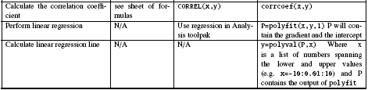
For fitting a power law such as: IWC=AxExt^{b}
It could be that you fitted a power law, for example your input was log(x) and log(y) and you fitted a straight line.
In this case, after fitting your straight line, you would have to calculate A=exp(a) and b=b

