Slide 1
TUTORIAL 1 · THURSDAY 1 OCTOBER
What are we investigating?
ENSO, clouds and your mini research project
YOU LEAVE WITH
The notebook running, your first cloud figures, and two patterns worth a closer look.
Tutorial 1 of 8 · Semester 1
EART29200 · ENSO and cloud cover mini-project · Writing strand

Slide 2
Today's plan
Goal: Get the notebook running and see your first cloud figures.
1
The project: one question, 3–5 figures, 2,000 words
BRING / HAVE READY
A laptop (or a cluster PC)
The Binder link from Canvas
The student handbook
Somewhere to save files: Binder sessions are temporary
2
The two ingredients: ERA5 reanalysis and ENSO
3
Why should clouds change with ENSO?
4
A tour of the notebook
5
Get it running and note two patterns
Tutorial 1 of 8 · Semester 1

Slide 3
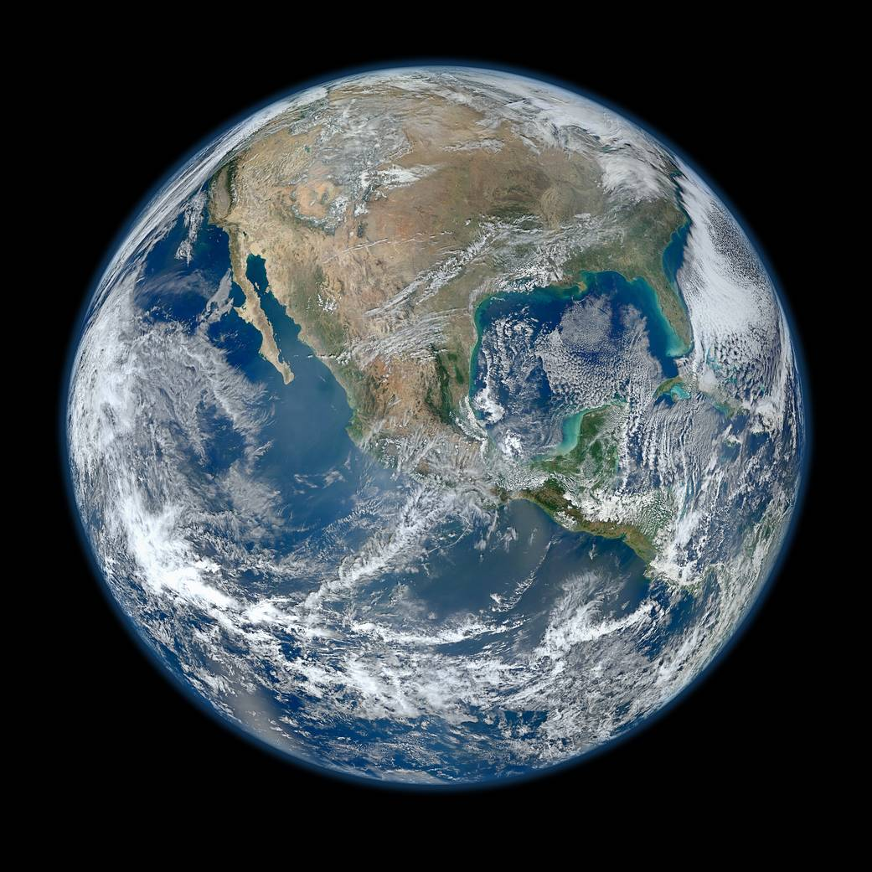
The bigger picture: Earth's clouds from space
Cloud bands like these shift with ENSO, and with them the odds of drought and flood across much of the planet.
ENSO is the largest source of year-to-year climate variability on Earth.
The signals you'll analyse are the same ones national weather services watch for seasonal forecasts.
This term you'll find one of those signals in real data and explain it: a small, genuine piece of climate science.
Image: NASA/NOAA/GSFC/Suomi NPP/VIIRS, Norman Kuring (‘Blue Marble’ composite, 4 Jan 2012).

Slide 4
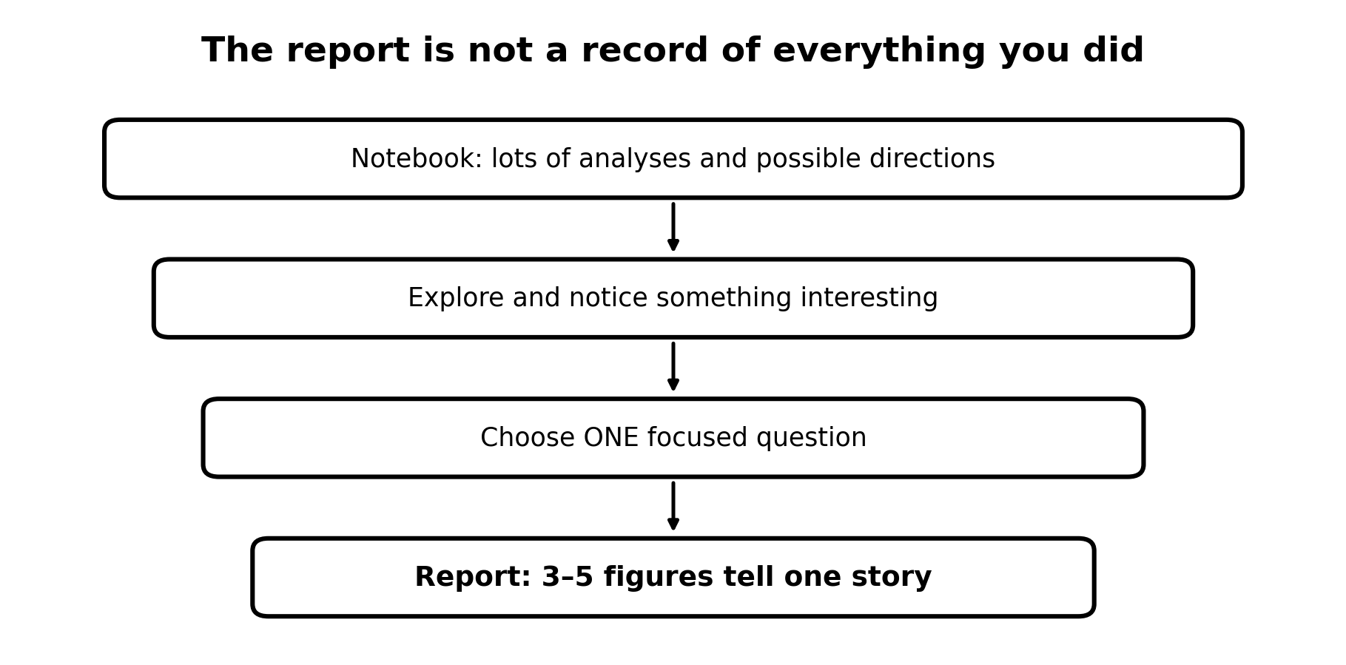
A mini research project, not a checklist
The notebook contains more analyses than you can use. That's deliberate: it's a toolbox.
Explore first. Then choose one aspect of ENSO and clouds that interests you.
Answer one focused question with about 3–5 figures, in a report of at most 2,000 words.
You are not expected to write the Python from scratch, or to understand every line.
Report: 100% of the course mark. AI category: AI Minimal (more next week).

Slide 5
The year at a glance
DATE
TUTORIAL
YOU PRODUCE
Thu 1 Oct
Launch: ERA5, ENSO, notebook running
Two patterns
Thu 8 Oct
Readers and the report · ERA5 cloud, weighting, anomalies · finding sources
150 words; reference manager
Thu 15 Oct
The Introduction · thresholds and composites
Purpose statement
Thu 29 Oct
Commit to ONE question · correlation, choosing a region
Storyboard; Methods draft
Thu 12 Nov
Figures as evidence · significance: r, n, p
Results draft
Thu 19 Nov
Paragraphs that argue · reporting statistics
Introduction draft
Thu 26 Nov
Discussion and Conclusion · lags and mechanisms
Discussion draft
Thu 3 Dec
Draft complete: from writer to editor
Complete first draft
Then: draft submitted Fri 5 Feb (formative; no DASS extensions) → peer feedback (w/c 8 or 15 Feb) → group presentation (w/c 1 Mar) → final report Fri 12 Mar, 12:00.

Slide 6
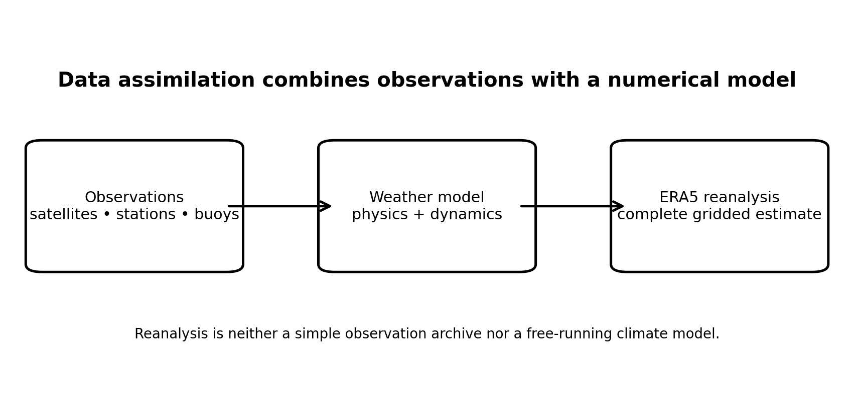
METHODS
Ingredient 1: ERA5 reanalysis
Observations are incomplete in space and time.
A weather model represents the physics and dynamics of the atmosphere.
Data assimilation blends the two into a complete, gridded, physically consistent record: a reanalysis.
Ours: ERA5 monthly means, 0.75° grid, January 2005 – August 2025, including total, low, medium and high cloud cover.
Reanalysis is neither a plain archive of observations nor a free-running climate model. (Next week: what that means for cloud.)
Data: ERA5, ECMWF / Copernicus Climate Change Service (Hersbach et al. 2020). Schematic: course team.
Notes:
EXPLANATION
Weather observations are patchy: dense over Europe, sparse over the oceans, and missing at most heights. A weather model fills the gaps using physics, but drifts away from reality on its own. Data assimilation combines the two: start from a model forecast, nudge it towards all available observations (by an amount that depends on how much each is trusted), then forecast again, every 12 hours. Done for every day since 1940 with one fixed model version, this gives ERA5: a complete, consistent 3-D record of the atmosphere. Its strength is consistency; its weakness is that quantities the model has to calculate itself, such as cloud, are only as good as the model.

Slide 7
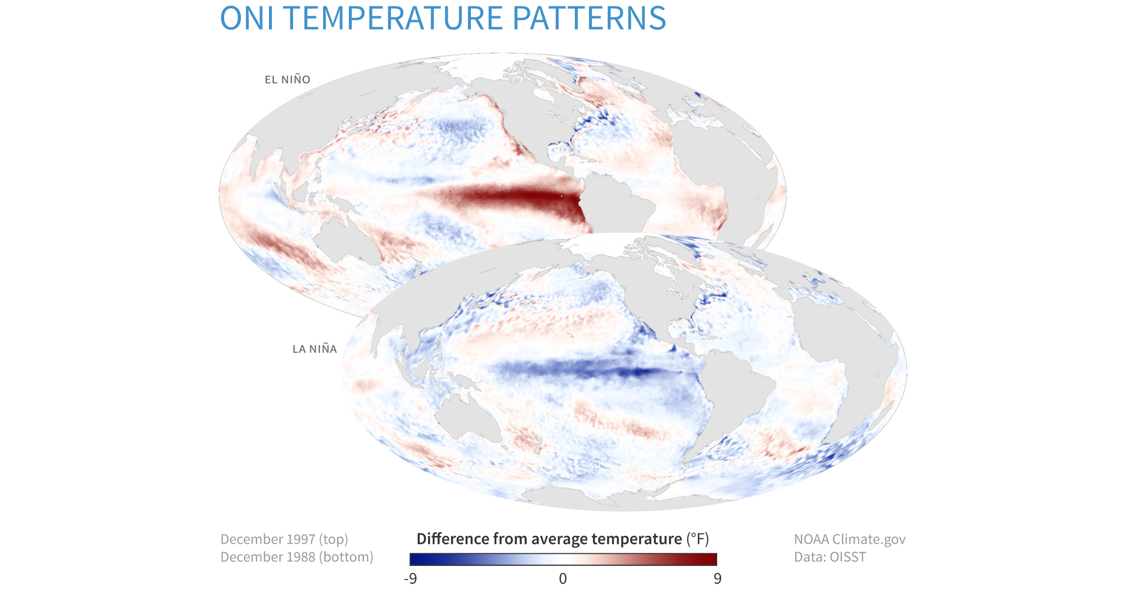
METHODS
Ingredient 2: ENSO
El Niño: an anomalously warm central and eastern tropical Pacific. La Niña: anomalously cool.
The ocean pattern drags winds, convection and rainfall with it, so cloud is a natural response to study.
We measure ENSO with the ONI: the 3-month running-mean SST anomaly in the Niño 3.4 region.
In our period: El Niño in 2009–10, 2015–16 (very strong) and 2023–24; La Niña in 2010–12 and 2020–23.
Maps: NOAA Climate.gov, based on NOAA OISST data (El Niño Dec 1997, top; La Niña Dec 1988, bottom).
Notes:
EXPLANATION
ENSO is a see-saw in the tropical Pacific. Normally the trade winds push warm surface water west, so the warmest water and the deepest convection sit over Indonesia, and cold water rises off South America. In El Niño the trade winds weaken, warm water spreads east, and convection follows it. La Niña is an exaggerated version of normal conditions. The ONI is the sea-surface temperature anomaly in a box in the central Pacific (Niño 3.4), smoothed over three months: above +0.5 °C counts as El Niño conditions, below −0.5 °C as La Niña.

Slide 8
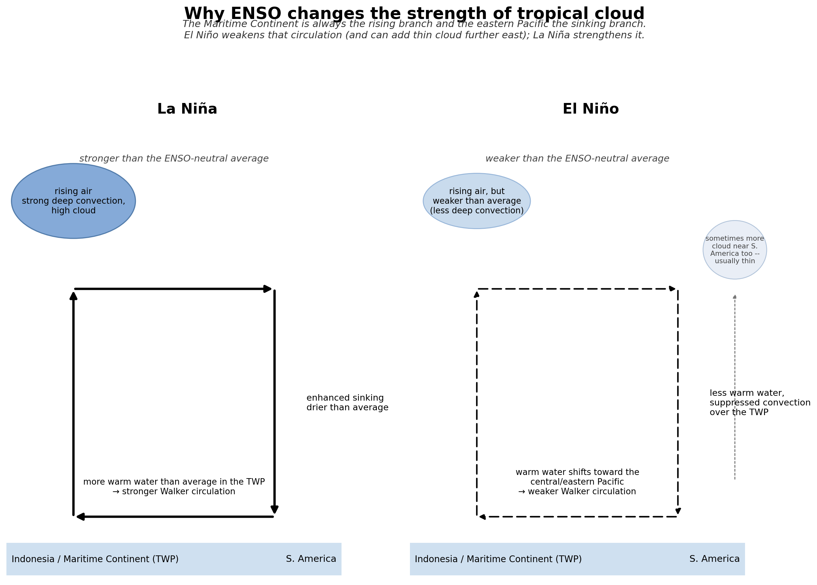
METHODS
Why should the clouds change?
Warm sea surface and the atmospheric circulation are coupled.
The Maritime Continent stays the Walker cell's rising branch: El Niño weakens the circulation and La Niña strengthens it.
During El Niño, convection and high cloud shift towards the central Pacific, and are suppressed over the Maritime Continent.
Any extra cloud further east near South America is usually thin, not a new deep-convection centre.
Low cloud can respond through different physics (stability, subsidence). Keep an open mind.
Schematic: course team (corrected Walker-circulation version).
Notes:
EXPLANATION
Clouds form where air rises and cools. The Walker circulation is a loop: air rises over the warm western Pacific (deep convection, tall clouds), flows east high up, sinks over the cool eastern Pacific (dry above a low cloud deck), and returns west as the trade winds. In El Niño the eastern Pacific warms, the loop weakens, and deep convection spreads towards the central Pacific: more high cloud there, less over Indonesia. The rising branch doesn't swap sides; it weakens and shifts. You'll need this mechanism in your Discussion.

Slide 9
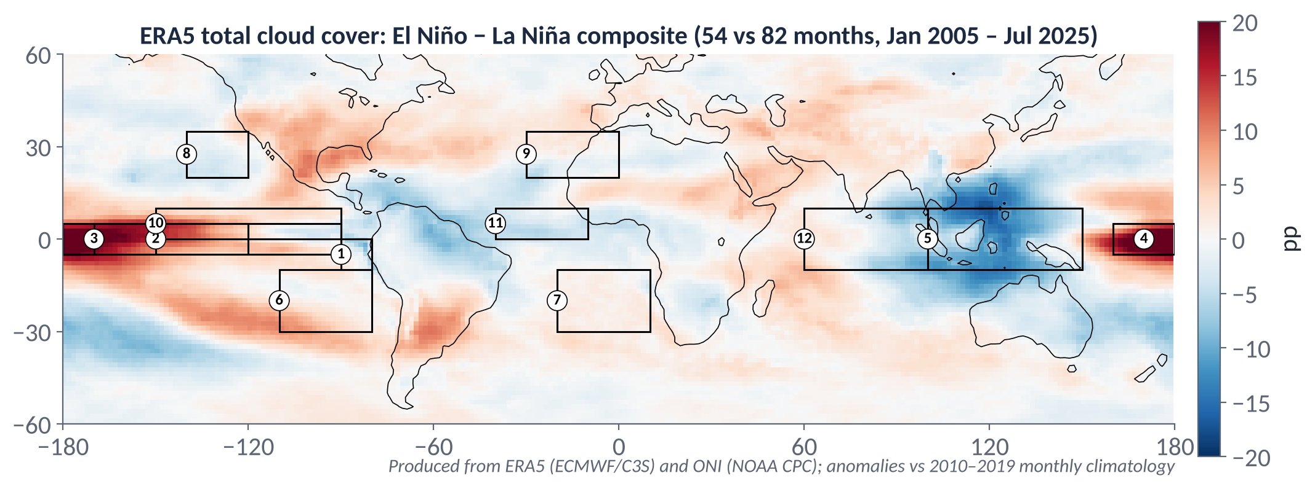
By December you'll be able to explain this map
Total cloud in El Niño months minus La Niña months, from the same ERA5 data you'll use. Red = cloudier during El Niño; blue = cloudier during La Niña.
The numbered boxes are the notebook's regions. Your report will explain one part of a map like this, in depth.
Notes:
EXPLANATION
This is the El Niño minus La Niña difference in total cloud cover, made from the same ERA5 data you'll use. For now, just notice where it's strongly red (cloudier during El Niño) and strongly blue (cloudier during La Niña), and which part catches your interest. In Tutorial 3 we build this map step by step; by December you'll explain one part of a map like this properly, with numbers.

Slide 10
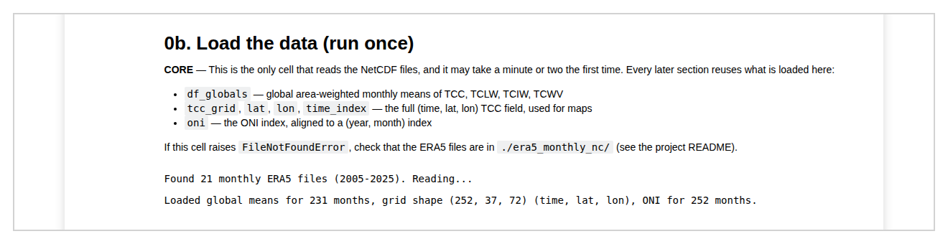
A tour of the notebook
0 · 0b
Setup and load the data (run once)
CORE
1
The global seasonal cycle
CORE
2
Global ENSO maps: composite and correlation
CORE
3 (+3b)
Global-mean anomalies (+ year-to-year tests)
CORE (3b optional)
What ‘0b. Load the data’ looks like when it works
4
Regional analysis: 12 numbered regions
EXPLORE
THREE RULES
5
ONI vs regional anomaly: correlation and regression
EXPLORE
Run from the top, in order: later cells reuse data loaded in 0b.
Binder sessions are temporary: download figures/, results/ and your notebook.
To study another variable, change one line: VARIABLE = "lcc", "hcc", …
6
Autocorrelation and lag
OPTIONAL
STOP
Choose your investigation (before more analysis)

Slide 11
How your report will be marked
40–49%
Question present but vague; figures not well chosen; reads like a notebook summary rather than an argument.
Pass
50–59%
One reasonably specific question, answered with thin reasoning; figures mostly relevant; attribution present.
2:2
60–69%
A focused question, directly answered; 3–5 well-designed figures; quantified, physically interpreted evidence.
2:1
70–79%
Well-chosen question; real physical insight; Claim → Evidence → Interpretation → Qualification throughout; independent thinking in the Discussion.
First
80%+
All of the above plus something beyond what was taught: an original angle or a careful treatment of a subtlety. Rare.
Exceptional
Full descriptors are in the handbook (§9). The same scheme applies all year, so you know from day one what ‘good’ looks like.

Slide 12
IN-CLASS ACTIVITY · 18 MIN
Get something working
1
Open the project through the Binder link on Canvas (the first launch can take a few minutes).
YOU LEAVE WITH
The notebook running (or a clear note of what went wrong)
Two patterns written down
2
Run the notebook from the top, through 0b. Load the data, then section 1, and section 2 if time allows.
3
Look at the first cloud figures. Where is cloud cover high or low? What changes through the year?
4
Write down two patterns or regions that catch your eye, with where, what and when.
PAIR CHECK
Compare your two patterns with a neighbour. Did you notice the same things?
If your Binder fails, pair with someone whose works and run it together.
5
Before you leave: download your figures and notebook. Binder forgets everything.

Slide 13
Before Tutorial 2 · Thu 8 Oct
About 1½ hours. Next week the writing starts, using what you notice now.
1A · 45 min
1B · 15 min
1C · 30 min
Finish running the notebook
Two patterns, written properly
Read the handbook
Sections 0–3 at least
Save figures outside Binder
Note anything that errors
For each: where, what (which cloud variable), when (season / ENSO phase)
One sentence on why it might happen
§1–3: the project, ERA5, ENSO and clouds
Skim §9 (marking)
Download the writing workbook from Canvas
NOTEBOOK STRAND
READ · SCHULTZ (2009) ELOQUENT SCIENCE
Sections 0–3. Analysis slides: 01 Project launch (and 02 if you're keen).
Optional: the Introduction (‘An incoherent truth’) and ‘How to use this book’: a quick taste of the course writing text

Slide 14
Sources and attribution
ERA5: ECMWF / Copernicus Climate Change Service. Hersbach, H. et al. (2020) The ERA5 global reanalysis. Q. J. R. Meteorol. Soc., 146, 1999–2049.
ONI: NOAA Climate Prediction Center.
ENSO maps: NOAA Climate.gov, based on NOAA OISST data.
Blue Marble: NASA/NOAA/GSFC/Suomi NPP/VIIRS, Norman Kuring (4 Jan 2012).
Composite map: produced for this course from ERA5 and ONI (anomalies relative to the 2010–2019 monthly climatology).
Schematics: created by the course team for these tutorials.

