Slide 1
TUTORIAL 6 · THURSDAY 19 NOVEMBER
Paragraphs that argue
Turning a Results draft from description into evidence
YOU LEAVE WITH
A Results section where every paragraph makes a claim, backs it with numbers, and links to the next.
Tutorial 6 of 8 · Semester 1
EART29200 · ENSO and cloud cover mini-project · Writing strand

Slide 2
Today's plan
Goal: Turn your Results draft into paragraphs that argue, not describe.
1
Methods: reporting a correlation in full; asymmetry
BRING / HAVE READY
Task 5B Results draft (printed is best: you'll mark it up)
Highlighters or coloured pens
Your figures and captions
2
One paragraph, one job; the order of an argument
3
Flow: old information → new information
4
Numbers a sceptic would accept
Tutorial 6 of 8 · Semester 1

Slide 3
METHODS
Reporting a correlation in full
A correlation in a report needs: r, n (and n_eff), p or a 95% range, the period, and what was correlated with what.
Add the slope for the size of the effect, with units (pp per °C).
Two decimal places for r; ‘≈’ for n_eff.
‘Significant’ only if you tested it, and say against what.
Notebook §6 prints every number you need: r, n, n_eff, r_lo95, r_hi95, slope_per_ONI, p_adj.
TEMPLATE (ILLUSTRATIVE NUMBERS)
“Monthly high-cloud anomalies over [region] are negatively correlated with the ONI (r = −0.45, 95% range −0.63 to −0.22; n = 247 months, n_eff ≈ 60; p < 0.001; January 2005 – July 2025), a decrease of about 2.1 pp per °C of ONI.”
Every number earns its place: strength, uncertainty, sample, significance, period, size.
Notes:
EXPLANATION
Look at each piece of the template. r is the strength; the 95% range is the uncertainty in r; n and n_eff say how much data, and how much independent data; p is the significance; the period says when; the slope gives the size of the effect in physical units. Each number answers a question a sceptical reader would ask. The notebook's section 6 table prints all of them. Use two decimal places for r, and only say 'significant' if you've done the test.

Slide 4
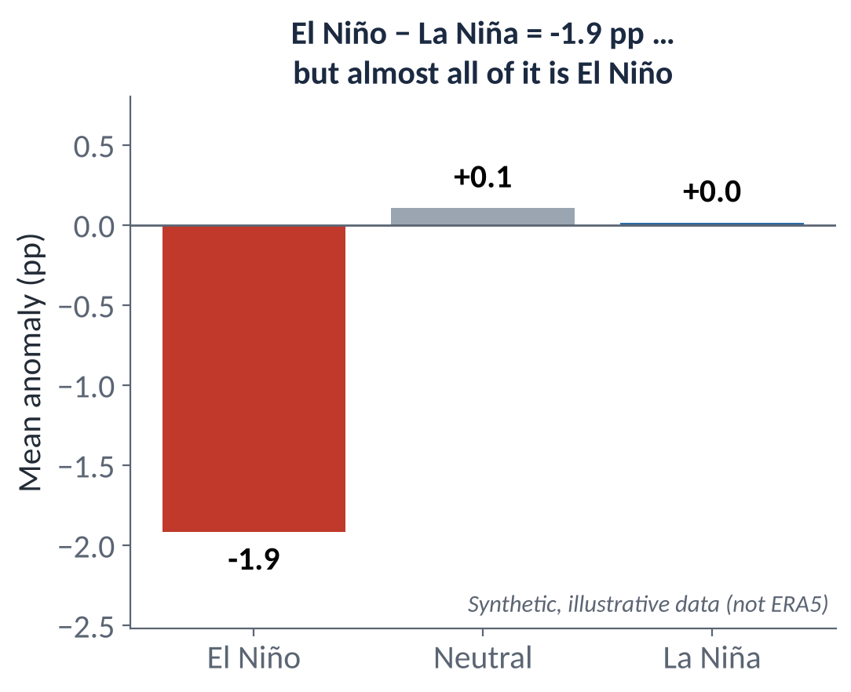
METHODS
El Niño and La Niña are not mirror images
The atmosphere often responds more strongly, or in a different place, to one phase than the other.
Both the El Niño − La Niña difference and r hide this.
Compare each phase against neutral. The notebook prints mean anomalies for El Niño, Neutral and La Niña months (sections 3 and 4).
A one-sided response is a strong Results sentence and a great Discussion point.
IN YOUR RESULTS, THIS BECOMES
“The composite difference (−1.9 pp) comes almost entirely from El Niño months; La Niña months are close to neutral.”
Notes:
EXPLANATION
A single El Niño minus La Niña number assumes both phases push equally in opposite directions. Often they don't: the atmosphere may respond strongly to El Niño and hardly at all to La Niña, or the response may sit in a different place. In this made-up example the difference is −1.9 percentage points, but all of it comes from El Niño; La Niña months look the same as neutral ones. The fix is simple: compare each phase with neutral months. The notebook prints mean anomalies for El Niño, neutral and La Niña months in sections 3 and 4. A one-sided response is a strong result and well worth discussing.

Slide 5
One paragraph, one job
Schultz: paragraphs are the ‘fundamental organisational unit’ of a paper. Each has unity (one theme) and coherence (sentences in a logical order).
The topic sentence announces the job, usually first.
Two themes in one paragraph? Split it, widen the topic sentence, or delete one theme.
Aim for 4–8 sentences; avoid one-sentence paragraphs.
Speed-readers read first sentences (proposal tutorials). If your point is in sentence 5, many readers miss it.
ANATOMY OF A RESULTS PARAGRAPH
Topic sentence: the claim
Evidence: numbers, figure cited
Evidence / comparison
Qualification: where it doesn't hold
Link onward (optional)
~110–140 words
Source: Schultz, D. M. (2009) Eloquent Science, American Meteorological Society, ch. 8, §8.1 and §8.4.

Slide 6
The order of an argument
DATA
RESULTS
INTERPRETATION
INFERENCE
SPECULATION
RESULTS SECTION
DISCUSSION SECTION
SCHULTZ'S WARNING
SO WHICH COMES FIRST?
He gives a paragraph that opens with ‘We speculate that…’ and only then shows the data.
Readers become sceptical: they've been asked to believe before seeing the evidence.
Rewritten in the order data → results → interpretation → inference → speculation, the same sentences persuade.
Flag speculation honestly: “We speculate that…”, “One possible explanation is…”.
Assert the finding first (topic sentence), then show the evidence: that's assert–justify, and it fits this chain.
Never lead with speculation.
It maps onto the handbook's pattern: Claim → Evidence → Interpretation → Qualification.
In a short report, a light interpretation can follow a result; deeper mechanisms go in the Discussion.
Source: Schultz, D. M. (2009) Eloquent Science, American Meteorological Society, §7.3 ‘Structuring logical arguments’.
Notes:
EXPLANATION
Schultz's chain runs data, results, interpretation, inference, speculation. Readers accept speculation only after they've seen the evidence, so speculation always comes last, flagged as speculation. This doesn't contradict 'assert first': the topic sentence of a Results paragraph states a finding, which is a result, not a speculation. So: finding first, evidence second, interpretation third, and 'we speculate that…' last, ideally in the Discussion.

Slide 7
From a list of numbers to an argument
A LIST
AN ARGUMENT
“The correlation between high-cloud anomaly and ONI over CP is 0.8. The El Niño composite is +14. The La Niña composite is −12. Over MC the correlation is −0.6. High cloud decreases in El Niño over MC. Some years do not follow this.”
“High cloud responds to ENSO in opposite senses on either side of the Pacific warm pool (Figs 2–3). Over CP, high-cloud anomalies are positively correlated with the ONI (r = 0.8, n = 247 months); consistently, El Niño months average 14 percentage points above normal, whereas La Niña months average 12 points below. In contrast, high cloud over MC is negatively correlated with the ONI (r = −0.6). The MC relationship is weaker, however: [n] of [N] El Niño events show little response there.” (illustrative)
WHAT CHANGED
A topic sentence states the claim; transitions (consistently, whereas, in contrast, however) show how each fact relates to the last.
Numbers gain units and sample size: ‘percentage points’ and ‘n = 247 months’, not a bare ‘+14’.
The exception becomes a qualification with a count, not a vague ‘some years’.
Modelled on Schultz (2009) §8.2.3, mammatus-lobe example (adding transitional devices to a list-like paragraph).

Slide 8
Flow: old information first, new information last
Gopen & Swan (via Schultz): the start of a sentence (topic position) holds information the reader already has; the end (stress position) holds what's new and important. The stress of one sentence becomes the topic of the next.
topic
sentence 1
stress
topic
sentence 2
stress
topic
sentence 3
stress
CHOPPY
LINKED
“ONI is a three-month running mean of SST anomalies in the Niño 3.4 region. Composites were constructed using a ±0.5 °C threshold. Cloud anomalies were averaged for these months.”
“ENSO is represented by the Oceanic Niño Index (ONI), a three-month running mean of SST anomaly in the Niño 3.4 region. Months with ONI above +0.5 °C are classed as El Niño, and months below −0.5 °C as La Niña. Cloud anomalies are then averaged over each set of months to form the El Niño and La Niña composites.”
Source: Schultz, D. M. (2009) Eloquent Science, American Meteorological Society, §8.1 ‘Coherence within paragraphs’ (after Gopen & Swan 1990).
Notes:
EXPLANATION
Readers expect the start of a sentence to connect to what they already know and the end to deliver something new. If the end of one sentence becomes the start of the next, the paragraph reads as a chain. In the choppy version, the reader has to work out how three separate facts connect (and which months 'these months' are). In the linked version, each sentence hands on to the next: Niño 3.4 region → months → La Niña → cloud anomalies.

Slide 9
Numbers a sceptic would accept: spot the problem
SENTENCE A
SENTENCE B
“Cloud cover increased by 10% during El Niño.”
“The correlation was r = 0.4837261.”
Percent or percentage points? Relative to what? Where, and in which months?
False precision. Give 2 d.p. Add the period, n and what was correlated with what.
SENTENCE C
SENTENCE D
“El Niño significantly reduces cloud over the Maritime Continent.”
“Figure 4 clearly shows a strong relationship.”
Was a test done? If not, drop ‘significantly’. ‘Reduces’ is causal: say ‘is associated with lower…’ unless you argue the mechanism.
Describe the science, not the figure. ‘Clearly’ and ‘strong’ are unquantified: give r, the slope, or the size of the difference.
Builds on handbook §8 ‘Reporting numbers well’; Schultz (2009) §10.3.2 Numbers and units.

Slide 10
IN-CLASS ACTIVITY · 16 MIN
Paragraph surgery on your own Results
1
Highlight the first sentence of each Results paragraph. Read only those, in order. Do they answer your question?
YOU LEAVE WITH
A marked-up Results draft and a list of fixes (Task 6A)
A ‘Discussion parking lot’: the start of Tutorial 7
2
Label every sentence C / E / I / Q (claim, evidence, interpretation, qualification). Move deep interpretation to a ‘Discussion parking lot’.
3
Circle every number. Does each have units, a baseline, a period or n? Fix percent vs percentage points.
4
Find the weakest link between two sentences and repair it (repetition, transition or reordering).
PAIR CHECK
Can you say the paragraph's claim in one breath after reading it?
Is there any sentence that just describes the plot?
Is the exception counted?
5
Swap one paragraph with your partner, who marks where they got lost.

Slide 11
Before Tutorial 7 · Thu 26 Nov
One week. About 2½ hours. You'll then have Introduction, Methods and Results in draft.
6A · 45 min
6B · 60 min
6C · 30 min
Revise Results
Introduction, full draft ~350 words
Discussion brainstorm
Apply today's surgery to every paragraph
Topic sentences = findings, in order
Within ~650 words
Rewrite 3A now that you know your results
Context → however → purpose (+ hypothesis)
Fold in your 3B synthesis paragraph
List 3 possible physical explanations for your main result
List 2 limitations that genuinely matter
Play devil's advocate: what would a critic say?
NOTEBOOK STRAND
READ · SCHULTZ (2009) ELOQUENT SCIENCE
Only what your Results need: fill any [ ] numbers; optional sensitivity check.
No new directions now. Your question is fixed.
Ch. 8 Constructing effective paragraphs
§7.3 Structuring logical arguments
§9.1 Active vs passive voice

