Slide 1
TUTORIAL 2 · THURSDAY 8 OCTOBER
Who reads your report, and how?
Starting to write in week 2, not week 10
YOU LEAVE WITH
A plan to 5 February, the four things your marker must believe, and your first 150 words.
Tutorial 2 of 8 · Semester 1
EART29200 · ENSO and cloud cover mini-project · Writing strand

Slide 2
Today's plan
Goal: Know what your report has to do for its reader, and start writing about your project this week.
1
The road to 5 February: what you write each week
BRING / HAVE READY
Your notebook open (Binder or downloaded copy)
The two patterns you noted in Tutorial 1
This term's writing workbook (Canvas)
Pen and paper: today you write by hand
2
Methods: ERA5 cloud, area weighting, anomalies
3
How scientists read, and what your marker must believe
4
Explain an anomaly to a friend: your first 150 words
5
Finding sources and setting up a reference manager
Tutorial 2 of 8 · Semester 1

Slide 3
The road to 5 February
SEMESTER 1 · THESE TUTORIALS
SEMESTER 2
8 Oct – 26 Nov
Dec – Jan
w/c 8 or 15 Feb
Fri 12 Mar, 12:00
Write a piece every week
Rest, then edit (3 passes)
Swap drafts: peer feedback
Final report submitted
3 Dec
Fri 5 Feb
w/c 1 Mar
7 Apr
Complete first draft
Draft submitted (formative)
Group presentation
Marks and feedback
Every tutorial from today produces one piece of your report; the pieces add up to a full draft on 3 December.
January is then for editing, not first drafting, and it is also exam season. The draft on 5 Feb carries no marks and has no DASS extensions; it exists so you get feedback.
Report: max 2,000 words, individual, 100% of the course mark. AI category: AI Minimal.

Slide 4
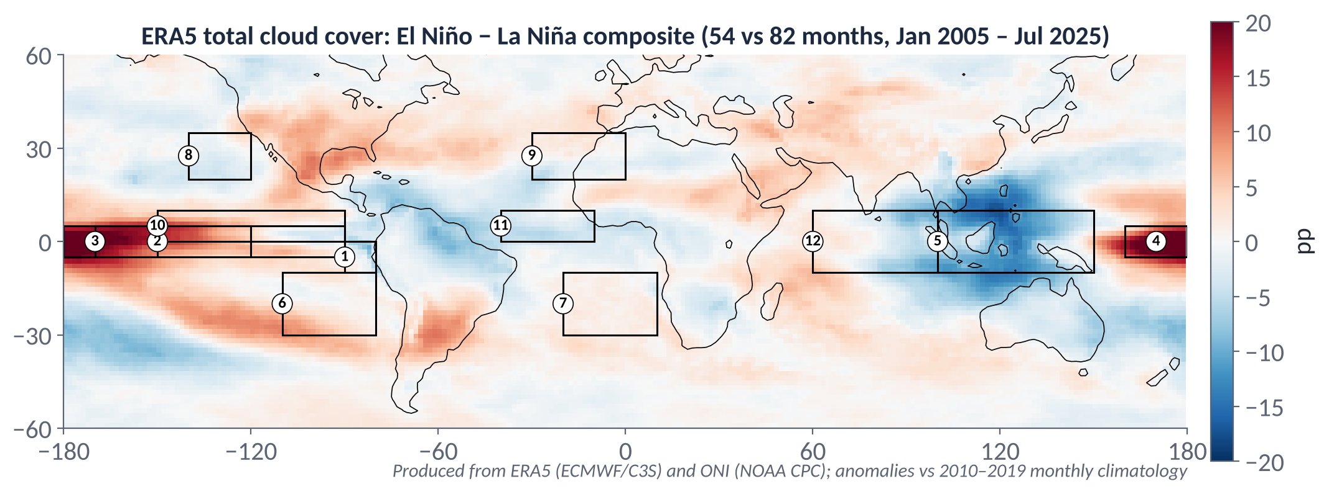
RIGHT NOW
Right now: a very strong El Niño
AS OF LATE SEPTEMBER 2026
NOAA's Climate Prediction Center has an El Niño Advisory in place, and expects a very strong event through the northern autumn and winter 2026–27, possibly the strongest since 1950.
It reports enhanced convection and rain from the central to the eastern Pacific and suppressed convection over Indonesia: the same pattern our cloud maps show for past El Niños.
Forecasters at IRI (Columbia) report that all 22 forecast models expect it to strengthen further through the winter.
What past El Niños did to cloud (ERA5, 2005–2025): the shape to watch for this winter.
OPTIONAL: FOLLOW IT LIVE
Look up this week's Niño 3.4 value on NOAA CPC's ENSO page.
Write one sentence: what does it mean for cloud over the central Pacific and the Maritime Continent?
TWO CAVEATS
Our dataset ends in 2025: none of this event is in your analysis.
Forecasts change: treat this as context, not data.
Sources: NOAA CPC ENSO Diagnostic Discussion (10 Sep 2026); IRI ENSO Forecast (21 Sep 2026). Information as of late September 2026; forecasts are updated monthly.
Notes:
EXPLANATION
As of late September 2026, NOAA has an El Niño Advisory in place and expects a very strong event through the northern winter. NOAA reports more convection and rain from the central to the eastern Pacific, and less over Indonesia. That's the same shape as the cloud maps in our notebook for past El Niños. Two things to remember: our dataset ends in 2025, so this event isn't in your analysis; and forecasts are updated every month, so treat this as context, not evidence. In a Discussion you can mention it as a flagged expectation ("if this relationship holds, the 2026–27 El Niño would be expected to…"), not as a result.

Slide 5
METHODS
What is ERA5 ‘cloud cover’?
Reanalysis: a weather model continually corrected by observations, giving a complete gridded record. Ours: monthly means, January 2005 – August 2025.
Cloud is a model product. ERA5 cloud comes from the model's cloud scheme; observations constrain it only indirectly. Trust the sign of a change more than its exact size.
Four variables: total (TCC), low (LCC), medium (MCC) and high (HCC) cloud cover: the fraction of each grid box covered (0–1, plotted as %).
TCC ≠ LCC + MCC + HCC. Layers overlap, so seen from above the total is less than the sum.
Changes are in percentage points (pp): 40% → 44% is +4 pp (a 10% relative increase).
ONE GRID BOX, SIDE VIEW
HIGH 40%
MEDIUM 20%
LOW 30%
Covered when seen from above: TCC = 60%
Sum of the layers: 40 + 20 + 30 = 90%
IN YOUR METHODS, THIS BECOMES
“Monthly mean high-cloud cover (HCC) from the ERA5 reanalysis (Hersbach et al. 2020) was analysed for January 2005 – July 2025.”
Schematic. ERA5 combines layers using an overlap assumption.
Notes:
EXPLANATION
Cloud cover is the fraction of a grid box covered by cloud. In ERA5 it's calculated by the model's cloud scheme rather than measured: the model predicts humidity, temperature and vertical motion, then works out how much cloud there should be. Observations steer the model's weather, so they shape the cloud only indirectly. That's why you can trust the sign of a change more than its exact size. Low, medium and high cloud each describe how much of the box has cloud at that level. Seen from above, layers hide each other, so total cover is less than the sum; ERA5 combines the layers using an overlap assumption. Cloud cover is already a percentage, so a change from 40% to 44% is 4 percentage points, not 4%.

Slide 6
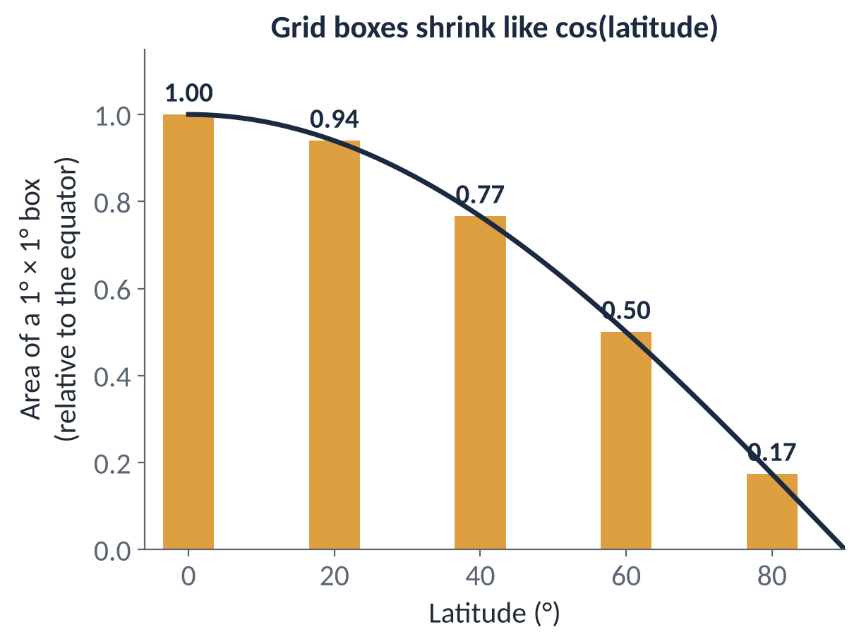
METHODS
Averaging over an area: cos(latitude) weighting
On a latitude–longitude grid every box spans the same degrees, but boxes near the poles cover far less area.
Area ∝ cos(latitude): a box at 60° is half the size of one at the equator.
Weighted mean: X̄ = Σ wᵢXᵢ / Σ wᵢ, with wᵢ = cos φᵢ. An unweighted mean over-counts high latitudes.
When it matters: hugely for a global mean (weights run from 1 to 0); little for a tropical box (5°S–5°N: 0.996–1.00). Say you did it anyway.
The notebook weights both global and regional means (area_weights).
IN YOUR METHODS, THIS BECOMES
“Regional and global means were area-weighted by the cosine of latitude.”
Notes:
EXPLANATION
Lines of longitude converge towards the poles, so a 1° × 1° box at 60° is half as wide as one at the equator, and so has half the area. If you simply average all the grid boxes, the many small high-latitude boxes count as much as the big tropical ones, and high latitudes get far too much influence. Weighting each box by cos(latitude) gives each one a say in proportion to its area. Quick check: for a box from 5°S to 5°N the weights are all between 0.996 and 1, so weighting barely matters; for a global mean it matters enormously.

Slide 7
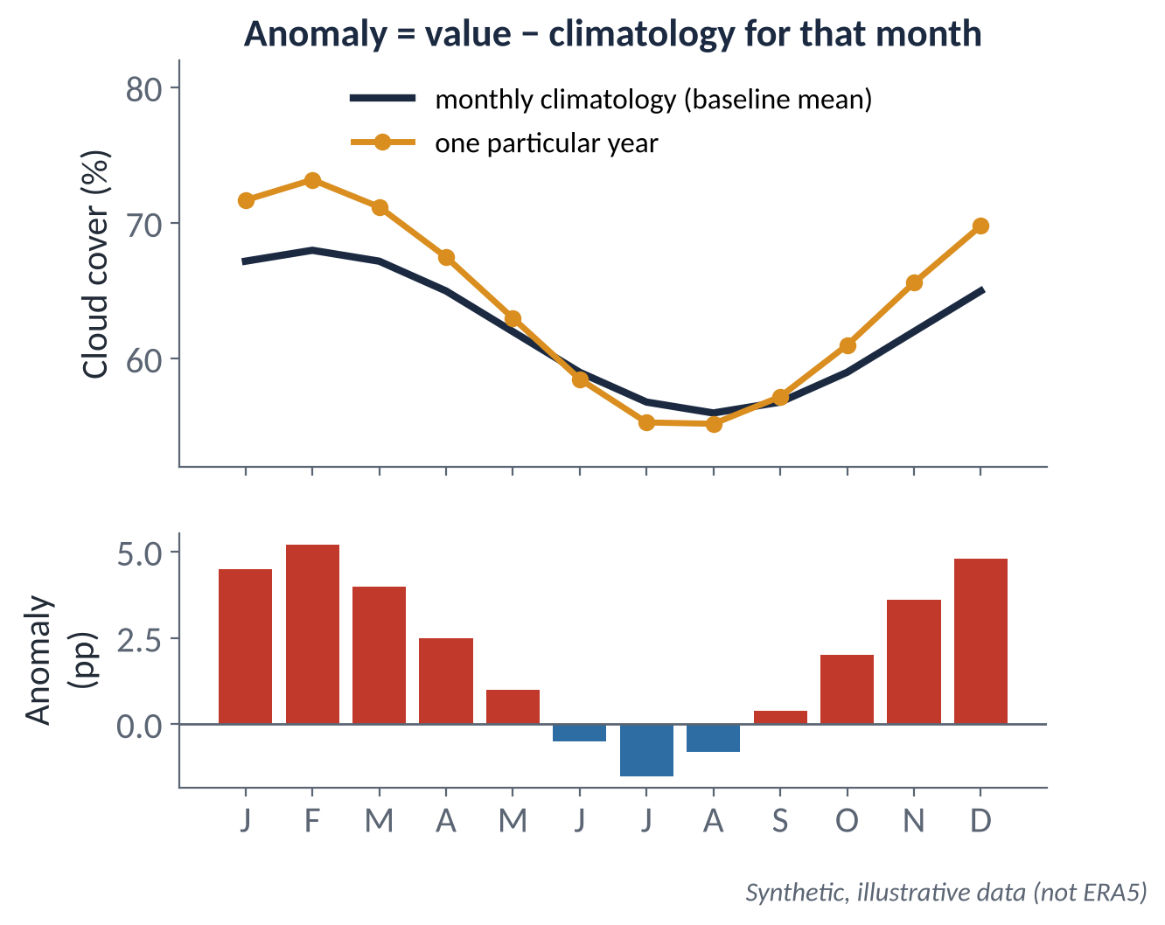
METHODS
Climatology and anomalies
Climatology: the average for each calendar month over a baseline period (notebook: 2010–2019, CLIM_START/CLIM_END).
Anomaly = value − climatology for that month. Positive = cloudier than usual for that place and month, not ‘very cloudy’.
Removing the seasonal cycle lets the year-to-year (ENSO) signal show through.
The baseline is a choice: change it and every anomaly shifts. Say which you used.
Averaging anomalies over a region gives the same answer as taking the anomaly of the regional mean. Both steps are linear.
IN YOUR METHODS, THIS BECOMES
“Anomalies were calculated relative to the 2010–2019 monthly climatology.”
Notes:
EXPLANATION
The seasonal cycle is much bigger than the ENSO signal: comparing a January with a July mostly shows you the season. So for each calendar month we take the average over a baseline period (here 2010–2019): that's the climatology. The anomaly is this January minus the average January. A positive anomaly means cloudier than usual for that place and time of year, not that it's cloudy. Changing the baseline shifts every anomaly for that month by a constant, which is why your Methods must say which baseline you used.

Slide 8
How scientists actually read
Almost nobody reads a paper front to back. Title → abstract/introduction → figures → conclusion, and only then (maybe) the rest. Schultz calls this nonlinear reading.
Your marker reads every word, but forms a view early from the title, first paragraph, figures and conclusion.
So put your best, clearest writing: where the reader looks first, and make each paragraph's first sentence carry its point.
Westinghouse managers: share who read each part of a report
Executive summary
100%
Introduction
60%
Conclusion
50%
Body of report
15%
Appendix
10%
Schultz (2009, §4.2): ‘Nine reports sat on their shelves largely unread for every one that was read in its entirety.’
Source: Schultz, D. M. (2009) Eloquent Science, American Meteorological Society, §4.2 ‘Nonlinear reading’.

Slide 9
Four things your marker must believe
Research funders judge proposals on four propositions (Research Funding Toolkit). A report is judged the same way: only the tense changes.
IMPORTANCE
SUCCESS
The question is worth asking.
The report actually answers it.
Introduction: why should anyone care what ENSO does to this cloud, here?
Results + Conclusion: a direct answer, backed by quantified evidence.
VALUE
COMPETENCE
Every figure and sentence earns its place.
The methods are sound and the limits honest.
2,000 words, 3–5 figures: anything that doesn't serve the question goes.
Methods + Discussion: could someone repeat it, and do you know where it could fail?
Adapted from the four propositions in Aldridge & Derrington, The Research Funding Toolkit (used in the EART29200 proposal tutorials).

Slide 10
AI Minimal: what it means in practice
Allowed: grammar, spelling, fluency and formatting support on text you have already written.
Not allowed: generating or choosing your question, structure, arguments, interpretation or conclusions; summarising papers for you; drafting or rewriting paragraphs.
Why it matters here: the marks are for your scientific thinking, and in this course the writing is the thinking we are teaching.
Protect yourself: keep dated versions (e.g. report_v04_2026-11-12.docx) and your writing log. Together they show how your work developed.
Unsure whether something is allowed? Ask your tutor before you do it, not after.
THE POLICY
Category: AI Minimal
“AI may be used only for limited presentation-related support, such as grammar, fluency, spelling, or formatting. Students' ideas, arguments, and conclusions must remain their own.”
EART29200 course unit description

Slide 11
IN-CLASS ACTIVITY · 13 MIN
Explain it to a friend
1
Imagine writing to a friend who studies something else (Schultz: write ‘a letter to a friend about your work in plain language’).
YOU LEAVE WITH
150 words in your workbook (Task 2A)
Raw material for your Methods (anomaly) and Introduction (why ENSO matters for cloud)
2
In 150 words, by hand, no notes, explain (a) what a cloud-cover anomaly is and (b) why ENSO might change cloud somewhere.
3
Stop at 7 minutes, even if unfinished. Count your words.
4
Swap with a neighbour. Underline the clearest sentence. Circle the first place you had to reread.
PAIR CHECK
5
Get yours back. Rewrite the circled sentence in the margin.
Did they use the word ‘anomaly’ correctly: unusual for that month, not just ‘high’?
Did the ENSO explanation name a mechanism (e.g. the Walker circulation), not just ‘ENSO affects weather’?
Source: Schultz, D. M. (2009) Eloquent Science, American Meteorological Society, §5.4 ‘Opening the floodgates’.

Slide 12
LITERATURE
Finding sources, and keeping track of them
Google Scholar: broad and fast (preprints, theses too) but noisy. Settings → Library links → University of Manchester, so full texts open through your login.
Web of Science (formerly ‘Web of Knowledge’): webofscience.com → sign in through the University (institutional login). Curated peer-reviewed journals, precise filters. Start from one good paper, go backward (references) and forward (‘Times cited’); filter for reviews.
Library Search: books and full text. Core journals: Journal of Climate, J. Atmos. Sci., Geophys. Res. Lett., Q. J. R. Meteorol. Soc.
Background vs evidence: NOAA Climate.gov is great background; scientific claims need peer-reviewed sources.
AI Minimal: don't use AI tools to find, choose or summarise papers for you.
SET UP A REFERENCE MANAGER THIS WEEK
Zotero (recommended) or EndNote
Zotero (free, zotero.org): the browser connector saves a paper in one click; the Word / Google Docs plugin inserts citations and builds the reference list.
EndNote: licensed by the University (free via the software download service); Harvard Manchester style; Library workshops.
Avoid starting on Mendeley Desktop: legacy, no further updates.
Pick one author–year style and keep it.
Notes:
EXPLANATION
Use two tools for two jobs. Google Scholar is the broad, quick search: it finds almost everything, including preprints and theses, and with library links set it opens full texts through your university login. Web of Science is the precise tool: only curated peer-reviewed journals, reliable citation counts, and filters such as 'review articles only'. The key skill is citation chasing. Find one good recent review; its reference list takes you back in time, and 'Times Cited' takes you forward to newer work. Set up a reference manager now, not in January. Under AI Minimal, don't use AI tools to find, choose or summarise papers for you.

Slide 13
Before Tutorial 3 · Thu 15 Oct
About 2½ hours in total. Everything goes in your writing workbook; bring it next week.
2A · 20 min
2B · 45 min
2C · 20 min
Explain it to a friend (final)
Reverse-outline a real paper
Set up: log + reference manager
Redraft today's piece to ≤200 words
Fix the circled sentence
Add one sentence on where you'd look for an ENSO cloud signal
Find one paper on ENSO and clouds (Google Scholar or library)
One line per Introduction paragraph: its job + its point
Where is the ‘however’? Where is the purpose?
Writing log: after every notebook session, what I ran / noticed / puzzled me
Install Zotero (or EndNote); save your 2B paper into it
Choose one author–year citation style
NOTEBOOK STRAND
READ · SCHULTZ (2009) ELOQUENT SCIENCE
Run notebook sections 1–3 (seasonal cycle, global ENSO maps, global-mean anomalies).
Each section opens with a short explanation: read it before you run the cells.
§4.1–4.2 (parts of a paper; nonlinear reading)
Ch. 7 Accessible scientific writing (≈ 6 pages)

Slide 14
LITERATURE
Searching Web of Science: a quick guide
SEARCH, REFINE, CHASE, SAVE
TRY THIS SEARCH
Sign in: webofscience.com → sign in through the University (institutional login).
Advanced Search, Core Collection. Fielded Search tab: one idea per Topic row, joined by AND, with no TS= tags. Query Builder tab: paste a tagged query straight into the Query Preview box (TS= topic, TI= title, AU= author, PY= year).
Phrases in quotes ("Walker circulation"); AND / OR / NOT; truncation with * (cloud* = cloud, clouds, cloudiness); NEAR/3 for words close together.
Refine: Document Types → Review Article; Web of Science Categories → Meteorology & Atmospheric Sciences; publication years.
Sort by Citations (highest first) to find the classics; by Date for the newest.
Chase: Cited References (backward), Times Cited (forward), Related Records (similar papers).
History: combine searches (#1 AND #2) without retyping.
Save: the Zotero Connector grabs one result or a whole page; or Export → RIS / EndNote.
TS=("El Nino" OR ENSO OR "Southern Oscillation")
AND TS=("cloud cover" OR "cloud fraction" OR "cloud amount")
AND TS=(reanalysis OR ERA5 OR satellite)
Query Builder tab: paste into the Query Preview box (not the term box above it). Or use three Topic rows in Fielded Search, minus TS=( ). Then refine to Review Article, sort by Citations, and swap in your own region or cloud type.
SCHOLAR OR WEB OF SCIENCE?
Scholar to explore broadly and find full texts fast.
Web of Science for a precise search of peer-reviewed journals, reliable citation counts and filters.
Notes:
EXPLANATION
Go to Advanced Search with Web of Science Core Collection selected. The easiest route is the Fielded Search tab: use three Topic rows joined by AND, one idea per row, with no TS= tags. To use the tagged query instead, open the Query Builder tab and paste it straight into the Query Preview box at the bottom (not the term box above it). Then refine to Review Article, sort by Citations (highest first), open a key paper, and use Cited References (backward) and Times Cited (forward) to follow the literature.

Slide 15
LITERATURE
Zotero in Word: set up once, then three rules
SET UP (15 MIN, ONCE)
THREE RULES
Install Zotero (desktop) and the Zotero Connector for your browser from zotero.org.
The Word plugin installs itself the first time Zotero runs; restart Word and a Zotero tab appears (Windows and Mac).
Zotero tab: Add/Edit Citation inserts a citation; Add/Edit Bibliography builds the reference list; Document Preferences sets the style.
Google Docs: use the Zotero menu that the Connector adds. LibreOffice has its own plugin.
Word for the web (OneDrive in a browser) is not supported: open the file in the desktop Word app to cite.
Optional: a free Zotero account syncs your library between computers (300 MB free storage).
1 Never hand-edit a citation or the reference list: Zotero overwrites it on the next refresh. Fix the entry in your Zotero library instead.
2 One style, chosen once in Document Preferences (an author–year style, e.g. a Harvard variant or the AMS journal style).
3 Share a PDF, not the live Word file, for the February peer swap, so citations show correctly for someone without Zotero.
Check every saved item: title, authors, year, journal and DOI. Connectors occasionally grab messy metadata.
Notes:
EXPLANATION
Zotero runs on your computer and saves papers from your browser with one click. Once it's installed, Word gets a Zotero tab: Add/Edit Citation opens a search box where you type an author or keyword to insert a citation, and Add/Edit Bibliography builds the reference list and keeps it up to date. Follow the three rules to avoid problems later: don't hand-edit citations (Zotero overwrites them), choose your citation style once, and share PDFs rather than live Word files. The plugin doesn't work in Word in a web browser, so use desktop Word.

