Slide 1
TUTORIAL 3 · THURSDAY 15 OCTOBER
Hook, problem, purpose: the Introduction
Turning a pattern on a map into a reason to read on
YOU LEAVE WITH
A draft purpose statement, a ‘however’ hook and a working title for a question you might investigate.
Tutorial 3 of 8 · Semester 1
EART29200 · ENSO and cloud cover mini-project · Writing strand

Slide 2
Today's plan
Goal: Draft the opening and the purpose statement for a question you might investigate.
1
Check-in: what did your reverse outline show?
BRING / HAVE READY
Task 2A (≤200 words) and Task 2B (reverse outline)
Your composite and correlation maps (notebook §2)
1–2 patterns that caught your eye
2
Methods: thresholds, ENSO's calendar, composites
3
Predict before you plot
4
The three moves of an Introduction; openings that work
5
The purpose statement; synthesising literature
Tutorial 3 of 8 · Semester 1

Slide 3
Check-in: what did the reverse outline show?
With a neighbour (3 min), compare your reverse outlines:
How many paragraphs before the problem appeared?
Was there a clear purpose sentence? Where?
Which sentence made you want to keep reading, and why?
Then (2 min): two or three pairs report back one thing they noticed.
WHAT YOU'LL PROBABLY FIND
Context first, kept short
A turn (‘however’, ‘but’, ‘yet’, ‘remains unclear’)
A purpose near the end of the Introduction
Very little about the results themselves

Slide 4
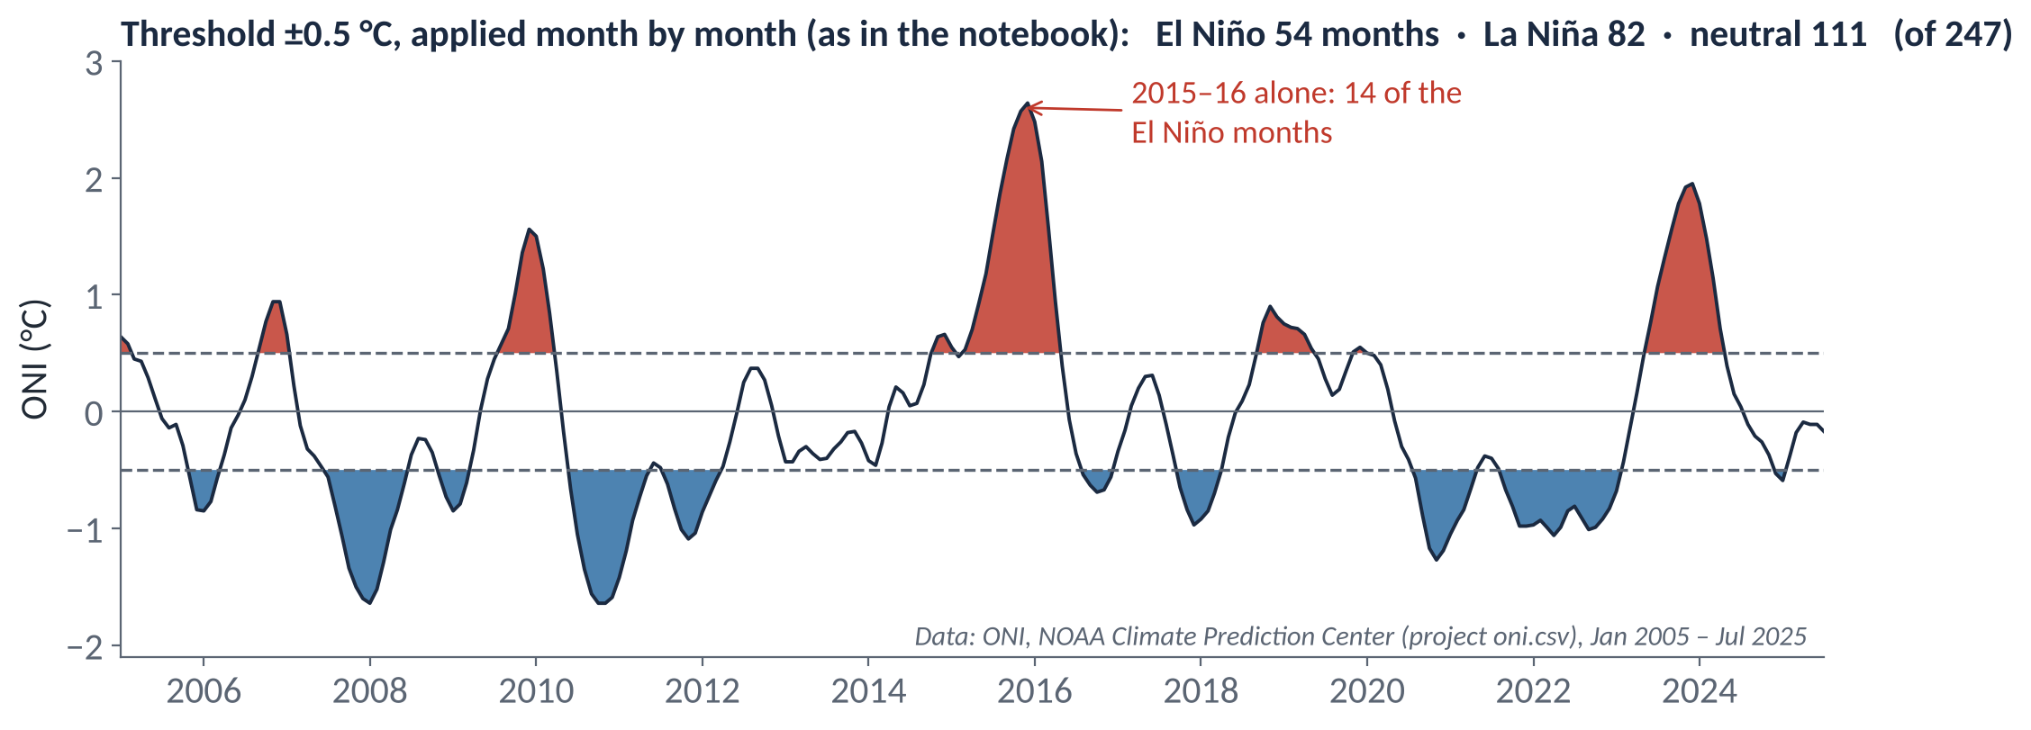
METHODS
Choosing El Niño and La Niña months: thresholds
ONI: 3-month running mean of sea-surface-temperature anomaly in the Niño 3.4 region (5°N–5°S, 170°W–120°W), NOAA CPC.
The notebook's rule: each month with ONI ≥ +0.5 °C is an El Niño month, ≤ −0.5 °C La Niña, otherwise neutral (ENSO_THRESH).
NOAA's official episodes are stricter: ±0.5 °C must hold for ≥ 5 consecutive overlapping seasons. Say which rule you used.
One event dominates: 2015–16 supplies 14 of the 54 El Niño months. Your El Niño composite is partly a 2015–16 composite.
IN YOUR METHODS, THIS BECOMES
“Months with ONI ≥ 0.5 °C (≤ −0.5 °C) were classed as El Niño (La Niña), giving 54 El Niño and 82 La Niña months.”
Notes:
EXPLANATION
The ONI is a continuous number, but a composite needs groups, so we draw lines at ±0.5 °C. The notebook labels each month on its own: above +0.5 °C is an El Niño month, below −0.5 °C a La Niña month, and everything else neutral. NOAA's official definition is stricter: the threshold must be crossed for five overlapping three-month seasons in a row. Either is defensible, but say which you used. On the plot, the red and blue areas are the months that go into each group. Note that the 54 El Niño months come from only about six events, and 14 of them belong to the very strong 2015–16 event, so the El Niño composite is partly a 2015–16 composite.

Slide 5
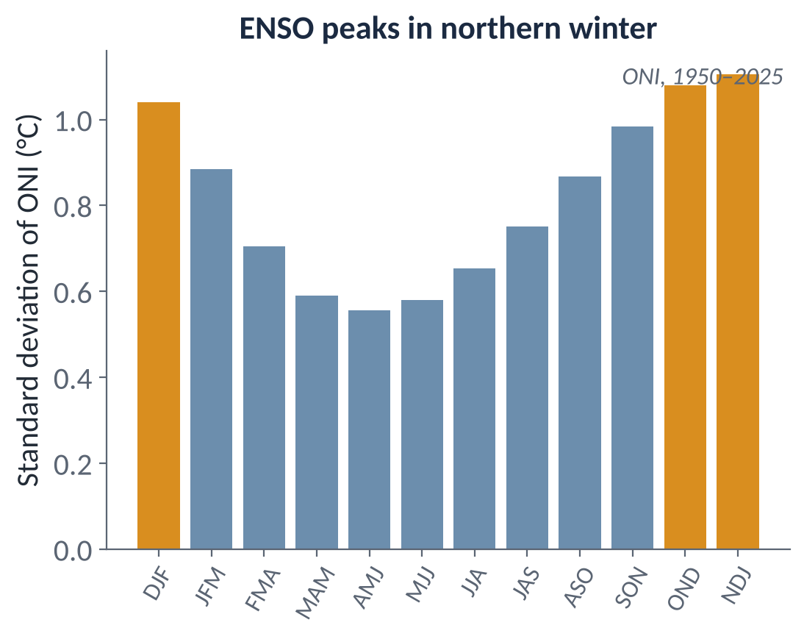
METHODS
ENSO keeps to a calendar
ENSO is phase-locked to the seasons: events grow through northern summer and autumn, peak around Nov–Jan, and decay by spring.
ONI varies about twice as much in Nov–Jan as in Apr–Jun (s.d. ≈ 1.1 vs 0.56 °C, 1950–2025).
So many El Niño months are winter months. Anomalies remove the seasonal cycle, but the response itself can depend on season.
A season-specific question (e.g. DJF only) can be a good one; notebook §6 compares DJF and JJA.
The 3-month running mean blurs timing by about ±1 month.
Notes:
EXPLANATION
ENSO events are tied to the seasons. They usually start growing in northern spring or summer, peak around November to January, and fade by the following spring. The bar chart shows how much the ONI varies in each three-month season: about twice as much in Nov–Jan as in Apr–Jun. So many El Niño months are winter months, and the cloud response may really be a winter response. A question restricted to one season (DJF, for example) can therefore be sharper. Because the ONI is a three-month average, any timing is blurred by about a month either way.

Slide 6
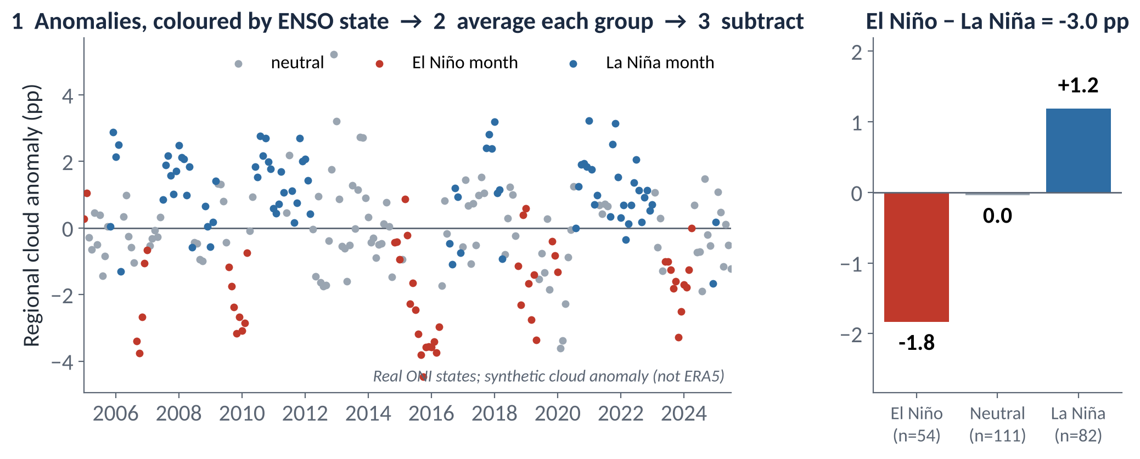
METHODS
What a composite is: El Niño − La Niña
A composite asks: on average, how different is the anomaly in El Niño months from La Niña months?
1 anomalies → 2 average each group → 3 subtract. Units stay those of the variable (pp).
Positive El Niño − La Niña = higher during El Niño. It's a difference between two states, not a correlation.
Always give the group sizes (54 and 82 months), and look at each phase against neutral too (Tutorial 6).
IN YOUR METHODS, THIS BECOMES
“The composite is the mean anomaly over El Niño months minus that over La Niña months.”
Notes:
EXPLANATION
Follow the three steps on the figure. Step 1: each dot is one month's cloud anomaly, coloured by ENSO state. Step 2: average the El Niño, neutral and La Niña months separately. Step 3: subtract the La Niña average from the El Niño average. That difference is the composite, in the same units as the variable (percentage points of cloud); positive means cloudier during El Niño. It compares two groups of months: it doesn't use the neutral months or how large the ONI was. The cloud series in this figure is made up, to show the method clearly.

Slide 7
IN-CLASS ACTIVITY · 3 MIN
Predict before you plot
1
Without looking at your maps, predict the sign (+, −, 0) of the El Niño − La Niña total cloud composite in: (a) region 4, Niño 4 (central Pacific); (b) region 5, Maritime Continent; (c) region 6, SE Pacific stratocumulus.
YOU LEAVE WITH
Three predictions with reasons
Any surprise is a candidate ‘however’ for your Introduction
2
Write a one-line physical reason for each (Walker circulation? SST? subsidence?).
3
Now look at the real map (next slide) or your §2 map. Where were you wrong?
PAIR CHECK
Compare predictions before the reveal. Did you use the same reasoning?
Notes:
EXPLANATION
Committing to a prediction before you look at the result is how science works: a prediction you could be wrong about is a real test. Write down your expected sign for each region and a one-line physical reason, then compare with the map. Any surprise is valuable: an unexpected result, explained carefully, makes a strong 'however' for your Introduction.

Slide 8
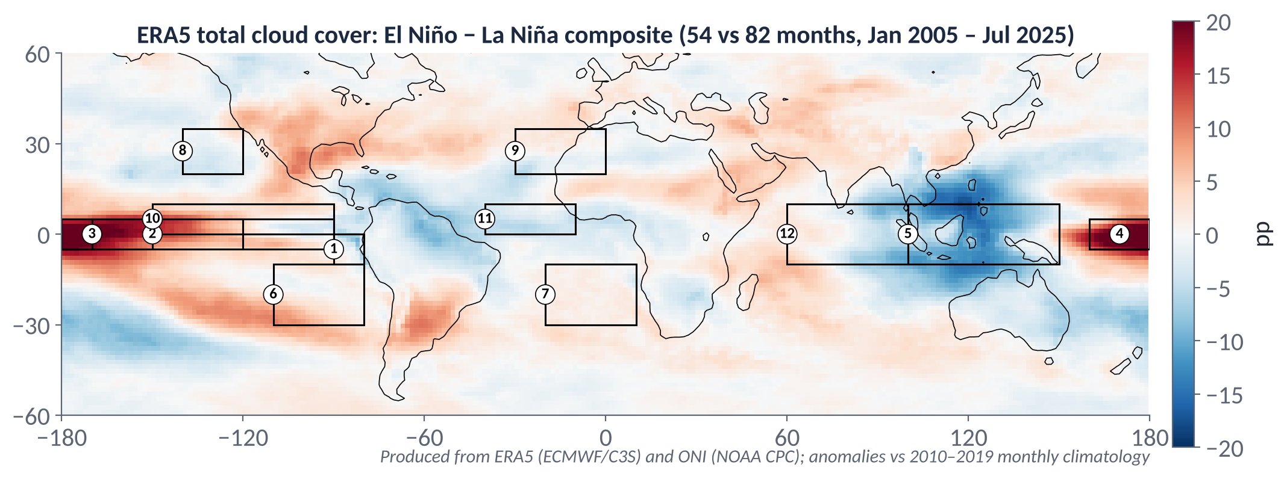
METHODS
The answer: El Niño − La Niña, real ERA5 total cloud
Strong positive over the central and eastern equatorial Pacific (regions 2–4); strong negative over the Maritime Continent (5). This is the Walker circulation weakening and convection shifting east.
Weaker, patchier signals elsewhere, including the subtropical stratocumulus boxes (6–9). Some surprise people; that's a question waiting to be asked.
Notes:
EXPLANATION
This is the map you'll produce in notebook section 2. The strong red tongue along the equator in the central and eastern Pacific means more cloud during El Niño; the strong blue patch over the Maritime Continent means less. Together they show the Walker circulation weakening and convection shifting east. Elsewhere the signals are weaker and patchier, and some of those weaker areas are where interesting questions can be found.

Slide 9
Every good Introduction makes three moves
IN AN ENSO–CLOUD REPORT, FOR EXAMPLE
1 CONTEXT
ENSO reorganises tropical convection through the Walker circulation, and cloud responds.
Common ground the reader already accepts
2 PROBLEM
However, cloud at different levels is controlled by different processes, so the response need not be the same everywhere.
The hook: a contrast, puzzle, gap or stake
3 RESPONSE
The purpose of this report is to compare … over … using ERA5 and the ONI.
What this report does, and its scope
Source: Schultz, D. M. (2009) Eloquent Science, American Meteorological Society, §4.6, Table 4.4 (after Booth et al. 2003): context → problem statement → response.

Slide 10
First sentences: avoid the ‘resounding banality’
Medawar's phrase (via Schultz) for an opening that is true, obvious, and does no work at all.
WEAK
STRONG
“ENSO is a very important phenomenon that affects weather all over the world. Clouds are also very important for the climate system.”
“ENSO is the largest source of year-to-year climate variability on Earth, and clouds record it: as the Walker circulation weakens during El Niño, convection over the Maritime Continent is suppressed while parts of the central Pacific become cloudier.”
WHAT CHANGED
Specific: names the mechanism (Walker circulation) and real places, instead of ‘very important’.
Points somewhere: the reader can already sense the question coming (where else does cloud change, and why?).
Schultz: avoid statements nearly everyone knows are true, unless you are about to contradict them.
Source: Schultz, D. M. (2009) Eloquent Science, American Meteorological Society, §4.6 (Medawar’s ‘resounding banality’; Williams’ orchestra tuning up).

Slide 11
The purpose statement: a little formula helps
Schultz recommends every Introduction contain a sentence like “The purpose of this paper is to …”
It forces you to compress your goal into one or two sentences. If you can't, the question isn't ready yet.
Put it in the last paragraph of the Introduction, after the hook.
State the scope: what the report will not cover. That stops a reader expecting more than 2,000 words can give.
A hypothesis is optional but strong: “We expect … because …”.
TEMPLATE
The purpose of this report is to…
verb: quantify / compare / test whether …
what: the ENSO-related change in [cloud variable]
where/when: over [region], in [season / all months], [period]
how: using ERA5 monthly anomalies and the ONI (composites / correlation)
optional: We hypothesise that … because …
Source: Schultz, D. M. (2009) Eloquent Science, American Meteorological Society, §4.6 (‘The purpose of this paper is to…’; scope); §6.1 ‘nutshelling’.

Slide 12
IN-CLASS ACTIVITY · 10 MIN
From a pattern to a purpose
1
Pick one or two patterns from your composite or correlation maps that you might investigate.
YOU LEAVE WITH
1–2 nutshells, a hook and a title in your workbook (p. for Tutorial 3)
A first sense of which question you'll commit to on 29 Oct
2
For each, write a nutshell: one sentence that starts “The purpose of this report is to…”.
3
Write a two-sentence hook: one sentence of common ground, then one starting “However, …”.
4
Write a working title that passes at least three of the five title tests.
PAIR CHECK
Could you guess which figures the report would need?
Is the scope small enough for 3–5 figures and 2,000 words?
Is there a real ‘however’, or just a topic?
5
Read only your purpose sentence to your partner. They tell you back what you will do. If they can't, rewrite it.

Slide 13
Using the literature: synthesis, not a grocery list
Schultz: describe the topic, not the papers. Organise sources around ideas, and show what is known versus what this report adds.
GROCERY LIST
SYNTHESIS
“Smith (2001) studied low clouds. Jones (2005) looked at ENSO. Lee (2012) found that SST affects clouds. Brown (2018) also studied this.”
“Subtropical low cloud is closely tied to the stability of the lower troposphere (Smith 2001; Lee 2012), so ENSO-driven changes in sea-surface temperature could alter it. Whether this happens in the same sense across the eastern Pacific is less clear (Jones 2005; Brown 2018), which motivates comparing two regions here.”
WHAT CHANGED
The idea is the subject of each sentence; the citations sit in brackets as evidence.
Sources are grouped by what they agree on, and the gap leads straight into your purpose.
(The names here are placeholders. Cite real sources, and always cite ERA5 and the ONI.)
Source: Schultz, D. M. (2009) Eloquent Science, American Meteorological Society, §4.7 ‘Literature synthesis’ (the ‘grocery list’); ch. 12 on citation.

Slide 14
Before Tutorial 4 · Thu 29 Oct
Two weeks, including reading week (no tutorial on 22 Oct). About 3½ hours of writing, plus notebook time.
3A · 45 min
3B · 75 min
3C · 30 min
Opening paragraph(s), ~250 words
Literature synthesis paragraph
Three candidate questions
For your leading candidate question
Context → ‘however’ → purpose statement
No banalities in sentence 1
Find 3 relevant sources (at least 2 peer-reviewed)
Write one ~150-word paragraph that synthesises them around one idea
Full references in one consistent style
Each: the question + “I find this interesting because…”
+ the figure that would answer it
Bring all three on 29 Oct
NOTEBOOK STRAND
READ · SCHULTZ (2009) ELOQUENT SCIENCE
Sections 4–5 (+ 6 if timing interests you); try other cloud levels (VARIABLE).
Optional: methods_demos.ipynb §1–2 (thresholds; composites).
§3.1–3.2 Titles
§4.6–4.7 Introduction; literature synthesis
§12.1–12.3 Why, how and what to cite

