Slide 1
TUTORIAL 7 · THURSDAY 26 NOVEMBER
What does it mean?
Discussion, honest limitations, and a Conclusion that lands
YOU LEAVE WITH
A Discussion plan built from three or four ‘moves’, and a Conclusion whose first sentence answers your question.
Tutorial 7 of 8 · Semester 1
EART29200 · ENSO and cloud cover mini-project · Writing strand

Slide 2
Today's plan
Goal: Leave with a Discussion plan and a Conclusion that answers your question.
1
Methods: lags, causation and mechanisms
BRING / HAVE READY
Revised Results (6A) and Introduction (6B)
Task 6C Discussion brainstorm
Your ‘Discussion parking lot’ from last week
2
Results vs Discussion; a menu of Discussion moves
3
Limitations that build trust
4
Conclusions that land, and the mirror test
Tutorial 7 of 8 · Semester 1

Slide 3
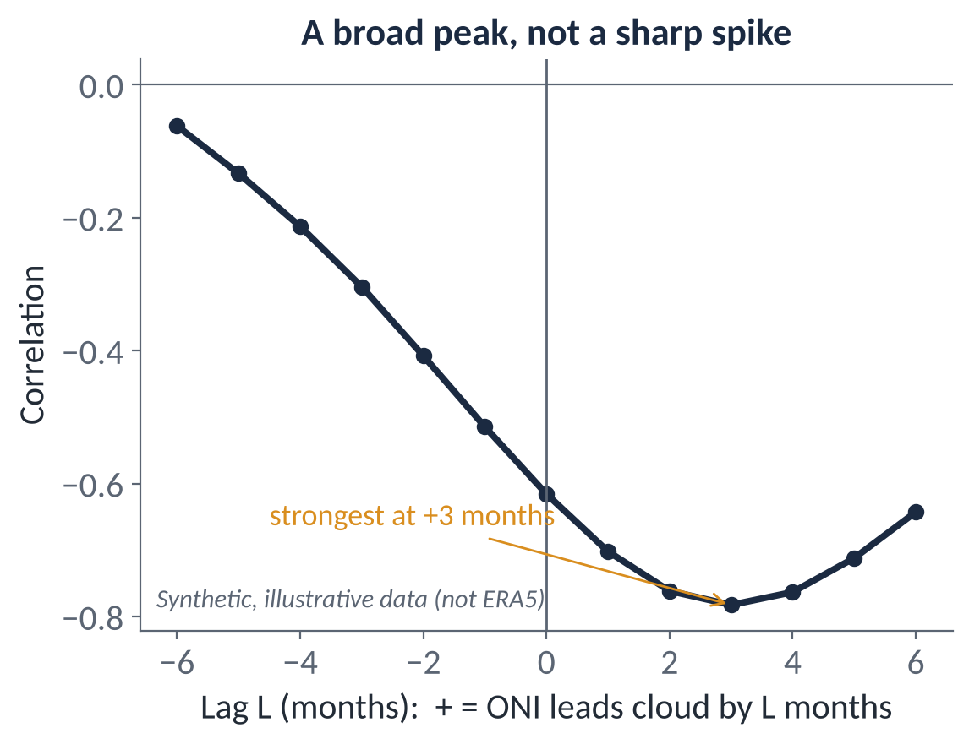
METHODS
Lags, timing and causation
Lag correlation: shift the ONI against cloud and recompute r. In notebook §6, lag +3 pairs the ONI from 3 months earlier with cloud now (ONI leads).
Peaks are broad because both series have long memory: neighbouring lags give similar r.
A peak at +3 months is consistent with a delayed response, but doesn't prove ENSO causes it, and the ONI is already a 3-month mean.
From correlation to cause you need a mechanism, a time order, and independent evidence (another variable).
Until then write ‘is associated with’ or ‘is consistent with’, not ‘causes’.
Notes:
EXPLANATION
Lag correlation shifts one series against the other and recalculates r; in the notebook a positive lag means the ONI leads. If cloud responds a few months after the sea warms, the correlation peaks at a positive lag. Be careful with two things. Peaks are broad because both series change slowly, so the exact peak month is uncertain. And a lag is consistent with cause and effect but doesn't prove it: to argue cause you need a mechanism, the right order in time, and independent support, such as the sea-temperature pattern under the cloud.

Slide 4
METHODS
From correlation to mechanism: cloud is a symptom
The notebook can load other ERA5 fields: change VARIABLE to skt (skin temperature ≈ SST over the ocean), tcwv (water vapour), tclw / tciw (cloud liquid / ice).
A consistent story across variables is strong evidence: warmer SST + more water vapour + more high cloud over the central Pacific during El Niño → convection shifted east.
Low cloud: warmer SST under a stratocumulus deck tends to weaken the inversion and thin the cloud, but stability isn't in this dataset, so say so.
ENSO events differ in where the warming is strongest (central vs eastern Pacific ‘flavours’). Composites blend them.
One figure from another variable can earn its place, if it tests the mechanism.
TRY IT (5 MIN IN THE NOTEBOOK)
Set VARIABLE = "skt" and rerun §2
Does the El Niño − La Niña SST pattern line up with your cloud signal?
In the real data, skin temperature over Niño 4 has r ≈ +0.9 with the ONI.
If your region's cloud signal has no SST signal under it, what else could drive it?
Notes:
EXPLANATION
Cloud is the end of a chain: sea temperature → rising or sinking air → moisture → cloud. A correlation between ONI and cloud is more convincing if the links in between behave consistently, and the notebook can load them: set VARIABLE to skt (skin temperature, effectively sea-surface temperature over the ocean) or tcwv (water vapour). For the central Pacific in El Niño, warmer sea, more water vapour and more high cloud tell one consistent story of convection moving east. For low cloud, the important link is the strength of the inversion that caps the cloud layer; that isn't in this dataset, so state it as a limitation. One supporting figure from another variable can earn its place in a 3–5 figure report.

Slide 5
Results say what; Discussion says why and so what
Results: what pattern, sign, magnitude, relationship? (evidence)
Discussion: what does it mean physically, how sure are we, and how does it fit what others found? (interpretation)
Schultz: separate speculation explicitly, e.g. ‘We speculate that…’. It avoids reviewers concluding you can't tell results from speculation.
Don't re-describe results in the Discussion; refer back briefly (“the weaker MC relationship (Section 3)”) and interpret.
USEFUL PHRASES
This is consistent with…
One explanation is…; an alternative is…
This differs from [source], possibly because…
We speculate that…
This result does not hold for…, which suggests…
If this relationship holds, the 2026–27 El Niño would be expected to…
Source: Schultz, D. M. (2009) Eloquent Science, American Meteorological Society, §4.10 Discussion; §4.11 on the Results/Discussion/Conclusion distinction.
Notes:
EXPLANATION
Results report what the data show, with numbers. The Discussion explains what that means physically, how certain it is, and how it compares with published work. It's easy to mix the two by explaining as you go; keep explanation for the Discussion. The phrases on the right are the Discussion's vocabulary. For example, 'If this relationship holds, the 2026–27 El Niño would be expected to bring more high cloud to the central Pacific' is a legitimate, clearly flagged speculative sentence.

Slide 6
A menu of Discussion moves: choose three or four
EXPLAIN
COMPARE
EXCEPTIONS
Give a physical mechanism for the main result: Walker circulation, subsidence, stability, SST, convection.
Agree or disagree with published work? If you disagree, say why that might be.
Discuss events, regions or seasons that don't fit. They are often the most interesting part.
ALTERNATIVES
LIMITATIONS
BACK TO THE QUESTION
Could something other than your preferred explanation produce the same pattern?
The ones that genuinely affect your answer, with their likely effect.
Return to the Introduction's question: did you answer it? What remains open?
~450 words is room for 3–4 moves done well. EXPLAIN and BACK TO THE QUESTION are essential; pick the others that fit your result.
Source: Schultz, D. M. (2009) Eloquent Science, American Meteorological Society, §4.10, Table 4.6 (adapted from Perelman et al. 1998; Day & Gastel 2006).

Slide 7
Limitations that build trust
Schultz: being forthright about limitations ‘will enhance, not reduce, your credibility’. Astute readers will spot them anyway.
WEAK
STRONG
“There are some limitations to this study, such as the short dataset. More data would improve the results and further research is needed.”
“The 54 El Niño months come from only about six events, and 14 of them belong to the exceptionally strong 2015–16 event. Recomputing the composite without 2015–16 would show whether the CP signal is a property of El Niño in general or of one extreme event. In addition, ERA5 cloud cover comes from the model's cloud scheme rather than direct observation, so the magnitude (though probably not the sign) of the response should be treated with caution.”
WHAT CHANGED
Specific: says exactly what is limited, how much, and its likely effect on the answer.
Suggests a concrete check instead of ‘more research is needed’.
Picks limitations that matter for this question, not a generic list.
Source: Schultz, D. M. (2009) Eloquent Science, American Meteorological Society, §7.2 ‘Making writing more accessible’ (justify assumptions; explain limitations).

Slide 8
Conclusions that land
Schultz: answer the question; two or three take-home findings; nothing new; end ‘forcefully, not on a whimper’.
A WHIMPER
A LANDING
“In conclusion, ENSO affects clouds in many different ways and it is a complicated system. More research is needed to understand this further.”
“High cloud responds to ENSO in opposite senses on either side of the Pacific warm pool: over CP it increases by about [X] percentage points during El Niño, while over MC it decreases by about [Y]. The MC response is weaker and less consistent between events, so a single ‘ENSO cloud response’ is misleading. Compositing central- and eastern-Pacific El Niño events separately would test whether event type explains the inconsistency.” (illustrative)
WHAT CHANGED
Sentence 1 answers the question in the same words and tags as the purpose statement.
Findings carry their key number. No new results, figures or citations.
‘Further research’ becomes a specific, testable next step, or is left out.
Source: Schultz, D. M. (2009) Eloquent Science, American Meteorological Society, §4.11 Conclusion, conclusions or summary.

Slide 9
The mirror test
END OF INTRODUCTION
START OF CONCLUSION
“The purpose of this report is to test whether high cloud over the central Pacific (CP) and the Maritime Continent (MC) responds to ENSO in opposite senses, and to compare the strength of each relationship with the ONI.”
“High cloud over CP and MC responds to ENSO in opposite senses, and the MC relationship with the ONI is the weaker of the two (r = [ ] vs [ ]).”
PUT THEM SIDE BY SIDE AND ASK
Does the conclusion answer exactly what the purpose promised: not more, not less?
Are the same tag-phrases used (CP, MC, ONI)?
Would a reader who read only these two boxes know your question and your answer? (Many will read only these.)
Source: Schultz, D. M. (2009) Eloquent Science, American Meteorological Society, §4.11; final checks sidebar in §13.6 (abstract and conclusions consistent).

Slide 10
IN-CLASS ACTIVITY · 16 MIN
Plan the Discussion, draft the landing
1
From your parking lot and brainstorm, choose 3–4 moves from the menu. EXPLAIN and BACK TO THE QUESTION are compulsory.
YOU LEAVE WITH
Discussion topic sentences + one strong limitation
Conclusion sentence 1, mirror-tested
Everything you need to finish the draft by next week
2
Write the topic sentence for each Discussion paragraph.
3
For your best limitation, write it the ‘strong’ way: what, how much, effect on the answer, a check.
4
Draft the first sentence of your Conclusion: it must answer your question.
PAIR CHECK
5
With a partner, run the mirror test on your purpose statement and that sentence.
Is the EXPLAIN paragraph a mechanism, or just ‘ENSO affects…’?
Is the limitation tied to its effect on the answer?
Mirror test: same question, same tags?

Slide 11
Before Tutorial 8 · Thu 3 Dec
One week. About 3 hours. Next week you bring a COMPLETE first draft: the natural end of this term's writing.
7A · 75 min
7B · 25 min
7C · 60 min
Discussion draft, ~450 words
Conclusion, 100–150 words
Assemble the full draft
Your 3–4 moves, one paragraph each
Mechanism + honest limitation + back to the question
Flag speculation as speculation
Sentence 1 answers the question
2–3 findings with key numbers
No new material; a strong last sentence
Title · all five sections · captions · references
Word count (≤ ~2,200 is fine for now)
Bring it printed or as a PDF on 3 Dec
NOTEBOOK STRAND
READ · SCHULTZ (2009) ELOQUENT SCIENCE
Freeze the analysis. Polish figures only (labels, units, legibility).
Make sure every number in the text matches the figures.
§4.9–4.11 Results, Discussion, Conclusion
§7.2 Making writing accessible (limitations)

