Slide 1
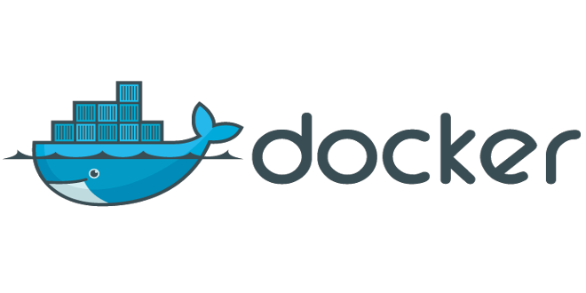

Slide 2
Do any of these sound familiar
It worked fine on my machine
I set that up months ago but can't remember the details
I installed so much stuff trying to get it to work I can't really say which are actually required
It only works on a linux machine
I just want to test it without installing
I want to test/use different versions
Set-up is too complicated to explain in a paper

Slide 3
Possible solutions
Hand holding support
Very detailed documentation
Virtual machine
Docker

Slide 4
Virtual Machines
"is an emulation of a particular computer system"[1]
Completely separate
Full set of resources (or as much as possible)
Current set-up can be saved, copied and shared
No central repositories of images
Black-box on how it was set-up
Full GUI support
Ideal for working on a host operating system/ controlled set-up
  ex. Word on a Linux or doing a training where everyone has the same set-up
[1]https://en.wikipedia.org/w/index.php?titlatorle=Virtual_machine&oldid=669500805

Slide 5
How Docker describes itself
Build, Ship, Run
An open platform for distributed applications for developers and sysadmins
Ship Applications Faster and Easier
Application Portability and Infrastructure Flexibility
Dynamically Update, Change and Scale Apps

Slide 6
Docker
Uses LinuX Containers (LXC)
Sharing resources
Central repositories of images
Current set-up can be saved, copied and shared
Dockerfile showing exact set-up
Typically no GUI support
Ideal for running a single application or service
Many Docker images can be run side by side

Slide 7
Docker compared to VMs
Virtual Machines
Docker Images
Application A
Application B
Application A
Application B
Bins/libs
Bins/libs
Bins/libs
Bins/libs
Guest OS
Guest OS
Virtual Machine Monitor
Docker Engine
Host Operating System
Host Operating System
Hardware
Hardware
http://www.jayway.com/wp-content/uploads/2015/03/vm-vs-docker.png

Slide 8
Docker Linux vs Windows
Windows/ Mac OS
Linux
Application A
Application B
Application A
Application B
Bins/libs
Bins/libs
Bins/libs
Bins/libs
Docker Engine
Boot2Docker Virtual Engine
Docker Engine
Host Operating System
Host Operating System
Hardware
Hardware
http://www.jayway.com/wp-content/uploads/2015/03/vm-vs-docker.png

Slide 9
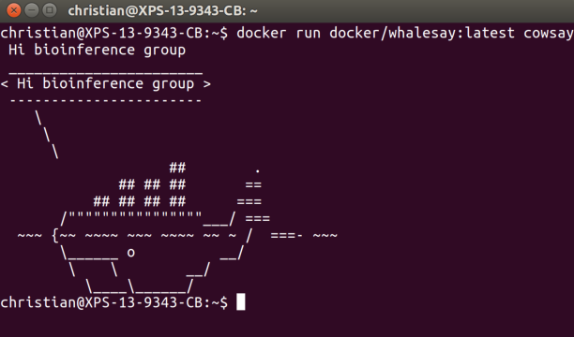
A few Run Examples
docker run docker/whalesay:latest cowsay Hi bioinference group
See: http://docs.docker.com/linux/started/

Slide 10
Parts of docker command
docker : Starts the docker application
run : docker command to run an image
docker/whalesay : image to run
  docker : owner of the repository
  whalesay : image to run
  :latest :tag of image to run (:latest is the default
cowsay : Application inside the image to run
Hi Bioinference group: parameters for application

Slide 11
Separate Run environment
docker run -i -t --rm docker/whalesay
  -i = Keep STDIN open even if not attached
  -t = Allocate a pseudo-TTY
  --rm = Automatically remove the container when it exits
Open a bin/bash terminal
ls
  Cows directory , cowsay progam

Slide 12
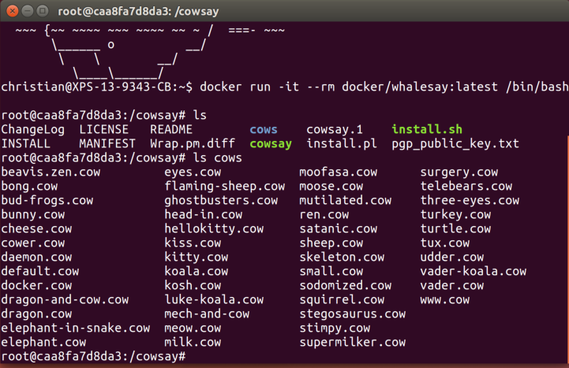

Slide 13
Ipython example
docker run -d -p 443:8888 -e "PASSWORD=test" --name iserver ipython/scipyserver
docker ps
https://0.0.0.0/tree (use password entered in run command)
If using boot2docker
  boot2docker ip (to get ip address vm uses)
  https://*.*.*.*/tree
https://www.ibm.com/developerworks/community/blogs/jfp/entry/using_ipython_notebooks_in_docker_containers_on_windows?lang=en

Slide 14
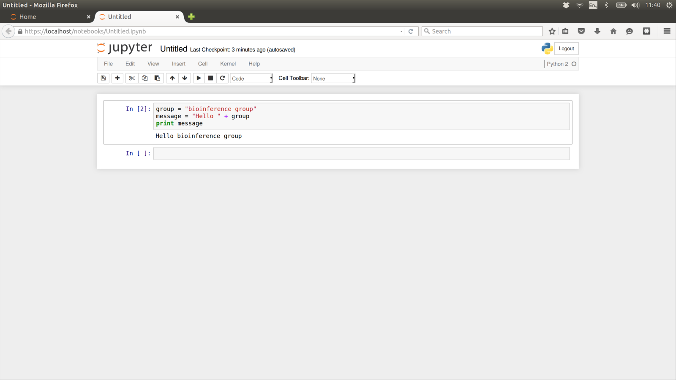
Docker ipython

Slide 15
Ipython continued
-d
  Run container in background and print container ID
-p 443:8888
  Publish a container's port(s) to the host
-e "PASSWORD=test"
  Set environment variables
--name iserver
  Assign a name to the container
ipython/scipyserver
  Name of the image

Slide 16
Container
docker ps
  CONTAINER ID b61cf298f297
  IMAGE ipython/scipyserver
  COMMAND "/notebook.sh"
  CREATED 28 minutes ago
  STATUS Up 28 minutes
  PORTS 0.0.0.0:443->8888/tcp
  NAMES iserver
Docker ps -a
docker rm `docker ps --no-trunc -aq`

Slide 17
Container start and start
At https://0.0.0.0/tree
  New Python 2
  print “hello world”
  Run Button
Close and reopen Jupiter
docker stop iserver
See https://0.0.0.0/tree fails
docker start iserver
See https://0.0.0.0/tree saves still there

Slide 18
RStudio
docker run -d -p 8787:8787 -v /home/christian/docker/rdata/:/home/rstudio/rdata --name=rstudio -e USER=rstudio -e PASSWORD=rstudio rocker/rstudio
  v maps a directory into the docker container
http://0.0.0.0:8787/
Outside changes to ../rdata are visible in rstudio
see https://github.com/rocker-org/rocker/wiki/Using-the-RStudio-image

Slide 19
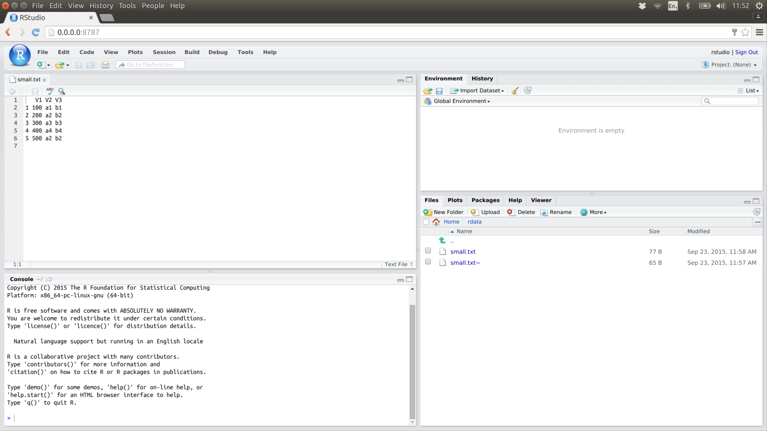
Docker RStudio

Slide 20
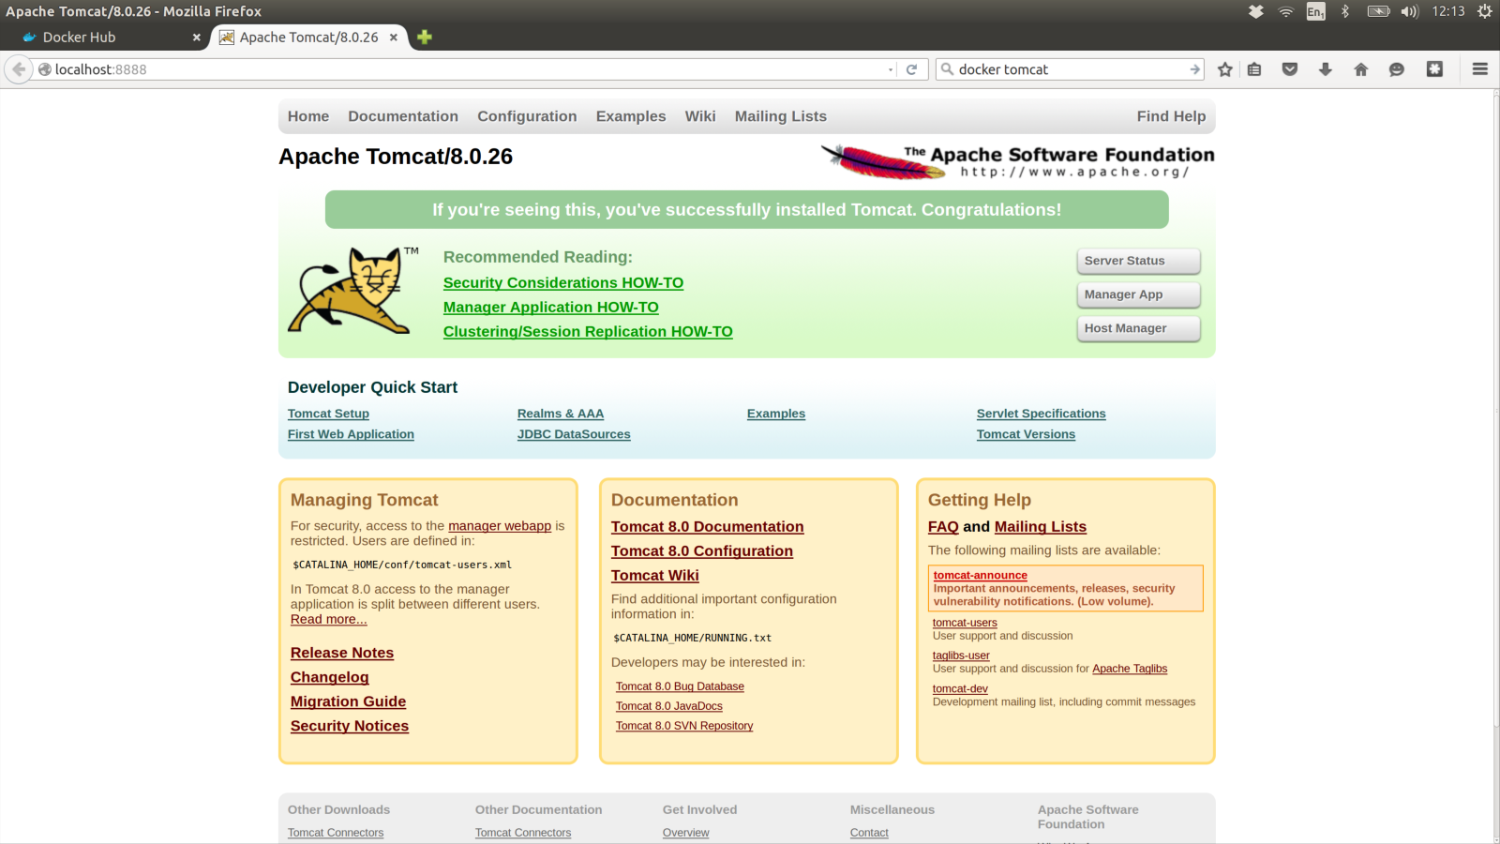
docker run -it --rm -p 8888:8080 tomcat:8.0
https://hub.docker.com/_/tomcat/

Slide 21
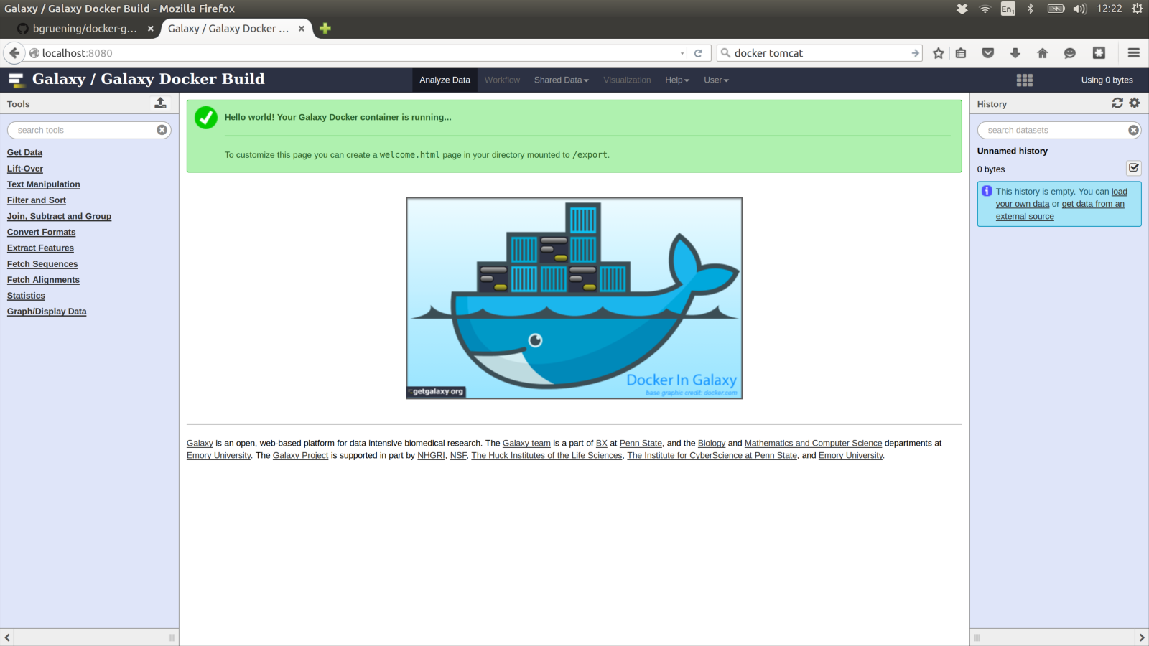
docker run -d -p 8080:80 -p 8021:21 bgruening/galaxy-stable

Slide 22
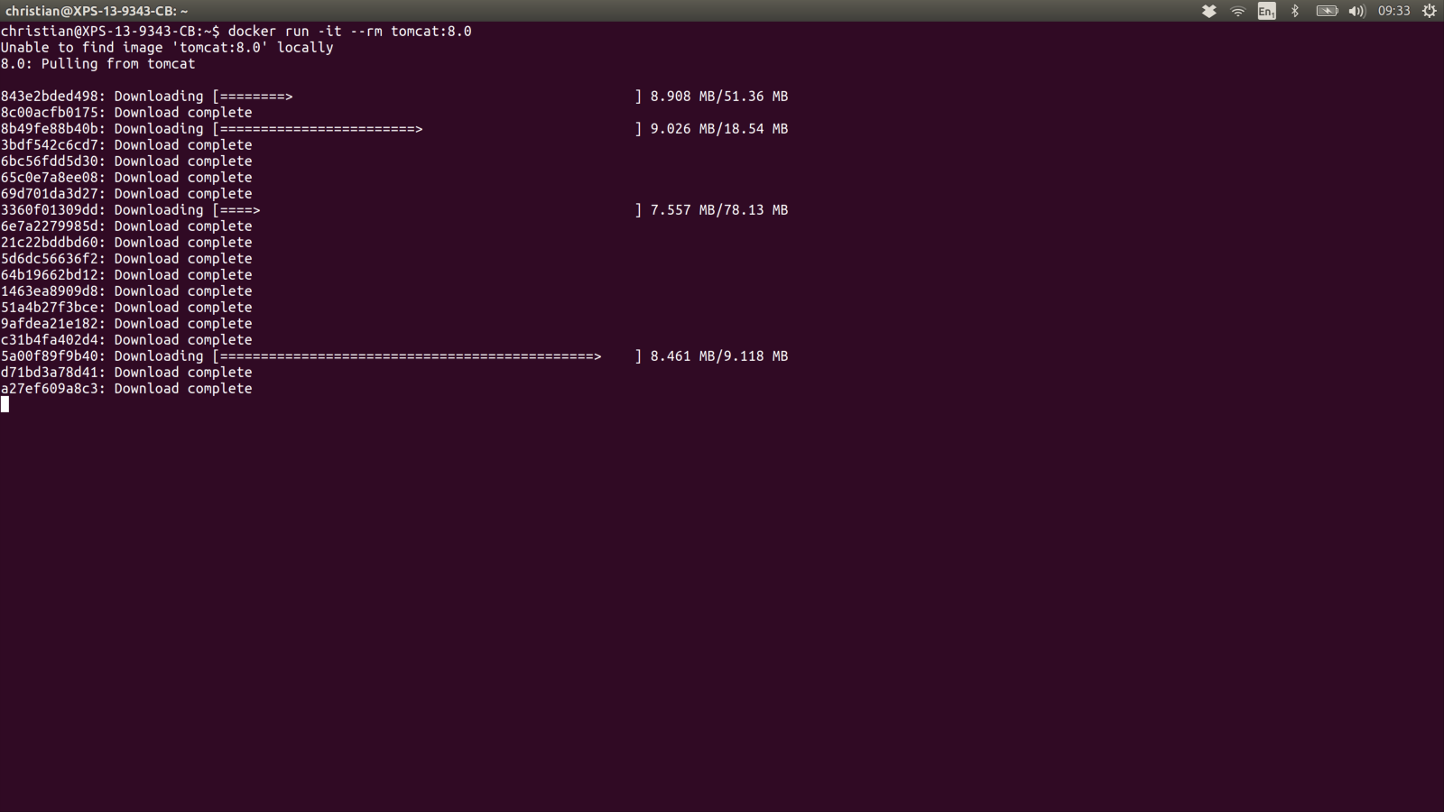
Docker downloads the first time

Slide 23
Ship
https://hub.docker.com
  Images that can be downloaded
docker pull xyz (gets an image and its parents)
docker run xyz (pulls if required)
Many images linked to a github account
  Dockerfile
  Extra files
  Info files
Automatically built so you know exactly what you get

Slide 24
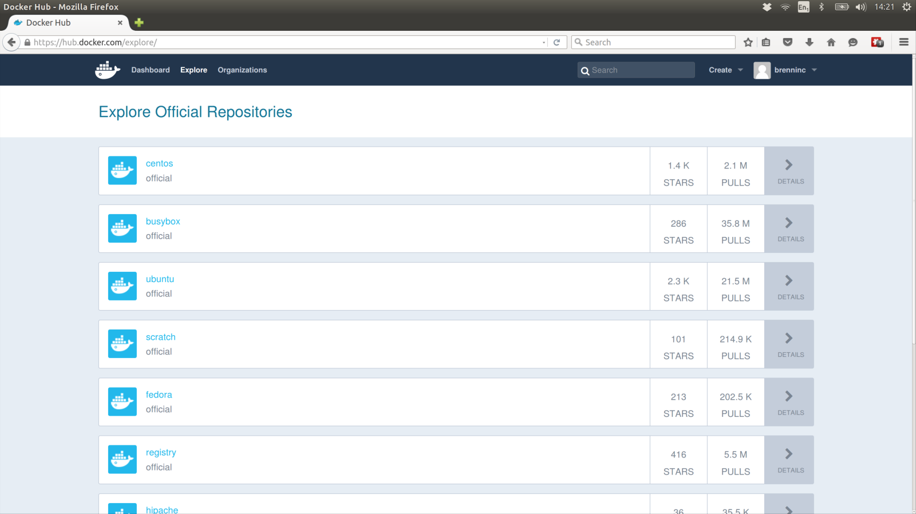
https://hub.docker.com/explore/

Slide 25
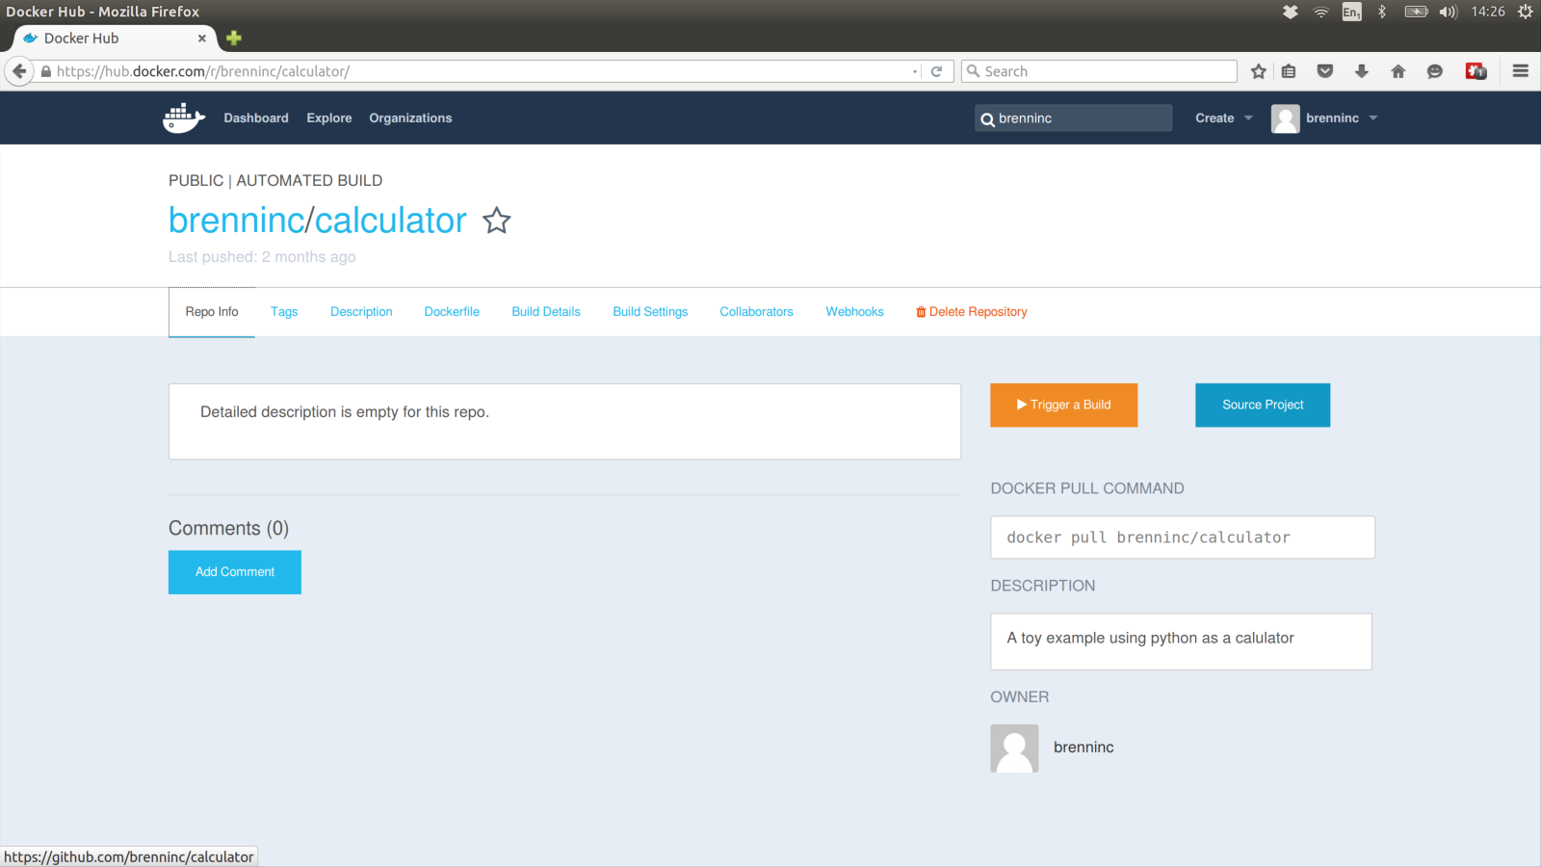
https://hub.docker.com/r/brenninc/calculator/

Slide 26
Build (the BAD WAY)
docker run -i -t --name=bad ubuntu:14.04
  curl --version
    curl: command not found
  sudo apt-get install curl
  curl --version
    curl 7.35.0 .....
  exit
docker run -i -t --rm ubuntu:14.04
  curl --version
    curl: command not found
docker start -i bad
  curl --version
    curl 7.35.0 .....

Slide 27
Build (The bad way)
These images can be uploaded to docker hub
No Dockerfile will be available
No Automatic build
Would you trust someone else’s black box?

Slide 28
Build using Docker files
Saved in a text file called Dockerfile
Exact record of how the system was built
Dockerfile can built upon other docker images
Built up in layers
  Max 128 layers
Each command in a Dockerfile is a layer
Docker file allow for “automatic builds” on Docker hub
Docker files typically shared via github

Slide 29
Calculator Example
docker run –rm brenninc/calculator 4+5*2
  4+5*2 = 14
docker run –rm brenninc/calculator
  1 + 2 * 3 = 7

Slide 30
Dockerfile instructions
FROM
MAINTAINER
LABEL
RUN
ENTRYPOINT
CMD
EXPOSE
ENV
COPY
ADD
VOLUME
USER
WORKDIR
ONBUILD

Slide 31
From
Base or parent image
Can be an operating system
  FROM ubuntu:14.04
  FROM centos
  FROM febora
Only Linux family operating system
Can be a base image
  ipython/scipyserver
  ipython/scipystack
  ipython/ipython:3.x
  …..
Can be scratch
  Root of operating system images

Slide 32
MAINTAINER
A way of signalling who is responsible for the image
MAINTAINER Christian Brenninkmeijer <Christian.Brenninkmeijer@manchester.ac.uk>
MAINTAINER IPython Project <ipython-dev@scipy.org>
Does count towards the 128 layer limit

Slide 33
LABEL
key-value paired metadata
LABEL com.example.label-with-value="foo"
LABEL version="1.0"
LABEL description="This text illustrates \
that label-values can span multiple lines."
Exposed vai
docker inspect image_name
  Includes other metadata
  Includes info from MAINTAINER

Slide 34
RUN
Executes command on base image and saves a new image
apt-get Install stuff
Download stuff
Unzip stuff
Create directories
Run setup and config scripts
Delete temporary files

Slide 35
Run examples
RUN apt-get update && apt-get install -y python
RUN curl -L http://downloads.sourceforge.net/project/libpng/libpng16/older-releases/1.6.7/libpng-1.6.7.tar.gz > libpng-1.6.7.tar.gz && \
tar -xzf libpng-1.6.7.tar.gz &&
rm libpng-1.6.7.tar.gz && \
mkdir libpng && \
cd libpng-1.6.7 && \
./configure --prefix=/libpng && \
make && \
make install && \
cd / && \
rm -r /libpng-1.6.7

Slide 36
Run notes
Multiple command can be combined
  These then count as one layer (out of 128 max)
Temporary files must be removed in same layer as used or they stay in the image
  Next image builds on previous
cd (change directory) only effects that layer
  Each new layer starts in home
export only effects that layer
  See ENV command

Slide 37
ENTRYPOINT and CMD
Command to run then the image is run
There can only be one of each
  Earlier ones are ignored
Both are optional and independent
Various different formats possible
Example:
  ENTRYPOINT ["python","calculator.py"]
  CMD ["1","+","2","*","3"]
  Runs "python calculator.py 1+2*3

Slide 38
ENTRYPOINT
Command part expected to be used every time
Makes the image an executable file
If docker run is provided arguments the ENTRYPOINT commands are still included
Can be ignored with the docker run flag --entrypoint

Slide 39
CMD
Default arguments for Docker run
Ignored if any arguments are provided when docker images is run
docker run –rm brenninc/calculator 4+5*2
  4+5*2 = 14
docker run –rm brenninc/calculator
  1 + 2 * 3 = 7

Slide 40
EXPOSE
“informs Docker that the container will listen on the specified network ports at runtime”
Connects ports of any application/ service to be run to the outside of the docker
Note requires the -p flag at runtime to expose it from docker to the host

Slide 41
ENV
Sets Key value environment variable
Persist on all future layers and runtime
Can be overwritten
ENV myName John Doe
ENV myDog Rex The Dog
ENV myCat fluffy
ENV myName="John Doe" myDog=Rex\ The\ Dog \
myCat=fluffy

Slide 42
COPY
COPY source destination
Copies local files or directories into the docker image
Source must be in the same context as the Dockerfile
  Files in the same context as the Docker file are only available in the image if copied in
Multiple sources can be specified but then destination must be a folder
COPY calculator.py calculator.py

Slide 43
ADD
Similar to COPY but with extra functionality
  Docker recommends using COPY when possible
If source is a local tar archive in a recognized compression format (identity, gzip, bzip2 or xz) then it is unpacked as a directory.
ADD can add data from URLS
  Never unpacked

Slide 44
VOLUME
Creates a mount point
  Creates a directory in /var/lib/docker/volumes/
  With a random name
Used by containers that save data
  Example Ipython
Similar to the -v flag in docker run image
Directory created when a container is created are not removed even if the container is

Slide 45
USER
Allow you to run image as other than root user
User must be created

Slide 46
WORKDIR
Sets the working directory
Should be an absolute directory
  Absolute within docker image not the host
Unlike cd persists between layers

Slide 47
ONBUILD
Used in images that will be parents to other images
Adds instructions to run then child image builds
example
RUN mkdir -p /usr/src/app
WORKDIR /usr/src/app
ONBUILD COPY Gemfile /usr/src/app/
ONBUILD COPY Gemfile.lock /usr/src/app/
ONBUILD RUN bundle install
ONBUILD COPY . /usr/src/ap

Slide 48
Calculator Dockerfile
FROM ubuntu:14.04
MAINTAINER Christian Brenninkmeijer <Christian.Brenninkmeijer@manchester.ac.uk>
LABEL "description"="An example docker app using python as a calculator"
#Install python via apt-get
RUN apt-get update && apt-get install -y python
#copy in the code
COPY calculator.py calculator.py
ENTRYPOINT ["python","calculator.py"]
CMD ["1","+","2","*","3"]

Slide 49
Calculator.py
import parser
import sys
command = " ".join(sys.argv[1:])
st = parser.expr(command)
code = st.compile('file.py')
print command,"=",eval(code)

Slide 50
Build Calculator
docker build -t brenninc/calculator .
-t provides a tag (name) for your image
Docker will reuse existing images layers wherever this is possible
Automatically detecting the first layer that changed
  Including if a file copied in has changed
All subsequent layers are built

Slide 51
SHIP Calculator
Source file uploaded to:https://github.com/brenninc/calculator
  Dockerfile
  Calculator.py
Linked to:https://hub.docker.com/r/brenninc/calculator/
Automatically built image (by docker hub)
docker pull brenninc/calculator

