Slide 1

University of the People CS-1101 Student Hour
Dr. Itauma Itauma

Slide 2
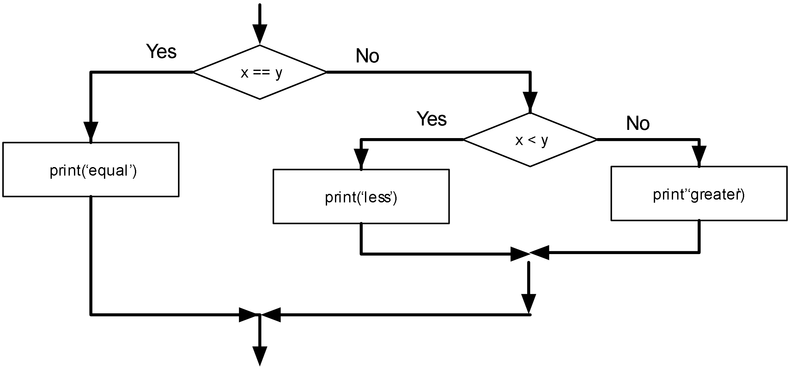
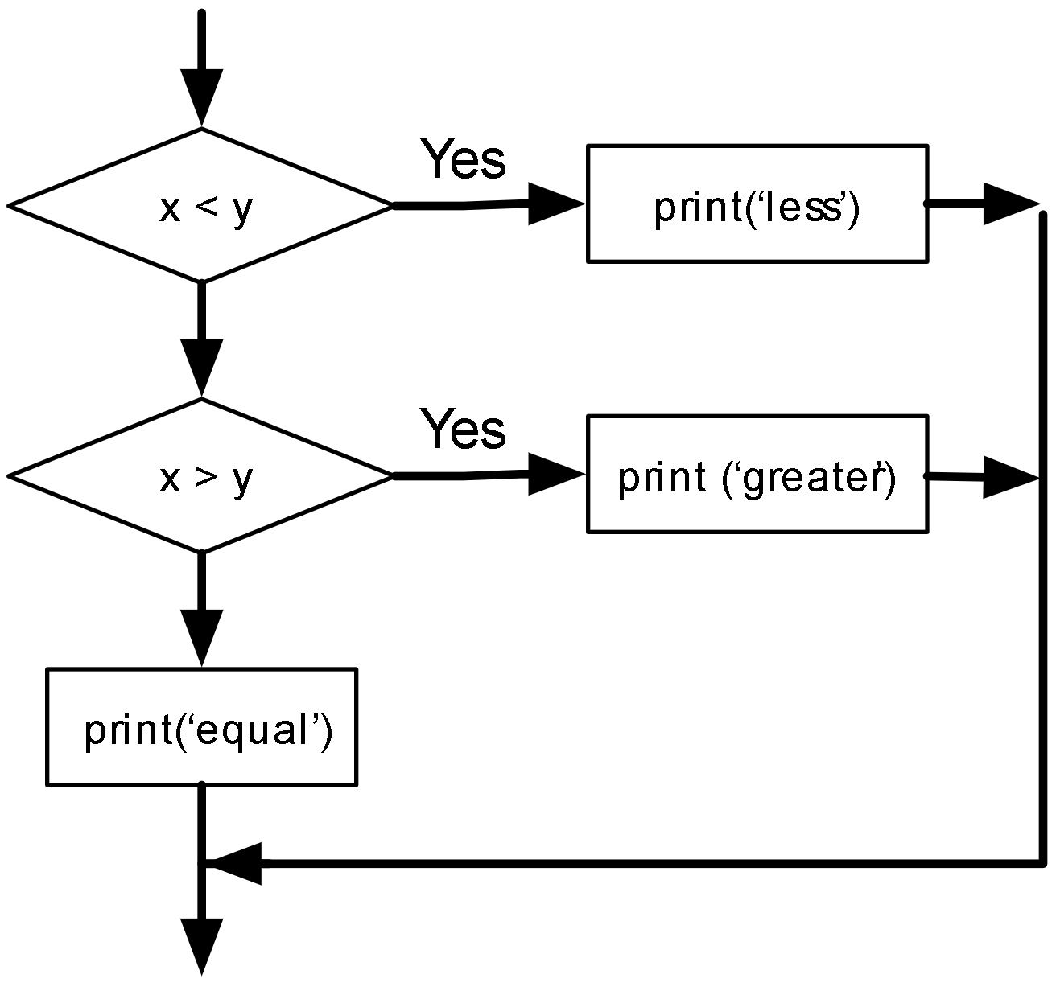
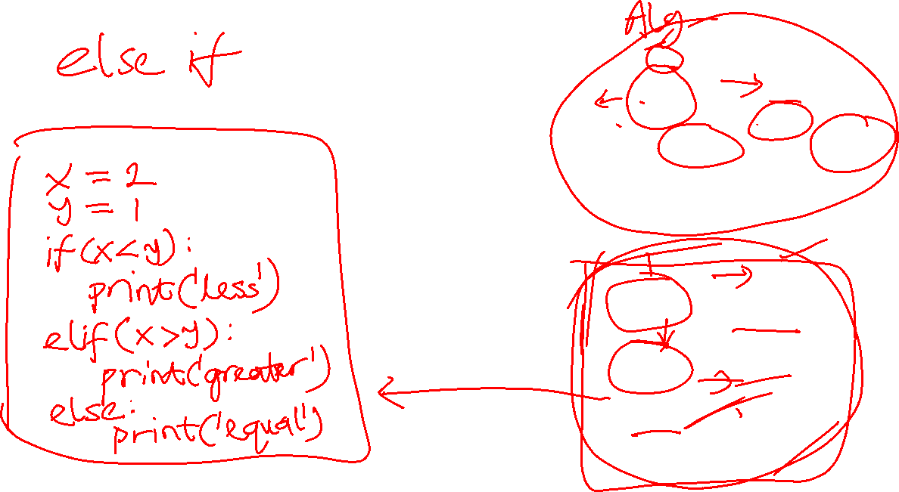
Conditional Statements
Notes:
Conditional statements are usually a core part of any application. If this is true, do that; otherwise do something else or nothing at all. That makes sense. We use conditional statements in our lives, so they are easy to understand. If Grace finished her vegetables, give her desert. It really is that simple.

Slide 3
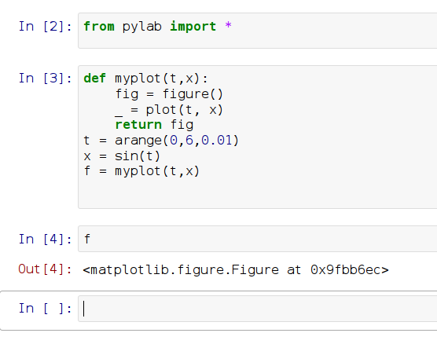
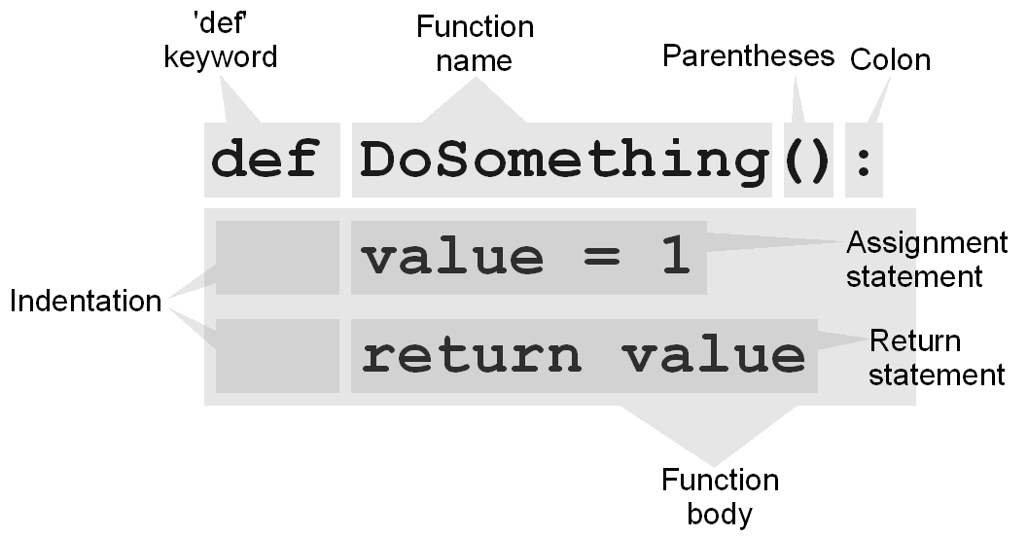
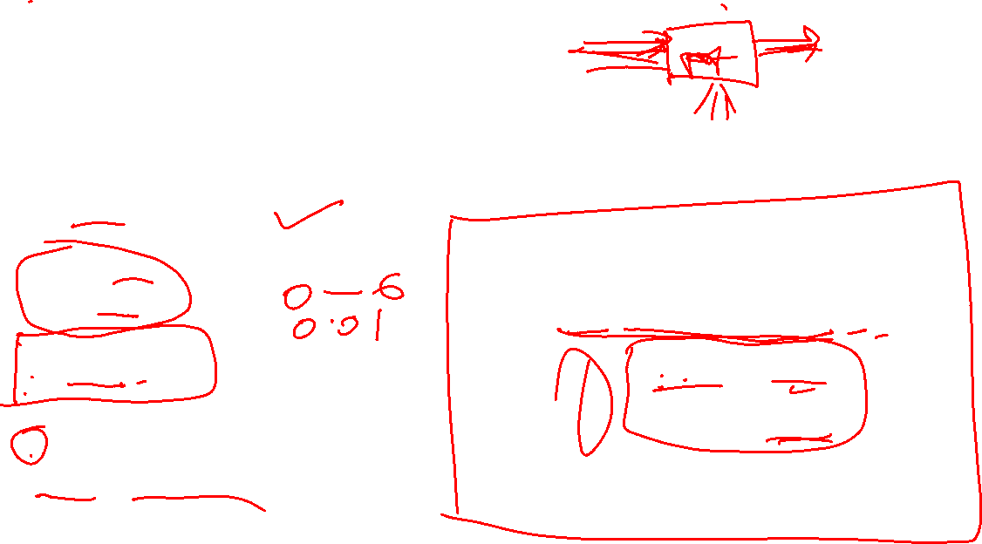
Functions

Slide 4
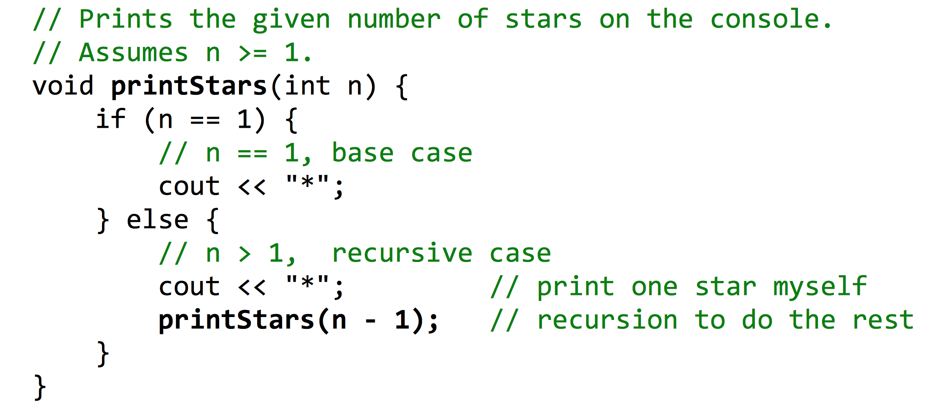
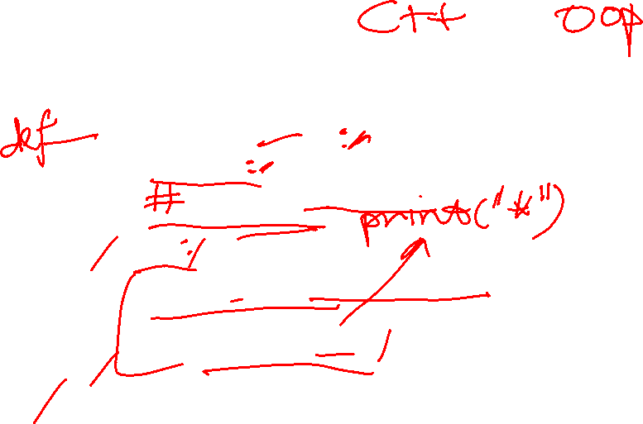
Recursions

