Slide 1

What are passwords?
Notes:
Script:
A password is like a combination lock that keeps our information safe. We’re going to introduce how to create good passwords.

Slide 2
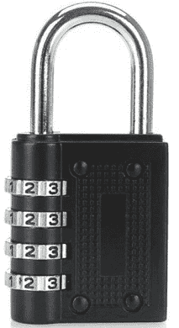
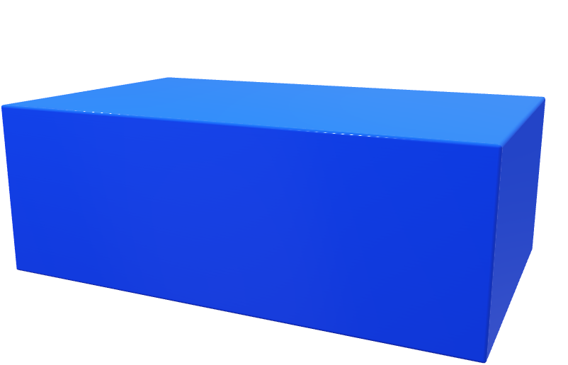
Picture of combination lock
Picture of box
Notes:
Script:
You can choose the combination number that you use on the lock.
You should keep the number private
You don’t share it with anyone
If someone gets hold of it they can get into the box
If you forget the combination number, you will want to reset it so that you can get into the box
Notes for the animator:
Have three numbers on the box
The combination can be on the box, doesn’t have to be separate
This animation changes to a website and a password for the next slide

Slide 3


Picture of password
Picture of website
Notes:
Script:
A combination lock is analogous to choosing a password and you want to use that password to get into a website.
in the same way that you can get into a box.
You typically use a password with your email address to log into a website, to access your email and other online applications.
Note: website should change to images of bank/utility/doctor and the password key image needs to change each time too.

Slide 4
Why do we need a password?
Safeguard our sensitive information
Only you should know it and no one else
Notes:
Script:
We use a password to safeguard our sensitive information online. We don’t want everyone to know how much is in our bank accounts nor what kind of medication we take.
It is meant to be something you know and no one else should be able to find out.

Slide 5
How do we create strong passwords?
Notes:
Script:
Now les us look at how to create strong passwords? Strong passwords are ones which are difficult for someone else to guess.

Slide 6

Picture of website
Picture of password box with 8 or more slots in it
e
F
5
A
2
w
$
!
Notes:
Script: When we think about strong passwords we might think of random letters, numbers and symbols as one way to provide a strong password to protect our access to our accounts on a website. These are difficult for us to remember and for a someone else to crack.
Note to animator:
the animation then unlocks the website and the website turns green or something to indicate success of access to the website
No character animation

Slide 7

Picture of website
Red
Pants
Tree
Picture of password box with 3 or more slots in it animating different random words until we settle on one
Red
Pants
Tree
Notes:
Script:
The UK’s National Cyber Security Centre advises creating strong passwords based on putting different three random words together.
These are easier for us to remember but difficult for someone else to work out the password.
Note to animator:
Now we need to show the concept of truly choosing a random word, like a slot machine going round and when it stops the person looks like happy and not scratching head
Then when got a three random word password show the website unlocking
[ANIMATION OF THREE RANDOWM WORDS BEING JOINED TOGEHER and shown to be STRONG Use RedPantsTree as the final choice of three random words] FIND a way of representing strong [some person also looking happier with the password above their head]
https://xkcd.com/936/
Website for random common words: https://passwordcreator.org/#poor use that for choosing the three random words and make sure that they are all 4 of more characters in a word.
Website for the random characters https://passwordcreator.org/#subpar for 8 random characters
Analysis of the advise: https://www.pentestpartners.com/security-blog/three-word-passwords/
https://www.ncsc.gov.uk/cyberaware/home for adding the

Slide 8
We should use different passwords for different websites
Notes:
Script:
We should use a different password to access our emails, do our online shopping, manage our utility bills and insurance accounts and log into to the doctor’s surgery.
We don’t want someone to be able to find out one of your passwords and then be able to reuse your passwords.

Slide 9

0000
0000
0000
Notes: Row of combination locks, first one highlighted
Set all of them to 0000
Set the first one to 5391
First combination opens lock
Set all the other boxes to 5391, 5291 open box
next animation all boxes animate to open
Notes:
Script:
Let’s go back to the analogy of the combination lock to illustrate this . Suppose you had lots of boxes. Initially all their combinations were 0000.
Note to animator: I would like the number on the combination lock.

Slide 10
5391
5391
5391
Notes: Row of combination locks, first one highlighted
Set all of them to 0000
Set the first one to 5391
First combination opens lock
Set all the other boxes to 5932, 5933 open box
next animation all boxes animate to open
Notes:
Script:
Then you set the first lock to a number and the others to the same number.

Slide 11
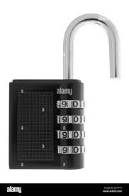
5391
5391
5391
Notes: Row of combination locks, first one highlighted
Set all of them to 0000
Set the first one to 5391
First combination opens lock
Set all the other boxes to 5932, 5933 open box
next animation all boxes animate to open
Notes:
Script:
If someone else can guess or learn the combination of the first lock they can use that on the other locks.
Note to animator:
Now make them open one after each other

Slide 12

RedPantsTree4!
RedPantsTree4!
RedPantsTree4!
Notes for animator:
The password names for each website needs to be visible
the password for website one flashes and there is an animation of the password being sent to the website 1 picture and gets a tick back. A person doesn’t have to be in the animation but there needs to be an animation of the password being sent over the internet to the website.
Then RedPantsTree5! Password to website 2 and a tick is sent back
Then RedPantsTree6! Password is sent to website 3 and gets a tick back
Maybe this is where the picture of an attacker could be included but we do not want it to be too scary.
Notes:
Script:
The same is true of passwords. Consider that you use the similar passwords on more than one site,
If a computer can work out the password for one website it will be able to use the passwords for all the other websites.

Slide 13
Summary
Choose 3 random words
Use different passwords on different websites
Notes:
Script:
To summarise: choose a password made up of three random words and make sure you use different passwords on different websites

