Slide 1
Euler and other “useful timewasters”

Slide 2
Waste time while being productive?
Improve known techniques
Learn new techniques
Portfolio material
Problem-solving thinking
Ultimately, save time in the future
Notes:
Writing small programs or functions is a gateway to learning new techniques and understanding how to use them to their full potential.
Getting a complicated assignment or a work project done quicker is much more possible when you are already used to the programming language and structures.
Rewriting an already known generic application or program such as calculators and measurements converter, creating a game like a maze or a text based adventure is the easiest way to create and populate an eye-catching portfolio when you are looking for a placement or a job in IT.
These are just some of the reasons why wasting time with side projects is ultimately the best thing you can do with your time in the long run.

Slide 3
How?
https://codefights.com/
https://www.hackerrank.com/
https://www.codingame.com/start
https://www.reddit.com/r/dailyprogrammer/
http://codeforces.com/
http://www.codeabbey.com/index/task_view/min-of-three

Slide 4
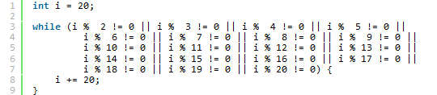
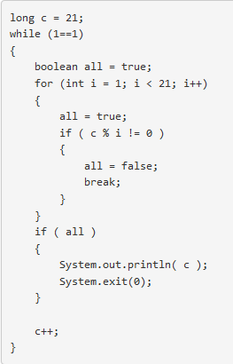
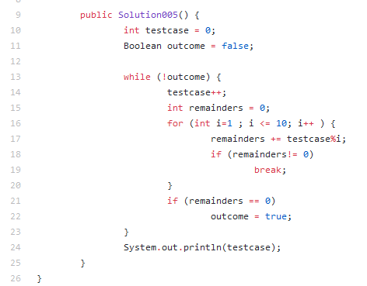
The “right” way isn’t the only way
Problem: 2520 is the smallest number that can be divided by each of the numbers from 1 to 10 without any remainder. What is the smallest positive number that is evenly divisible by all of the numbers from 1 to 20?

Slide 5
Questions?

