Slide 1
Hackathons
An Introduction

Slide 2
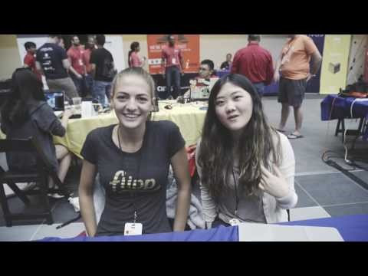
What is A Hackathon?

Slide 3

MLH
The Official student hackathon league
Every team that presents get a point for their university
The university with the most points at the end of the league wins
Last year it was the University of Manchester

Slide 4
UP Coming Hackathons
Great Uni Hack @ Man Met – Nov 11th to 12th
Stockport Council 12 hour Hackathon – March (Dates TBC)
Auto-Trader Hackathon @ their Manchester office – TBC
More MLH events: https://mlh.io/seasons/eu-2018/events

Slide 5

Hack Manchester
Final event of Manchester Science Festival
Organised by Gemma Cameron (UoS Alumni) [@ruby_gem on Twitter]

Slide 6
Hack Manchester 2017 Challenges (1)
WebApplicationsUK – Best in Show
Texecom - Use our network of wireless sensors to show us something interesting about the behaviour of people at Manchester Science Festival and the Texecom head office. Come up with ways to extract, visualise, analyse and pool the data gathered from the sensors deployed across the Great Western Warehouse and our own offices.
Dunnhumby - We challenge you to use technology to enhance the retail experience for a customer in the home or in store.

Slide 7
Hack Manchester 2017 Challenges (2)
Co Op - Co-op Funeralcare needs your help. We want to find digital ways to help people who’ve lost someone they love. These recently bereaved people often feel lonely because their friends don’t know what to say or how to behave around them. Your Hack Manchester challenge is to design an app, game, website or other digital service that re-connects people who’ve lost someone with other people and things to do in the places they live.
Ombudsman - We want you to create the most frustrating, irritating, intolerable and anger inducing complaint experience. Be careful though, if you make it too infuriating people might not actually register the complaint, so you will need to entice them to complete the torturous process.

Slide 8
Hack Manchester 2017 challenges (3)
Carbon Co Op - The task is to create an energy monitor which would be suitable for a visually impaired user. This hardware device or application would need to communicate key information to the user about their current and historical energy use and the availability of electricity from local micro-generation. You will be provided with an example real household data set for a year including demand and PV generation which you can use to simulate the operation of your energy monitor.
GCHQ - Your challenge is to develop a new way to send information to the emergency services. This could involve communicating data in a secure or anonymous way, verifying the received information is genuine or interpreting and analysing information so that it provides new insight.

Slide 9
Brain Storming Sessions
Get into groups of around 4 people (preferably people you don’t know)
Pick a challenge
You’ve got 2 minutes to come up with as many ideas as you can
Pick one of the ideas
Develop it further (3 mins)
Make a new group

