Slide 1

GIT BAsics
A VERY BASIC INTRO TO GIT

Slide 2

WHY GIT
It is industry standard
It will be expected that you have at least a basic understanding of its use by the time you get to the workplace
ARE THERE OTHERS?
SVN was most popular before this and there are others
    Linus Torvalds created GIT after trying SVN (hating SVN)
      You have an opinion on Linus Torvalds? (A Genius god with a bad attitude is mine :-/)

Slide 3
GIT CMD or gui
Should I use CMD or GUI
  Learning to use the cmd can give you a better understanding of controlling your version control
Getting started
  GUIs normally are a great place to start but with GIT you wont really know WHAT is happening behind the scene or what you are trying to achieve
  You get the paid version whilst at uni (gitkraken)

Slide 4
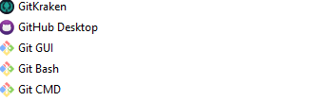
GIT CMD or gui
What can I use
  WINDOWS - Learn to use the cmd
    Win + r
    Cmd
      Here is your new home
  LINUX
    Console
  GUI
    GitKraken – Pro is FREE to students
    GitHub Desktop
    Git GUI
    Git Bash
    Git CMD
    WSL Bash

Slide 5
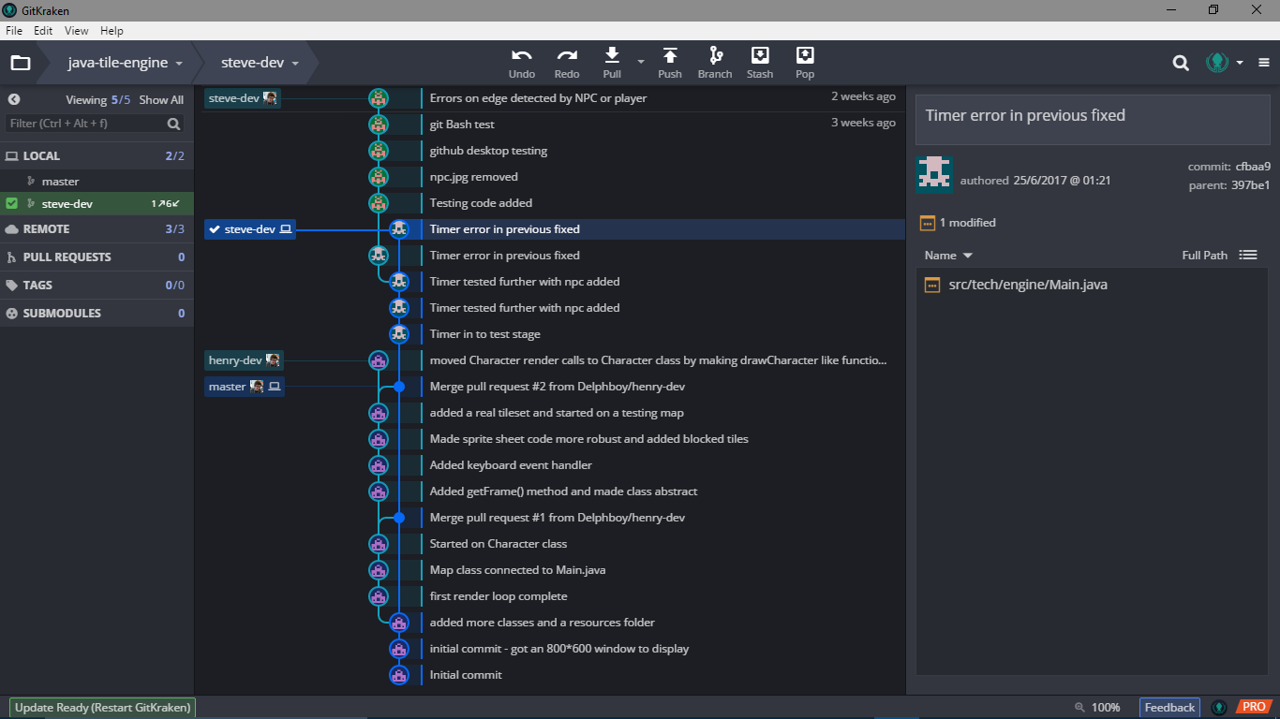
GitKraken
Easy to use
Drag and Drop interface

Slide 6
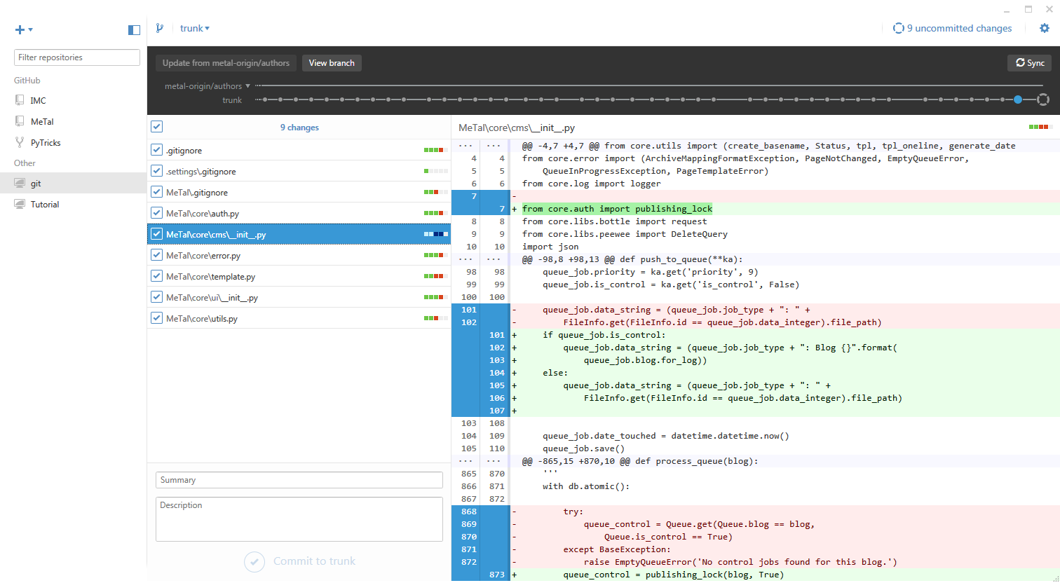
Gitdesktop
Easy to use
Informative timeline

Slide 7

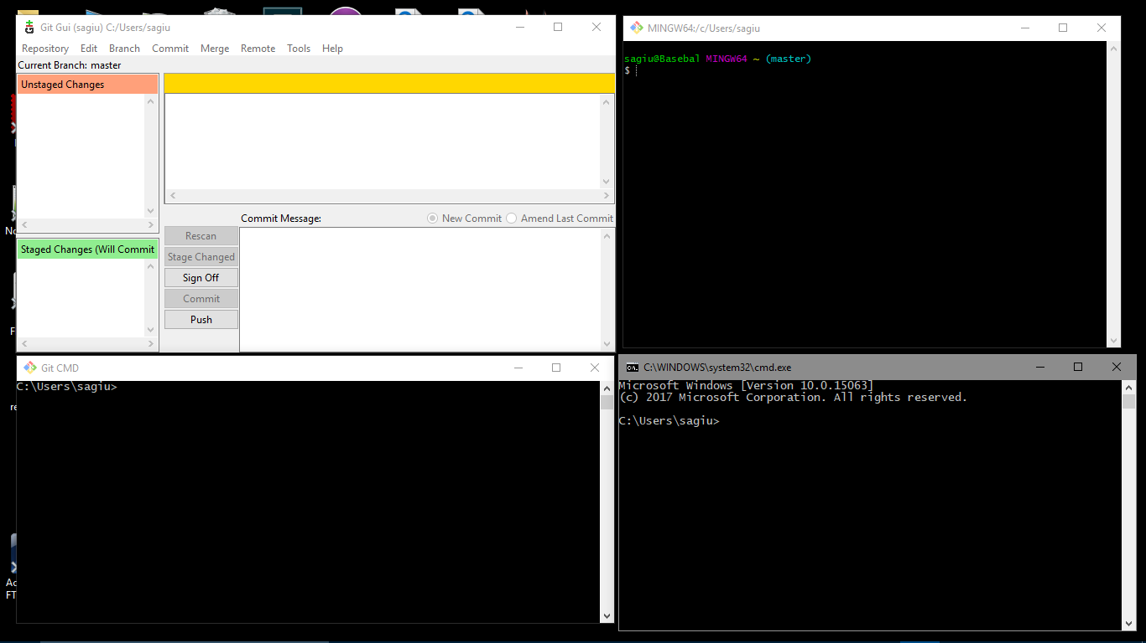
GitGUI
A nice half way house :-/
I found it disjointed

Slide 8
Gitbash
You will get used to the terminal commands

Slide 9
gitcmd
You will get used to the terminal commands

Slide 10

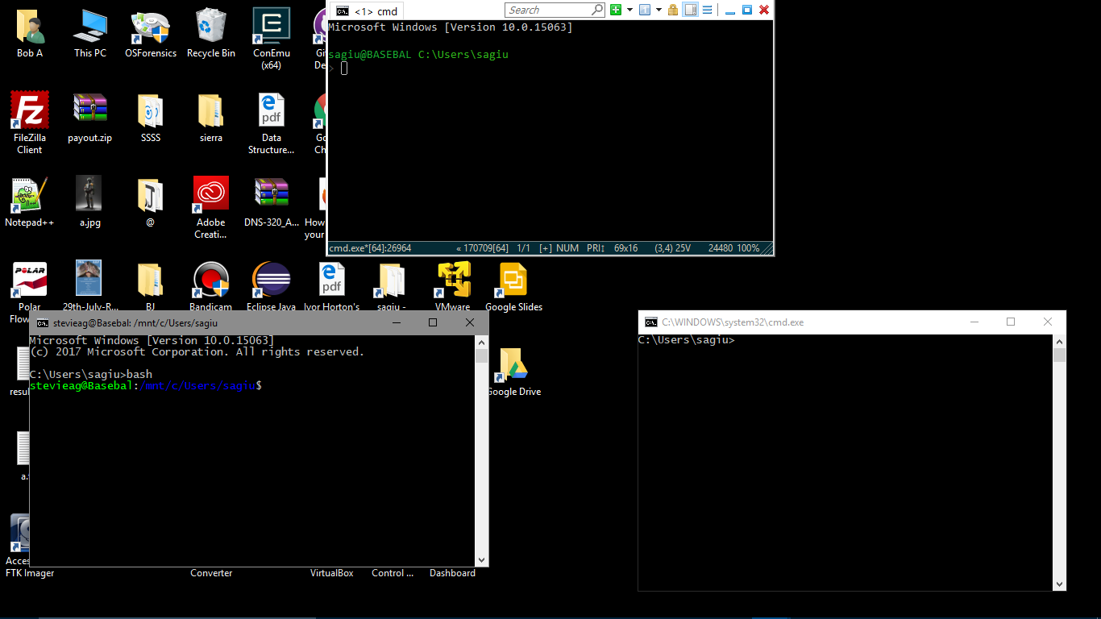
Com emu
Command line interface
Much Easier To Use
Can feel like magic
You will understand what is going on in the background of the GUI type and so know what to click
ComEmu?
See Henry ☺
Wsl bash
cmd

Slide 11
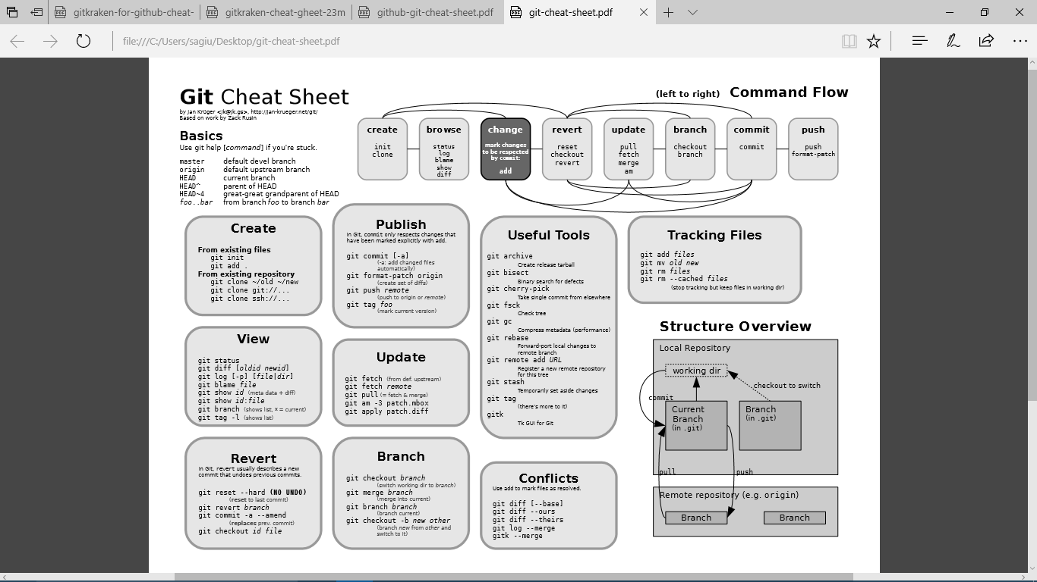
Here can be seen the basic funcions

Slide 12
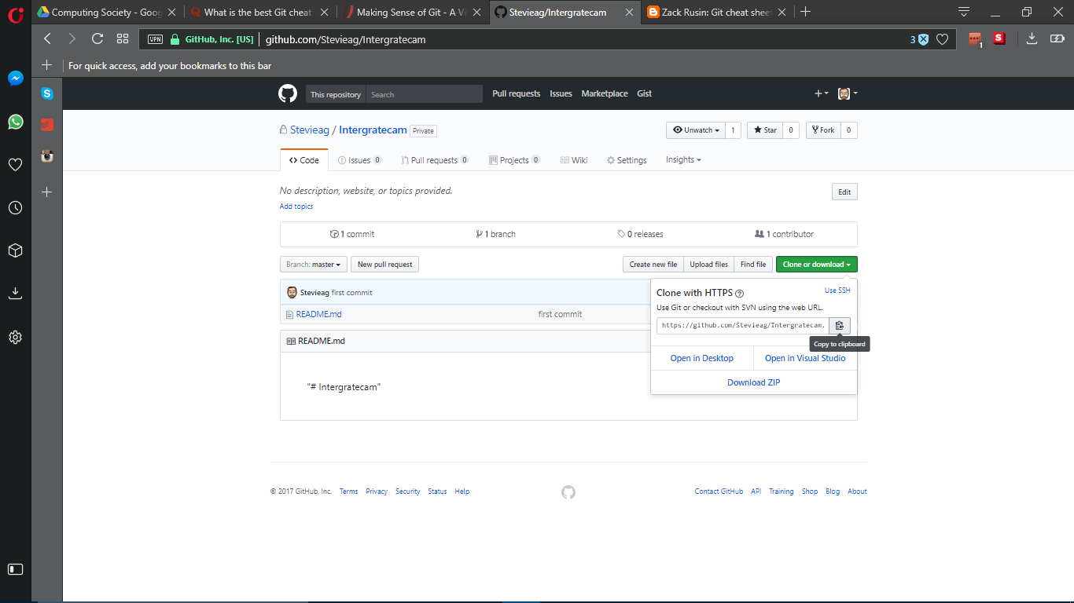
Here is the start of or git repo
Navigate to the folder to hold the program or holding the program
(>cd /home/compsoc/myprg/
>git init
>git add
If pulling a program from git
>git clone git://….

Slide 13
We can now check how we are??
>git status
We will initially be on the master branch
We create a new branch to work on
This command will show on which branch you are on
>git branch
To create
>git branch branch-name
Set the working branch
>git checkout branch-name
Now the master (original) is safe and we can now work in safety

Slide 14
>git add ……
This list all files that have changed since the last update
Each file will need adding
We can now check how we are??
>git status
This will give you all files ready to be added or updated to the repo online

Slide 15
To commit the files ready to publish to the online repo?
>git commit -a

Slide 16
To commit the to the online repo?
>git push origin branch-name

Slide 17
OLD MASTER
NEW MASTER
LOCAL FILES
OR
GITHUB REPO
GITHUB REPO
GITHUB REPO
GITHUB REPO
So
Initialise to git repo
Create a branch of the master
Check status
Commit to issue
Push to online
Merging will thread changes of new into the old.
You can always go back
This is where GUI comes in useful as you can see what you are reverting too
GITHUB BRANCH
REPO
SO WE WILL EITHER PULL/CLONE FROM THE REPO
OR
CREATE A REPO LOCALLY TO PUSH UP TO ONLINE
So
When we are ready we can MERGE the working
repo into the main MASTER
Repo
THIS IS ORIGIN (MASTER)
LOCAL REPO
LOCAL REPO
LOCAL REPO
THIS IS OUR BRANCH TO SAFELY
WORK ON
LOCAL REPO
THIS WILL BE SENT BACK AND FORTH
AS WE UPDATE

Slide 18
THIS CHEAT SHEET WE CAN GIVE YOU
THERE ARE ALSO MANY OTHERS ON LINE

Slide 19
LINKS TO LEARN GIT
https://try.github.io/levels/1/challenges/1
https://www.git-tower.com/learn/
https://www.visualstudio.com/learn-git/
https://www.atlassian.com/git
https://learn.co/lessons/git-github-learn-quiz
https://www.webpagefx.com/blog/web-design/git-tutorials-beginners/
https://www.youtube.com/user/GitHubGuides

