Slide 1
A Computing Degree with Ease
Some tools and skills that make Computing just that little bit easier

Slide 2
Tools and Skills Covered
The obvious
1
Git and GitHub
2
Fixing Windows
3
Some useful tools
4

Slide 3
Obvious Things
Work
Hard work
Stay
Stay OS Agnostic where possible
Keep
Keep Organised
Trello
Google Keep
Taiga.io
GitHub Projects

Slide 4
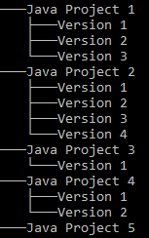
Git and GitHub: Say Goodbye to Folder Version Control
One way of being able to save changes to your code is to copy and paste it to different version names
Another way would be to use a Version Control system
There are a few available
Git
SVN

Slide 5
Git and GitHub: Why Git?
It’s the industry standard
Everyone used SVN, now everyone wants to use Git
Git is used to maintain both Windows and Linux source code
Git is fast, maintains data integrity, and supports distributed and non-linear workflows – Dr Wikipedia

Slide 6
Git and GitHub: Git’s power up, GitHub
Git is great and all, but you’ll want to keep your code on a server so you can get it from other computers
There are alternatives
GitLab
BitBucket
GitHub Student Pack
GitHub pro for free whilst you’re studying
NetBeans products
AWS Codes
Loads more

Slide 7
Git and GitHub: Learn more!
An upcoming Computing Society talk on getting up and running on Git and GitHub coming soon!

Slide 8

Fixing Windows:
Install Linux!

Slide 9
Fixing Windows: Minimum Requirements
Your PC must be running (at a minimum) a 64-bit version of Windows 10 Anniversary Update. Creators Update is recommended.

Slide 10
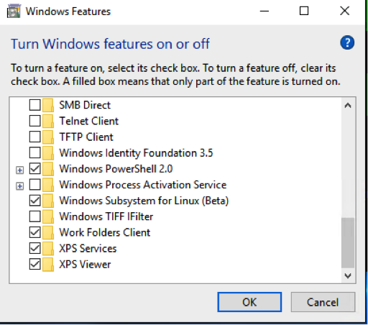
Fixing Windows: Enabling Windows Subsystem for Linux
Enable Developer Mode
Settings > Update and Security > For Developers
Select “Developer Mode”
Enable WSL
Start > Search > “Turn Windows features on or off
Open Windows Features menu
Select the “Windows Subsystem for Linux (beta)” option
Restart
Search “Bash” to use WSL
Follow the in-terminal instructions to set up a Unix account

Slide 11
Fixing Windows: Getting a decent terminal
Command Prompt sucks
Two Alternatives
ConEmu
CMDer

Slide 12
Fixing Windows: Getting CMDer Up and Running
Download from http://cmder.net/
Remember to add a reference to Bash on Windows!

Slide 13
Some Useful Tools
BlueJ
Text Editor
Visual Studio Code
Atom
Vim / Emacs (If you’re very brave!)
IDEs
Visual Studio
Xamarin
Eclipse
IntelliJ

