Slide 1
From a question to an answer
What was not working
Finding a usable public dataset takes days. The labels are inconsistent, the sample counts are not what they seem, and once you find one you still cannot see what it says.
What locus does
Ask in plain English. It searches the public archives, reads the sample records to count cases and controls, and then runs the first analysis on your laptop.
1
Ask
A question, typed or spoken
2
Find
Ranked studies, with counted facts
3
Analyse
Counts, statistics and figures
Open source · Apache-2.0 · github.com/UoSDDNB/omics-agent
Notes:
After the video. What was not working, what locus does, the three steps. Keep to 30 seconds, then switch to the browser.

Slide 2
Live
The question we are about to ask
“bulk RNA-seq of human cells treated with an mTOR inhibitor
such as rapamycin, compared with vehicle”
Search the archives
Open the study it ranks first, with its cases and controls already counted
Press Process
Notes:
Switch to the browser here. Cached question, so results in about four minutes; press Process while talking. Do not claim a Nextflow run: Process uses salmon on the laptop tier, and the samplesheet button exports the Nextflow handoff.

Slide 3
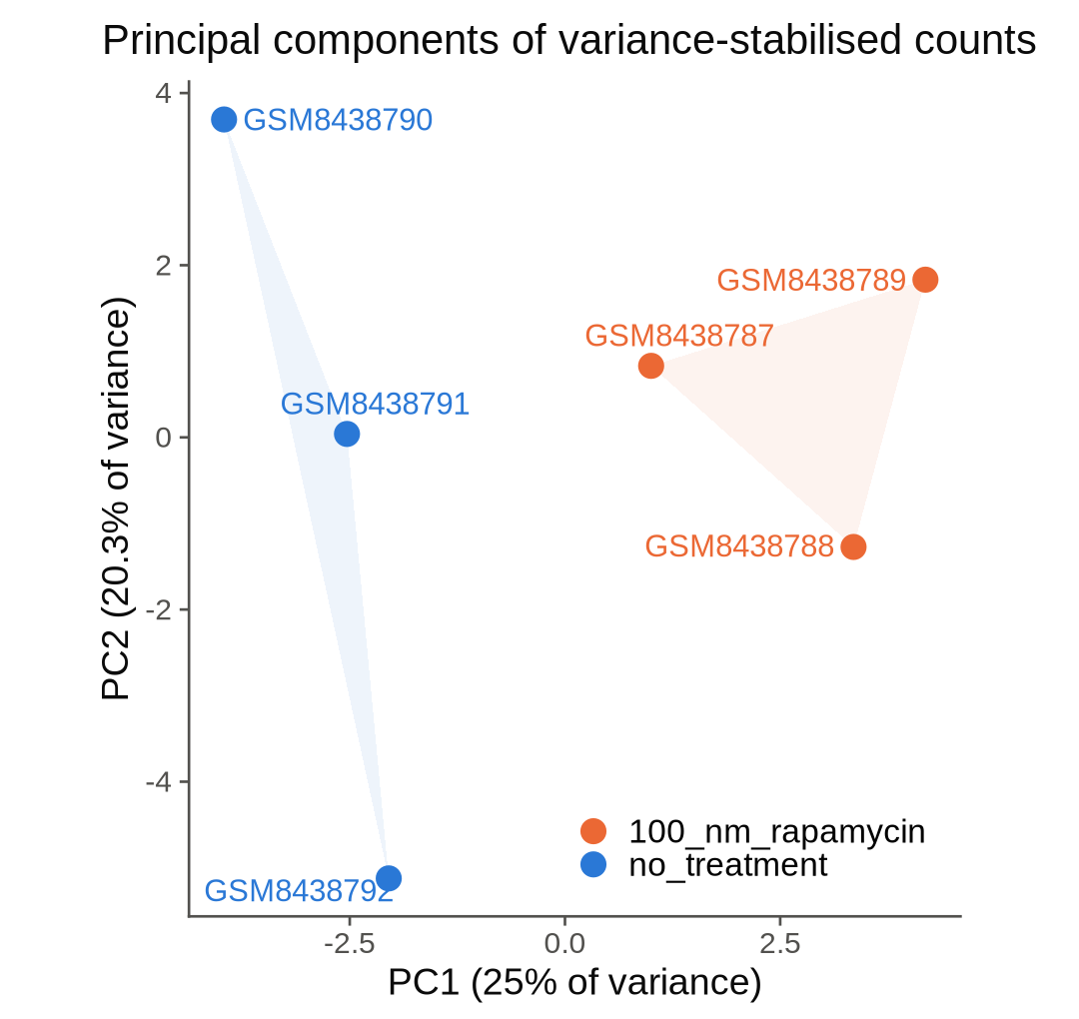
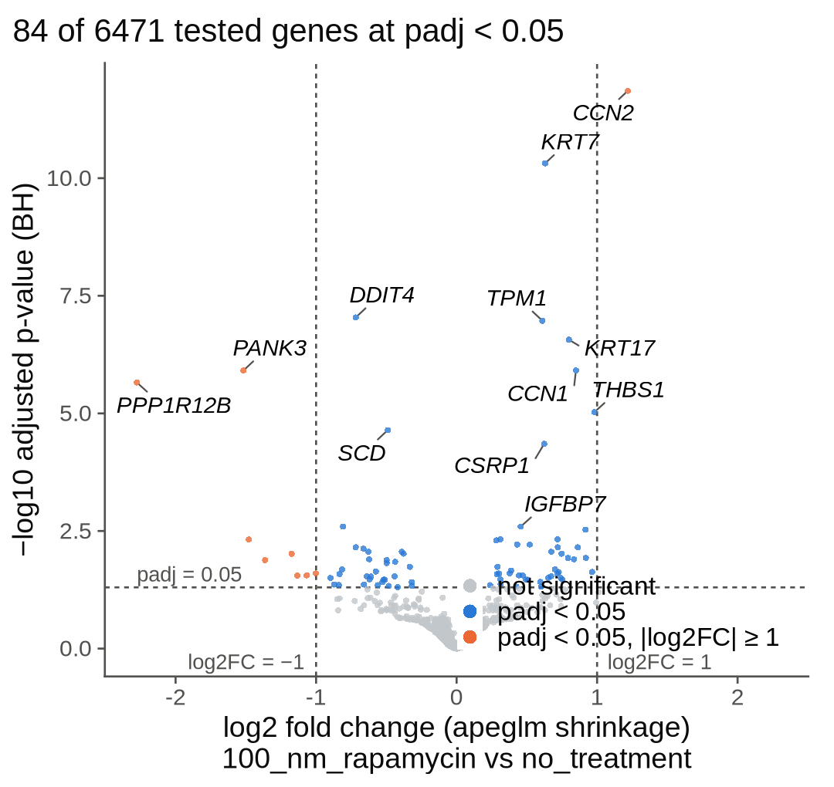
Three minutes later, on a laptop
84
genes changed
(padj < 0.05)
DDIT4 ↓
a gene that needs mTOR,
falling as expected
Treated and untreated samples separate. Nobody wrote any code.
GSE273888 · HeLa cells, rapamycin vs untreated, 3 + 3 · first 2 million reads per sample · every tool version recorded in a manifest
Notes:
The payoff slide. Rapamycin blocks mTOR; DDIT4 depends on mTOR and goes down, so the biology is right. Say the reads are subsampled for speed.

Slide 4
What it does not do yet
Reads are subsampled for speed, so the gene counts are smaller than a full run.
One comparison per dataset, and we choose which column marks treatment.
Bulk RNA-seq only so far. Ribo-seq and proteomics are designed, not built.
Proteomics sample counts need an SDRF file, which only some projects have.
The heavy pipelines stay on a cluster. We export the files and the command for Nextflow and MaxQuant rather than pretending a laptop can run them.
This machine has no index built, so today's search queries GEO, PRIDE and CELLxGENE live rather than all 18.
The written summary comes from a model, and a check rejects any number it did not get from us.
Notes:
For questions. Being first to name the limits is worth more than being asked.

Slide 5
What is underneath
18
891k
9
21
repositories covered
by the index
datasets, once the
index is built
MCP tools, so an
agent can use it too
tests, green from
a clean clone
Counted, not guessed. Cases and controls are counted in people where the records allow it, and reported as unknown where they do not. The model chooses which field marks treatment; the arithmetic is code.
Runs on your own hardware. Search works against a local model, so no data leaves the machine and no API key is needed.
Notes:
For questions about scale, trust, or agent access.

