Slide 1
Level 4/5 Group 5
Joseph Barber, Bethany Cowle,
Courtney-Jade Pearson, Henry Smith

Slide 2
Emotion 1: Monachopsis
BC

Slide 3

Emotion 2: Onism
The frustration of being stuck in just one body that inhabits only one place at a time.
Why?
Many different paths and options.
Applies to the mechanics and gameplay.
HS

Slide 4
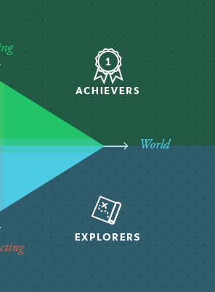
Target Demographic
Bartle’s taxonomy of Player Types: Achievers and Explorers
Age:
CP

Slide 5
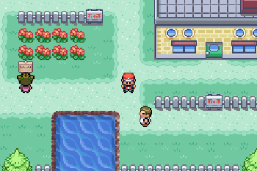
Genre/Style
Puzzle
Strategy
Angled top-down perspective
BC

Slide 6
Narrative
Build narrative as you play.
Collecting memories.
Character feels emotions along with the player.
Monachopsis in narrative
HS

Slide 7
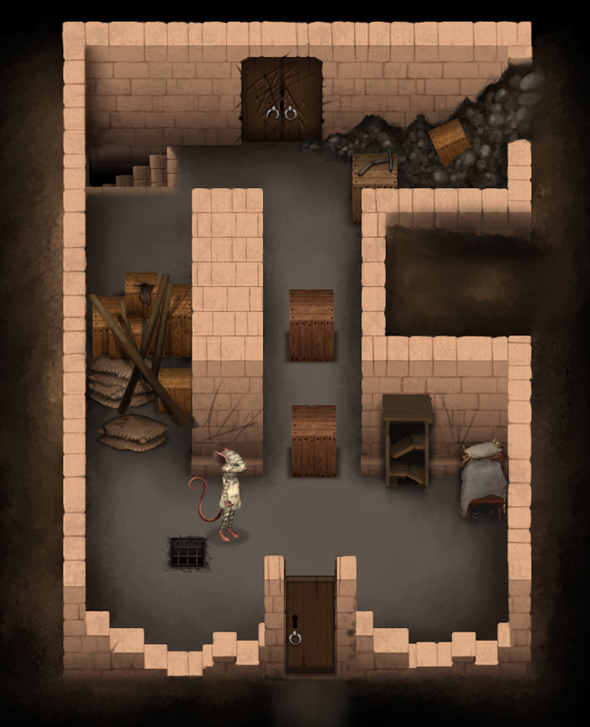

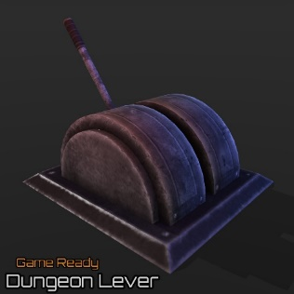
Mechanics: What does the player do?
Walk
Take control of NPCs
Operate objects Key/locks Switches/levers
JB

Slide 8
Unique Selling Point
Unravel narrative through gameplay
Take control of NPCs in the game world
Access different mechanics upon taking over an NPC
JB

Slide 9
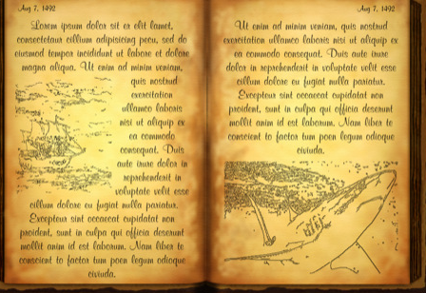


Player Rewards
Collect diary memories
Health Hearts
Keys
Over time, piece together narrative.
CP

Slide 10
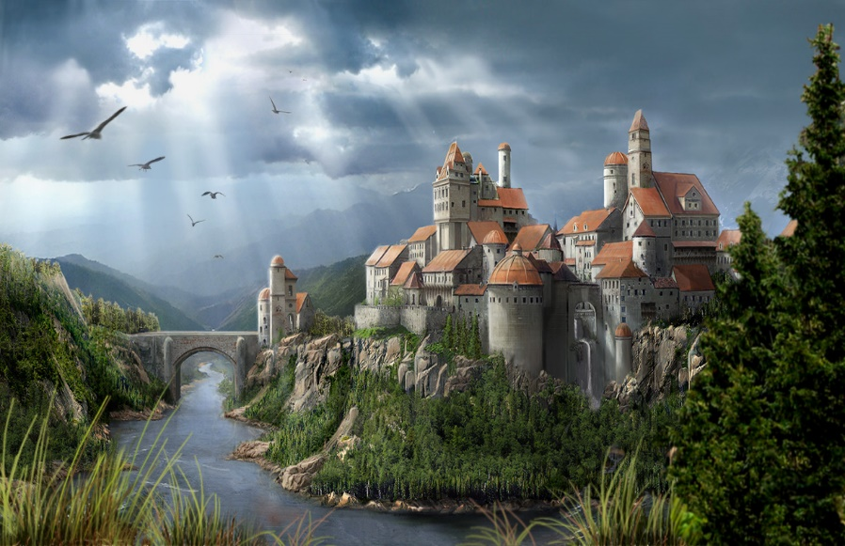
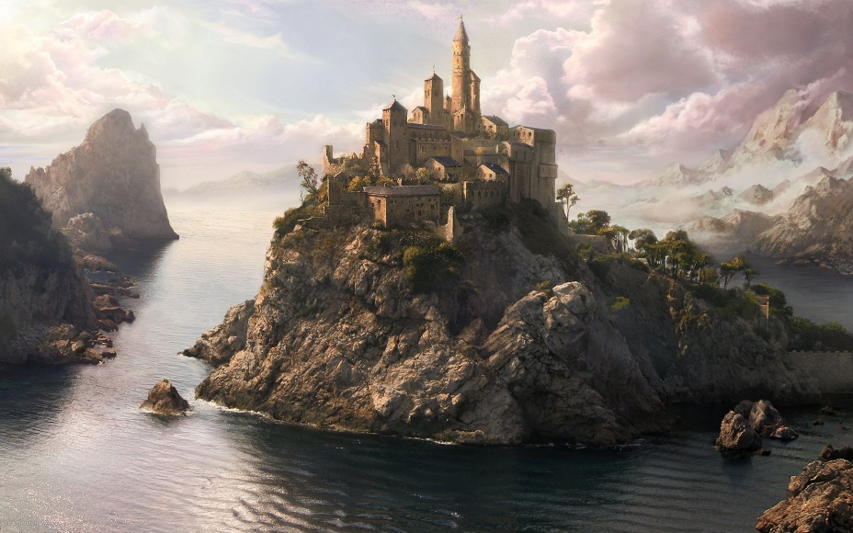
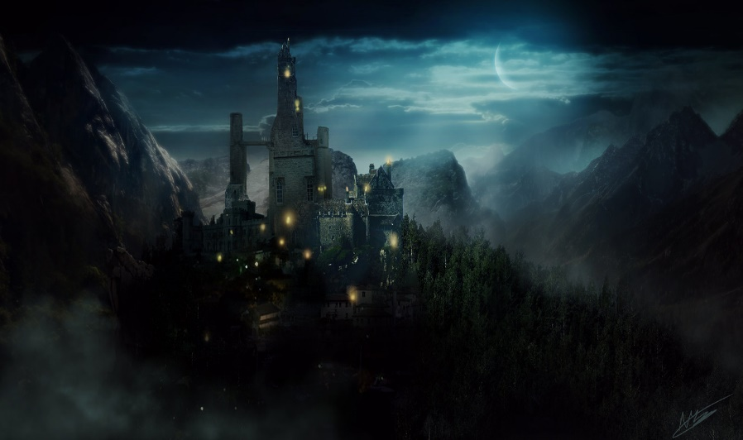
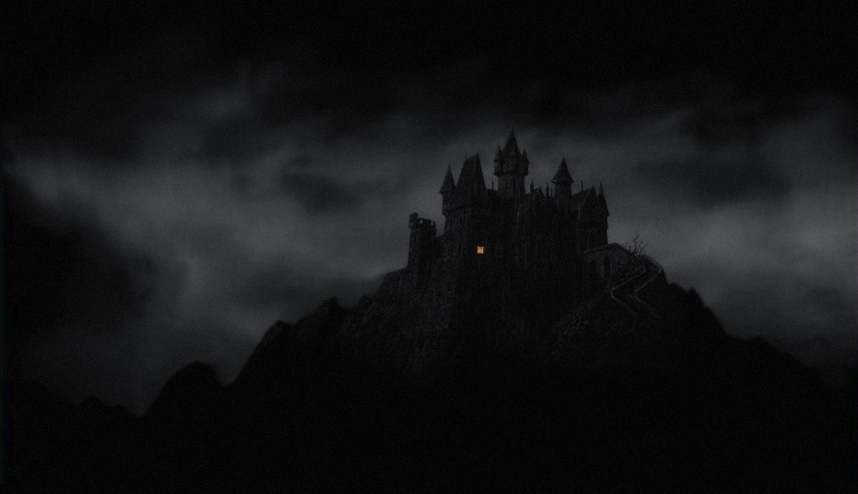
Mood boards
HS

Slide 11
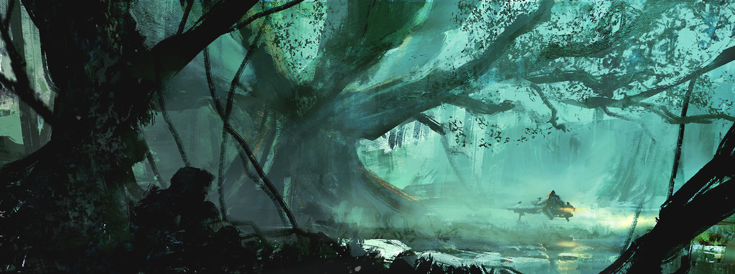
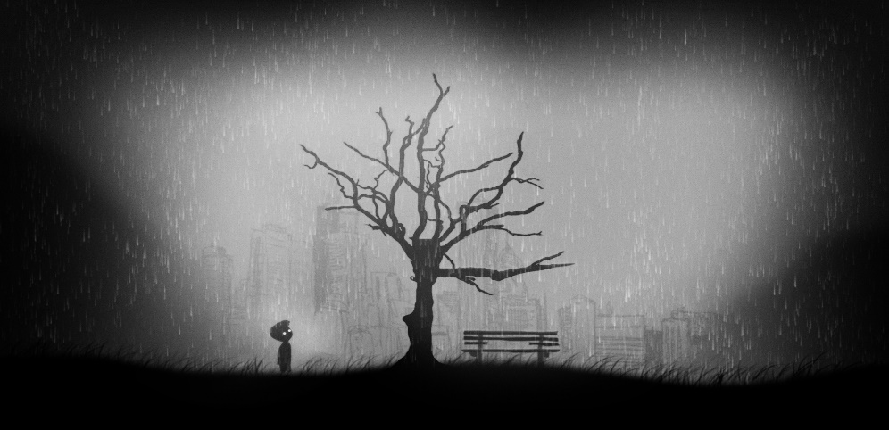
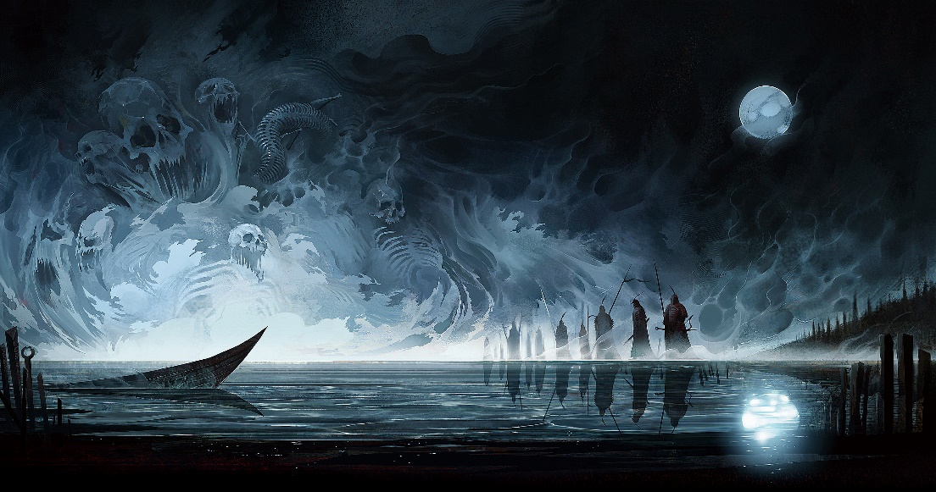
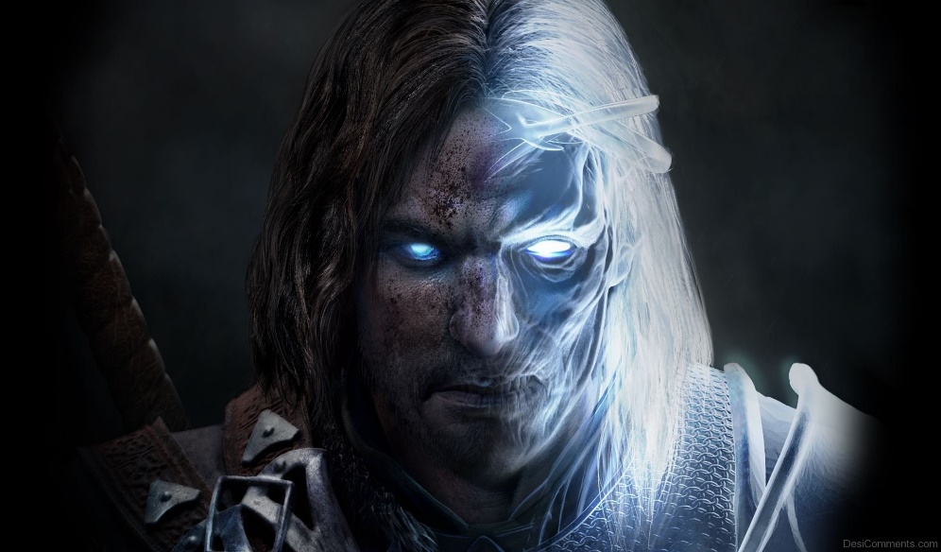
Mood boards
HS

Slide 12
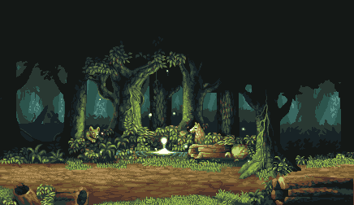
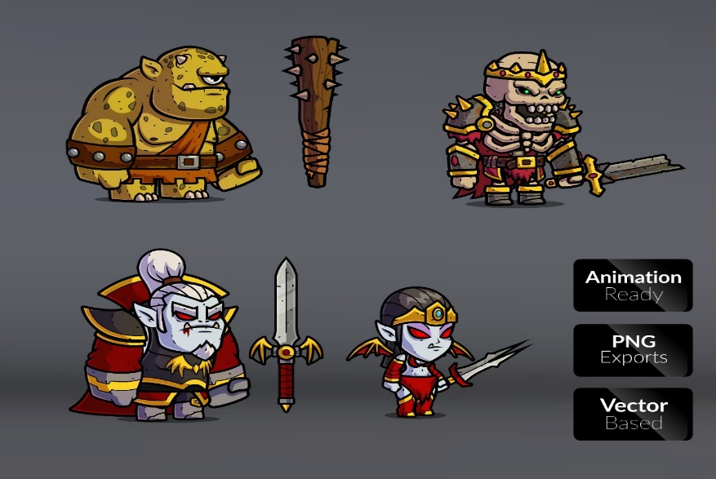
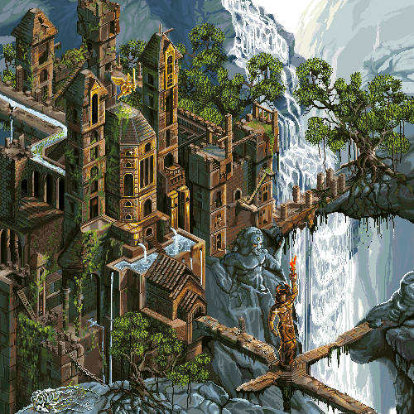
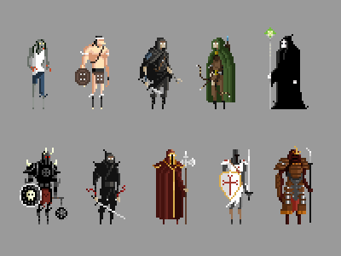
Art style
HS

Slide 13
Bibliography

