Slide 1
L4/5 – group 11
Thomas Wenman
Jordan Marks
Mark Key

Slide 2
Logline
After experiencing an all night party for the first time. Lily will have to find her friends missing items.
Target audience: 18+ ( Use of alcohol).
Genre: Point and click
Platform: PC

Slide 3
Monachopsis & Rückkehrunruhe
“The subtle but persistent feeling of being out of place.”
“The feeling of returning home after an immersive trip only to find it fading rapidly from your awareness. ”

Slide 4
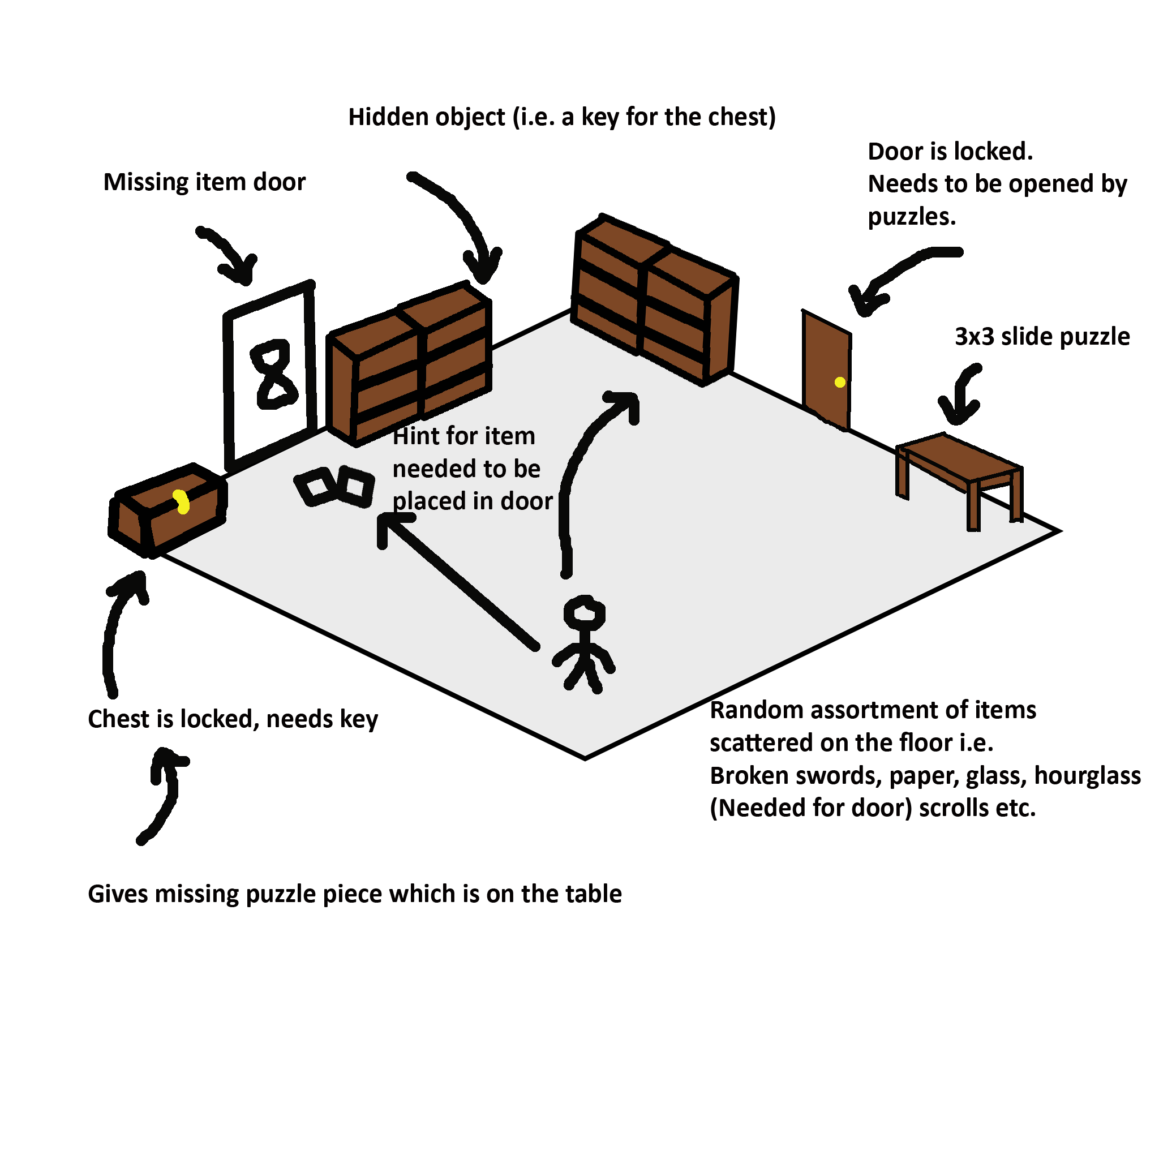
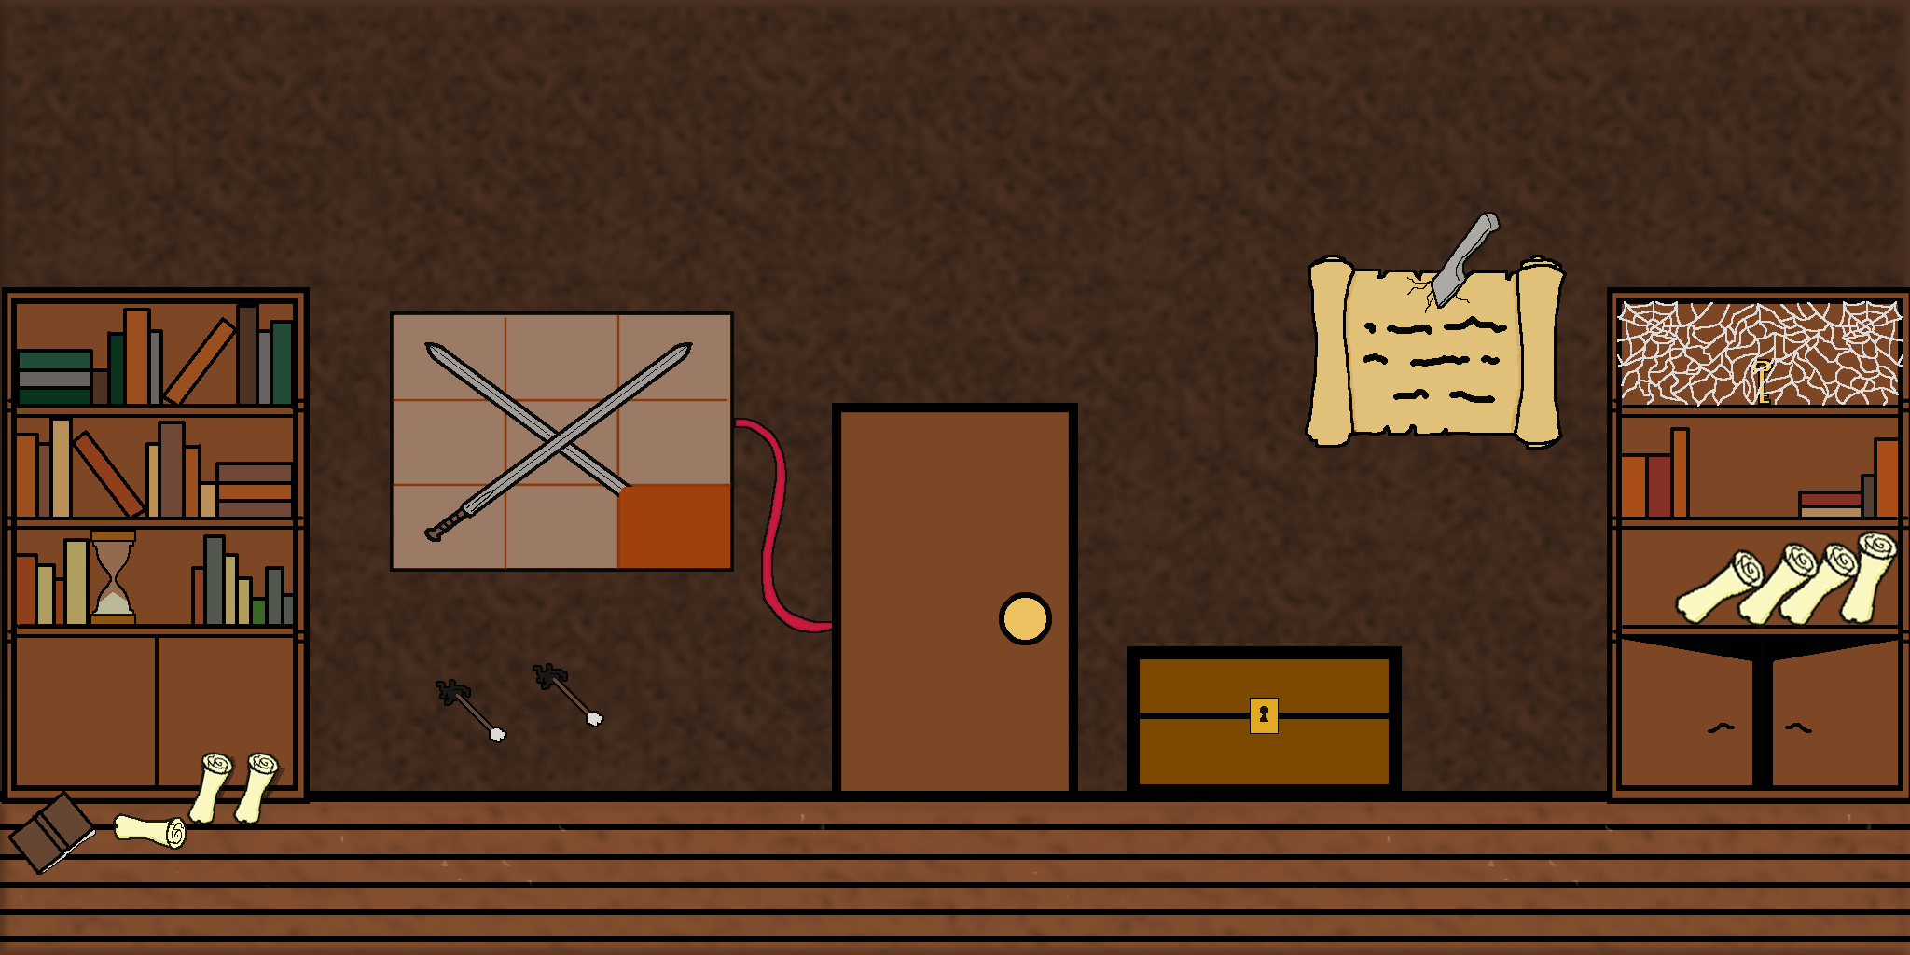

iterations
Our old game idea focused on “Monachopsis” and “Vellichor”

Slide 5
Contribution
Tom: 44 hours of work. (60 with meeting minute documentation).
Jordan: 37 hours of work.
Mark: 2 hours of work.
Emails:
Tom: 51 sent to members.
Jordan: 39 sent to members.
Mark: 3 sent to members.

Slide 6
Footage

Slide 7
Questions?

