Slide 1
Game's name (TBA)
Level 4/5 Group 15

Slide 2
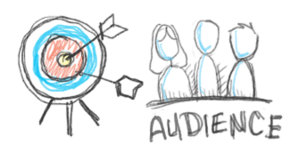
Target Audience
Gender: Male & Female
Age between 16-26
General interests in:
Puzzles
Reading
Narrative driven video games.
Notes:
Callum

Slide 3
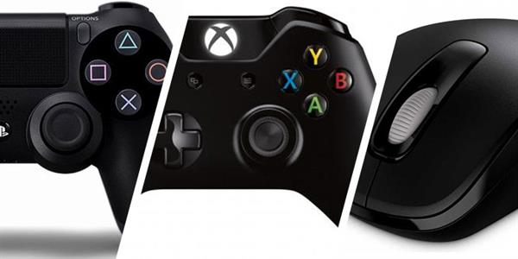
Platform
Our game will be on a PC.
Mac, Linux and Windows.
Selling on average for £5.00
Notes:
Mac(Jake cover)

Slide 4

Logline
The player must endure mundane everyday office tasks and allow their curiosity to take over and reveal the secret of his company.
Notes:
Callum

Slide 5
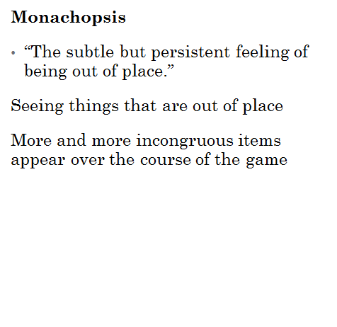
Liberosis and Monachopsis
Liberosis
•”The desire to care less about things”
Boring tasks
Greyscale, plain office cubicle
Notes:
Connor and Jake

Slide 6

The player experience
Over all what we want to try and make the player experience.
Notes:
Callum and Jake

Slide 7

Game mechanics
3D Point and click
Which focuses on a rhythm and repeat matching game.
Notes:
Connor

Slide 8

Structure and rewards.
Player will completes stages
Then the player will be rewarded with hint at the games narrative.
The will repeat this until completions.
Notes:
Callum

Slide 9
Prototype
Notes:
Callum – Video
Connor(Pis/Gifs)

Slide 10
Future plans
Notes:
Connor

Slide 11
Any questions

